Slide 1
Message Composition - II
Positive, Negative and Neutral Messages

Slide 2
Introduction
The best strategy is to get to the point. Make it clear:
Why you’re writing.
What supporting details the reader needs to know.
If the reader needs to do anything.

Slide 3
One helpful tip is to end the communication by looking towards the future.
Tell the reader what you want them to do.
If they merely need to be aware of the information, you could use a phrase like “If you have any questions, let me know.”
If they need to do something, state it clearly. For example, you might say, “Please send your changes to this document to me by Thursday at 10 am so that I can get them into the final draft.

Slide 4
Format to Follow
Be direct: start with the good news to put the reader in a positive frame of mind.
Give supporting details, explanation and commentary. These should be clearly organized. If you have a large amount of information, you may choose to use bullet points, headings or links/attachments.
If there are any drawbacks, state them clearly but positively. (“Please mail the defective phone back so that we can issue you a new model).
End with a note of thanks or congratulations.

Slide 5
Example
Thank you for emailing us about the broken strap on your wrist watch. We would be happy to send you a replacement at no cost.
To receive your new strap, please:
1) Cut the straps of your damaged watch and take a photo. Make sure that the warranty number located on the wristband of your watch is clearly displayed. I’ve attached a PDF with a series of photos to show you how to do this.
2) Email me the photo along with your mailing address
Once we receive this information, we will send your new watch strap with next-day shipping.
Let me know if there’s anything more we can help you with.
Thanks,

Slide 6
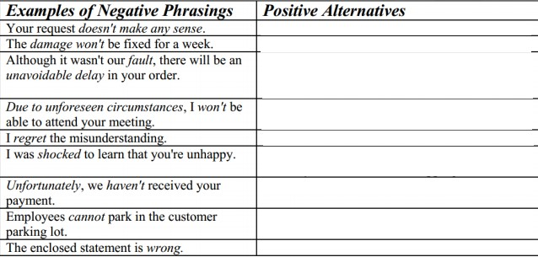
Let see how quickly you can come up with better alternatives

Slide 7
BAD NEWS MESSAGES
Delivering negative news is never easy
A bad news message (or negative news message) delivers news that the audience does not want to hear, read, or receive.
Some people prefer their bad news to be direct and concise. Others may prefer a less direct approach.
How you break bad news will also depend on your culture, your family and norms of your industry.

Slide 8
Buffer statement
The first part of a negative news message, verbal or written, is a buffer statement.
It provides neutral or positive information.
It sets the tone and often serves as a cushion for the information to come.
It is important that the buffer not be overly positive because this can be misleading or set up the reader to expect a positive news message instead.

Slide 9
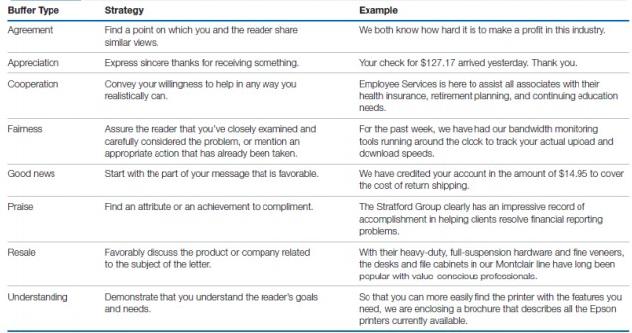

Slide 10
Examples
If you have to lay off a good employee because of budget cuts, the best case scenario is that the person is upset but understands that the layoff wasn’t about their work performance. If you handle the news with professionalism, you might be able to preserve the working relationship in the future.
If you’re firing an employee who hasn’t responded to multiple Performance Improvement Plans, however, you would want to break the news clearly and compassionately, but you might not care as much about preserving the relationship.

Slide 11
Seven Goals of a Bad News
Be clear and concise to minimize the chances of confusion or back-and-forth communication.
Help the receiver understand and accept the news.
Maintain trust and respect for the business or organization and for the receiver.
Avoid legal liability or erroneous admission of guilt or culpability.
Maintain the relationship, even if a formal association is being terminated. (Note: this only applies to situations where you want the relationship to continue. When dealing with an abusive client, for example, your goal might be to clearly break the relationship).
Reduce the anxiety associated with the negative news to increase comprehension.
Achieve the designated business outcome.

Slide 12
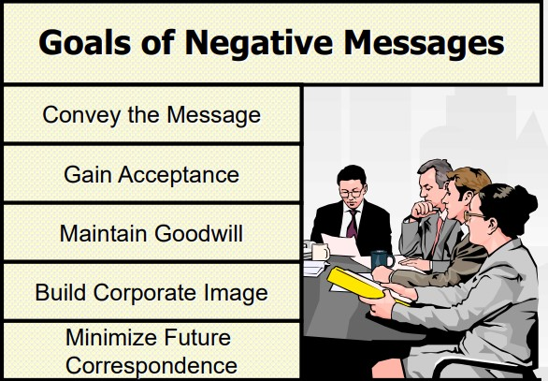

Slide 13
Sequence for a Bad News Message
Buffer statement
Explanation
Break the bad news
Redirect or provide alternatives
End politely and act sensitive

Slide 14
TASK:
https://www.youtube.com/watch?v=z6pRXVbhlJk
Watch ^ this video and write a better version in 3-4 lines. Post it on Microsoft Teams Assignments Section for me to read.
Thanks ☺

