Slide 1
Organization of the Paragraph

Slide 2
Features
A. Unity (the main idea)
B. Coherence (a logical manner a definite plan of development)
C. Start (a nonsense sentence: e.g. I want to talk about X. and a cliché: e.g. plays a great role in our lives)
D. Topic Sentence (main idea, attitude, evaluation )
E. Development of Ideas (adequate explanation, and support through evidence and examples)
F. Vocabulary Choice

Slide 3
The only way information technology is going to be useful to schools is if all staff members are well-informed and fully supported. It is the principal's responsibility, and should be part of the school's plan, to ensure that all staff are consulted about the changes, and that the change is carefully organized. Some teachers may be resistant, especially if they have not had much experience with computers, so training teachers is essential in implementing IT into the school curriculum. Staff members must feel involved in the process of acquiring technology, and in learning how to operate it, in order for them to increase their confidence in using IT as a curriculum tool. Teachers are only going to be able to incorporate IT into their lessons if they are competent users themselves (Reksten, 2000).

Slide 4
Introduction
Give a unique touch.
Don’t repeat the title.
Dedicate 1-2 sentences to explaining why the article is important.
Dedicate 2-3 sentences to articulating what the article will cover.
Refer to a concern or problem readers might have.
But ... be careful telling stories.
Try drafting the rest of the article before working on the introduction.
Don’t oversell it.

Slide 5
For a Research Article particularly;
It works on the principle of introducing the topic of the paper and setting it in a broader context, gradually narrowing the topic down to a research problem, objective(s) and hypothesis. A good introduction explains how to solve the research problem, and creates ‘leads’ to make the reader want to delve further into work.

Slide 6
Body
Present paper’s main points.
Should contain:
ample textual evidence,
correctly formatted,
seamless transitions.
Illustrations/Examples

Slide 7
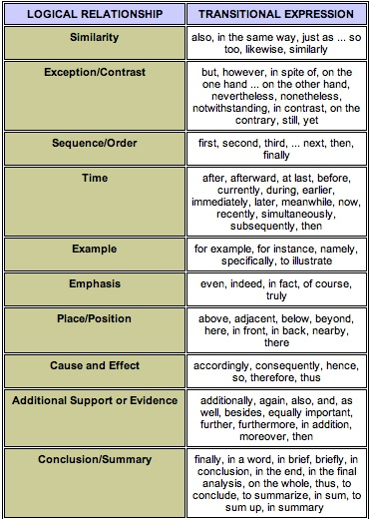

Slide 8
Conclusion
Establish a sense of closure
Amplify your main point
Set discussion into a different, perhaps larger, context
Redefine thesis statement
Take away
Don't simply summarize
Try answering the “SO WHAT?”
Make an impact

Slide 9
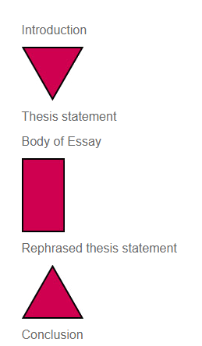
“Wraps up” essay
Demonstrates that what was
set out to do has been
accomplished
Shows how thesis is proven
Provides the sense of closure
Opposite of the introduction
Introduction begins general and ends specific
Conclusion begins specific and moves to the general

