Slide 1





DEPARTMENT OF COMPUTER ENGINEERING
AHMADU BELLO UNIVERSITY, ZARIA
COEN 807 – MACHINE LEARNING
2025/2026 FIRST SEMESTER
PROJECT-BASED EXAMINATION
PROGRAMME: MSc. Artificial Intelligence
BY:
MUHAMMAD RABIATA KANI
P25EGCP8026
JUNE, 2026

Slide 2
PREDICTING STUDENT ACADEMIC PERFORMANCE USING MACHINE LEARNING TECHNIQUES: A COMPARATIVE STUDY OF CLASSIFICATION ALGORITHMS
PROJECT TITLE:
Submitted to:
Dr. Y. Ibrahim

Slide 3
PROBLEM OVERVIEW
Educational institutions generate large volumes of student data.
Early identification of at-risk students is important.
Machine learning can support academic decision-making.
Problem: Predict whether a student will Pass or Fail.

Slide 4
PROJECT OBJECTIVES:
Acquire a real-world dataset
Preprocess and transform data
Implement multiple classification models
Compare model performance
Identify the best-performing model

Slide 5
DATASET DESCRIPTION
Dataset: UCI Student Performance Dataset
395 student records
33 attributes
Pass/Fail target variable
Real educational data suitable for predictive analytics

Slide 6
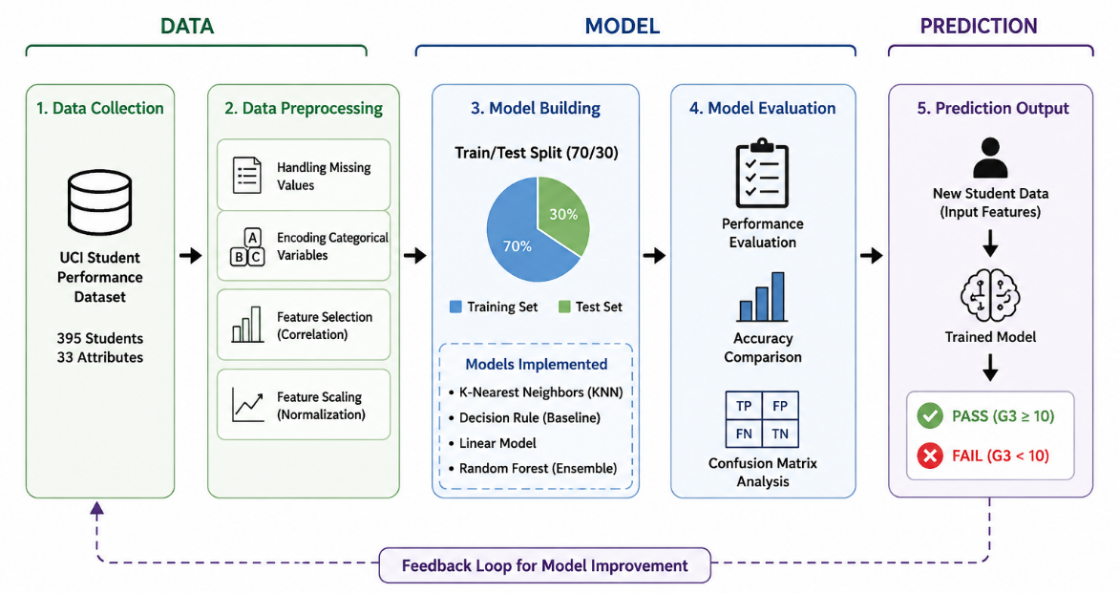
METHODOLOGY
Data preprocessing
Categorical encoding
Feature selection
Classification modelling
Figure 1: Problem Workflow Diagram

Slide 7
MACHINE LEARNING MODELS
K-Nearest Neighbors (KNN)
Decision Rule Classifier
Linear Classification Model
Random Forest (Simulated)
Note: No MATLAB ML Toolbox was used.

Slide 8
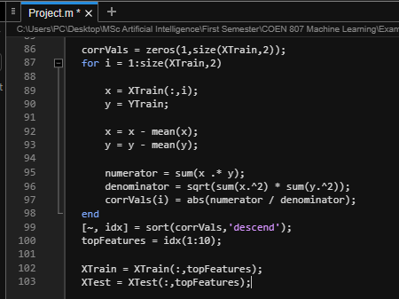
EXPERIMENTAL SETUP
MATLAB implementation
70% Training / 30% Testing
Accuracy evaluation metric
Figure 2: Train-Test Split Diagram

Slide 9
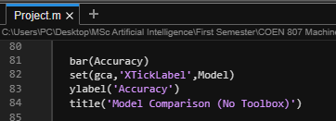
RESULTS
Model Performance:
KNN = 30.51%
Decision Rule = 30.51%
Linear Model = 30.51%
Random Forest = 53.39%
Figure 3: Model Accuracy Comparison Bar Chart

Slide 10
COMPARATIVE ANALYSIS
Random Forest achieved the highest accuracy.
Ensemble learning outperformed simple classifiers.

Slide 11
KEY FINDINGS
Student performance can be predicted using ML.
Feature engineering affects performance.
Random Forest was the best-performing model.

Slide 12
CHALLENGES AND LESSONS LEARNED
Challenges:
No licensed MATLAB toolbox
Small dataset size
Lessons:
Data preprocessing is critical
Ensemble methods improve performance

Slide 13
THANK YOU

