Slide 1

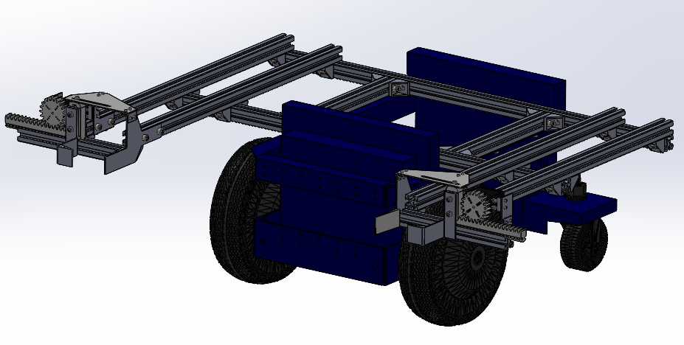
Computer Aided Design Documentation (SEP 1)
Group 4: Shaun, Bellamy,Ariff, Min Wei, Chai
Notes:
Slide 1: Introduction
CAD Design Video
Group 4 Members:
Bellamy
Ariff
Min Wei
Shaun
Chai
Slide 2: Project Objectives
Systems Engineering Project 1
Design a gripper to engage/grip the airport trolley
Trolley Dimensions:
[Insert Trolley Dimensions Here]
Slide 3: Use Case/Concept Solution
Video showcasing the use case and solution concept
Slide 4: Mechanisms Involved
Overview of mechanisms used in the design
Slide 5: Bill of Materials (BOM)
List of materials used
Fabrication methods:
3D Printing
Metal Cutting
Drilling
Slide 6: Sub-Assemblies
Overview of sub-assemblies used in the design
Slide 7: Frame Assembly
Details and visuals of the frame assembly
Slide 8: Gripper Assembly
Details and visuals of the gripper assembly
Slide 9: Complete Assembly
Visuals of the entire assembly
Slide 10: Gripper Simulation
Simulation of how the gripper engages with the trolley
Slide 11: Conclusion
Thank you for your attention

Slide 2
Contents
Introduction
Overview of CAD Design Video
Group 4 Members
Project Objectives
Goals of Systems Engineering Project 1
Design Requirements for the Gripper
Trolley Dimensions
Use Case and Concept Solution
Video Demonstration
Description of the Concept Solution
Mechanisms Involved
Overview of Mechanisms
Functional Components
Bill of Materials (BOM)
List of Materials
Fabrication Methods:
3D Printing
Metal Cutting
Drilling
Sub-Assemblies
Breakdown of Sub-Assemblies
Visuals and Descriptions
Frame Assembly
Details of Frame Assembly
Visuals and Assembly Process
Gripper Assembly
Details of Gripper Assembly
Visuals and Assembly Process
Complete Assembly
Visuals of the Entire Assembly
Integration of Components
Gripper Simulation
Simulation of Gripper Engagement
Performance and Effectiveness
Conclusion
Summary and Final Thoughts
Acknowledgements and Thank You

Slide 3

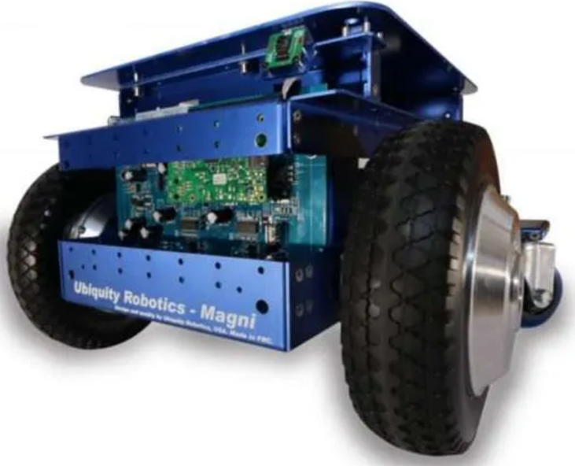
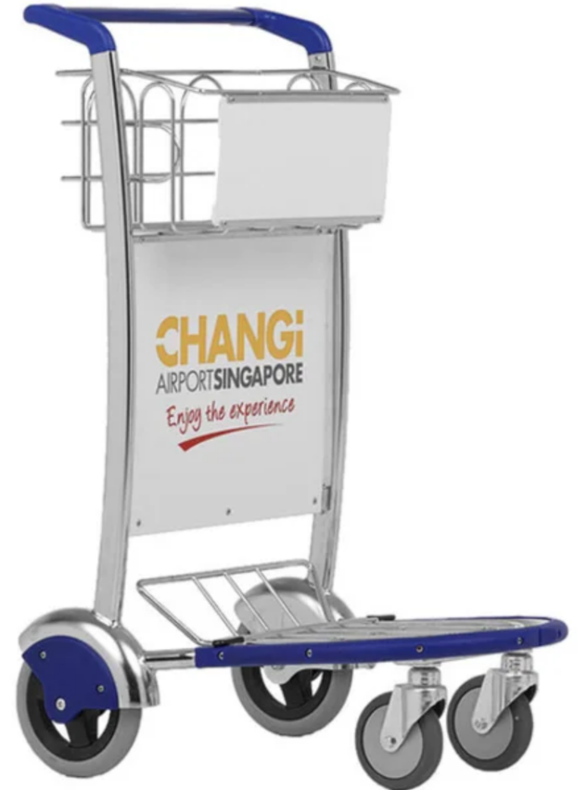
Problem Statement: Airport Trolley Collection Robots
Task: Design a gripper subsystem
Area of interest: Transit Area
Engages/grip trolley to push it

Slide 4
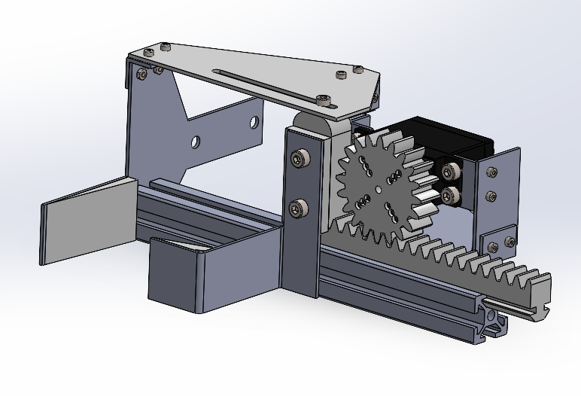
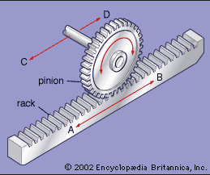
Mechanisms Involved
Rotary to Linear Motion
Rack and Pinion

Slide 5
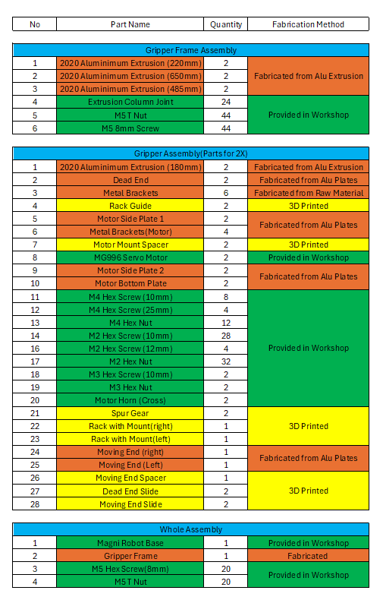
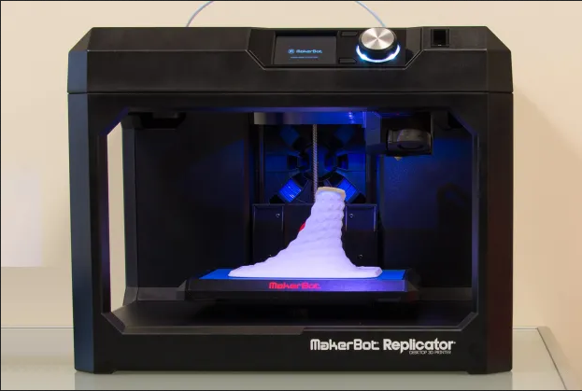
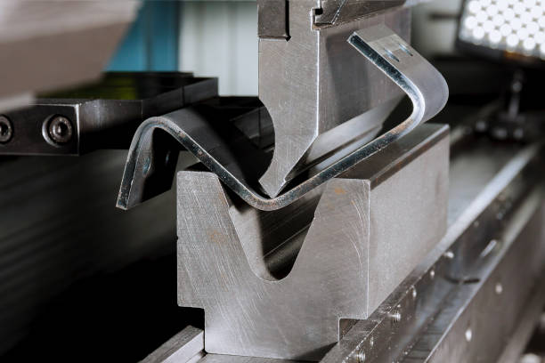
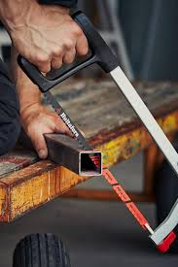
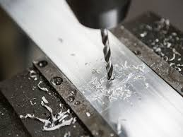
Bill Of Materials and Fabrication Methods
3D Printing
Metal Bending
Metal Cutting
Metal Drilling

Slide 6
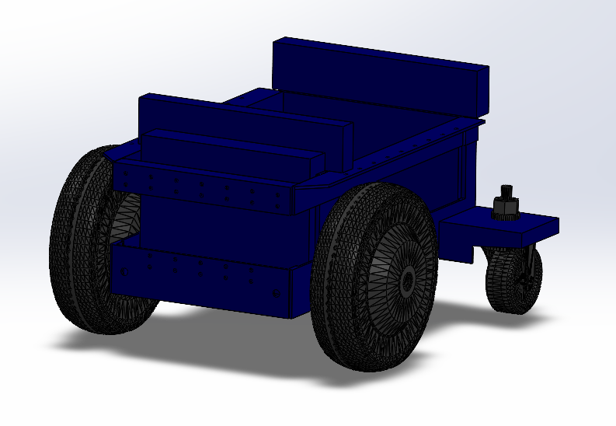
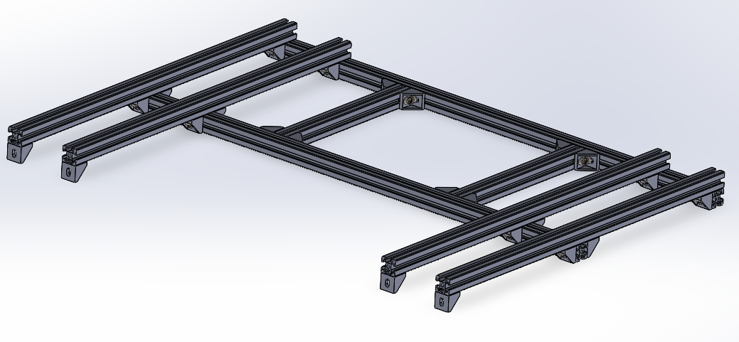
Assemblies Involved
Frame Assembly
Gripper Assembly
Magni Robot Base

Slide 7
Thank You!

