Slide 1
S-Tetro Safety Mechanisms
By: Ariff

Slide 2
Contents
Introduction of robotic platform.
Addressing concerns for the robotic platform
System Design Explanation

Slide 3
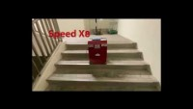
Introduction
S-Tetro is a cleaning robot that climbs stairs.
Made of 3 reconfigurable modules that moves up and down.

Slide 4
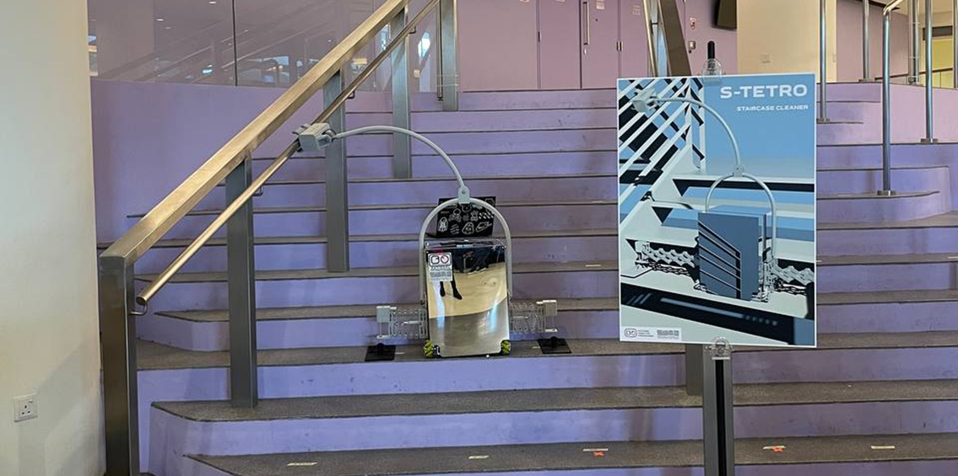
Addressing Safety Concerns for S-tetro
Robot has no safety mechanisms in place. Although being able to run autonomously, is unable to hold or catch itself when it falls
May cause injury to others if falls or damage to the robot.
Designed a safety mechanism that can grab ahold of the railing if the robot falls
A cleaning mechanism must be devised as it is no longer being able to move from side to side.

Slide 5
SYSTEM DESIGN
This robotic system uses Dynamixel Servos (Robotis) and is not supported directly by Arduino and a 3rd party shield has to be bought to use them.
Arduino library developed by them is not user friendly and not logical to use in further development of the robotic platform as commands are long.
Solved this by inheriting the default dynamixel servo Arduino library and adding extra functions for safer use.
The new cleaning mechanism also requires a class and class functions as the enabling/output pins has to be set to high or low for it to extend or contract according to the feedback received.

Slide 6
Works cited

