Slide 1
NETWORK SECURITY IMPLEMENTATION BERL 2143
NAME | MATRIX NO.
MUHAMMAD AZRUL BIN REDZUAN | B122310626

Slide 2
Introduction
This lab involves configuring a secure network with three routers (R-Prime, R-Secondary, R-Tertiary), three PCs (PC-Prime, PC-Secondary, PC-Tertiary), and three servers (Server-Prime, Server-Secondary, Server-Tertiary) connected via switches (S1, S2, S3).
The setup includes enabling NTP on Server-Prime to synchronize time across routers, configuring secure SSH access on R-Prime, implementing OSPF with MD5 authentication for routing, and using ACLs to control traffic between devices. The lab demonstrates secure communication, efficient routing, and traffic management in a structured network environment.

Slide 3
Objective
NTP Synchronization:
Configure Server-Prime to provide accurate time to all routers with secure NTP authentication.
Secure Remote Access:
Set up SSH on the R-Prime router for secure management.
Traffic Control:
Use ACLs to allow specific traffic, like web access and ping, while blocking unauthorized communication.
OSPF Routing:
Implement OSPF routing with MD5 authentication for secure routing updates.

Slide 4
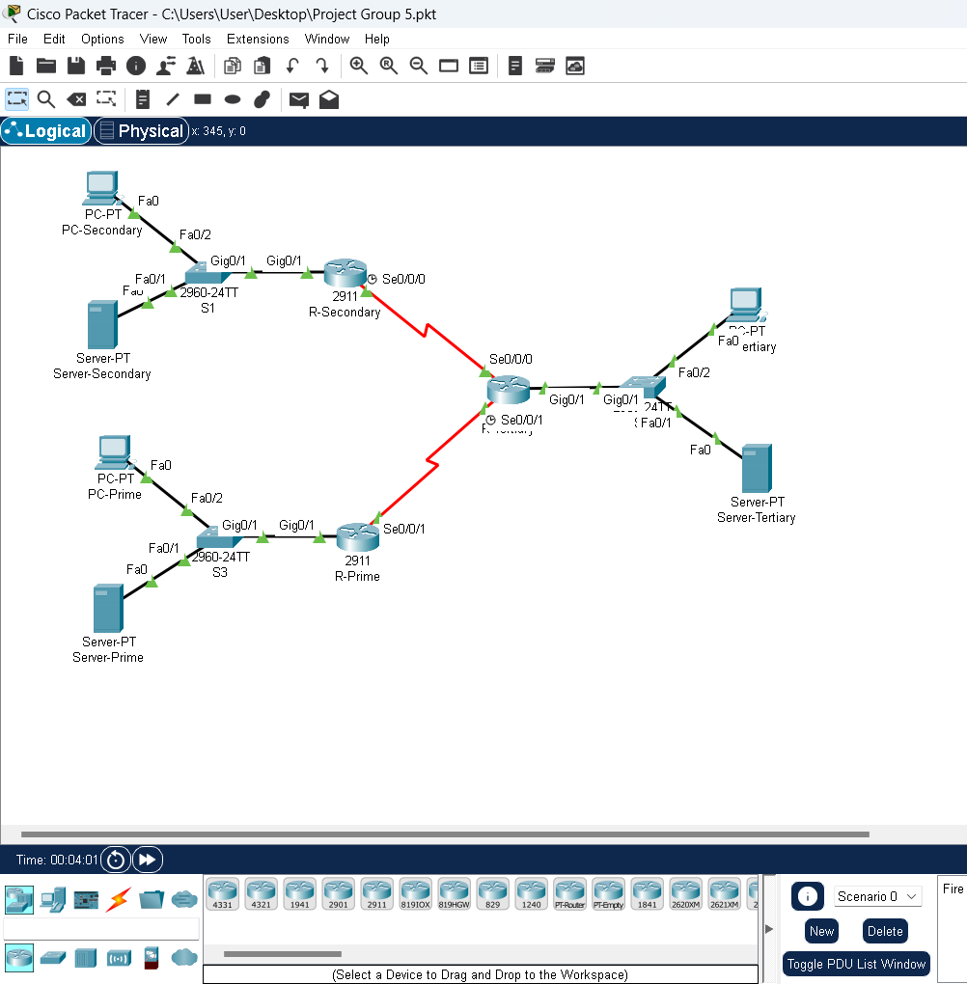
Methodology

Slide 5
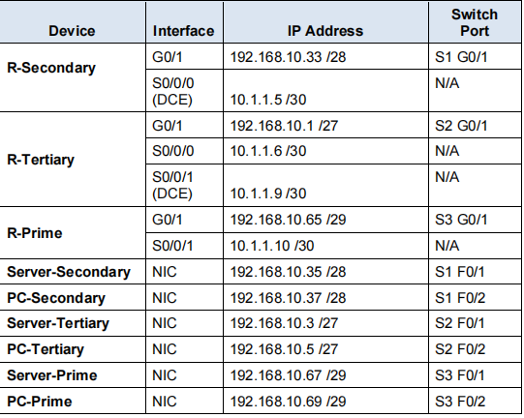
Addressing Table

Slide 6
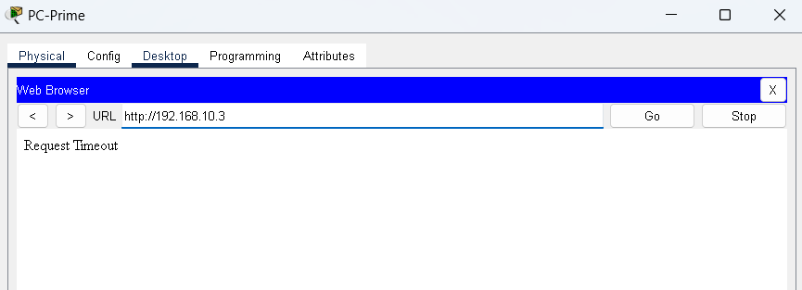
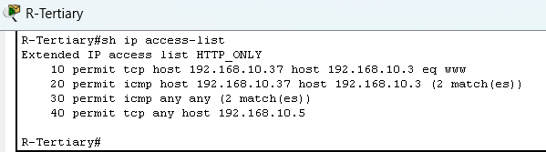
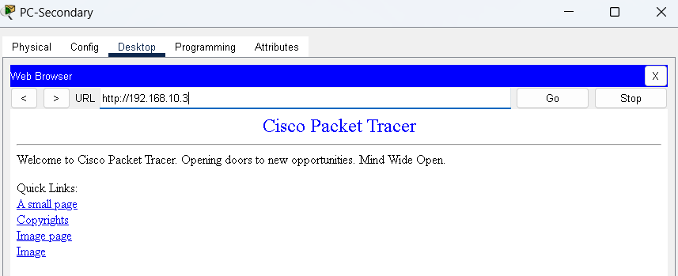
Web access from PC-Secondary to Server-Tertiary.
Only PC-Secondary can web access to server-Tertiary because at Router-Tertiary we made ACL for permit tcp host PC-secondary to Server-Tertiary equal world wide web.

Slide 7
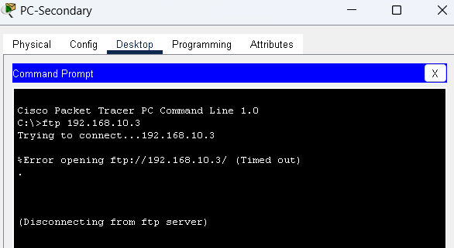
FTP access from PC- Secondary to Server-Tertiary.
FTP access from pc-secondary to server-tertiary is Failed, because no permit for ftp access, and already declared permit for a traffic and it make any traffic that have no permit by default is denied

Slide 8
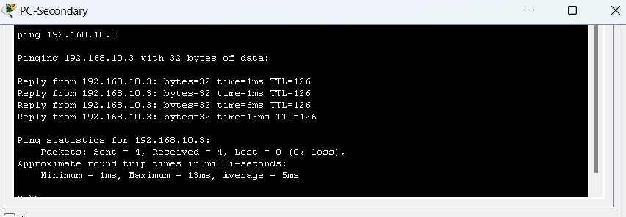
Ping from PC- Secondary to Server-Tertiary
The ping will succeed because in ACL we make permit for icmp, this is for give ping for a traffic

Slide 9
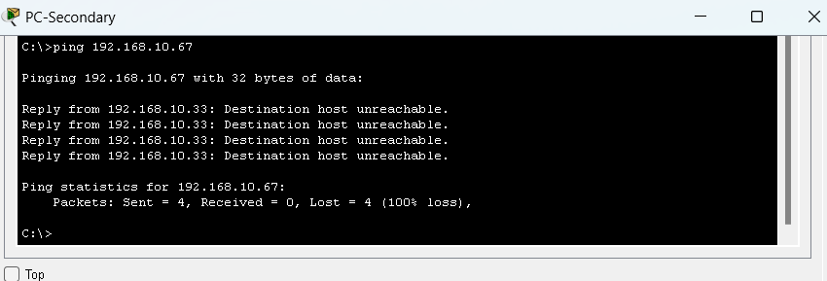
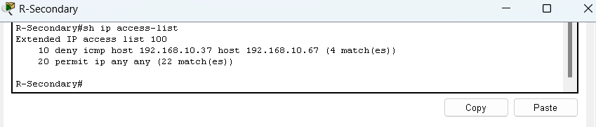
Ping from PC- Secondary to Server-Prime.
The ping will Failed because in secondary router we make ACL for deny icmp server prime host address. So the ping will fail only between pc-secondary to server-prime

Slide 10
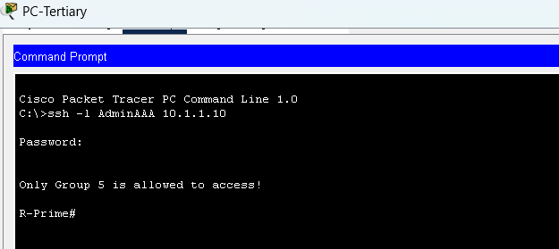
SSH access from PC-Tertiary to R- Prime.
SSH access will succeed because in router-Tertiary we permit tcp for router Prime

