Slide 1

Implementation of a Cloud-Native Architecture for Secure, Scalable and Distributed Computation
Final presentation on the master thesis
Muhammad Fahad Ali, Virtual, 10.12.2024

Slide 2
Implementation of a Cloud-Native Architecture for Secure, Scalable and Distributed Computation
1
Introduction
3
2
Authentication
6
3
Authorization
10
4
Distributed Computation
15
5
Bibliograph
27

Slide 3

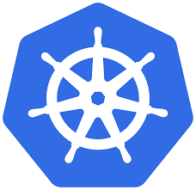
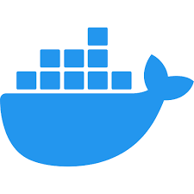

In today’s modern computing and rapidly evolving technological landscape, cloud-native technologies have become pivotal.
Allow us to design and deploy applications that are highly secure, scalable, and distributed across multiple environments.
Provides flexibility, fault tolerance, and portability across different cloud environments.
Automates deployment, scaling, and operations of application containers.
Ensure security, scalability, and distribution which are crucial for modern computing.
Cloud
Cluster
Container
Code

Slide 4
Addressing the challenges of security, scalability and distributed computation are crucial for building robust and efficient cloud infrastructure.
Challenges
Vulnerabilities such as cyber attacks and unauthorized access.
How to handle varying workloads and achieve flexible use of resource.
Data synchronization, latency, and fault tolerance must be addressed. [3]
Objectives
Integrating Keycloak with ArgoCD for secure SSO, to protect against cyber-attacks and unauthorized access.
Implement RBAC in Kubernetes clusters to improve security by automating role provisioning.
Implement Ray for distributed computing in ML workflows and optimize workload through dynamic resource allocation and GPU utilization.

Slide 5
Implementation of a Cloud-Native Architecture for Secure, Scalable and Distributed Computation
1
Introduction
3
2
Authentication
6
3
Authorization
10
4
Distributed Computation
15
5
Bibliograph
27

Slide 6
Authentication protocols are essential for implementing SSO because they provide standardized methods for managing user authentication across applications.
OIDC is an authentication protocol supported by Keycloak that uses JWT standards to digitally sign and encrypt data in a compact, web-friendly format.
Recommended for web applications, offering browser-based authentication flows and simplifies client-side implementation.
Keycloak integrates with ArgoCD using OIDC, enabling SSO with token-based authentication. [6]
user
Keycloak
ArgoCD
user enter url: https://ArgoCD-example.com
redirect to: https://Keycloak.app
login page
user gives credentials
validates user
If valid, redirect to: https://ArgoCD-example.com
invalid credentials

Slide 7
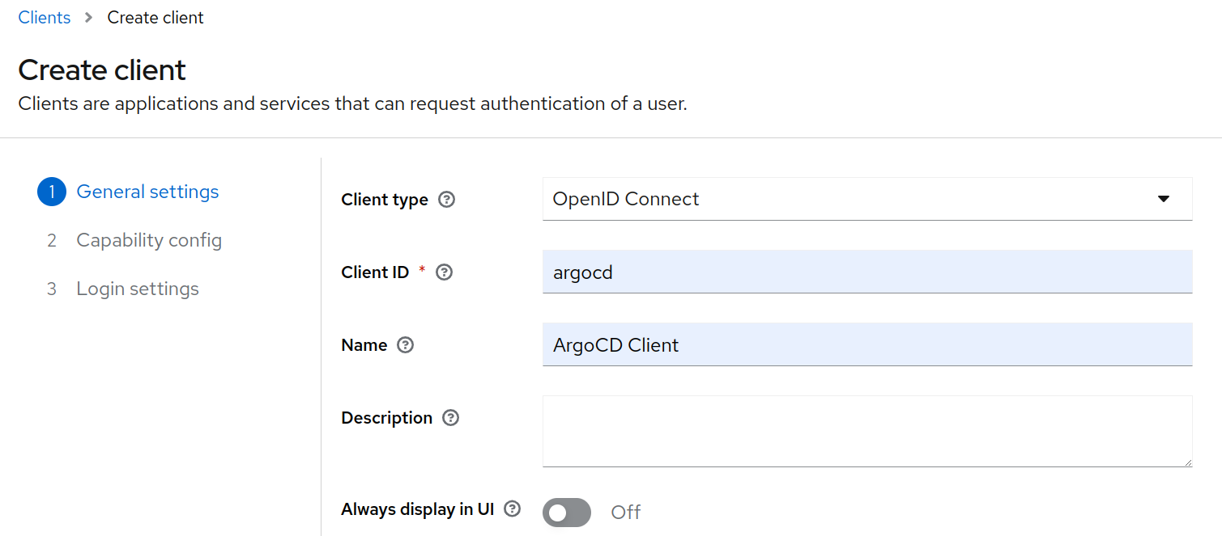
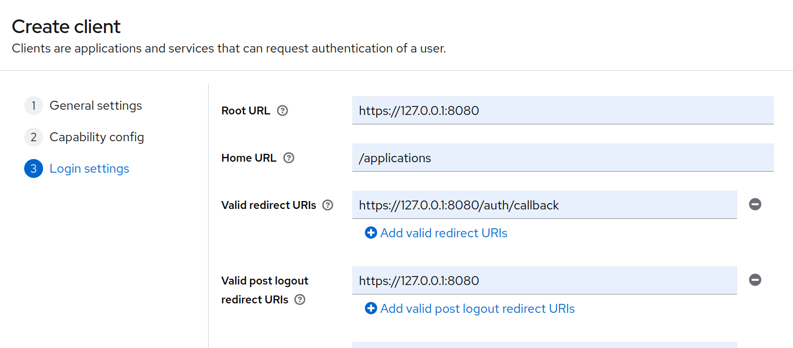
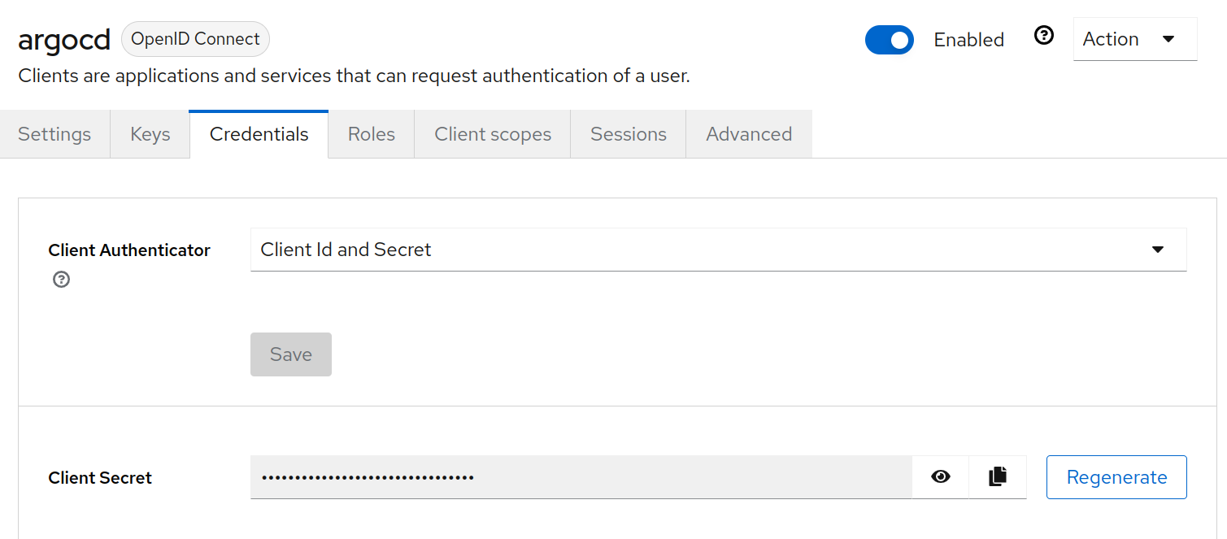
Create a new realm and client in Keycloak, configure root, web and admin URLs, set up client secret and define roles and users.

Slide 8
Configure ArgoCD to integrate with Keycloak as its OIDC provider for secure authentication.
Client Secret
Configuring ConfigMap
apiVersion: v1
kind: Secret
metadata:
name: ArgoCD-secret
data:
...
oidc.keycloak.clientSecret:
...
apiVersion: v1
kind: ConfigMap
metadata:
name: argocd-cm
data:
oidc.config:
name: keycloak
issuer: http://192.168.49.2:30965/realms/argocd
clientID: ArgoCD
clientSecret: oidc.keycloak.clientSecret
requestedScopes: ["openid", "profile", "email", "groups"]
url: https://127.0.0.1:8080

Slide 9
Implementation of a Cloud-Native Architecture for Secure, Scalable and Distributed Computation
1
Introduction
3
2
Authentication
6
3
Authorization
10
4
Distributed Computation
15
5
Bibliograph
27

Slide 10
Role-based access control is a comprehensive mechanism for managing authorization in cloud-native environments.
Components of role-based access control
User Accounts
Service Accounts
Role
Cluster Role
Role Binding
Cluster Role Binding
Authorization Service
verify
Client
request
Kubernetes API
config file in Kubeconfig format

Slide 11



Define and manage namespace specific access control using Kubernetes RoleBindings
RoleBindings
Assign a pod-reader role to a user for viewing pods in namespace1 only.
cluster
namespaces1
role binding
rolebinding-role
role
get, watch, create, list
deployment
configmap
pod
service
user
namespaces2
deployment
configmap
pod
service

Slide 12
Define and manage cluster specific access control using Kubernetes ClusterRoleBindings
ClusterRoleBindings
Assign cluster-wide role to user, groups, or service accounts.
cluster
namespaces1
cluster role binding
rolebinding-role
cluster role
get, watch, create, list
deployment
configmap
pod
service
user
namespaces2
deployment
configmap
pod
service

Slide 13
Streamline role-based access control authorization in Kubernetes through automation.
User Creation
Automate generation of a private key and CSR specific to the user.
Register the user as a system authenticated entity via the Kubernetes CSR object.
Simulate admin approval and retrieve the signed certificate.
Configure kubeconfig with user credentials and associate context with cluster and namespace.
Creating Roles and Assigning it to Users
Validate the existence of specified Role and RoleBinding to avoid duplication.
Define role with specific permissions (e.g., get, list, watch pods in namespace).
Bind the created role to the user for secure and authorized access.

Slide 14
Implementation of a Cloud-Native Architecture for Secure, Scalable and Distributed Computation
1
Introduction
3
2
Authentication
6
3
Authorization
10
4
Distributed Computation
15
5
Bibliograph
27

Slide 15
Distributed computing enable scalable architectures to meet the growing demands of modern AI workloads
Distributed Computing
Involves multiple independent nodes collaborating to solve tasks by sharing resources and information.
Selected Ray for its ability to handle distributed workloads, ideal for AI models with high computational demands. [11]
Processor
Processor
Memory
Memory
Processor
Processor
Memory
Memory

Slide 16
Leverage Ray's distributed architecture to efficiently manage resources and scale AI workloads across nodes.
Ray Architecture
Head nodes manage Ray components, metadata, and locate large objects using a global control store.
Worker nodes execute tasks and manage resources with their own Raylet.
Global control store helps workers find and share objects across the cluster.
Raylet is responsible for resource management and the administration of the object store.
Dynamic scaling allows adding/removing worker nodes during execution.
Distributed object store enables efficient sharing of large objects. [12]
Ray head node
Ray worker node
driver
worker
worker
Raylet
Raylet
scheduler
object store
scheduler
object store
global control store

Slide 17
Integrate Ray with Kubernetes using KubeRay for scalable and efficient AI workload management
Ray uses Kubernetes to scale and manage distributed AI tasks.
Kubernetes provides resource management, fault tolerance, and autoscaling for Ray clusters.
KubeRay automates the deployment, scaling, and management of Ray clusters.
Ray clusters scale with autoscaling and GPU management in Kubernetes.
Kubernetes provides orchestration, while KubeRay streamlines the management of Ray tasks. [12]
Scalable Ray Applications
third party application
services
Ray core APIs
Kuberay
Kuberay operator
Ray autoscaler
Ray head node pod
Ray worker node pod
Kubernetes

Slide 18
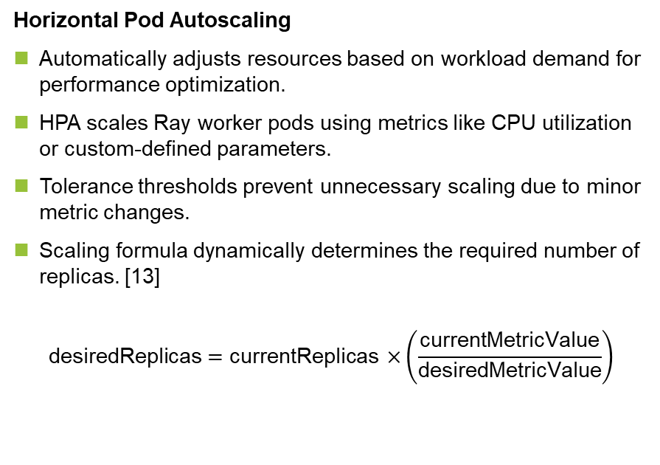
Scale Ray clusters with horizontal pod autoscaling for optimal utilization and dynamic workload management.
Horizontal Pod Autoscaling
Automatically adjusts resources based on workload demand for performance optimization.
HPA scales Ray worker pods using metrics like CPU utilization or custom-defined parameters.
Tolerance thresholds prevent unnecessary scaling due to minor metric changes.
Scaling formula dynamically determines the required number of replicas. [13]
$$\text{desiredReplicas}=\text{currentReplica}\text{s}×\left(\frac{\text{currentMetricValue}}{\text{desiredMetricValue}}\right)$$
Pod 1
Pod 1
Pod 1
RC / Deployment
Scale
Horizontal Pod Autoscaler

Slide 19
Streamline Ray clusters on Kubernetes with automation for efficient resource management and dynamic scaling.
Start
Create Kubernetes Cluster with Kind
Apply Ray Autoscaler Config
Create Dockerfile
Deploy KubeRay Operator
Verify Setup - Watch Kubernetes Pods
Build Custom Docker Image
Fetch Ray Autoscaler Config YAML
Push Docker Image to Repository
Modify Ray Autoscaler YAML

Slide 20
Manage container dependencies using Docker images and lifecycle hooks for efficient scaling and resource management.
Installed dependencies in containers to ensure the necessary libraries and tools for the application to function properly.
Container Image Method: Pre-configured Docker image with dependencies to ensure consistency and faster pod startup when scaling.
Container lifecycle hooks:
PostStart Hook:
Executes custom setup tasks after container creation.
PreStop Hook: Executes cleanup tasks before container termination.
Enables Kubernetes HPA to deploy new worker pods with preinstalled dependencies.

Slide 21
Ray Core simplifies distributed computing, optimizes resources, and scales seamlessly for dynamic workloads.
Ray Core enables scalable, efficient distributed computing for AI/ML workloads.
Integrates with Kubernetes for dynamic resource management.
Supports stateless tasks and stateful actors for diverse needs.
Simplifies distributed operations with seamless orchestration and intuitive APIs.
Optimizes performance and resource use, accelerating AI/ML innovation. [12]
No. | Features | Ray Core | Apache Spark | Dask
1 | Scalability
2 | Performance
3 | Flexibility
4 | Cost
5 | Compatibility
6 | Ease of Use
Limited
Intermediate
Significant

Slide 22
Ray Data optimizes scalable, parallel processing for large-scale data workflows in AI/ML applications.
Designed for large-scale distributed data processing.
Distributes datasets for parallel processing and transformation.
Distributes tasks across nodes for optimal resource use.
Ideal for scalable, high-performance AI/ML workflows. [12]
No. | Features | Ray Data | Apache Spark | Modin
1 | Scalability
2 | Performance
3 | Flexibility
4 | Cost
5 | Compatibility
6 | Ease of Use
Limited
Intermediate
Significant

Slide 23
Ray Train, a distributed solution designed for training large-scale ML workloads.
Accelerates distributed model training across multiple nodes.
Optimizes large ML/DL workloads with parallel processing.
Scales efficiently in Kubernetes, reducing training time and resource use.
Organized around training functions, workers, and scaling configurations. [12]
No. | Features | Ray Train | Apache Spark | Dask
1 | Scalability
2 | Performance
3 | Flexibility
4 | Cost
5 | Compatibility
6 | Ease of Use
Limited
Intermediate
Significant

Slide 24
Ray Tune, a powerful distributed solution for large-scale ML tasks, optimises and scales hyperparameter tuning.
Explores hyperparameter spaces for optimal model configurations.
Speeds up tuning with algorithms like Population-Based Training and HyperBand.
Supports distributed hyperparameter optimization on Ray clusters.
Logs and tracks trial results with built-in tools. [12]
No. | Features | Ray Tune | Optuna | Hyperopt
1 | Scalability
2 | Performance
3 | Flexibility
4 | Cost
5 | Compatibility
6 | Ease of Use
Limited
Intermediate
Significant

Slide 25
Enhance AI workloads with secure authentication, fine-grained authorization, and scalable distributed computing.
Integrated Keycloak with ArgoCD for secure deployment using SSO and OIDC.
Used Kubernetes RBAC for fine-grained access control and automated role assignment.
Manage scalable AI workloads using Ray via KubeRay and Kubernetes HPA.
Enabled GPU usage for efficient AI model training and deployment.
Exploring frameworks like Apache Spark, Dask and Modin.
Analyzed scalability, resource efficiency, and responsiveness of distributed AI workloads.

Slide 26
Implementation of a Cloud-Native Architecture for Secure, Scalable and Distributed Computation
1
Introduction
3
2
Authentication
6
3
Authorization
10
4
Distributed Computation
15
5
Bibliograph
27

Slide 27
By looking at references that supports research, it allows to deepen insights and validate conclusions.
[1] | D. Gannon, R. Barga, and N. Sundaresan, “Cloud-native applications,” IEEE Cloud Computing, vol. 4, no. 5, pp. 16–21, 2017.
[2] | Kong Inc., “Kong: Cloud native,” 2019. Accessed: 2024-09-05.
[3] | N. K. Sehgal, P. C. P. Bhatt, and J. M. Acken, Cloud computing with security and scalability. Springer, 2020.
[4] | M. Babaeizadeh, M. Bakhtiari, and A. M. Mohammed, “Authentication methods in cloud computing: A survey,” Research Journal of Applied Sciences, Engineering and Technology, vol. 9, no. 8, pp. 655–664, 2015.
[5] | N. Sakimura, J. Bradley, M. Jones, B. de Medeiros, and C. Mortimore, “Openid connect core 1.0.” http://openid.net/specs/openid-connect-core-1_0.html, 2014. Online; accessed 8-August-2024.
[6] | R. Hat, “Keycloak identity and access management.” https://www.keycloak.org/ docs. Accessed: 2024-08-11.
[7] | M. Talal, “Openid connect with .net core 2.2 with keycloak, google, and twitter.” https://mohsentalal.medium.com/openid-connect-with-net-core-2-2-with-keycloakgoogle-and-twitter-35db86db8ea8. Accessed: 2024-08-20.
[8] | Cloud Native Computing Foundation, “Kubernetes rbac 101: Authorization.” https:// www.cncf.io/blog/2020/08/28/kubernetes-rbac-101-authorization/, August 2020. Accessed: 2024-07-31.

Slide 28
By looking at references that supports research, it allows to deepen insights and validate conclusions.
[9] | Rahasak, “Kubernetes role-based access control with service account.” https://medium.com/rahasak/kubernetes-role-base-access-control-with-serviceaccount-e4c65e3f25cc. Accessed: 2024-08-11.
[10] | P. Storage, “Parallel vs. distributed computing: An overview.” https://blog.purestorage.com/purely-educational/ parallel-vs-distributed-computing-an-overview/. Accessed: 2024-08-11.
[11] | R. Wattenhofer, “Online and distributed algorithms.” https://www.uni-ulm. de/fileadmin/website_uni_ulm/mawi.inst.080/Online_and_Distributed_ Algorithms_WS14_15/podc_roger_compilation.pdf, 2014-2015. Lecture Notes.
[12] | “Ray: A Distributed Framework for Emerging AI Applications.” https://docs.ray.io/ en/latest/. Accessed: 2024-08-11.
[13] | Kubernetes, Kubernetes Documentation, 2024. Accessed: 2024-08-04.
[14] | Argo CD Documentation, “Argo cd documentation,” 2024. Accessed: 2024-09-05.

