Slide 1
UK CLINICAL GUIDELINE · TEACHING DECK
Anaemia in Pregnancy
A structured pathway for obstetric, midwifery and haematology teams
Aligned with BSH · NICE · RCOG · MHRA · SPS · NHS SCT
v1.0 · 19 April 2026

Slide 2
Why does anaemia in pregnancy matter?
2 / 12
Mother · baby · system — the case for a structured pathway
Mother
Baby
System
• Fatigue, breathlessness, dizziness
• Higher transfusion risk at delivery
• Impacts recovery and breastfeeding
• Low birth weight and preterm birth
• Reduced neonatal iron stores
• No consistent cognition signal
• MBRRACE-UK flags avoidable harm
• Transfusion and IV iron carry cost
• Structured pathway cuts variation
Anaemia in Pregnancy · UK Clinical Guideline · v1.0

Slide 3
What are the thresholds?
3 / 12
Trimester Hb · ferritin confirms iron deficiency · BSH 2020 · NICE NG201
< 110 g/L
< 105 g/L
< 100 g/L
< 30 µg/L
First trimester (Hb)
Second / third trimester (Hb)
Postpartum first 48 h (Hb)
Ferritin confirms iron deficiency
Interpretation cautions
• Mid-T2 dilutional trough — do not over-treat
• Ferritin is acute-phase; add TSAT + CRP
• MCV rises ≈6 fL physiologically
• Hepcidin and sTfR — NOT routine in UK
Anaemia in Pregnancy · UK Clinical Guideline · v1.0

Slide 4
Who gets screened, and with what?
4 / 12
FBC for all · ferritin for those who need it
Routine FBC — established
Ferritin — targeted only
• FBC at booking
• FBC at 28 weeks
• Earlier if symptoms or risk factors
• If anaemic — confirm deficiency
• HMB · prior IDA · vegan / vegetarian
• Bariatric · malabsorption · multiples
• NOT routine unselected screening
Emerging — HOW Collaborative 2025 (not UK standard)
Proposes routine ferritin at booking and 24–28 weeks. Adopt only as audited local policy.
Anaemia in Pregnancy · UK Clinical Guideline · v1.0

Slide 5
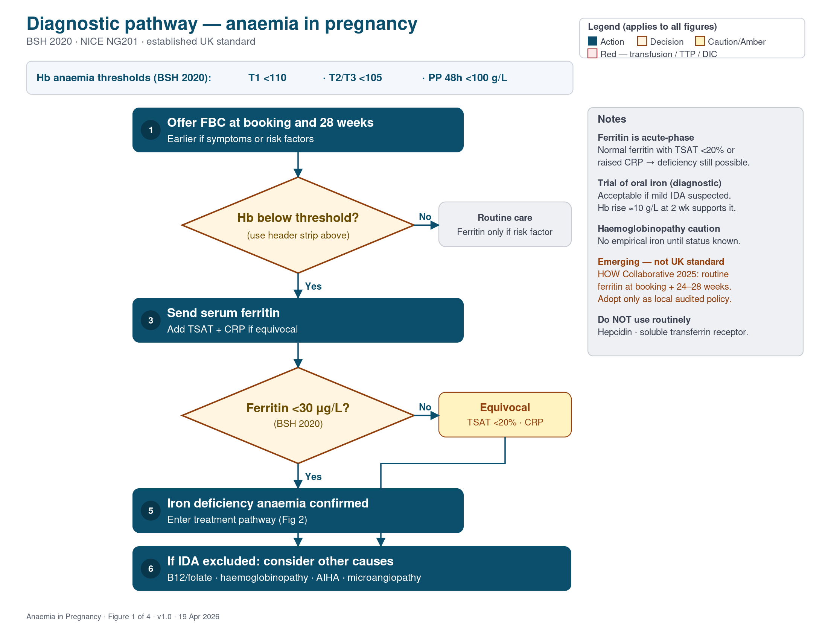
How do I reach the diagnosis?
5 / 12
FBC → threshold → ferritin → equivocal work-up → alternatives
Anaemia in Pregnancy · UK Clinical Guideline · v1.0

Slide 6
How do I give oral iron well?
6 / 12
First-line: elemental iron 100–200 mg daily · review at 2 weeks
• Elemental iron 100–200 mg daily
• Empty stomach; vitamin C helps
• Avoid tea, coffee, calcium, antacids
• Review Hb at 2 weeks — expect ≈10 g/L
• Continue 3 months after Hb normalises
Regimens (any one)
• Ferrous sulfate 200 mg
• Ferrous fumarate 210 mg
• Ferrous gluconate 300 mg
• Each 2–3× daily
Intolerance: change formulation · dose reduce · alternate-day — keep 2-week review target
Anaemia in Pregnancy · UK Clinical Guideline · v1.0

Slide 7
When do I escalate to IV iron?
7 / 12
FCM · FDI · confine to T2/T3 unless clearly necessary
• Oral intolerance despite change
• True non-response after 2 weeks
• Malabsorption (coeliac, bariatric, IBD)
• Severe anaemia Hb <90 from T2
• Late presentation ≥34 weeks
Safety essentials
• Dose per current SPC
• Observe ≥30 min every dose
• Reassess Hb ≥4 weeks
• Phosphate after FCM if at risk
• Consent covers hypersensitivity
Anaemia in Pregnancy · UK Clinical Guideline · v1.0

Slide 8
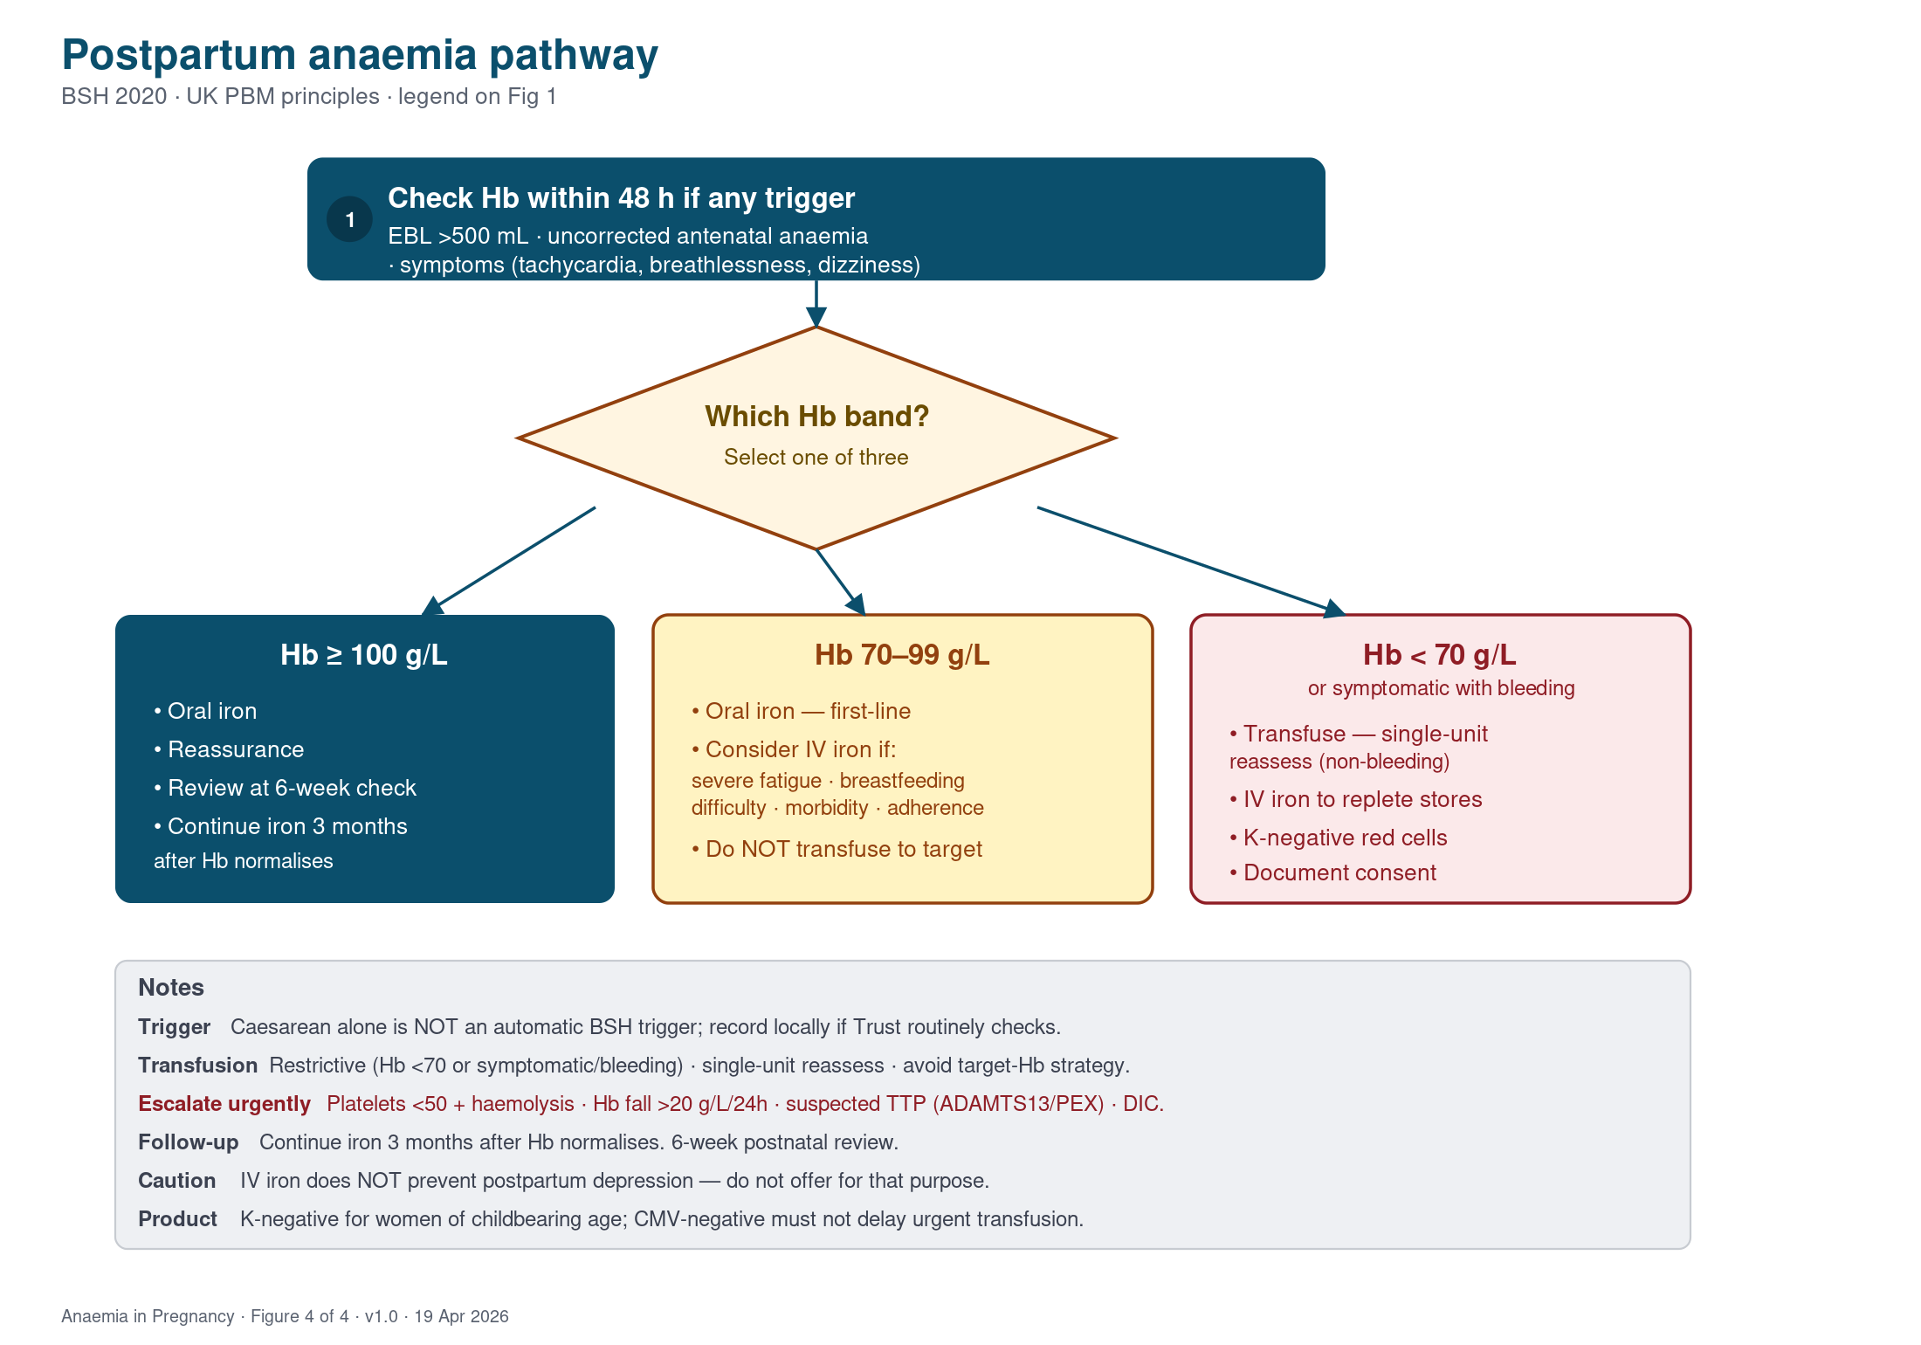
How do I treat postpartum anaemia?
8 / 12
Check when triggered · stratify by Hb band
Anaemia in Pregnancy · UK Clinical Guideline · v1.0

Slide 9
When do I transfuse — and which blood?
9 / 12
Restrictive threshold · single-unit reassess · correct product
• Restrictive threshold Hb <70 g/L
• Single-unit reassess in non-bleeding women
• K-negative for women of childbearing age
• CMV-negative for elective pregnancy transfusion
• Do NOT delay urgent transfusion for CMV-negative
Anaemia in Pregnancy · UK Clinical Guideline · v1.0

Slide 10
When do I escalate urgently?
10 / 12
Microangiopathy · TTP · DIC — do not miss these
• Platelets <50 with haemolytic indices
• Hb fall >20 g/L in 24 h — no overt bleed
• Suspected TTP → ADAMTS13 + plasma exchange
• Deranged DIC screen → major haemorrhage pathway
• Consider HELLP, aHUS, AIHA, AFLP
Anaemia in Pregnancy · UK Clinical Guideline · v1.0

Slide 11
Common mistakes in practice
11 / 12
Avoidable errors identified from audit and incident review
• Empirical iron before excluding haemoglobinopathy
• Ferritin interpreted alone during inflammation
• Reassessing Hb before 4 weeks after IV iron
• Skipping 30-minute post-IV-iron observation
• Transfusing to a target Hb when IV iron feasible
Anaemia in Pregnancy · UK Clinical Guideline · v1.0

Slide 12
Five take-home messages
12 / 12
What to remember at the bedside
1
Know the thresholds
T1 <110 · T2/T3 <105 · PP 48 h <100 · ferritin <30
2
Start oral iron well
100–200 mg daily · review Hb at 2 weeks
3
Use IV iron with care
Dose per SPC · observe ≥30 min · Hb ≥4 weeks
4
Stratify postpartum by Hb
≥100 oral · 70–99 consider IV · <70 transfuse
5
Escalate red flags early
Platelets <50 + haemolysis · Hb fall >20 g/L / 24 h
Anaemia in Pregnancy · UK Clinical Guideline · v1.0

