Slide 1



Smart Timetable Generator for Colleges using AI
AI-Based Academic Scheduling System
COMPUTER SCIENCE & ENGINEERING
FACULTY GUIDE: SAINI JACOB SOMAN
Team
Muheeb P S · Rahul T R · Ladheed Nousharvan P · Sanju Santhosh · Aadarsh S L

Slide 2

Abstract
We present an automated timetable generation system that produces conflict-free academic schedules by encoding constraints such as faculty availability, classroom and lab capacity, and course requirements. The system reduces manual effort and scheduling errors, speeds up iteration, and lays groundwork for a future AI optimization module to adapt schedules dynamically to real-world changes.

Slide 3

Problem Statement
Current Challenges
Manual timetable creation is time-consuming and labor-intensive
High risk of conflicts between classes, teachers, and rooms
Hard to manage multiple simultaneous constraints
Inefficient allocation of limited resources (labs, halls)
Absence of smart automation and adaptability

Slide 4
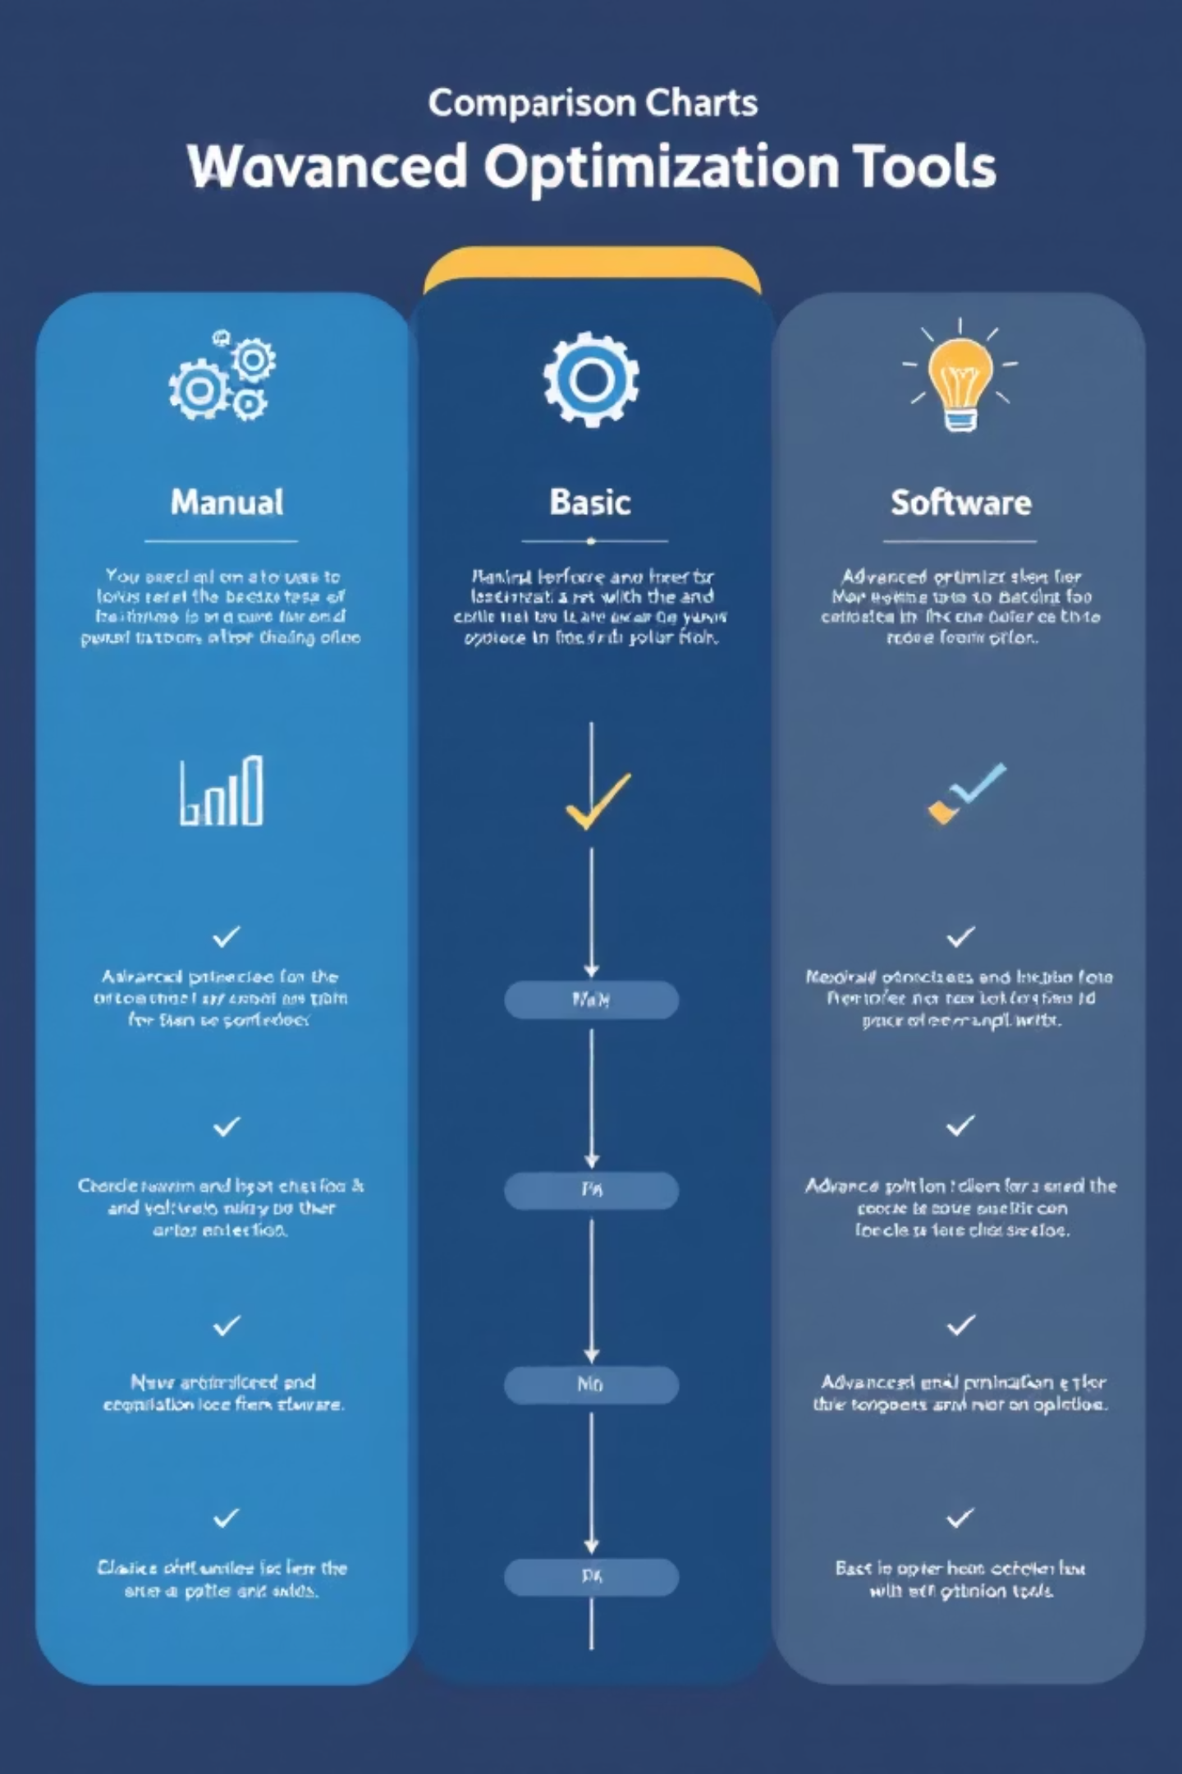
Literature Survey & Research Gap
Compared Approaches
Research Gap
Manual scheduling — flexible but slow and error-prone
Basic timetable software — faster but limited constraint handling
Existing optimization tools — powerful but complex and hard to adapt
No simple, adaptive AI-based system exists that dynamically models real-world college constraints (ad hoc changes, mixed resources) while remaining easy to use for administrative staff.

Slide 5
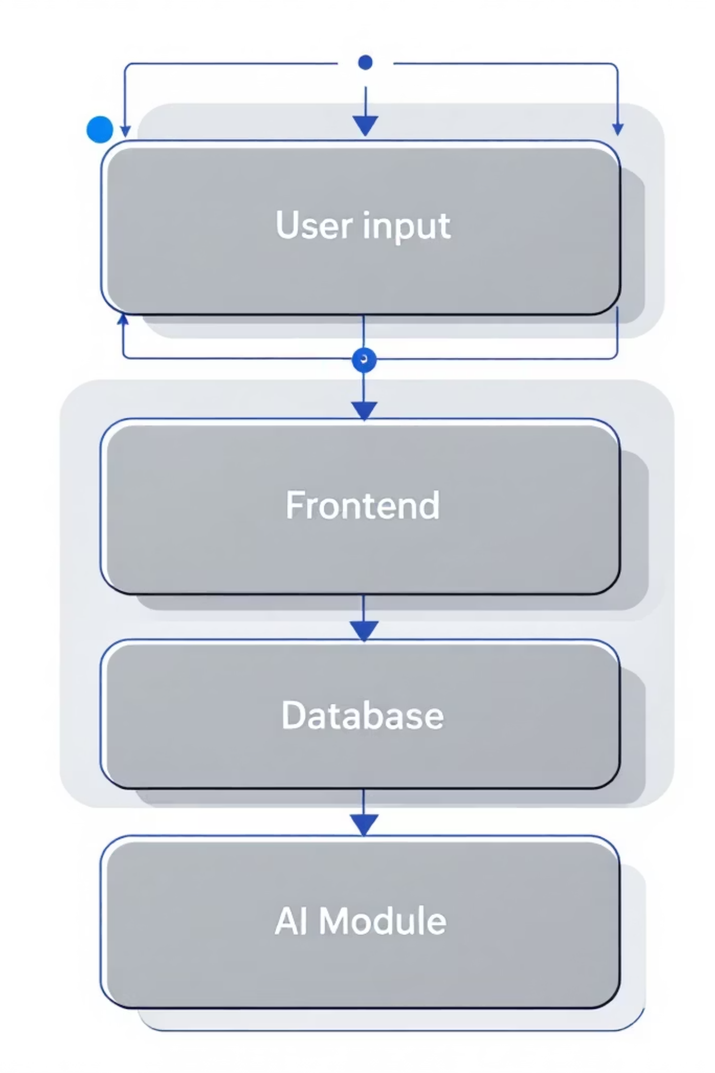

System Architecture
User inputs
Classes, subjects, teachers
Future AI module
Schedule System Flow
Frontend interface
Optional optimization suggestions
Presentation and forms
Database
Backend logic
Persistent storage of assignments
Scheduling and rules engine
The architecture separates presentation, scheduling logic, and persistent storage. Future AI will plug into the backend to suggest optimized assignments and adaptations.

Slide 6

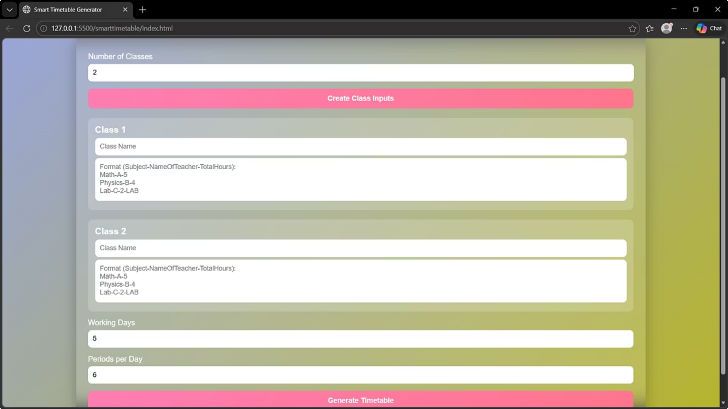
Initial Implementation (Status)
Frontend Completed
Timetable Generation Working
User interface for data entry and schedule preview is implemented.
Algorithm produces valid schedules using deterministic logic rules.
Logic-Based Scheduling
AI Module: Not Yet Integrated
Constraint engine handles availability, room assignments, and basic precedence.
Planned as future enhancement for optimization and dynamic adjustments.

Slide 7
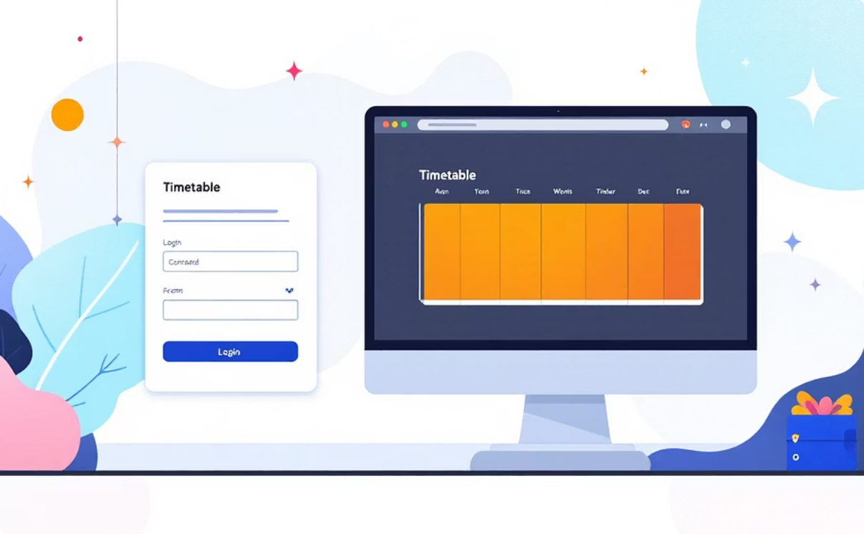
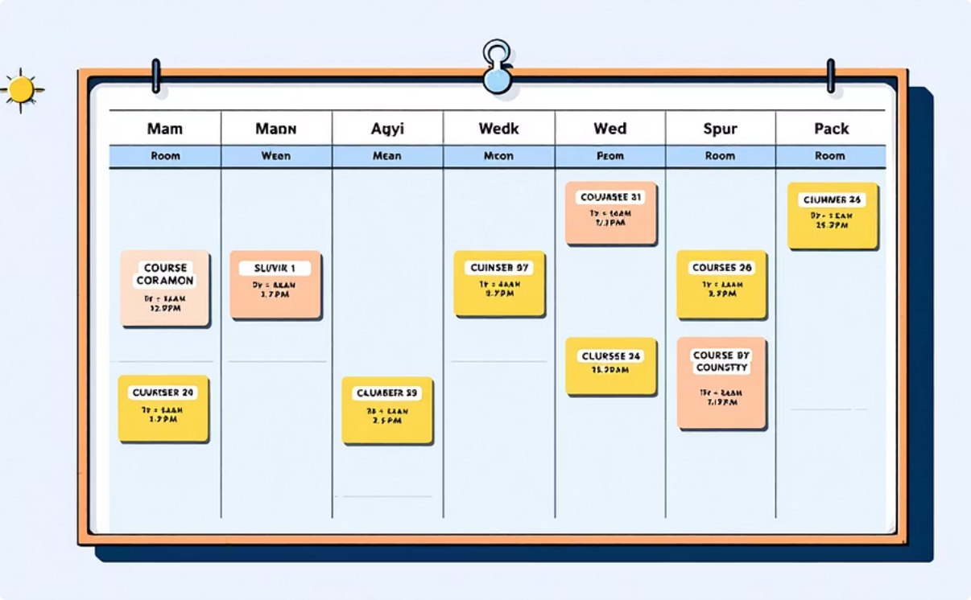
Working Output (Placeholders)
Frontend Interface Screenshot
Generated Timetable Screenshot
Placeholder for UI capture — displays forms for classes, subjects, teachers, and availability inputs.
Placeholder for generated schedule image — grid view showing conflict-free allocations.
Insert actual screenshots here before final submission.

Slide 8





Key Features
User-Friendly Interface
Class & Subject Management
Conflict-Free Generation
Intuitive forms and previews reduce training time for staff.
Constraint checks ensure no overlapping assignments for resources or teachers.
Flexible entry for courses, sections, and lab sessions.
Teacher Allocation System
Scalable Design
Respects availability, workload balance, and specialization.
Modular architecture to handle growing student cohorts and additional constraints.

Slide 9
Project Timeline
Phase 1
1
Frontend & basic logic — Completed
2
Phase 2
Backend improvement — ongoing
Phase 3
3
AI integration — planned
4
Phase 4
Testing & optimization — upcoming
Phase 5
5
Deployment & training — final rollout

Slide 10


Conclusion & Future Work
The Smart Timetable Generator dramatically reduces manual workload and scheduling errors. The current release provides a functioning, logic-based timetable engine and a polished frontend. Integrating an AI optimization module is the next priority to enable dynamic, efficient, and adaptive scheduling that responds to ad hoc changes and complex constraints.
Next Steps
Prototype AI scheduler · Expand test dataset · Run pilot with department
Contact: Faculty Guide Saini Jacob Soman — ready for demo and evaluation
Short-term: strengthen backend, add richer constraint types
Medium-term: integrate ML/AI for optimization and predictions
Long-term: real-time adaptation, user feedback loop, multi-campus support

