Slide 1
A Robust Transformer-Based Sentiment Analysis System
GUIDED BY,
Mr.N.Umakanth
AP(Sl.G.)
Muhesh Prabhu S, 23BCS047
Pugal Abishek A, 23BCS051

Slide 2
Introduction
Sentiment analysis is a fundamental task in Natural Language Processing (NLP) that focuses on identifying and classifying the textual data. With the rapid growth of social media platforms and from many sources Large volumes of data are generated making the sentiment analysis efficient. Due to noisy data, most Sentiment analysis models struggles across different datasets and fail to capture negation.

Slide 3


SDG Alignment
Automating feedback analysis: businesses receive thousands of reviews. Your model classifies them automatically (92% test accuracy), replacing slow manual reading and raising productivity
Helping small business that cant afford analyst
Innovation in AI research: you combine a pretrained transformer (DeBERTa) with an ordered-neuron recurrent decoder (ON-LSTM), attention pooling, adversarial training (FGM) and automatic hyperparameter tuning (Optuna) in one hybrid model. That's research-level innovation in NLP
Listening to the public at scale: governments and institutions collect public feedback through surveys ,social media. Sentiment analysis turns thousands of opinions into clear signals, so decisions can be made
Robustness against manipulated text providing confident prediction

Slide 4
Problem Statement
Existing sentiment analysis models suffer from poor robustness, limited contextual understanding, Limited awareness of negation, and high sensitivity to noisy or real-world text data.
Also the previous models struggles for complex inputs and doesn’t build up the relationships between words continuously written.

Slide 5
Objectives
To design a data encoding module that converts raw text into content and positional vectors and feed it to Transformer.
To construct a 12-layer transformer encoder with disentangled multi-head attention mechanism to capture long semantic relationships and provide Adversarial Training.
To develop a ON-LSTM layer to get Hierarchical representation of tokens.
To design an attention pooling module that takes important information from neuron and classifying the sentiment scores after Fully connected layer.
To integrate an optuna-based Bayesian hyper-parameter optimization modules to tune model parameters and improve overall performance

Slide 6
Expected Outcomes
The raw text is successfully transformed into robust numerical embedding that are resistance to adversarial inputs.
Deep and long contextual relationships between words are effectively
captured with the help of Transformer Encoder.
Hierarchical representation of neurons are generated from low-level to high-level from which important information are taken with Attention weight.
Attention pooling extracts important features and generates sentiment scores with help of FC and soft-max
Optimal hyper-parameter configurations are automatically identified through optuna’s Bayesian search, resulting in improved model accuracy and reduced manual tuning effort.

Slide 7
Literature Survey - 1
He et al., “DeBERTaV3: Improving DeBERTa Using ELECTRA-Style Pre-Training with Gradient-Disentangled Embedding Sharing,” ICLR 2023.
Replaces MLM with Replaced Token Detection (RTD).
Uses ELECTRA-style generator/discriminator pre-training.
Introduces Gradient-Disentangled Embedding Sharing (GDES).
Reduces the conflicting gradient effect between generator and discriminator embeddings.
Why because is that both the Generator and Discriminator will end up in tug of war situation.
He et al., “DeBERTaV3: Improving DeBERTa Using ELECTRA-Style Pre-Training with Gradient-Disentangled Embedding Sharing,” ICLR 2023.

Slide 8
Literature Survey – 1 contd
Merits:
More sample-efficient pre-training
Improves DeBERTa pre-training efficiency
Reduces embedding gradient conflict
Achieves strong downstream NLP performance
Demerits:
More complicated pre-training procedure
Requires generator and discriminator components
Increased implementation complexity
More computationally demanding than simple fine-tuning
He et al., “DeBERTaV3: Improving DeBERTa Using ELECTRA-Style Pre-Training with Gradient-Disentangled Embedding Sharing,” ICLR 2023.

Slide 9
Literature Survey - 2
Akiba et al. (2019), “Optuna: A Next-generation Hyperparameter Optimization Framework,” KDD 2019.
Provides an automated framework for hyperparameter optimization.
Uses efficient optimization and pruning strategies.
Automatically explores different hyperparameter configurations.
Can be integrated with machine-learning training workflows.
Efficient Search: Automatically explores different hyperparameter combinations to find better configurations.
Early Pruning: Stops poorly performing trials early, reducing unnecessary training time.
Akiba et al. (2019), “Optuna: A Next-generation Hyperparameter Optimization Framework,” KDD 2019.

Slide 10
Literature Survey – 2 contd
Merits:
Captures long-term dependencies
Reduces the vanishing-gradient problem
Effective for sequential data
Uses gated memory to control information flow
Demerits:
Sequential processing limits parallelization
Computationally more expensive than simple RNNs
Can still struggle with very long sequences
Does not explicitly model hierarchical structures
Akiba et al. (2019), “Optuna: A Next-generation Hyperparameter Optimization Framework,” KDD 2019.

Slide 11
Literature Survey - 3
Devlin et al. (2019) performed, "BERT: Pre-training of Deep
Bidirectional Transformers for Language Understanding," in Proc. NAACL-
HLT, Minneapolis, MN, USA, pp. 4171–4186, 2019.
BERT (Bidirectional Encoder Representations from Transformers):
Uses a bidirectional Transformer encoder to understand context from both left and right sides of a sentence.
Masked Language Model (MLM):
Randomly masks words and predicts them to learn contextual relationships.
Next Sentence Prediction (NSP):
Determines whether two sentences are logically connected.
Devlin et al., “BERT: Pre-training of Deep Bidirectional Transformers for Language Understanding,” 2019.

Slide 12
Literature Survey – 3 contd
Merits
Captures deep contextual meaning of words
Achieves high accuracy in sentiment analysis tasks
Supports transfer learning across NLP tasks
Handles complex sentence structures
Demerits
Requires high computational resources
Large model size
Slow training and inference
Needs large datasets
Devlin et al., “BERT: Pre-training of Deep Bidirectional Transformers for Language Understanding,” 2019.

Slide 13
Literature Survey - 4
He et al. (2021), “DeBERTa: Decoding-enhanced BERT with Disentangled Attention,” in ICLR 2021.
Disentangled Attention: Separately represents content information and position information.
Uses relative positional information to improve word-to-word interaction.
Enhanced Mask Decoder: Incorporates absolute position information during masked-token prediction.
Improves contextual and position-sensitive language representation.
He et al.: . Introduced DeBERTa, A Decoding-enhanced BERT model with Disentangled Attention. 2021

Slide 14
Literature Survey – 4 contd
Merits:
Better contextual representation than BERT
Separates content and positional information
Captures position-sensitive relationships
Strong performance on NLP tasks
Demerits:
High computational requirements
Large model size
Still primarily relies on Transformer-based contextual representation
Standard classification may not explicitly model hierarchical sequence structure
He et al.: . Introduced DeBERTa, A Decoding-enhanced BERT model with Disentangled Attention. 2021

Slide 15
Literature Survey - 5
Hochreiter and Schmidhuber, “Long Short-Term Memory,” Neural Computation, vol. 9, no. 8,pp 1997.
Adversarial Training: Adds small perturbations to input embeddings to improve robustness
FGM (Fast Gradient Method):
Applies single-step perturbation based on gradients
PGD (Projected Gradient Descent):
Multi-step adversarial attack for stronger robustness
Embedding Perturbation:
Forces model to learn stable representations under noisy inpu
Hochreiter and Schmidhuber, “Long Short-Term Memory,” Neural Computation, vol. 9, no. 8,pp 1997.

Slide 16
Literature Survey – 5 contd
Merits:
Handles long-term dependencies
Reduces vanishing-gradient problems
Effective for sequential data
Controls information using gated memory
Demerits:
Processes sequences sequentially
Limited parallelization
Mainly models linear sequential relationships
Does not explicitly impose hierarchical structure
Hochreiter and Schmidhuber, “Long Short-Term Memory,” Neural Computation, vol. 9, no. 8,pp 1997.

Slide 17
Literature Survey - 6
Shen et al. (2019), “Ordered Neurons: Integrating Tree Structures into Recurrent Neural Networks,” ICLR 2019.
Introduces Ordered Neurons LSTM (ON-LSTM).
Organizes neurons according to different information timescales.
Introduces master input and forget gates.
Uses the cumax() function to impose an ordering on neuron updates.
Enables the model to capture hierarchical/tree-like structures.
Shen et al. (2019), “Ordered Neurons: Integrating Tree Structures into Recurrent Neural Networks,” ICLR 2019.

Slide 18
Literature Survey – 6 contd
Merits:
Captures hierarchical structures
Preserves long-term information
Models different information timescales
Provides an inductive bias toward tree-like structures
Demerits:
More complex than standard LSTM
Adds additional parameters for master gates
Sequential processing remains a limitation
Primarily designed for recurrent sequence modeling
Shen et al. (2019), “Ordered Neurons: Integrating Tree Structures into Recurrent Neural Networks,” ICLR 2019.

Slide 19
Literature Survey - 7
Gupta and Joshi, “Feature-Based Twitter Sentiment Analysis With Improved Negation Handling,” IEEE Transactions on Computational Social Systems, 8(4) 2021.
Investigates the effect of negation on sentiment polarity.
Uses lexicon-based, morphological, POS-based and n-gram features.
Introduces negation exception rules for cases where a negation cue does not necessarily indicate actual negation.
Evaluates SVM, Naive Bayes and Decision Tree classifiers on SemEval-2013 Task 2
Gupta and Joshi, “Feature-Based Twitter Sentiment Analysis With Improved Negation Handling,” IEEE Transactions on Computational Social Systems, 8(4) 2021.

Slide 20
Literature Survey – 7 contd
Merits:
Explicitly models negation
Handles negation exception cases
Combines multiple linguistic features
Improves sentiment classification performance
Demerits:
Depends heavily on manually engineered features
Uses traditional machine-learning classifiers
Limited contextual representation compared with pretrained language models
Designed specifically for Twitter-style text
Gupta and Joshi, “Feature-Based Twitter Sentiment Analysis With Improved Negation Handling,” IEEE Transactions on Computational Social Systems, 8(4) 2021.

Slide 21
Literature Survey - 8
Goodfellow, Shlens and Szegedy, “Explaining and Harnessing Adversarial Examples,” ICLR 2015.
Sequence-to-Sequence (Seq2Seq) Model: Converts natural language input into structured outputs
Encoder–Decoder Architecture: Encodes input text and generates corresponding output
Attention Mechanism: Focuses on important words during generation
Text-to-Visualization Mapping: Translates user queries into visual representations
Goodfellow, Shlens and Szegedy, “Explaining and Harnessing Adversarial Examples,” ICLR 2015.

Slide 22
Literature Survey – 8 contd
Merits:
Simple and computationally efficient
Uses gradient information to create perturbations
Improves model robustness through adversarial training
Provides a foundation for gradient-based adversarial methods
Demerits:
Single-step perturbation may be weaker than iterative methods
Perturbation strength must be carefully selected
Originally demonstrated mainly in image/classification settings
Does not specifically address NLP embedding spaces
Goodfellow, Shlens and Szegedy, “Explaining and Harnessing Adversarial Examples,” ICLR 2015.

Slide 23
Literature Survey - 9
Zhu et al., “FreeLB: Enhanced Adversarial Training for Natural Language Understanding,” ICLR 2020.
Applies adversarial perturbations directly to word embeddings.
Uses multiple perturbation steps to improve robustness.
Encourages greater invariance in the embedding space.
Demonstrates improvements on Transformer-based NLP models.
It is also know as Free-Latch Batches instead of computing and updating
computes single time and updates
Zhu et al. (2020), “FreeLB: Enhanced Adversarial Training for Natural Language Understanding,” ICLR 2020.

Slide 24
Literature Survey – 9 contd
Merits:
Designed specifically for NLP
Perturbs word embeddings
Improves robustness and generalization
Works effectively with Transformer models
Demerits:
Requires additional adversarial computation
Multiple perturbation steps increase training time
Requires careful selection of perturbation parameters
More expensive than normal fine-tuning
Zhu et al. (2020), “FreeLB: Enhanced Adversarial Training for Natural Language Understanding,” ICLR 2020.

Slide 25
Literature Survey - 10
Liu et al., “OnDeBERTa: An Ordered Neuron Memory Enhanced DeBERTa Model for E-commerce Review Sentiment Classification,” CICSE 2026.
Combines DeBERTa + ON-LSTM + Attention Pooling.
Uses DeBERTa for contextual representation.
Uses ON-LSTM to model hierarchical sequence information.
Uses attention pooling to emphasize important sentiment fragments.
Evaluated on the Amazon Review Polarity dataset.
Liu et al. (2026), “OnDeBERTa: An Ordered Neuron Memory Enhanced DeBERTa Model for E-commerce Review Sentiment Classification,” CICSE 2026.

Slide 26
Literature Survey – 10 contd
Merits:
Combines contextual and hierarchical representation
Better handling of negation, contrast and delayed sentiment cues
Attention pooling focuses on important sentiment fragments
Achieves 94.18% accuracy and 91.64% F1-score in the reported one-layer configuration.
Demerits:
Increased architectural complexity
Higher computational cost than plain DeBERTa
Requires an additional ON-LSTM decoder
Performance depends on pooling and decoder configuration
Liu et al. (2026), “OnDeBERTa: An Ordered Neuron Memory Enhanced DeBERTa Model for E-commerce Review Sentiment Classification,” CICSE 2026.

Slide 27
Literature Survey – 1 - 4
Consolidation of the literatures:
# | Author(s) & Year | Methodology used | Limitations
1 | Elman (1990) | Proposed a simple recurrent neural network using recurrent connections to maintain previous Information. | Difficulty in learning long-term dependencies; vanishing
2 | Hochreiter & Schmidhuber (1997) | Introduced LSTM with gated memory and cell state to capture long-term dependencies in sequential data. | Sequential computation; higher complexity than basic RNN; limited parallelization.
3 | Shen et al. (2019) | Proposed ON-LSTM with ordered neurons, master gates and cumax to model hierarchical sequences. | More complex than LSTM; recurrent computation; additional parameters.
4 | Devlin et al. (2019) | Proposed BERT using a bidirectional Transformer encoder with pre-training through MLM and NSP. | Large computational and memory requirements; expensive pre-training.

Slide 28
Literature Survey – 5 - 8
Consolidation of the literatures:
# | Author(s) & Year | Methodology used | Limitations
5 | He et al. (2021) | Proposed DeBERTa with disentangled attention to separately model content and relative positional information. | High computational cost; large model size; does not explicitly model hierarchical structure.
6 | Gupta & Joshi (2021) | Proposed feature-based sentiment analysis - negation handling using linguistic features and negation rules. | Requires manual feature engineering; limited contextual understanding.
7 | Goodfellow et al. (2015) | Introduced gradient-based adversarial and adversarial training to improve neural network robustness. | Single-step perturbation can be weaker than iterative methods; requires tuning.
8 | Zhu et al. (2020) | Proposed FreeLB, which performs multi-step adversarial perturbation. | Requires adversarial hyperparameter tuning.

Slide 29
Literature Survey – 9, 10
Consolidation of the literatures:
# | Author(s) & Year | Methodology used | Limitations
9 | Liu et al. (2026) | Proposed combining DeBERTa, ON-LSTM, attention pooling hierarchical sentiment representation. | Increased model complexity and cost due to additional ON-LSTM decoder.
10 | Akiba et al. (2019) | Proposed Optuna for automated hyperparameter optimization using trial-based search and early pruning. | Multiple trials require considerable computational resources.

Slide 30
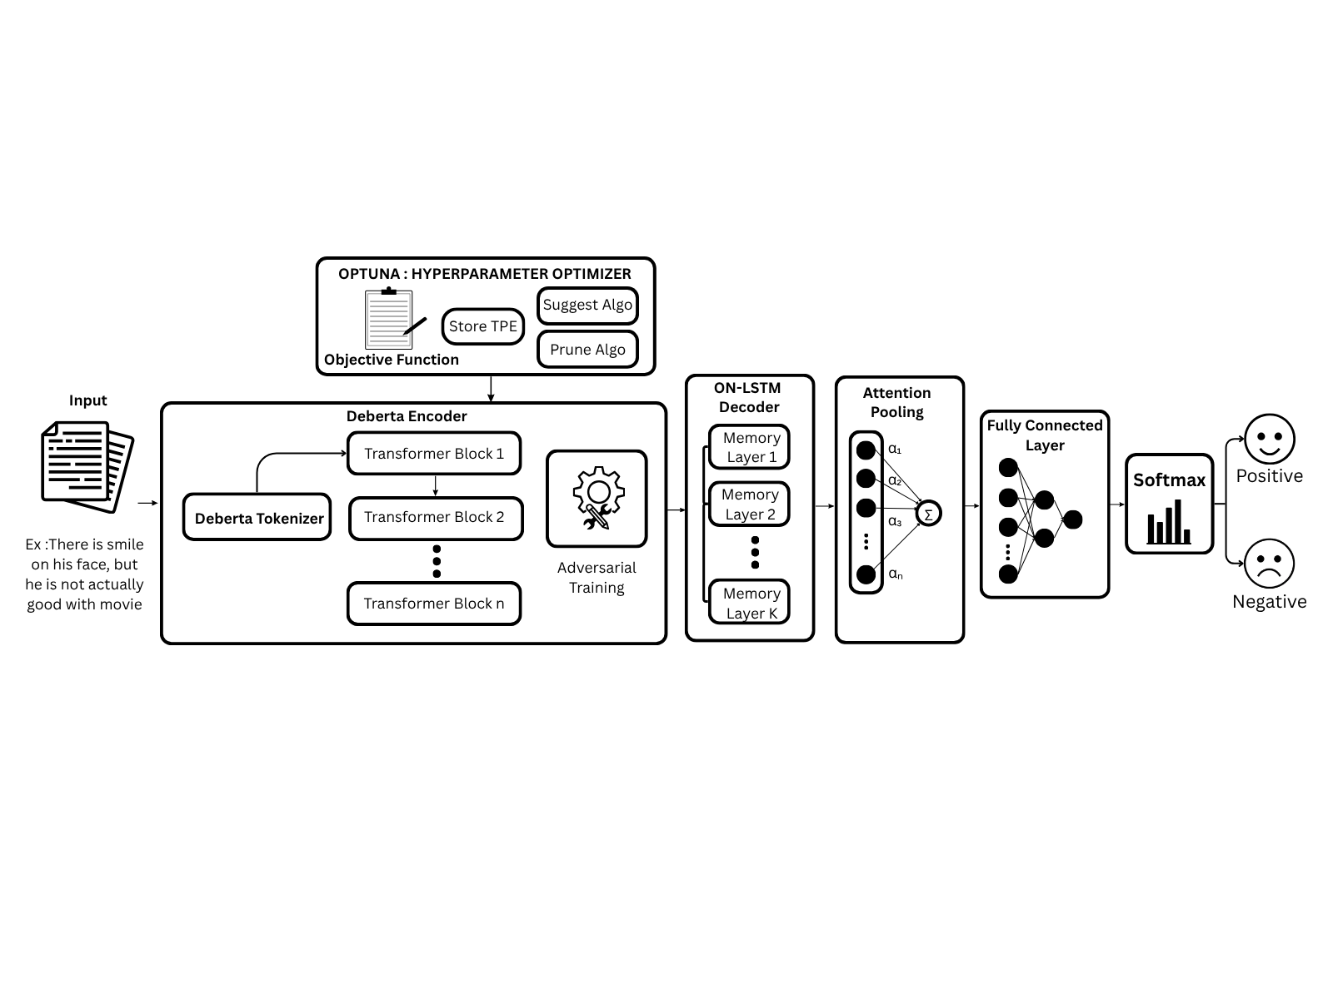
SYSTEM DIAGRAM

Slide 31
Dataset Details
DATASET NAME | IMDB MOVIE REVIEWS
No of Records | 50,000
No of Classes | 2
Name of Classes | Positive / Negative
Split Representation (%) | 70 / 20 / 10
No of Records for Training | 35,000 (70%)
No of Records for Testing | 10,000 (20%)
No of Records for Validation | 5,000(10%)

Slide 32
Description of Modules
1. Data Preprocessing and Tokenization:
Text Preprocessing
Remove HTML tags, URLs, extra spaces, and normalize Unicode characters.
Dataset Splitting
Split the IMDB dataset into 70% training, 20% testing, and 10% validation sets.
DeBERTa Tokenization
Tokenize each review into sub-word tokens and add [CLS] and [SEP] tokens.
Encoding & Padding
Convert tokens into input IDs, truncate to maximum length L, and pad shorter sequences with [PAD].
Attention Mask & Output
Create an attention mask where 1 represents real tokens and 0 represents padding, producing input_ids, attention_mask, and labels.

Slide 33
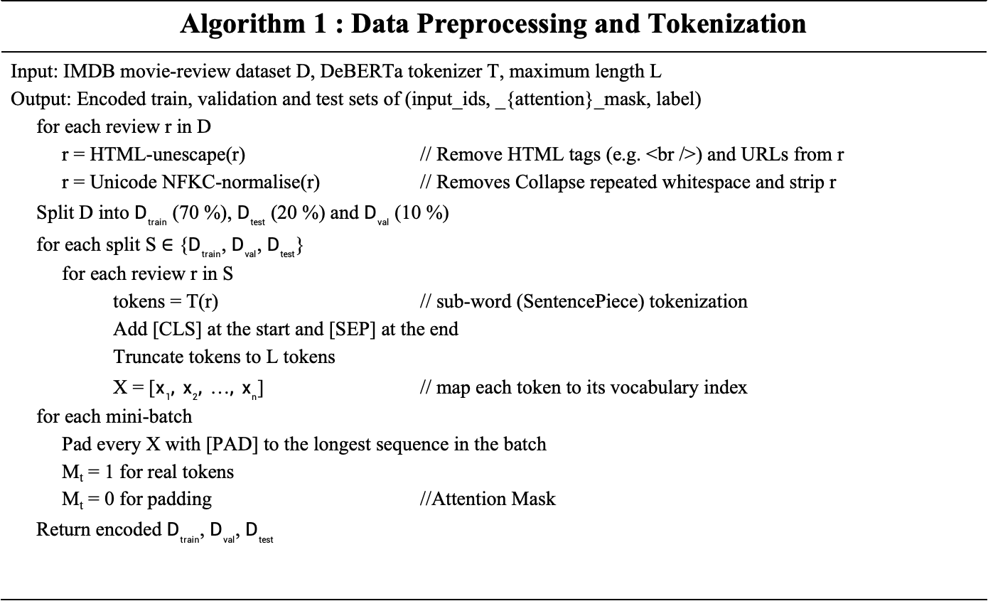
Algorithm 1 : Data Preprocessing and Tokenization
Input: IMDB movie-review dataset D, DeBERTa tokenizer T, maximum length L Output: Encoded train, validation and test sets of (input_ids, _{attention}_mask, label) for each review r in D r = HTML-unescape(r) // Remove HTML tags (e.g. <br />) and URLs from r r = Unicode NFKC-normalise(r) // Removes Collapse repeated whitespace and strip r Split D into $D_{train}$ (70 %), $D_{test}$ (20 %) and $D_{val}$ (10 %) for each split S ∈ {$D_{train}$, $D_{val}$, $D_{test}$} for each review r in S tokens = T(r) // sub-word (SentencePiece) tokenization Add [CLS] at the start and [SEP] at the end Truncate tokens to L tokens X = [$x_{1}, x_{2}, …, x_{n}$] // map each token to its vocabulary index for each mini-batch Pad every X with [PAD] to the longest sequence in the batch M_{t} = 1 for real tokens M_{t} = 0 for padding //Attention Mask Return encoded $D_{train}$, $D_{val}$, $D_{test}$

Slide 34
Results : Preprocessing and Tokenization
Input : Movie Reviews
Output : Tokenization, Generation of Token ID, Attention mask generation
Text : There is a smile on his face, but he is not actually good with movie
Process | Outputs
Preprocessing | There is a smile on his face, but he is not actually good with movie
Token generation | [CLS] ▁There ▁is ▁a ▁smile ▁on ▁his ▁face , ▁but ▁he ▁is ▁not ▁actually ▁good ▁with ▁movie [SEP]
Input IDs | [1, 443, 269, 266, 3292, 277, 315, 812, 261, 304, 313, 269, 298, 675, 397, 275, 1421, 2]
Attention Mask | [1, 1, 1, 1, 1, 1, 1, 1, 1, 1, 1, 1, 1, 1, 1, 1, 1, 1]

Slide 35
Results : Preprocessing and Tokenization
Input : Movie Reviews
Output : Tokenization, Generation of Token ID, Attention mask generation
Text : The acting was brilliant and the story kept me hooked till the end.<br /><br />Loved it
Process | Outputs
Preprocessing | The acting was brilliant and the story kept me hooked till the end. Loved it
Token generation | [CLS] ▁The ▁acting ▁was ▁brilliant ▁and ▁the ▁story ▁kept ▁me ▁hooked ▁till ▁the ▁end . ▁Loved ▁it ! [SEP]
Input IDs | [1, 279, 3754, 284, 4269, 263, 262, 697, 1756, 351, 10826, 3925, 262, 513, 260, 17249, 278, 300, 2]
Attention Mask | [1, 1, 1, 1, 1, 1, 1, 1, 1, 1, 1, 1, 1, 1, 1, 1, 1, 1]

Slide 36
Results : Preprocessing and Tokenization
Input : Movie Reviews
Output : Tokenization, Generation of Token ID, Attention mask generation
Text : What a waste of time &amp; money. The plot was boring, see http://example.com
Process | Outputs
Preprocessing | What a waste of time & money. The plot was boring, see
Token generation | [CLS] ▁What ▁a ▁waste ▁of ▁time ▁& ▁money . ▁The ▁plot ▁was ▁boring , ▁see [SEP]
Input IDs | [1, 458, 266, 2150, 265, 326, 429, 580, 260, 279, 4278, 284, 6715, 261, 398, 2]
Attention Mask | [1, 1, 1, 1, 1, 1, 1, 1, 1, 1, 1, 1, 1, 1, 1, 1, 1, 1]

Slide 37
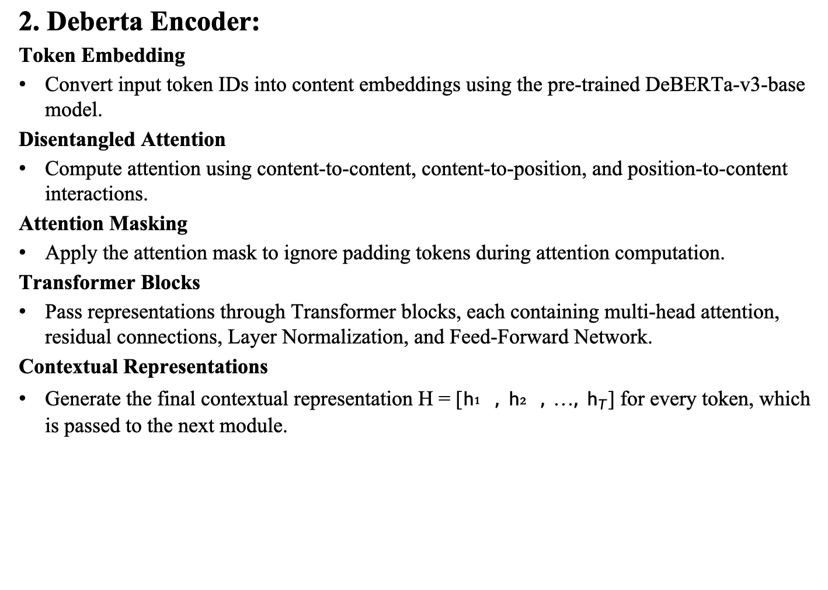
2. Deberta Encoder:
Token Embedding
Convert input token IDs into content embeddings using the pre-trained DeBERTa-v3-base model.
Disentangled Attention
Compute attention using content-to-content, content-to-position, and position-to-content interactions.
Attention Masking
Apply the attention mask to ignore padding tokens during attention computation.
Transformer Blocks
Pass representations through Transformer blocks, each containing multi-head attention, residual connections, Layer Normalization, and Feed-Forward Network.
Contextual Representations
Generate the final contextual representation H = [$h₁, h₂, …, h_{T}$] for every token, which is passed to the next module.

Slide 38
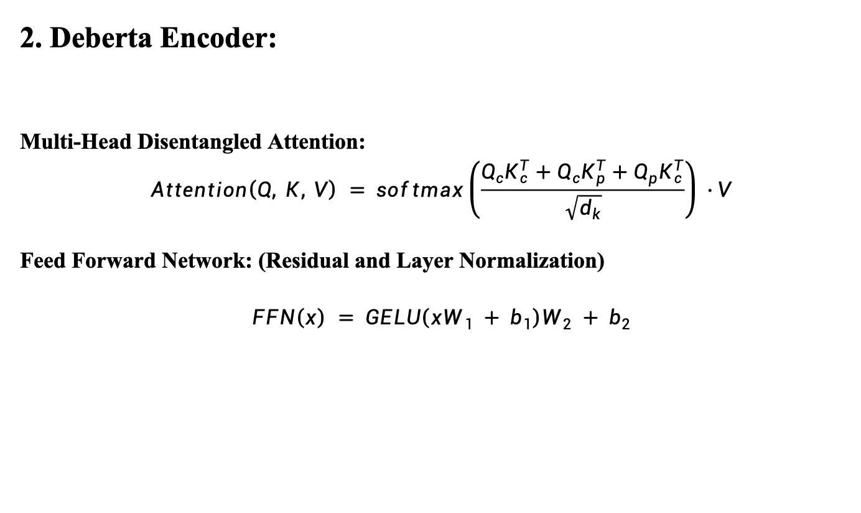
2. Deberta Encoder:
Multi-Head Disentangled Attention:
$$Attention\left(Q, K, V\right) = softmax\left(\frac{Q_{c}K_{c}^{T}+Q_{c}K_{p}^{T}+Q_{p}K_{c}^{T}}{\sqrt{d_{k}}}\right) · V$$
Feed Forward Network: (Residual and Layer Normalization)
$$FFN\left(x\right) = GELU\left(xW_{1} + b_{1}\right)W_{2} + b_{2}$$

Slide 39
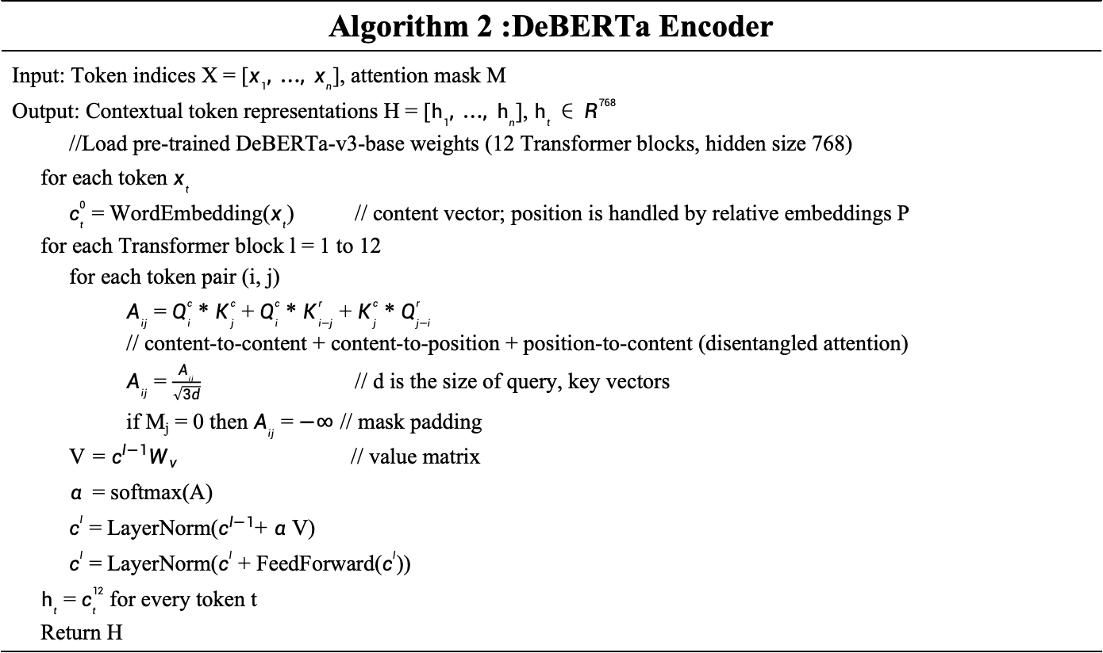
Algorithm 2 :DeBERTa Encoder
Input: Token indices X = [$x_{1}, …, x_{n}$], attention mask M Output: Contextual token representations H = [$h_{1}, …, h_{n}$], $h_{t}$ ∈ $R^{768}$ //Load pre-trained DeBERTa-v3-base weights (12 Transformer blocks, hidden size 768) for each token $x_{t}$ $c_{t}^{0}$ = WordEmbedding($x_{t}$) // content vector; position is handled by relative embeddings P for each Transformer block l = 1 to 12 for each token pair (i, j) $A_{ij}$ = $Q_{i}^{c}$ * $K_{j}^{c}$ + $Q_{i}^{c}$ * $K_{i−j}^{r}$ + $K_{j}^{c}$ * $Q_{j−i}^{r}$ // content-to-content + content-to-position + position-to-content (disentangled attention) $A_{ij}$ = $\frac{A_{ij}}{\sqrt{3d}}$ // d is the size of query, key vectors if M_{j} = 0 then $A_{ij}$ = $−∞$ // mask padding V = $c^{l−1}W_{v}$ // value matrix $α$= softmax(A) $c^{l}$ = LayerNorm($c^{l−1}$+ $α$ V) $c^{l}$ = LayerNorm($c^{l}$ + FeedForward($c^{l}$)) $h_{t}$ = $c_{t}^{12}$ for every token t Return H

Slide 40
Results : Deberta Encoder
Input : Dataset Splits, Tokenization, Generation of Token ID, Attention mask generation
Output : H : Contextual token features
For every Token Contextual representation is provided. H(1, 18, 768) H(1, 19, 768)
Sentence | Outputs
H[CLS] | [0.1368, 0.2143, 0.0260, -0.0358, 0.0872, …]
H[_There] | [-0.5937, -0.0801, -0.0892, -0.9752, 0.3787,…]
Sentence | Outputs
H[CLS] | [0.3911, 0.2688, 0.0475, -0.0311, 0.0742, …]
H[_The] | [1.0908, 0.0500, 0.1680, -0.8739, 0.0586, …]
Sentence | Outputs
H[CLS] | [0.1559, 0.1284, 0.1515, -0.0597, 0.1814]
H[_What] | [0.4089, 0.1812, -0.0377, -0.1305, 0.0906]

Slide 41
3. Adversarial Training:
Clean Training
Compute the cross-entropy loss using the original input and back-propagate to obtain gradients.
Generate Perturbation
Obtain the gradient of the DeBERTa word embeddings and create a small adversarial perturbation using strength ε.
Adversarial Training
Add the perturbation to the embeddings and compute the adversarial loss using the perturbed input.
Gradient & Restoration
Back-propagate the adversarial loss, combine the gradients with the clean gradients, and restore the original embeddings.
Parameter Update
Clip the gradient norm and update model parameters using AdamW with a linear warm-up scheduler.

Slide 42
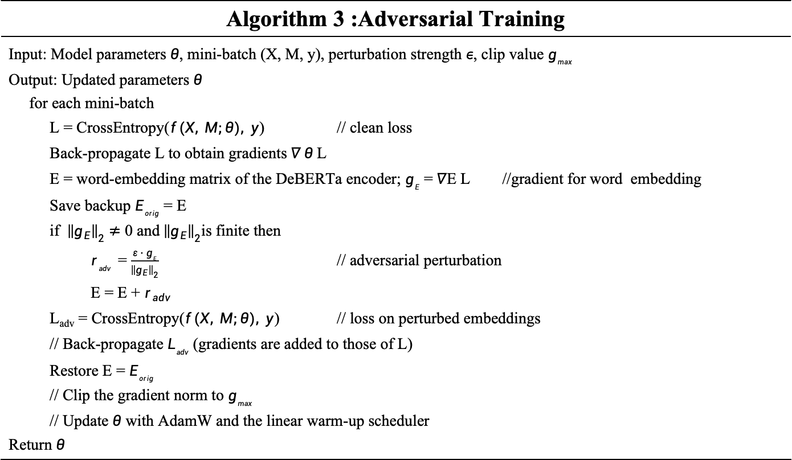
Algorithm 3 :Adversarial Training
Input: Model parameters $θ$, mini-batch (X, M, y), perturbation strength $ε$, clip value $g_{max}$ Output: Updated parameters $θ$ for each mini-batch L = CrossEntropy($f(X, M;θ), y$) // clean loss Back-propagate L to obtain gradients $∇ θ$L E = word-embedding matrix of the DeBERTa encoder; $g_{E}$ = $∇$E L //gradient for word embedding Save backup $E_{orig}$ = E if ${\left\|g_{E}\right\|}_{2}$ $≠$ 0 and ${\left\|g_{E}\right\|}_{2}$is finite then $r_{adv}$ = $\frac{ε · g_{E}}{{\left\|g_{E}\right\|}_{2}}$ // adversarial perturbation E = E + $r_{adv}$ L_{adv} = CrossEntropy($f(X, M;θ), y$) // loss on perturbed embeddings // Back-propagate $L_{adv}$ (gradients are added to those of L) Restore E = $E_{orig}$ // Clip the gradient norm to $g_{max}$ // Update $θ$ with AdamW and the linear warm-up scheduler Return $θ$

Slide 43
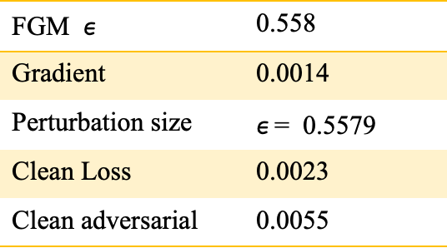
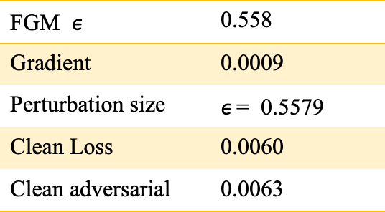
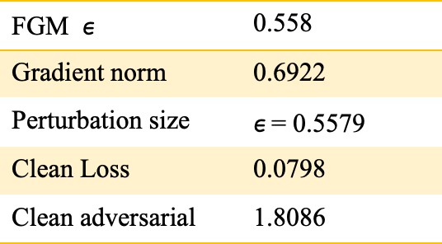
Results : Adversarial Training
Input: Model params, mini-batch, perturbation strength, clip value.
Output: Updated Parameters
FGM $ε$ | 0.558
Gradient norm | 0.6922
Perturbation size | $ε$= 0.5579
Clean Loss | 0.0798
Clean adversarial | 1.8086
FGM $ε$ | 0.558
Gradient | 0.0009
Perturbation size | $ε$= 0.5579
Clean Loss | 0.0060
Clean adversarial | 0.0063
FGM $ε$ | 0.558
Gradient | 0.0014
Perturbation size | $ε$= 0.5579
Clean Loss | 0.0023
Clean adversarial | 0.0055

Slide 44
4. ON-LSTM Decoder
Input & Chunking
Take the DeBERTa encoder output H and divide the hidden neurons into chunks of size.
Memory Initialization
Initialize the hidden state and cell state to zero for each ON-LSTM memory layer.
Master & Standard Gates
Compute the LSTM gates and split them into master gates for chunk-level hierarchy and standard gates for neuron-level updates.
Hierarchical Memory Update
Use cumax-based master gates to control information flow between neuron chunks and perform hierarchical memory updates.
Contextual Output
Generate the updated representation sₜ, apply the attention mask and dropout, and pass the output through the remaining memory layers to obtain Z.

Slide 45

Algorithm 4 :ON-LSTM Decoder
Input: Encoder output H = [$h_{1}, …, h_{n}$], attention mask M, hidden size $d_{h}$, chunk size C, number of memory layers K Output: Decoded token representations Z = [$z_{1}, …, z_{n}$] $n_{chunk}$ = $\frac{d_{h}}{C}$ // number of neuron chunks U = H // input of the first memory layer for each memory layer k = 1 to K Initialise hidden state $s_{0}$ = 0 and cell state $c_{0}$ = 0 for each time step t = 1 to n gates = $W_{ih}$ $U_{t}$ + $W_{hh}$ $s_{t−1}$ + b // Split gates into master gates ($f̃, ĩ$), one per chunk, standard gates ($o, ĉ, i, f$), one per token $f̃$ = cumax($f̃$); $ĩ$ = 1 − cumax($ĩ$) // cumax(x)k = $Σ(j ≤ k)$ $softmax{\left(x\right)}_{j}$ $ω$ = $f̃$ $∘$ $ĩ$ // overlap of master gates $f$=$f∘ω+\left(\tilde{f}−ω\right);i$ = $i∘ω+(ĩ − ω)$ $c_{t}$=$f∘c_{t−1}+i∘ĉ$ // hierarchical memory update s_{t} = o ∘ tanh(c_{t}) if M_{t} = 0 then keep previous s, c and output 0 // padding U = Dropout(outputs $s_{1} … s_{n}$) // input of next layer Z = output sequence of layer K Return Z

Slide 46
Results : OnLSTM Decoder
Input : Deberta’s Output Output : ON-LSTM hidden sequence
Z – Contextualized Hidden vector from Deberta Encoder
Process | Output
Z[CLS] | [-0.2756, -0.2404, 0.0918, -0.0643, 0.0745]
Master forget gate | 0.02, 0.12, 0.44, 0.46, 0.84, 0.88, 0.93, … , 0.99, 1.00
Master input gate | 0.99, 0.98, 0.97, … , 0.81, 0.60, 0.19, 0.00
Process | Output
Z[CLS] | [-0.2909, -0.3105, 0.2442, 0.2059, 0.3493]
Master forget gate | 0.91, 0.92, 0.92, 0.94, … , 0.99, 1.00
Master input gate | 0.99, 0.98, 0.97, … , 0.79, 0.75, 0.00
Process | Output
Z[CLS] | [-0.3221, -0.2834, 0.2028, 0.0481, 0.0627]
Master forget gate | 0.22, 0.83, 0.90, 0.91, … , 0.99, 1.00
Master input gate | 0.99, 0.98, 0.95, … , 0.80, 0.74, 0.00

Slide 47
5. Optuna : Hyperparameter Optimizer
Define Search Space
Specify ranges for learning rate, weight decay, dropout, hidden size, chunk size, warm-up ratio, and adversarial strength.
Initialize Trials
Perform the first 4 trials using random sampling to explore different hyperparameter combinations.
TPE Optimization
Use TPE (Tree-structured Parzen Estimator) to select promising hyperparameters based on previous trial results.
Training & Pruning
Train and evaluate the model using F1-score, while the Median Pruner stops poorly performing trials early.
Select Best Parameters
Select the hyperparameter set with the highest validation F1-score and use it for final model training.

Slide 48
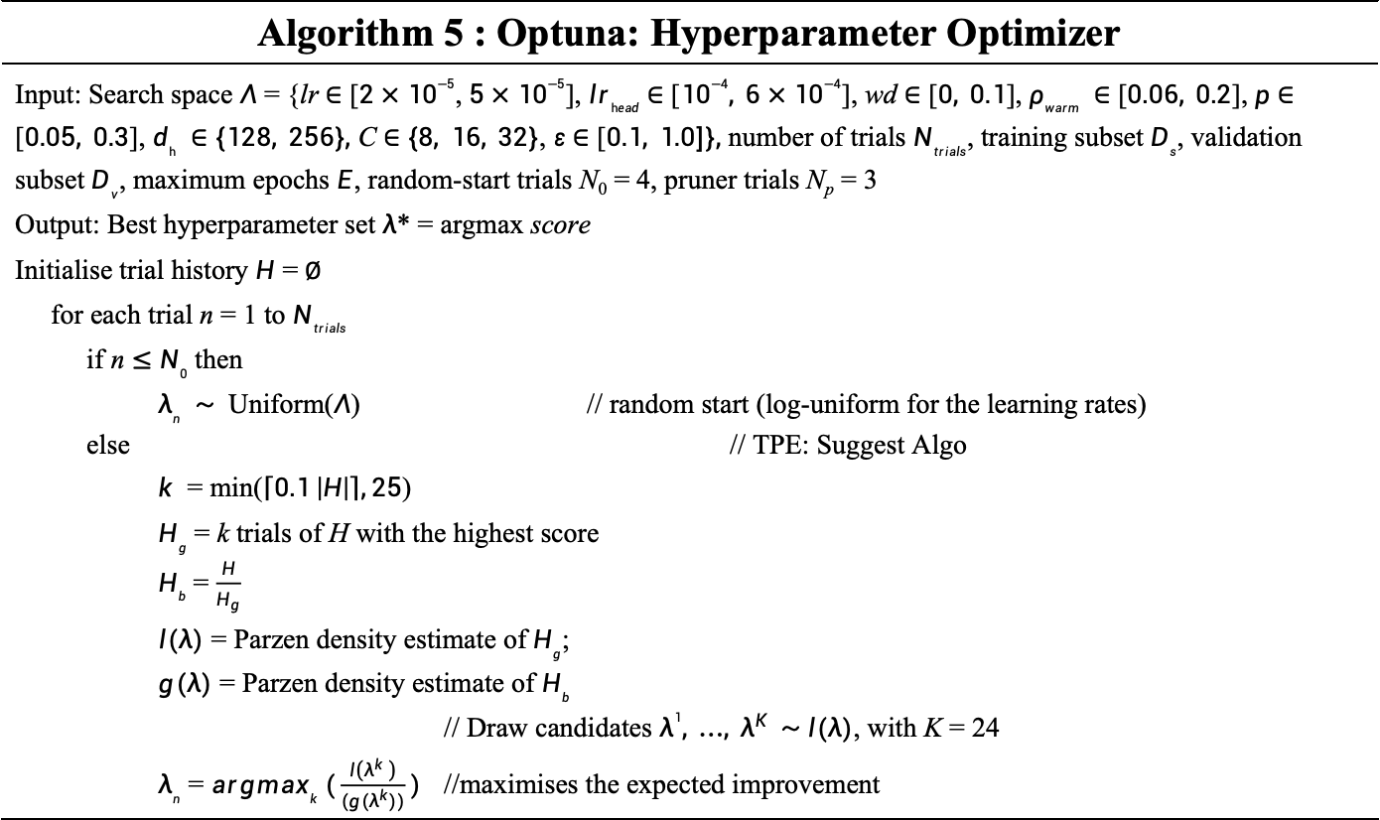
Algorithm 5 : Optuna: Hyperparameter Optimizer
Input: Search space $Λ$ = {lr $∈$ [$2×{10}^{−5}$, $5×{10}^{−5}$], $lr_{head}$ $∈$ [${10}^{−4}, 6×{10}^{−4}$], wd ∈ [$0, 0.1$], $ρ_{warm} ∈$ [$0.06, 0.2$], $p$ $∈$ [$0.05, 0.3$], $d_{h} ∈$ $\{128, 256\},$ C $∈$ $\{8, 16, 32\}$, $ε$ $∈$ [$0.1, 1.0]\},$ number of trials $N_{trials}$, training subset $D_{s}$, validation subset $D_{v}$, maximum epochs $E$, random-start trials N₀ = 4, pruner trials N_{p} = 3 Output: Best hyperparameter set $λ$* = argmax score Initialise trial history $H$ =$∅$ for each trial n = 1 to $N_{trials}$ if n $≤$ $N_{0}$ then $λ_{n} ∼$ Uniform($Λ$) // random start (log-uniform for the learning rates) else // TPE: Suggest Algo $k$ = min($\left\lceil 0.1 \left|H\right|\right\rceil ,25$) $H_{g}$ = k trials of H with the highest score $H_{b}$ = $\frac{H}{H_{g}}$ $l(λ)$ = Parzen density estimate of$H_{g}$; $g(λ)$ = Parzen density estimate of $H_{b}$ // Draw candidates $λ^{1}, …, λ^{K}$ $∼$ $l(λ)$, with K = 24 $λ_{n}$ = $argmax_{k} (\frac{l\left(λ^{k} \right)}{(g(λ^{k}))})$ //maximises the expected improvement

Slide 49
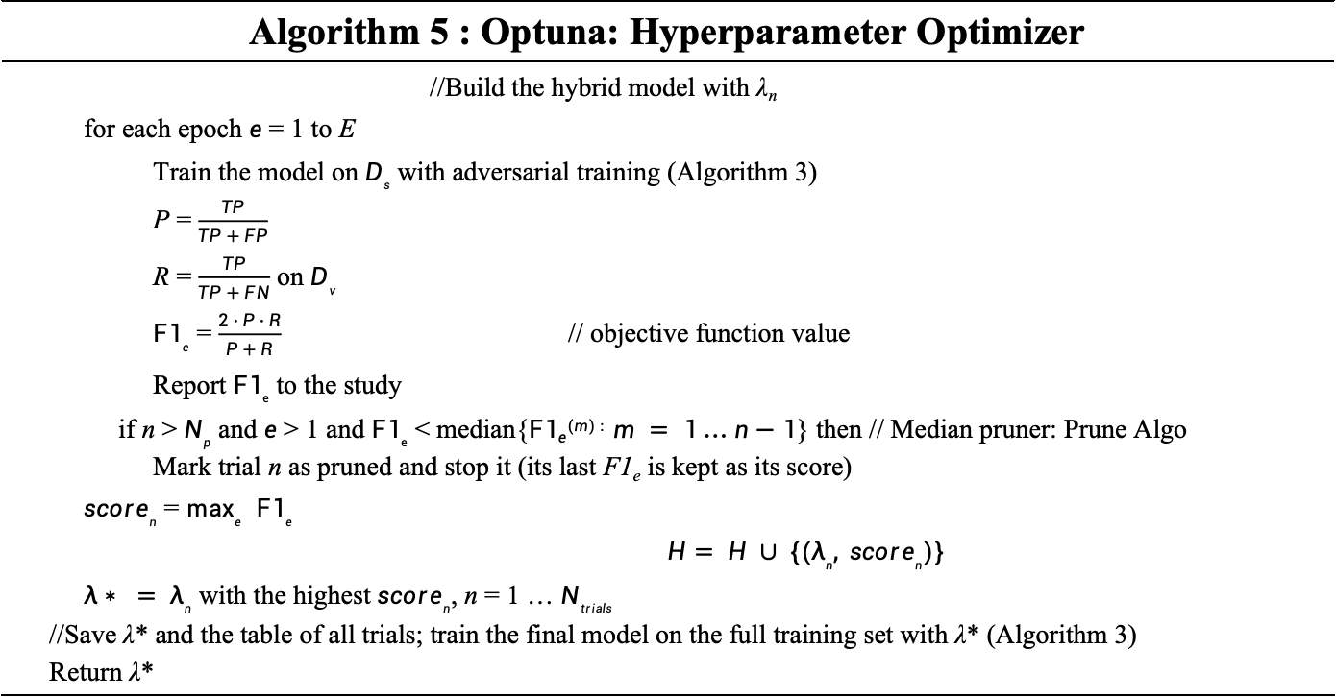
Algorithm 5 : Optuna: Hyperparameter Optimizer
//Build the hybrid model with λ_{n} for each epoch $e$ = 1 to E Train the model on $D_{s}$ with adversarial training (Algorithm 3) P = $\frac{TP}{TP + FP}$ R = $\frac{TP}{TP + FN}$ on $D_{v}$ $F1_{e}$ = $\frac{2 · P · R}{P + R}$ // objective function value Report $F1_{e}$ to the study if n > $N_{p}$ and $e$ > 1 and $F1_{e}$ < median{$F1e(m) : m = 1 … n−1$} then // Median pruner: Prune Algo Mark trial n as pruned and stop it (its last F1_{e} is kept as its score) $score_{n}$ = $\max_{e}$ $F1_{e}$ $$H= H ∪ \{(λ_{n}, score_{n})\}$$ $λ∗ = λ_{n}$ with the highest $score_{n}$, n = 1 … $N_{trials}$ //Save λ* and the table of all trials; train the final model on the full training set with λ* (Algorithm 3) Return λ*

Slide 50
Results: Optuna: Hyperparameter Optimizer
Input : Search space, no of trails, datasets, prune trails, max epochs
Output : Best Hyperparameters
After each run on datasets optuna checks with F1 score
Optimized Parameter from runs :
Encoder = microsoft/deberta-v3-base
Max length = 128
Learning rate = 3.3031 × 10⁻⁵
Head LR = 2.6873 × 10⁻⁴
Weight decay = 0.002848
Warmup ratio = 0.1358
Dropout = 0.2228
ON-LSTM hidden = 128
Chunk size = 8
FGM epsilon = 0.5579
Trials | F1 Score
0 | 0.901
1 | 0.909
2 | 0.914
3 | Pruned
4 | 0.918
5 | 0.920

Slide 51
6. Attention Pooling
Projection
Project each token representation zₜ into the attention space using a linear layer with tanh.
Importance Scoring
Calculate an attention score for each token to measure its importance.
Attention Weighting
Apply the attention mask to ignore padding tokens and use Softmax to obtain normalized attention weights.
Review Representation
Compute the weighted sum of token representations to produce the review-level vector s.

Slide 52
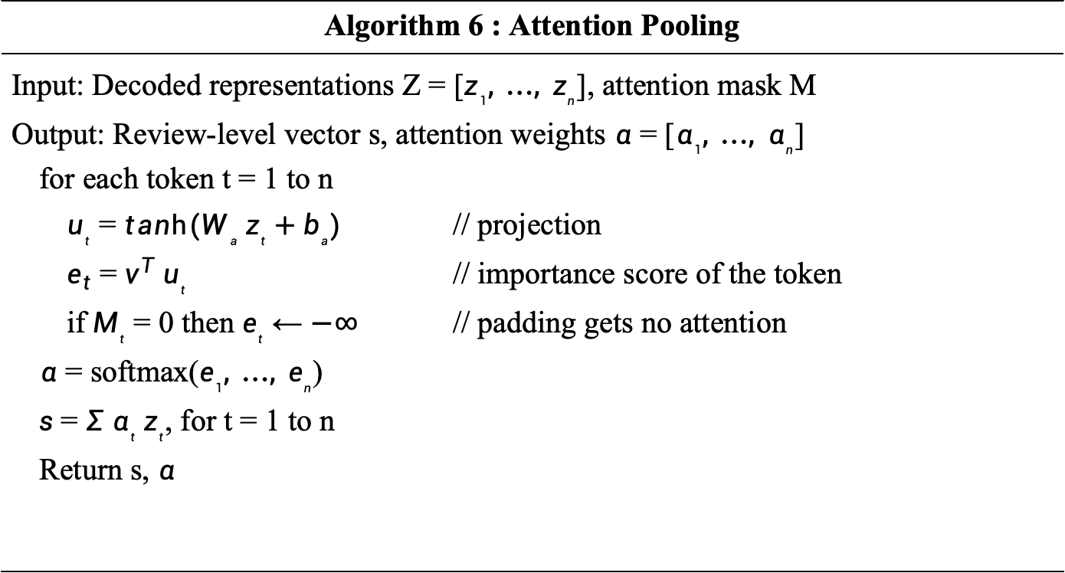
Algorithm 6 : Attention Pooling
Input: Decoded representations Z = [$z_{1}, …, z_{n}$], attention mask M Output: Review-level vector s, attention weights $α$ = [$α_{1}, …, α_{n}$] for each token t = 1 to n $u_{t}$ = $tanh(W_{a} z_{t}+b_{a})$ // projection $e_{t}$ = $v^{T} u_{t}$ // importance score of the token if $M_{t}$ = 0 then $e_{t}$ ← $−∞$ // padding gets no attention $α$ = softmax($e_{1}, …, e_{n}$) $s$ = $Σ α_{t} z_{t}$, for t = 1 to n Return s, $α$

Slide 53
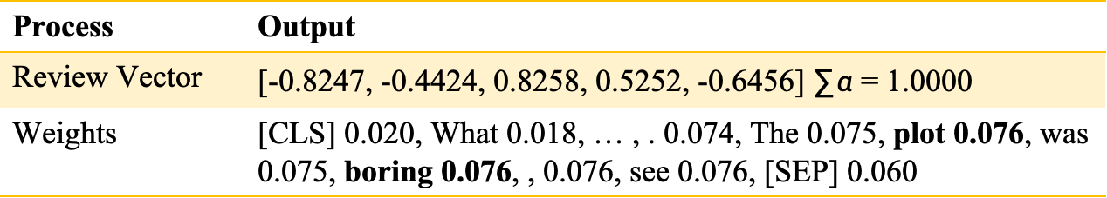
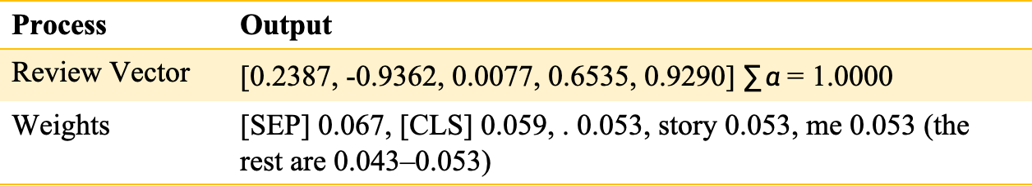
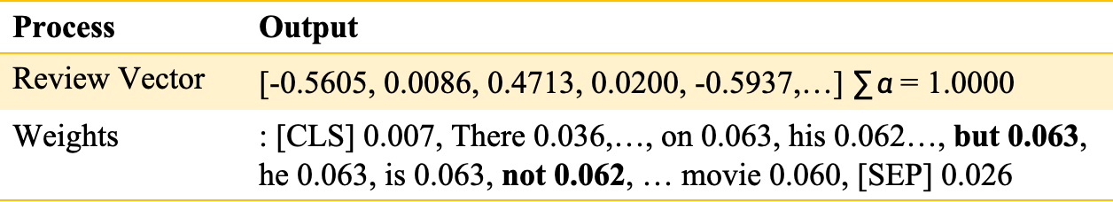
Results: Attention Pooling
Input : Output from ON-LSTM
Output : Review Level Vector
Process | Output
Review Vector | [-0.5605, 0.0086, 0.4713, 0.0200, -0.5937,…] $∑α$= 1.0000
Weights | : [CLS] 0.007, There 0.036,…, on 0.063, his 0.062…, but 0.063, he 0.063, is 0.063, not 0.062, … movie 0.060, [SEP] 0.026
Process | Output
Review Vector | [0.2387, -0.9362, 0.0077, 0.6535, 0.9290]$∑α$= 1.0000
Weights | [SEP] 0.067, [CLS] 0.059, . 0.053, story 0.053, me 0.053 (the rest are 0.043–0.053)
Process | Output
Review Vector | [-0.8247, -0.4424, 0.8258, 0.5252, -0.6456] $∑α$= 1.0000
Weights | [CLS] 0.020, What 0.018, … , . 0.074, The 0.075, plot 0.076, was 0.075, boring 0.076, , 0.076, see 0.076, [SEP] 0.060

Slide 54
7. Fully Connected Layer and softmax
Dropout Regularization
Apply dropout to the review-level vector s to reduce overfitting.
Fully Connected Layer
Pass s through a fully connected layer with GELU activation to learn classification features.
Class Prediction
Generate logits for the 2 sentiment classes and apply Softmax to obtain class probabilities.
Loss & Final Output
During training, calculate cross-entropy loss; for the final output, select the class with the highest probability: 0 = Negative, 1 = Positive.

Slide 55
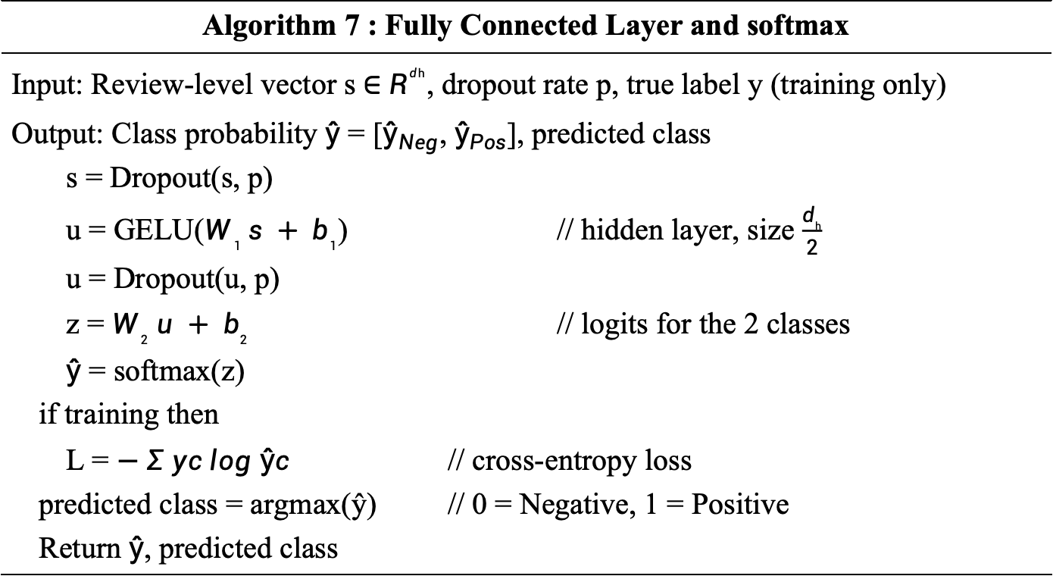
Algorithm 7 : Fully Connected Layer and softmax
Input: Review-level vector s $∈$ $R^{dh}$, dropout rate p, true label y (training only) Output: Class probability $ŷ$ = [$ŷ_{Neg}$, $ŷ_{Pos}$], predicted class s = Dropout(s, p) u = GELU($W_{1} s + b_{1}$) // hidden layer, size $\frac{d_{h}}{2}$ u = Dropout(u, p) z = $W_{2} u + b_{2}$ // logits for the 2 classes $ŷ$ = softmax(z) if training then L = $− Σ yc log ŷc$ // cross-entropy loss predicted class = argmax(ŷ) // 0 = Negative, 1 = Positive Return $ŷ$, predicted class

Slide 56
Result: Fully Connected Layer and Softmax
Input : Attention Pooling Output
Output : Final Prediction
Process | Output
Logits | [1.1345,-1.3534]
Softmax Scores | 0.9233 , 0.0767 (Neg,Pos)
Prediction | Negative
Process | Output
Logits | [-2.2639, 2.8433]
Softmax Scores | 0.0060 , 0.9940 (Neg,Pos)
Prediction | Positive
Process | Output
Logits | [2.8741,-3.2081]
Softmax Scores | 0.9977 , 0.0023 (Neg,Pos)
Prediction | Negative

Slide 57
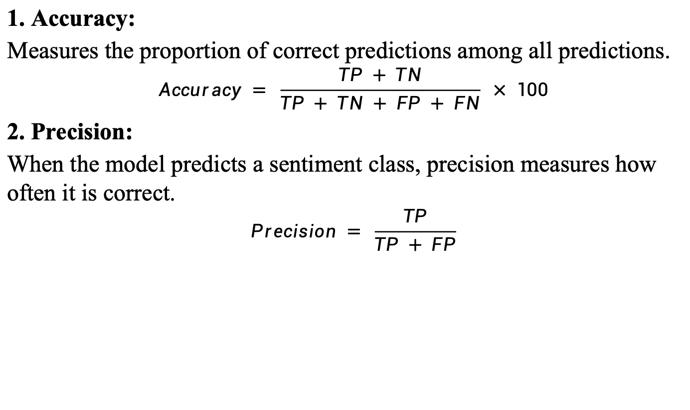
Evaluation Metrics
1. Accuracy:
Measures the proportion of correct predictions among all predictions.
$$Accuracy = \frac{TP + TN}{TP + TN + FP + FN} × 100$$
2. Precision:
When the model predicts a sentiment class, precision measures how often it is correct.
$$Precision = \frac{TP}{TP + FP}$$

Slide 58
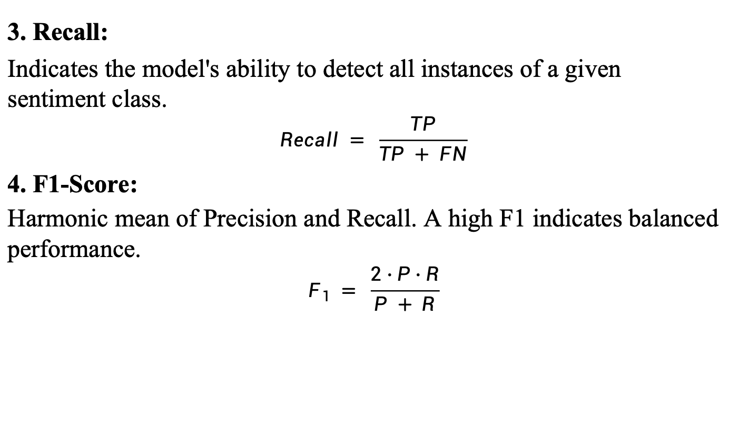
Evaluation Metrics
3. Recall:
Indicates the model's ability to detect all instances of a given sentiment class.
$$Recall = \frac{TP}{TP + FN}$$
4. F1-Score:
Harmonic mean of Precision and Recall. A high F1 indicates balanced performance.
$$F_{1} = \frac{2 · P · R}{P + R}$$

Slide 59
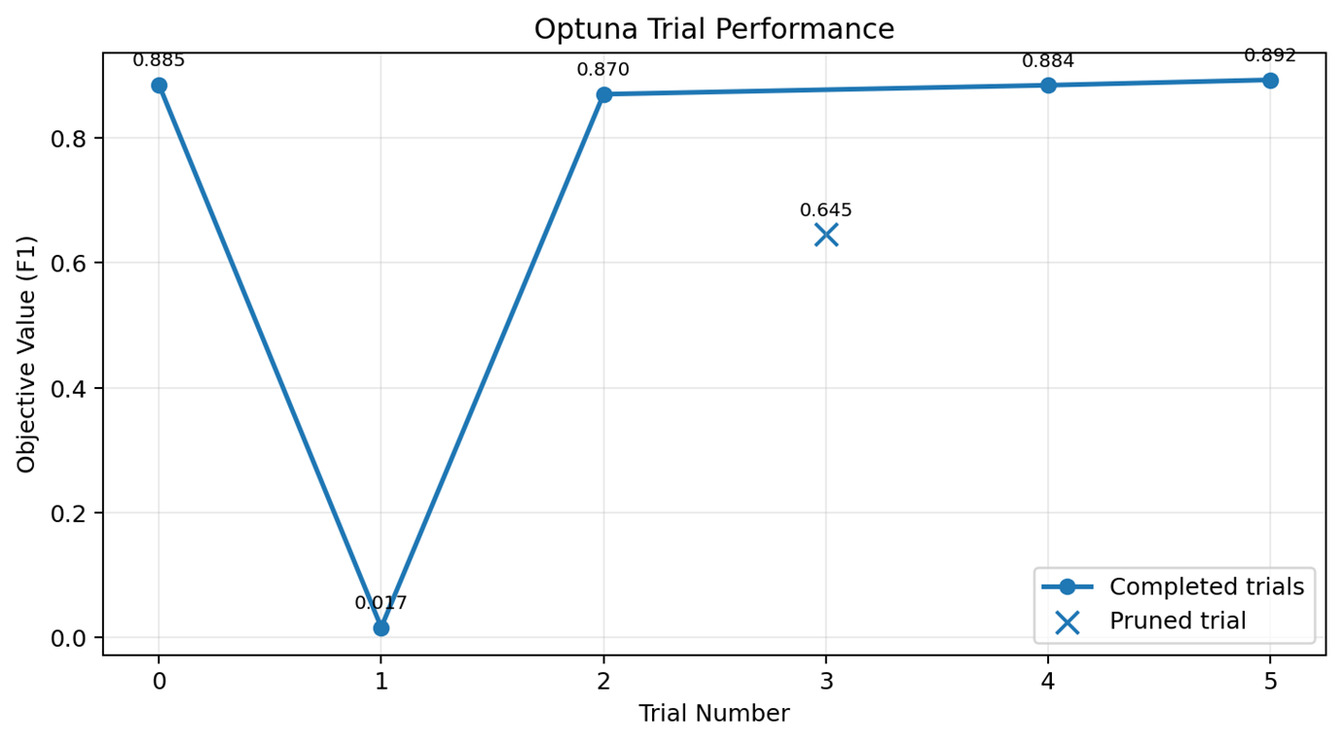
Results

Slide 60
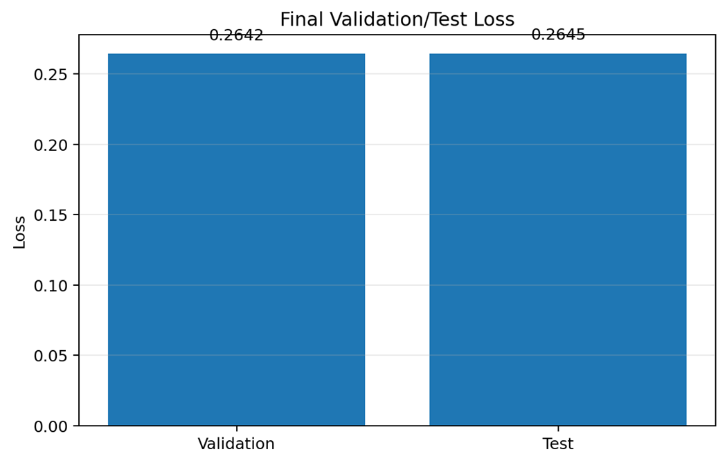
Results

Slide 61
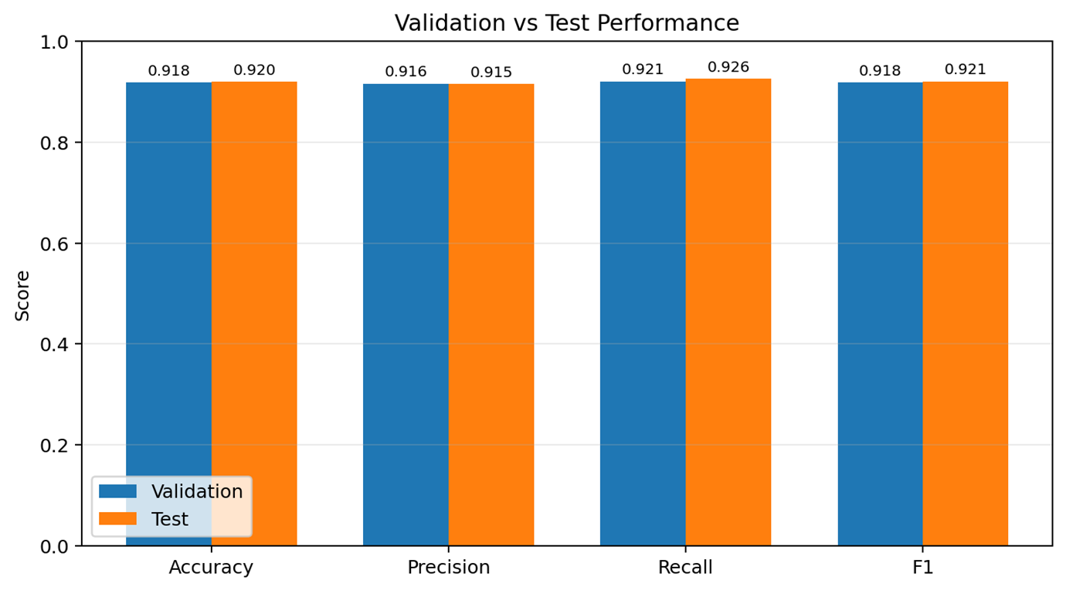
Results

Slide 62
Results
Predicted
Negative
Predicted
Positive
Actual
Negative
2285
215
Actual
Label
Actual
Positive
184
2316
Predicted Label

Slide 63
Results
Metric | Validation | Test
Accuracy | 0.9182 | 0.9202
Precision | 0.9160 | 0.9152
Recall | 0.9208 | 0.9262
F1 | 0.9184 | 0.9207
Loss | 0.2642 | 0.2645
Test F1 = 0.9207

Slide 64
Reviewer comments and Action Taken
Reviewer Comments | Action Taken
System diagram and implementation is not as per the base paper | The system design for base paper is proposed during the III review for what we have done in base paper
Focus on preprocessing step | Preprocessing steps are well studied and the outputs for each modules are reproduced
Try to understand the implementation | The flow of the model is studied

Slide 65
Working Environment
Programming Language
Python: 3.12.10
Pytorch: 2.7.1+cu118
Transformer 4.46.2
TensorFlow: 2.21.0
Deep Learning Libraries
Hugging Face Transformers
Pytorch / TensorFlow
Hardware
NVIDIA RTX 3050 GPU

Slide 66
Social Impacts
Hearing the public at scale: analyses thousands of opinions automatically, so governments and organizations can understand what people feel and respond to it quickly.
Understanding difficult language: reads mixed sentences like "a smile on his face, but not actually good" correctly (Negative, 0.92), so subtle complaints aren't mistaken for praise.
Resisting manipulated text: adversarial training (FGM) makes the model harder to fool with small wording changes, which reduces the risk of fake or gamed opinions skewing results.
A step toward transparency: attention pooling gives a weight for each word, a starting point for showing users why a prediction was made instead of a pure black box.
Making AI accessible: runs on a free Kaggle GPU and a laptop GPU, so students, researchers and small organisations can use advanced NLP without expensive hardware

Slide 67
Economic Aspects
Lower labour cost: classifies 10,000 reviews in about 1–2 minutes on a laptop GPU, replacing hours of manual reading and cutting the cost of customer feedback analysis.
Cheaper development through smart tuning: Optuna's pruning stopped weak trials early and tuning used only 10% of the data, saving GPU time, which means lower cloud costs and energy use.
Support for small businesses: gives small companies instant insight into customer satisfaction without hiring data analysts, helping them improve products and compete.
Better business decisions: high accuracy (92% on the test set) means companies can trust the automated sentiment trends when planning marketing, products or services.
Reusable for many uses: the same model can be retrained for product reviews, app feedback, support tickets or surveys, so one investment gives value across many applications.

Slide 68
REFERENCES
Bo Yang et al., “TRALSem: A Robust Model for Textual Sentiment Analysis” IEEE Transactions on Computational Social Systems, vol. 12, no. 6, pp. 4727–4743, Dec. 2025. DOI: 10.1109/TCSS.2025.3558622
S. Hochreiter and J. Schmidhuber, “Long Short-Term Memory” Neural Computation, vol. 9, no. 8, pp. 1735–1780, 1997.
Y. Shen, S. Tan, A. Sordoni, and A. Courville, “Ordered Neurons: Integrating Tree Structures into Recurrent Neural Networks” in Proc. ICLR, 2019.

Slide 69
REFERENCES
Y. J. Devlin, M.-W. Chang, K. Lee, and K. Toutanova, “BERT: Pre-training of Deep Bidirectional Transformers for Language Understanding” in Proc. NAACL-HLT, Minneapolis, MN, USA, pp. 4171–4186, Jun. 2019.
P. He, X. Liu, J. Gao, and W. Chen, “DeBERTa: Decoding-enhanced BERT with Disentangled Attention” in Proc. ICLR, 2021.
I. Gupta and N. Joshi, “Feature-Based Twitter Sentiment Analysis With Improved Negation Handling” IEEE Transactions on Computational Social Systems, vol. 8, no. 4, 2021.

Slide 70
REFERENCES
I. J. Goodfellow, J. Shlens, and C. Szegedy, “Explaining and Harnessing Adversarial Examples” in Proc. ICLR, 2015.
C. Zhu et al., “FreeLB: Enhanced Adversarial Training for Natural Language Understanding” in Proc. ICLR, 2020.
J. Liu, W. Gao, M. Ou, B. Fu, X. Huang, and Y. Huan, “OnDeBERTa: An Ordered Neuron Memory Enhanced DeBERTa Model for E-commerce Review Sentiment Classification” in Proc. 2026 International Conference on Computer Intelligence and Software Engineering (CICSE), 2026.

Slide 71
REFERENCES
T. Akiba, S. Sano, T. Yanase, T. Ohta, and M. Koyama, “Optuna: A Next-generation Hyperparameter Optimization Framework” in Proc. 25th ACM SIGKDD International Conference on Knowledge Discovery & Data Mining, 2019.

Slide 72
THANK YOU

