Slide 1
TITLE: UNITASK FREELANCE PLATFORM
Presented By: Muhia Lincorn Samuel
Supervisor:
Institution: Chuka University
Date: 9TH April 2025

Slide 2
OBJECTIVES
•To create a user registration and authentication system for freelancers and employers.
•To implement a comprehensive profile management feature for freelancers and employers.
To create a platform for job posting, application and submission
•To create an inbuilt chat system between clients and freelancers
•To develop a secure payment gateway that ensures fair and timely transactions.
•To design a responsive and intuitive user interface accessible across devices.

Slide 3
REQUIREMENTS
Functional Requirements
User Registration and Authentication
Profile Management
Job Posting and Application
Secure Payment Gateway
Ratings and Reviews
Non-functional Requirements
Performance
Scalability

Slide 4
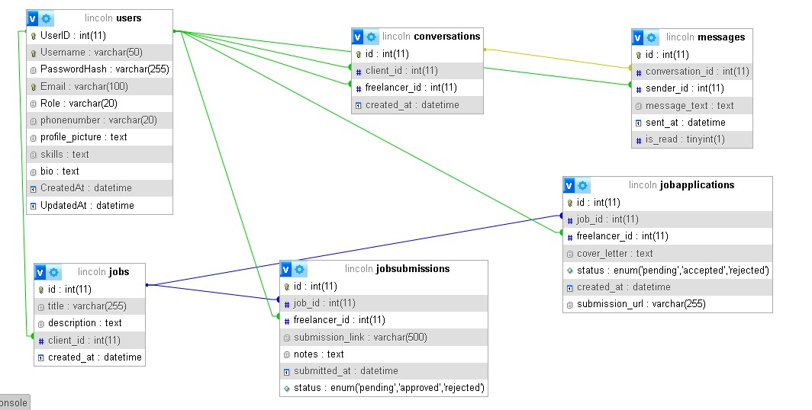
Database Design

Slide 5
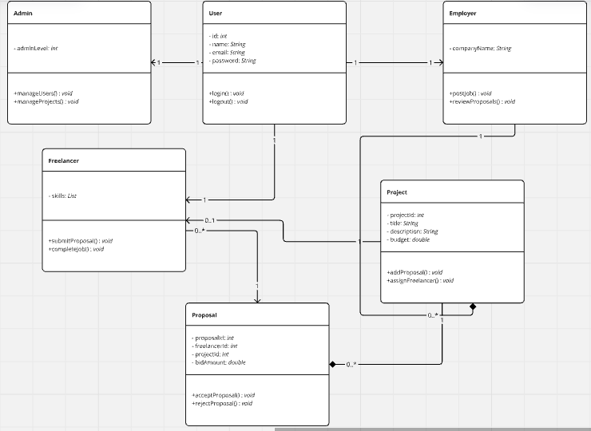
class diagram

Slide 6
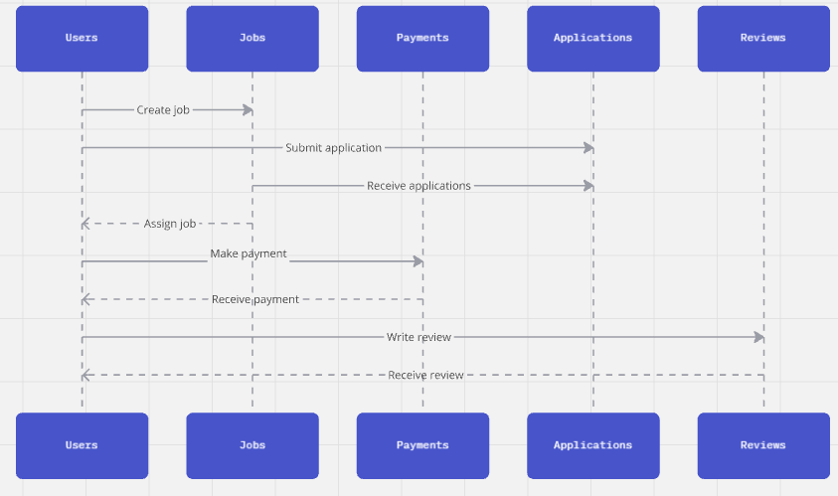
Sequence Diagram

Slide 7
System Design
Presentation Layer (frontend)
Technology: Angular + Typescript
Responsibility: user interface, form validations, rendering data from APIs
Application Layer (Backend/API)
Technology: Node.js + Express + TypeScript
Responsibility: Business logic, API endpoints, authentication, and routing
3. Data Layer ( Database)
Technology: SQL server
Responsibility: all data storage

