Slide 1

Thesis Defense
Event Detection and Cyber-Attacks Prediction of Smart
Power Grid Using Machine Learning
Presented By:
Md Muhibbin Hossin Sarder
Roll: 1707081
Supervised By:
Dr. Kazi Md. Rokibul Alam
Professor
Department of Computer Science and Engineering
Khulna University of Engineering & Technology(KUET)

Slide 2
Outline
Introduction
Related Works
Objectives
Proposed Methodology
Experimental Analysis
Conclusions

Slide 3
Introduction
Protect smart grid infrastructure from the growing threat of cyber attacks.
Phasor measurement units (PMU) : PMU measures the phasor values of current and voltage.
An attack detection model for power system based on machine learning that can be trained by using information and logs collected by phasor measurement units (PMUs)
Crucial for ensuring the stability and reliability of the power grid and minimizing the consequences of cyber attacks.

Slide 4
Related Works
Ahmed et al. used sensor and process noise fingerprint to detect stealthy cyber-attacks in CPS, and validated the method on a dataset from a real-world water treatment facility.
Shoukry et al. proposed a Multi-Modal Luenberger observer that can isolate the attacked sensors and estimate the state of the underlying dynamics from the remaining sensors and their approach can be applied to large-scale CPSs.
Hadžiosmanovi´c et al. developed a semantic, network-based instruction detection system to detect attacks on process control by using network traffic from water plants

Slide 5
Related Works (cont.)
Other works
Junejo and Goh proposed a behavior-based machine learning approach for the intrusion detection
Nader et al. utilized a fast one- class classification approach which overcome the drawback of high sensitivity towards to outliers
Pan et al. proposed a sequential pattern mining approach to accurately extract patterns of power system disturbances and cyber-attacks.

Slide 6
Gap in the Research
Traditional methods of event and cyber attack detection in the power grid are based on rule-based algorithms that are limited in their ability to detect complex and evolving cyber threats.
The increasing volume and complexity of data generated by the power grid also makes it difficult to detect attacks using traditional methods.

Slide 7
Objectives
To propose an approach that uses machine learning to detect events and cyber attacks in the power grid.
To minimize features and better the performance without sacrificing event and attack detection ability.

Slide 8
Contribution
An approach to deal with unusual data in the datasets, such as Not a Number(NaN) and Infinity values
Feature engineering to construct new features
Feature selection technique to reduce the data
A machine learning-based classification model that can successfully distinguish 37 types of event, including cyber-attacks

Slide 9
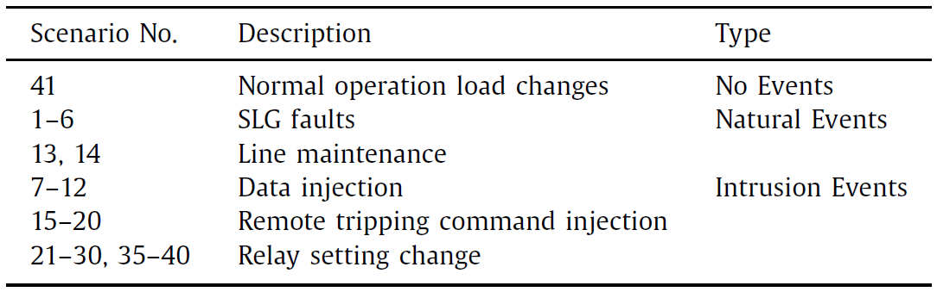
Proposed Methodology
Dataset Collection:
the dataset used was created by Uttam Adhikari, Shengyi Pan in cooperation with Oak Ridge National Laboratories
The dataset mainly includes measurement data related to normal, fault and cyber-attack behaviors described in table 1.
Table 1: Description of Scenarios

Slide 10
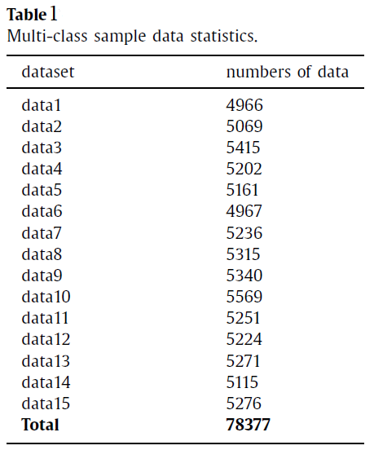
Dataset Collection
Table 2 shows the situation of each group of dataset. The data distribution is relatively uniform for different label types.
There are 78377 data and 128 features in the dataset
Table 2 : Multi-class sample data statistics

Slide 11
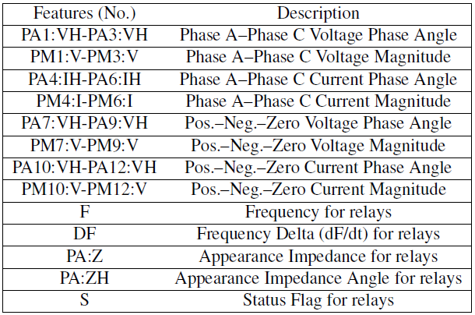
Dataset Collection
The 128 features are explained in the Table 3
In the system there are 4 PMUs which measure 29 features for 116 PMU measurement columns total.
After the PMU measurement columns, there are 12 columns for control panel logs, Snort alerts and relay logs
Table 3 : Description of features measured by a PMU

Slide 12
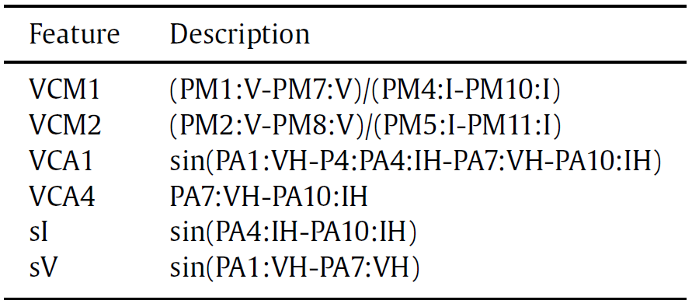
Proposed Methodology : Features Construction
16 new features are extracted and then added to the original dataset
We adopt relevant calculation measures to extract new features. The extracted features are shown in Table 4 .
Table 4 : Description of Extracted Features

Slide 13
Proposed Methodology : Data Processing
Data Cleaning
the dataset often exists the Not a Number(NAN) and infinity(INF) values
it is generally replaced and filled by the average value or 0
We proposed KNN interpolation method to replace NAN and INF values existing in the data

Slide 14
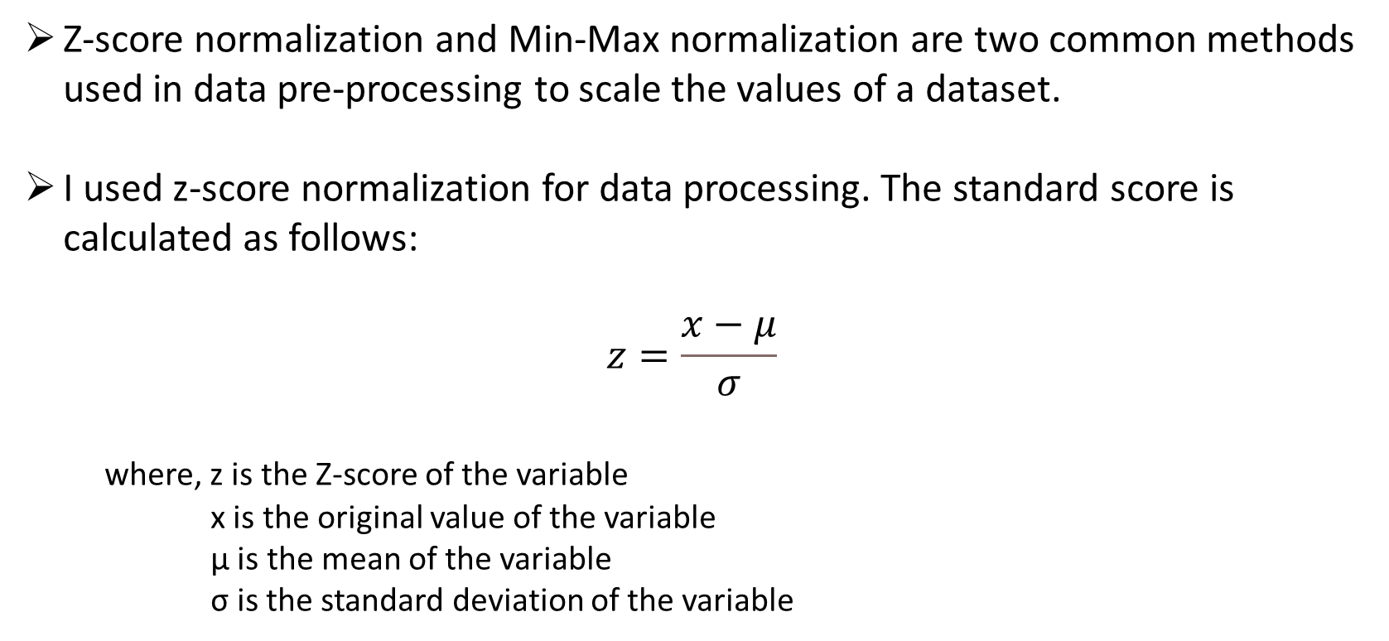
Proposed Methodology : Data Transformation
Z-score normalization and Min-Max normalization are two common methods used in data pre-processing to scale the values of a dataset.
I used z-score normalization for data processing. The standard score is calculated as follows:
$$z=\frac{x−μ}{σ}$$
where, z is the Z-score of the variable
x is the original value of the variable
μ is the mean of the variable
σ is the standard deviation of the variable

Slide 15
Proposed Methodology : Data Transformation
Z-score normalization transforms the values of a dataset to have a mean of zero and a standard deviation of one. This method ensures that all variables have the same scale and unit of measurement, which is important when comparing variables that have different units or scales.
Min-Max normalization scales the values of a dataset to a specific range. It may not reflect the true relationship for different units of measurement.

Slide 16
Proposed Methodology : Data Reduction
Improved computational efficiency
Improved model performance
Reduced storage and transmission costs
Better data visualization
Better feature selection

Slide 17
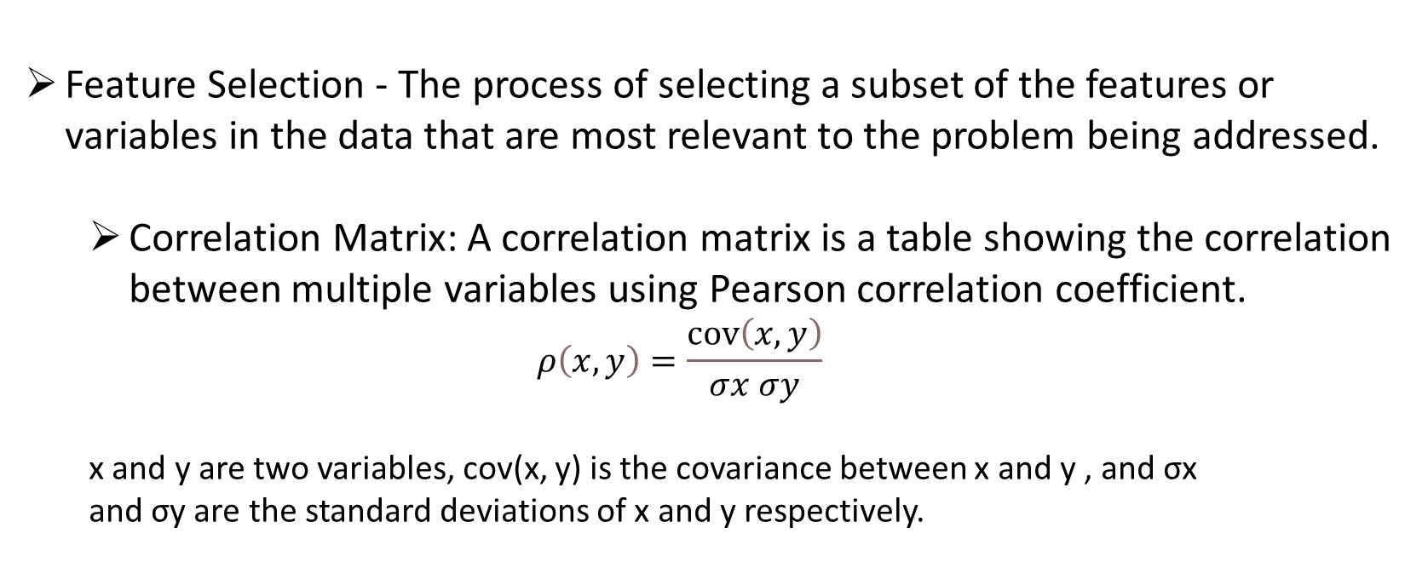
Data Reduction : Correlation Matrix
Feature Selection - The process of selecting a subset of the features or variables in the data that are most relevant to the problem being addressed.
Correlation Matrix: A correlation matrix is a table showing the correlation between multiple variables using Pearson correlation coefficient.
$$ρ\left(x,y\right)=\frac{\operatorname{cov}\left(x,y\right)}{σx σy}$$
x and y are two variables, cov(x, y) is the covariance between x and y , and σx
and σy are the standard deviations of x and y respectively.

Slide 18
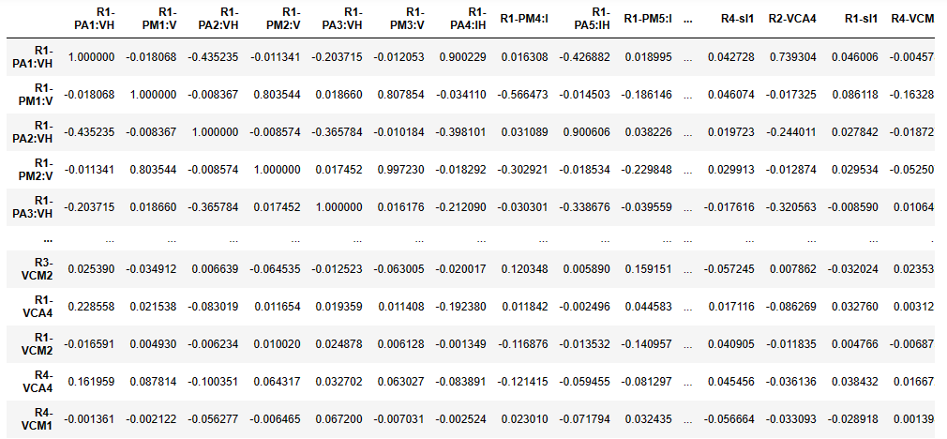
Data Reduction : Correlation Matrix
Fig 1 Shows the correlation matrix of the dataset
we drop out the highly correlated data from our dataset to reduce the data
Fig 1 : Correlation Matrix

Slide 19
Data Reduction : Feature Importance
In XGBoost, the feature importance score measures the relative importance of each feature in the prediction of the target variable.
The feature importance scores are calculated based on the average decrease in impurity (e.g., Gini impurity) across all trees in the model.
In other words, the feature importance score indicates how much the model performance improves if the feature is used compared to if the feature is not used.

Slide 20
Data Reduction : Feature Importance
The main indicators used to evaluate feature importance are weight and gain
The proposed method is to utilize weight to calculate feature importance
Weight is the number of times a feature appearance in a tree

Slide 21
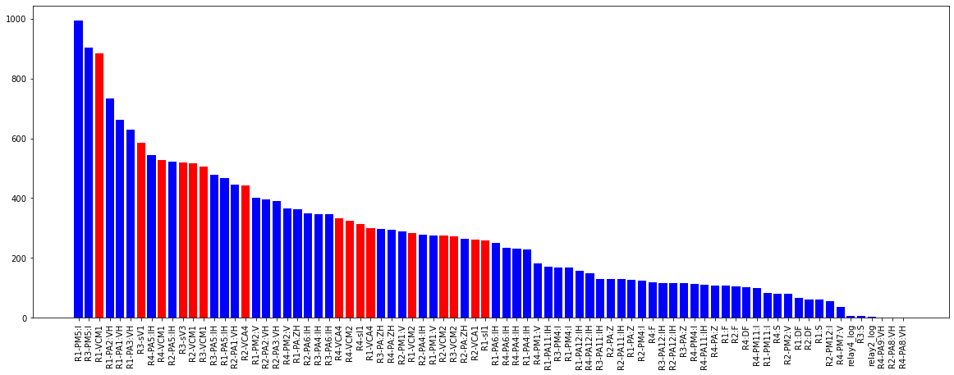
Data Reduction : Feature Importance
Fig 2: Importance feature score

Slide 22
Data Reduction : Feature Importance
The blue part in the fig. 2 represents the original features and the red mark are the features generated by feature construction engineering.
It can be seen that the all 16 constructed features are in the top 40.

Slide 23
Proposed Methodology : Machine Learning Models
K-nearest Neighbor Algorithm
It is classified according to the distance between feature values. The formula for calculating distance mainly includes Euclidean distance or Manhattan distance formula.
Decision Trees
a supervised learning algorithm that recursively splits the data into smaller subgroups based on the feature that provides the maximum reduction in impurity.
Gradient Boosting (GB)
an iterative, non-linear, supervised learning algorithm that trains weak models, such as decision trees, and combines their predictions to form a final prediction.

Slide 24
Proposed Methodology : Machine Learning Models
XGBoost (XGB)
XGB is an optimized version of gradient boosting that uses efficient data structures and parallel processing to improve the speed and accuracy of the model.
Random Forest (RF):
RF is an ensemble learning method for classification and regression. It builds multiple decision trees, and the final prediction is made by aggregating the predictions of individual trees
AdaBoost
It builds multiple weak learners in a sequential manner, each trying to correct the mistakes of the previous one. The final prediction is made by weighting the predictions of individual weak learners.

Slide 25
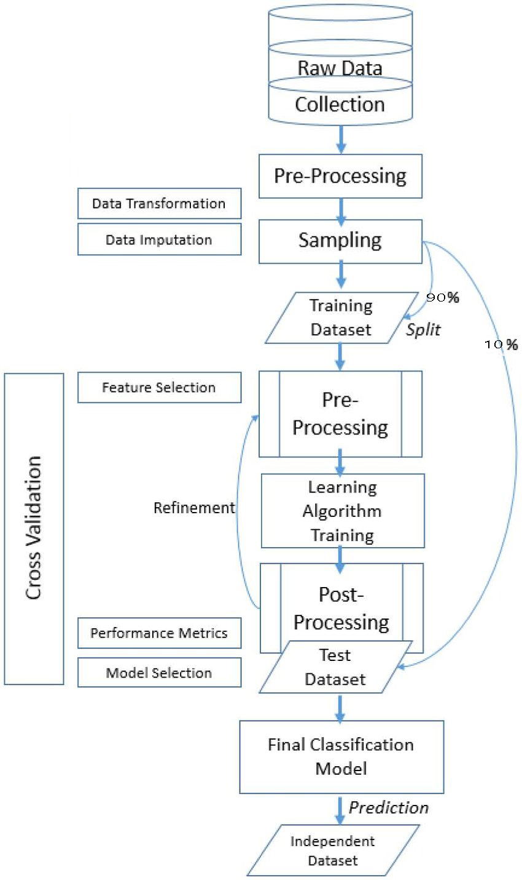
Proposed Methodology : Flow diagram
Fig. 3: Flow diagram of proposed methodology

Slide 26
Experimental Analysis
In the experiment, 15 groups of multi-class classification datasets were trained and tested respectively and the accuracy, precision, recall and f1 score were adopted as the evaluation metrics.
Fig. 4 and fig.5 shows the evaluation metrics of different models
17

Slide 27
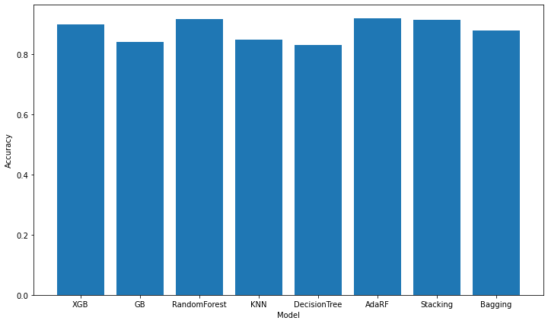
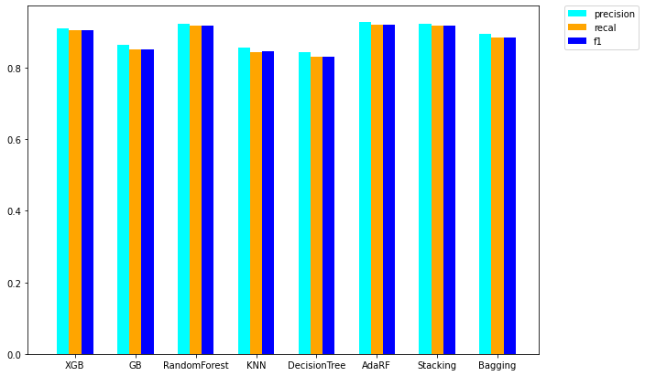
Experimental Analysis
After extensive testing, it has been shown that the AdaBoost classifier model performs best on the dataset.
Fig. 5: Precision, recall and f1 score of different model
Fig. 4 : Accuracy of different model
17

Slide 28
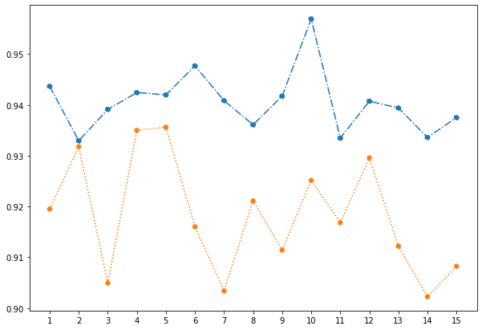
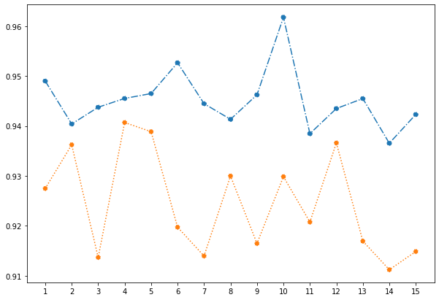
Experimental Analysis
(a) Accuracy over 15 dataset
(b) Precision over 15 dataset

Slide 29
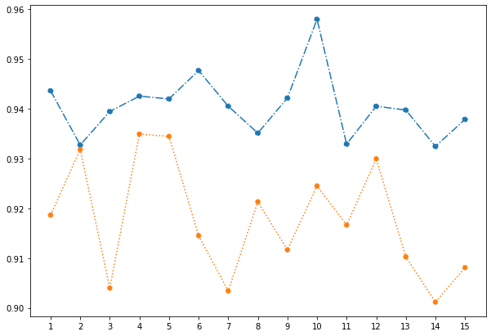
Experimental Analysis
(c) Recall over 15 dataset
(d) F1 Score over 15 dataset
Fig 6: comparison with features using different evaluation matrics

Slide 30
Experimental Analysis
Fig. 6 is a detailed comparison of the use of original 128 features and combined features from different evaluation by using AdaBoost model.
While working with 128 features we got accuracy 0.9182 while after data processing steps the accuracy got upto 0.94053.
Obviously, using combined features is better than using original data in all evaluation metrics.
Compared to the original features, the dimension of combined features is only 31 dimensions, and the dimension is reduced by 75%, thereby saving computing resources.
It verifies the above mentioned that the better the features, the better performance of the model.

Slide 31
Conclusions
The proposed model is to identify faults and cyber-attacks in power grid.
The proposed model extracts the main features of power grid data and thus reduce the computational cost
A variety of machine learning evaluation metrics are used to evaluate the model proposed in this thesis and traditional machine learning models in the experiment.
The results show that the data processing method can improve the existing accuracy of the model, and AdaBoost Classification model can effectively detect 37 kinds of behaviors in the power grid.

Slide 32
Future Work
In our future work, We will try
Will continue to enhance relevant data and work on deep learning models combined with Big Data processing in the future
Collecting representative instances of various attack events is usually a difficult task. We will also work on semi-supervised learning in this case in the future.

Slide 33
References
Ahmed CM, Zhou J, Mathur AP. Noise matters: Using sensor and process noise fingerprint to detect stealthy cyber attacks and authenticate sensors in cps. In: Proceedings of the 34th Annual Computer Security Applications Conference. New York, NY, USA: ACM; 2018. p. 566–81. ISBN 978-1-4503-6569-7. doi: 10. 1145/3274694.3274748 .
Shoukry Y , Chong M , Wakaiki M , Nuzzo P , Sangiovanni-Vincentelli A , Se- shia SA , et al. Smt-based observer design for cyber-physical systems under sensor attacks. ACM Transactions on Cyber-Physical Systems 2018;2(1):5 .
Hadžiosmanovi ´c D, Sommer R, Zambon E, Hartel PH. Through the eye of the plc: Semantic security monitoring for industrial processes. In: Proceedings of the 30th Annual Computer Security Applications Conference. New York, NY, USA: ACM;
Nader P , Honeine P , Beauseroy P . Lp-norms in one-class classification for intru- sion detection in scada systems.. IEEE Trans Ind Informa 2014;10(4):2308–17 .

Slide 34
References
Junejo KN , Goh J . Behaviour-based attack detection and classification in cyber physical systems using machine learning. In: Proceedings of the 2nd ACM International Workshop on Cyber-Physical System Security. ACM; 2016. p. 34–43 .
Pan S , Morris T , Adhikari U . Classification of disturbances and cyber-attacks in power systems using heterogeneous time-synchronized data. IEEE Trans Ind Inf 2015;11(3):650–62 .
Che L , Liu X , Shuai Z , Li Z , Wen Y . Cyber cascades screening considering the impacts of false data injection attacks. IEEE Trans Power Syst 2018 .
Case DU . Analysis of the cyber attack on the ukrainian power grid. Electric. Inform. Shar. Anal. Center (E-ISAC) 2016 .

Slide 35
Thank You

