Slide 1
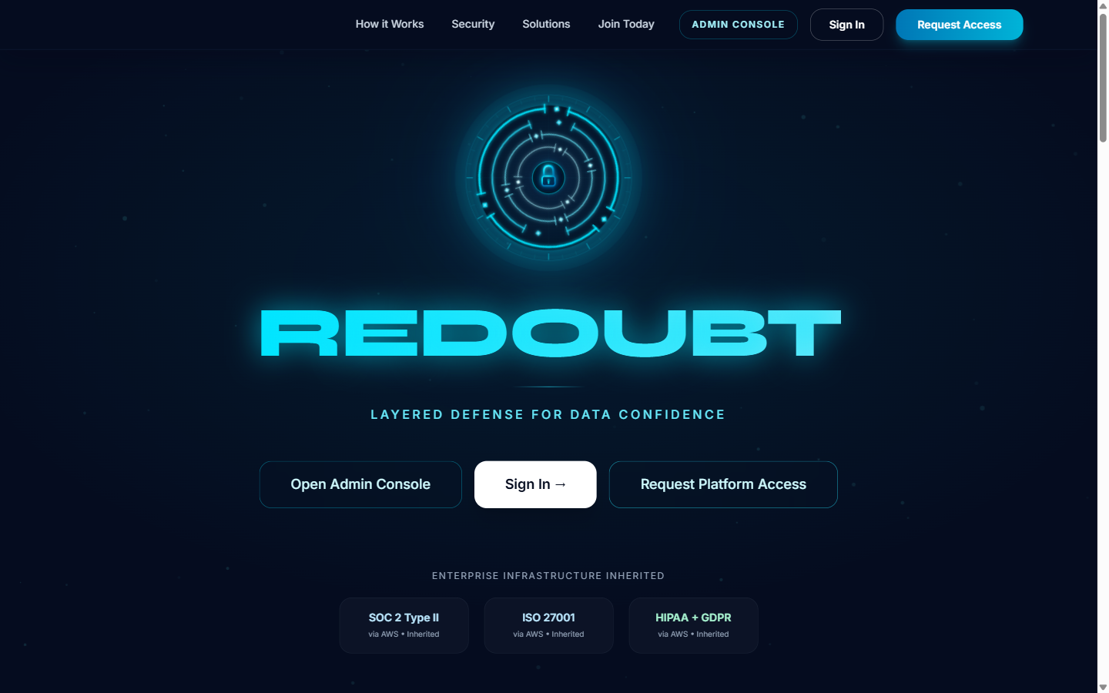
REDOUBT
Trust-First Data Access Infrastructure
Built for regulated industries that need verified, governed, and auditable data exchange.
Invite-only provider onboarding
AI-powered dataset confidence scoring
Compliance-first workflows with immutable auditability
Identity-safe collaboration between buyers and providers
Healthcare
Finance
Government
Project stage: Prototype / investor demo
Prepared from repository artifacts
Redoubt Confidential | Repo-based prototype deck | March 2026
1/12

Slide 2
Problem: Data Trust Breaks in Regulated Markets
Current data marketplaces optimize for volume, not verifiable confidence.
Regulated teams need high-quality data, but today they face fragmented verification, weak accountability, and high compliance risk.
Slow Procurement
Opaque Quality
Buyers spend cycles vetting dataset credibility manually
Security and legal teams block or delay approvals.
No persistent confidence signal across datasets.
Providers lack a structured mechanism to prove trustworthiness
Compliance checks are often bolted on after data exchange
Open listings increase exposure for sensitive providers
Audit Gaps
Identity Risk
Inconsistent event logging complicates compliance reviews.
Contributors may avoid participation without privacy controls.
Repo statement: Regulated buyers need guarantees on trustworthiness, compliance, and provider accountability - and current marketplaces do not provide them.
Redoubt Confidential | Repo-based prototype deck | March 2026
2/12

Slide 3
Solution: A Trust-First Access Layer
Redoubt inserts governance, scoring, and control between contributor and consumer.
1. Invite-only Onboarding
2. AI Quality Validation
3. Trust Score Assignment
4. Audited Controlled Access
Verification
Scoring
Protection
Compliance
Provider identity and intent checks before participation.
Dataset confidence based on quality and anomaly signals.
Provider anonymity and policy-driven access boundaries.
Audit trail, consent, and governance workflows built in.
Positioning: Not a public marketplace. A governed confidence infrastructure for enterprise data collaboration.
Redoubt Confidential | Repo-based prototype deck | March 2026
3/12

Slide 4
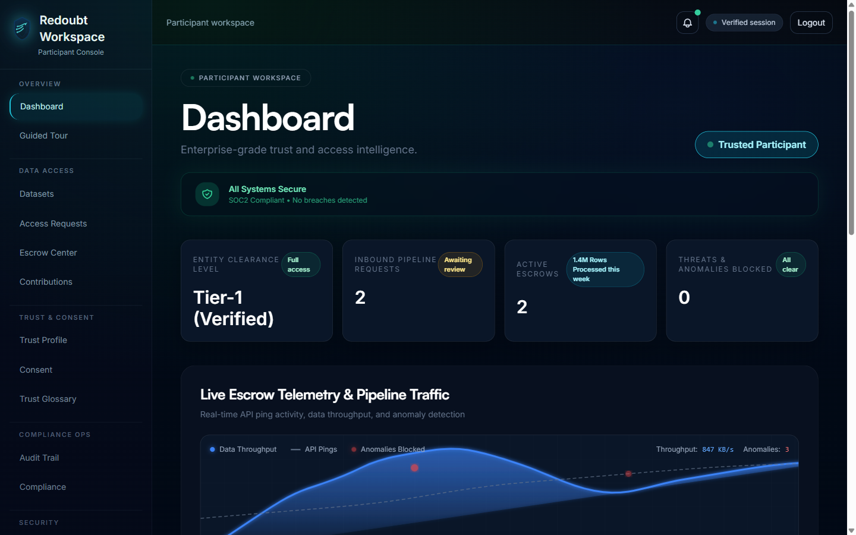
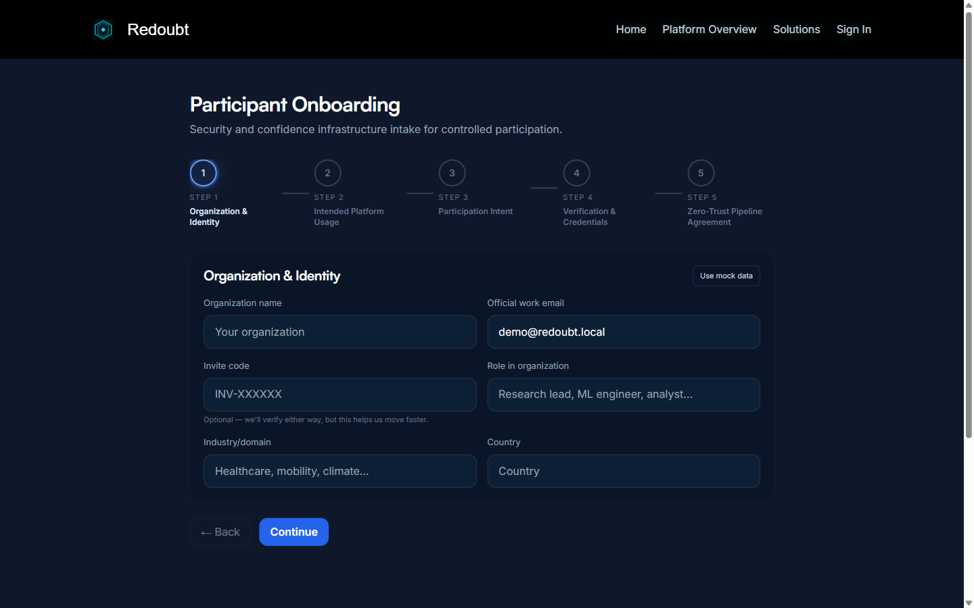
Product Snapshot
Selected screens from the current frontend prototype.
Landing
Participant Dashboard
Onboarding Flow
Trust-first positioning and controlled access CTA.
Telemetry, trust posture, escrow, and audit surfaces.
5-step intake with identity and usage declarations.
Redoubt Confidential | Repo-based prototype deck | March 2026
4/12

Slide 5
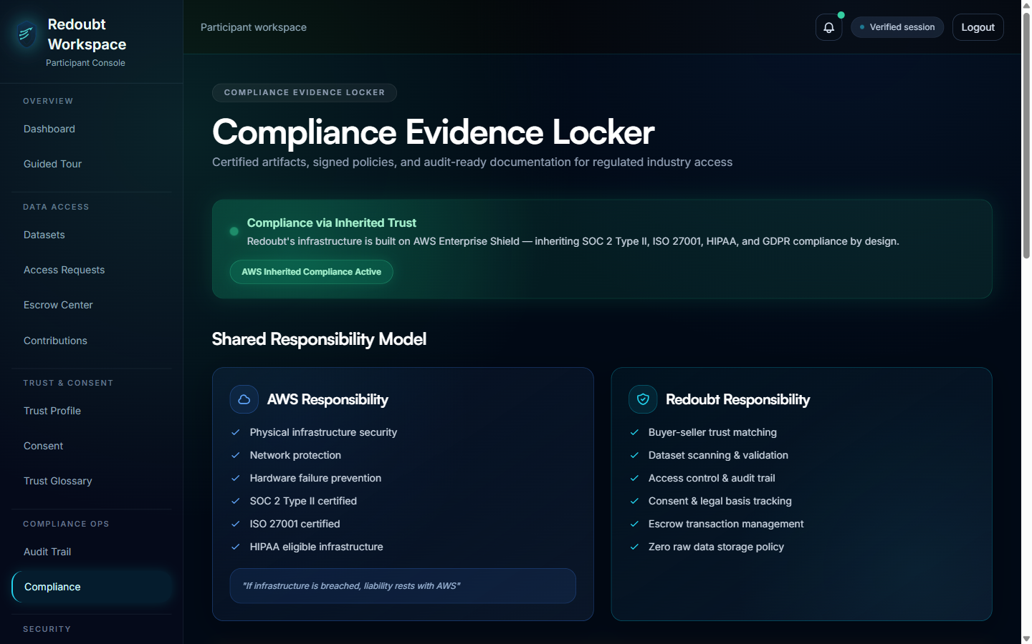
Trust, Compliance, and Deployment Model
Operational controls surfaced directly in the product experience.
Compliance posture visible in-product
SOC 2 Type II certified (Jan 2026)
HIPAA compliance target achieved (Feb 2026)
GDPR alignment marked (Dec 2025)
ISO 27001 in progress (target Q3 2026)
Shared-responsibility model documented
Deployment options: SaaS, private cloud, on-prem
Redoubt Confidential | Repo-based prototype deck | March 2026
5/12

Slide 6
Prototype Evidence From Repository
Depth of product surface already implemented in frontend routes and pages.
53
52
28
Route distribution
Page components
App routes
Workspace routes
Onboarding
7
12
7
5
Workspace
28
Admin routes
Onboarding routes
Onboarding steps
12
Admin
Security modules include RBAC, red-team mode, secure enclave
Compliance modules include audit trail and evidence locker
Data exchange modules include escrow center and usage analytics
Deployment prep documented for Vercel with SPA-safe routing
Redoubt Confidential | Repo-based prototype deck | March 2026
6/12

Slide 7
Who Redoubt Serves
Segment-specific value surfaced directly in solutions and workflow pages.
Researchers
AI/ML Teams
Verified datasets for scientific and institutional work.
Confidence-scored training data and lineage visibility.
Enterprises
Data Contributors
Governed access, compliance evidence, and policy controls.
Controlled contribution with trust and licensing guardrails.
Initial focus industries from README: Healthcare, Finance, and Government organizations.
Redoubt Confidential | Repo-based prototype deck | March 2026
7/12

Slide 8
Monetization Model (Prototype Pricing Surface)
Pipelines page already encodes tiered API packaging and enterprise expansion path.
Starter
Growth
Enterprise
$500/mo
$2,000/mo
Custom
1,000 API calls/month
10,000 API calls/month
Unlimited API calls
Basic API access
Priority support + integrations
Dedicated support + SLA
Included API volume by tier
Tiering aligns to API throughput and support depth
Starter
1,000
Enterprise plan opens private deployment + SLA motion
Growth
10,000
Escrow and compliance layers support premium positioning
Model can evolve into usage + governance bundles
Redoubt Confidential | Repo-based prototype deck | March 2026
8/12

Slide 9
Go-To-Market Motion
From prototype to first governed design partners in regulated sectors.
Phase 1
Phase 2
Phase 3
Design Partners
Controlled Pilots
Scale
Land 3-5 lighthouse institutions in healthcare/finance/government.
Run compliance-first pilots with clear trust-score and audit KPIs.
Expand through private cloud and enterprise channel partnerships.
Execution priorities from current repo state
Status today: Prototype with deploy checklist and investor-demo UX across onboarding, admin, and workspace views.
Connect frontend flows to production backend services
Harden trust-score and policy engine APIs
Operationalize compliance export and audit reporting
Convert investor demo into customer pilot playbook
Redoubt Confidential | Repo-based prototype deck | March 2026
9/12

Slide 10
Differentiation: Confidence Infrastructure vs Open Marketplace
Redoubt competes on trust assurance and governed execution, not listing volume.
Capability
Typical Marketplace
Redoubt
Verified onboarding
No
Yes
Persistent trust scoring
Partial
Yes
Provider identity protection
Limited
Yes
Escrow-native workflows
Rare
Yes
Immutable audit trail
Inconsistent
Yes
Compliance evidence locker
No
Yes
Strategic moat: integrated trust scoring + policy enforcement + auditability embedded in daily workflows.
Redoubt Confidential | Repo-based prototype deck | March 2026
10/12

Slide 11
Product and Compliance Roadmap
Execution priorities mapped to visible milestones in the prototype.
Q2 2026
Q3 2026
Q4 2026
Q1 2027
Pilot readiness
Trust and cert depth
Regional expansion
Scale confidence network
Backend integration, API hardening, first design-partner pilots.
ISO 27001 target milestone and expanded policy controls.
AP-Southeast residency target and enterprise deployments.
Operationalize repeatable sales, onboarding, and governance ops.
Redoubt Confidential | Repo-based prototype deck | March 2026
11/12

Slide 12
Build the trusted data layer for regulated AI
Redoubt turns compliance friction into a defensible network advantage.
Current Ask
Strategic investors to accelerate prototype-to-production delivery
Deck Notes
All product claims in this deck are grounded in repository artifacts reviewed on 23 March 2026.
Design partners in healthcare, finance, and government
Cloud/compliance partners for private deployment and certifications
Enterprise introductions for first controlled pilots
Thank you
Redoubt Confidential | Repo-based prototype deck | March 2026
12/12

