Slide 1
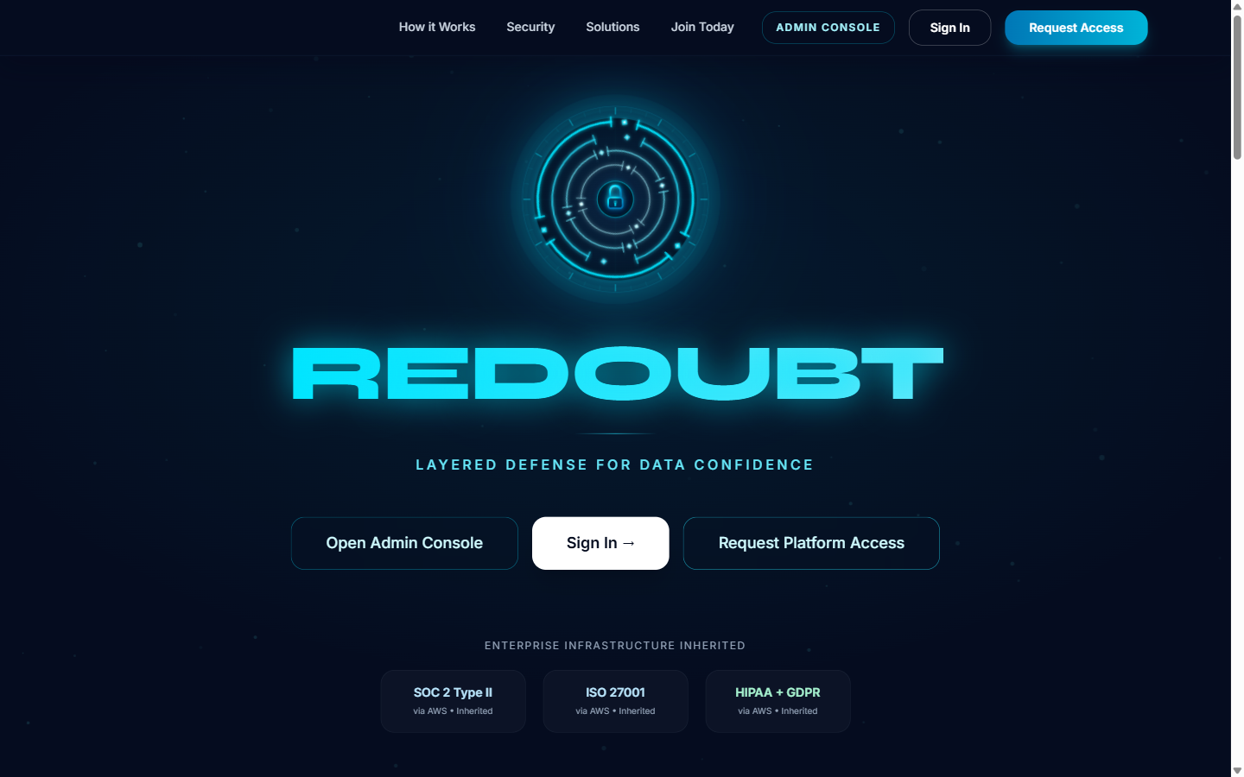
REDOUBT
Trust-First Data Access Infrastructure
Security-first data collaboration for healthcare, finance, and government buyers.
Security and compliance as primary product surfaces
AI-powered confidence scoring with auditable policy controls
Governed access workflows for regulated enterprise buyers
Clear path from prototype to cert-backed enterprise platform
Healthcare
Finance
Government
Fundraising edition | Stage: prototype / investor demo
Prepared from repository artifacts
Redoubt Confidential | Investor + security/compliance edition | March 2026
1/12

Slide 2
Why Now: Trust and Compliance Bottlenecks Are Expensive
Regulated teams cannot scale AI/data programs without verifiable governance.
Data buyers in regulated industries face security review delays, legal uncertainty, and low confidence in third-party data quality.
Long Sales Cycles
Quality Uncertainty
Security/legal reviews delay access and increase cost-to-acquire data
Procurement stalls when trust and policy proof are missing.
Low confidence in external data degrades model outcomes.
No persistent trust score to guide procurement decisions
Compliance evidence is fragmented across tools and teams
Sensitive providers avoid open marketplaces due to exposure risk
Compliance Drag
Provider Risk
Audit readiness is manual and expensive to maintain.
Contributors need anonymity and policy-safe distribution.
Investment thesis: the market is missing a trust-and-compliance execution layer between data supply and regulated AI demand.
Redoubt Confidential | Investor + security/compliance edition | March 2026
2/12

Slide 3
Solution: Security-Native Trust Layer
Redoubt embeds governance, confidence scoring, and auditable controls into every transaction.
1. Invite-only Onboarding
2. AI Quality Validation
3. Trust Score Assignment
4. Audited Controlled Access
Verification
Scoring
Protection
Compliance
Corporate identity, role, and usage-intent checks before access.
Multi-factor confidence scoring tied to quality and anomaly signals.
Policy guardrails, escrow controls, and provider identity shielding.
Audit trail, consent records, and evidence workflows by default.
Positioning: Not an open marketplace. A defensible security/compliance infrastructure for regulated data exchange.
Redoubt Confidential | Investor + security/compliance edition | March 2026
3/12

Slide 4
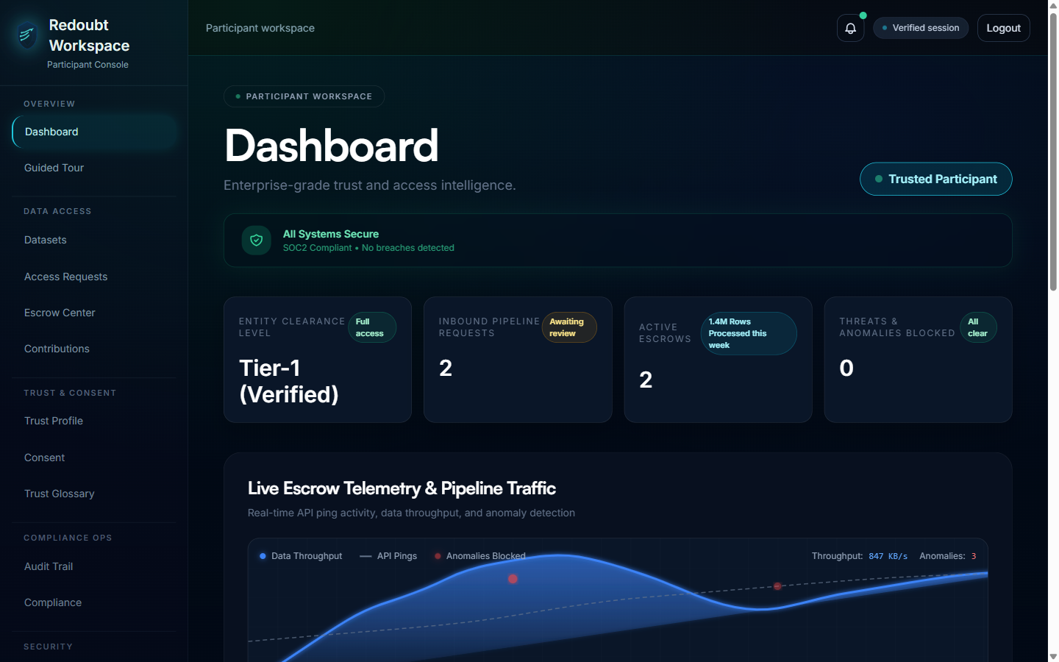
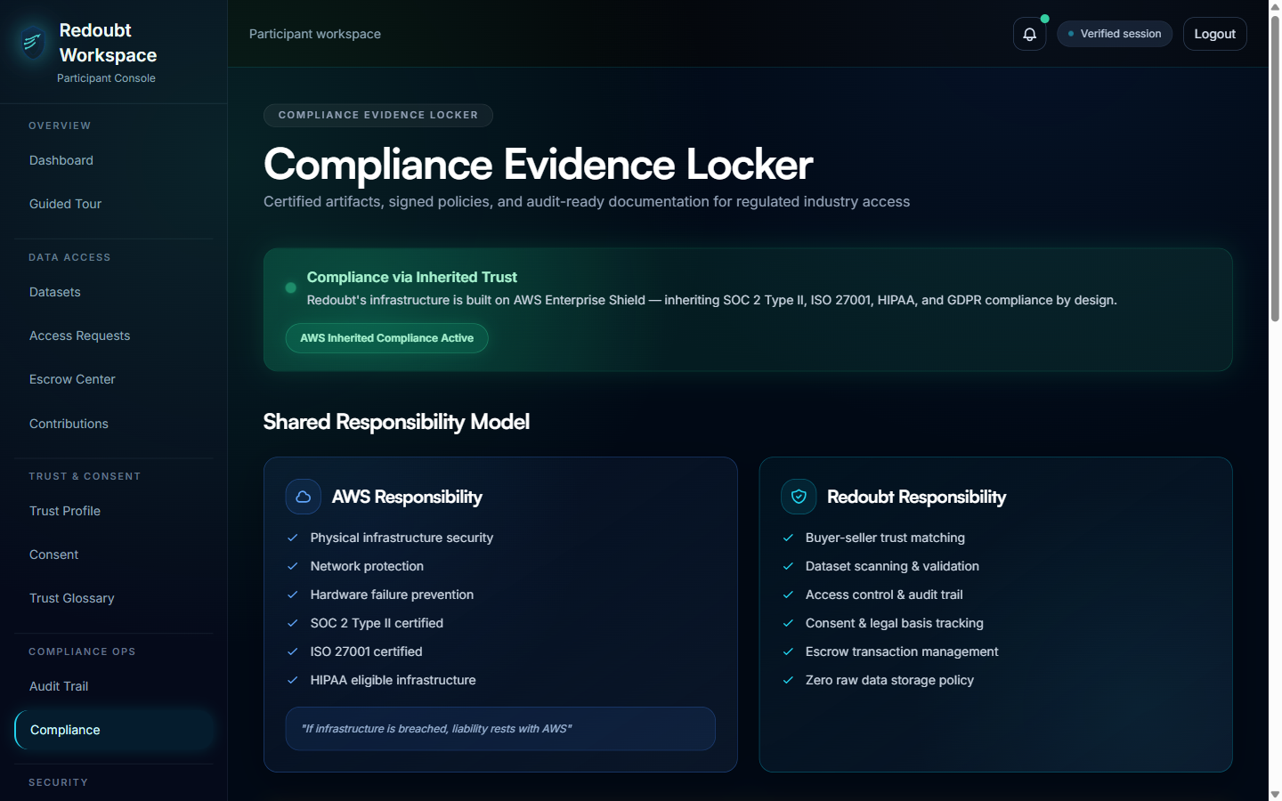
Product Evidence: Security and Governance UX
Screens captured from the live prototype in this repository.
Landing
Participant Dashboard
Compliance Locker
Trust-first market positioning and controlled-access motion.
Security telemetry, trust posture, and compliance status.
Shared-responsibility and certification evidence in-product.
Redoubt Confidential | Investor + security/compliance edition | March 2026
4/12

Slide 5
Security and Compliance Posture
A core investment moat: controls are productized, visible, and workflow-native.
Compliance posture and control depth
SOC 2 Type II milestone reflected in status surface
HIPAA and GDPR-aligned controls visible in product flows
ISO 27001 program tracked with target Q3 2026
Shared-responsibility model articulated for enterprise buyers
Immutable audit + consent + escrow workflows already prototyped
Deployment options: SaaS, private cloud, and on-prem
Redoubt Confidential | Investor + security/compliance edition | March 2026
5/12

Slide 6
Security Readiness Evidence (Repo-backed)
Current implementation depth reduces execution risk on the path to production.
53
52
28
Route distribution
Page components
App routes
Workspace routes
Onboarding
7
12
7
5
Workspace
28
Admin routes
Onboarding routes
Onboarding steps
12
Admin
Security modules: RBAC, red-team mode, secure enclave
Compliance modules: audit trail, evidence locker, consent tracker
Governance modules: escrow center, lineage, and usage analytics
Deployment checklist already documented for production rollout
Redoubt Confidential | Investor + security/compliance edition | March 2026
6/12

Slide 7
Initial Buyer Profiles
Investor focus: highest urgency segments with acute compliance and trust pain.
Regulated Enterprises
Model Risk & Security Teams
Governed access plus audit-ready controls for production workloads.
Continuous confidence and policy enforcement for AI operations.
Compliance & Legal Functions
Data Contributors
Evidence-first workflows to accelerate approvals and audits.
Controlled monetization with identity shielding and escrow protection.
Beachhead markets from repo positioning: Healthcare, Finance, and Government.
Redoubt Confidential | Investor + security/compliance edition | March 2026
7/12

Slide 8
Revenue Model and Security Upsell Path
Tiered API packaging plus enterprise compliance/deployment expansion.
Starter
Growth
Enterprise
$500/mo
$2,000/mo
Custom
1,000 API calls/month
10,000 API calls/month
Unlimited API calls
Foundational trust-scored API access
Priority support + governed integrations
Private deployment + SLA + compliance support
Included API volume by tier
Land with API value, expand with governance and compliance depth
Starter
1,000
Enterprise tier unlocks private cloud/on-prem deployment economics
Growth
10,000
Security and audit features justify premium ACV in regulated accounts
Long-term model: usage + policy automation + trust analytics
Redoubt Confidential | Investor + security/compliance edition | March 2026
8/12

Slide 9
Go-To-Market and Capital Deployment
Execution plan aligned to design partners, compliance wins, and enterprise conversion.
Phase 1
Phase 2
Phase 3
Design Partner Revenue
Compliance Conversion
Enterprise Expansion
Convert 3-5 lighthouse institutions into paid pilot accounts.
Win security/legal stakeholders with measurable control outcomes.
Scale via private deployment and strategic channel alliances.
Use of proceeds priorities (first 18 months)
Status today: prototype with deploy checklist and end-to-end trust/compliance UX already demonstrated.
Platform engineering: production backend + policy engine hardening
Security/compliance: audit exports, controls automation, cert execution
Go-to-market: design partner onboarding and enterprise sales motion
Customer success: pilot-to-production implementation support
Redoubt Confidential | Investor + security/compliance edition | March 2026
9/12

Slide 10
Defensible Moat: Security + Compliance Execution Layer
Redoubt wins where procurement requires proof, controls, and auditable outcomes.
Capability
Typical Marketplace
Redoubt
Verified onboarding and identity controls
Inconsistent
Yes
Persistent trust scoring across workflows
Partial
Yes
Policy-enforced access and revocation
Limited
Yes
Escrow and dispute-aware transaction model
Rare
Yes
Immutable audit and consent logging
Inconsistent
Yes
Compliance evidence UX for enterprise buyers
No
Yes
Strategic moat: compliance and security become daily workflow primitives, not post-processing add-ons.
Redoubt Confidential | Investor + security/compliance edition | March 2026
10/12

Slide 11
18-Month Security and Certification Roadmap
Milestones designed to de-risk enterprise procurement and support premium pricing.
Q2 2026
Q3 2026
Q4 2026
Q1 2027
Production security baseline
ISO 27001 milestone
Regional + private deployment
Enterprise scale
Backend hardening, policy engine APIs, and first paid pilots.
Certification execution and deeper control automation.
AP-Southeast target and private cloud expansion.
Repeatable sales, implementation, and compliance operations.
Redoubt Confidential | Investor + security/compliance edition | March 2026
11/12

Slide 12
Fund the trust layer for regulated AI
Redoubt converts compliance friction into defensible enterprise revenue.
Fundraising Ask
Target raise (draft): $3.0M Seed to reach enterprise pilot scale
Use of Funds (Draft)
45% engineering and platform hardening | 30% security/compliance execution | 25% GTM and enterprise delivery.
Focus: security/compliance productization and production hardening
Milestones: paid pilots, certification progress, private deployments
Investor value: category-defining trust moat in regulated data access
Thank you
Redoubt Confidential | Investor + security/compliance edition | March 2026
12/12

