Slide 1
An efficient algorithm for finding a maximum weight 2-independent set on interval graphs
Design and Analysis of Algorithms - project phase 1
Dawood Minhas i170362
Farman Hasnain i170366
Muhid Abid i180560

Slide 2
Introduction of the domain (6 marks) + related work (3 marks)
Farman Hasnain i170366

Slide 3
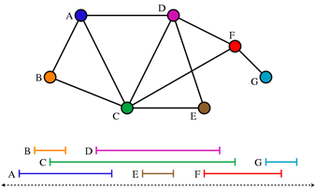
Interval graphs

Slide 4
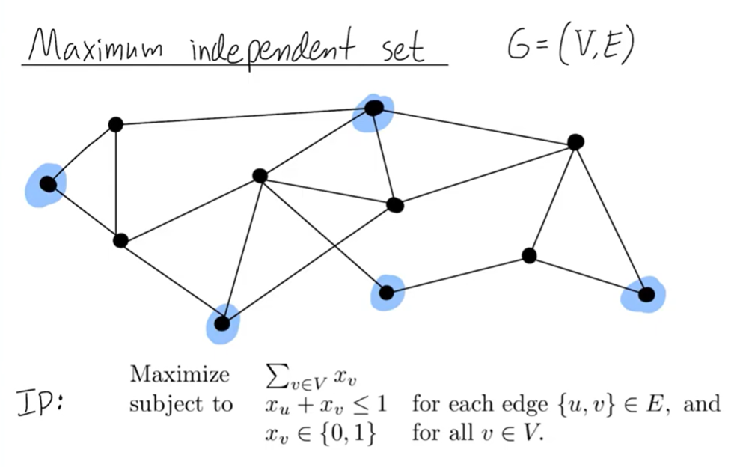

Slide 5
Related work
■ Single step graph searching problem
■ Two-track assignment problem
■ Maximum 2-chain problem
■ Relationship between the M2IS and Topological problem
Notes:
Hsiao, Tang and Chang solved the single step graph searching problem by solving the M2IS problem
Hsu and Tsai solved the two-track assignment problem by solving the M2IS problem on circular arc graphs
Lou, Sarrafzadeh and Lee solved the maximum 2-chain problem on a given point set, which is the same as the M2IS problem on a permutation graph
Sarrafzadeh and Lee proposed the relationship between the M2IS problem and the topological via minimization problem.

Slide 6
Aim of paper (5 marks) + methodology (8 marks)
Muhid Abid i180560

Slide 7
Based on the definition of MIS
■ Maximum Weighted Independent Set (MWIS)
■ Maximum Weighted K Independent Set (MWKIS)
Notes:
Maximum Weighted Independent Set (MWIS) is Maximum Independed Set of a Weighted graph
Maximum Weighted K Independent Set (MWKIS): MKIS problem on a graph G is to determine k disjoint independent sets S₁, S₂,...,S_{k} in G such that S₁ U S₂ U ...S_{k} is maximum. The MKIS problem is NP-complete for general graphs (Gavril and Yannakakis in Das, 2010).

Slide 8
Maximum Weight 2-Independent Set
Notes:
Maximum Weighted 2 Independent Set (MW2IS): MW2IS is an MWKIS problem as defined earlier. MW2IS includes 2 independent, *disjoint* sets such that S₁ U S₂ is maximum.

Slide 9
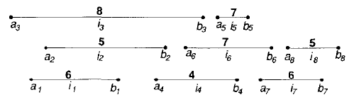
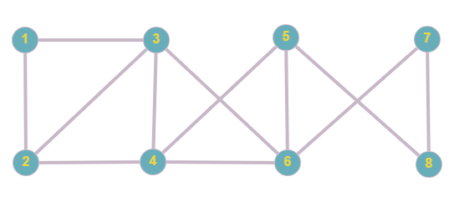
Set of weighted intervals I
6
8
7
6
4
5
7
5
Interval Graph

Slide 10

Set of weighted intervals I
8
7
6
Maximum Weighted Independent Set (MWIS)

Slide 11
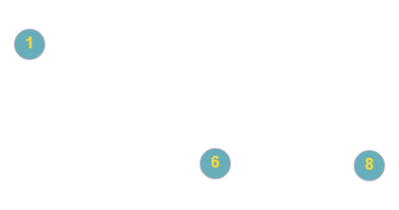
Set of weighted intervals I
6
8
7
6
7
5
Maximum Weighted 2-Independent Set (MW2IS)

Slide 12
Set of weighted intervals I
6
8
7
6
7
5
Maximum Weighted 2-Independent Set (MW2IS)

Slide 13
Set of weighted intervals I
6
8
7
6
4
5
7
5
Interval Graph

Slide 14
Different from previous work
■ Weighted interval graphs
■ More efficient

Slide 15
Methodology

Slide 16
Assumptions
■ No common endpoint
■ Sorted endpoints
Notes:
· Each interval contains both its endpoints and that no two intervals share a common endpoint
· The sorted endpoints list is given and the intervals in I are indexed by increasing right endpoints, that is, b₁ < b₂ < . . . < b_{n}.

Slide 17
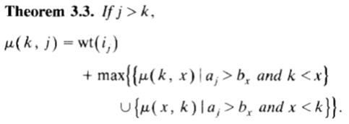
Steps
■ µ(k, j) in every possible range
■ Table
■ Weight of MW2IS
■ MW2IS

Slide 18
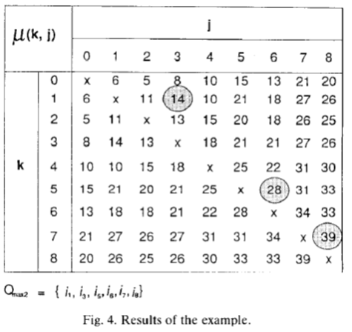

Slide 19
Evidence and Result (8 marks) +foreseen challenges (5 marks)
Muhammad Dawood i170362

Slide 20
Evidence

Slide 21
Result
O(n) time algorithm to solve the maximum weight independent set problem
O(n2) time algorithm using O(n2) space to solve the maximum weight 2-independent set problem on an interval graph with n vertices.
With a slight extension and modification of our algorithm, the maximum weight k-independent set problem on an interval graph with n vertices can be solved in O(nk) time using O(nk) space.

Slide 22
Foreseen Challenges
Less Research
Time Complexity and Computing Power

Slide 23
Assumptions
We have to assume that each interval contains both its endpoints and that no two intervals share a common endpoint.
The sorted endpoints list is given and the intervals in I are index by increasing right endpoints, that is, b1<b2....<bn

Slide 25
Dry run (15 marks)

Slide 26
Maximum Weighted Independent Set Algorithm (7 marks)
Farman Hasnain

Slide 27
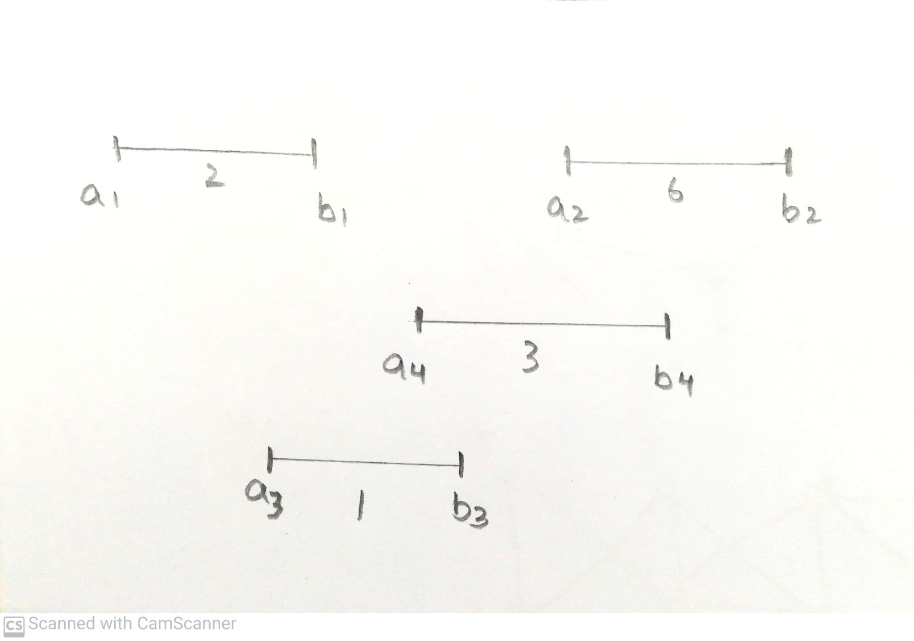
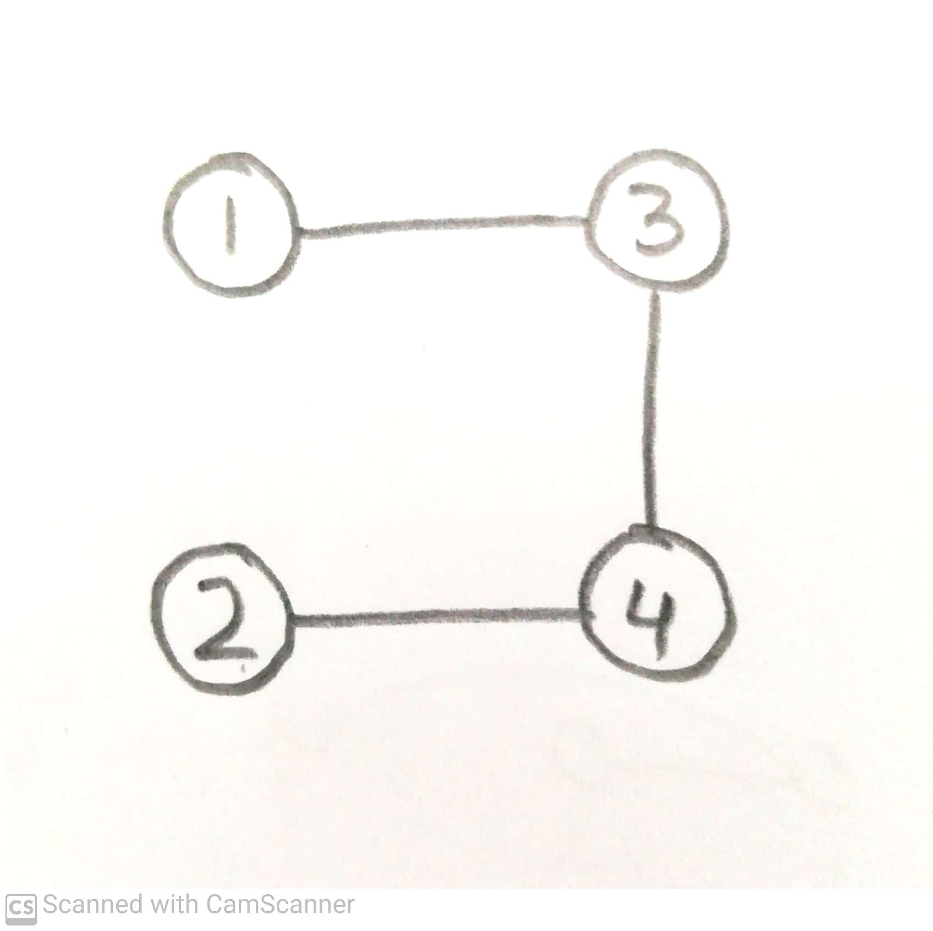

Slide 28
Step 1 – Calculate weight of MWIS
1. temp_max = 0
2. Every endpoint scanned from left to right
3. If scanned endpoint is left endpoint, ac: x(c) = wt(ic) + temp_max
4. If scanned endpoint is right endpoint, bc: if x(c) > temp_max: temp_max = x(c)
* Weight of MWIS stored in temp_max = x(last interval)
Step 2 – Derive MWIS (let it be Smax­)
1. Put last interval (let it be ilast_interval) into Smax­
2. temp_max = temp_max – wt(ilast_interval)
3. search for interval ic with right endpoint smaller than the left endpoint of ilast_interval
and x(c) = temp_max
4. put ic into Smax
5. ilast_interval = ic
6. repeat until all intervals checked

Slide 29
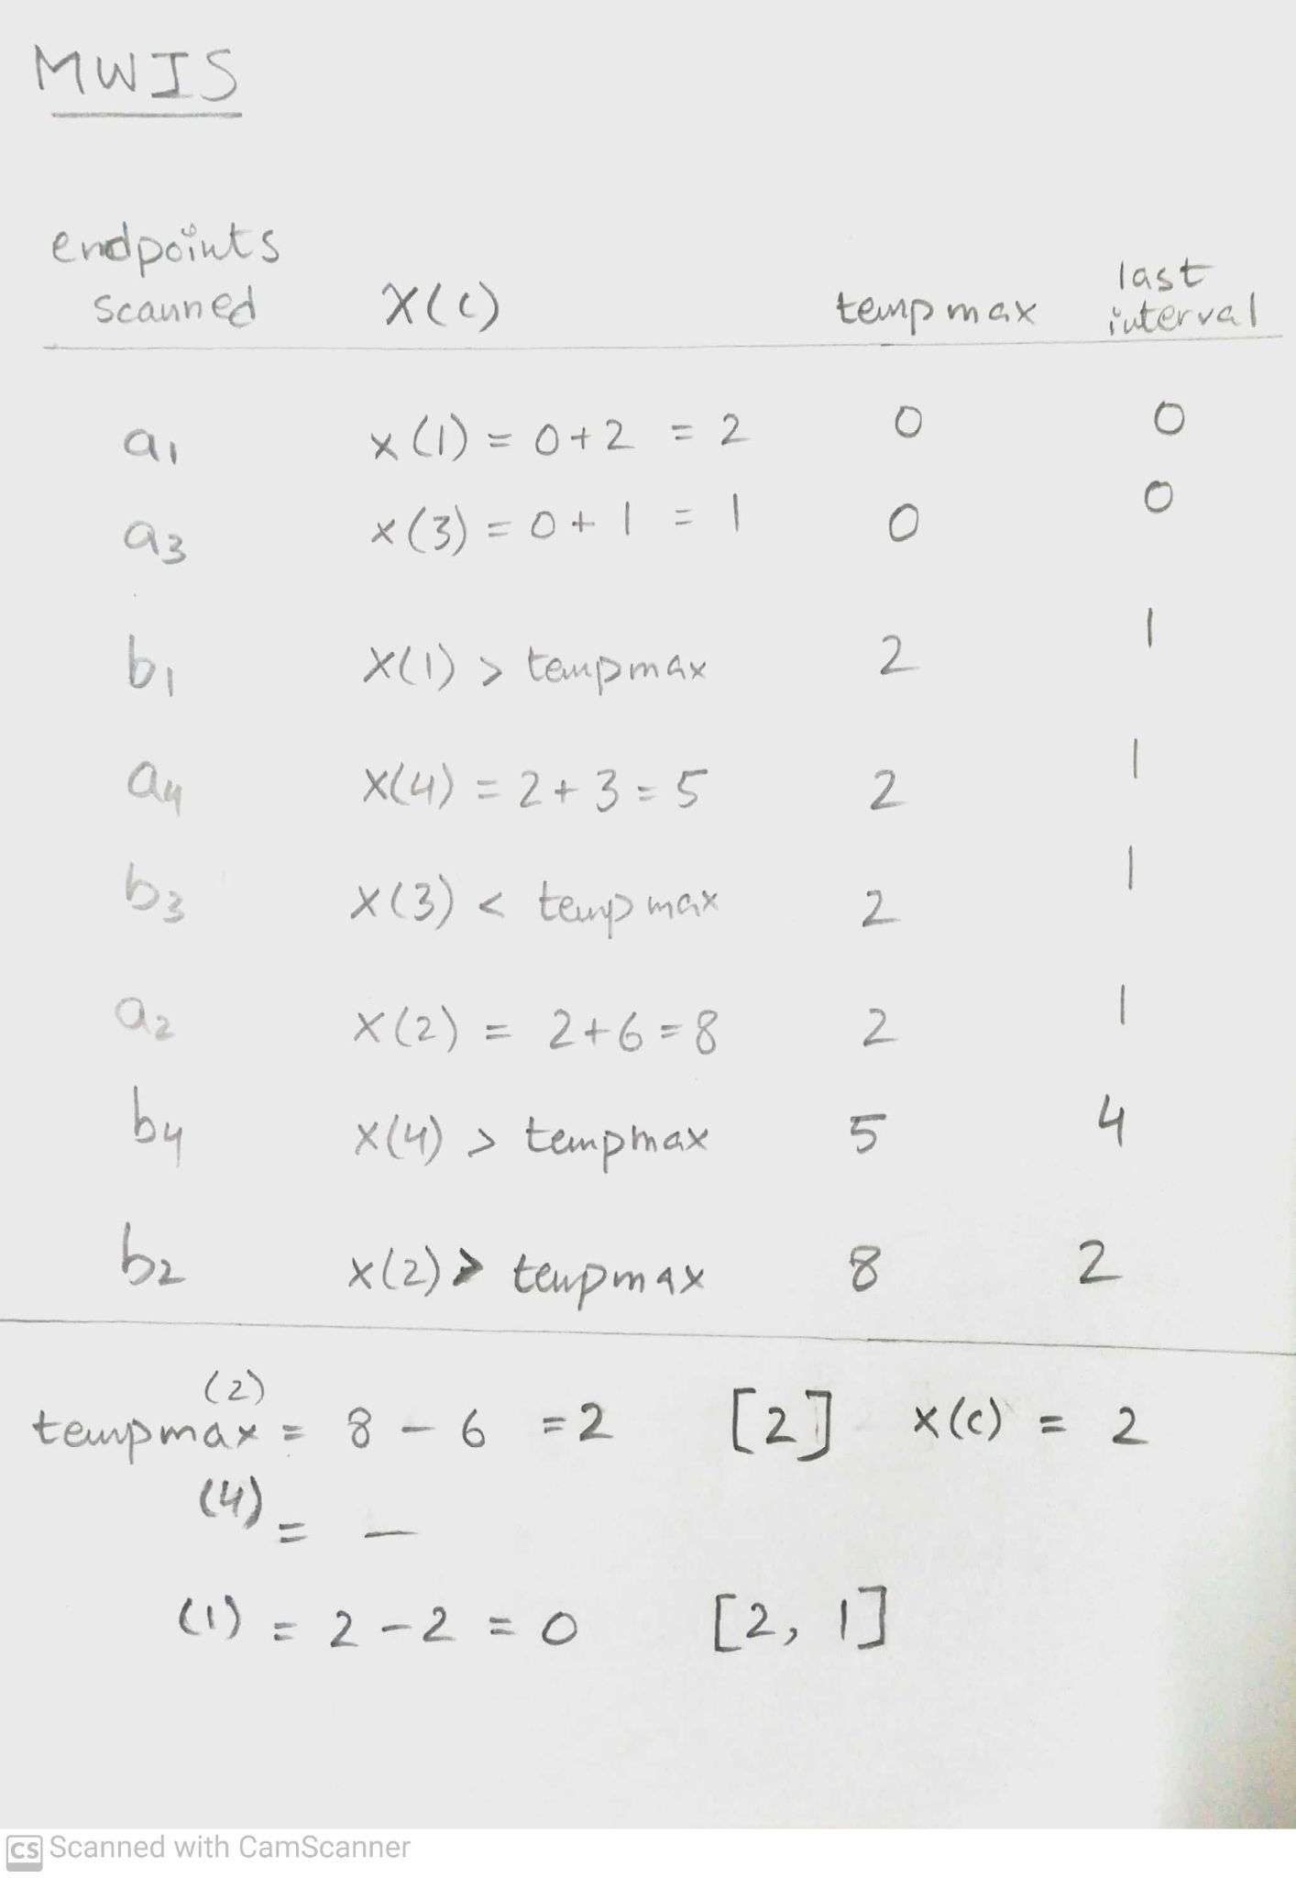

Slide 30
Maximum Weighted 2-Independent Set Algorithm Step 1 (3 marks)
Muhid Abid i180560

Slide 31
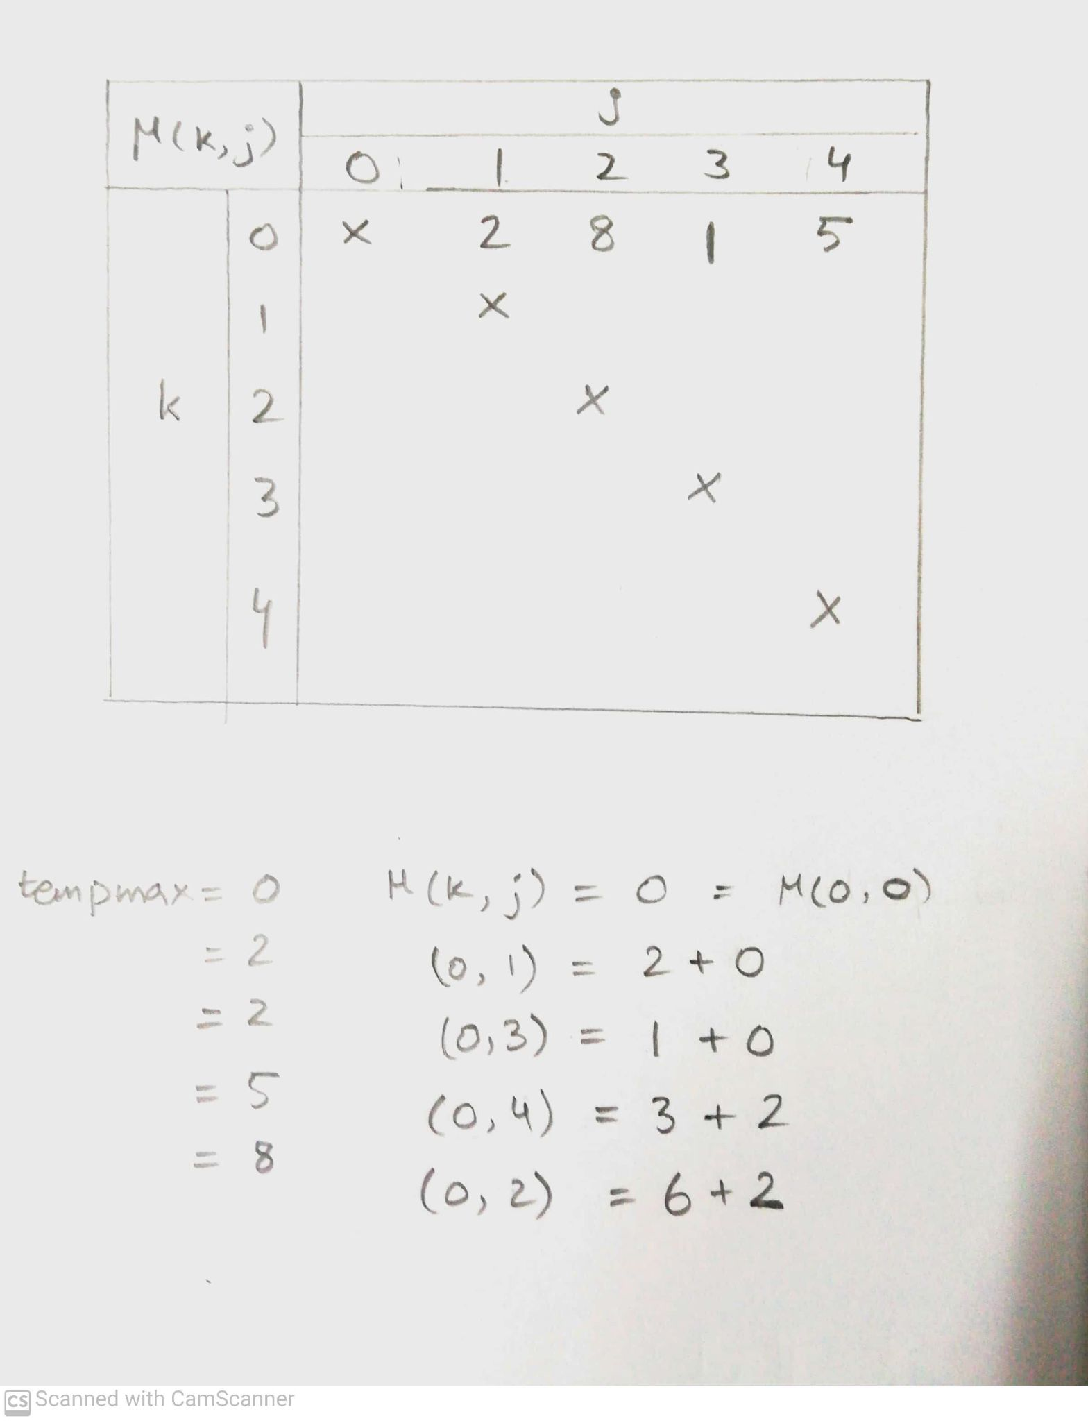
Step 1 – Calculate µ(k, j)
1. temp_max = 0, µ(k, c) = 0
2. Scan endpoints from left to right
3. Initial temp_max = µ(k, 0) (temp max will have max µ(k, x))
4. if is left endpoint and c < k: <do nothing>
5. elif is left endpoint and c > k: by Theorem 3.3, µ(k, c) = wt(ic) + temp_max
6. elif endpoint is one of ik: <do nothing>
7. elif is right endpoint: if µ(k, c) > temp_max: temp_max = µ(k, c)
else: <do nothing>
8. Iterate n times for different values of k in increasing sequence

Slide 32
Maximum Weighted 2-Independent Set Algorithm Step 2 (3 marks)
Dawood Minhas

Slide 33
Step 2 – Find MW2IS, Qmax:
1. Assume ѱ(I) to be the last calculated value (bottom corner in table) ,
µ(u,v). Where u=7 and v=8 in this case.
2. Set ѱ(I) = µ(u,v) and subtract wt(iu)+wt(iv) from ѱ(I)
3. Add iu and iv into final MW2IS, Qmax2
4. Then iterate upward column-wise and check if µ(k,j) = ѱ(I)
5. Add ik and ij into final MW2IS, Qmax2
6. if yes, repeat step 4 and 5 until no interval left

Slide 34
fin.

