Slide 1

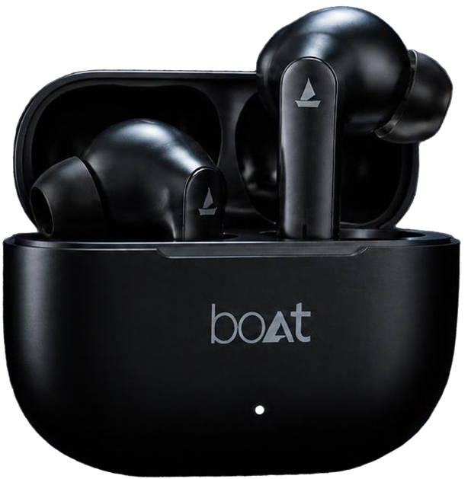
Beyond
the Bass
A public-source digital marketing audit of
boAt Airdopes 131
J.S.Muhil Vannan
Findings are directional.
No internal performance data accessed.

Slide 2



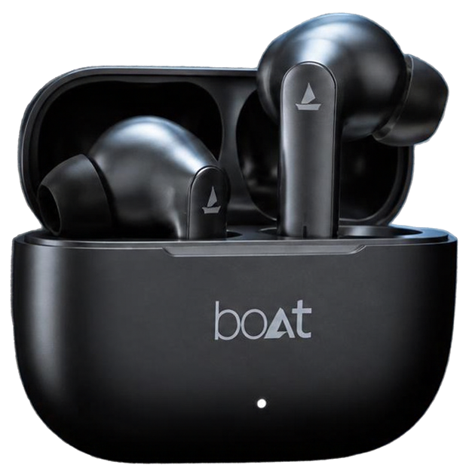
Audit
Question & Scope
Evaluated
Discovery, product-page clarity, competitor comparison, shopper journey
Reviewed
Official product/brand pages, reported social examples, selected Google search snapshots, competitor pages
Limitations
No access to ad spend, CTR, conversions, ROAS, customer-level data,
or internal sales data

Slide 3

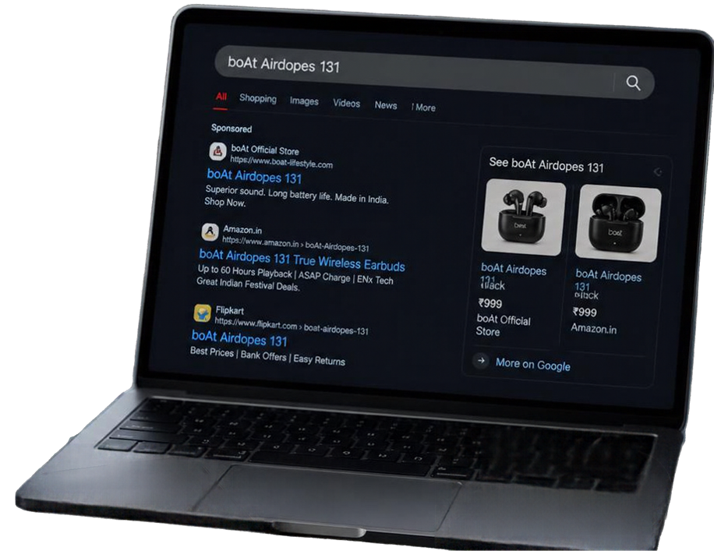





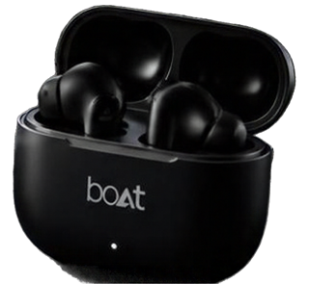
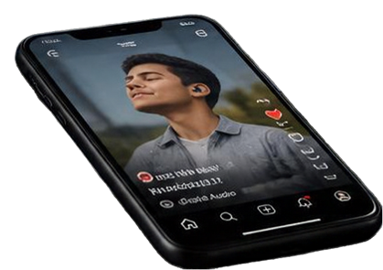

Digital
Touchpoints
SOCIAL ECOSYSTEM
  Diverse mix of use cases across reels and posts
  Product features and unboxing highlights
  Creator and celebrity-led content
  Price-led promotions and deal-driven posts
SEARCH LANDSCAPE
  Official boAt D2C store and brand pages
  Marketplace listings and offers
  Category and price band search modules
EXAMPLE
  Query: “boAt Airdopes 131”
  Observation: Official-store and marketplace listings appeared together in the reviewed search snapshot.

Slide 4



Research Framework
How I Audited the Brand?
1) Brand-Owned Sources
Reviewed the Airdopes 131 product page for advertised features, specifications and offer information.
2) Social & Search Touchpoints
Examined selected Instagram content and Google results to identify visible content themes and product-discovery touchpoints.
3) Competitor Benchmarking
Compared published claims for boAt Airdopes 131, Noise Buds N1 and Boult Z40 using official product pages.
4) Evidence-to-Action
Separated direct observations from strategic interpretations and recommendations requiring further validation.

Slide 5


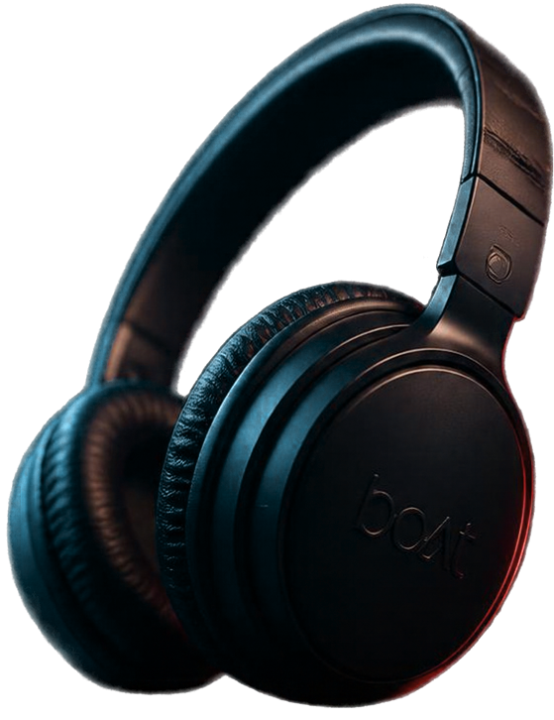





What the Audit Revealed?
Signal
Meaning
Product-page trust
Impact: stronger credibility and fewer support queries
Verify Bluetooth version consistency
Choice friction
Impact: easier decisions
and higher conversion
Clarify D2C value proposition
Student-focused positioning
Impact: evidence-led messaging that resonates
Test as a hypothesis, not a proven gap
Clearer proof, Easier comparison &
Measurable experimentation.

Slide 6




Competitive
Positioning
Official Claims Only
boAt Airdopes 131
Noise Buds N1
Boult Z40
60h
40h
60h
up to playback
up to playback
up to playback
13 mm
11 mm
10 mm
drivers
BoomX drivers
drivers
quad-mic ENC
(Noise claim)
Zen ENC / IPX5
(Boult claim)
Strategic takeaway
Playback claims overlap with Boult. Noise highlights call-related features. boAt can strengthen its value story by making its benefits and offer easier to understand.

Slide 7

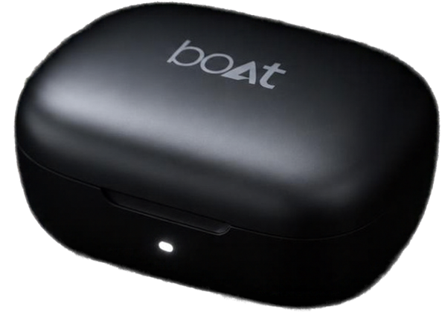
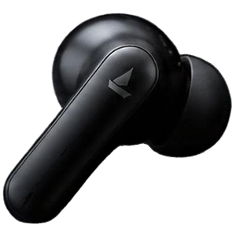
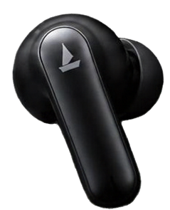
Three Signals
Worth Investing
Bluetooth specification inconsistency
Verify the conflicting version details before confirmation.
01
D2C and marketplace visibility
Clarify the D2C value proposition. This observation does not prove lost sales.
02
Student-focused positioning
Treat it as a hypothesis and validate it through research.
03

Slide 8













Recommendations
with Measurement Plans
NEXT STEPS
HOW WE’LL MEASURE
ACTION PLAN
Verify product specs across
page, packaging, and listings
Confirm that identified specification inconsistencies have been corrected.
Track search impressions, clicks and click-through rate, if Search Console data is available.
1.
Publish a dated budget-earbuds buying guide with clear comparisons
2.
Test student-value messaging
with interviews or survey
Use research responses to assess relevance before testing a campaign or landing page.
3.
We will not claim results before measurement.

Slide 9


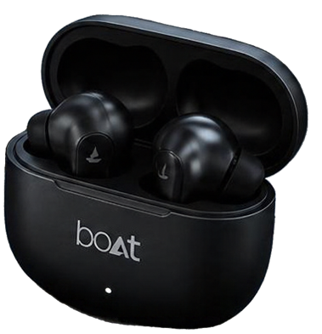


Clarify. Compare. Validate.
SOURCES CONSULTED
https://www.boat-lifestyle.com/products/airdopes-131
https://www.boat-lifestyle.com/pages/who-are-we
https://www.gonoise.com/products/noise-buds-n1-truly-wireless-earbuds
https://www.boultaudio.com/products/z40
https://www.instagram.com/boat.nirvana/

