Slide 1

Secure Payment by Facial Recognition using Haar Cascade Algorithm
Jaya Engineering College
Department of Information Technology
Presented By:
Muhilan P (110821205030)
Mugundhan G (110821205029)
Raghul M (110821205038)
Guided By:
Dr. V. Seedha Devi IT/HOD

Slide 2
Agenda
Aim
Objective
Goal
Abstract
Feasibility Study (Existing and Proposed System)
System Requirements (H/W & S/W Requirements)
Project Plan
Literature Survey
Architecture
Modules
Conclusion
Future Enhancement
Reference Links

Slide 3
Aim:
To develop a secure, efficient, and seamless facial recognition payment system that enables users to perform transactions without the need for physical cards, cash, or mobile devices.
The system will leverage advanced biometric technology to identify and authenticate users through their unique facial features, ensuring fast and reliable payment experiences while prioritizing privacy, security, and user convenience.

Slide 4
Objectives:
Enhance Security
Improve Transaction Speed
User Convenience
Ensure Privacy & Compliance
Scalability & Adaptability
User Adoption & Awareness

Slide 5
Goal:
Develop a Secure Facial Recognition Model
Ensure High Transaction Accuracy
Enhance User Experience
Optimize for Speed and Efficiency
Implement Strong Data Security Measures
Ensure System Scalability
Reduce Fraud and Payment Risks

Slide 6
Abstract:
The Domain of this project consist of Biometric, Machine Learning, Computer Vision, Digital Payments.
The major challenges include privacy concerns, data security risks, spoofing attacks, user acceptance issues, high implementation costs, regulatory compliance, and integration with existing payment systems.
The existing payment systems rely on traditional methods such as cash, credit/debit cards, mobile wallets, and PIN-based authentication, which can be time-consuming, prone to fraud, and less convenient compared to biometric-based solutions.
To overcome these challenges by providing a fast, secure, and contactless transaction method using biometric authentication, reducing fraud risks, eliminating the need for physical cards or PINs, and enhancing user convenience.

Slide 7
Feasibility Study:
Existing System:
Facial recognition payment, a rapidly growing contactless payment method post-COVID-19, offers speed, convenience, and enhanced security by enabling transactions through facial scans, eliminating the need for cards or phones, while requiring advanced fraud detection to distinguish real users from spoofing attempts.
Disadvantages:
Privacy concerns
Accuracy issues
Accessibility issues
Bias in identification
Potential for abuse
Security vulnerabilities

Slide 8
Continues…
Proposing System:
The system enables fast, secure, and contactless transactions using AI-driven liveness detection, encrypted biometric data, and multi-factor authentication, ensuring privacy, fraud prevention, and compliance with GDPR and CCPA, while adaptive AI, cross-platform compatibility, secure authentication protocols, blockchain-based identity verification, federated learning, and hardware-level security enhance reliability, mitigate bias, and protect against evolving threats.
Advantages:
Improving Security
Easy to Transact The money
Increase the Efficiency
User can update their data if they want
Fast transaction

Slide 9
System Requirements:
Hardware Requirements:
Camera: HD/IR camera (min 720p resolution)
Processing Unit: Raspberry Pi / PC with GPU support
CPU: Intel Core i5/i7 or equivalent (or ARM-based for Raspberry Pi)
RAM: Minimum 8GB (16GB for better performance)

Slide 10
Continues…
Software Requirements:
Python: Main Developmental Language for face recognition
OpenCV: Haar Cascade algorithm
Flask: Backend API framework
MySQL: Database for storing user and transaction details
HTML & CSS: Used to create user inferface
Libraries like OpenCV, face-recognition, NumPy etc…

Slide 11
Project Plan:
Develop An Application for user to Register their Data and Manage Their Account.
Develop An AI model to Store and recognise the Facial Related Data
Create the database for Storing and Comparing the data
Deploy the system on Cloud or Server.

Slide 12
Literature Survey
Yongping Zhong, Hee-Cheol Moon "Investigating Customer Behavior of Using Contactless Payment in China: A Comparative Study of Facial Recognition Payment and Mobile QR-Code Payment", information, ISSN: 2071-1050​, Volume 14, issued date: June 10, 2022
Description:
The research examines the behavioral differences between users of facial recognition and QR-code payments, analyzing factors that drive continued usage. It finds that QR-code payments have a stronger influence on user satisfaction and habitual behavior. Many consumers initially try facial recognition payments but revert to QR codes due to privacy concerns and technical failures, such as issues with mask detection. The study suggests strategies for improving facial recognition payment adoption, including enhanced security measures and better consumer education
Limitations:
Sample Diversity
Technological Barriers
Habitual Behavior

Slide 13
Continues…
Marta Beltrán, Miguel Calvo, “A privacy threat model for identity verification based on facial recognition”, Computers & Security, ISSN: 0167 - 4048, Volume: 132, Issue: June 6, 2023
Description:
The paper "A Privacy Threat Model for Identity Verification Based on Facial Recognition" explores the privacy risks of using facial recognition for identity verification in areas like access control, mobile authentication, and payments. While enhancing security and convenience, these technologies raise concerns about data protection, surveillance, and ethics. The proposed threat model identifies key risks, including linkability, identifiability, non-repudiation, detectability, disclosure, unawareness, and non-compliance. The study also outlines safeguards to mitigate these risks, promoting secure and ethical use of facial recognition.
Limitations:
Data Sensitivity
Regulatory Gap
security Vulnerabilities

Slide 14
Continues…
Romano Araujo, Adarsh Potekar, Mayuresh Raikar, Sumedha Mainkar, Salil Salgaonkar, Ashish Narvekar, Yogini Lamgaonkar “ Face Recognition Based Payment Processing System”, International Research Journal of Engineering and Technology (IRJET), e-ISSN: 2395-0056, p-ISSN: 2395-0072, Volume: 09, Issued: July, 2022
Description:
The paper "Face Recognition Based Payment Processing System" proposes a biometric payment system using facial recognition for secure transactions. It employs Haar Cascade and LBPH algorithms to verify user identity by matching facial features with a pre-registered database. After successful recognition, an OTP is sent to the user’s phone for added security. Implemented with OpenCV and Python, the system ensures real-time processing, enhancing security, convenience, and reducing reliance on physical payment methods.
Limitations:
Accuracy Challenges
Security Concerns
Processing Speed

Slide 15
Continues…
Mohammad Fauzi Aziz, Gavin Sadiya Taraka, Sidharta Sidharta, “Face Recognition as Base Protocol in Online Transactions ”, ScienceDirect, Volume: 245, ISSN: 1877-0509​, Issue: 2024
Description:
The paper "Face Recognition as Base Protocol in Online Transactions" explores the role of facial recognition technology in enhancing the security of digital transactions. With the increasing threats of fraud and identity theft in e-commerce, traditional authentication methods such as passwords and PINs are becoming more vulnerable. This study investigates how facial recognition can serve as a primary authentication protocol to reduce fraud risks and improve the efficiency of online payments.
Limitations:
Security Risks
Privacy Concerns
Legal & Ethical Issues

Slide 16
Continues…
Kuldeep Vayadande, Rachit Chandawar, Anuj Mahajan, Swapnil Garud, Mansi Parse, Jaykumar Gavit, Pushkar Gajdhane, Aryan Chalpe, Pratik Davare, Atharva Borade, Eshan Dasarwar, “Optimized Haar-cascade Algorithm for Face Recognition and Authentication”, International Journal of Intelligent and Application in Engineering, Volume 12, ISSN: 2147-6799​, issue: 2024
Description:
The paper "Optimized Haar-Cascade Algorithm for Face Recognition and Authentication" explores an improved approach to face detection and authentication using the Haar-Cascade algorithm. The study emphasizes the role of biometric security in modern applications such as identity verification, digital transactions, and surveillance systems. Traditional face recognition techniques often face challenges related to accuracy, speed, and adaptability to varying environmental conditions. To enhance performance, the proposed system integrates Local Binary Pattern (LBP) and Multi-Task Cascaded Convolutional Networks (MTCNN) with the Haar-Cascade classifier. This hybrid approach improves feature extraction, detection accuracy, and real-time processing. The system is tested in real-world scenarios, such as payment authentication, security access control, and human-computer interaction systems. The paper further discusses the application of machine learning and neural networks in face recognition, highlighting their role in improving facial feature identification and classification.
Limitations:
Security Risks
Computational Load
Scalability Challenges

Slide 17
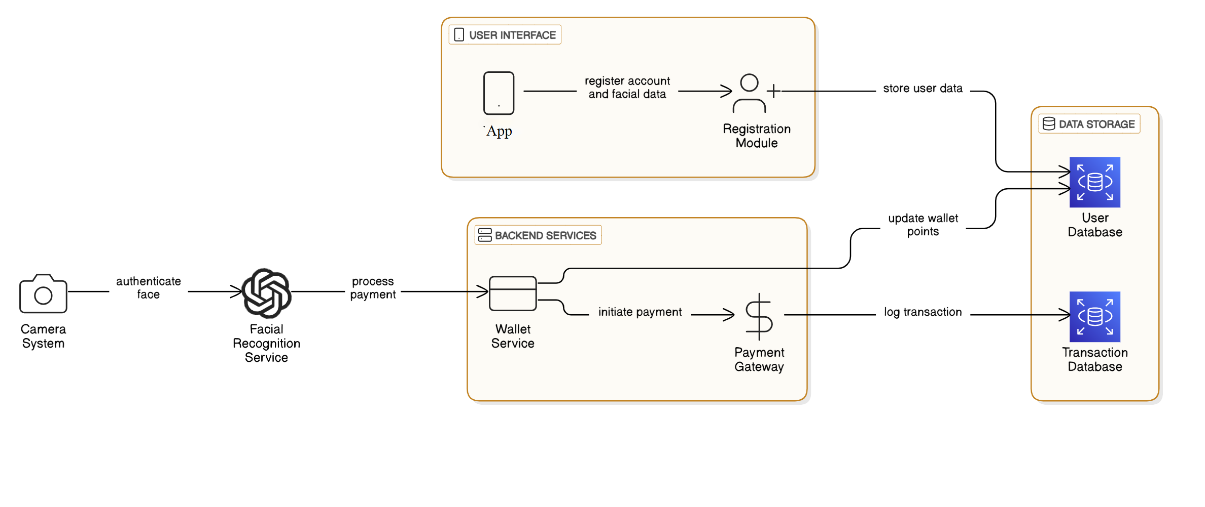
Architecture:

Slide 18
Step By Step Description
Step 1: User Registration
The user opens the App (Web Application Interface).
Navigates to the Registration Module.
Inputs their account details and facial data.
The system stores the user data into the User Database for future identification and transactions.
Step 2: Face Authentication
The Camera System captures the user's face at the payment point.
Facial data is sent to the Facial Recognition Service.
The service authenticates the face by comparing it with the registered data in the User Database.

Slide 19
Continues…
Step 3: Payment Processing
Once the face is authenticated, the Facial Recognition Service triggers a payment request.
This request is handled by the Wallet Service, which verifies wallet balance and initiates the payment.
Step 4: Transaction Execution
The Wallet Service sends a payment request to the Payment Gateway.
The gateway processes the payment by deducting wallet points or funds from the user account.

Slide 20
Continues…:
Step 5: Data Update
The Wallet Service updates the User Database to reflect the new wallet balance.
Simultaneously, the Transaction Database is updated to log the transaction for recordkeeping.

Slide 21
Modules:
User Registration Module
Scanner & Payment Module
Shop Dashboard Module

Slide 22
Modules:
1. User Dashboard Module
Users register by providing account details and capturing their face. Existing users log in by entering credentials and capturing a new face image for verification.
Technology Stack:
Frontend(Web app): HTML,CSS
Backend(API Server): Flask(Python)
Database: Mysql
User Registration Process:
Register their Card details
Register their Facial data
Register their Finger Print(Optional)

Slide 23
Continues…
2. Scanner and Payment Module
The system uses the Haar Cascade Algorithm to compare the captured face with stored data. If matched, authentication is successful; otherwise, access is denied.
Technology Stack:
Python: OpenCV(Haar cascade Algorithm)

Slide 24
Continues…
3. Shop Dashboard Module
This module provides merchants with real-time insights into their shop's performance, including transaction summaries, customer activity, and wallet balance updates
Technology Stack:
Frontend(Web app): HTML,CSS
Backend(API Server): Flask(Python)
Database: MySQL

Slide 25

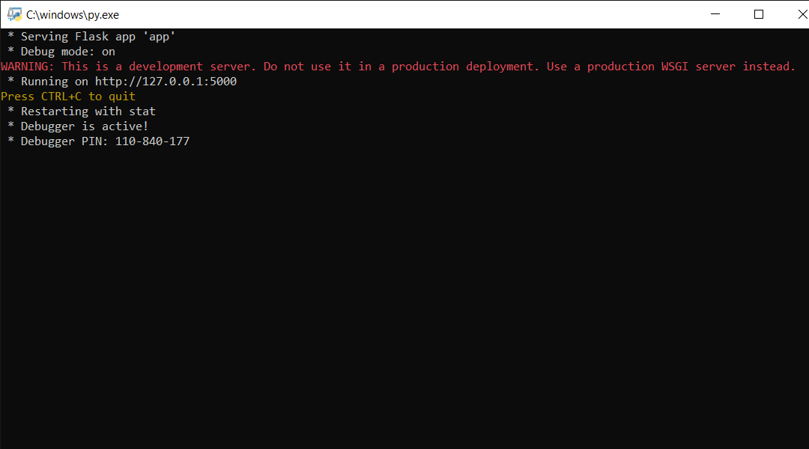
Sample Outputs:

Slide 26
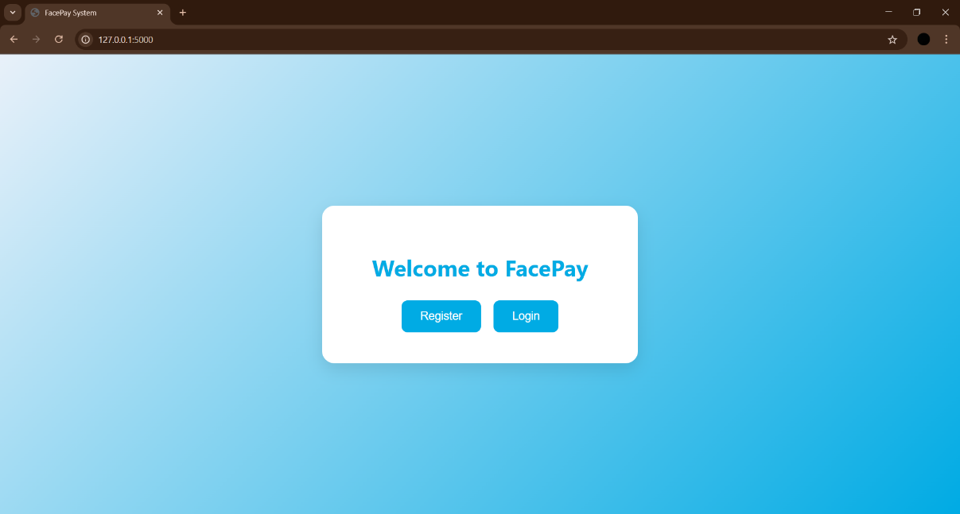
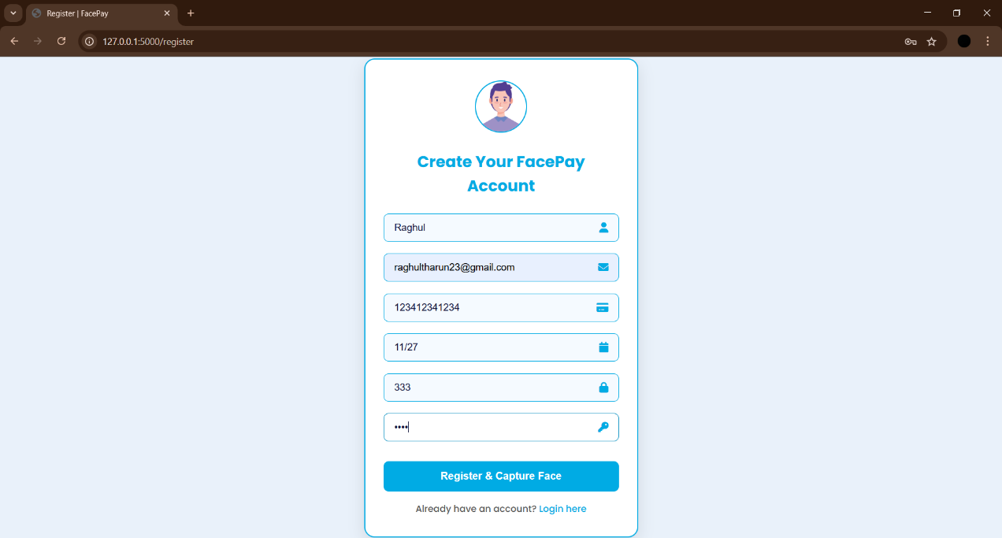
Continues…

Slide 27


Continues…

Slide 28


Continues…

Slide 29
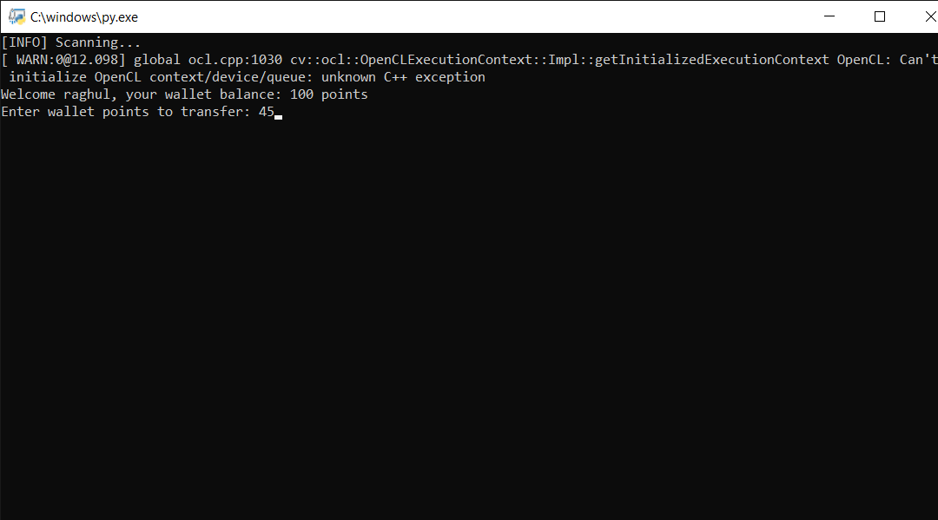
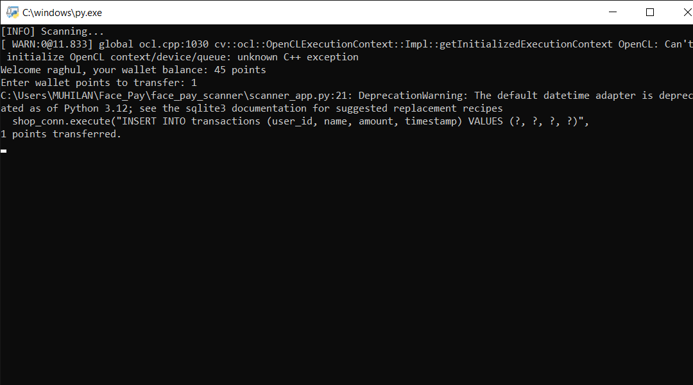
Continues…

Slide 30
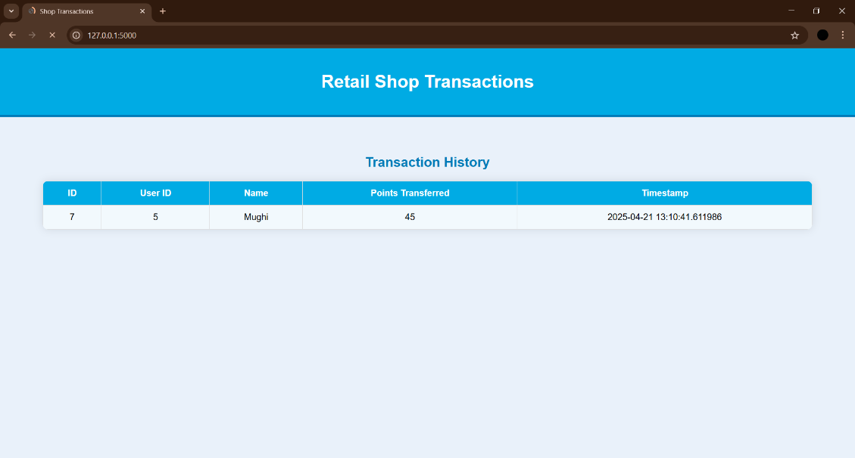
Continues…

Slide 31
Conclusion
Provides a secure and contactless method of transaction using biometric (facial) authentication.
Integrates facial recognition with wallet-based transactions for seamless user payments.
Users can register facial data for future payment authentication.
System consists of three main modules:
Web platform for user registration.
Desktop face scanner for authentication and wallet point deduction.
Shopkeeper dashboard to view incoming transactions.

Slide 32
Continues…
Demonstrates integration of AI-based facial recognition with traditional payment systems.
Enhances convenience and security in retail environments.
Modular design allows for scalability and easy deployment across different platforms.

Slide 33
Future Enhancement
Multi-Factor Authentication
Mobile Registration App
Face Recognition Model Upgrade
Integration with Real Payment Gateways
Admin Panel for Shopkeeper
User Notifications
Data Encryption & Security Enhancements

Slide 34
References Link
https://youtu.be/z_dbnYHAQYg?feature=shared
https://medium.com/analytics-vidhya/haar-cascades-explained-38210e57970d
https://flask.palletsprojects.com/
https://www.sqlite.org/
https://docs.opencv.org/4.x/dc/dc3/tutorial_py_face_recognition.html
https://developer.mozilla.org/
https://www.python.org/doc/

Slide 35
Thank you

