Slide 1
FINAL YEAR PROJECT REPORT
MULTI-MODE ENCRYPTION
AND DECRYPTION SYSTEM
For Text, File and Image Security using Java & AES-128
PRESENTED BY
Vanji Muthu P
S. Udhaiappan
D. Sathiyan
B.E., Electronics and Communication Engineering
V.S.B. College of Engineering Technical Campus | Anna University | 2026

Slide 2
TABLE OF CONTENTS
01
Project Overview & Tools Used
.....
03
08
How to Compile & Run
.....
10
02
Project Folder Structure
.....
04
09
GUI Output — Text Module Screenshots
.....
11
03
Module 1 — Text Encryption Engine (AESUtil.java)
.....
05
10
GUI Output — File Module Screenshot
.....
12
04
Module 2 — File Encryption (FileEncryptor.java)
.....
06
11
GUI Output — Image Module Screenshot
.....
13
05
Module 3 — Image Encryption (ImageEncryptor.java)
.....
07
12
Testing Workflow
.....
14
06
Module 4 — Console Menu (Main.java)
.....
08
13
GitHub Deployment
.....
15
07
Module 5 — GUI Design (EncryptionGUI.java)
.....
09
14
Conclusion
.....
16

Slide 3
Project Overview & Tools Used
03
This project was developed step-by-step using Java, covering text, file, and image encryption with a complete GUI application and cloud-based deployment.
Language
IDE
Java (JDK 17)
VS Code + Java Extension Pack
Algorithm
Library
AES-128 (Advanced Encryption Standard)
javax.crypto (built-in Java security library)
GUI Framework
Version Control
Java Swing
Git & GitHub
Cloud Testing
Documentation
GitHub Codespaces
Markdown (README.md)
Multi-Mode Encryption & Decryption System
03

Slide 4
Project Folder Structure
04
EncryptionProject/
├── AESUtil.java (Core AES encrypt/decrypt logic)
├── FileEncryptor.java (File encryption/decryption module)
├── ImageEncryptor.java (Image encryption/decryption module)
├── EncryptionGUI.java (Java Swing GUI with 3 tabs)
├── Main.java (Console menu - text version)
├── test.txt (Sample test file)
├── test.png (Sample test image)
├── EncryptionSystem.jar (Runnable JAR file)
└── README.md (Project documentation)
All modules share a common AES-128 secret key defined in AESUtil.java, ensuring consistent encryption logic across text, file, and image operations.
Multi-Mode Encryption & Decryption System
04

Slide 5
Module 1: AESUtil.java — Core Encryption Engine
05
import javax.crypto.Cipher;
import javax.crypto.spec.SecretKeySpec;
import java.util.Base64;
public class AESUtil {
private static final String SECRET_KEY = "MySecretKey12345";
public static String encrypt(String text) throws Exception {
SecretKeySpec key = new SecretKeySpec(
SECRET_KEY.getBytes(), "AES");
Cipher cipher = Cipher.getInstance("AES");
cipher.init(Cipher.ENCRYPT_MODE, key);
byte[] encrypted = cipher.doFinal(text.getBytes());
return Base64.getEncoder().encodeToString(encrypted);
}
// decrypt() mirrors encrypt() using
// Cipher.DECRYPT_MODE and Base64 decode
}
Multi-Mode Encryption & Decryption System
05

Slide 6
Module 2: FileEncryptor.java — File Module
06
public class FileEncryptor {
private static final String SECRET_KEY = "MySecretKey12345";
public static void encryptFile(String inputFile,
String outputFile) throws Exception {
SecretKeySpec key = new SecretKeySpec(
SECRET_KEY.getBytes(), "AES");
Cipher cipher = Cipher.getInstance("AES");
cipher.init(Cipher.ENCRYPT_MODE, key);
FileInputStream fis = new FileInputStream(inputFile);
byte[] inputBytes = fis.readAllBytes();
fis.close();
byte[] outputBytes = cipher.doFinal(inputBytes);
FileOutputStream fos = new FileOutputStream(outputFile);
fos.write(outputBytes);
fos.close();
}
// decryptFile() follows the same pattern using
// Cipher.DECRYPT_MODE instead
}
Multi-Mode Encryption & Decryption System
06

Slide 7
Module 3: ImageEncryptor.java — Image Module
07
public class ImageEncryptor {
private static final String SECRET_KEY = "MySecretKey12345";
public static void encryptImage(String inputFile,
String outputFile) throws Exception {
SecretKeySpec key = new SecretKeySpec(
SECRET_KEY.getBytes(), "AES");
Cipher cipher = Cipher.getInstance("AES");
cipher.init(Cipher.ENCRYPT_MODE, key);
FileInputStream fis = new FileInputStream(inputFile);
byte[] inputBytes = fis.readAllBytes();
fis.close();
byte[] outputBytes = cipher.doFinal(inputBytes);
FileOutputStream fos = new FileOutputStream(outputFile);
fos.write(outputBytes);
fos.close();
}
// Image bytes treated as raw data — same AES
// cipher logic directly encrypts pixel data
}
Multi-Mode Encryption & Decryption System
07

Slide 8
Module 4: Main.java — Console Menu Logic
08
Scanner sc = new Scanner(System.in);
System.out.println("1. Encrypt Text");
System.out.println("2. Decrypt Text");
System.out.println("3. Encrypt File");
System.out.println("4. Decrypt File");
System.out.println("5. Encrypt Image");
System.out.println("6. Decrypt Image");
int choice = sc.nextInt();
sc.nextLine();
if (choice == 1) {
String text = sc.nextLine();
System.out.println(AESUtil.encrypt(text));
} else if (choice == 3) {
String in = sc.nextLine();
String out = sc.nextLine();
FileEncryptor.encryptFile(in, out);
} else if (choice == 5) {
String in = sc.nextLine();
String out = sc.nextLine();
ImageEncryptor.encryptImage(in, out);
}
// choices 2, 4, 6 call the matching decrypt methods
Multi-Mode Encryption & Decryption System
08

Slide 9
Module 5: EncryptionGUI.java — Swing GUI
09
1
JFrame main window (600x500) with dark theme
2
JTabbedPane with 3 tabs: TEXT, FILE, IMAGE
3
Each tab has: input field, Browse/Encrypt/Decrypt buttons
4
JFileChooser used to browse files and images
5
ActionListener on each button calls AESUtil / FileEncryptor / ImageEncryptor
6
JOptionPane shows success/error popups after every operation
encryptTextBtn.addActionListener(e -> {
String result = AESUtil.encrypt(textInput.getText());
textResult.setText(result);
});
Multi-Mode Encryption & Decryption System
09

Slide 10
How to Compile & Run
10
1. Compile all files
javac AESUtil.java FileEncryptor.java ImageEncryptor.java EncryptionGUI.java Main.java
2. Run Console Version
java Main
3. Run GUI Version
java EncryptionGUI
4. Create JAR file
jar cfe EncryptionSystem.jar EncryptionGUI *.class
5. Run JAR file
java -jar EncryptionSystem.jar
Multi-Mode Encryption & Decryption System
10

Slide 11
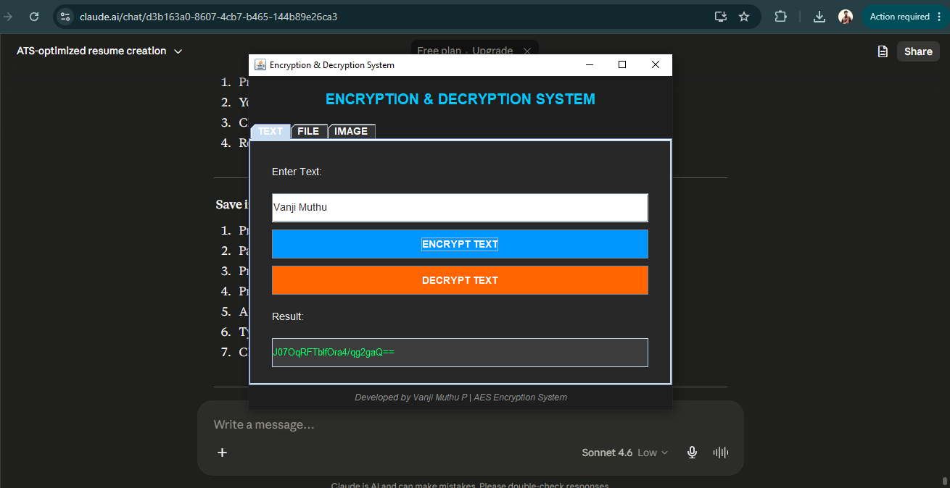
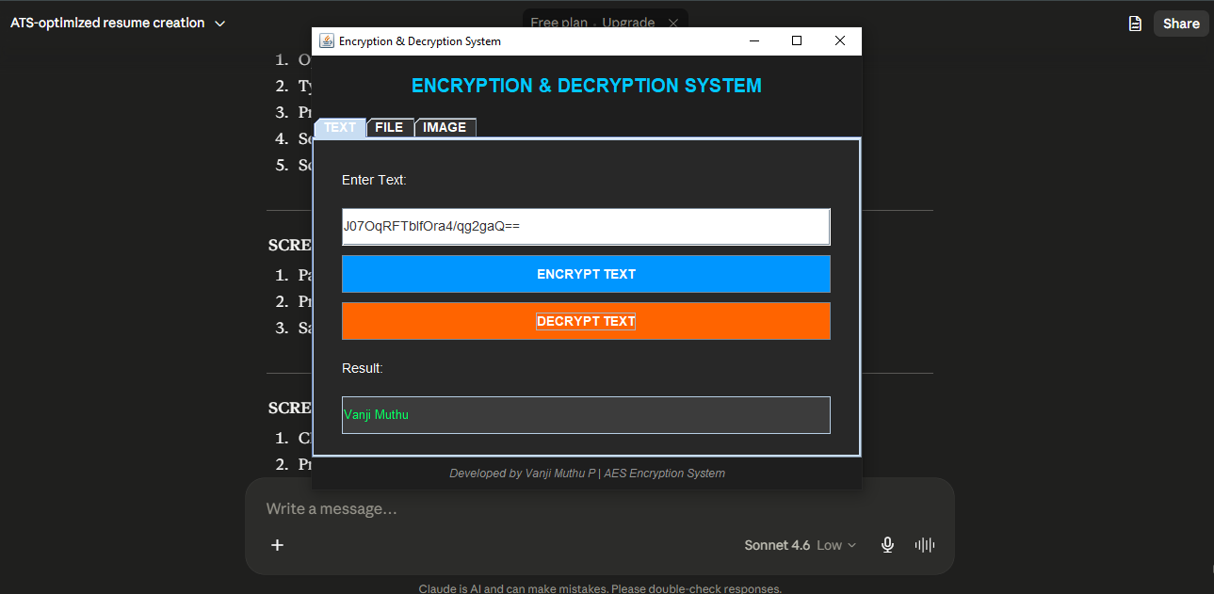
GUI Output — Text Encryption Module
11
Step 1 — Text Encrypted
Step 2 — Text Decrypted (Original Restored)
Multi-Mode Encryption & Decryption System
11

Slide 12
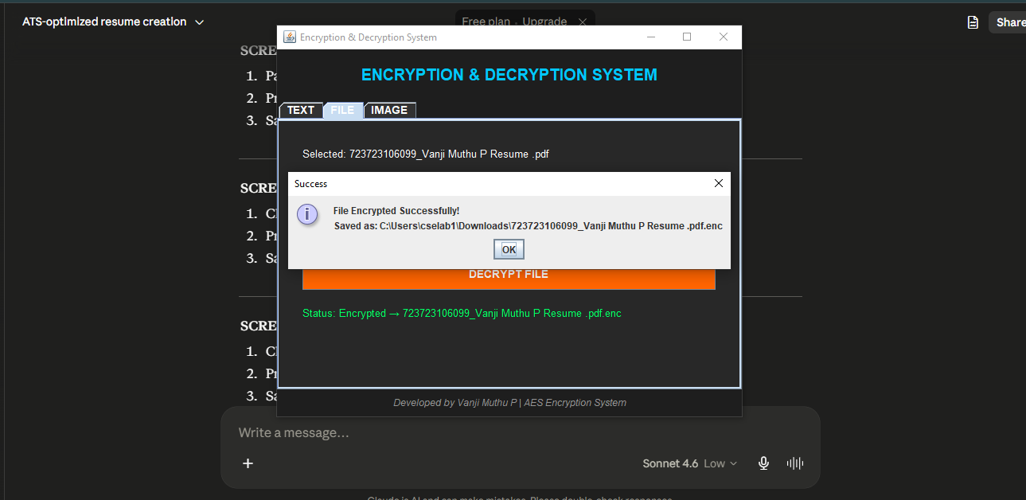
GUI Output — File Encryption Module
12
File successfully encrypted and saved with .enc extension
Multi-Mode Encryption & Decryption System
12

Slide 13
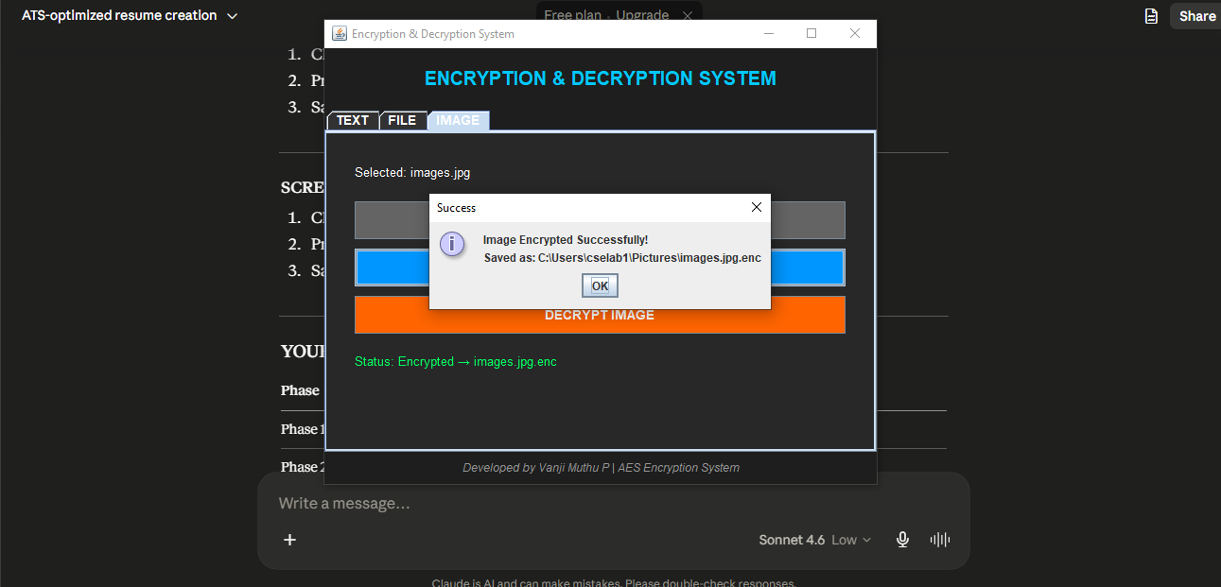
GUI Output — Image Encryption Module
13
Image successfully encrypted and saved with .enc extension
Multi-Mode Encryption & Decryption System
13

Slide 14
Testing Workflow — Step by Step
14
STEP 1
STEP 2
Created test.txt with sample content
Ran Encrypt File → produced test.enc (unreadable)
STEP 3
STEP 4
Ran Decrypt File → restored decrypted.txt (matched original)
Added test.png image to project folder
STEP 5
STEP 6
Ran Encrypt Image → produced encrypted.png
Ran Decrypt Image → restored decrypted.png (matched original)
Multi-Mode Encryption & Decryption System
14

Slide 15
GitHub Upload & Deployment
15
✔
Created GitHub repository: Encryption-Decryption-System
✔
Uploaded all .java files, test files, and JAR file
✔
Added detailed README.md with project description, modules, and how-to-run instructions
✔
Tested project inside GitHub Codespaces (cloud terminal)
✔
Compiled and ran Main.java successfully in the cloud
✔
Added team GitHub/LinkedIn links and contact details to README
Multi-Mode Encryption & Decryption System
15

Slide 16
Conclusion
16
✓
Successfully built a complete AES-128 encryption system covering Text, File, and Image data
✓
Implemented a professional Java Swing GUI for non-technical users
✓
Verified functionality through console testing and GUI testing
✓
Deployed full source code, JAR file, and documentation to GitHub
✓
Validated cloud execution using GitHub Codespaces
Multi-Mode Encryption & Decryption System
16

Slide 17
THANK YOU
Presented by
VANJI MUTHU P
S. UDHAIAPPAN
D. SATHIYAN
GitHub: github.com/muhilvanji987-lang/Encryption-Decryption-System
V.S.B. College of Engineering Technical Campus | Anna University | 2026

