Slide 1
Telco customer churn: IBM dataset Analysis and Prediction
Abdullah-Al-Muhit

Slide 2
Used Libraries
Numpy
Pandas
Matplotlib
Seaborn
Pandas Profiling

Slide 3
Analysing Dataset
Used dataframe for better understanding
Rows 7043 and columns 33
“Total Charges” column was defective, should be dtype of float, but showing object
‘Total Charges’ column was made numerical
No duplicate values
‘Total Charges ’ and ‘Churn Reason’ had missing value

Slide 4
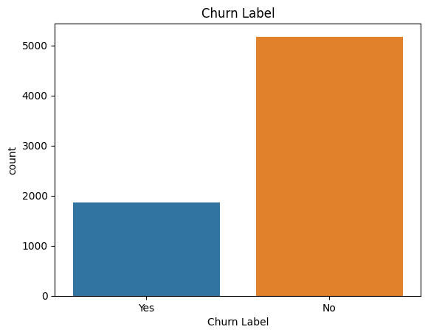
Handling Missing Values
Handles the missing values of ‘Total Charges’ by multiplying tenure months and monthly charges
Churn reasons are there only if the customer have churned
For every Churn value of 1, there was Churn Reason(about 1869)
For every Churn value of 0 there was no Churn Reason(about 5174)
Decided to drop ‘Churn Reason’ as handling it might make the dataset bias

Slide 5
Exploratory Data Analysis(EDA)
Data interpretation:
Count, Country and State has constant values
Customer Id is not needed for prediction as all of it’s values are unique
There is almost no imbalance between Male and Female
Around 51% people don’t have partners
80% customers are not dependent
73% people have not churned, 27 % have churned
People using fiber optics have more churn rate than other service utilizers
Churn value and Churn label are same thing after encoding

Slide 6
Demographic Analysis
Females who are seniors with no dependents and no partners have the highest rate of churn around 66%
Male senior citizens with a partner and dependents have the least value of churn
Senior citizens might have issues handling technologies
People with partner have less churn ratio because there maybe stability in them, will be living in that area for longer
Females have the most churn rate

Slide 7
Geographical Analysis
People living in Los Angeles have the highest customer base
Max churn value is in Boulder Creek with value of 1.0
Big cities have higher customer base
Small cities have higher churn rates as it is easy for competitors to compete in small cities
In latitude of 36-40 have the highest rate of users
In latitude of 40-42 has the lowest users
Country and state has the same amount of churn

Slide 8
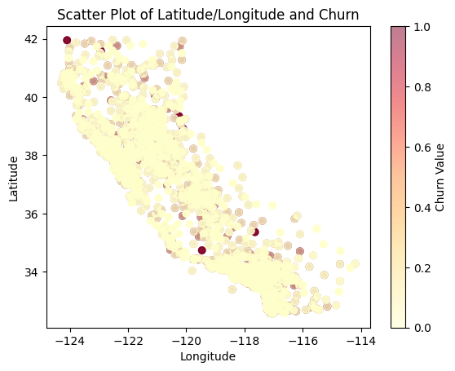
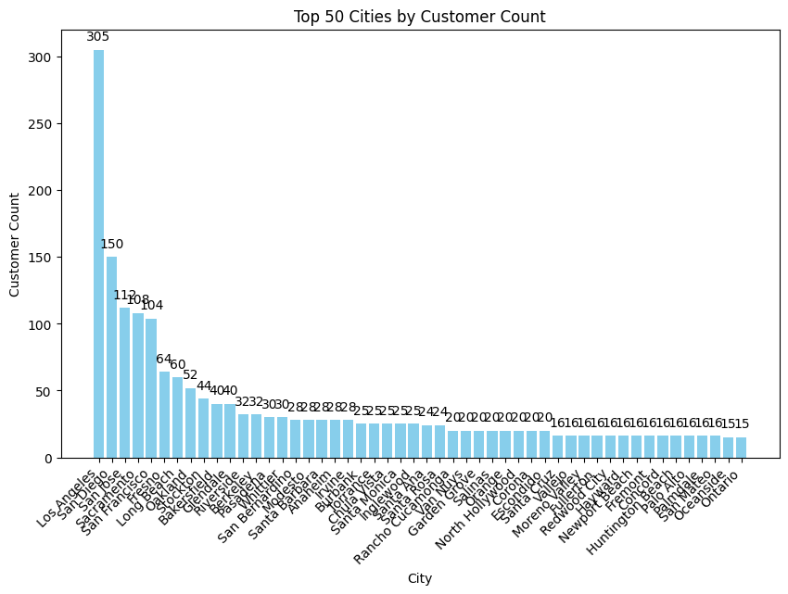

Slide 9
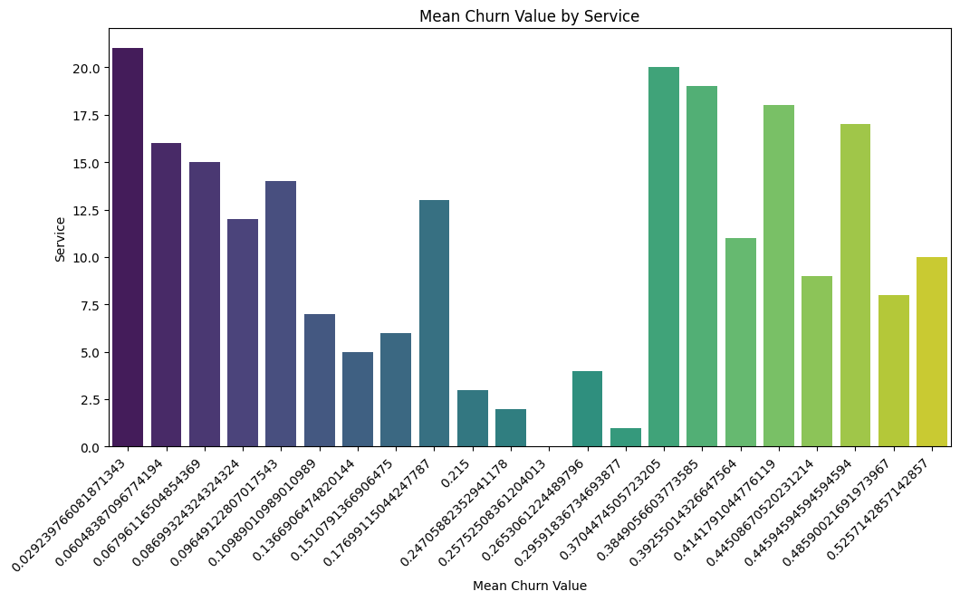
Service Utilization Analysis

Slide 10
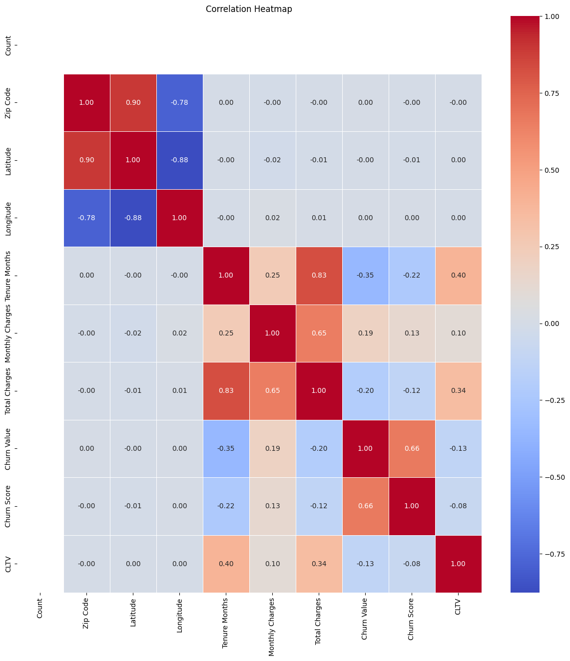

Slide 11
Service Utilization Analysis
People with fiber optics have the most churn rate
Has unique results for different combinations of service
Also, fiber optics user giving the most monthly charges
People with no internet service has the least churn rates

Slide 12
Feature Engineering
Dropped columns: 'Country','State','Count','Zip Code','Churn Reason','City','Churn Score','Churn Value','CLTV','CustomerID','Lat Long','Latitude','Longitude'
Columns are dropped based on:
I have dropped datas which has no importance such as 'Customer Id'
I have dropped 'Churn Reason' as there are a lot of missing values and handeling them might make the dataset bias
dropped columns with constant values or one values for a column like 'Count', 'Zip Code' etc.
dropped columns with low correlations

Slide 13
Feature Engineering
Encoded dependent variable differently
Dependent column was ‘Churn Label’, manually made yes=1, no=0
Taken all the categorical values and encoded them
Used One Hot Encoding Technique
Could have used Label Encoding as well(validated and have almost the same results)
X= independent features, y = dependent features
Imbalanced dataset, so balanced it using SMOTE
Could have used other balancing tools(explained in the code)
As I have used SMOTE, I have splitted dataset I preserved the original dataset in both training and testing

Slide 14
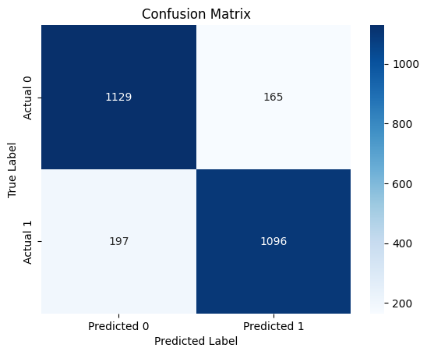
Model and Evaluation
Model used: XGBoost
Accuracy: 86%
Confusion matrix:

Slide 15
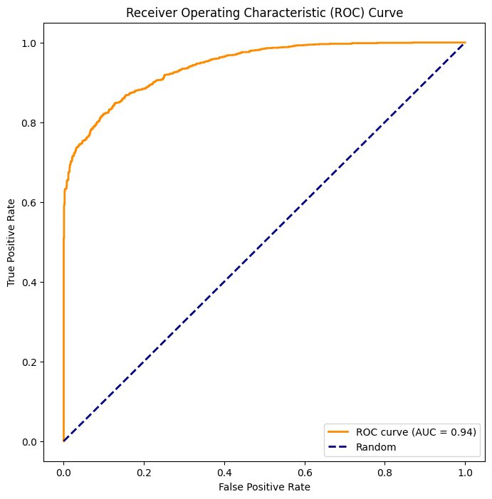
Model and Evaluation
ROC-AUC: 0.9422

Slide 16
Cross Validation and tuning hyparameters
Cross-Validation Scores: [0.86859903 0.85748792 0.85942029 0.85693572 0.84871919]
Mean Accuracy: 0.8582
Standard Deviation: 0.0064
After tuning parameters
Test Accuracy with Best Model: 0.8666
Best Hyperparameters: {'colsample_bytree': 1.0, 'learning_rate': 0.1, 'max_depth': 4, 'n_estimators': 100, 'subsample': 0.8}
Here parameter grid is:
param_grid = {
'n_estimators': [100, 200, 300],
'learning_rate': [0.01, 0.1, 0.2],
'max_depth': [3, 4, 5],
'subsample': [0.8, 0.9, 1.0],
'colsample_bytree': [0.8, 0.9, 1.0],
}

