Slide 1
Encouraging Academic Honesty through Anti-plagiarism Software
UMWIMERERE
SOFTWARE

Slide 2


Slide 3

My Gang…….

Slide 4
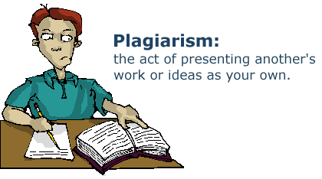

Slide 5
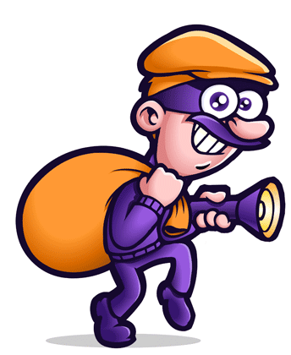

Slide 6


Slide 7
Quality for Selection of a Paper
Editors and reviewers of all scholarly journals look for the following for selection of a paper for its inclusion in a journal:
Originality – what’s new about subject?
Relevance to and extension of existing knowledge
Research methodology – are conclusions valid and objective?
Clarity, structure and quality of writing – does it communicate well?
Sound, logical progression of argument
Currency of references
Compliance to the editorial scope and objectives of the journal

Slide 8

Plagiarism: Made Easy
The Internet has made it easier for everyone to plagiarise.

Slide 9

How are Papers Made !

Slide 10
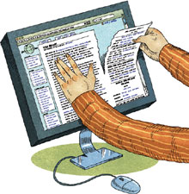
Plagiarism: Made Easy

Slide 11

Plagiarism: Made Easy

Slide 12

Say No to Plagiarism

Slide 13
Definition
According to the Merriam-Webster Online Dictionary, to "plagiarise" means
to steal and pass off (the ideas or words of another) as one's own
to use (another's production) without crediting the source
to commit literary theft
to present as new and original an idea or product derived from an existing source.

Slide 14
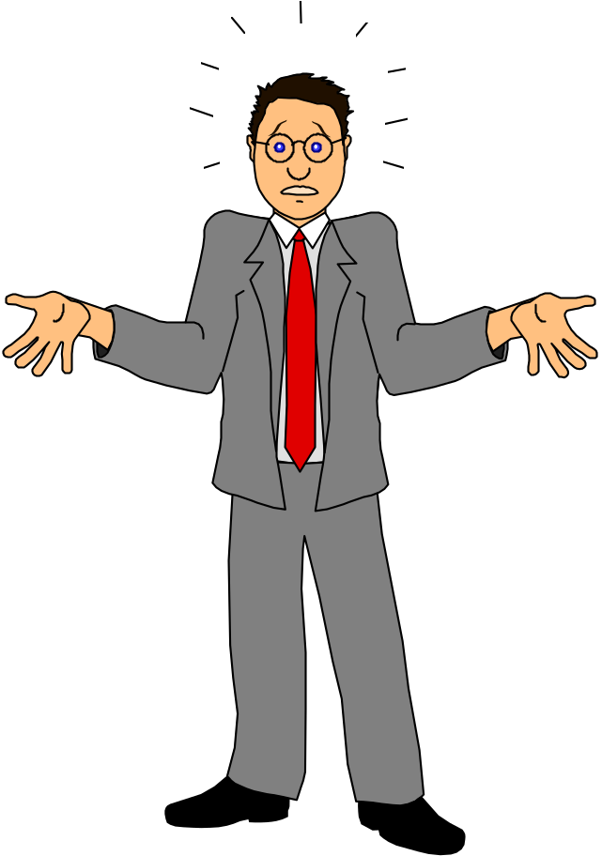
Why People Plagiarise?

Slide 15
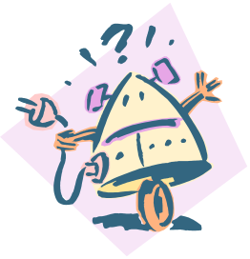
Why People Plagiarise?
Lack of time / planning
Pressures to publish
(for career advancement)
To influence others
Competition
(parental & colleague pressure)
Fear of failure
Lack of
Enforcement
Laziness
Lack of knowledge
Notes:
What do you think of these excuses? Are they valid?

Slide 16
Plagiarism Includes
Using someone else’s exact words without using quotation marks or a citation.
Using someone else’s ideas without using a citation (even if the source is in the bibliography).
Using rearranged words from a source without a citation.

Slide 17
Types of Plagiarism
Complete Plagiarism-A piece of work copied entirely from one or more sources
Copy and Paste-Available information off internet or electronic journals
Word Switch-If you copy a sentence or paragraph into your assignment and change a few words it will still be considered to be plagiarism
Self-plagiarism-Self-plagiarism is when you re-use your own previously written work or data in a new assignment and do not reference it appropriately

Slide 18

Stop Plagiarism

Slide 19
Plagiarism Detection
Manual detection requires substantial effort and excellent memory
Computer-assisted detection allows vast collections of documents to be compared to each other
Notes:
What do you think? Is plagiarism worth the risk?

Slide 20
Anti-plagiarism Tools
Plagiarism.org (www.plagiarism.org)
Turnitin.com (www.turnitin.com)
Plagiarism Checker (http://www.plagiarismchecker.com/)
Plagiarism Detector (http://www.plagiarism-detector.com)
And many more software…….
Notes:
Any thoughts on this real-life impact of cheating?

Slide 21

Say No to Plagiarism
Notes:
Plagiarism is a form of cheating. Copying and writing the ideas of others and presenting them as your own.
Plagiarism is no exception and could be known as theft and should be treated as such.

Slide 22

Say No to Plagiarism

Slide 23
Avoiding Plagiarism
One way to avoid plagiarism is reading something and putting it into your own words
Another way is to credit the author of what you read and not taking credit for it
Using quotations is another way of avoiding plagiarism
At the beginning of the first sentence in which you quote, paraphrase, or summarize, make it clear that what comes next is someone else's idea

Slide 24
Avoiding Plagiarism
If you are worried about being accused of plagiarism, your best defense is to…
Do your own work
Keep careful track of your sources and notes
Understand everything you have written
Finally, acknowledge those who contribute to your work

Slide 25
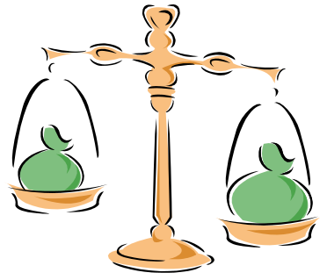
Avoiding Plagiarism
attribute references
describe all sources of information
give acknowledgments
provide footnotes
use quotation marks wherever required
paraphrase the original, attributed work
for extensive quotations, obtain permission from the publisher of the original work
avoid self-plagiarism by taking permission from the publisher of the previous article authored by you
obtain permission for use of published drawings or other illustrations

Slide 26
Punishments
Plagiarism may result in serious sanctions, including
public disclosure,
loss of research funding,
loss of professional stature and
termination of employment
legal action against the individual's committing plagiarism

Slide 27

Say No to Plagiarism
When in doubt,
cite it!

Slide 28
Conclusion…
The librarian role can be:
To develop Web pages, guides for proper citation and plagiarism
To offer checking services to its users and faculty
To educate the users and faculty, through library users training programme.
Final steps to addressing plagiarism problem are:
Acknowledge the problem
Universally define plagiarism
Increase its awareness among masses
Prevent (Create an Academic Integrity Policy/ Adjust assignments)
Develop a method for catching/screening
Be a good role model
Notes:
Any thoughts on this real-life impact of cheating?

Slide 29

Thank You . . . . .
ASI-DISTRIBUTION

