Slide 1


Introduction to Turnitin:
The Anti-Plagiarism Prevention Service
Rafael Scapin, Ph.D.
Coordinator of Educational Technology
Dawson College

Slide 2
What is Turnitin ?
What it does
Turnitin compares papers to a vast repository of data to deliver originality reports in just a few seconds.
How it does
The Turnitin Web Crawler scans and indexes new and existing content from the Web in the Turnitin database.
A student uploads a paper to Turnitin.com
The paper is compared to millions of books/publications; over 45 billion web pages; and 337 million student papers.
Results are returned in seconds, showing matches of the student paper to content from the Turnitin database.

Slide 3
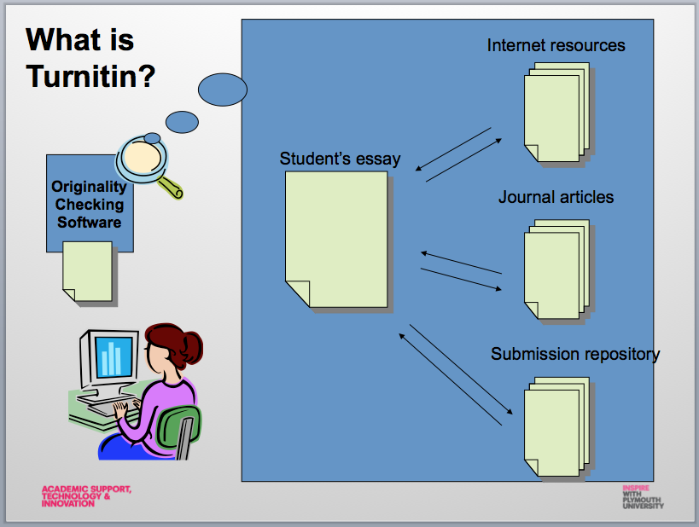
What is Turnitin ?

Slide 4
Accepted File Types
Microsoft Word (.doc)
Plain text (.txt)
Adobe Acrobat PDF (.pdf)
Rich Text Format (.rtf)
PostScript (.ps)
WordPerfect (.wpd)
HTML (.html, htm)
If you use a different word processor (e.g. StarWriter, LaTeX, etc.) you should be able to save your paper in one of these formats and then submit it to Turnitin.com. Alternatively, you can cut and paste the contents of your paper into an online form when submitting.

Slide 5
Turnitin Database
The Current and Archived Web
Similar to Google and Bing, Turnitin has built a web crawler that crawls the Internet and indexes content into a searchable form. Turnitin currently contains over 45 billion web pages from the current web as well as archived web pages.
Student Papers
Over 50 percent of plagiarism comes from other student’s work. Turnitin compares submitted papers to a database of over 337 million papers in the Turnitin paper database. Each day, the Turnitin student database grows by 190,000 papers.

Slide 6

Turnitin: Languages
Turnitin works in 30 languages
Arabic, Chinese (simplified and traditional), Japanese, Thai, Korean, Catalan, Croatian, Czech, Danish, Dutch, Farsi, Finnish, French, German, Greek, Hebrew, Hungarian, Italian, Norwegian (Bokmal, Nynorsk), Polish, Portuguese, Romanian, Russian Serbian, Slovak, Slovenian, Spanish, Swedish, and Turkish
A paper submitted in French text is checked against the Turnitin French text database which contains French language papers and crawled French language webpages.

Slide 7
Turnitin Database
Content Partnerships
Turnitin has partnered with leading content publishers:
library databases
text-book publishers
digital reference collections
subscription-based publications
homework helper sites
books
These partnerships have contributed over 130 million additional articles to our databases.

Slide 8
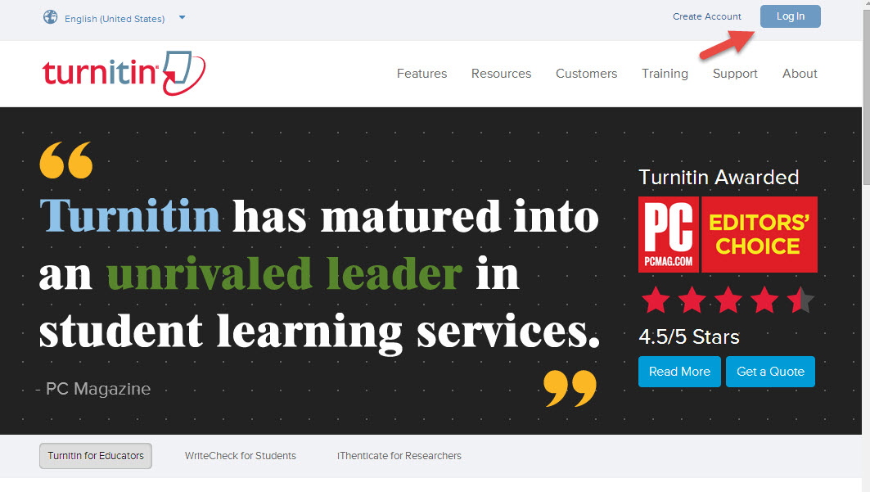
Loging to Turnitin
Go to http://www.turnitin.com

Slide 9
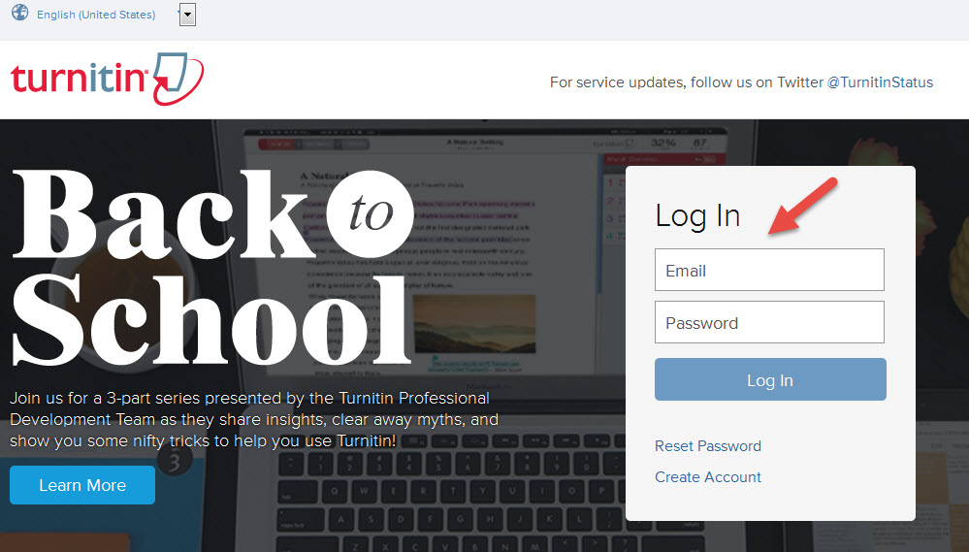
Loging to Turnitin

Slide 10
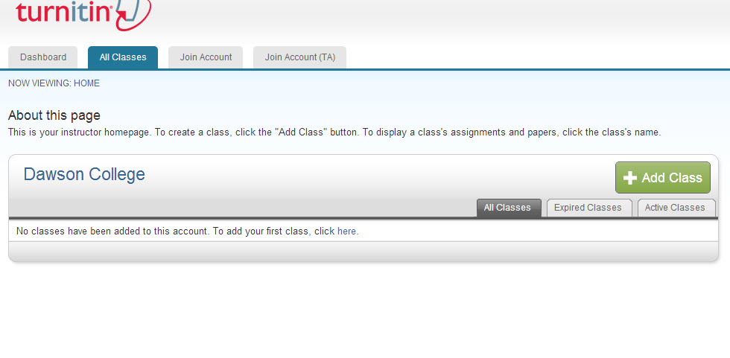
Adding Classes

Slide 11
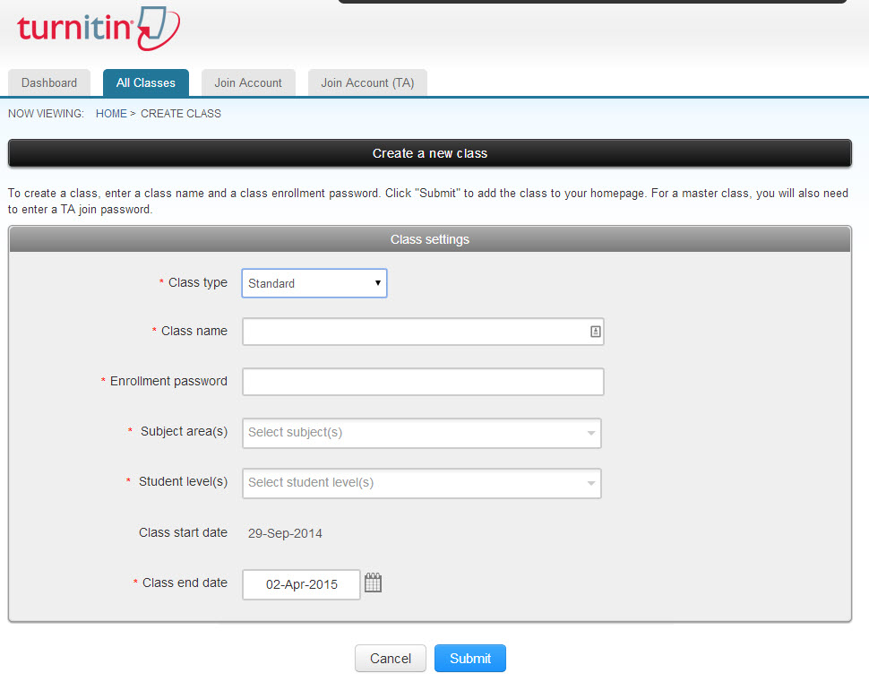
Adding Classes

Slide 12
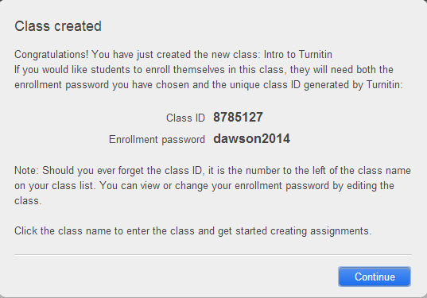
Adding Classes

Slide 13
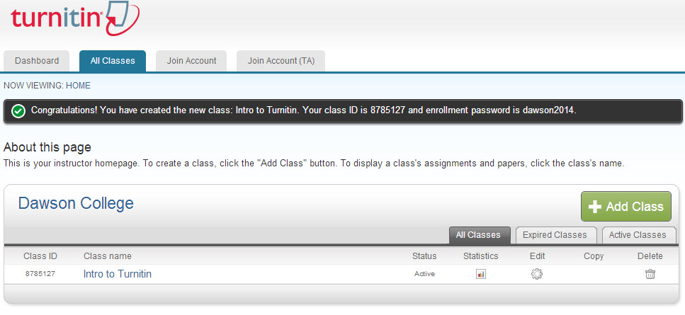
Adding Classes

Slide 14
Adding Students to a Class
2 Ways
Students enroll themselves
Teacher enrolls them manually

Slide 15
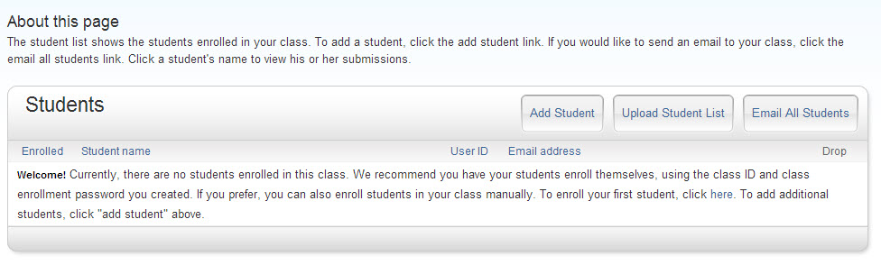
Adding Students to a Class
Manual Enrollment
One by one

Slide 16
Adding Students to a Class
Manual Enrollment
As a batch file (student list)

Slide 17
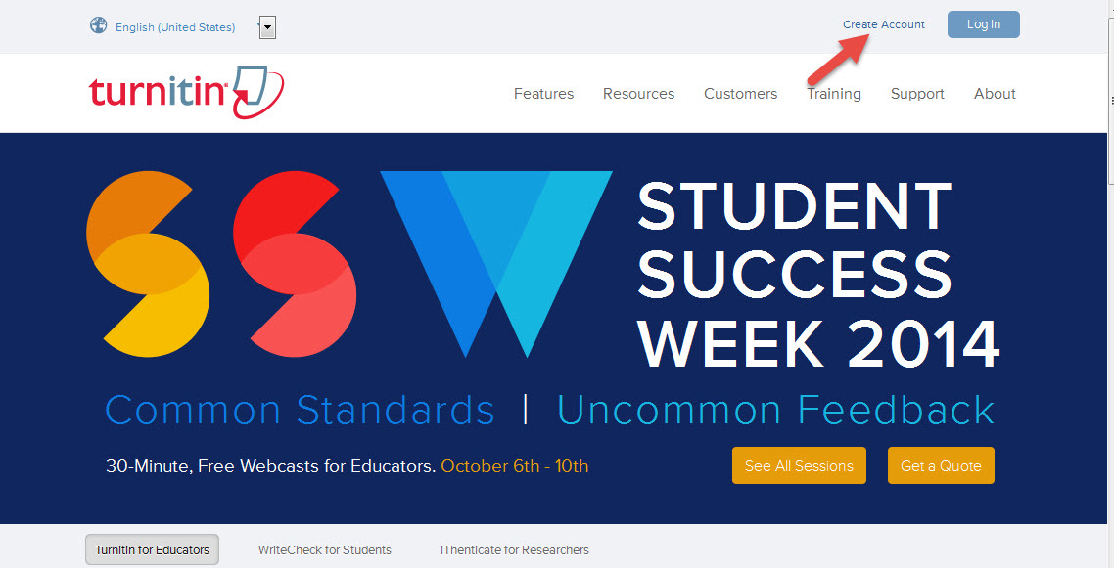
Adding Students to a Class
Students enroll themselves

Slide 18
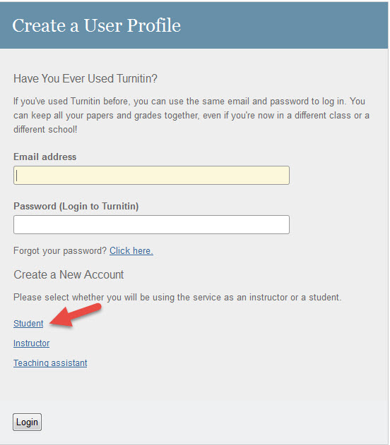
Adding Students to a Class
Students enroll themselves

Slide 19
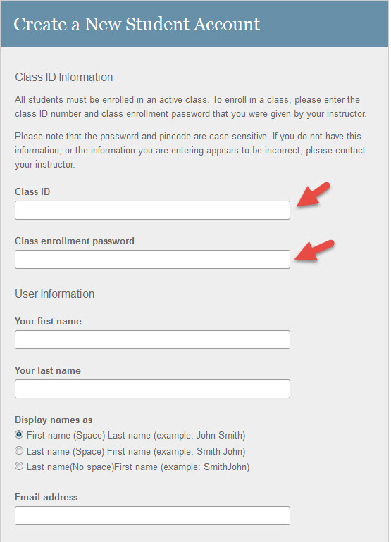
Adding Students to a Class
Students enroll themselves
Student will provide his/her email and create a password

Slide 20
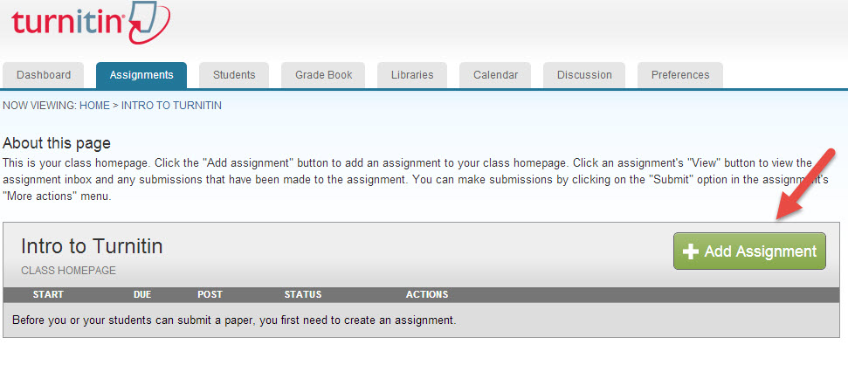
Setting Up Assignments
Select Your Course and click on it.
Then click on “Add Assignment”

Slide 21
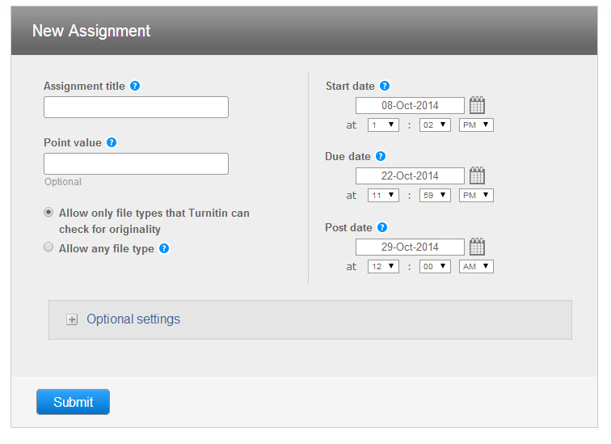
Setting Up Assignments

Slide 22
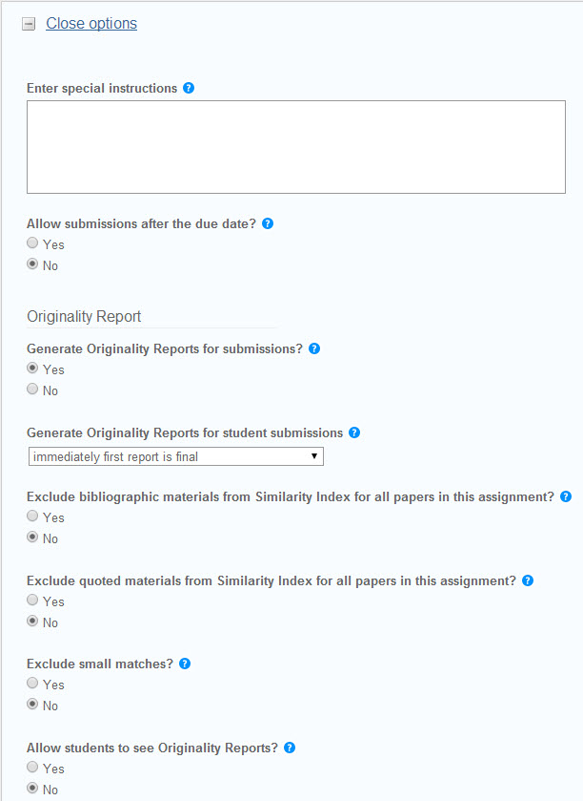
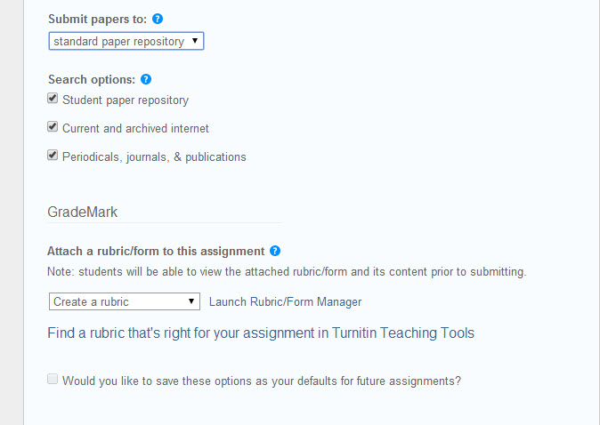
Setting Up Assignments

Slide 23
Submiting Assignments
There are 2 ways to submit an assignment
On behalf of a student
Students submit their own assignments

Slide 24
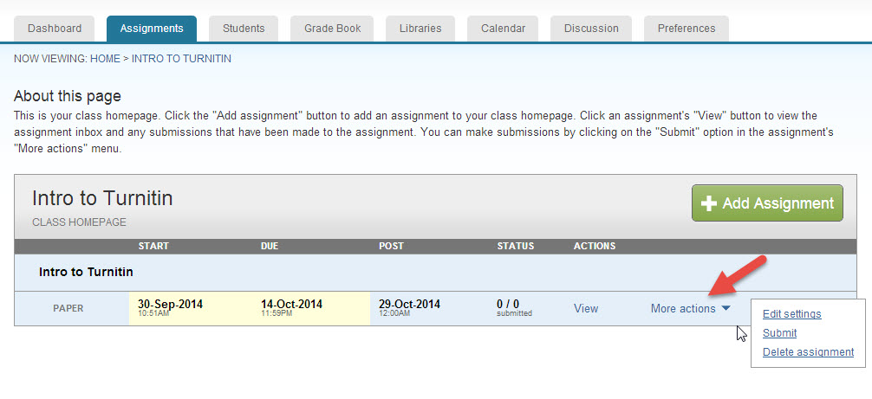
Submiting Assignments
On Behalf of a Student

Slide 25
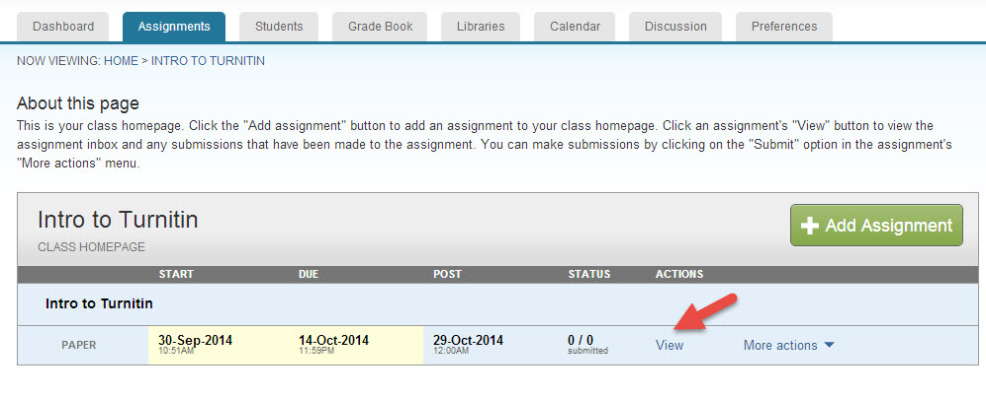
Submiting Assignments
On Behalf of a Student

Slide 26
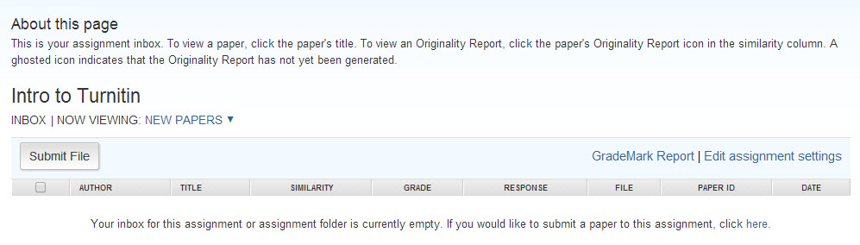
Submiting Assignments
On Behalf of a Student

Slide 27
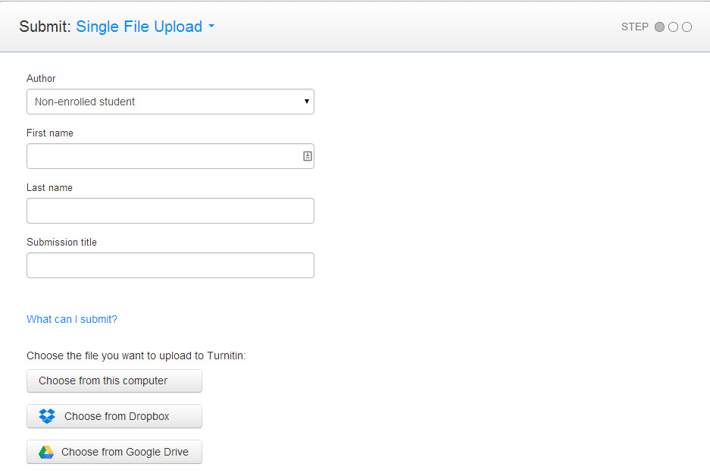
Submiting Assignments
On Behalf of a Student

Slide 28
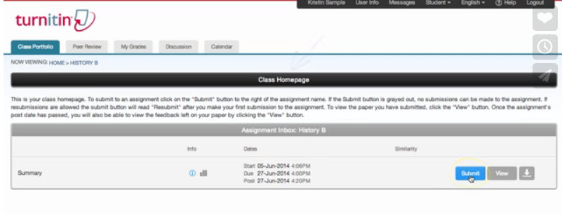
Submiting Assignments
Student Submission
Class Homepage and click “Submit”

Slide 29
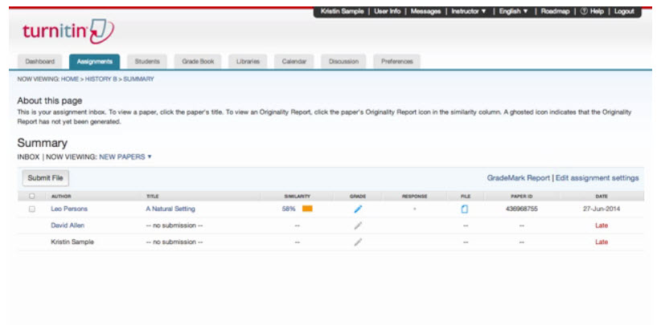
Reading Originality Reports
Student Name
File was submitted?
Similarity
Grade
Date submitted

Slide 30
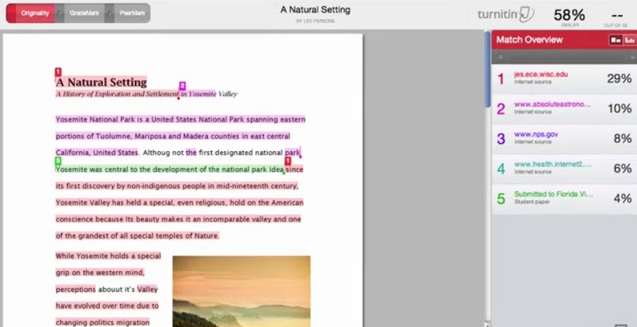
Reading Originality Reports

Slide 31
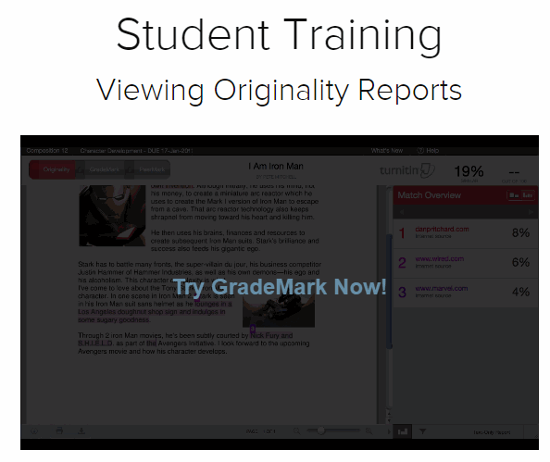
Understanding Originality Reports
http://turnitin.com/en_us/training/student-training/viewing-originality-reports

Slide 32
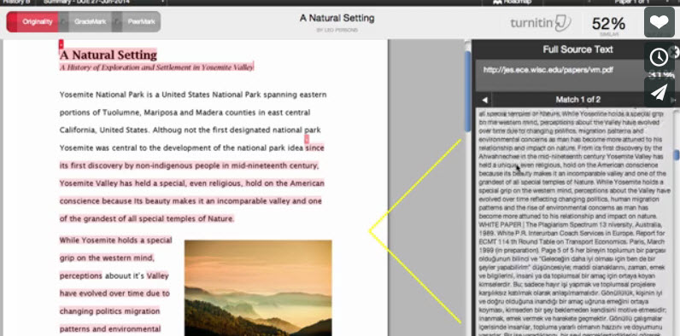
Reading Originality Reports
Check the original source

Slide 33
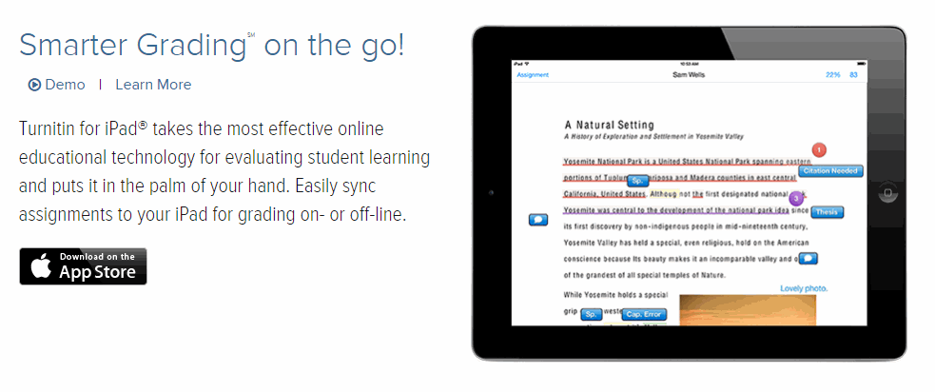
Using Turnitin
iPad Integration

Slide 34
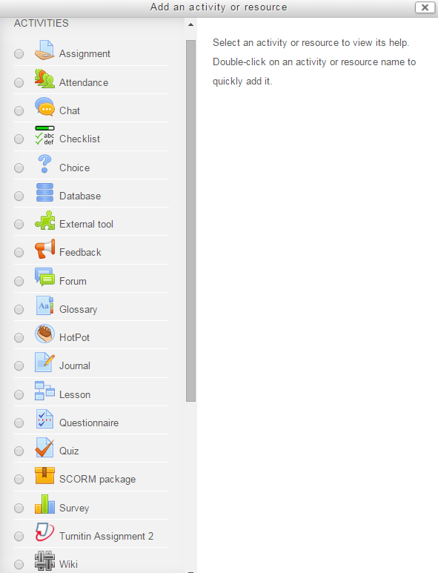
Using Turnitin in Moodle

Slide 35
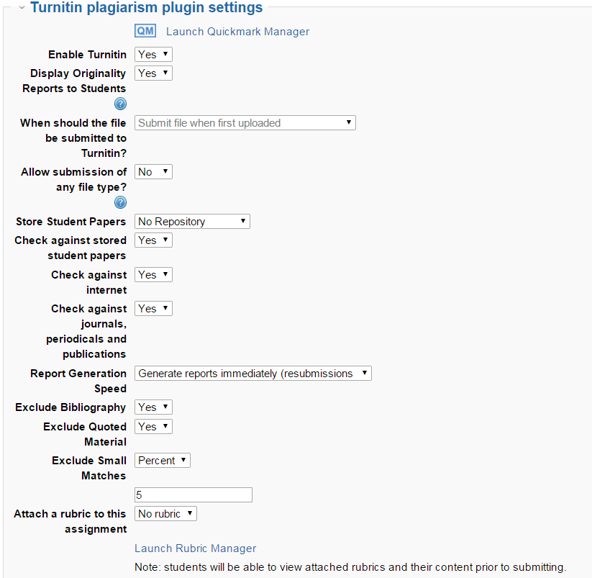
Using Turnitin in Moodle
Turnitin option on a regular Moodle assignment

Slide 36
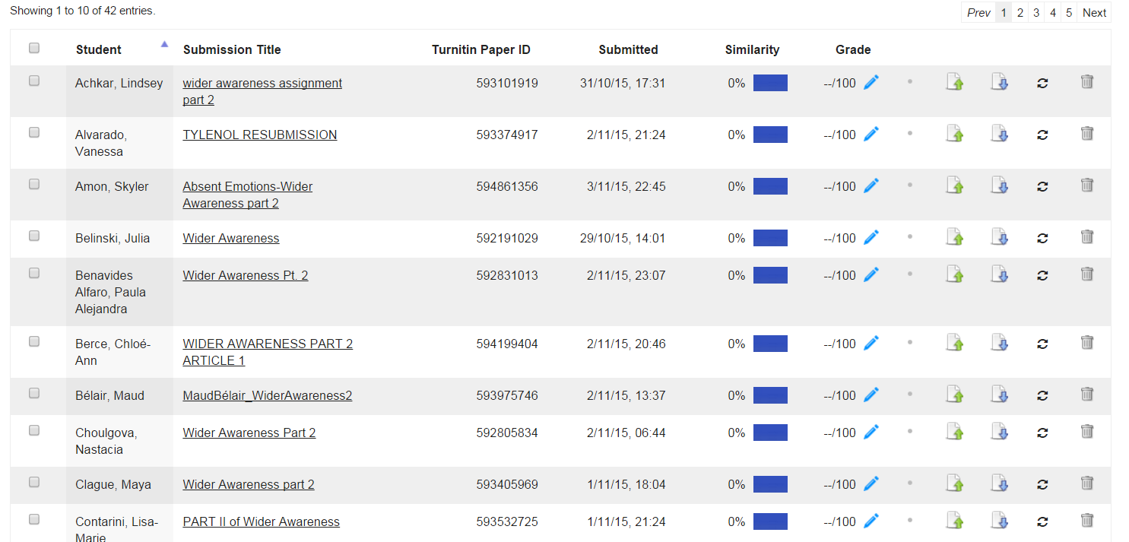
Using Turnitin in Moodle
Turnitin Assignment Plugin

Slide 37
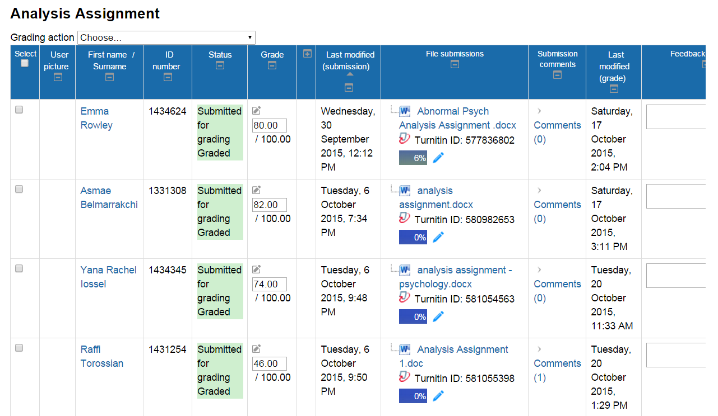
Using Turnitin in Moodle
Regular Assignment using Turnitin in Moodle

Slide 38
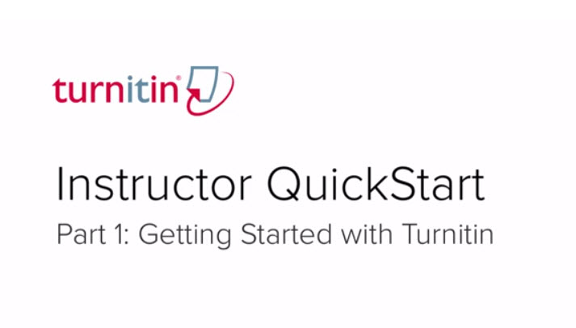
Training Videos
http://turnitin.com/en_us/training/instructor-training

Slide 39

Questions

Slide 40


Turnitin Accounts
Karina D’Ermo (OID)
kdermo@dawsoncollege.qc.ca
1405

Slide 41
Contact Me
Rafael Scapin, Ph.D.
rscapin@dawsoncollege.qc.ca
1404
Schedule a One-on-one Meeting:
http://rscapin.youcanbook.me

Slide 42


