Slide 1
Retail Crisis?
Aaron – Muhlis – Megan - Christy

Slide 2
Finding & Cleaning
Finding
US Census Bureau (https://www.census.gov/retail/index.html)
Year by year data
Cleaning
The woes of yearly data
Merging files into usable dataframes
Notes:
Time spent gathering information 5 hours

Slide 3
Exploring the Context
The starter questions:
Have sales decreased?
How many stores have closed?
How many employees let go?
Where to go from there

Slide 4
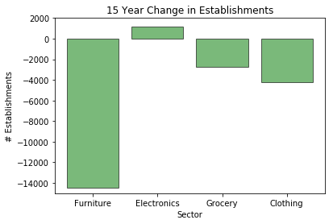
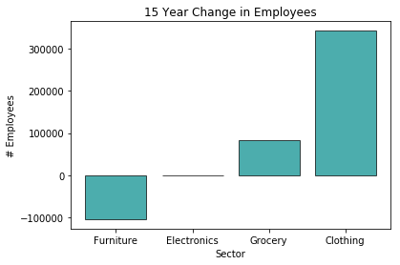
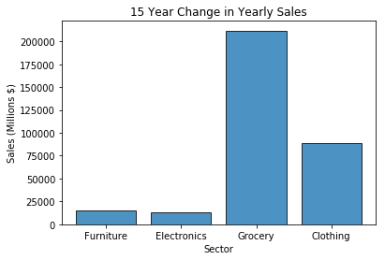

Slide 5
What happened over time?
We looked at the changing sales, employee count, and number of establishments over a 15 year period.
We were interested to see how each sector made adjustments to their business over this period.

Slide 6
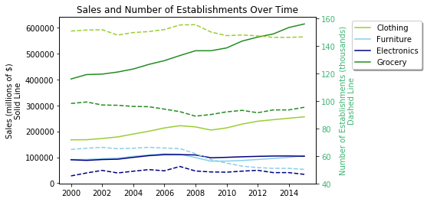

Slide 7
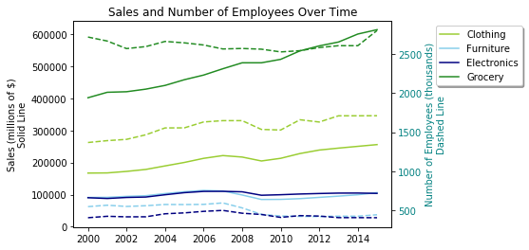

Slide 8
Drastic changes?
We looked at a few benchmark years to see the highs and lows over this period.
We hoped to see when and how big of a change occurred in employees and establishments during the beginning, peak, and end of our dataset.

Slide 9
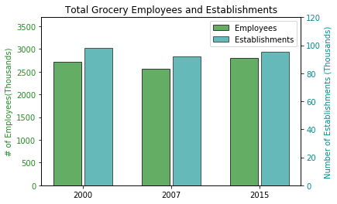
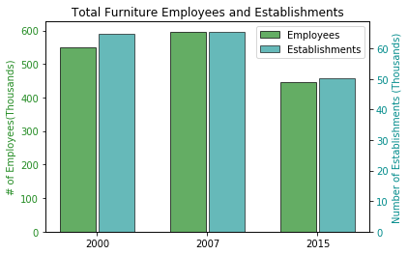
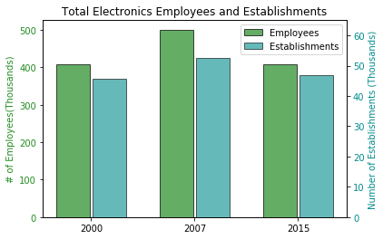
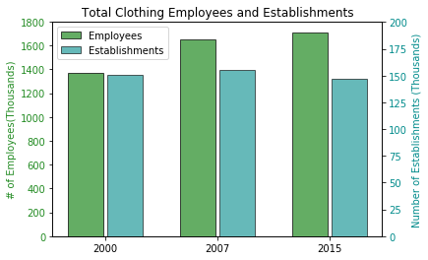

Slide 10
Adapting Companies
How did these companies adjust to keep revenue up?
We wanted to see if different sectors reacted differently and who had more success

Slide 11
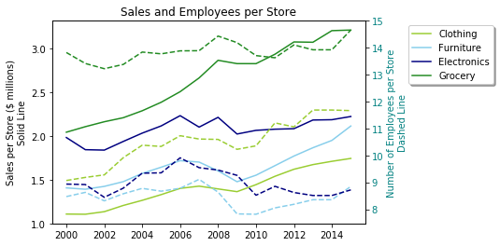

Slide 12
Conclusion
Cutting excess stores
Not necessarily firing lots of employees only one lost employees, all lost firms
Perceived disappearance of retailers not an accurate reflection on health of industry

