Slide 1
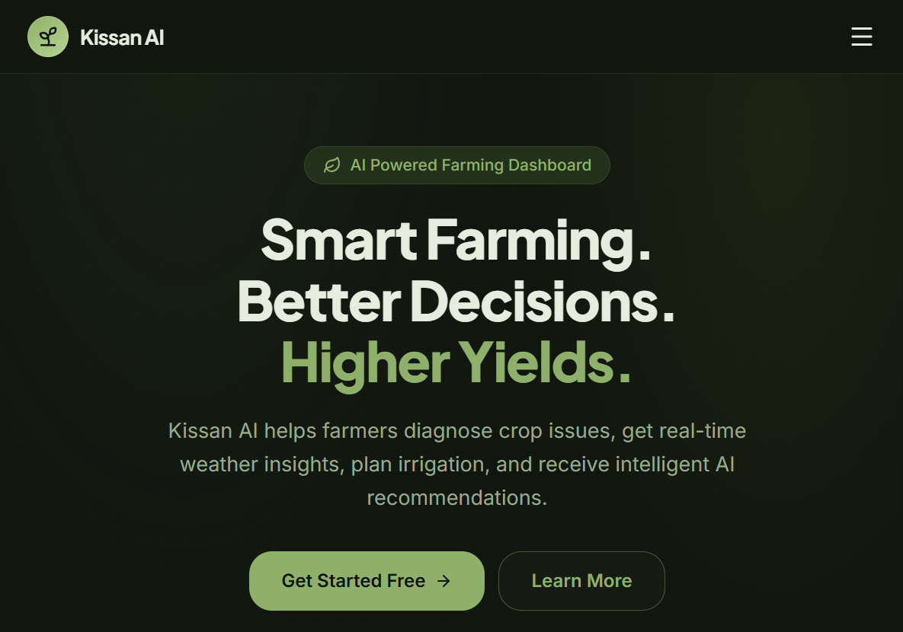
Kissan AI
Final year project · 2026
● Urdu-first · Offline-tolerant · Built for smallholders
Farming advice
that speaks
your language.
An AI assistant that turns a crop photo, today's weather and the farm's own records into one clear next step — in Urdu or English.
Presented by Muhammad Adeel Live kissan-ai-six.vercel.app
Kissan AI · pitch
1 / 14
Notes:
ASSALAM-O-ALAIKUM. I'm Muhammad Adeel, and this is Kissan AI — an AI farming assistant built for smallholder farmers in Pakistan.
The one-line version: farming advice that speaks your language. Not just translated into Urdu — designed in Urdu from the first screen.
([25 s] Point at the live URL. Say it's deployed, not a mock-up.)

Slide 2
Kissan AI
The problem
A farmer makes dozens of decisions a season, with nobody to ask.
Advice is scattered
Risk stays invisible
Pesticide shop, YouTube, neighbours, the extension officer who visits twice a year. Nobody agrees.
Heat, frost, untimely rain and disease pressure are only noticed after the damage is done.
Diagnosis costs a trip
English-only tools exclude
A sick leaf means a photo, a journey and a wait — so most farmers guess, or over-spray.
The people who farm are least served by apps written for a different user in a different language.
The information exists. It just never reaches the farmer in a form they can use, in a language they read.
Kissan AI · pitch
2 / 14
Notes:
A farmer makes dozens of decisions in a season: when to water, when to spray, what's wrong with this leaf, is the weather about to ruin everything.
Four things make that hard. Advice is scattered across the pesticide shop, YouTube, neighbours and an extension officer who visits twice a year. Risk is invisible until the damage is done. A proper diagnosis costs a photo, a journey and a wait — so most people guess, or over-spray. And almost every agri-app is English-first, which excludes exactly the people who farm.
The information exists. It just never reaches the farmer in a form they can use.
([50 s])

Slide 3
Kissan AI
The solution
One app. Ten jobs. Two languages that actually matter.
Crop Doctor
AI Assistant
Weather
Irrigation
Risk alerts
Photo → diagnosis
Chat + voice
7-day + impact
When and how much
Before the damage
Today's actions
Yield
Crop calendar
Expenses
Farm profile
Prioritised list
Estimate + factors
Sow → harvest
Cost per season
Soil, water, crop
25+
2
10
0
crops recognised
UI languages, full RTL
serverless AI functions
API keys in the browser
Built for a phone, in the field, on a weak connection.
Kissan AI · pitch
3 / 14
Notes:
So we put ten jobs in one app: crop diagnosis, an AI assistant with voice, weather, irrigation, risk alerts, today's actions, yield, crop calendar, expenses and a farm profile.
Two languages that matter — Urdu and English — with full right-to-left layout.
And it runs on a phone, in the field, on a weak connection.
([45 s] Don't read all ten cards. Sweep your hand across them.)

Slide 4
Kissan AI
Live demo · 1 of 6
The whole farm
on one screen.
Today's weather and the 7-day outlook — in one glance
Crop stage, farm health and active risks
Irrigation due, recent diagnoses, tasks for today
Everything the AI needs, already on the page
Dashboard
paste screenshot as slides/img/02-dashboard.png
Kissan AI · pitch
4 / 14
Notes:
This is the whole farm on one screen. Today's weather and the week ahead, the crop and its stage, farm health, active risks, when irrigation is due, and recent diagnoses.
Everything the AI needs to answer a question is already here — which is why the answers sound like they're about THIS farm, not farms in general.
([40 s])

Slide 5
Kissan AI
Live demo · 2 of 6
Photo in. Diagnosis out — in Urdu.
Camera or gallery → compressed upload
Vision model returns severity, confidence, causes, actions, caveats
Saved to history so the farm remembers
Language checked server-side, not left to the model's mood
Crop Doctor result (capture in Urdu)
paste screenshot as slides/img/03-crop-doctor.png
Kissan AI · pitch
5 / 14
Notes:
This is the part people react to. You take a photo of a sick leaf, and you get a diagnosis: what it probably is, how severe, how confident, why it happened, what to do — and what not to assume.
Notice it's in Urdu, and the advice is a smallholder's advice: what you can actually afford and safely do.
Two things I want to highlight. First, it's saved to history, so the farm remembers. Second — the language isn't left to the model's mood. The server checks the script of every field and repairs it if the model drifts back to English.
([55 s — pause and let the panel read the Urdu.])

Slide 6
Kissan AI
Live demo · 3 of 6
Ask it the way
you'd ask a neighbour.
Answers grounded in this farm: crop, stage, soil, water, weather, risks
Type or hold the mic — speech in, speech out
Reply is read aloud, including key points and next steps
'What should I do today?' works in Urdu and English
AI Assistant
paste screenshot as slides/img/04-assistant.png
Kissan AI · pitch
6 / 14
Notes:
You can just ask. 'What should I do today?' or 'meri fasal ke liye aaj kya karna chahiye?'
It answers using the farm's own data — crop, stage, soil, water, weather, risks — and it can read the answer aloud, including key points and next steps, so a farmer who can't read comfortably can still use it.
([45 s] If live: one short spoken question. Have a typed fallback ready.)

Slide 7
Kissan AI
Live demo · 4 of 6
Irrigate on evidence,
not on habit.
Forecast from Open-Meteo — no key, no billing, no lock-in
Weather translated into farming impact, not just degrees
Irrigation advice uses soil type, method, crop stage and recent rain
Every recommendation says why, so it can be trusted
Weather / Irrigation
paste screenshot as slides/img/05-weather.png
Kissan AI · pitch
7 / 14
Notes:
Weather is the easy part — forecast from Open-Meteo, no key, no billing. The useful part is what we do with it: every forecast is translated into farming impact, not just degrees.
Irrigation combines that with soil type, irrigation method, crop stage and recent rain, and tells you when to water and roughly how much — and it explains why, so you can trust it.
([40 s])

Slide 8
Kissan AI
Live demo · 5 of 6
Know what's coming.
And what to do about it.
Heat, frost, rain, wind, pest and disease windows
Each alert explains the trigger and the window
Today's Actions turn everything into a short, ordered list
One screen the farmer can act on in 60 seconds
Risks / Today's Actions
paste screenshot as slides/img/06-risks.png
Kissan AI · pitch
8 / 14
Notes:
The risk screen looks ahead: heat, frost, rain, wind, pest and disease windows. Every alert tells you what triggered it and when the window is.
Then Today's Actions turns all of it into a short ordered list — ideally one screen the farmer can act on in under a minute.
([35 s])

Slide 9
Kissan AI
Live demo · 6 of 6
Plan the season.
And the money.
Yield estimate with the factors behind it — not a magic number
Costs tracked by category across the season
Sowing → harvest calendar tied to the real crop stage
Comparisons that make the next season cheaper
Yield / Expenses
paste screenshot as slides/img/07-yield.png
Kissan AI · pitch
9 / 14
Notes:
Finally, the season and the money. Yield gives an estimate WITH the factors behind it — not a magic number. Expenses track cost by category across the season, and the calendar ties sowing to harvest using the real crop stage.
The point is the next season being cheaper and better planned than this one.
([35 s])

Slide 10
Kissan AI
Design decision
Urdu isn't a translation layer.
It's the product.
Real RTL, not flipped
Typography that stays readable
AI follows the UI
Logical spacing and alignment throughout, so layouts mirror correctly instead of breaking.
Noto Sans Urdu for UI at 12–16 px; no root font scaling, so nothing overflows.
Diagnosis and chat answer in the selected language — verified on the server.
UI · ENGLISH
What should I do today?
UI · URDU
آج کیا کرنا ہے؟
AI · URDU
آلو کے پتوں پر دھبے دیر سے جھلسنے کی علامت ہیں۔
Every key exists in both dictionaries, and a test fails the build if English and Urdu drift apart.
Kissan AI · pitch
10 / 14
Notes:
I want to spend a slide on the decision I'm proudest of, because it's the one most teams skip.
Urdu isn't a translation layer here — it's the product. Real right-to-left layout using logical properties, so screens mirror instead of breaking. Noto Sans Urdu for the UI, because Nastaliq is beautiful but unreadable at 13 pixels. And the AI answers in the language the app is set to, enforced on the server.
There's also a test that fails the build if English and Urdu ever drift apart. [Point at the Urdu strip.] That's the product, not a translation of it.
([45 s])

Slide 11
Kissan AI
How it works
A small stack with nothing to babysit.
CLIENT
React 18 TypeScript Vite 7 Tailwind 4 Radix UI Recharts Vercel
▼
BACKEND
Supabase Postgres Row Level Security Auth Storage 7 tables
▼
EDGE FUNCTIONS
analyze-crop chat-assistant assess-risks irrigation-advisor today-actions recommend-crops get-weather speak-answer sarvam-stt whisper-stt
▼
AI & DATA
Gemini — vision, text, speech OpenRouter fallback Open-Meteo forecast
Secrets live only in Edge Function env vars. The browser never sees a model key.
Kissan AI · pitch
11 / 14
Notes:
The stack is deliberately boring. React, TypeScript, Vite and Tailwind on the client; Supabase for Postgres, auth, storage and row-level security; ten Deno edge functions for anything that needs a secret; Gemini for vision, text and speech, with OpenRouter as a fallback; Open-Meteo for weather, which is free and needs no key.
The browser never sees an API key. That was a hard rule from day one.
([50 s])

Slide 12
Kissan AI
Engineering choices
AI where it helps. Deterministic code where it matters.
1
2
Rules, not guesses
The model only does language
Growth stage, risk scoring, irrigation and yield are plain TypeScript engines. Same input, same answer — explainable, testable, free.
Gemini reads the photo and writes the sentence. It never decides the risk score or the watering amount.
3
4
Language is enforced server-side
Degrade, don't fail
Prompt + schema hints + a script check on every field, with a repair pass if the model drifts back to English.
Rate-limited model → second provider. Weather source down → cached view. Missing data → the UI says so.
Kissan AI · pitch
12 / 14
Notes:
Here's the design decision that makes the rest work.
Anything that must be right is deterministic code, not a model. Growth stage, risk scoring, irrigation amounts and yield are plain TypeScript engines — same input, same answer, explainable, testable, and free.
The model only does language: reading the photo and writing the sentence. It never decides the risk score or the watering amount.
And because models drift, the language is enforced server-side: prompt, schema hints, a script check on every field, and a repair pass if the output comes back in the wrong language.
([60 s — this is where technical judges decide whether you built or assembled.])

Slide 13
Kissan AI
Quality & security
Boring on purpose.
76
100%
10
0
automated tests
tables behind RLS
JWT-verified functions
secrets shipped to users
Every table is row-level secured — one farmer never sees another's farm
Function calls are JWT-verified, with an explicit CORS allow-list
Typecheck and production build gate every change; tests cover engines, i18n parity and voice
No placeholder numbers in the UI: when data is missing, it says so
Kissan AI · pitch
13 / 14
Notes:
76 automated tests, every table behind row-level security, every function JWT-verified, and typecheck plus a production build gating changes.
And no placeholder numbers in the interface: when data is missing, the screen says so instead of inventing it.
([40 s])

Slide 14
Kissan AI
Impact · Roadmap · Ask
Built and shipped.
Now it needs farmers.
Next: reach
Next: offline
Next: trust
SMS and IVR for feature phones — no smartphone, no data plan required.
Cache today's advice and the crop calendar so the field has no dead zones.
An agronomist review loop that audits AI diagnoses and feeds corrections back.
The ask
Why it can work
A pilot with 25–50 farmers this season, and mentorship on turning the prototype into a service they keep using after harvest.
Free-tier infrastructure, a model-agnostic backend and Urdu-first design mean each extra farmer costs almost nothing.
Thank you. Questions — and an Urdu demo — welcome.
Kissan AI · pitch
14 / 14
Notes:
So: it's built, it's deployed, and it's in Urdu.
What it needs now is farmers. My ask is a pilot with 25 to 50 farmers this season, and mentorship on turning this prototype into something they keep using after harvest.
Thank you — happy to take questions, and happy to demo in Urdu.
([35 s] End with the ask, not 'that's all'.)

