Slide 1

Home | About | Distribution Channels | Our Brands | Retail Partners | Capabilities | Contact Us
“Pioneering Beauty and Health Solutions Throughout the Middle East”
Interactive map highlighting: UAE (Nutripharm LLC), Bahrain (Nutripharm WLL), Kuwait, Oman, KSA, and Qatar.
Clicking on each country should provides details about local distribution partners in each country

Slide 2
Home | About | Distribution Channels | Our Brands | Retail Partners | Capabilities | Contact Us
About Us
Established in 2006, Nutripharm LLC charted its initial course in the domain of pharmacy distribution. With a keen sense of market dynamics, we soon expanded our horizons, stepping into modern trade, specialty channels, and travel retail. Anticipating the digital revolution, we made our foray into e-commerce, ensuring that our diverse product range was accessible to a broader audience.
Further diversifying, we embraced the beauty professional channel and established our presence in premium beauty stores. We widened our geographical reach, establishing a formidable presence across the GCC countries. This growth was powered by our proficient sales and marketing team, known for their market acumen and dedication. With in-house resources and a robust logistical framework, Nutripharm became the go-to partner for international brands seeking a reliable footprint in the Middle East.
Today, as we look back at our journey of nearly two decades, we are filled with gratitude and pride. Representing leading international brands, we are committed to bringing only the best to our partners and customers. Our journey symbolizes our passion for innovation, our collaborative spirit, and our undying commitment to service excellence. At Nutripharm, we don't just distribute products; we build lasting relationships.
Mission: At Nutripharm LLC, our mission is to seamlessly connect the world's most reputable health and beauty brands with the diverse and dynamic markets of the Middle East. We pledge to provide unparalleled distribution services rooted in efficiency, authenticity, and innovation.
Vision: To be the Middle East's foremost distribution partner, recognized for our unwavering commitment to excellence, our ability to anticipate market needs, and our capacity to forge enduring partnerships.
Values:
Integrity: At the heart of our operations lies an uncompromising commitment to honesty and transparency.
Innovation: We believe in continuously evolving, embracing new technologies, and pioneering strategies that set us apart.
Collaboration: Our strength lies in the relationships we build - with brands, partners, and consumers alike.
Excellence: We set the bar high in every endeavor, driven by our passion for unparalleled service and results.
Sustainability: In our pursuit of growth, we remain steadfast in our commitment to environmental responsibility and community well-being.

Slide 3
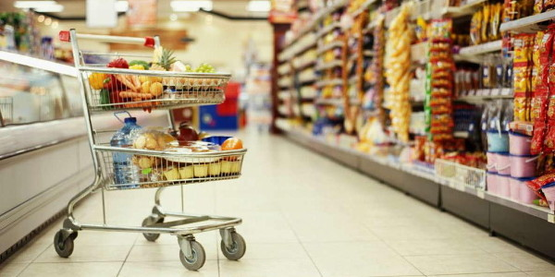

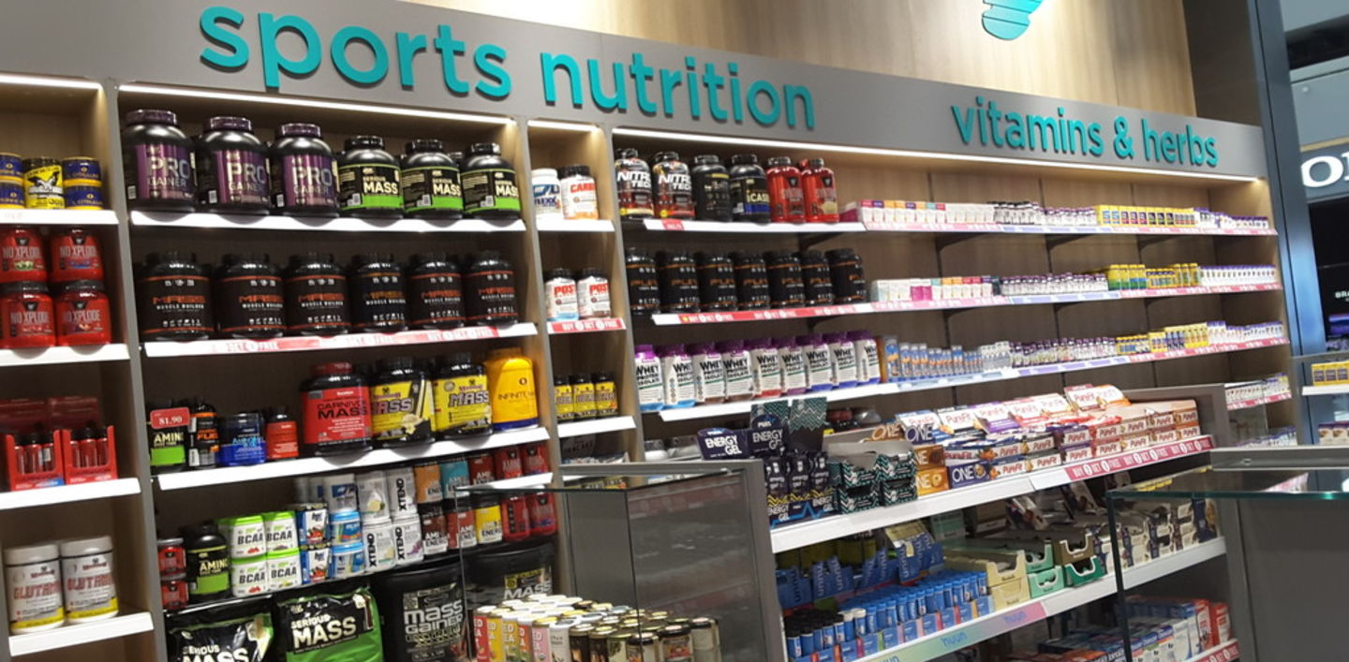
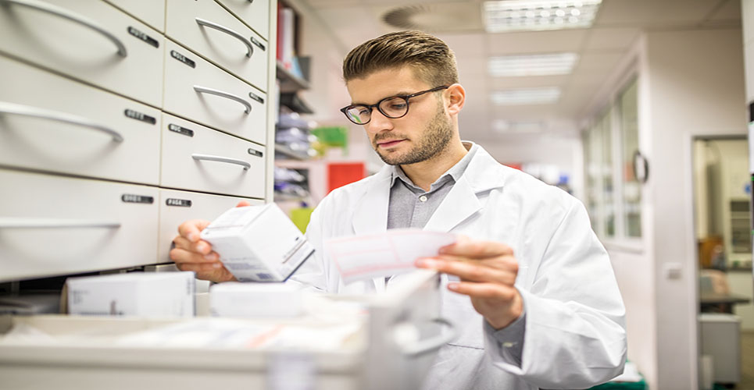
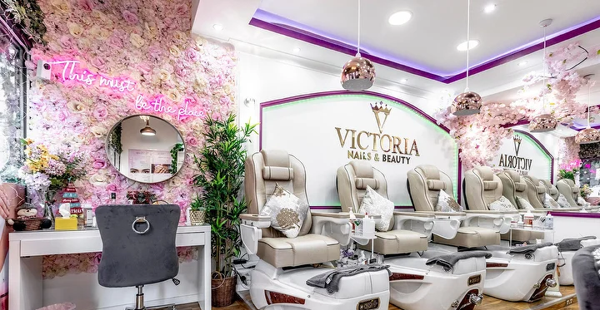
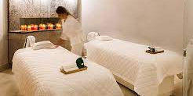
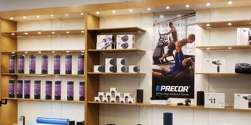

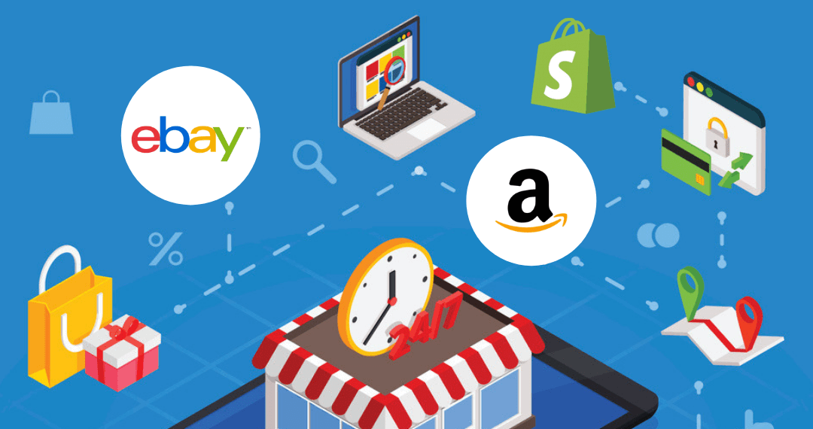
Home | About | Distribution Channels | Our Brands | Retail Partners | Capabilities | Contact Us
MODERN TRADE
PHARMACY TRADE
SPECIALITY TRADE
CLINICS & HOSPITALS
SALONS
SPAS
GYMS
PREMIUM STORES
ECOMMERCE TRADE

Slide 4
Home | About | Distribution Channels | Our Brands | Retail Partners | Capabilities | Contact Us
SUNSHINE
OGX
SOLGAR
MARC ANTHONY
GARDEN OF LIFE
TRISTER
MAUI MOISTURE
TRADITIONAL MEDS
BIOMAGIC
MUSCLE CORE
BEAUTY FORMULAS
TREE HUT
PURE PROTEIN
PURE ESEENTIAL
DR. PAWPAW
PHARMACERIS
SUKIN
DIFEEL
EVELINE
GIOVANNI
FAITH IN NATURE
EARTHS FINEST
WEDDERSPOON
PETAL FRESH PURE
LEE STAFFORD
ADERMA
ORGANIC TRADITIONS
ATTENDS
DR.ORGANIC
BETTERBODY FOODS
SOSKIN
BIO BALANCE
AVALON
NATURES AID LTD
COLGATE
RULE 1
NUTRITIONL
YOUTHEORY
BIO NUTRITION
KIKI
WESTLAB
RAPID FIRE
MERIDOL
NATURES PLUS
SWATI
ANDALOU
KYOLIC
OM MUSHROOM
BIOLANE
In Logo- By clicking logos, it should lead to the brand-specific pages or external brand websites- without prices .

Slide 5

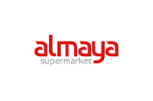







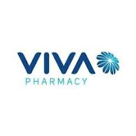










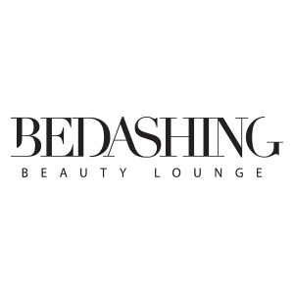


Home | About | Distribution Channels | Our Brands | Retail Partners | Capabilities | Contact Us
Retail partners are not complete – Rochelle will provide the complete list & it need to be separated channel wise

Slide 6
Home | About | Distribution Channels | Our Brands | Retail Partners | Capabilities | Contact Us
Tailored Sales & Marketing: Our specialized sales and marketing team stands out with its tailored strategies and market insights. Combining years of experience with a passion for the industry, they drive growth and foster relationships that last.
Warehouse Facility: Our state-of-the-art, 200K sq. ft temperature-controlled warehouse is purposefully designed to uphold the integrity of premium beauty products. Every space and system is optimized to ensure safe storage and easy access.
Delivery Vehicles: Boasting a fleet of 100+ temperature-controlled vehicles, we guarantee that products maintain their quality throughout the delivery process. Every vehicle is equipped and maintained to provide reliable and efficient transportation.
Premium Beauty Distribution Network: Nutripharm's extensive network reaches the crème de la crème of beauty salons and spas. Our collaborations extend our reach, ensuring that premium brands find their place in the region's most esteemed establishments.
Dedicated Brand Managers & Executives: Leading our brand partnerships are seasoned professionals dedicated to upholding brand values and maximizing market presence. Their expertise is pivotal in aligning strategies and ensuring mutual growth.
In-House Marketing Team: In the dynamic digital age, our in-house marketing team is at the forefront of online engagement. With collaborations spanning over 200+ beauty influencers and vloggers, we amplify brand voices, ensuring they resonate with the right audience.
Suggest to picturize each capabilities and on click, let it go to each resources

Slide 7
Home | About | Distribution Channels | Our Brands | Retail Partners | Capabilities | Contact Us
Customer Login for B2B Partners:
If you are an existing partner, please here to access brand decks and product lists.
Contact Form:
Name, Contact number, Email, Subject, Message.
Location Map:
Map showing Nutripharm LLC's main office.
Social Media Links:

Slide 8
Home | About | Distribution Channels | Our Brands | Retail Partners | Capabilities | Contact Us
New Trade Enquiry: Interested in partnering with Nutripharm LLC? We invite potential distributors to share their details for a fulfilling collaboration. Please fill out the form below:
New Distributor Form:
Company Details:
Full Company Name:
Address/ Contact Details (Phone/Email):
Years of Operation: Drop down menu - 1-5 years, 6-10 years, 11-20 years, 20+ years
Experience & Market Presence:
Brands Currently Being Distributed:
Years Distributing Similar Products/Brands: (Dropdown Menu: 1-5 years, 6-10 years, 11-20 years, 20+ years)
Regions of Oman You Cover: (Checkbox Options: North, South, East, West, Central)
Facilities & Logistics:
Warehouse Capabilities (sq. ft / type):
Delivery Capabilities (fleet size, coverage):
Trade Channels & Market Reach:
Channels Used for Current Brands: Dropdown – (Modern Trade, Traditional Trade, E-Commerce)
Number of Doors in Each Channel: ( for each channel)
Regulatory & Compliance:
Experience with Regulatory Processes for Beauty and Cosmetics:
Time Frame for Beauty Product Registration :
Business Plans (Three-Year Plan):
Projected Sales (Year-wise breakdown):
Marketing Strategies (Including channels and campaigns):

