Slide 1

<PROJECT TITLE>
MUHSINA
MES24MCA-2035
Department of Computer Applications
MES College of Engineering, Kuttippuram
20-AUG-2025

Slide 2
PRODUCT OWNER Ms.FEBIN AZIZ Assistant Professor DEPARTMENT OF COMPUTER APPLICATIONS MES COLLEGE OF ENGINEERING, KUTTIPPURAM

Slide 3
TABLE OF CONTENTS
Introduction
Objective
Existing System
Proposed System
Motivation
Functionalities
Module Description
Developing Environment
Sprint Backlog
Product Backlog
User Story
Project Plans
Data Flow Diagrams
ER Diagram

Slide 4
THE COMMERCIAL VEHICLE BOOKING
Booking commercial vehicles is inefficient and lacks price transparency.
An online platform to simplify commercial vehicle booking.
The service will be accessible via a website and a mobile application for user convenience.

Slide 5
Key Features:
Browse and select vehicles.
Transparent pricing for easy comparison.
Real-time vehicle availability and scheduling.

Slide 6
OBJECTIVES
Easy Booking: Create a simple platform for booking commercial vehicles.
User-Friendly: Ensure easy navigation and access to vehicle info.
Wide Selection: Maintain a large database of commercial vehicles.
Admin Tools: Develop a dashboard for managing users, drivers, and vehicles.
Self-Service for Users/Drivers: Allow users and drivers to manage their own profiles and bookings.

Slide 7
EXISTING SYSTEM
Vehicle booking is mostly done manually through phone calls or local agents
Limited visibility of available vehicles leads to booking delays
No unified platform to compare vehicle types, prices, or schedules
Manual record-keeping causes errors and inefficiencies
Lack of transparency in pricing and availability

Slide 8
PROPOSED SYSTEM
Online Platform: Connects businesses and individuals with commercial vehicle operators.
Access: Available via a website or mobile application.
Key Features:Transparent pricing, Real-time availability and scheduling, Vehicle tracking.
Benefits: Offers convenience, time savings, and cost efficiency.

Slide 9
MOTIVATIONS
This project aims to create a centralized online platform to fix the inefficient and non-transparent traditional process of booking commercial vehicles.
Enhance the user experience with a user-friendly interface for easy navigation and quick access to information.
Provide transparent pricing , real-time availability , and vehicle tracking to offer convenience, save time, and promote cost efficiency.
A key motivation was to address difficulties in project planning and creating an attractive user interface.

Slide 10
FUNCTIONALITIES
User & Driver Management:
Login & Registration: Users and drivers can create accounts and log in.
Profile Management: Users and drivers can add and update their personal details and change passwords.
User/Driver Access: Users can view information about available drivers and vehicles.

Slide 11
Vehicle & Booking Management:
Vehicle Booking: Users can search, view, select, and book commercial vehicles based on various requirements (type, capacity, location, dates).
Vehicle Management (Drivers): Drivers can add and delete their registered vehicles.
Vehicle Filtering (Users): Users can filter vehicles by type for easier access.
Admin Dashboard: An administrative interface for managing:
Vehicle inventory (add, edit, delete).
User accounts and permissions.
Booking records.

Slide 12
MODULE DESCRIPTION
User Module: Manages user accounts and allows users to browse, book, and view commercial vehicles.
Driver Module: For vehicle operators to register, log in, add or delete vehicles, and manage their bookings and profile.
Admin Module: Provides a dashboard for administrators to manage users, drivers, vehicle inventory, and bookings.

Slide 13
DEVELOPING ENVIRONMENT
Framework: Django.
Front End: Templates from Colorlib and Bootstrapdash.
Back End: Python with the Django framework.
Database: A relational database is used to manage user, driver, vehicle, booking, and payment data.
Libraries:
Django Jazzmin:Improves the Django admin's look and navigation.
Pillow: Processes images, enabling resizing and cropping.
IDE:VS Code

Slide 14
SPRINT BACKLOG
Backlog tem | Status And Completion Date | Original Estimation in Hours | Day 1 hrs | Day 2 hrs | Day 3 hrs | Day 4 hrs | Day 5 hrs | Day 6 hrs | Day 7 hrs | Day 8 hrs | Day 9 hrs | Day 10 hrs
SPRINT1
Table designing | 16/8/2022 | 2 | 1 | 1 | 0 | 0 | 0 | 0 | 0 | 0 | 0 | 0
Form designing | 22/8/2022 | 3 | 1 | 1 | 1 | 0 | 0 | 0 | 0 | 0 | 0 | 0
Coding | 27/8/2022 | 3 | 1 | 1 | 1 | 0 | 0 | 0 | 0 | 0 | 0 | 0
SPRINT 2
Data collection | 13/9/2022 | 7 | 1 | 1 | 1 | 1 | 1 | 1 | 1 | 0 | 0 | 0
Data processing | 29/9/2022 | 7 | 1 | 1 | 1 | 1 | 1 | 1 | 1 | 0 | 0 | 0
The table given above is for reference only. Update/create a table with your data.

Slide 15
SPRINT BACKLOG
Backlog tem | Status And Completion Date | Original Estimation in Hours | Day 1 hrs | Day 2 hrs | Day 3 hrs | Day 4 hrs | Day 5 hrs | Day 6 hrs | Day 7 hrs | Day 8 hrs | Day 9 hrs | Day 10 hrs
SPRINT3
Course contents | 3/10/2022 | 7 | 1 | 1 | 1 | 1 | 1 | 1 | 1 | 0 | 0 | 0
Assassement | 20/10/2022 | 7 | 1 | 1 | 1 | 1 | 1 | 1 | 1 | 0 | 0 | 0
SPRINT 4
Certificate | 8/11/2022 | 7 | 1 | 1 | 1 | 1 | 1 | 1 | 1 | 0 | 0 | 0
Testing | 15/11/2022 | 7 | 1 | 1 | 1 | 1 | 1 | 1 | 1 | 0 | 0 | 0
TOTAL |  | 50 | 9 | 9 | 8 | 6 | 6 | 6 | 6
The table given above is for reference only. Update/create a table with your data.

Slide 16
PRODUCT BACKLOG
ID | NAME | PRIORITY <high/medium/low> | ESTIMATE (Hours) | STATUS <Planned/In progress/Completed>
1 | REGISTRATION | High | 5 | COMPLETED
2 | LOGIN | High | 5 | COMPLETED
3 | CRUD(Course,Student,University) OPERATIONS | High | 20 | COMPLETED
4 | STUDENT ENROLLMENT | High | 10 | COMPLETED
5 | CERTIFICATE GENERATION | MEDIUM | 10 | COMPLETED
The table given above is for reference only. Update/create a table with your data.

Slide 17
USER STORY
User Story ID | As a type of User | I want to <Perform some task> | So that i can <Achieve Some Goal>
1 | ADMIN | Login | login successful with correct username and password
2 | ADMIN | View and Manage | Can view and Manage registered users,Faculties and Universities
3 | ADMIN | Verification | Verify Courses
4 | USER | Register | Can users register
5 | USER | Login | login successful with correct username and password
6 | USER | Enrollment | Can enroll in any Courses
7 | USER | View Profile | View users profile in application
The table given above is for reference only. Update/create a table with your data.

Slide 18
PROJECT PLAN
User StoryID | Task Name | Start Date | End Date | Days | Status
1 | Sprint 1 | 16/08/2022 | 17/08/2022 | 10 | Completed
4 |  | 18/08/2022 | 19/08/2022 |  | Completed
5 |  | 20/08/2022 | 22/08/2022 |  | Completed
10 |  | 23/08/2022 | 24/08/2022 |  | Completed
11 |  | 25/08/2022 | 27/08/2022 |  | Completed
2 | Sprint 2 | 13/09/2022 | 23/09/2022 | 16 | Completed
7 |  | 23/09/2022 | 24/09/2022 |  | Completed
12 |  | 24/09/2022 | 29/09/2022 |  | Completed
The table given above is for reference only. Update/create a table with your data.

Slide 19
PROJECT PLAN
User StoryID | Task Name | Start Date | End Date | Days | Status
3 | SPRINT 3 | 03/10/2022 | 06/10/2022 | 14 | Completed
6 |  | 07/10/2022 | 10/10/2022 |  | Completed
13 |  | 13/10/2022 | 20/10/2022 |  | Completed
14 | SPRINT 4 | 28/10/2022 | 5/11/2022 | 10 | Completed
8 |  | 7/11/2022 | 11/11/2022 |  | Completed
9 |  | 13/11/2022 | 15/11/2022 |  | Completed
The table given above is for reference only. Update/create a table with your data.

Slide 20
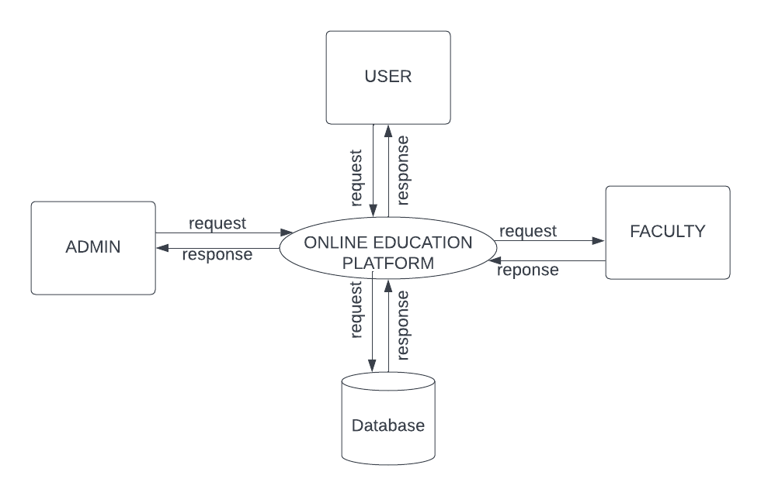
DATA FLOW DIAGRAM
LEVEL 1
The figure given above is for reference only. Create a figure with your data.

Slide 21
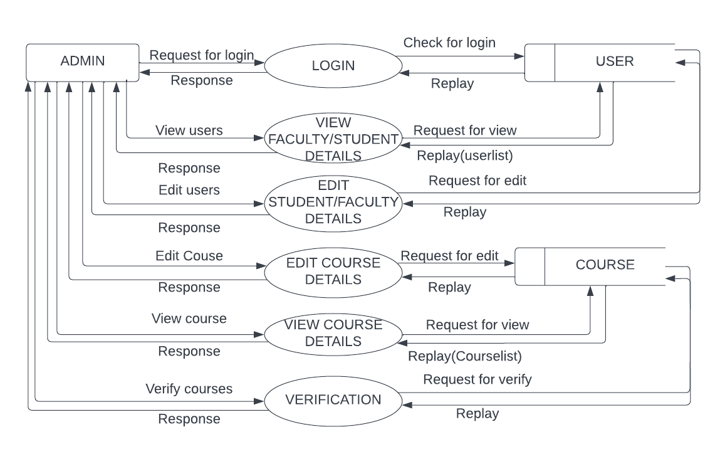
DATA FLOW DIAGRAM
Level 1.1
The figure given above is for reference only. Create a figure with your data.

Slide 22
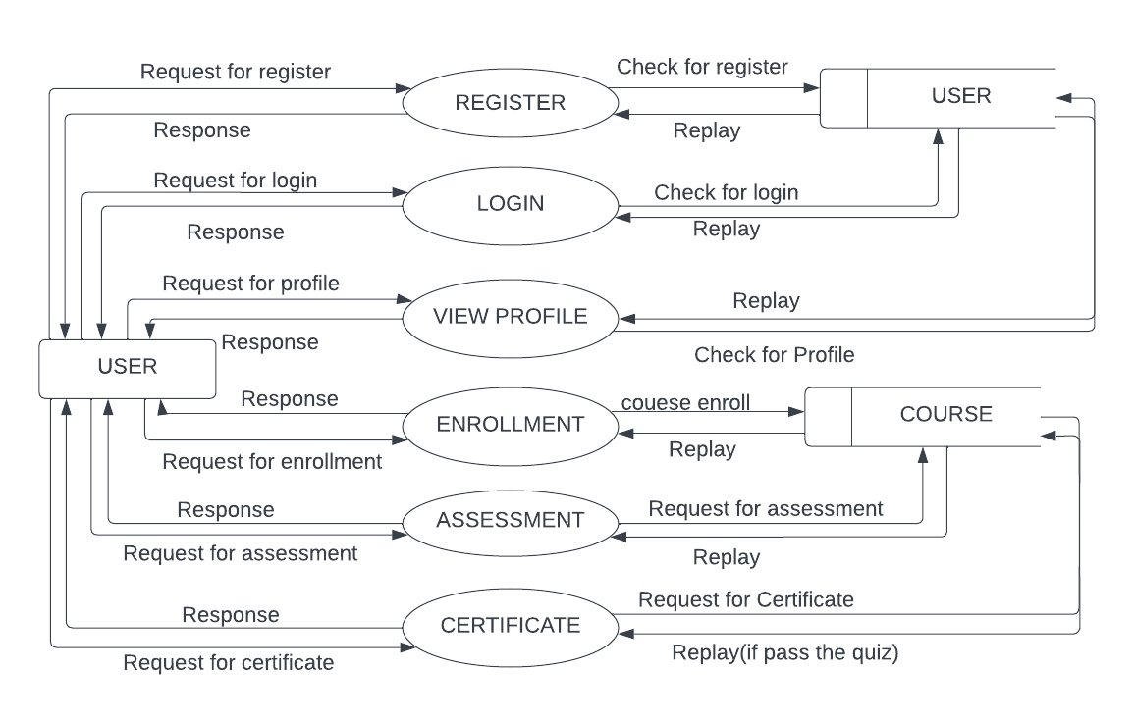
DATA FLOW DIAGRAM
Level 1.2
The figure given above is for reference only. Create a figure with your data.

Slide 23
ER DIAGRAM
Place you ER Diagram (if any) here.

Slide 24
THANK YOU

