Slide 1
IRONHACK · NLP BUSINESS CASE
Automated Customer Reviews
Turning thousands of Amazon reviews into sentiment, product categories, and recommendation articles — automatically.
Ursula
Muhanad
Clustering
Sentiment & GenAI Summarization
Notes:
Good morning everyone. We're presenting our NLP business case project — an automated customer review system built on real Amazon product review data.

Slide 2
The Problem, and Our Goal
1000s
Sentiment
Classify each review as Positive or Negative.
of reviews per product — realistically, no one reads them all.
69%
Categories
Group products into 4–6 meta-categories.
of reviews are 5-star — a heavy skew we had to design around.
Summaries
The question we're answering
Generate a short recommendation article per category.
A shopper wants a fast read: is this actually good? A business wants a different one: what do customers keep complaining about? We built one system to answer both.
Automated Customer Reviews · Ironhack NLP Business Case
2
Notes:
Here's the problem we set out to solve. E-commerce platforms collect thousands of reviews per product, and realistically, nobody reads all of them — not shoppers , not the businesses selling the product. A shopper wants a fast answer: is this thing actually good? A business wants a different answer: what do people keep complaining about, across their whole catalog? So our goal was to build a system that reads through that pile of reviews automatically and turns it into three things: a sentiment label per review, a set of product categories, and a short, readable summary article per category. Then we wrapped all three into one web app.

Slide 3
The Data
Ursula — Data Preprocessing
59,743
89
119
7
Unique reviews
after merge + dedupe
Raw product IDs
(unreliable — see below)
Cleaned product
names
Brands — a narrow,
Amazon-device catalog
Data quality issue found — and fixed
The product ID field is unreliable: about 11% of reviews (21 of 89 IDs) shared an ID with a completely unrelated product — one ID covered an Echo, a Fire tablet, a Kindle cover, a USB charger, and even coconut water. Some product names were also corrupted, with two unrelated names concatenated in one field.
Fix: merge all three raw files first, then clean, then dedupe — and use a cleaned product name (first comma-separated segment) as the trusted key instead of the broken ID.
Automated Customer Reviews · Ironhack NLP Business Case
3
Notes:
Ursula and me started with the data itself. We had three overlapping Datafiniti exports of Amazon reviews — merge them, clean them, them, and you get almost 60,000 unique reviews. Real-world data comes with real problems, though. The product ID field turned out to be unreliable: about 11% of reviews shared an ID with a completely unrelated product. we traced that down and fixed the pipeline order — merge first, then clean, — and switched to a cleaned product name as the trusted key instead of the broken ID field.

Slide 4
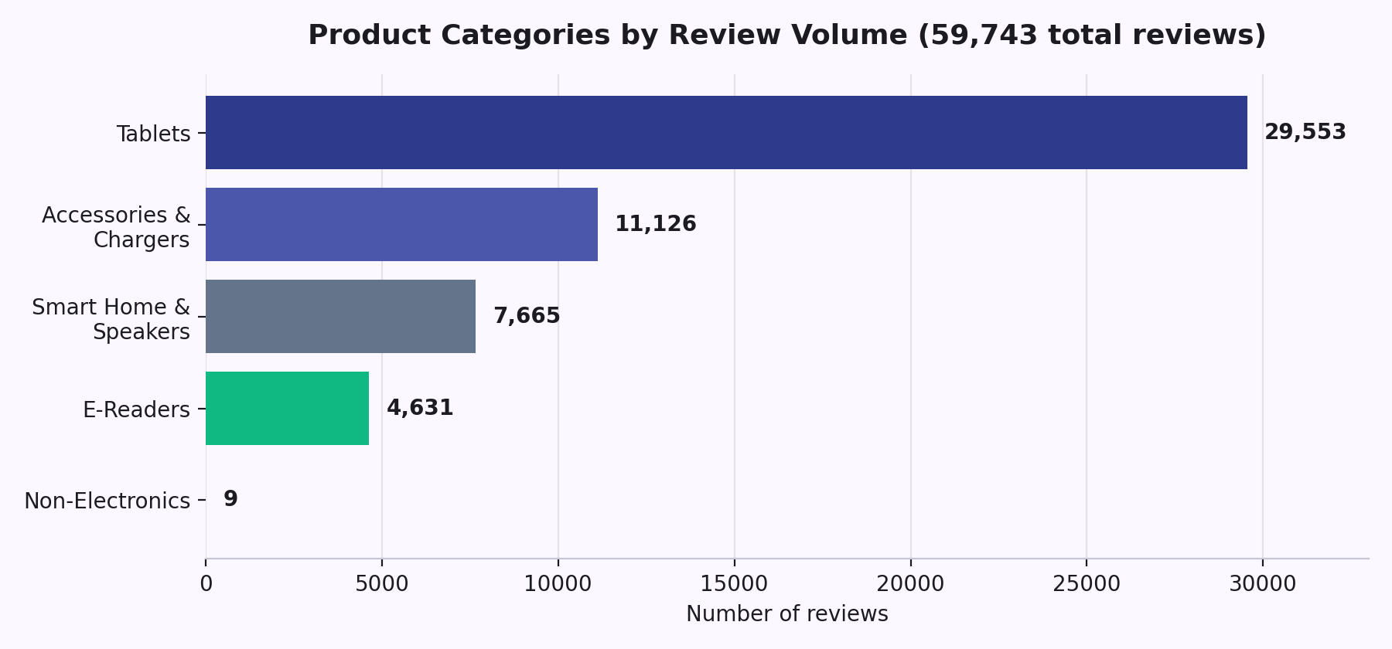
Product Category Clustering
Ursula — Unsupervised Clustering
5 meta-categories, from 106 distinct products
Unsupervised clustering on product text, refined with the dataset's own category metadata to keep group names interpretable.
One category is too small to trust
Non-Electronics has only 9 reviews across 7 products — we flagged it rather than drawing conclusions from it alone.
Automated Customer Reviews · Ironhack NLP Business Case
4
Notes:
From there, Ursula grouped the 106 distinct products into five meta-categories, using unsupervised clustering refined with the dataset's own category metadata. The split isn't even, and that's worth saying out loud rather than hiding: Tablets make up roughly half of all reviews, and Non-Electronics — things like pet carriers and Nespresso pods — has only 9 reviews total. That's too small to draw any real conclusions from on its own, so we flagged it instead of pretending it's a meaningful category by itself.

Slide 5
Sentiment Analysis: Approach
Muhanad — Sentiment Model + GenAI Summarization
2-class design, on purpose
Dropped the ambiguous Neutral (3-star) class — mixed-sentiment text with a small, noisy sample — to focus on the two classes with clear textual signal.
Models fine-tuned
distilbert-base
Class-weighted training
bert-base
Countered the 69%-positive skew so the model can't just default to “positive” and still look accurate.
roberta-base
cardiffnlp-twitter
5 pretrained models compared
BERT, DistilBERT, RoBERTa, Twitter-RoBERTa, and multilingual BERT — selected by macro F1, not raw accuracy.
nlptown-multilingual
Automated Customer Reviews · Ironhack NLP Business Case
5
Notes:
My part starts with sentiment analysis. Reviews skew heavily positive — about 69% are five stars — which makes plain accuracy a misleading scoreboard; a model that always guesses “positive” would still score in the mid-90s without learning anything. So I fine-tuned and compared five pretrained transformers, used class-weighted training to counter the imbalance, and judged them on macro F1 instead of accuracy, since macro F1 doesn't let the majority class hide the model's mistakes.

Slide 6
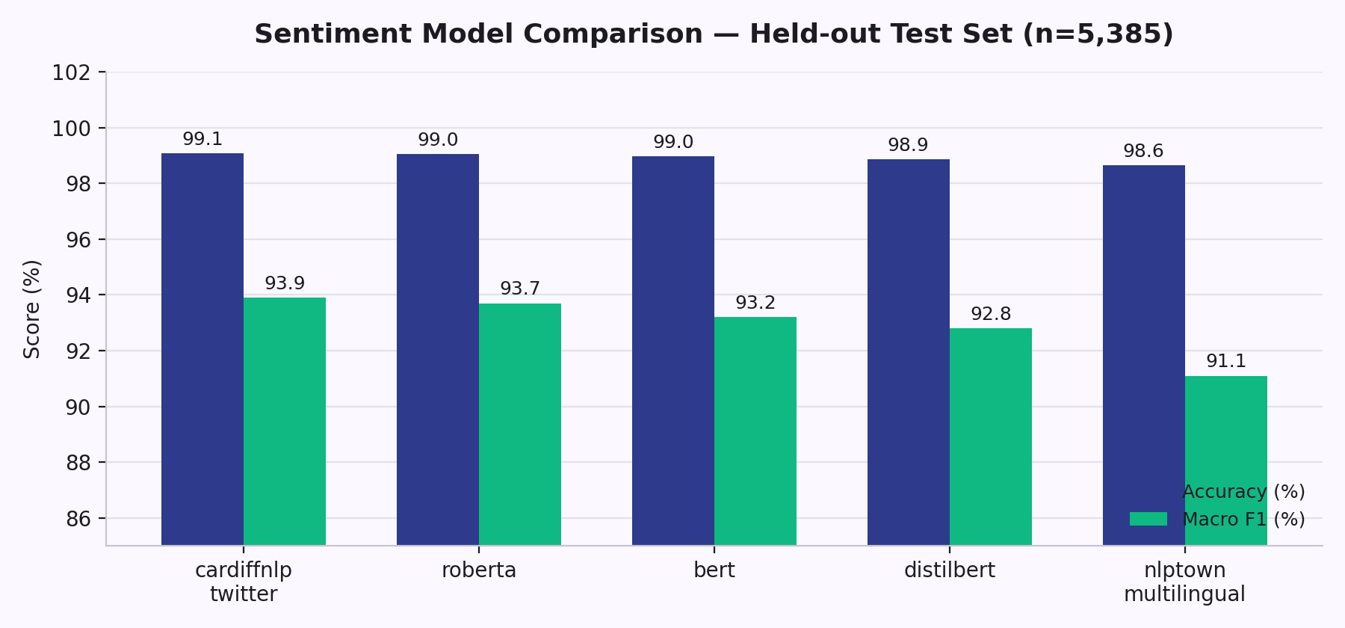
Sentiment Analysis: Results
99.07%
0.939
Why macro F1, not accuracy
With this dataset's 69%-positive skew, a model that always guesses “positive” would still score around 96% accuracy without learning anything. Macro F1 treats both classes equally, so it can't be fooled by the imbalance — that's what we used to pick a winner.
Accuracy — best model
Macro F1 — the metric that matters here
Winner: Twitter-RoBERTa (cardiffnlp) — best balance across both classes, not just the easy one.
All 5 models, ranked
cardiffnlp-twitter 99.07% / 0.939
roberta-base 99.05% / 0.937
bert-base 98.96% / 0.932
distilbert-base 98.87% / 0.928
nlptown-multi 98.64% / 0.911
Automated Customer Reviews · Ironhack NLP Business Case
6
Notes:
The winner was a Twitter-pretrained RoBERTa model, at 99.07% accuracy and 0.939 macro F1 — the best balance across both classes, not just the easy one. All five models are on screen if anyone wants the full comparison.

Slide 7
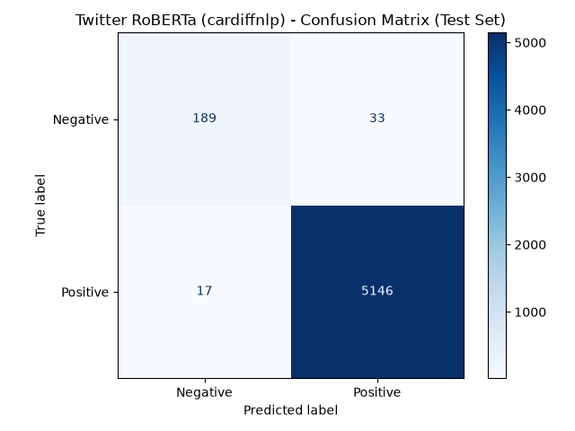
Being Honest About the Weak Spot
Negative-review recall is the hard part
33 of 222 genuinely negative reviews were still misread as positive. Class weighting and macro-F1 selection helped, but mixed-sentiment text remains the failure mode.
A concrete example we traced
“My son loves it. And it's too expensive!” gets predicted Positive with 99.9% confidence. Why: of 1,157 training reviews containing “expensive,” 96.5% are Positive — mostly “inexpensive” or favorable comparisons. The model learned that correlation correctly; genuine price complaints are a documented blind spot, not a bug we're hiding.
Automated Customer Reviews · Ironhack NLP Business Case
7
Notes:
Here's that model's confusion matrix. I want to be upfront about the weak spot instead of glossing over it: negative-review recall is the hardest part of this problem. Mixed-sentiment reviews — someone loving a product but calling it overpriced — tend to get misread as positive, because in this dataset the word “expensive” shows up in positive reviews 96% of the time. That's a documented limitation of the training data, not a bug we're hiding.

Slide 8
Generative Summarization
Muhanad — Sentiment Model + GenAI Summarization
Aggregate real stats
EXAMPLE · E-READERS & E-BOOKS
Top-rated products, sample complaint text, and the single worst-rated product per category.
Top pick: Kindle Paperwhite
4.89 / 5.0 average, zero recorded complaints across its reviews.
One to avoid: Kindle Replacement Power Adapter
Prompt an LLM, tightly scoped
“Use only the data below — do not invent products, ratings, or complaints.”
2.8 / 5.0 average. Reviewers report the cord's outer insulation cracking and falling off after minimal use.
Out comes a short article
“Write a short blog-post-style article — keep the tone helpful and factual, not salesy.”
Top picks, what reviewers actually complain about, and one product to avoid.
Automated Customer Reviews · Ironhack NLP Business Case
8
Notes:
The second half of my work is generative summarization. For each category, the pipeline aggregates real numbers — top-rated products, sample complaint text, the single worst-rated product — and feeds that into an LLM with a prompt that explicitly forbids inventing facts. What comes out is a short, readable article: top picks, what people actually complain about, and one product to avoid. For E-Readers, for instance, it correctly surfaced the Kindle Paperwhite as a top pick, and flagged a specific replacement power adapter — by name, with real complaint quotes — as the one to skip.

Slide 9
The Chatbot
Ursula + Muhanad — Joint Effort
Where both halves of the project meet: clustering metadata + sentiment + generated summaries, queried live.
Recommender persona
Anti-Recommender persona
Enthusiastic and encouraging. Leads with what reviewers loved, and ends on a confident buy-it recommendation when the data supports it.
Sarcastic and skeptical, on purpose. Leads with complaints and buyer's remorse from real reviews, and pushes back on the purchase.
Same underlying data — two honest angles on it.
Answers with real data via function-calling:
lookup_product
compare_product_reviews
rank_products
Automated Customer Reviews · Ironhack NLP Business Case
9
Notes:
The chatbot is where Ursula's and my work actually meet. Instead of just talking around the reviews, it can query the dataset live — look up one specific product, rank the best or worst in a category, or pull two contrasting reviews for a side-by-side comparison. We also gave it two personalities: an enthusiastic recommender that leads with what reviewers loved, and a skeptical anti-recommender that leads with the complaints and tries to talk you out of buying. Same underlying data, two honest angles on it.

Slide 10
The Final Product
Marketing dashboard
Browse by category and see rating stats alongside the generated recommendation article.
Next.js frontend
FastAPI backend
Search box
Type a product or category, get back its matched category, sentiment split, and a summary snippet.
One deployable product combining all three models.
Chatbot drawer, everywhere
Ask a follow-up question from anywhere in the app — it has the same live data as the dashboard.
Automated Customer Reviews · Ironhack NLP Business Case
10
Notes:
All three models live inside one Next.js and FastAPI web app. There's a dashboard where you browse by category and see rating stats next to the generated article, a search box where you type a product or category and get back its sentiment breakdown and a summary snippet, and the chatbot sits in a drawer throughout, so you can ask a follow-up question no matter where you are in the app.

Slide 11
✓
Thank You
Questions? — or we can pull up the chatbot live and try both personas on a real product.
Notes:
That's our project. Thank you — we're happy to take questions, and if anyone wants, we can pull up the chatbot live and try both personas on a real product.

