Slide 1
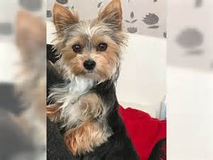
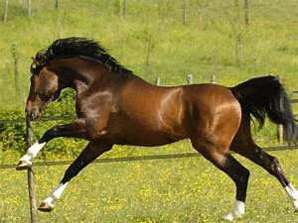
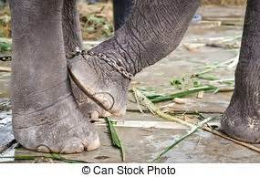
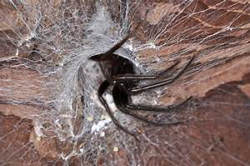
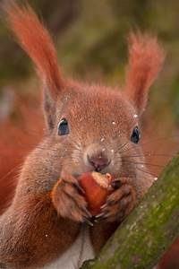

DEEP LEARNING · IMAGE CLASSIFICATION
Animals-10 Classifier
Building a CNN from scratch, then beating it with transfer learning
94% test accuracy · 10 animal species · live web demo
Muhanad Tello
Ironhack · Deep Learning Project · July 2026
Notes:
Hi, I'm Muhanad. I built an image classifier for 10 animal species — first a CNN from scratch, then transfer learning — and I deployed it as a live web demo. In the next few minutes I'll walk through the data, the models I compared, the results, and finish with a live demo. Headline up front: 94% test accuracy.

Slide 2
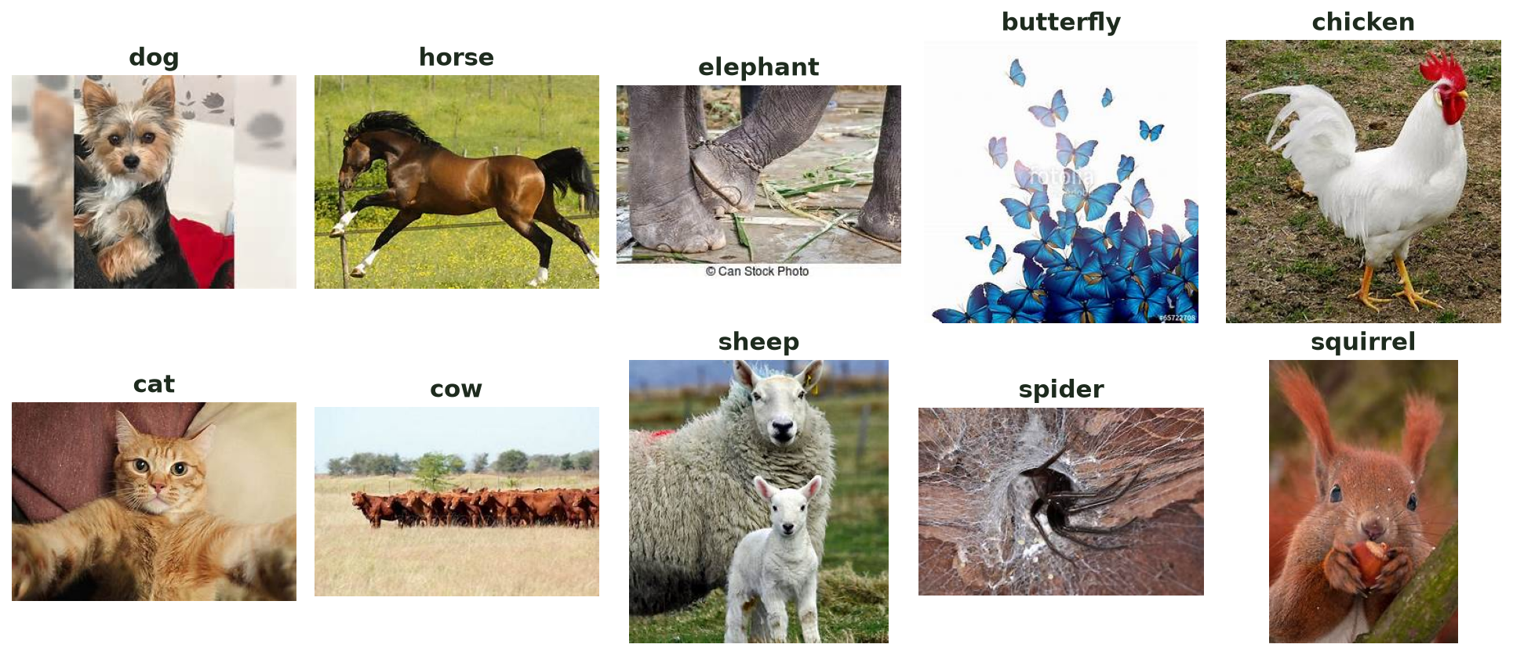
The problem & the solution
Task: given a photo, predict which of 10 animals it shows.
Dataset: Animals-10 — ~26,000 real photos scraped from the web, 10 species, imbalanced.
Approach: build a CNN from scratch, run a controlled sweep of 8 variants, then push accuracy with transfer learning.
Bonus: ship the winner as a live web app anyone can try in a browser.
One sample per class — the 10 targets
26,179
10
8
94%
images
classes
models trained
test accuracy
2
Notes:
The task: given a photo, predict which of 10 animals it shows. The dataset is Animals-10 — about 26,000 real photos scraped from the web, across 10 species, and it's imbalanced. My approach had three stages: build a CNN from scratch, run a controlled sweep of 8 variants, then push accuracy further with transfer learning. As a bonus I shipped the winning model as a web app anyone can try in a browser.

Slide 3
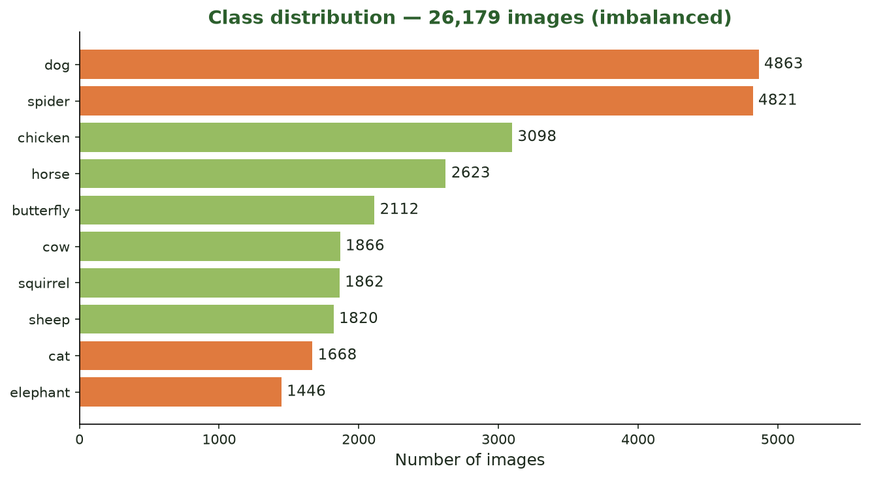
From raw photos to model-ready data
›
›
›
1
Resize
2
Normalize
3
Split
4
Augment
every image → 128×128×3
pixels rescaled to [0, 1]
stratified 70 / 15 / 15 (seed 42)
flip/rotate/zoom — train only, optional
Classes are imbalanced — dog & spider have ~4,800 each; elephant & cat under 1,700.
Handled with a stratified split so every set keeps the same balance.
The 15% test set is locked away — no model sees it until the final score.
3
Notes:
Every image is resized to 128 by 128 and normalized to the 0–1 range. I split the data stratified — 70% train, 15% validation, 15% test — so each set keeps the same class balance, and I locked the test set away so no model sees it until the very end. Augmentation is built into the pipeline as a toggle. Notice the imbalance on the right: dog and spider have nearly 4,800 images each, while elephant and cat have under 1,700 — that becomes important when we look at the weak classes later.

Slide 4
Designing the network: the winning idea
Backbone: 3 conv blocks (Conv→Conv→MaxPool), 32 → 64 → 128 filters.
Baseline used a Flatten head → heavily overfit (~13-point train/val gap).
The fix that mattered: replace Flatten with Global Average Pooling.
Dense head shrank from ~184,000 to ~1,300 parameters — overfitting dropped and accuracy rose.
Dense-head parameters
184k → 1.3k
Flatten → Global Average Pooling
Best from-scratch model — val accuracy 0.740
Same conv backbone throughout — only the head/technique changes, so every comparison is fair.
4
Notes:
The backbone is three convolutional blocks, 32 to 64 to 128 filters. My baseline used a Flatten head and it overfit badly — a 13-point gap between training and validation. The single change that helped most was replacing Flatten with Global Average Pooling. That shrank the dense head from about 184,000 parameters down to 1,300 — which cut the overfitting AND raised accuracy to 74%. This was my best model built entirely from scratch.

Slide 5
Fighting overfitting — one lever at a time
1
Global Average Pooling
2
Dropout (0.5)
The main fix — tiny dense head, far less overfitting.
Randomly drops units so the net can't memorize.
3
Early Stopping
4
Adam · lr 0.001
Watches val_loss, restores the best weights automatically.
Adaptive optimizer, categorical cross-entropy loss.
5
Data augmentation
6
Batch Normalization
Flip / rotate / shift / zoom — tested (didn't help here).
Tested in a separate variant — didn't beat plain GAP.
Rule of the sweep: change one thing per experiment → every result is comparable.
5
Notes:
To fight overfitting I used several levers. Global Average Pooling was the big one. On top of that: Dropout at 0.5, Early Stopping that watches validation loss and restores the best weights automatically, and the Adam optimizer. I also tested data augmentation and Batch Normalization in separate variants. The key discipline here is that I changed exactly one thing per experiment — so every comparison on the next slide is fair.

Slide 6
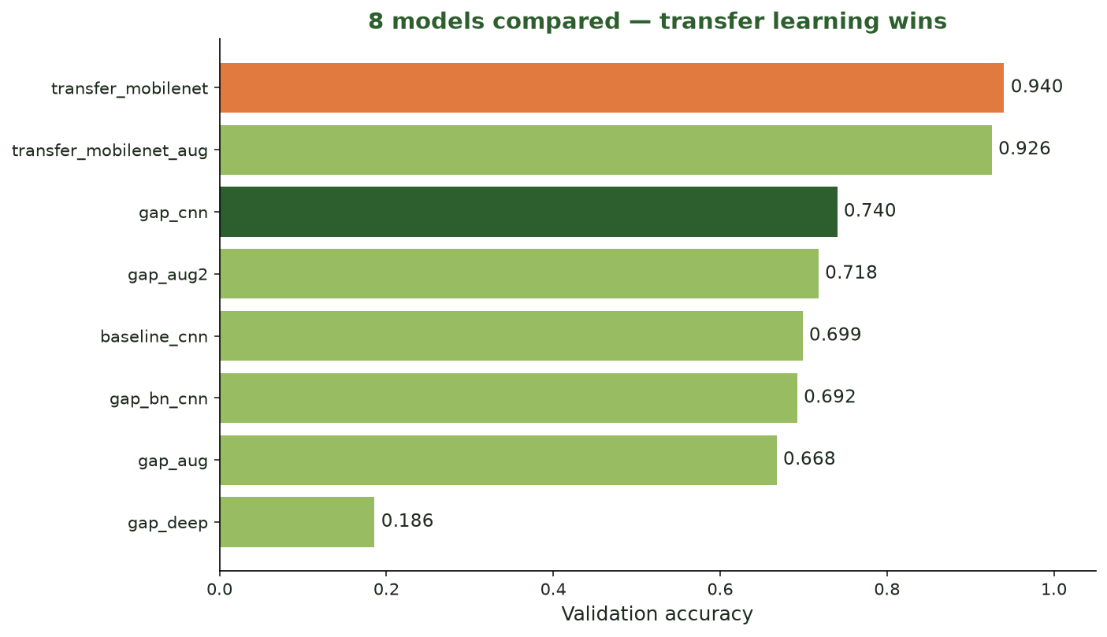
I let the data decide
Ran a controlled sweep of 8 models.
BatchNorm, augmentation (×2) and extra depth — none beat plain GAP.
gap_deep collapsed to random guessing at lr 0.001 — a textbook case for BatchNorm / a lower learning rate.
Negative results, but they show the method.
6
Notes:
Here's the whole sweep on one chart. I didn't stop at one model — BatchNorm, augmentation twice, and extra depth were all tested, and none of them beat plain GAP. The deep model at the bottom actually collapsed to random guessing at learning rate 0.001 — a textbook example of why deep plain CNNs need BatchNorm or a lower learning rate. These are negative results, but they show the method. And notice the top two bars — that's transfer learning, which I'll cover next.

Slide 7
Transfer learning: the leap
Pretrained model: MobileNetV2 (ImageNet weights), used frozen as a feature extractor.
Why: lightweight — trains in ~4 min on CPU — yet its ImageNet features (edges, textures, shapes) transfer well to animals.
Modifications: baked the [0,1]→[-1,1] rescale into the model, then GAP → Dropout → Dense(10, softmax).
Only ~13,000 trainable parameters — the pretrained base does the heavy lifting.
The architecture
Input 128×128×3
Rescale → [-1, 1]
MobileNetV2 base (frozen)
Global Average Pooling
Dropout 0.5
Dense(10, softmax)
0.940
0.943
+20 pts
~4 min
val accuracy
test accuracy
vs from-scratch
training time
7
Notes:
Then the bonus — transfer learning. Instead of learning features from scratch, I reused MobileNetV2, pretrained on ImageNet, and froze it as a feature extractor. I chose MobileNetV2 because it's lightweight — it trains in about 4 minutes on CPU — yet its ImageNet features, edges, textures, shapes, transfer really well to animals. My modifications: I baked the rescale to minus-one-to-one into the model, then added a small head — Global Average Pooling, Dropout, and a 10-class softmax. Only about 13,000 trainable parameters. The result: 94% test accuracy, a 20-point jump, in a quarter of the training time.

Slide 8
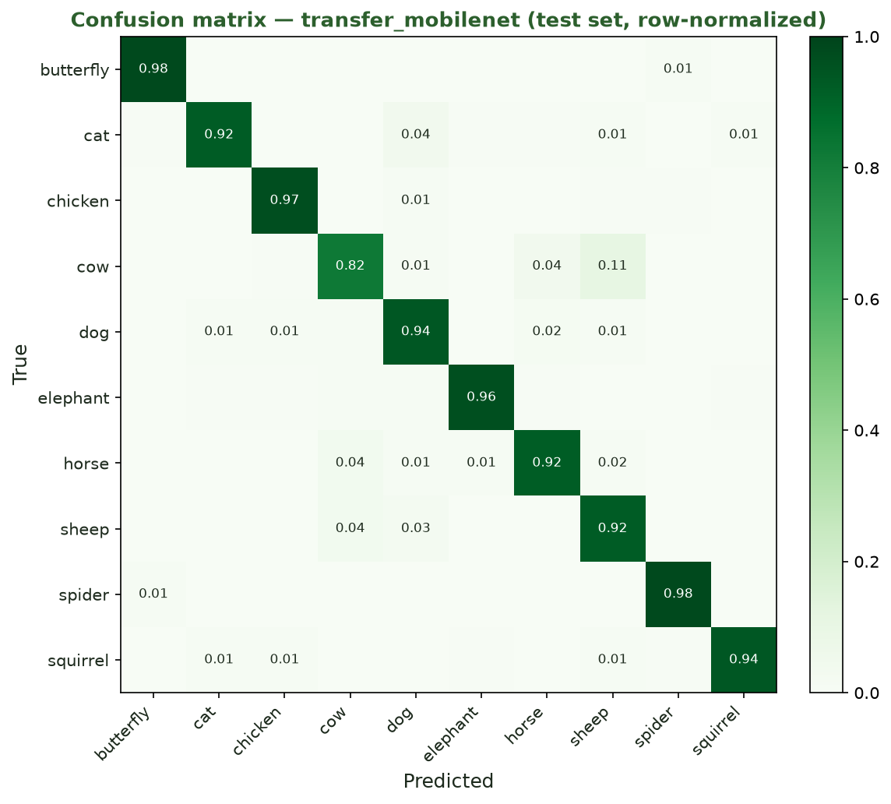
How the winner performs
0.943
0.935
Accuracy
Macro F1
0.934
0.936
Precision
Recall
Weakest class recovered
cow recall 0.36 → 0.82
Transfer learning sharpened the diagonal — every weak class improved. Test set scored once.
8
Notes:
On the held-out test set the winner scores 94.3% accuracy and a macro-F1 of 0.935. The confusion matrix on the left has a strong diagonal — most classes are above 0.92. The most important cell is cow: transfer learning took cow recall from 0.36, where the from-scratch model confused cows with horses and sheep, up to 0.82. And to be clear about method — I scored the test set only once, on this final winner, so there's no leakage.

Slide 9
The web app: upload a photo → prediction
The winning model is wrapped in a Gradio web app (app.py).
Upload any photo → the model returns its top-3 animals with confidence bars.
Deployed and working: python app.py opens the app locally plus a temporary public link (bonus completed).
The story in one upload: the from-scratch model missed a spotted Appaloosa horse (fell back to the majority class); the transfer model gets it right.
Prediction
horse
93%
cow
4%
dog
2%
Try it yourself: python app.py
Illustration of the Gradio output
9
Notes:
I also deployed the winning model as a Gradio web app — running `python app.py` opens it locally plus a temporary public link, so the deployment bonus is fully working. I'm not running it live today, so this panel shows exactly what the app does: you upload a photo and it returns the top-3 predictions with confidence bars. And here's the story it tells — the from-scratch model missed this exact image, a spotted Appaloosa horse, because it had never seen a horse that looked like this and fell back to the majority class. The transfer model gets it right, with 93% confidence. That's the whole project in a single upload. Anyone can run it themselves from the repo.

Slide 10
Recap & learnings
1
Architecture matters
Global Average Pooling beat Flatten — 74% from scratch, less overfitting.
2
Transfer learning wins
MobileNetV2 → 94% test accuracy in ¼ of the training time.
3
Augmentation didn't help here
Tested 3× across both tracks — always below the plain model.
4
Honest evaluation
Ranked on validation; the test set was scored only once, on the winner.
Next steps: fine-tune the top MobileNetV2 layers · tackle class imbalance directly.
Thank you — Muhanad Tello
10
Notes:
Two takeaways. First, from scratch, architecture mattered — Global Average Pooling was the lever that took me to 74% and fought overfitting. Second, transfer learning got me to 94% in a fraction of the time and fixed the failures I could actually see in the demo. Along the way, augmentation never helped on this dataset, and I kept the evaluation honest — ranking on validation and scoring the test set only once. If I continued, I'd fine-tune the top MobileNetV2 layers and tackle the class imbalance directly. Thank you.

