Slide 1
RASPIED Project
Proposal
An Educational Robot Platform for the UCT CS1 Extended Degree Program
Supervisor - G. Stewart
Notes:
Good afternoon everyone, our project is the Raspied project with supervisor Gary Stewart which involves the use of robots in university cs education.
The group members include myself, Josh di Bona, Jeremy Coupland, and Muhummad Patel

Slide 2
Introduction
Robots have been shown to be effective teaching tools
Opportunity to increase student motivation using robots
In particular, using robots to teach CS concepts
Room to investigate cost reduction of educational robots through shared remote access to the robot
Notes:
Robots have been shown to be effective teaching tools especially within the context of CS
There is an opportunity to increase student motivation using robots at UCT
In particular, using robots Teach CS concepts
There is room to investigate cost reduction of the robotic platform through shared remote access to the robot

Slide 3
Background
Many studies have shown positive results from using robots as CS teaching tools
Lack of access to the robots is a common thread in unsuccessful studies
Web based access has been used before in separate projects to program robots, and to schedule time to a shared robot.
Notes:
Previous studies have shown that the use of robots in teaching computer science generally has a positive impact, although there are many issues that have to be solved when using a robot in cs1.
Issues such as the cost of the robot, and access to the robot (A study done with 800 students about robot removing the essential write-run-debug cycle)
Almost all the past studies were very application specific, using either off the shelf robots with programming interfaces that only work with certain robots. We plan to include all the features and functionality found in some of the best studies into our robotic platform.

Slide 4
Our Project
Design and implementation of educational robot platform using a single robot
Programmable Raspberry Pi-based robot
Set of advanced features for use with the robot (camera, infrared sensors, ultrasonic sensors, 16x16 LED matrix)
Built using easily accessible software
2 Research Questions
Software Engineering component
Notes:
Muhummad
For our proj … we will be designing and implementing an educational robot platform for the first year CS1010H class.
Platform consists of:
Single programmable rpi-based robot -> Python programming
Set of advanced features for the robot (camera, infrared, ultrasonic, LED matrix) with associated code
Built using easily accessible software
The project has 2 RQs and a software engineering component

Slide 5
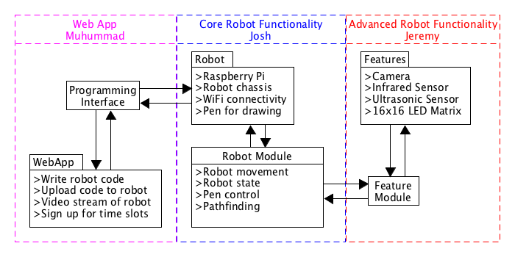
Our Project
Notes:
Muhummad
<Add description of full platform here>
This … broad overview of the platform showing the 3 components and how they fit

Slide 6
Research Question 1 - Josh
Can an educational robot, along with a high-level programming interface, be used in the UCT CS1 extended degree program to increase the motivation of the students learning basic Computer Science concepts?
Testing and Evaluation:
User testing with CSC1010H students. Measure the effect that using the robot has on student motivation.
Control group who do not use the robot and fill out a questionnaire to evaluate baseline motivation.
Experiment group given CS tasks to complete using the robot. Then complete a questionnaire to measure students’ motivation.
Notes:
Can an educational robot, along with a high-level programming interface, be used in the UCT CS1 extended degree program to increase the motivation of the students learning basic Computer Science concepts?
Test for increase motivation, need control group & experiment group....
Both sets come from CSC1010H…(There is precedent to be sure on this, otherwise we do have a backup-plan of extending to CS1 class)
User’s given a task to complete using the programming module (with its added features)...
After which given questionnaire to test for motivation...based on IMMS model, used extensively to evaluate relationship between motivation and specific instructional materials.
Students who don’t take part, given a questionnaire to test current motivation, to be used as control group (=No bias in answers)

Slide 7
Research Question 1 - Josh
Outcomes/Impact:
Fully functional, programmable robot to be used by students in CSC1010H
Analysis of the user study results
Conclusions as to whether the use use of robots would benefit CSC1010H in future years
Implementation:
Raspberry Pi robot with basic movement and pathfinding capabilities
Robot will be programmed in Python
Student-facing Python module used to program the robot
Integration with the features module
Notes:
OUTCOMES:
Fully functional built robot with a complete programming module containing robot movement, pen control and pathfinding methods, an analysis of my results with conclusions as to whether robots should be used in future years
IMPLEMENTATION:
GPIO Python Module to interact with the pins on the raspberry pi and in turn the motors.
The movement module will include high-level methods to control the robot, methods such as forward() and turn()
Along with movement and pathfinding, i will implement a motor holding a pen for the students to draw with the robot
Build using a grid system, the robot will store a version of the grid, and its position and orientation in the world.
Grid = turn 90 degrees and helps to return the robot back to the start (as well as pathfinding)
The grid will be sized to still allow complex movement with the robot.
Integration with features module: Dummy methods will be included while the features module is in development so that development can run independently of 1 another

Slide 8
Research Question 2 - Jeremy
Given a selection of cheaply available features (camera, infrared sensors, ultrasonic sensors, 16x16 LED matrix) to be used on an CS educational robot, which ones would students be most motivated to use, and which ones do students think would best help them understand the topic? Would these features be the same?
Testing and Evaluation:
User testing with CSC1010H students. Students complete a CS task making use of the robot and one of the features being tested. Measure the motivation of students when using the various features.
Notes:
Jeremy
Given a selection of cheaply available features (camera, infrared sensors, ultrasonic sensors, 16x16 LED matrix) to be used on an CS educational robot, which ones would students be most motivated to use, and which ones do students think would best help them understand the topic? Would these features be the same?
To test and evaluate this, user testing will be performed with students from the CSC1010H course. They will be asked to perform some simple tasks, each one using a specific feature, which tests their knowledge of a particular CS concept. For example, using the 16x16 LED matrix, or a camera image to teach 2D arrays. The students will then be asked which feature they most enjoyed using, and which they thought best illustrated the concept.

Slide 9
Research Question 2 - Jeremy
Outcomes/Impact:
Implementation of the features module that integrates the features with the robot
A list of features and which CS concepts they best motivate students to learn
Provide insight for the design of future educational robots in CS
Implementation:
4 features (camera, infrared sensors, ultrasonic sensor, and 16x16 LED matrix)
Integrate features with the robot and robot module
Developed independently using agreed-upon interfaces
Features will be made available to the robot through a Python ‘features’ module
Notes:
Jeremy
Outcomes/impact
I will produce a features module that integrates fully with the robot
As well as a list of features and which CS concept they best map to, which could provide insight into the future design of educational robots in CS
Implementation
Implement features using GPIO module which can interact with the features connected to the raspberry pi
These will be programmed using an agreed upon interface, such that these components of the project can be developed in parallel
The features will be made available to the main robot via this features module

Slide 10
Software Engineering Component - Muhummad
Supporting web app with the following basic functionality:
Write and upload programs to the robot and run them
Observe the robot via a live video stream
Book time slots for exclusive use of the robot
Success metrics:
Does the final web app implement the required functionality?
Does the web app enhance, or hinder students’ experience using the robot platform?
Gather user feedback via testing sessions and surveys
Notes:
Muhummad
The software engineering component of the project is a supporting web app.
The web app is required to:
Let students write and upload code to the robot and run those programs
Also … let students observe the robot via a live video stream -> fast feedback loop
Allow students to book time slots to use the robot (this is where we allow the sharing of one robot by many students)
success of the web app will be evaluated based on the following:
Does it meet the requirements/specifications?
Whether it enhances or hinders the students’ experience using the robot
We will measure this through feedback from user testing sessions

Slide 11
Software Engineering Component - Muhummad
Outcomes:
A finished web app allowing remote access to a single shared robot
Open source code base allowing for easy extensibility and reuse
Implementation:
Currently investigating frameworks (Rails, Django, Tornado, etc.) for the basic web app functionality
Hosted within the CS department
Notes:
Muhummad
Outcomes:
At the end, will have a finished, well polished web app allowing remote access to single shrd rbt->
Open source codebase -> extensible and reusable
Implementation:
Will use a web framework to simplify the implementation -> currently investigating -> also scheduled investigation time
Hosted within the cs department

Slide 12
Team Implementation Approach
Iterative development method
Weekly sprints
Minimum of one meeting per week (sprint planning and retrospective)
Weekly meetings with supervisor
Interfaces for inter-component interaction
Notes:
Muhummad
An iterative approach will be used in this project
Weekly sprints and meetings -> serve as sprint retrospective and planning
|-> also time to check compatibility and that we aren’t diverging
We’ll also have weekly meetings with supervisor to monitor the project progress and touch base
We will use agreed-upon interfaces for all interaction between the components. -> allow us to develop our components independently

Slide 13
Ethical, Professional, and Legal Issues
Ethical clearance needed for user testing
Software produced will be licensed as open source software where possible
Maintain professional demeanour when conducting user tests
Notes:
Muhummad
Ethical clearance to perform user testing with students
wrt , the software produced … it will be licensed as open source software where possible
Interacting w students -> Maintain professional demeanour when conducting user tests

Slide 14
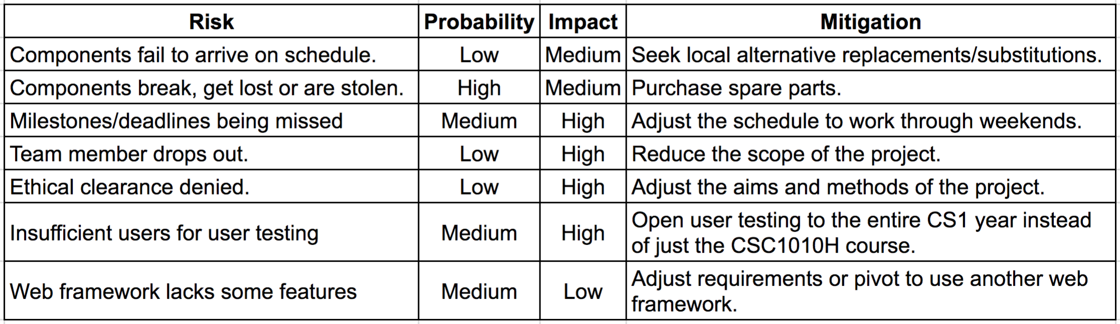
Risk Management
Notes:
Jeremy
Here are the risks that we have identified.
The first two deal with the physical components of the robot failing to arrive on schedule or getting broken or stolen. We will mitigate this by seeking local alternatives, or purchases spare parts.
If we fail to meet any milestones or deadlines, we will adjust our work schedules to work weekends, to catch up
If a team member drops out, we will simply reduce the scope of our project
If we fail to receive ethical clearance for testing, we will adjust the aims of our project
If not enough users from the CS1010H course are available for testing, we will expand our test base to all first year CS students
If the web framework lacks some of the features we need, we can either adjust the requirements of our web app, or find another web framework that works for us

Slide 15
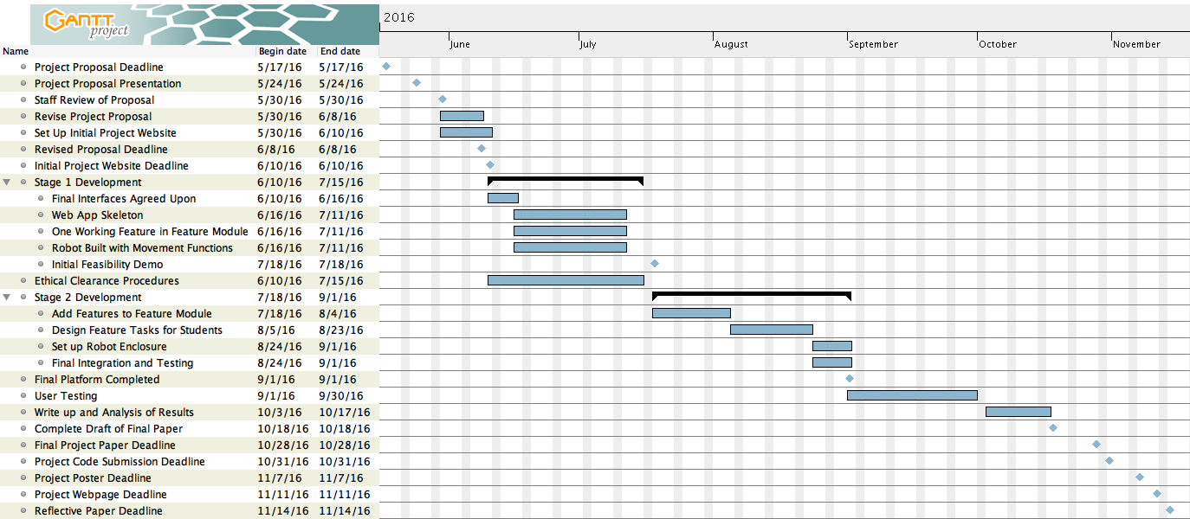
Project Schedule: Gantt Chart
Notes:
Jeremy
Here is our project timeline. We have two development phases
The first phase includes:
Agreeing on interfaces
Building the robot, and programming movement functions
Getting one additional feature functional
Building the web app skeleton
We plan to complete this phase by the end of the upcoming vac, so that we’re ready for the initial feasibility demo
The second phase includes:
Developing the remaining robot features
Completing the web app
Setting up an enclosure for user testing
The remaining time will be spent on user testing, and writing our final reports

Slide 16
Milestones & Deliverables
10 Jun - Initial project website
16 Jun - Final interfaces agreed-upon
18 Jul - Initial feasibility demo
1 Sept - Final platform completed
30 Sept - User testing completed
18 Oct - Draft of final paper
28 Oct - Final paper completed
31 Oct - Project code submitted
7 Nov - Project poster completed
11 Nov - Project website completed
14 nov - Reflective paper completed
Notes:
Jeremy
The following are our important milestones and deliverables
We have planned our project to try and finish development early enough, so that we have enough time to perform user testing
This will give us enough time to gather enough data, and analyse this data

Slide 17
Thank you
Questions?
Notes:
Jeremy
Questions?

