Slide 1

POWER BI DATA ANALYTICS PROJECT
Hotel Booking & Revenue Analysis
A Power BI study of hotel demand, cancellations and customer Behaviour.
By: Muhussin Muhagir M
Notes:
Welcome. This project analyses hotel bookings to understand demand, cancellations and customer behaviour using Power BI.

Slide 2
Project Overview and Dataset
This project analyses 119,385 hotel bookings to find out where guests come from, how they book, and how cancellations affect revenue.
119,385
15
Rows (bookings)
Columns
Goal
Turn raw booking records into clear, decision-ready dashboards.
Tools
Kaggle dataset | Power BI | DAX measures
2
9
Hotels covered
City Hotel and Resort Hotel
New columns created
DAX measures
Notes:
The data comes from Kaggle: 119,385 hotel bookings across 15 columns, for a city hotel and a resort hotel.

Slide 3
Cleaning, Transformation and DAX
Cleaning and transformation
NEW COLUMN
NEW COLUMN
Checked missing values, duplicates and data types
Reshaped columns for analysis
Final table: 119,385 rows, 15 columns
Total Guest
Total Nights
Adults and children combined into one column called Total Guest
Weekday and weekend nights added into one stay length
DAX measures powering the dashboard cards
Total Guests
Total Bookings
Successful Bookings
Cancelled Bookings
Cancellation Rate
Average ADR
Average Lead Time
Repeated Guest %
Average Stay
Notes:
Two calculated columns (Total Guests, Total Nights) and DAX measures drive every KPI card on the dashboards.

Slide 4
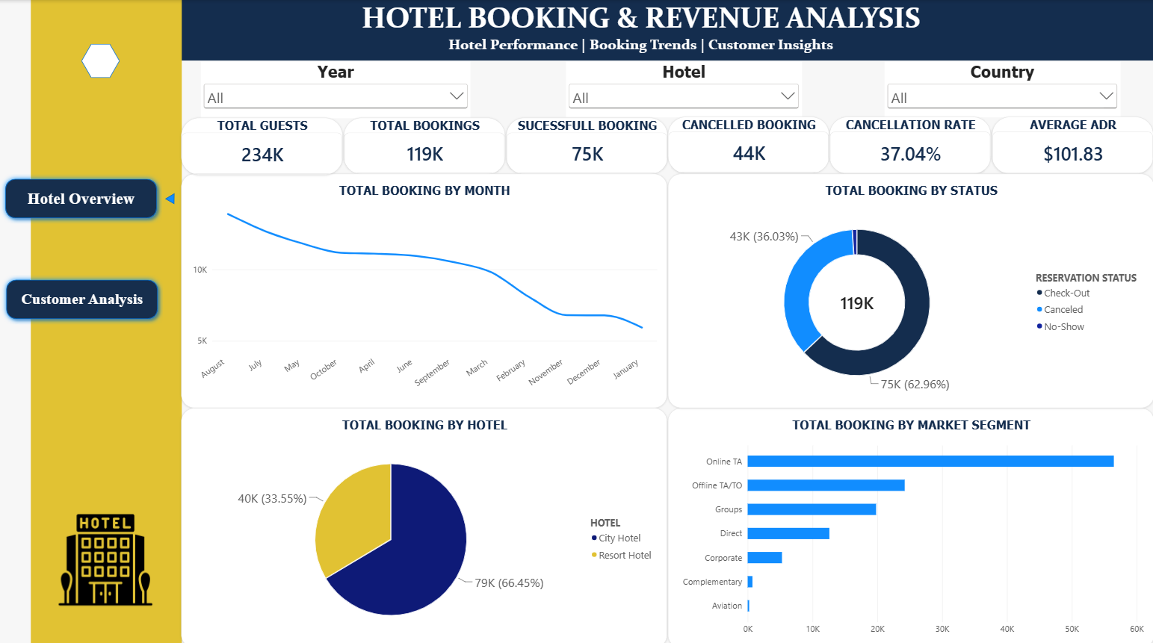
Dashboard 1: Hotel Overview
What stands out
1
37% of bookings cancelled
44K of 119K reservations never became stays.
2
Online travel agents lead
Online TA is the biggest booking channel by far.
3
Demand peaks in August
Bookings fall steadily through to January.
119K bookings
37.04% cancelled
$101.83 avg. ADR
Notes:
Dashboard 1 gives the big picture: volume, cancellations, hotel split and market segments. Filters for Year, Hotel and Country let viewers drill in.

Slide 5
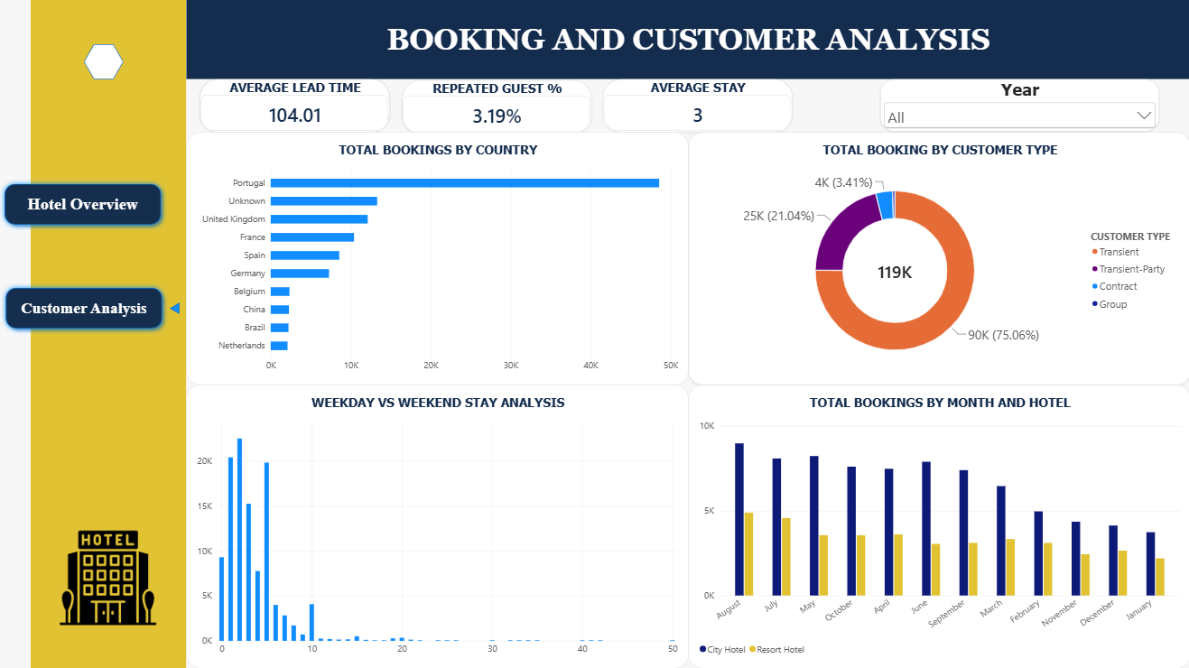
Dashboard 2: Customer Analysis
What stands out
1
Portugal is the core market
It sends the most bookings, ahead of the UK, France and Spain.
2
Mostly individual travellers
Transient guests make up about 75% of bookings.
3
Short stays, long planning
Typical stay is 3 nights, booked about 104 days ahead.
104 days lead time
3.19% repeat guests
3 Avg Stay
Notes:
Dashboard 2 looks at who the guests are: where they come from, what type they are, how long they stay, and how the two hotels compare month by month.

Slide 6
Key Findings and Insights
37%
66%
47%
Cancellations
City Hotel dominates
Online TA is the top channel
About 37% of bookings were cancelled before guests arrived.
The City Hotel takes about two thirds of bookings, the Resort Hotel one third.
Online travel agents bring nearly half of all bookings.
41%
104
3%
Portugal Has Highest
Guests plan ahead
Few repeat guests
Portugal sends the most bookings, ahead of the UK.
Guests book about 104 days before they arrive.
Only about 3 in 100 guests come back.
Notes:
Six headline findings pulled from both dashboards. Percentages marked with ~ are read from chart bars and rounded.

Slide 7
Conclusion and Recommendations
The hotels have strong demand, but cancellations and seasonality limit revenue. Tackling both, and building loyalty, offers the clearest gains.
1
Cut cancellations
Use deposits and flexible-rebooking offers on high-risk bookings.
2
Smooth the seasons
Run offers and packages in the quieter months, November to January.
3
Balance the channels
Grow direct bookings to lower dependence on online agents.
4
Build loyalty
Reward returning guests to lift the 3.19% repeat rate.
Thank You
Notes:
Close with the four actions: reduce cancellations, even out seasonal demand, diversify booking channels, and build repeat business.

