Slide 1
BUSINESS & DATA UNDERSTANDING Indian Start-up Funding Analysis
Prague
Evans Tetteh Akoto
Florentia teye
Stella Achar Oiro
Edwin mwangi

Slide 2
Week 1 – Business understanding
Determine Business Objectives
Assess Situation
Develop Hypothesis and Questions
Produce Project Plan

Slide 3
1. Business Objective
Team is trying to venture into the Indian start-up ecosystem. As the data expert of the team you are to investigate the ecosystem and propose the best course of action.

Slide 4
2. Assess situation
How does Venture Capital Funding Work?
Entrepreneurs pitch an idea to potential investors seeking finances (funding) to improve the business in various ways.
A business plan – often a requirement for Venture Capitalist to assess the viability of the entrepreneur’s idea.
Invention and Innovation – key concepts related to Venture Capital
Roughly 80% of funding goes into building infrastructure needed to grow the business. (Expenses-[manufacturing, sales, marketing] and Balance Sheet[working capital & assets])

Slide 5
Situation (cont’d)
Funding is short-term oriented –
When the company grows it is sold off (Corporation or IPO)
Sometimes the VC wants equity (a share of the business)
Start-ups (esp. in the new information economy) lack hard assets and can’t therefore access funding from banks (require collateral)
Large institutions are often behind VC funds – insurance companies, pension funds, financial firms, universities. Or Angel Investors (High net worth individuals)
Screening of Ventures by Venture Capitalists. They can impose restrictions on behaviour of entrepreneurs.

Slide 6
Venture Capital Funding – Indian context
A booming start-up ecosystem - become one of the world’s most vibrant and innovative business environments
Country is increasingly being recognized as popular destinations for venture capital (VC) investments
Early-stage investments seeing particularly strong growth in recent years.
Domestic investors - most active investor group

Slide 7
Overview of the data
Startup Name/Brand
Year of Founding
Location/Headquarters of Business
Sector of the business
Founders (Owners)
Investor (assume it’s the VCs)
Amount of Funding
Stage (at which business is in while seeking/offered funding)
2018 Data Lacks some of the above data, Conflict of some data (Currency)

Slide 8
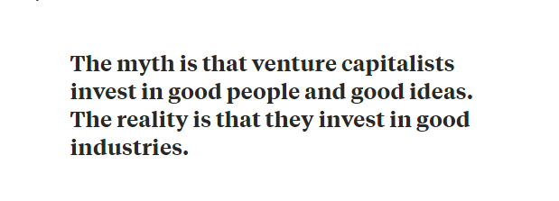
From the Harvard Business Review (1998)

Slide 9
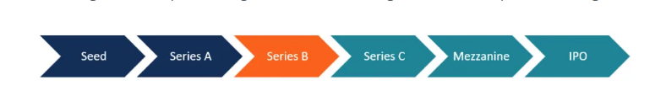
Stages of Venture Capital Funding

Slide 10
Seed financing
Earliest stage of capital raising process.
Riskiest, hence avoided by Venture Capitalists
Most complicated – investor doesn’t have enough info to make a decision
Participants – mostly Angel Investors (appreciate riskier ventures and expect high returns=Equity)
Management/Soft skills of entrepreneur can determine business success.(But modern Tech challenges this view)
Peter Thiel’s investment in Facebook.

Slide 11
Series a Funding
A type of equity-based financing (company offers convertible preferred shares).
Often comes with anti-dillution provisions.
Primary objective – Continued growth
Businesses that already generate revenues but are still in the pre-profit stage.
A more formal process – more complete company info, valuation of company done & VC firm does due diligence (progress made since start, management’s efficiency in managing resources)
Series A rounds raise approximately $2 million to $15 million (Median Series A funding 2021 = $10 million. (Investopedia)

Slide 12
Series b funding
3rd Stage Start-up Financing, 2nd stage VC financing
Equity based – company offers convertible preferred shares.
More participants enter – (willing to invest in later stages of growth) –
Objective – take business past development stage, help business scale or meet levels of demand.
Mostly VC firms and Private Equity Firms

Slide 13
Hypotheses
Null Hypothesis – No factors determine the amount of funding offered to a start-up by venture capitalists in India.
Alternative Hypothesis – A range of factors about a start-up(characteristics) (such as sector it wants to venture into, use of technology or years its has been in existence, Stage of growth, location) determine the amount of funding offered to start-ups by venture capitalists in India.

Slide 14
Research Questions
What sectors have attracted the largest funding in the last 4 years?
Does the location of the venture affect the amount of funding offered to a venture? Or what locations have received the biggest funding?
Who are the major funders of ventures in India in the last 4 years? And what are the major sectors they are directing their funding?
Does the number of business owners (entrepreneurs) in a venture determine the amount/likelihood of funding from investors?
Does the stage of the venture affect the amount of funding offered to ventures?
What are the Maximum, Minimum, Average and Median Funding amounts offered to each sector/ stage of funding and how do they compare?
What is the trend of financing over the four years, cumulatively (total funding) and in independent sectors? (Monthly and/Yearly Trends)
Does the year of founding determine/influence the funding amount?

Slide 15
References
Corporate Finance Institute. (2022). Private Equity vs Venture Capital, Angel/Seed Investors. Available at: https://corporatefinanceinstitute.com/resources/equities/private-equity-vs-venture-capital-vs-angel-seed/
Mbhele, T. P. (2012). The study of venture capital finance and investment behaviour in small and medium-sized enterprises. South African journal of economic and management sciences, 15(1), 94-111.
Reiff, N., Mansa, J. & Eichler, R. (2022). Series Funding: A, B, and C. Investopedia, Available at : https://www.investopedia.com/articles/personal-finance/102015/series-b-c-funding-what-it-all-means-and-how-it-works.asp
Zider, B. (1998). How venture capital works. Harvard business review, 76(6), 131-139.

Slide 16
Thank You

