Slide 1
Aviation Safety Analysis
Dean Muimi Mutie
October 3rd 2024

Slide 2
Overview
The project focuses on analyzing civil aviation accident data from 1962 to 2023 to assess safety risk and determine which aircraft types have the lowest risk to operate. The data-driven insights will guide our company’s decision making on which aircraft to purchase. The data set has been obtained from the National Transport Safety Board.

Slide 3
Problem Statement
The company is preparing to expand and diversify its portfolio into the aviation industry for both commercial and private enterprise. However, our stakeholders face a major challenge in ensuring that the aircraft selected are safe, reliable and aligned with our long-term business goal. Without data-driven decision making approach, our company risks making costly investment in an aircraft model with poor safety records, higher accident rates or operational risks. The lack of a structured analysis on the aviation accident data may lead to uninformed purchase decisions, potential financial losses and reputational damage with our esteemed clients.

Slide 4
Objectives
Identify aircraft makes, models and engine types with the highest and lowest accident rates.
Analyze accident patterns across different flight phases.
Examine accident trends over time to spot improvements or recurring risks.
Determine the safest aircraft models based on severity and injury data
Visualize key safety insights to support data-driven fleet decisions

Slide 5
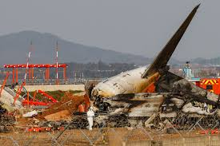
Analysis
A detailed analysis for the findings can be found on the GitHub repository link below which hosts the dataset as well as the Jupiter notebook used in the analysis: https://github.com/muimidean/aviation_safety_analysis.git
The dataset used was cleaned by removing duplicates, filling missing values, standardized date formats and Focused on 1980 to 2023 for modern aviation relevance

Slide 6
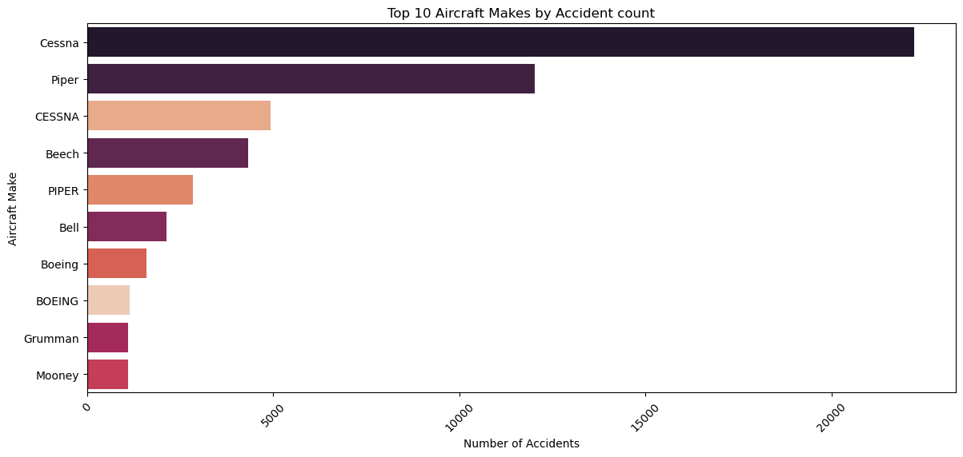
Top 10 Aircraft Makes by Accident count
Based on the bar chart Cessna Aircraft make has had the highest Number of Accident. Other makes like Piper, Beech and Bell appear to have high accident counts compared to the well known Aircraft model Boeing and BOEING which have low counts as they tend to be popular in the industry.

Slide 7
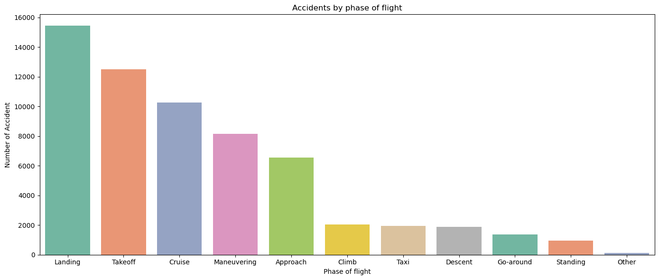
Accidents Distribution Across Flight Phases
Based on the Accident by phase of flight visualization, We see that most accidents occurred during the landing phase followed by takeoff

Slide 8
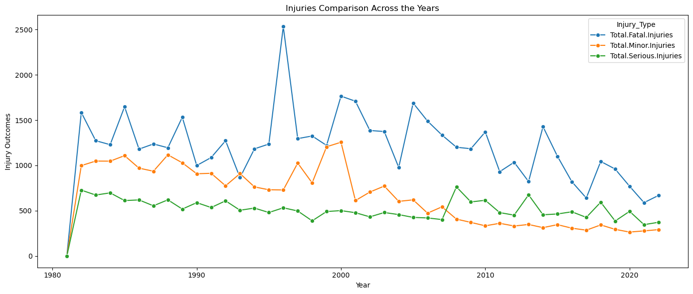
Trends in Accident Injury type Over Time
From the Injury comparison Across the years, we see that as much as there were minor injuries, most accidents were Fatal. We see that in the late 1990s there was a high number of fatal injuries, However over the injury trend went down over the years because of the modern aviation safety policies.

Slide 9
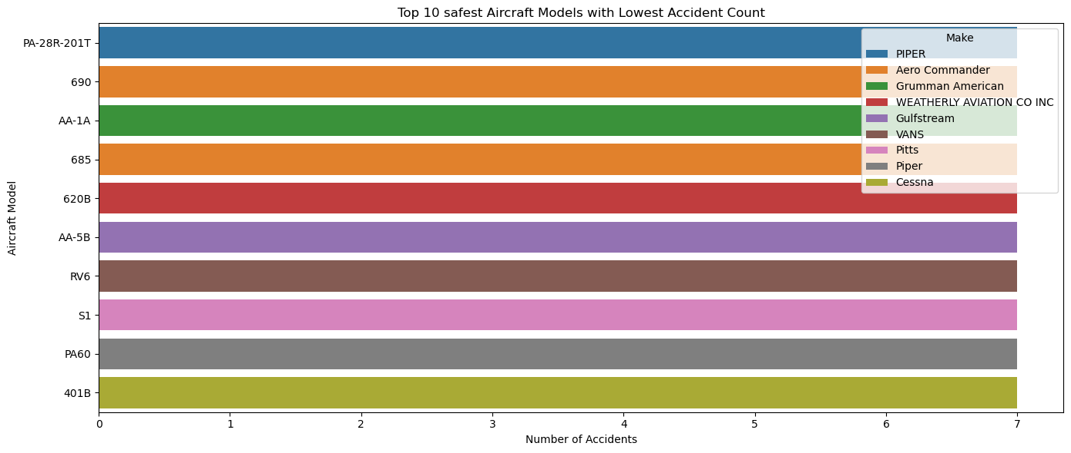
Safest Aircraft Models Analysis
The observation shows the top 10 safest Aircraft Models with the lowest Accident count having Piper PA-28R-201T, Aero Commander 690, Grumman American AA-1A, Piper PA60 and Cessna 401B in the list.

Slide 10
Conclusion
The analysis reveals distinct variations in aircraft safety across different manufacturers and models. The observation shows that the top 10 safest aircraft models with the lowest accident counts include the Piper PA-28R-201T, Aero Commander 690, Grumman American AA-1A, Piper PA-60 and Cessna 401B. From the injury comparison across the years, it is evident that although some accidents resulted in minor injuries, most were fatal. In the late 1990s, fatal injuries were significantly higher, but the trend has gradually declined over the years due to the implementation of modern aviation safety policies. Based on the accident-by-phase-of-flight visualization, most accidents occurred during the landing phase, followed by takeoff. Overall, Cessna and Piper recorded the highest number of reported accidents mainly due to their wide use in general aviation, while Boeing, Beech and Bell showed lower accident frequencies, reflecting stronger safety standards. Continuous monitoring, strict maintenance and data-driven safety measures remain essential to further reducing the likelihood and severity of aviation accidents.

Slide 11
Recommendations
Invest in aircraft models with the lowest historical accident and fatality records to enhance overall safety.
Strengthen pilot training programs and enforce regular mechanical inspections to reduce human and technical errors.
Prefer commercial operations where feasible, as they maintain stronger safety standards and compliance frameworks.
Adopt data-driven safety policies to continuously monitor performance and identify emerging risk patterns
Prioritize operations in regions with consistently low incident and accident rates.

Slide 12
Thank You

