Slide 1
Mind the G p
From “The model-code gap” by Simon Brown @simonbrown
Software Craftsmanship London Conference
October 4th 2018
From “Just Enough Software Architecture” by George Fairbanks
From “Clean Architecture” by Robert C Martin
Chapter 34 “The Missing Chapter” by Simon Brown
Notes:
Suggested Props:
Ball of mud (architectural style)
mirror (reflection!)
banana & gorilla (quote)
packaging
decoy: whisky? (If the presentation goes well, I’ll have a glass of whisky. If it goes bad, I’ll have the bottle!
I’m fascinated by architecture. Its difficult to put a label on it, there seem to be different kinds! What are the artifacts? When are they used?
Audience poll:
Any architects in the room?
Any programmers?
Any programmers that sometimes do architecture?
Any programmers created a Java package?
Intro:
PROP: Packaging
Me: I want you to consider your packaging and layering. And I want you to enforce it!
Its software architecture (according to Simon Brown).
Architecture is measured by the cost of change.
So, this is a talk about software architecture. We’ll look at some different ways of organising your code. We’ll touch on code rot, and we’ll see how to help prevent it.

Slide 2
What’s the problem?
Notes:
PROP: The Big Ball of Mud!
“A big ball of mud is a casually, even haphazardly, structured system. Its organization, if one can call it that, is dictated more by expediency than design.” Brian Foote and Joseph Yoder
Its slow, painful and expensive to work with!!
Pick up PROP: Banana (then transition to next slide!)

Slide 3
What’s the problem?
“you reach for the banana, and get the entire gorilla.”
–Michael Stahl
Notes:
PROP: Banana
Previous:
The Big Ball of Mud!
“A big ball of mud is a casually, even haphazardly, structured system. Its organization, if one can call it that, is dictated more by expediency than design.” Brian Foote and Joseph Yoder
Its slow, painful and expensive to work with!!

Slide 4
What’s the answer?
“a well structured highly modular codebase gives you the ability to move fast”
Notes:
How do you get one?!
Organise: Layer your code. Consider a Web app:
- Web Controllers
- Services
- DAOs / Repositories

Slide 5
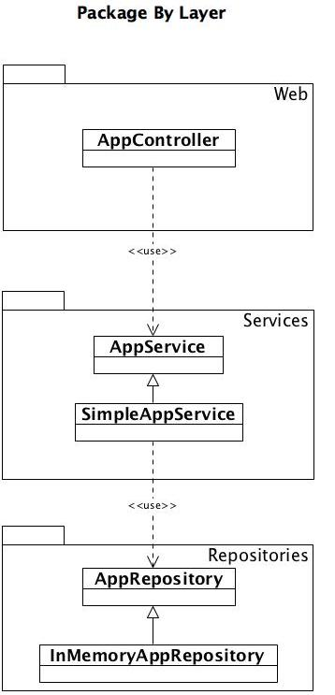
Notes:
Horizontal Slicing

Slide 6
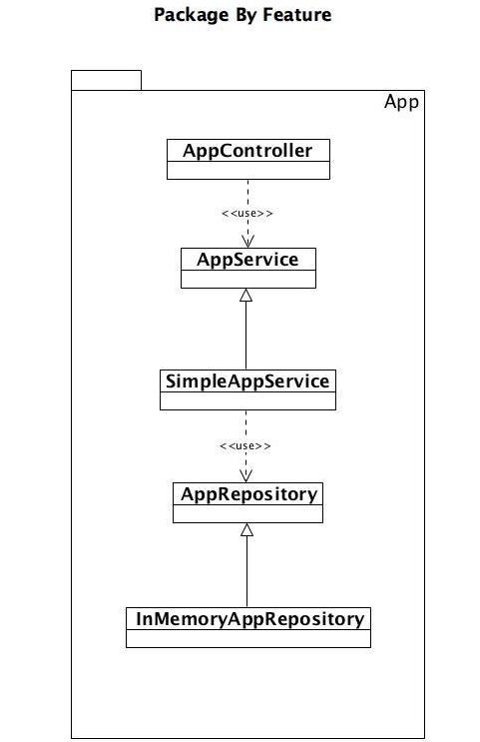
Notes:
By Feature:
Vertical Slicing (similar to a micro service)

Slide 7
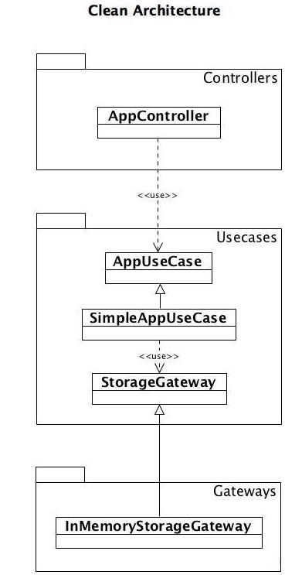
Notes:
Clean Architecture (Ports & Adapters / Hexagonal)
Frameworks etc on the outside
Business Code inside
Source code dependencies only point inwards

Slide 8
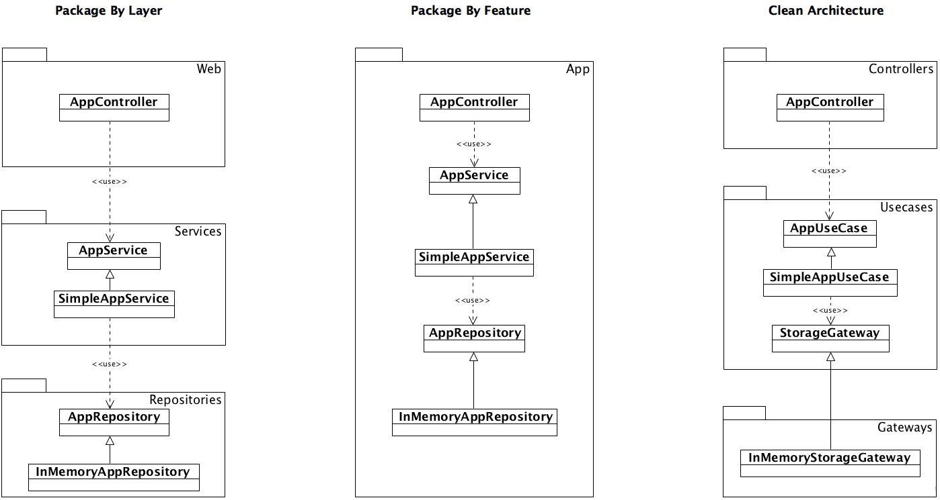
Notes:
All together - side by side
Can see they all have 5 classes / interfaces, the packaging is the difference.

Slide 9
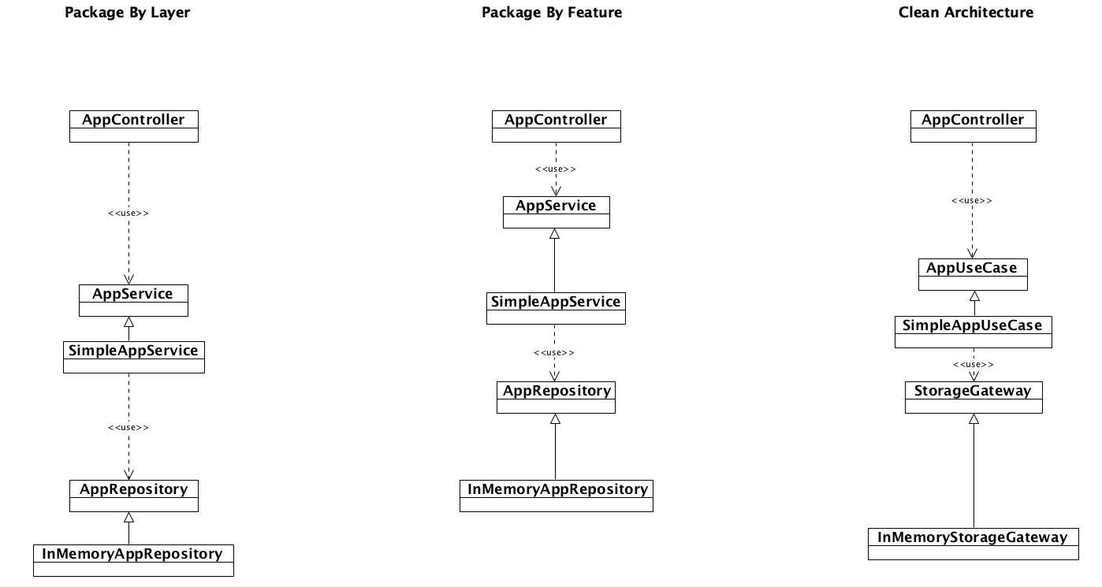
Notes:
This is the fun slide!!
1st problem: Use public everywhere then there is no encapsulation.

Slide 10
The problems
Surface Area
You can cheat - break the layering
Notes:
Surface Area: If you use public everywhere, … the 3 styles are syntactically identical. Really?? (Its the next slide)
If we make all the classes and interfaces public, these types are accessible from anywhere in your codebase. Although we have packages on the picture, they are meaningless - they are simply folder structures used to organise code. There is no encapsulation. If we're not using packages for encapsulation, lets remove them! (Simon Brown)
We’ll come back to cheating / breaking the layering shortly… however, both of these result in the code degrading towards a “Big Ball Of Mud”
(next slide)

Slide 11
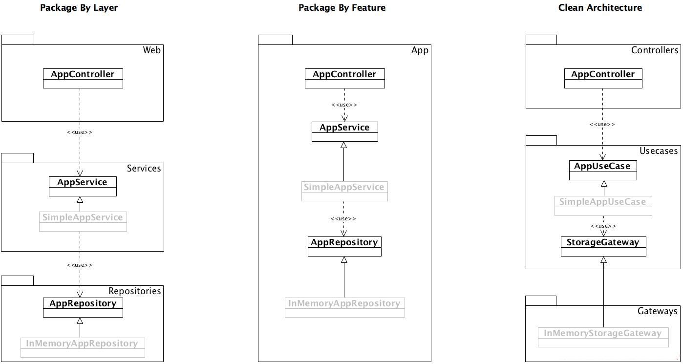
Notes:
This slide:
Lets reduce the surface area. Don’t use public when you can avoid it.
Java interfaces are always public, so we can’t hide those.
If we used abstract classes instead of interfaces, we can at least prevent them being public. But the classes extending them must be able to find them, so whats the benefit? If it “internal” to the package (eg with the “Package by Feature” example), then fine - perhaps this helps reduce the surface area.
We can hide concrete classes though by making them package protected, but then we have a challenge to instantiate them!
- Spring can instantiate package protected classes (but you’re tied in to Spring!). Who wants that? We’re taking a decision earlier than we need to as well.
You could create a Factory to instantiate the concrete classes. The the factory is visible, not the concrete classes.
PROP: Mirror (reflection)…
You already don’t want to use reflection! Thats getting around the barrier you’re putting in place… why not just use public everywhere? (Spring isn’t really much different!)
We still have the layering problems. Nothing stopping you cheating!

Slide 12
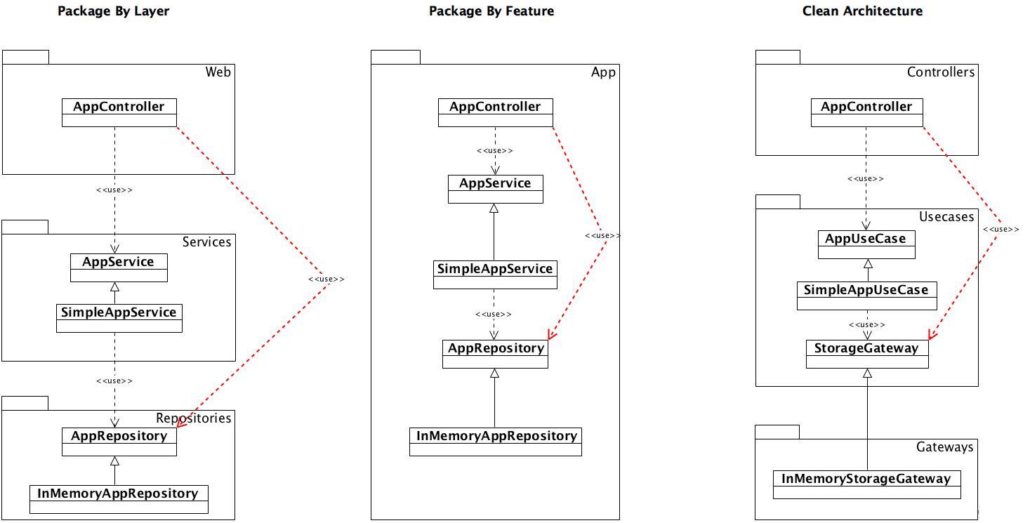
Notes:
2nd Problem:
Cheating! Breaking the layers.
These result in the code degrading towards a Big Ball Of Mud

Slide 13
Modularise your code
Java 9 modules: You can specify your “published” types as opposed to public.
You can also do this by having separate codebases.
The “ultimate” way to modularise your code - put a network layer in between!
Notes:
This slide: What else can we do?
Solves some of problem 1 - surface area is smaller outside the module
Point 2 - Put each package or layer into its own codebase.
Point 3 - microservices

Slide 14
Why not make the computer verify the architecture?
Time consuming to set up *
Break quickly on most codebases *
We have better things to do *
It seems like a hack *
- Simon Brown, SCL Conf October 2018.
Notes:
- Simon Brown, SCL Conf October 2018.

Slide 15
Really???
Notes:
We can solve problem 2
We write tests to ensure production code meets its specification.
We may write unit tests (London/Mockist/Outside in approach) to drive the architecture.
These aren’t hacks. Why would writing a test to assert the layering be a hack??
Let me show you…. (IntelliJ - Mind the Gap)

Slide 16
Take-aways
Consider your layers - your architectural principles
Consider Clean Architecture / Ports & Adapters
Enforce them through archUnit
Hide what you can
Don’t use public where you can avoid it
Consider using factories to hide concrete classes
Use modules, microservices

Slide 17


And that’s me
@muirandy
https://github.com/muirandy/mindthegap
Notes:
PROP: decoy: whisky? (If the presentation goes well, I’ll have a glass of whisky. If it goes bad, I’ll have the bottle!

