Slide 1
Used Car Price Prediction System
Web Scraping eBay to Deploying AI
Mujahid Afzal

Slide 2
Project Overview & Objective
Goal: Build a Machine Learning model to predict fair market value for used cars using real-time data.
Why eBay?
- Represents the true 'open market' with high volume.
- Data is unstructured (messy titles), offering a real Data Science challenge.
Tech Stack: Python, BeautifulSoup, SQLite, Pandas, LightGBM, Streamlit, Docker.

Slide 3
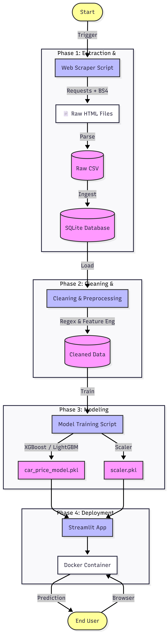
The Architecture (Pipeline)
End-to-End Workflow:
1. Web Scraping: Custom script to download thousands of listings.
2. Storage: Raw data stored in SQLite Database for persistence.
3. Cleaning: Regex & Feature Engineering to fix messy text.
4. Modeling: Benchmarking 8 models (Linear vs Tree-based).
5. Deployment: Dockerized Streamlit App.

Slide 4
Data Cleaning (The Secret Sauce)
Challenge: Raw data was unusable (e.g., '🔥2015 Toyota Camry!!! L@@K 74k').
Solutions:
- Regex: Extracted sticky years (e.g., 'listing2016').
- Logic: Normalized mileage ('74k' -> 74,000).
- 'Ghost Car' Fix: Injected 'Year + Brand' if cleaning wiped the title.
Result: 100% of valid rows preserved for training.

Slide 5
Analysis & Model Results
Insights:
- Year & Mileage are the strongest predictors followed by model.
- Seller Score proved to be noise (0% correlation) that’s why it was excluded.
Winning Model: LightGBM 🏆
- Accuracy: ~85.27% (R2 Score)
- Speed: 10x faster than Random Forest.
- Outperformed Linear Regression (~65%) significantly.

Slide 6
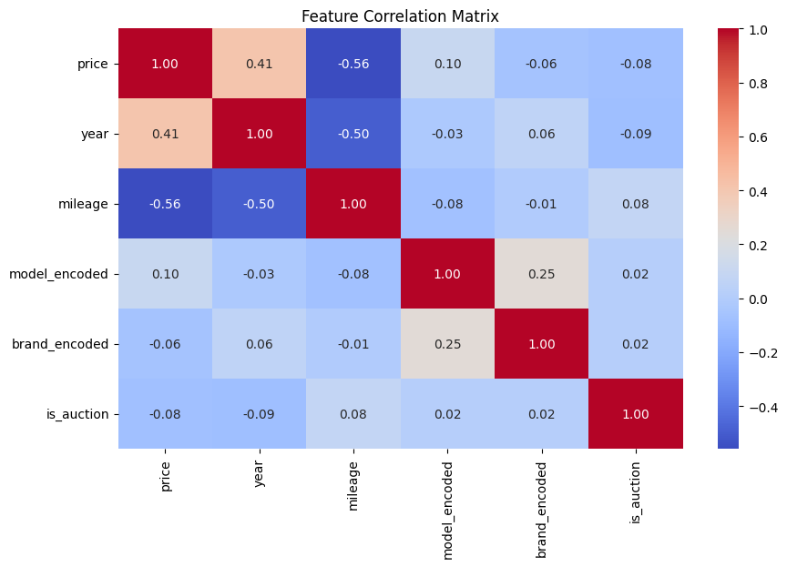
Feature Correlation Matrix

Slide 7
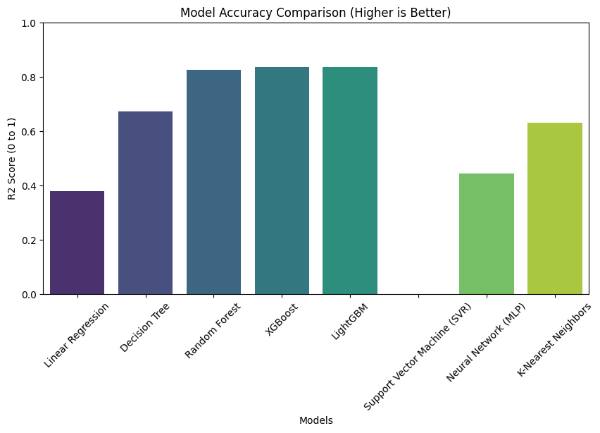
Model Accuracy Comparison

Slide 8
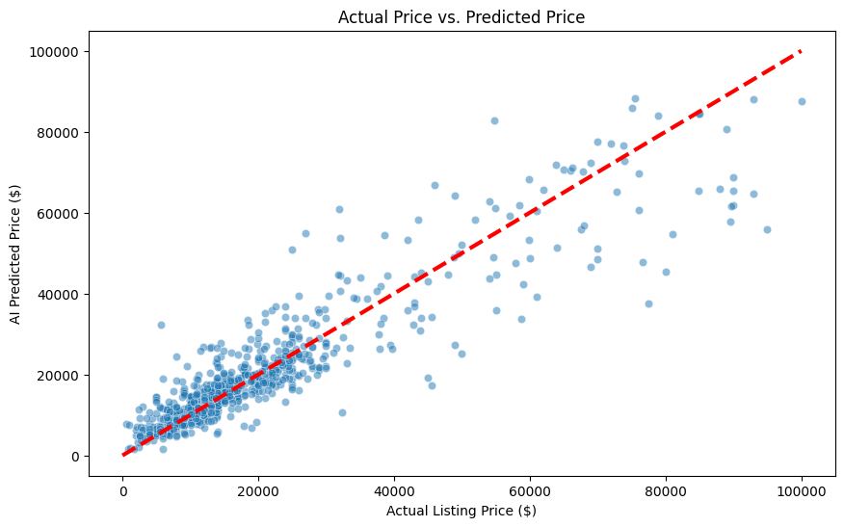
Actual price Vs predicted price

Slide 9
Deployment & Conclusion
Final Product: A Dockerized Streamlit App.
- Users select a brand and get instant price estimates.
- 'Scrap Guard' logic prevents negative price predictions.
Conclusion:
Successfully transformed messy HTML into a deployed AI product.
Demonstrated full-stack skills: Scraping -> SQL -> ML -> MLOps.

