Slide 1
Used Car Price Prediction System
Web Scraping eBay to Deploying Predictive Model
Mujahid Afzal

Slide 2
Project Overview & Objective
Goal: Build a Machine Learning model to predict fair market value for used cars using real-time data.
Why eBay?
- Represents the true 'open market' with high volume.
- Data is unstructured (messy titles), offering a real Data Science challenge.
Tech Stack: Python, BeautifulSoup, SQLite, Pandas, XGBoost, Streamlit, Docker.

Slide 3
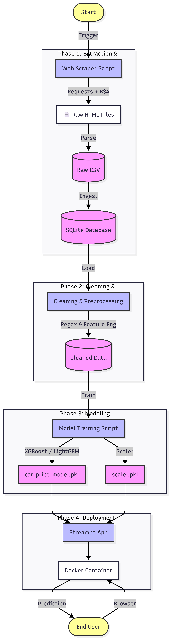
The Architecture (Pipeline)
End-to-End Workflow:
1. Web Scraping: Custom script to download thousands of listings.
2. Storage: Raw data stored in SQLite Database for persistence.
3. Cleaning: Regex & Feature Engineering to fix messy text.
4. Modeling: Benchmarking 8 models (Linear vs Tree-based).
5. Deployment: Dockerized Streamlit App.

Slide 4
Data Cleaning
Challenge: Raw data was unusable (e.g., '🔥2015 Toyota Camry!!! L@@K 74k').
Solutions:
- Regex: Extracted sticky years (e.g., 'listing2016').
- Logic: Normalized mileage ('74k' -> 74,000).
- 'Ghost Car' Fix: Injected 'Year + Brand' if cleaning wiped the title.
Result: 100% of valid rows preserved for training.

Slide 5
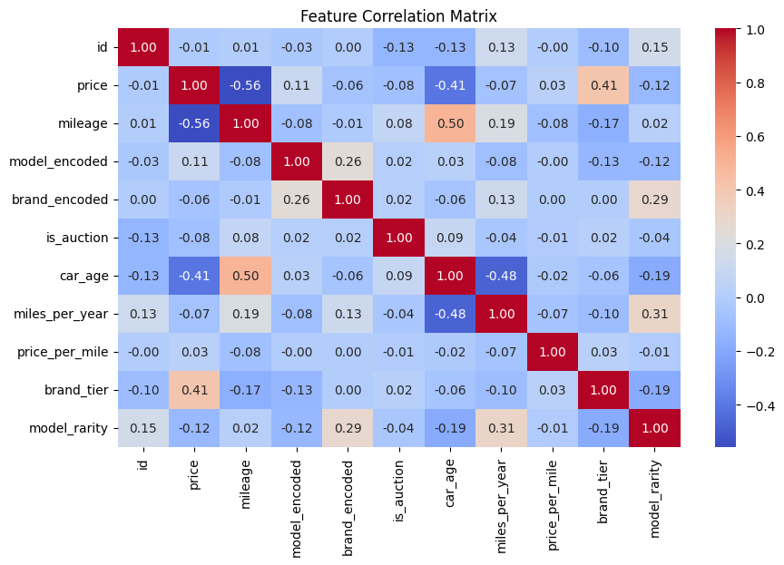
Feature Correlation Matrix

Slide 6
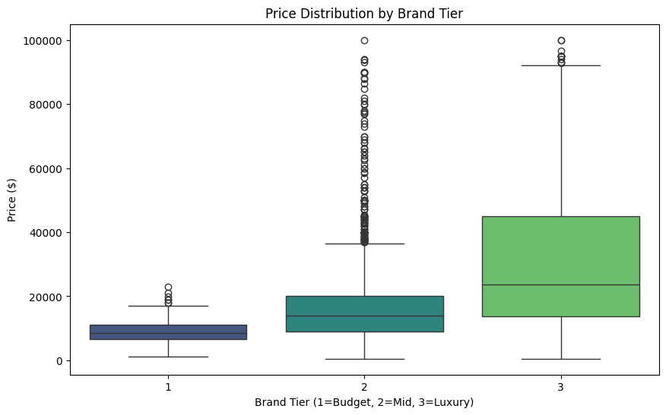
Feature Engineering
Brand Tier:
  Mapped brands to distinct categories (1=Economy, 2=Mid-Range, 3=Luxury).
  Captured the "Luxury Premium," proving a +0.41 correlation with price.

Slide 7
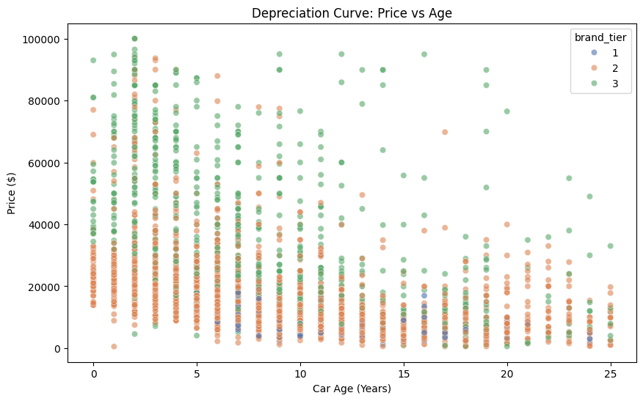
Feature Engineering
The Depreciation Curve (Justifies Price vs. Age: -0.41)
  This visualization validates the impact of car_age on value. It reveals the non-linear nature of depreciation.
  A steep drop in value during the first few years (0–5), followed by a flattening of the curve as cars get older.

Slide 8
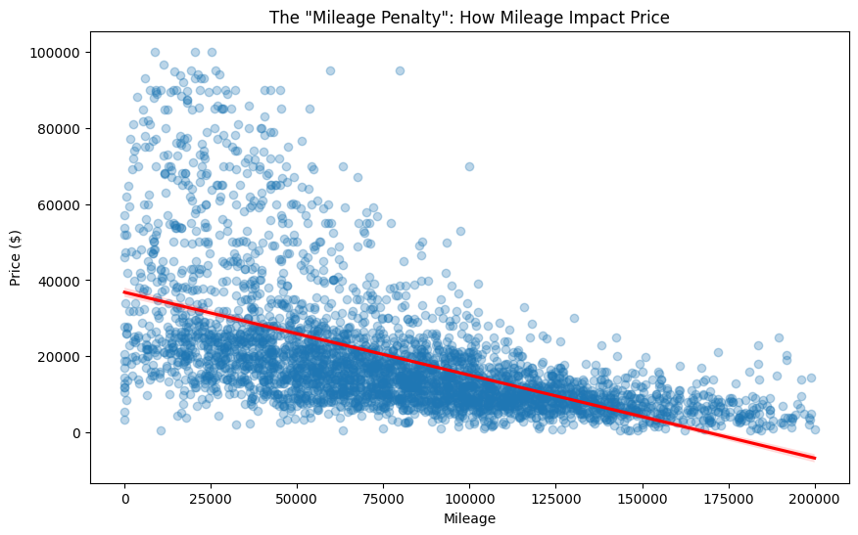
Feature Engineering
The "Mileage Penalty" (Justifies Price vs. Mileage: -0.56)
  This chart visually proves that as mileage increases, the price drops reliably. The red regression line helps confirm this negative trend, validating why mileage is likely strongest predictor.

Slide 9
Analysis & Model Results
Insights:
Car Age: Calculated `2025 - Year` to measure depreciation directly.
Mileage is also a strong feature followed by model.
- Seller Score proved to be noise (0% correlation) that’s why it was excluded.
Winning Model: XGBoost
- Accuracy: ~84.5% (R2 Score)
MAE: ~$4,300 (Average Error)
Speed: Training time 4.3s (vs LightGBM 53s). XGBoost was 10x faster in your specific tuning run.
- Outperformed Linear Regression (~50%) significantly.

Slide 10
Model Accuracy Comparison
Rank | Model | R² Score | MAE (Error) | Time (s) | Output
1 | XGBoost | 84.49% | ~$4,299 | 3.1s | The Winner. Highest accuracy ($R^2$), lowest error, and fastest training speed.
2 | LightGBM | 84.39% | ~$4,378 | 51.2s | Runner Up. Comparable accuracy to XGBoost but significantly slower training time.
3 | Random Forest | 81.11% | ~$4,811 | 11.2s | Solid performance (>80%), but higher error than the gradient boosting models.
4 | KNN | 76.14% | ~$5,223 | - | Effective baseline; confirms that "similar cars have similar prices."
5 | Decision Tree | 65.90% | ~$6,417 | - | Prone to overfitting; struggled to generalize to unseen data.
6 | Neural Network | 65.21% | ~$6,693 | - | Underperformed tree-based models on this specific tabular dataset.
7 | Linear Regression | 49.55% | ~$8,573 | - | Poor fit. Proves car pricing is highly non-linear.
8 | SVM (SVR) | -7.7% | ~$11,041 | - | Failed model. Could not effectively separate the data hyperplanes.

Slide 11
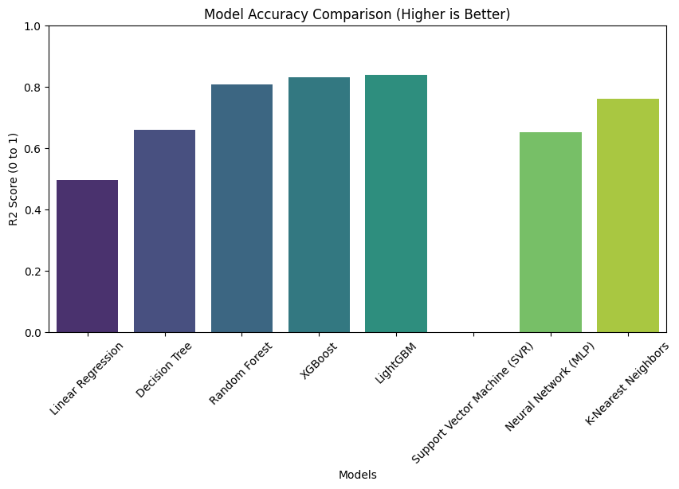
Model Accuracy Comparison

Slide 12
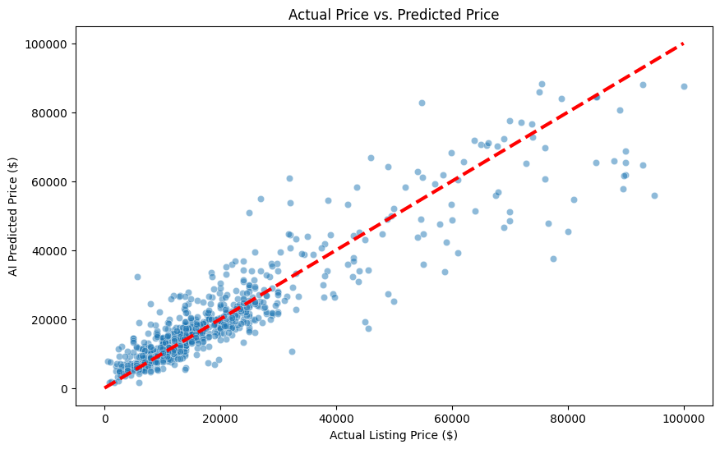
Actual price Vs predicted price

Slide 13
Deployment & Conclusion
Final Product: A Dockerized Streamlit App.
- Users select a brand and get instant price estimates.
- 'Scrap Guard' logic prevents negative price predictions.
Conclusion:
Architected a complete lifecycle: Scraping → Warehousing → Feature Engineering → Deployment
Delivered High-Precision AI: Engineered a model achieving 84.5% Accuracy, outperforming traditional regression baselines by over 35%.
Optimized for Production: Selected XGBoost for its superior efficiency, reducing training time to 3.1s while maintaining a low error margin (~$4,300 MAE).
Scalable Architecture: Built a robust pipeline capable of handling thousands of new listings without manual intervention.

