Slide 1

Decepticon: Attacking secrets of Transformers
Mujahid Al Rafi¹, Yuan Feng¹, Fan Yao², Meng Tang¹, Hyeran Jeon¹
¹ University of California Merced
² University of Central Florida
Notes:
Hi Everyone,
Thank you for attending my talk.
I am Mujahid Al Rafi, I’m a PhD student at UC Merced.
Today I am going to present our work called Decepticon where we attack the secrets transformer models.

Slide 2


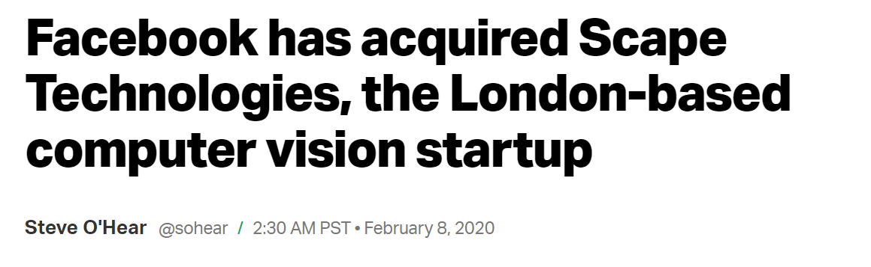
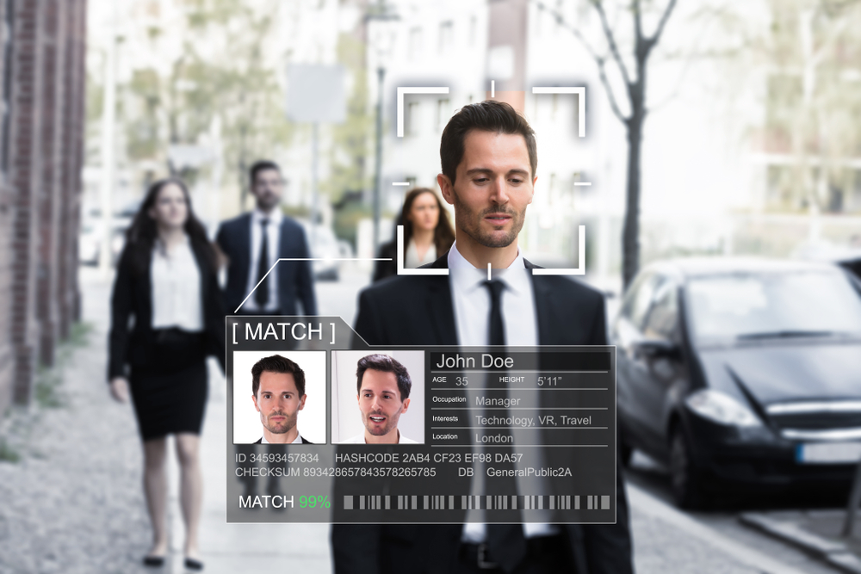
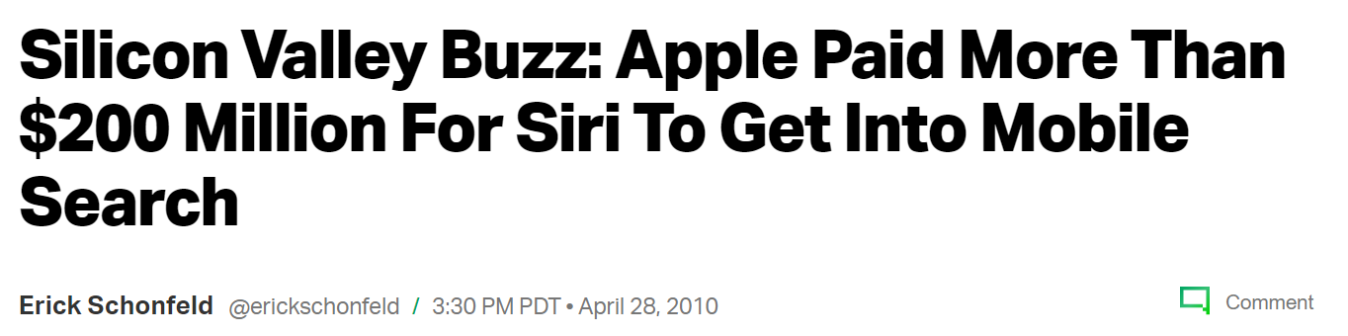

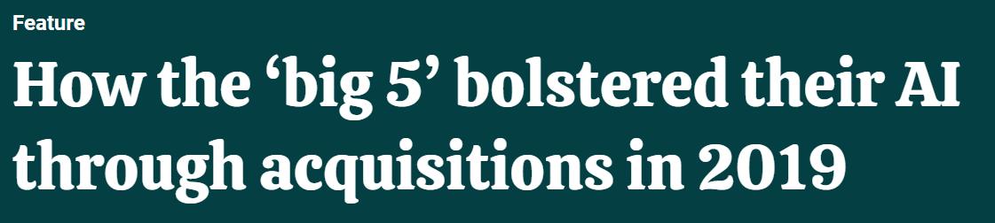
Increasing Impacts of Deep Learning
Several Hundreds of Millions to Billions dollar trades to acquire the best solutions!!
Notes:
Explain the importance of deep learning in daily lives and how large the market is now.
Big tech companies such as apple, meta, google, amazon, MS are aggressively acquiring AI startups.
The performance of deep learning solutions are directly leading to market revenue of tech companies.
So, algorithms and structures of deep learning solutions are critical information that the companies need to protect.
Extracting the arch and then weight

Slide 3
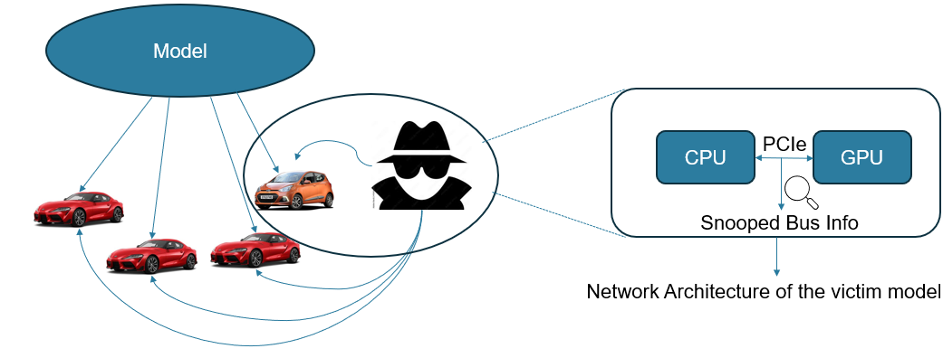
Model Extraction Attack
Extracting characteristics of a victim DNN model
Important model characteristics:
Model architecture:
Layer number and types
Layer topology
Layer dimension
Model parameters and hyperparameters
Successful model architecture extraction helps extract further model characteristics.
Creating a clone model – Stealing the IP
Adversarial attack
Notes:
Out of them, we are going to discuss model extraction attack today.
Explain the model extraction attack
Redraw the figure

Slide 4
Model Extraction Assumptions
State-of-the-art solutions assume that the attackers
DO NOT know
Model structure
Implementation details
DO know
Each layer executes a set of statically scheduled GPU kernels
CAN leverage various architecture side channels
PCI-e bus probing
Message trapping
Cache timing
Memory probing …
Notes:
Explain the assumptions of state-of-the-art solutions.

Slide 5
Challenges of Extracting Emerging Models
Quickly growing model complexity/size
CNN models in early 2010’s
AlexNet: 60 million parameters, 8 layers
VGG16: 138 million parameters, 16 layers
Transformers in 2023
BERT Large: 340 million parameters, 24 layers
GPT-2: 1.5 billion parameters, 12 layers
No explicit secret dependent control/data flows. Conventional side channel (e.g., via caches) won’t work.
State-of-the-arts do not utilize unique characteristics of emerging models.
Most existing attacks’ targets
Notes:
In RSA algorithm, the private key bit 0/1 decides whether 1 or 2 multiply instructions will be executed.
Let’s see some unique characteristics of some emerging models.
Talk about CNN and transformers. Then Talk about the existing works only targeting CNNs.

Slide 6



Our Motivations: Transfer Learning
SQuAD Dataset
Untrained Model
Pre-Training
Pre-Trained Model
Fine-Tuning
IMDb Dataset
Wikipedia Dataset
PubMED Dataset

Slide 7
Our Motivations: Transfer Learning
Why transfer learning is essential for many large models?
Not feasible to train task specific NLP models from scratch.
Waste of time to train individually with lots of common datasets (e.g., English grammar for all NLP models)
Pre-trained models are shared via
Public model zoos release general-purpose models pre-trained with several common but very large datasets.
Private institutes/companies internally share pre-trained models trained with large common datasets used for their products
Individual users/engineers develop task-specific models by fine-tuning the pre-trained model with small targeted datasets.
Notes:
Not feasible: It’s possible when the model creator has access to enough resources such as lots of GPUs, large memory and time. But it’s not feasible for everyone.

Slide 8
Transfer Learning Characterization
Weight value similarity in same pretrained-finetuned pairs
Notes:
In the Xp-XF case where a finetuned model is compared with its underlying pretrained model, most finetuned weights have small difference from the pretrained weights. (Related pretrained-finetuned pair)
In the Xp-YF case where a finetuned model is compared with a different pretrained model, finetuned weights have difference from the pretrained weights. (Unrelated pretrained-finetuned pair)
Related pretrained-finetuned pair: almost 50% weights show <0.002 distance
Related pretrained-finetuned pair: only 3% weights show <0.002 distance
As the same pretrained model can be finetuned for different tasks, we evaluated weight similarities among 9 different tasks models finetuned from the same pretrained model.

Slide 9
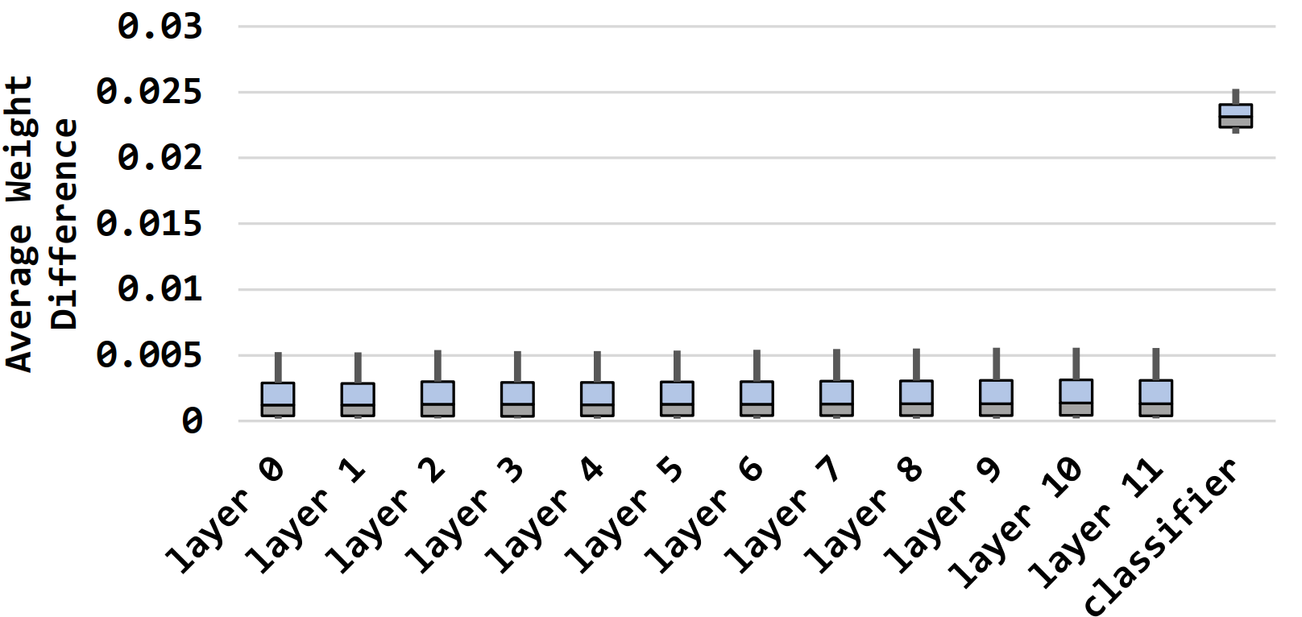
Transfer Learning Characterization
Weight value similarity in different task models
Observation 1. Pre-trained models provide enough hints for fine-tuned model weights.
9 different tasks finetuned with GLUE dataset from the same pretrained model
Notes:
Put the 9 tasks
But do all weights change similarly during tuning?

Slide 10
Transfer Learning Characterization
Outlier weights show higher updates during fine-tuning
Observation 2. Few outlier weights change by over 3× more and are the sources of the long tail weight gap distribution.
Notes:
This observation is a per layer observation. But do all layers have the same impact?

Slide 11
Transfer Learning Characterization
Layers do not have the same impact towards accuracy
Number of Frozen Layers | Accuracy (%)
0 | 80.13
1 | 80.23
2 | 79.15
3 | 76.53
4 | 71.91
5 | 68.55
6 | 64.58
Observation 3. The impact of layers towards model accuracy is different. A few layers may reuse pre-trained model’s weights without hurting accuracy.

Slide 12
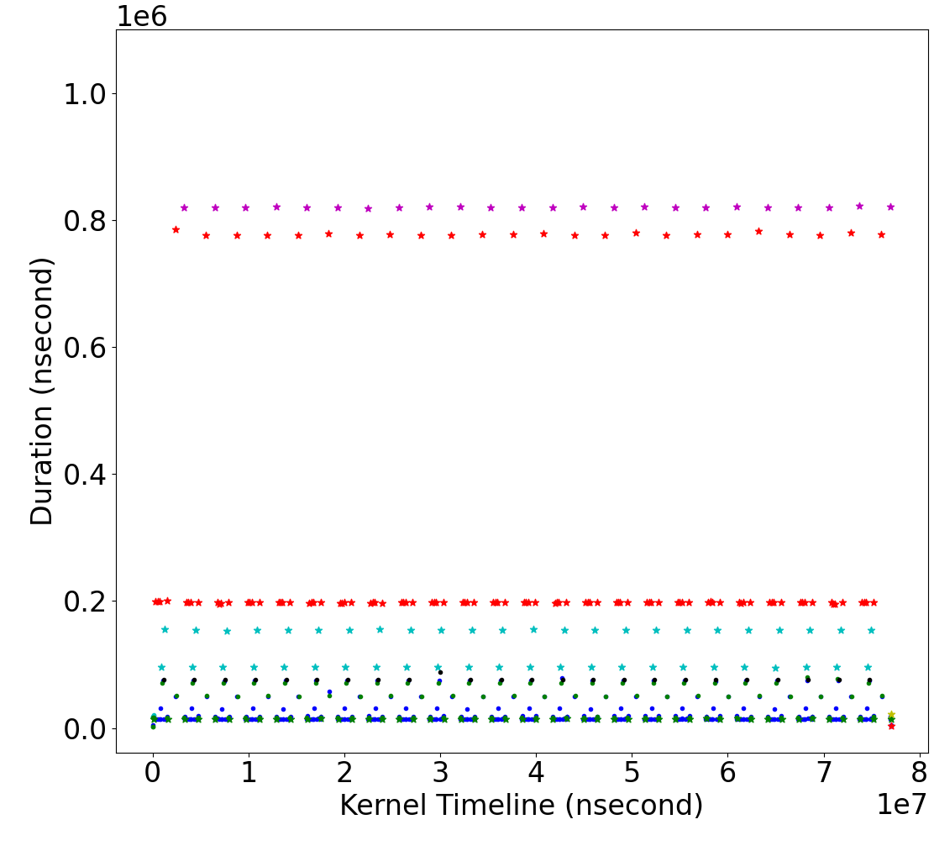
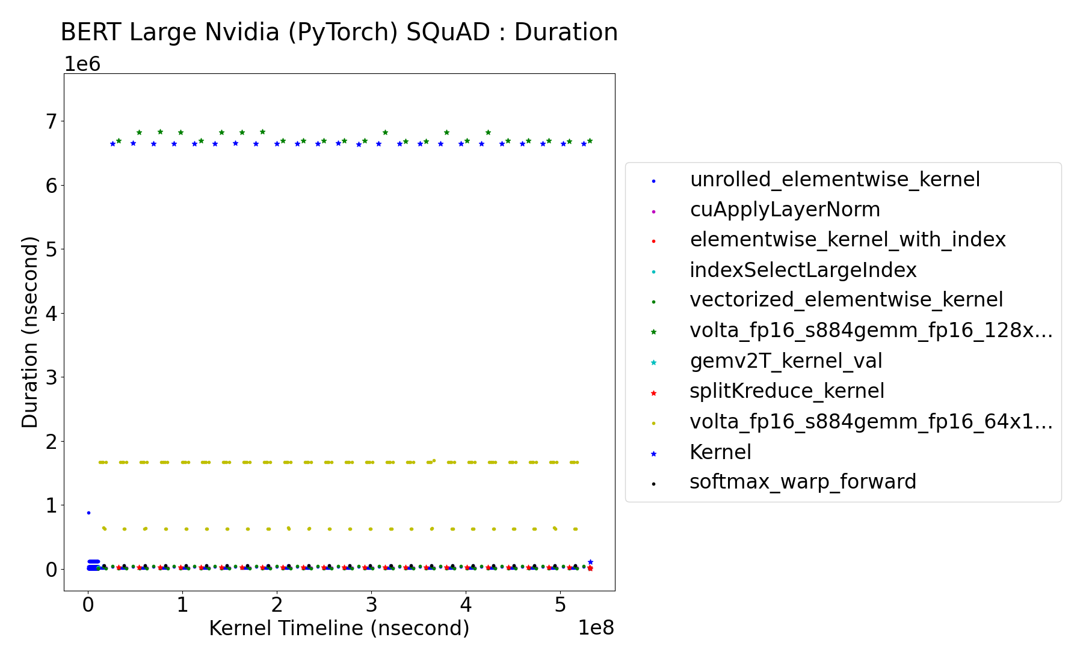
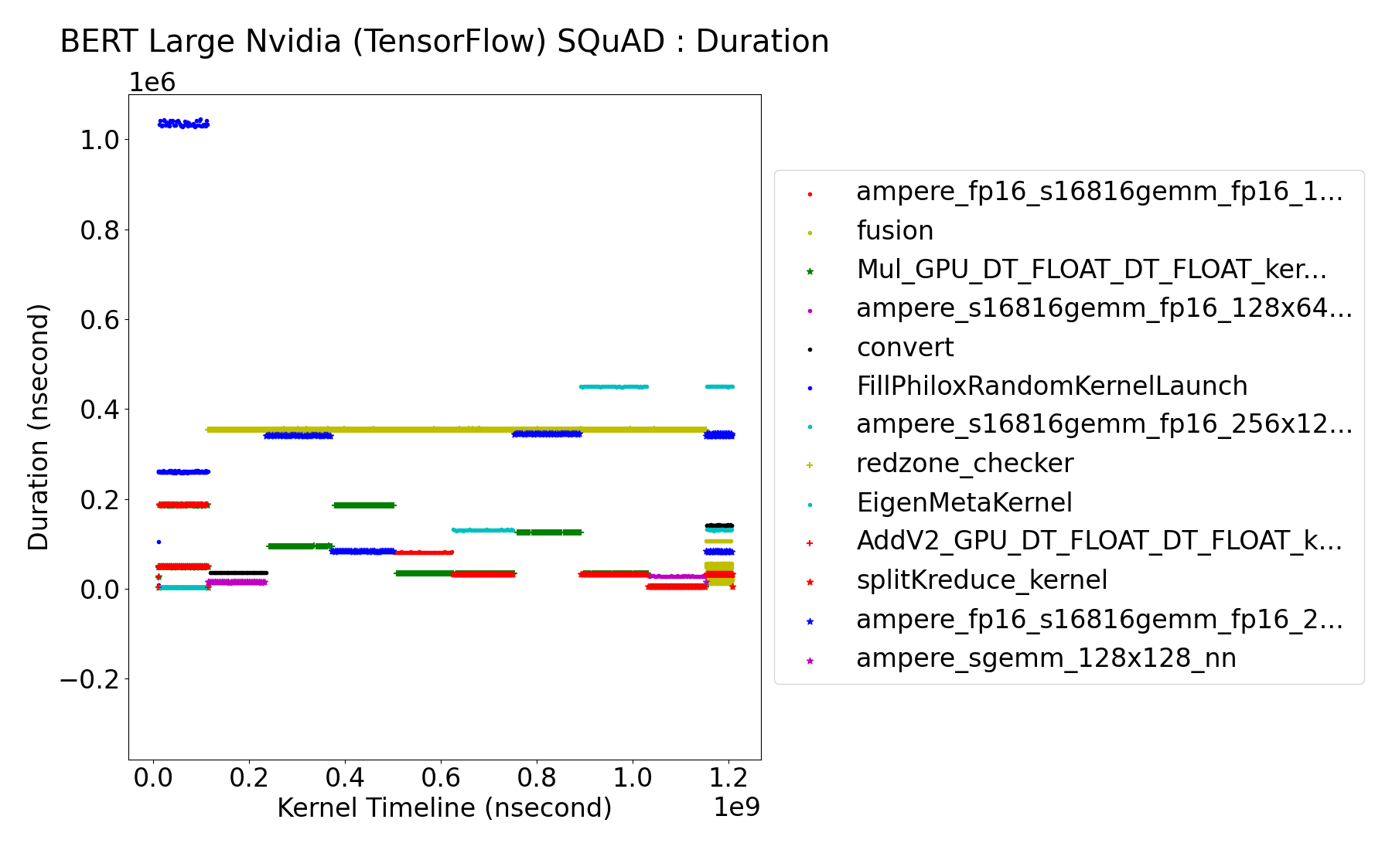
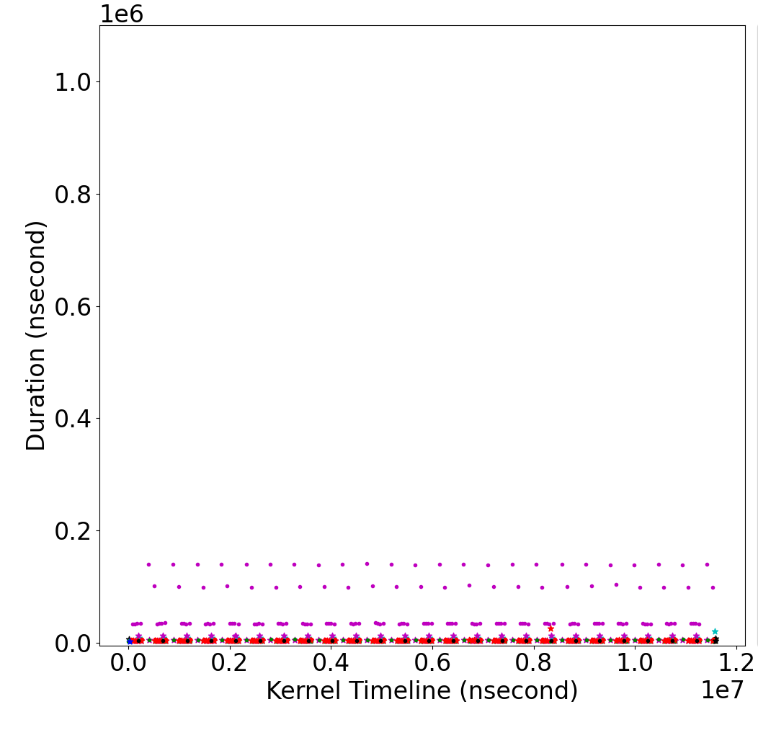
Transformer Characterization
Huggingface PyTorch
NVIDIA PyTorch
NVIDIA TensorFlow
Meta RoBERTa PyTorch
Diversity in Time-series Kernel Execution Times for BERT-Large Models Released by Different Sources
Observation 4. With fine-tuned models’ unique execution fingerprints, the pre-trained model can be located.
Notes:
Emphasize more on the fingerprint. With the previous 3 observations, we now need to locate the pretrained model of a finetuned model. If The assumption of early attack models were true: same model always have same arch-hint patterns, we cannot leverage weight value similarity. But we found that different finetuned model have different fingerprints based on the underlying pretrained model.
We tested early attack models with different framework models, the attack model’s accuracy was very low because the assumption of same arch-hint for same model arch does not hold true.

Slide 13


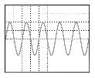


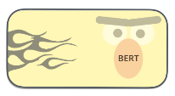

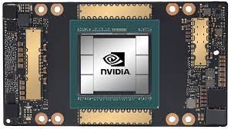

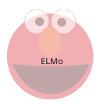
We Propose: Decepticon
pre-trained model extractor
(CNN model)
time-series
kernel execution time data
(1024x1024)
image converter
input-dependent model variant detector
(optional)
victim model
query output
(optional)
pre-trained
model name
(French/Russian/
cased/uncased..)
PTM-2
?
PTM-2
PTM-1
Almost
white-box
attacks
Kernel exe. Time monitoring
Decepticon
victim
model
predict
pre-trained
model name
PTM-K
PTM-N
pre-trained model pool
Notes:
Why we used CNN? We may have noise in the execution timings and CNNS are very tolerant to noises.
Talk about almost White box attack when we have extracted weights:
Cloning model
Adversarial attacks.

Slide 14

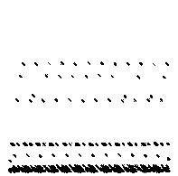

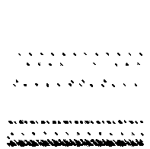





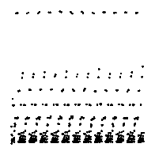
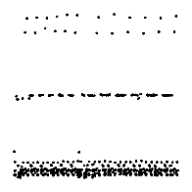
Pretrain Model Detection
fine-tuned model
execution time
graph images
Prediction ground truth:
pre-trained model
Data set:
training: 1430 trace images
Testing: 357 trace images
CNN model architecture:
2 Conv layers
2 Pooling layers
3 Fully connected layers
. . .
PTM-1
PTM-2
PTM-N
image label
(pre-trained
model name)
train
pre-trained model extractor
(CNN model)

Slide 15
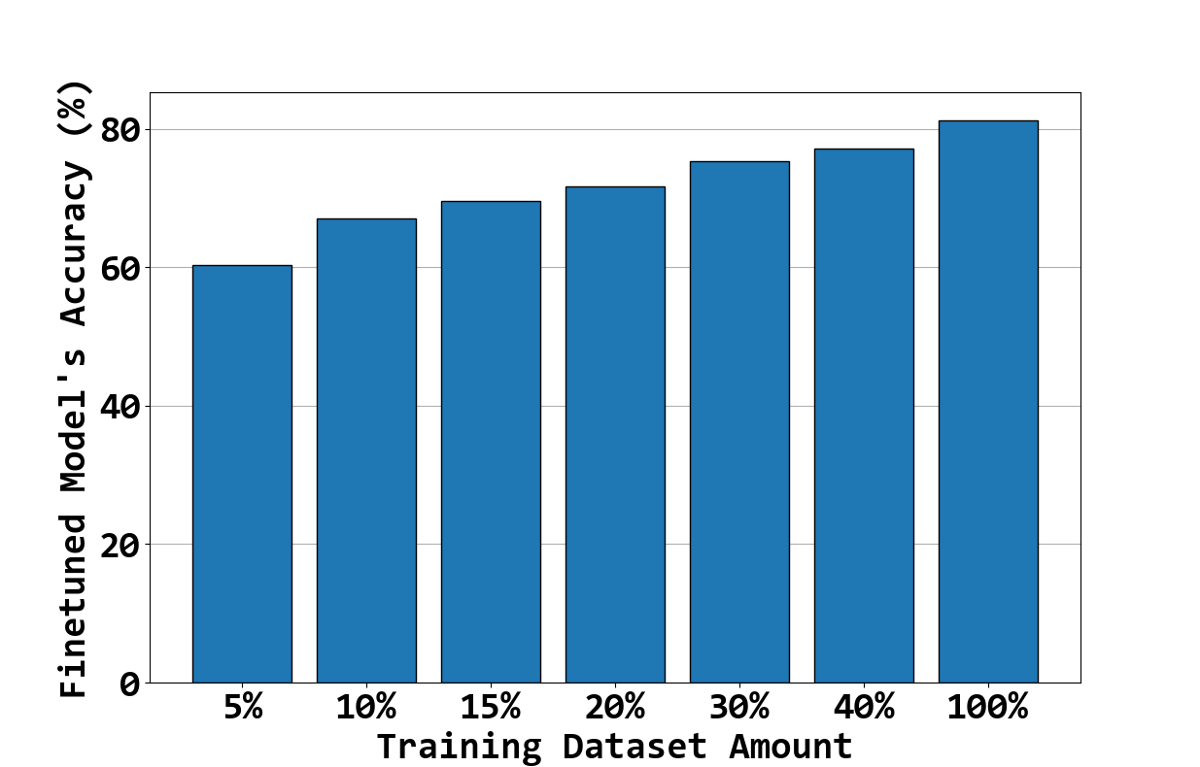
Are we ready to clone the victim model?
Attacker now has a whole model level weights, having small value gap with the victim fine-tuned model’s weights
Due to outlier weights and the task-specific last layer, it is challenging to create a highly-accurate clone model
Cloning Accuracy with Fine-tuning Data
Notes:
With Decepticon, we identify almost similar values. And if we have only s amall amount of downstream dataset (say 5%), we can create clone model that has 60% accuracy ass opposed to the original model’s 80% accuracy. But if we want to make a very accurate clone model, we need above 40% dataset which may not be possible in many cases. So to create accurate clone model, we design a supplementary attack method which is weightt

Slide 16
Weight Extraction
We leverage existing row-hammer-based bit value checking with significantly lower effort
[DeepSteal SP’22] checked every bits of all weight values
Instead of checking every bit, we only check few essential bits of outlier weights in layers of higher impact.

Slide 17
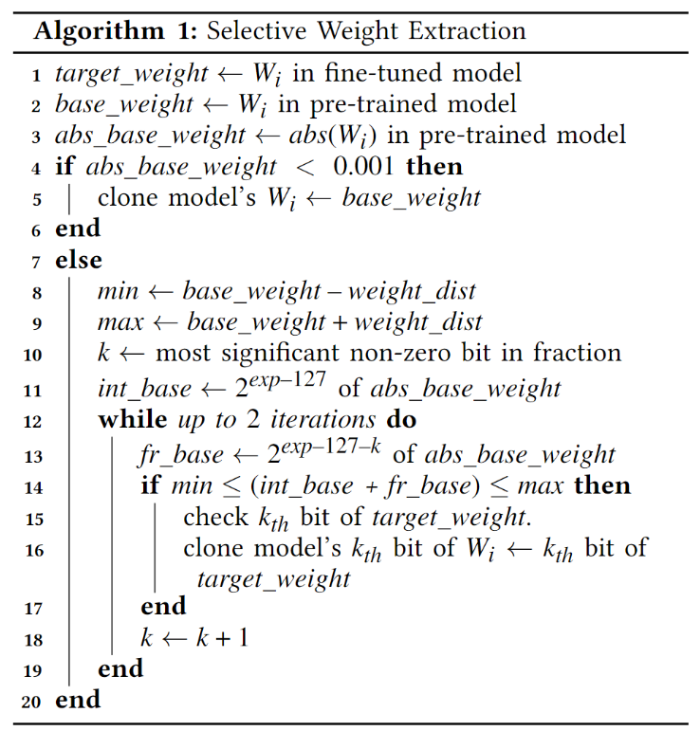
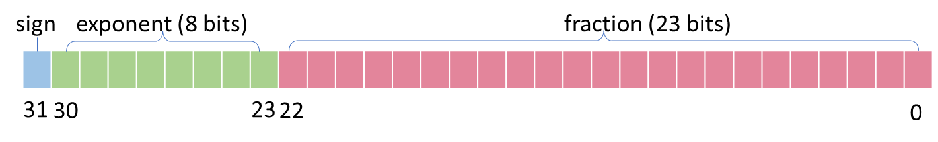
Selective Weight Extraction
sign
exponent (8bits)
fraction (23bits)
31
30
23
22
0
0.01908
→ 0 01111001 00111000100110110101001
0.018
→ 0 01111001 00100110111010010111100
Fine tuning
Identical
Ignorable region
: Insignificant for
accuracy
Region to adjust
: < 0.002 range

Slide 18
Evaluations
Tested models :
Downloaded from various model repositories having at least 100K download counts
70 pre-trained models and 170 fine-tuned models
Diverse Transformer architectures in different sizes
BERT, GPT-2, RoBERTa, MobileBERT, CamemBERT, ALBERT, DeBERTa, XLNet, BART, T5, and SpanBERT
Tiny, mini, distill, medium, base, large, xlarge, and xxlarge
Using DL frameworks: PyTorch/Tensorflow
On NVIDIA GeForce RTX 3050 (Ampere) GPU with CUDA v11.8

Slide 19
Evaluations: Cloned Model Accuracy
Prediction Accuracy of Victim BERT model and Extracted model Fraction of Matched Predictions

Slide 20
Evaluations: Model Extraction Accuracy
Robust detection accuracy is measured with two types of noise
Add ±20us noise to randomly selected 1 ~ 64 kernels
Add ± 5~45 us noise for 16 kernels in each validation image

Slide 21
Evaluations: Weight Extraction Efficiency

Slide 22
Evaluations: Adversarial Attack Effectiveness
Goal: Use substitute model’s mispredictions to fool the victim model.
Collect adversarial examples which make the substitute models mispredict
Try these examples on victim model
8 substitute models along with our extracted model
8 random pretrained
Then finetuned with 18K samples collected from victim’s model’s inference output
10K other samples are fed to 8 substitute models and the extracted clone model
Mispredicted samples are fed as adversarial inputs to the black-box BERT-large model.

Slide 23
Evaluations: Adversarial Attack Effectiveness
Compared
substitute models

Slide 24
Evaluations: Attack Generalization

Slide 25
Discussion: Mitigations against Model Extraction Attacks
Make the executions vary as much as possible
Execution time graphs can be different for each inference with the same input.
Harder to locate the underlying pretrained model.
Harder to train the pretrain model detector.
Use different frameworks, libraries, algorithms, kernels, …
Dynamic runtime behavior obfuscates timing side channel.

Slide 26
Conclusion
Model execution fingerprint reveals the underlying pretrained model of a black-box transfer-learned model.
Identified pretrained model’s weights reveal finetuned model’s approximate weights.
Cloned approximate model opens door for adversarial attacks.

Slide 27
Thank You!
Notes:
Thank you.
I will accept questions.
(Please list up a few questions that you may ask as an audience. We should prepare for the answers for the questions)

Slide 28
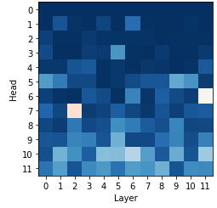
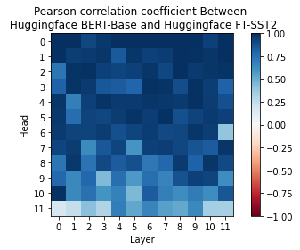
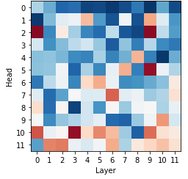
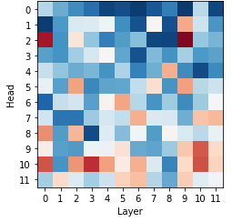
Discussion: Effectiveness on Pruned models
Head pruning is done based on confidence values
Confidence values are calculated based on weight values
→ The relative confidence values can be calculated once pre-trained model is identified
1.00
0.75
0.50
Head
0.25
0.00
-0.25
-0.50
Layer
Layer
Layer
Layer
-0.75
Confidence Corr. with
Baseline Pre-trained Model
(b) Confidence Corr. with
Different Pre-trained Model
-1.00

