Slide 1
Test Automation with Nightwatch using Selenium
Presenter: Bilal Ahmed
SQA Engineer at DatumSquare IT Services

Slide 2
Outline
Introduction
Theory of operation
Why Nightwatch
Setup & Configuration
Writing Nightwatch Tests
Running Tests using different options
Data driven Test
Page Object Model Implementation
Nightwatch Hooks
Integrate Html Reports
Basic overview of Mocha & Chai.js

Slide 3
End-to-End Testing
Involves ensuring that integrated components of an application function as expected
Black box type – knowledge of internal architecture and/or source code is not required
Problem Statement:
Manually executing same tests every time new changes are being introduced into the application

Slide 4
End-to-End Testing
Solution
User simulation: Get as close as possible to automating user actions without user
Implementation
Test Runner – Nightwatch.js
Browser Automation tool – Selenium webdriver

Slide 5

Introduction Nightwatch.js
Nightwatch.js
Automated testing framework for web applications & websites
Written in Node.js, aims to simply browser automation
Uses selenium webdriver api to perform commands & assertions on DOM elements
Can be used for writing Node.js unit & integration tests

Slide 6
Introduction
Selenium Webdriver
Allow selenium to use native browser engine and automate user interactions with website
Support many programming languages – we will use JavaScript
Multi browser support:
Chrome Driver – GUI and Headless
Firefox
Opera
Edge
Safari

Slide 7
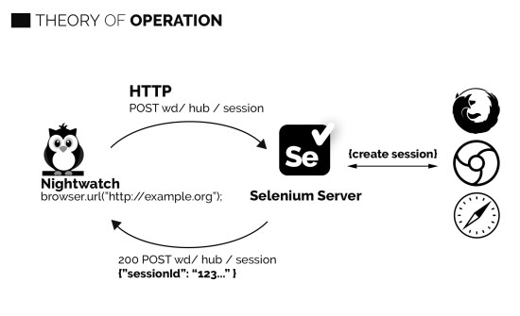
Theory of Operation

Slide 8
Why Nightwatch
Good documentation
Good community support
Test runner can execute sequentially or parallel
Grouping and filtering of tests is awesome
Page Objects support
Cloud testing support – SauceLabs & BrowserStack
Continuous Integration support
Built-in xml reprts
Easy to extend – custom commands & assertions

Slide 9
Four Artifacts
Commands
.navigate()
.click()
.clearValue()
.setValue()
Assertions
Assert-style
Expect-style
Page Objects
URL
Elements – css / xpath selectors
Commands
Global Data

Slide 10
Selectors Strategy
Element on the page needs to be located first in order to perform command and/or assertion on it.
Nightwatch support css and xpath selectors
Css selectors – Example
Tag[attribute = value] – input[name = email]
#element_ID
.element_class
Xpath selectors – Example
//tag[@attribute= ‘value’]
//input[@id=‘input_email’]
//button[@type=‘submit’]

Slide 11
Setup: Pre-requisites
Tools Needed:
Install node.js on your machine
Install Java
Selenium standalone server jar
Chrome Driver
Editor – VS Code and/or Sublime

Slide 12
Installation Steps
Create folder structure
Create package.json file – Run npm init , pr0vide info or just hit Enter
Create nightwatch.js file under root directory and add the line below:
require("./node_modules/Nightwatch/bin/runner.js")
Download and place selenium standalone jar & Chrome driver in project
Install Nightwatch
npm install –g Nightwatch – Installing Nightwatch globally - OR
npm install –save-dev Nightwatch – installing as dev dependency
Create configuration file – Nightwatch.json under root directory

Slide 13
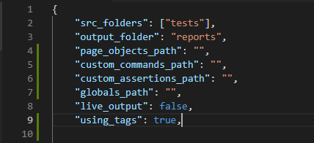
Configuration – Nightwatch.json
Provide paths to the required folders
Nightwatch will read tests from source folder & save results in provided “output folder”

Slide 14
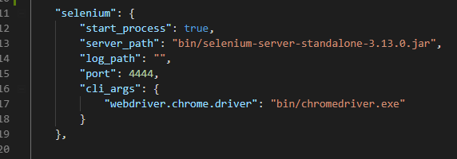
Configuration – Selenium Setup
Second Part – specify selenium settings
Provide path to selenium standalone jar file
Set “start process” flag to true when running tests locally

Slide 15
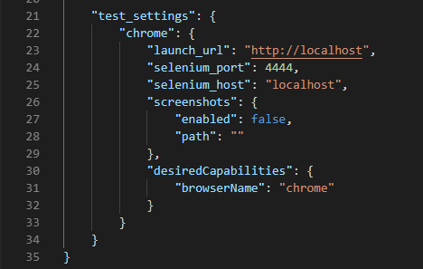
Configuration - Test Setup
Setup default options for browsers
Each browser will inherit the default settings

Slide 16
Hands-on Practice
Login test covering positive & negative scenarios – assert & expect style
Home page test – creating new user
Running tests in headless browser
Setting up different test Environments – multi browser
Test Grouping – options to run specific test group
Test Tags – using tags to run specific test
Disabling tests and specific test cases in a test module

Slide 17
AUT
We will use below sample application for our practice:
url: http://10.10.10.2:8081
Username: bhtest18@gmail.com
Password: @Datum123

Slide 18
First Test – Login Flow
Navigate to the login page
Verify the page title
Locate and verify Email field is visible
Type in correct email address
Locate password field and type in password
Wait for form submission to complete
Verify the page title – user is on home page

Slide 19
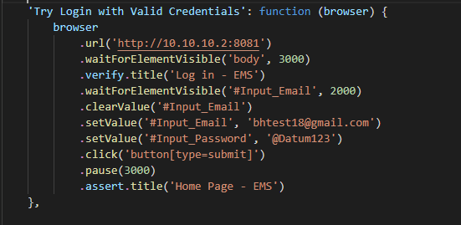
Nightwatch Test – Assert Style

Slide 20
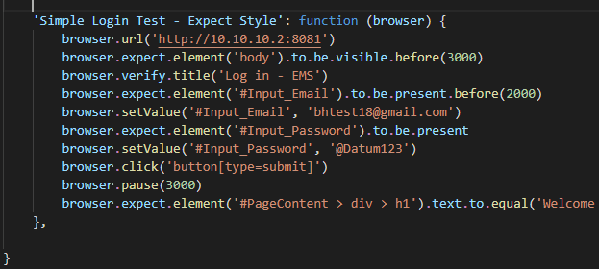
Expect Style

Slide 21
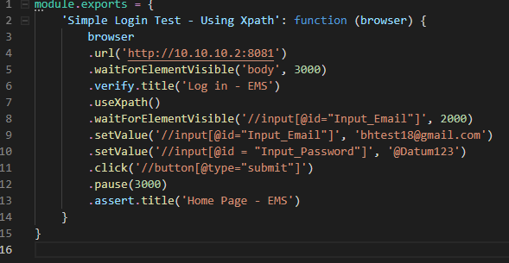
Using XPath

Slide 22
Running Tests
If Nightwatch is installed globally – Run the following command:
Nightwatch [source-folder] [options]
If installed as a dependency of your project
Node Nightwatch [source-folder] [options]
Example:
Node Nightwatch –env chrome tests/login.test.js
We can also define script in package.json file and run:
npm run test

Slide 23
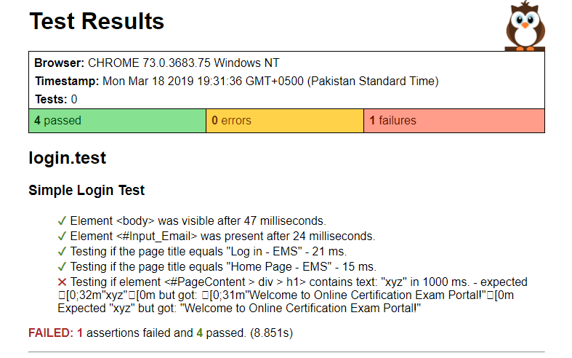
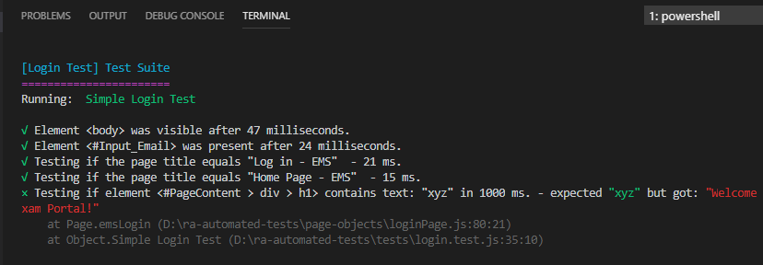
Test Result
Html Report
Console Results

Slide 24
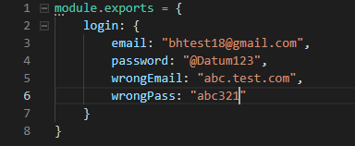
Data Driven Tests
Reading test data from a file, rather than using hardcoded values in our tests
Define your test data in form of Json objects
Access the data as an object property within the test file

Slide 25
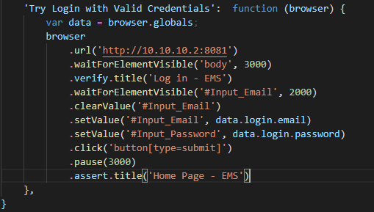
Using Data in Tests

Slide 26
Page Objects
Allows you to encapsulate page elements and commands in a separate file
Maintainable tests and helps you keep your code DRY
Reuse the same function/method in different tests, when needed.

Slide 27
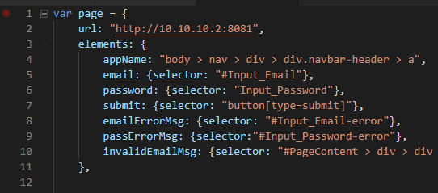
Page Objects - Elements
Make sure you add the folder path in Nightwatch.json file
Allows you to easily change the selector at one place, when needed
Use the elements in commands by calling the appropriate element name e.g. “@password”

Slide 28
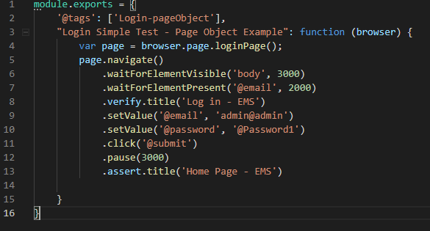
Using Page Objects in Test

Slide 29
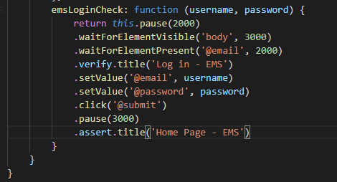
Page Objects - Commands
Nightwatch allows to encapsulate the page logic by defining methods
You can re-use the same method by calling it from the test file

Slide 30
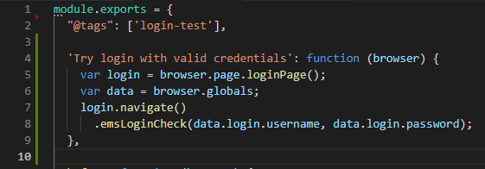
Using Commands in Test

Slide 31
Nightwatch Hooks
Setting up text fixtures is easy with Nightwatch hooks:
Before: Runs before the test execution – opening browser
After: Runs after test execution has finished – close browser
BeforeEach: Runs before each test case
AfterEach: Runs after each test case

Slide 32
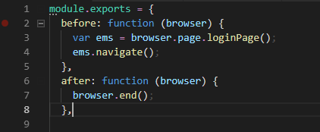
Hooks Example

Slide 33
Integrating Html Reports
Nightwatch gives you the ability to configure and generate html reports after test execution
Use –reporter flag while executing test
How to integrate html reports?
Run npm install handlebars fs path
Create html-reporter.js & html-reporter.hbs
Copy & paste code – github.com/bilal-ahmed211

Slide 34
JavaScript frameworks, commonly used together for unit testing
Mocha & Chai

Slide 35
Piece of code written that executes specific area of functionality of the code and asserts a “unit” behave as intended - typically a single function
Unit Test

Slide 36
Mocha.js
Feature rich testing framework that runs on Node.js and browser.
Use for unit and integration testing
Highly flexible – choose any assertion library – chai.js in our case
Makes Async testing simple and easy
Provide two functions “describe” and “it” to structure the test

Slide 37
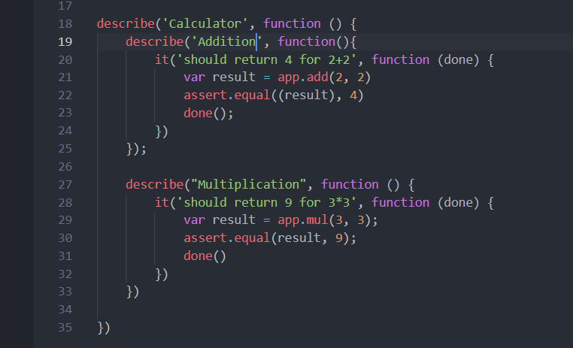
Test Syntax!
“describe” arrange the tests nicely in groups
We can use nested describe for more readability in test results
“it” behaves as a single test case where you actually write assertions
“describe” can have multiple “it” functions

Slide 38
Chai.js
Assertion library that can be used with any JavaScript framework
Runs on Node.js and browsers
Provides three different flavours of assertions
Assert
Expect
should

Slide 39
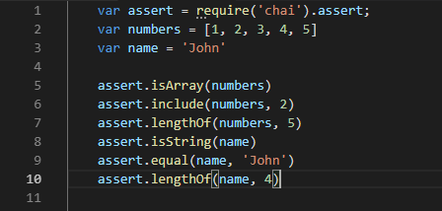
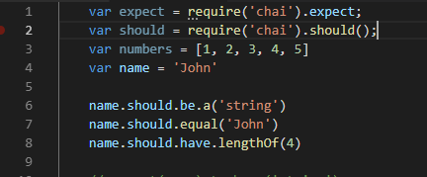
Examples
Assert-style
Should-style

Slide 40
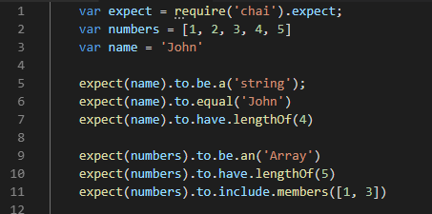
Expect-style

Slide 41
1. Npm install –g mocha 2. Npm install –save-dev chai
How to install

Slide 42
Hands-on Practice
We will use simple calculator app to make sure all of it’s functions are working as expected
Following functions/methods to be tested:
Sum()
Multiplication()
Subtraction()
Division()
Running mocha tests:
Mocha tests/app.test.js - example

Slide 43

References
Nightwatchjs.org
Mochajs.org
Chaijs.org
Github.com/bilal-ahmed211

