Slide 1

Wireless Communication Standards in Industry
Comparing wireless standards for flexible, mobile, and scalable Industry 4.0 automation

Slide 2

INDUSTRY 4.0
Why Wireless Matters in Industry 4.0
Industry 4.0 demands flexible, mobile, and scalable communication. Wired systems like PROFINET offer stable timing but are expensive to install and hard to reconfigure. Wireless enables AGVs, mobile sensors, and remote monitoring — but the real question is: which wireless standard fits which industrial task?

Slide 3


The Industrial Wireless Environment
Why Factories Are Hard on Wireless
Metal structures, motors, and moving machines create EMI, multipath fading, and unstable signal quality. Shared 2.4 GHz spectrum adds congestion; cybersecurity is critical.
Three Standards Under Evaluation
Wi-Fi / IEEE 802.11
Zigbee / IEEE 802.15.4
5G New Radio
High-bandwidth mobile communication
Low-power sensor networks
Real-time control & private networks
Evaluated on latency, throughput, reliability, energy use, and deployment complexity.

Slide 4
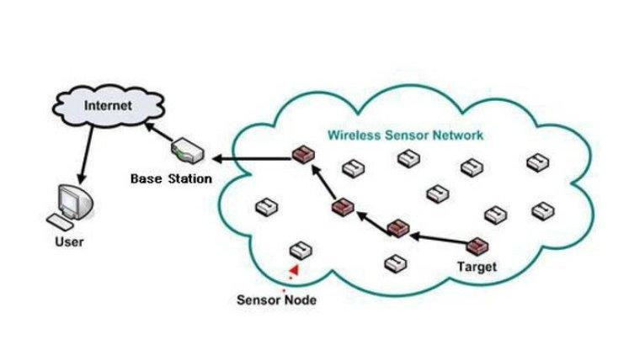
Early Wireless Sensor Networks (WSN)
Foundation
WSN established the foundation of industrial wireless communication, based on IEEE 802.15.4 standards.
Main Goal
Collect and transmit data wirelessly with low power consumption, allowing devices to run on batteries for years.
Key Challenges
Unstable delays, electromagnetic interference from machines, and signal loss in metallic factory environments.
Significance
Despite the challenges, WSN shaped the design principles still used in modern industrial wireless systems today.
Typical WSN architecture: sensor nodes relay data through the network to a base station and the internet.

Slide 5
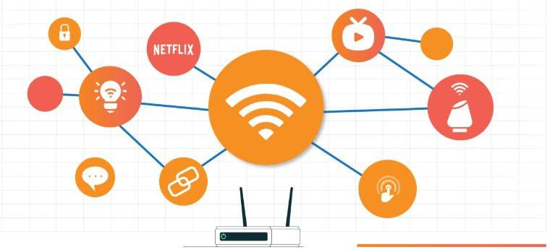
Industrial Wi-Fi Evolution
802.11b/g
High variable latency - not suitable for closed-loop industrial control.
802.11e
QoS introduced traffic prioritisation, improving reliability.
802.11n
MIMO antennas enabled spatial multiplexing and increased data rates.
Wi-Fi 6
OFDMA and TWT reduced latency to ~5 ms - suitable for high-bandwidth industrial applications.
Wireless connectivity links across an industrial network: routers, sensors, and IoT-enabled devices.

Slide 6
5G and the URLLC Paradigm
< 1 ms
99.9999%
70%+
Latency for motion control
Reliability (URLLC)
New private wireless spend on standalone 5G (2025)
3GPP Roadmap
• Release 15 (2018): air interface standardised.
• Release 16 (2020): mini-slot scheduling added for URLLC.
• Release 16 also defines 5G as a TSN bridge for end-to-end deterministic delivery.
• Many industries are now adopting private 5G networks for real-time control.

Slide 7
Emerging Trends
Wi-Fi 7 · Private 5G · Wireless TSN

Slide 8
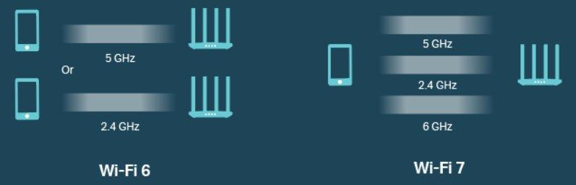
Wi-Fi 7 — Multi-Link Operation (MLO)
2.4 GHz
5 GHz
6 GHz
All three frequency bands used simultaneously
• MLO provides packet-level diversity — a dropped packet on one band is recovered on another without retransmission delay.
• IEEE 802.11be (Wi-Fi 7) is finalised. Draft 1.0 of Wi-Fi 8 (802.11bn) completed August 2025.
Wi-Fi 6 uses 2.4/5 GHz bands, while Wi-Fi 7 adds the 6 GHz band for simultaneous multi-link operation.

Slide 9
Private 5G & Wireless Time-Sensitive Networking
Private 5G Campus Networks
Wireless Time-Sensitive Networking (TSN)
• Companies build and manage their own 5G network instead of using public infrastructure.
• TSN ensures data arrives at the exact required time - critical for real-time control.
• Full control over security, service levels, and spectrum allocation.
• Closes the "last mile" gap: wireless now matches wired PROFINET and EtherCAT guarantees.
• Optimised for deterministic, high-density industrial environments such as factories.
• A single TSN scheduler can drive both wired and wireless robot axes at the same time.

Slide 10
Wireless Standards: Architecture and how they work
Wi-Fi (802.11) · Zigbee (802.15.4) · 5G New Radio

Slide 11
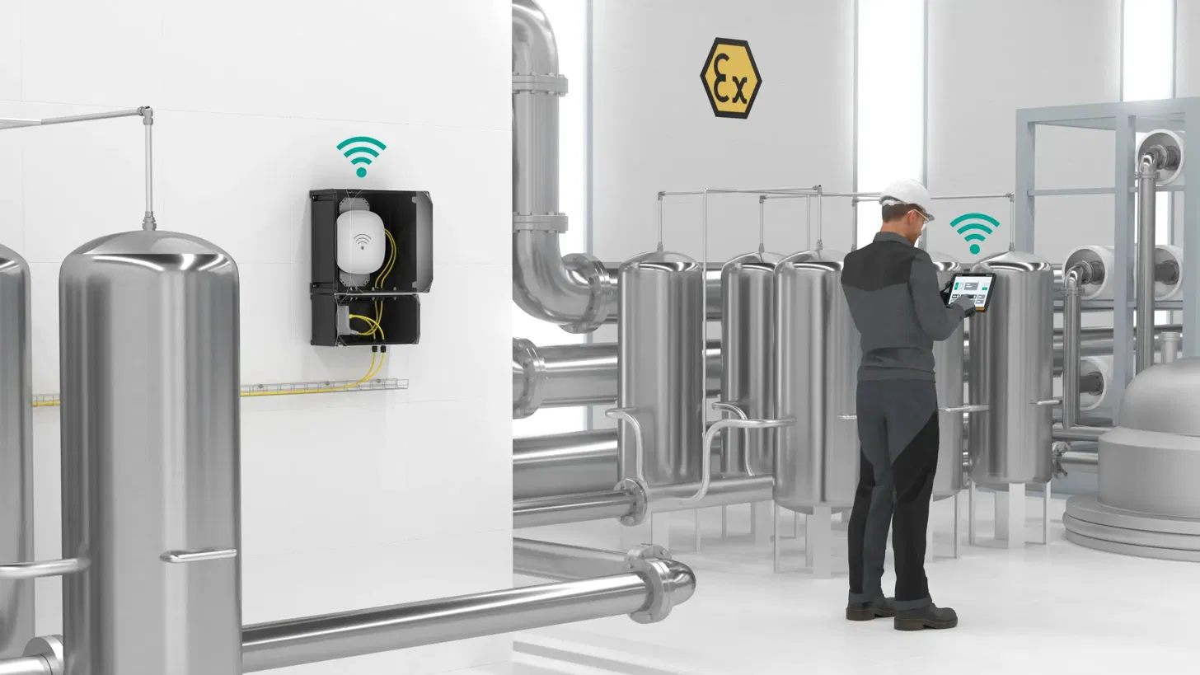
IEEE 802.11 (Wi-Fi)
Operates on 2.4, 5 and 6 GHz bands
CSMA/CA for channel access
802.11r enables fast roaming for AGVs
Speeds up to 9.6 Gbps
[ IMAGE ]
Wi-Fi factory deployment
PROS
High speed, huge ecosystem
CONS
Unreliable under load, shared spectrum
Notes:
CSMA/CA - Carrier Sense Multiple Access with Collision Avoidance.
OFDMA – orthogonal frequency-division multiple access. TWT – target wake time.
AVG – automated guided vehicle

Slide 12
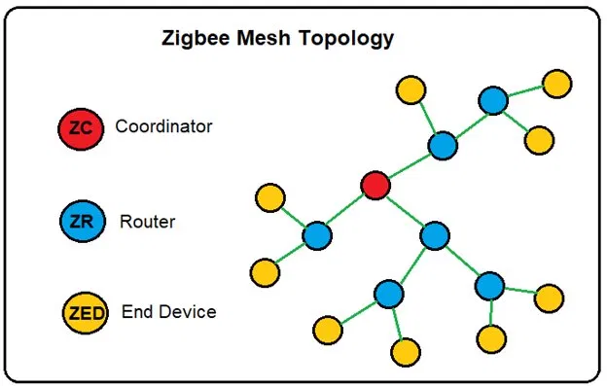
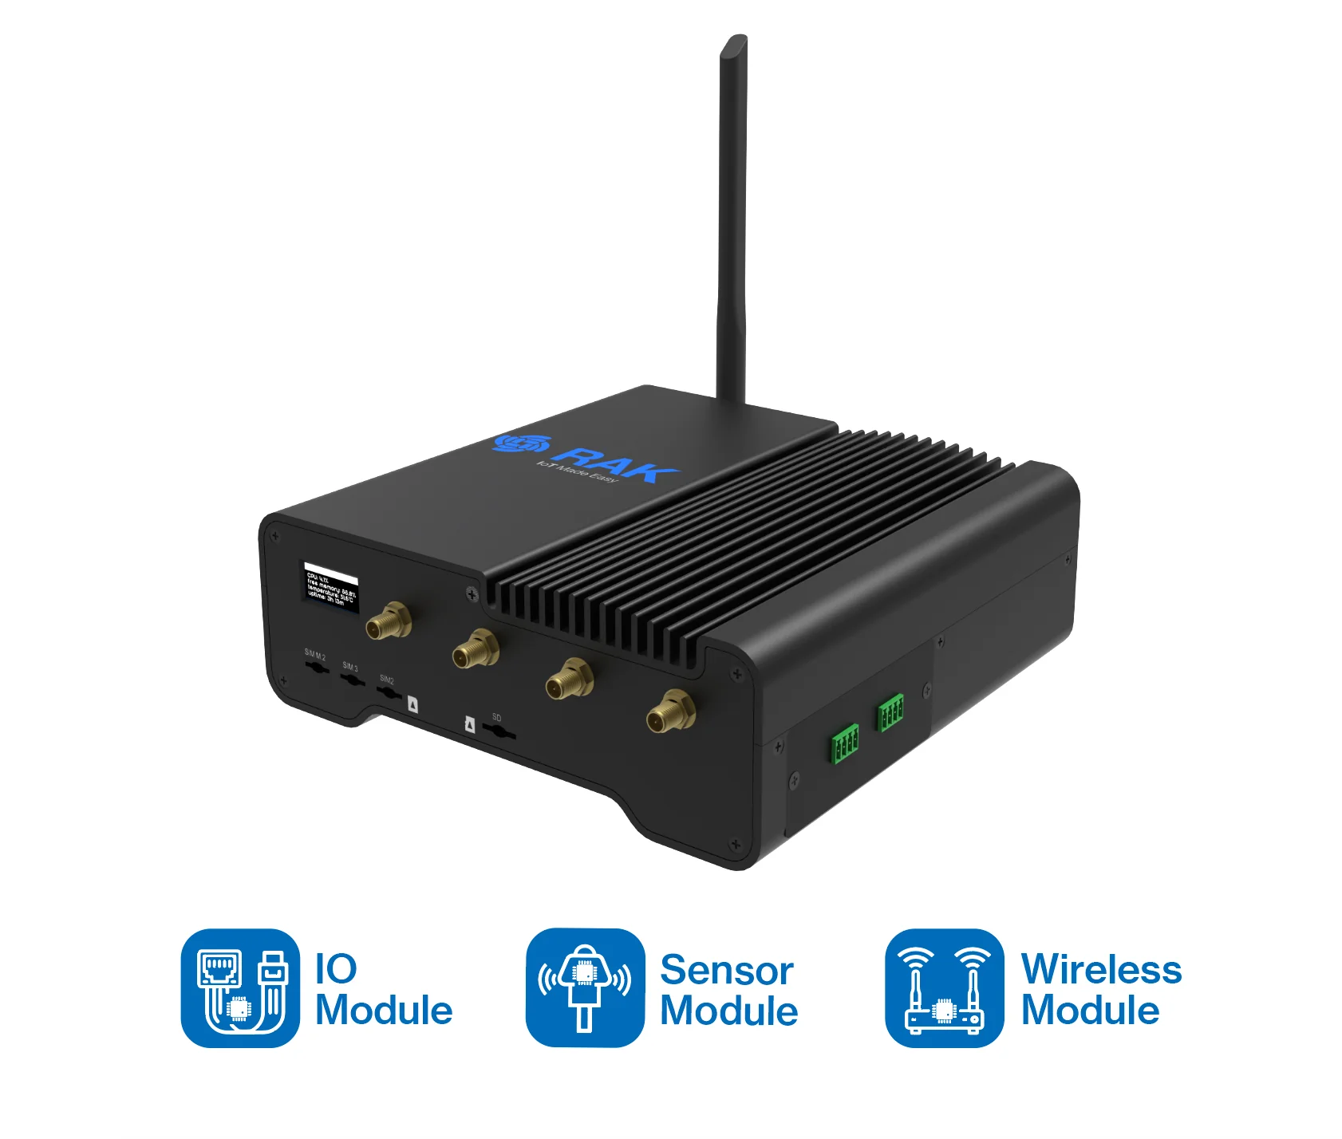
IEEE 802.15.4 / Zigbee
Low-power wireless WPAN standard
Runs at 2.4 GHz, up to 250 kbps
Three roles: Coordinator, Router, End Device
Supports mesh networking
Battery life of 2 to 5 years
[ IMAGE ]
Zigbee mesh topology
PROS
Long battery life, low cost, low power consumption
CONS
Low data rate, short range of 10 to 100 m
Notes:
WPAN — Wireless Personal Area Network.

Slide 13
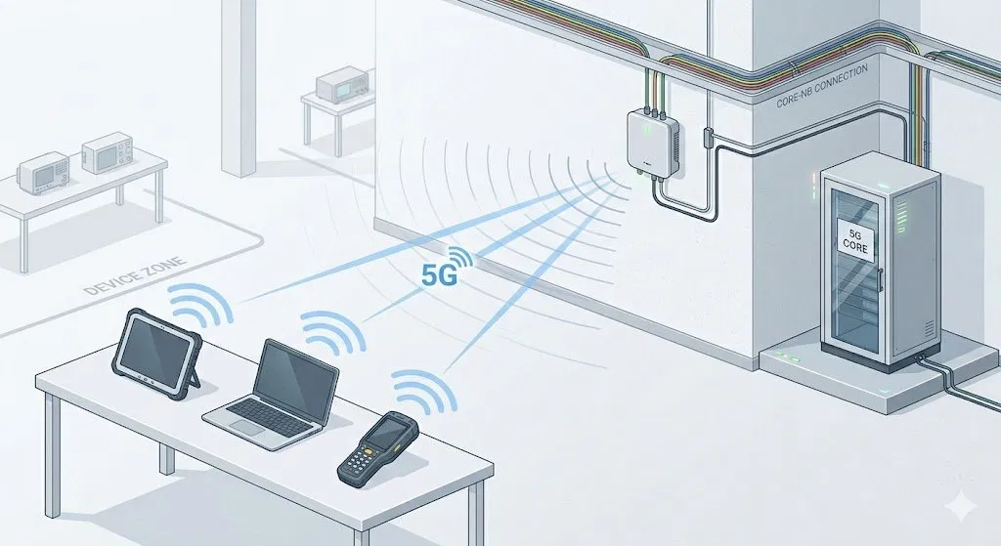
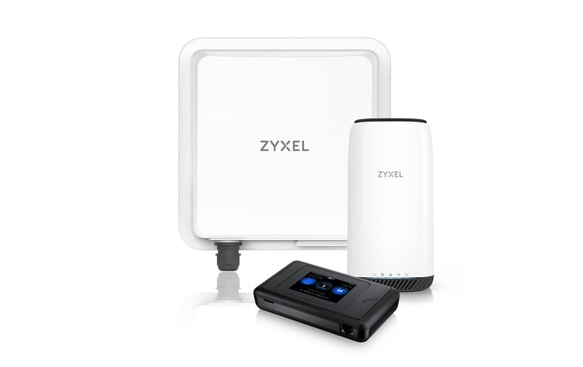
5G New Radio (NR)
Standardised by 3GPP, uses licensed bands
Three classes: eMBB, mMTC, URLLC
[ IMAGE ]
Private 5G campus network
PROS
Licensed spectrum, flexible, one network enough for whole factory
CONS
Costly, complex, power-hungry
Notes:
3GPP (3rd Generation Partnership Project) — the organisation that writes the official 5G standards.
eMBB (enhanced Mobile Broadband) — the 5G mode for high-speed data, like cameras or video.
mMTC (massive Machine-Type Communication) — the mode for connecting huge numbers of small sensors at once.
URLLC (Ultra-Reliable Low-Latency Communication) — the mode for real-time control. Extremely fast and extremely reliable. Used for things like robot arms.

Slide 14
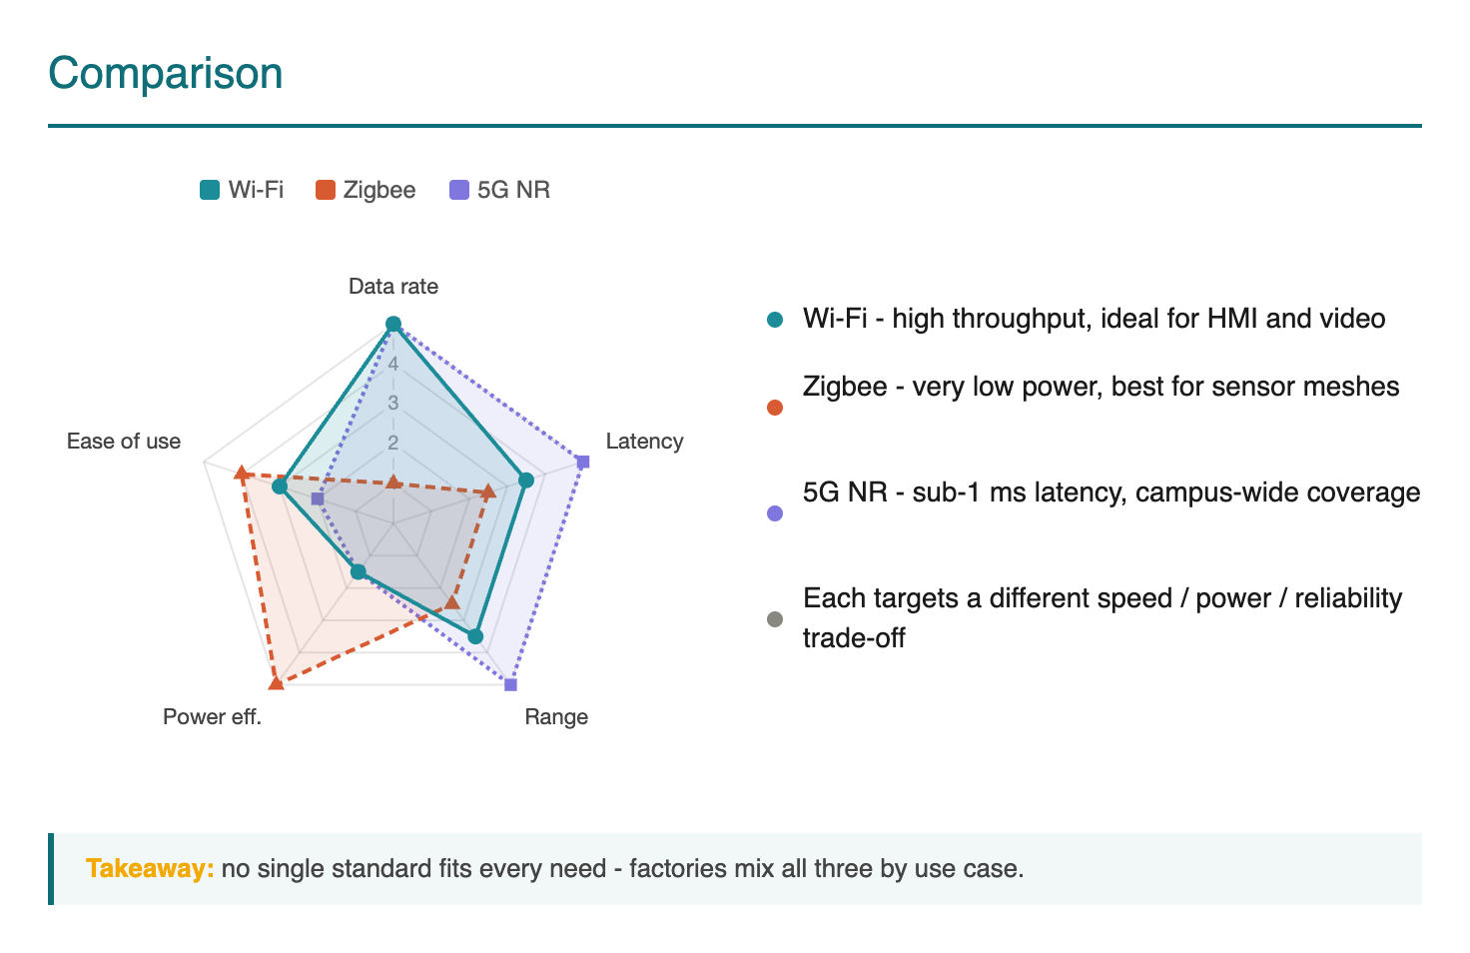

Slide 15
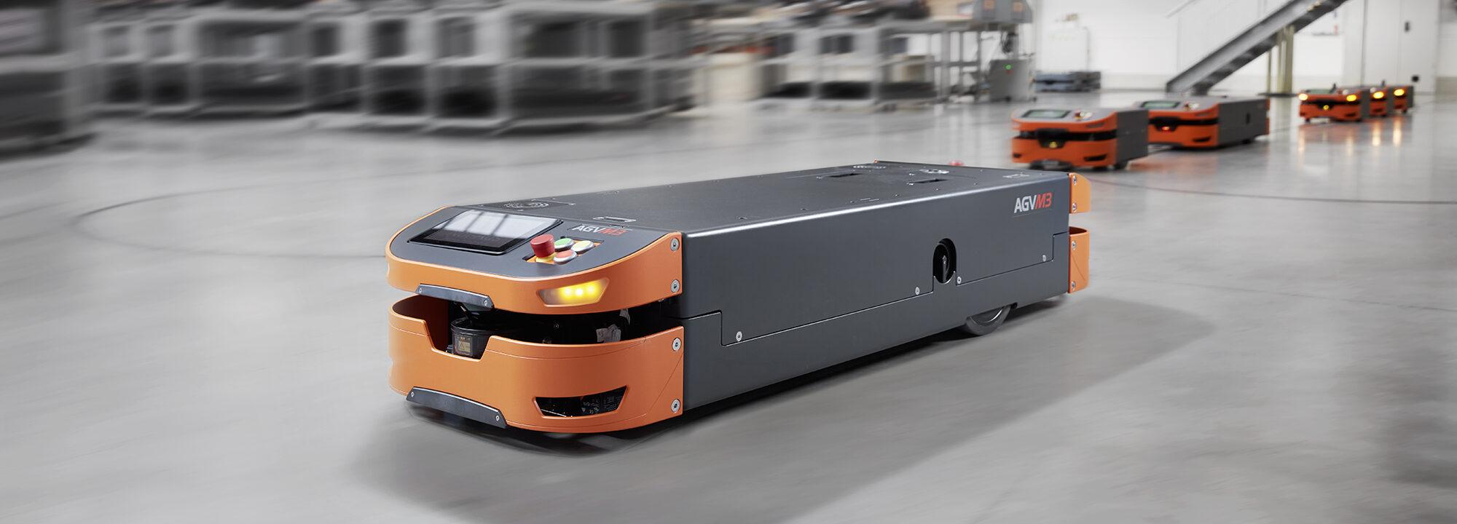


Evaluation example
Automated Production Cell Scenario
• Industry 4.0 production cell has different communication needs.
• 2 collaborative robots(cobots) require 1 ms latency and very high reliability.
• Sensors send small data packets every 30 seconds.
• AGVs need 10 Mbps video links with maximum 10 ms latency.
• Machine vision station transfers images to an edge server in 0.5 s

Slide 16
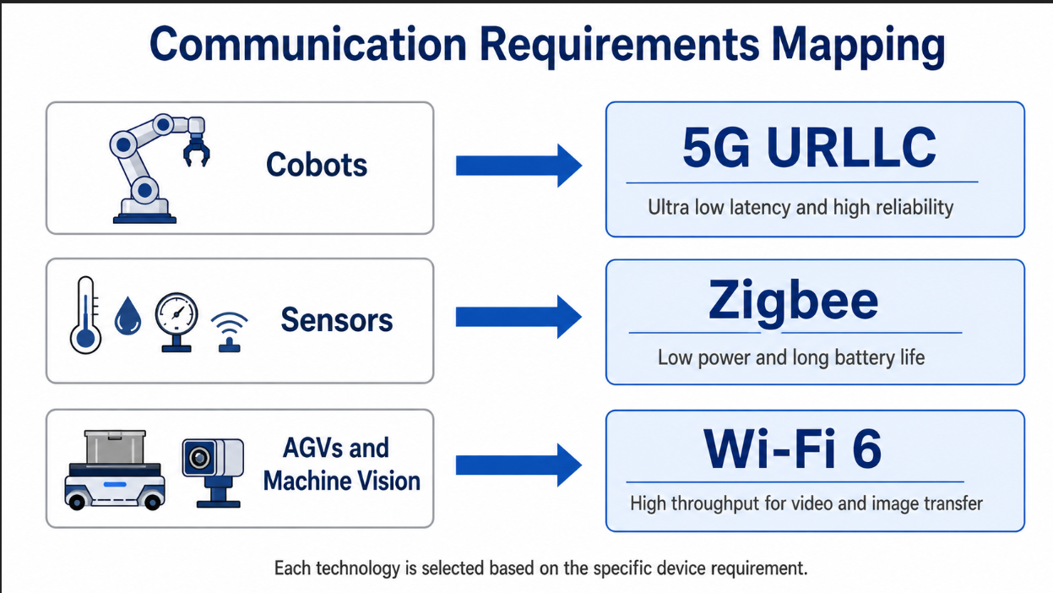

Slide 17
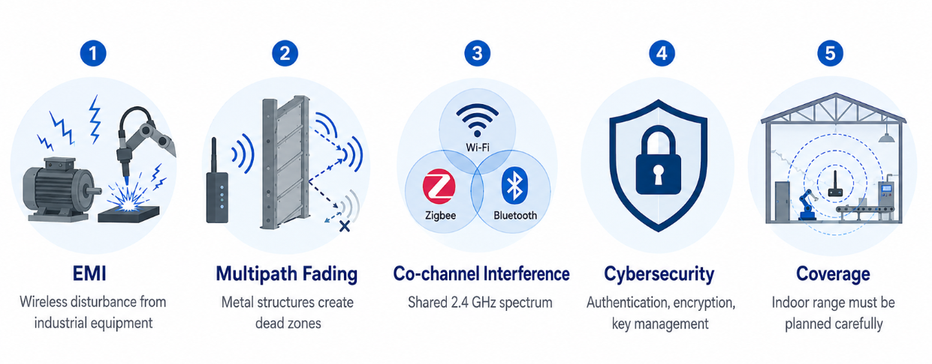
Deployment Challenges in Industrial Environments
• EMI from frequency converters, arc welders, and servo drives can disturb wireless communication
• Metallic factory environments cause multipath fading and signal dead zones
• Wi-Fi 6 and 5G handle multipath better than Zigbee because they use OFDM-based transmission
• Wi-Fi, Zigbee, and Bluetooth can interfere because they share the 2.4 GHz band
• Cybersecurity depends on correct configuration, authentication, encryption, and key management
• Indoor coverage is limited and must be carefully planned for Wi-Fi, Zigbee, and 5G mmWave

Slide 18

No Single Standard Fits Everything
The core finding: each standard excels in a different domain. Smart factories require a hybrid wireless architecture.
Standard
Best Suited For
Main Limitation
Wi-Fi 6/7
High-bandwidth mobile tasks: AGVs, machine vision, video monitoring
Shared spectrum, variable reliability
Zigbee
Low-power sensors: environmental monitoring, asset tracking
Low data rate
5G NR
Real-time control via URLLC in private campus networks
Higher cost & complexity
Key Takeaway: The optimal solution combines all three — matching each standard to its ideal use case.

Slide 19
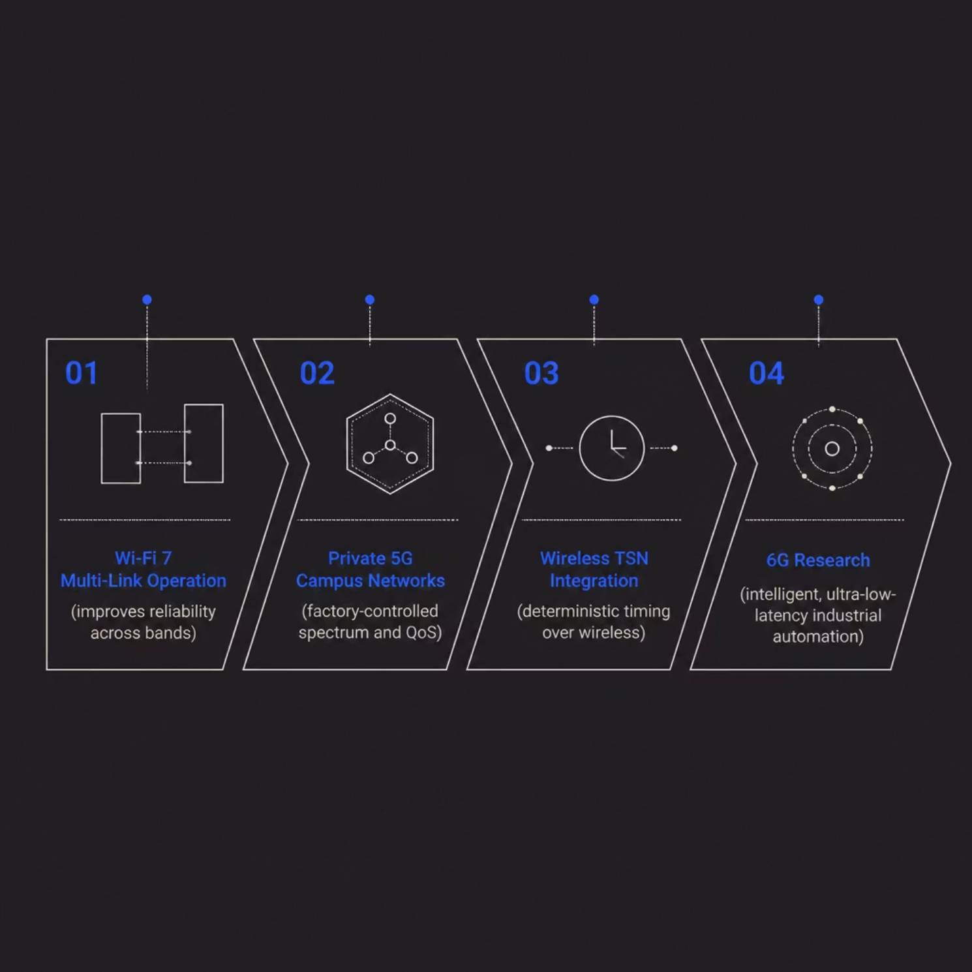
Future Direction: Toward Reliable Wireless Factories
Challenges Still to Solve
EMI and metal reflections
2.4 GHz band congestion
Cybersecurity risks
Deterministic timing gaps
Wi-Fi 7, private 5G, and Wireless TSN are closing the gap with wired systems. Wireless won't replace every cable — but it will become central to flexible, mobile Industry 4.0 factories.

Slide 20
DISCUSSION
Thank You
Questions and discussion welcome

