Slide 1
Literature Review
Industrial Wireless Communication for Industry 4.0

Slide 2
2.1 Early Wireless Sensor Networks (WSN)
Foundation
WSN established the foundation of industrial wireless communication, based on IEEE 802.15.4 standards.
Main Goal
Collect and transmit data wirelessly with low power consumption, allowing devices to run on batteries for years.
Key Challenges
Unstable delays, electromagnetic interference from machines, and signal loss in metallic factory environments.
Significance
Despite the challenges, WSN shaped the design principles still used in modern industrial wireless systems today.

Slide 3
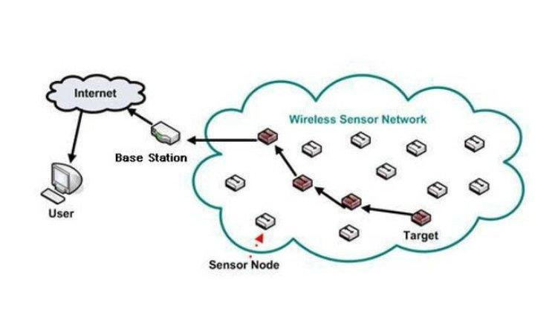
2.1 WSN Architecture Overview
Typical WSN architecture: sensor nodes relay data through the network to a base station and the internet.

Slide 4
2.2 Industrial Wi-Fi Evolution
802.11b/g
High variable latency - not suitable for closed-loop industrial control.
802.11e
QoS (EDCA) introduced traffic prioritisation, improving reliability.
802.11n
MIMO antennas enabled spatial multiplexing and increased data rates.
Wi-Fi 6
OFDMA and TWT reduced latency to ~5 ms - suitable for high-bandwidth industrial applications.

Slide 5
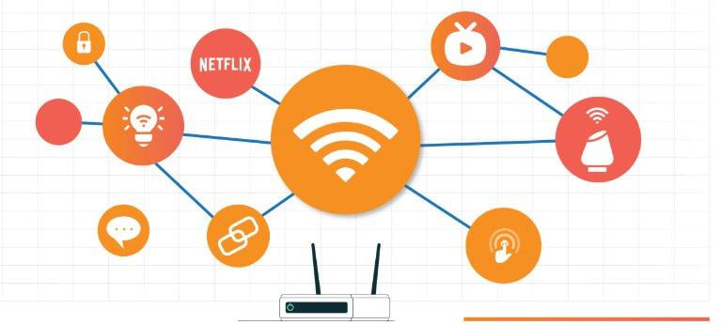
2.2 Industrial Wireless Connectivity
Wireless connectivity links across an industrial network routers, sensors, and IoT-enabled devices.

Slide 6
2.3 5G and the URLLC Paradigm
< 1 ms
99.9999%
70%+
Latency for motion control
Reliability (URLLC)
New private wireless spend on standalone 5G (2025)
• 3GPP Release 15 (2018): 5G NR air interface standardised.
• Release 16 (2020): mini-slot scheduling and enhanced HARQ added for URLLC.
• Release 16 also defines 5G as a TSN bridge for end-to-end deterministic delivery.
• Many industries are now adopting private 5G networks for real-time control tasks.

Slide 7
2.4 TSN Integration - Towards Wireless Determinism
What TSN Provides
Key Impact
• Credit-Based Shaping (802.1Qav)
• Wireless becomes as reliable as wired PROFINET / EtherCAT.
• Time-Aware Shaping (802.1Qbv)
• Wired and wireless robot axes driven by the same scheduler.
• Cyclic Queuing and Forwarding (802.1Qch)
• IEEE actively extending TSN standards to Wi-Fi (802.11).
• Sub-microsecond time synchronisation

Slide 8
Emerging Trends
Wi-Fi 7 · Private 5G · Wireless TSN · 6G Outlook

Slide 9
5.1 Wi-Fi 7 — Multi-Link Operation (MLO)
2.4 GHz
5 GHz
6 GHz
All three frequency bands used simultaneously
• MLO provides packet-level diversity — a dropped packet on one band is recovered on another without retransmission delay.
• IEEE 802.11be (Wi-Fi 7) is finalised. Draft 1.0 of Wi-Fi 8 (802.11bn) completed August 2025.
• Wi-Fi 8 targets deterministic performance and reliability rather than just higher throughput.

Slide 10
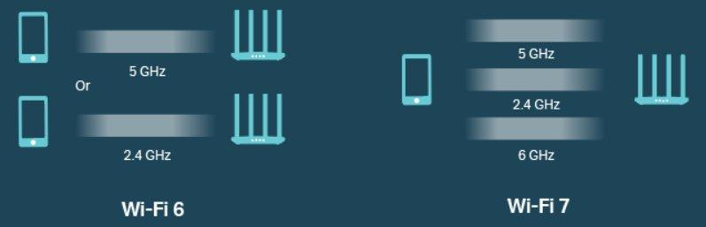
5.1 Wi-Fi 6 vs Wi-Fi 7 – Frequency Bands
Wi-Fi 6 uses 2.4/5 GHz bands, while Wi-Fi 7 adds the 6 GHz band for simultaneous multi-link operation.

Slide 11
5.2 Private 5G Campus Networks
of new private wireless
spend in 2025
• Companies build and manage their own 5G network instead of using public infrastructure.
• Full control over security, service levels, and spectrum allocation.
• Optimised for deterministic, high-density industrial environments such as factories.
• Complements industrial Ethernet and Wi-Fi in new (greenfield) factory deployments.

Slide 12
5.3 Wireless Time-Sensitive Networking
• TSN ensures data arrives at the exact required time - critical for real-time control.
• Closes the "last mile" gap: wireless now matches wired PROFINET and EtherCAT guarantees.
• A single TSN scheduler can drive both wired and wireless robot axes at the same time.

Slide 13
Wireless Standards: Architecture and Protocol Stack
Wi-Fi (802.11) · Zigbee (802.15.4) · 5G New Radio

Slide 14

3.1 IEEE 802.11 (Wi-Fi)
Operates on 2.4, 5 and 6 GHz bands
CSMA/CA for channel access
Wi-Fi 6 adds OFDMA and TWT
802.11r enables fast roaming for AGVs
Throughput up to 9.6 Gbps
[ IMAGE ]
Wi-Fi factory deployment
PROS
High speed, huge ecosystem, native TCP/IP
CONS
Unreliable under load, shared spectrum

Slide 15
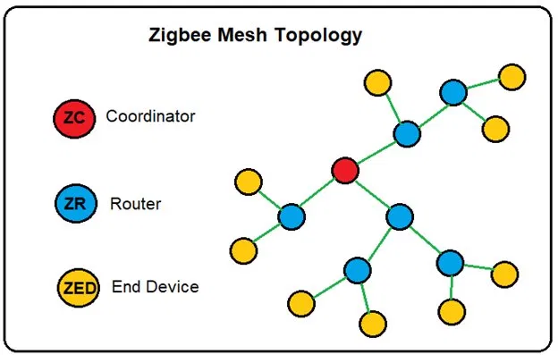
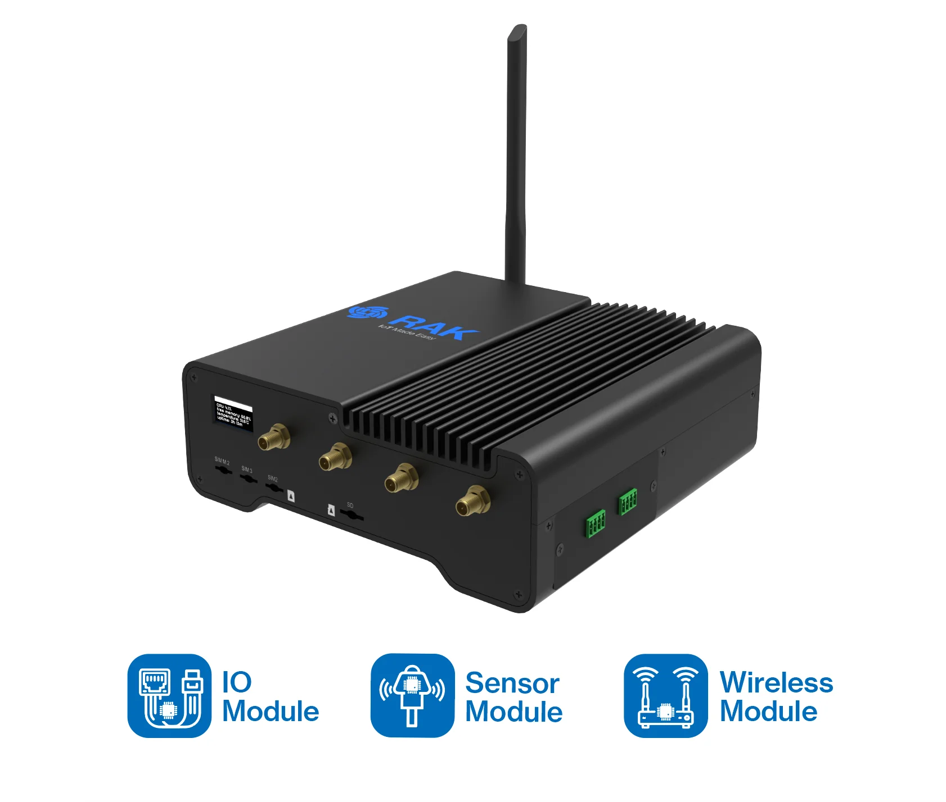
3.2 IEEE 802.15.4 / Zigbee
Low-power wireless WPAN standard
Runs at 2.4 GHz, up to 250 kbps
Three roles: Coordinator, Router, End Device
Supports star, tree and mesh topologies
Battery life of 2 to 5 years
[ IMAGE ]
Zigbee mesh topology
PROS
Long battery life, low cost, self-healing mesh
CONS
Low data rate, short range of 10 to 100 m

Slide 16
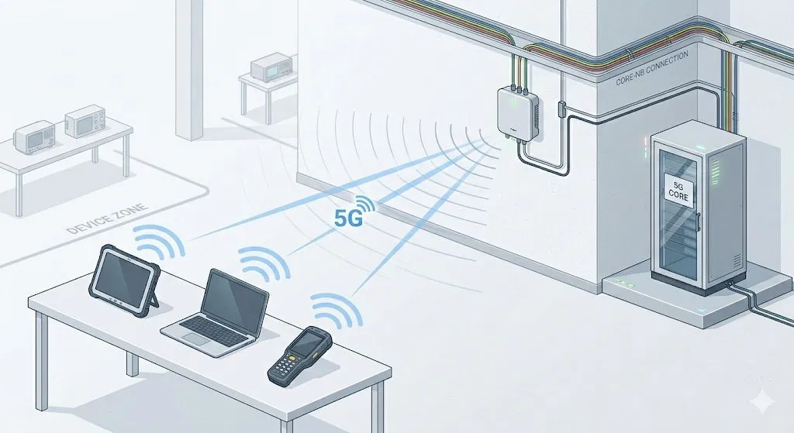
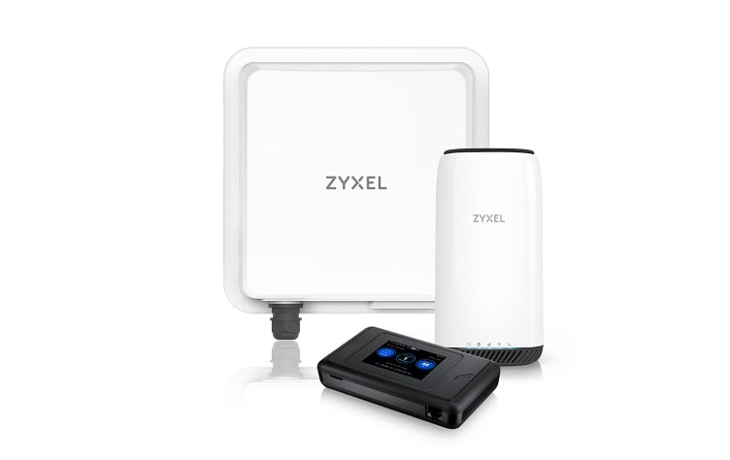
3.3 5G New Radio (NR)
Standardised by 3GPP, uses licensed bands
Three classes: eMBB, mMTC, URLLC
URLLC reaches under 1 ms at 99.999%
Private campus networks kept on site
Acts as a TSN bridge from Release 16
[ IMAGE ]
Private 5G campus network
PROS
Licensed spectrum, deterministic, private networks
CONS
Costly, complex, power-hungry

Slide 17
3.4 Standards at a Glance
 | Wi-Fi | Zigbee | 5G NR
Data rate | 9.6 Gbps | 250 kbps | Multi-Gbps
Latency | ~5 ms | 15 to 30 ms | < 1 ms
Range | ~100 m | 10 to 100 m | Wide / campus
Power use | High | Very low | High
Best for | High bandwidth | Sensors | Real-time control
Takeaway: no single standard fits every need, so factories mix all three by use case.

