Slide 1



social anxiety disorder
close relative of a patient

Slide 2
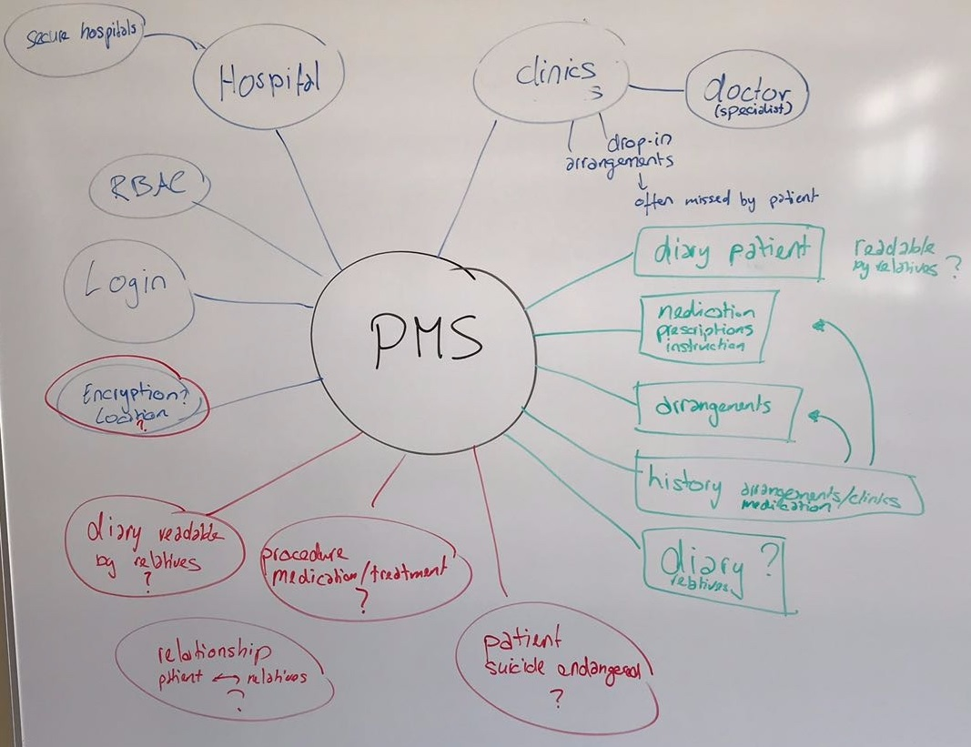
Scope

Slide 3
Research

Slide 4
Synthesize

Slide 5
Design

Slide 6
Prototype

Slide 7
Validate

Slide 8
Discussion
Andreas Erb, Beat Schärz, Nik Arm, Dario Furigo, Ivo Kozina, Jannick Lüdi, Ohran Mujkic

