Slide 1
Creatingly Test Cases
Test Scenario:
1. Login using the credentials
2. Drop an Artboard
3. Drop a Chart element inside a stack container.
4. Centre justify the content and the container.
5. Resize the Chart element to fit it to the container size.
Covered Test Cases
Functional
Performance
Compatibility

Slide 2
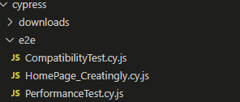

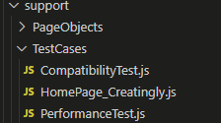
Folder Structure
Cy.js files to execute the test case
Fixtures
.js files containing the test cases

Slide 3
Functional Test case:
Perform the given test scenario But not for the chart Use following approach:
Navigate to Creatingly
List down all the elements available
Select the element you want to drag and drop by just giving an integer value as the element_index of the elements on the side bar.
Then resize it to the size of the art board
Can be able to be tested as a negative path when given the wrong integer value

Slide 4
Performance Test case:
- Perform the functional test
- Measure the basic performance metrics.

Slide 5
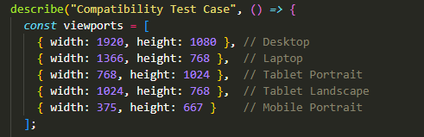
Compatibility Test case:
- Perform the functional Test
Use different view ports for the chrome browser (Not checking on other browsers for now)

