Slide 1

Presentation Roadmap
1
Client Profile & Needs
Macro & Market Context
German Statutory Pension Analysis
Gap Analysis & Scenario Drivers
Investment Instrument Research
Investment Strategy Design
Proposed Portfolio Glide Path
Stress Tests & Risk Mitigations
Appendix
2
3
4
5
6
7
8
9

Slide 2






Client Introduction
Professor, 45 years old (private university, Germany)
Married, wife 43 (not working)
Two children (5 & 8)
Own house, no mortgage
Private health insurance (€700/month)
Current income: €81,600 gross/year → €57,000 net/year
Plans to retire at 68 (2048), no other private pension plan
Lump sum: €250,000 to invest
Statutory pension expected: €46k/year gross (€25k net) at retirement
Pension gap: €26k/year net (today’s euros)
Starting Point

Slide 3





Objectives
Goal 1
Generate €26k/year (today’s euros at retirement)
Goal 2
Maintain lifestyle (80% of today’s net income)
Goal 3
Balance growth & downside protection (risk averse)
Goal 4
No liquidity need before retirement
Goal 5
Optimize for net-of-tax outcomes

Slide 4


Investment Requirement & Major Assumptions
22 years (from age 45 to 67, long-term oriented)
Investment Horizon
No interim withdrawals, capital locked until retirement
Liquidity
6–7% nominal (~4% real) to close pension gap.
Return Target
Moderate / slightly risk-averse.
Risk Profile
EUR-based liabilities → minimize FX risk (EUR bonds,
some unhedged USD equities acceptable but should avoid).
German pension/tax system applies.

Slide 5
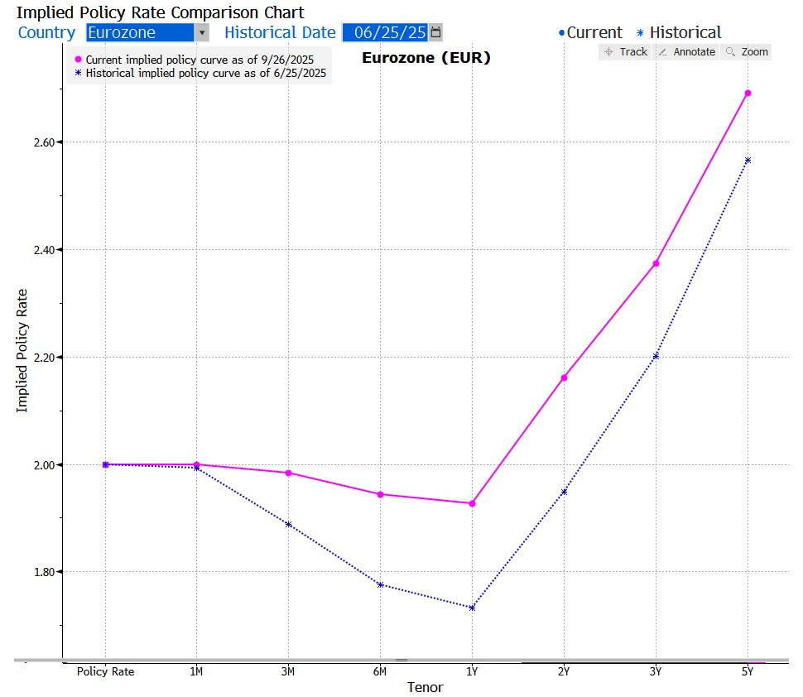
Current Interest Rate Environment
Higher for Longer Rate Environment with inflation upside risks and geo-political uncertainty.
Sources: Federal Funds Target Range - Upper Limit (DFEDTARU) | FRED | St. Louis Fed, Key ECB interest rates, Refinitiv

Slide 6
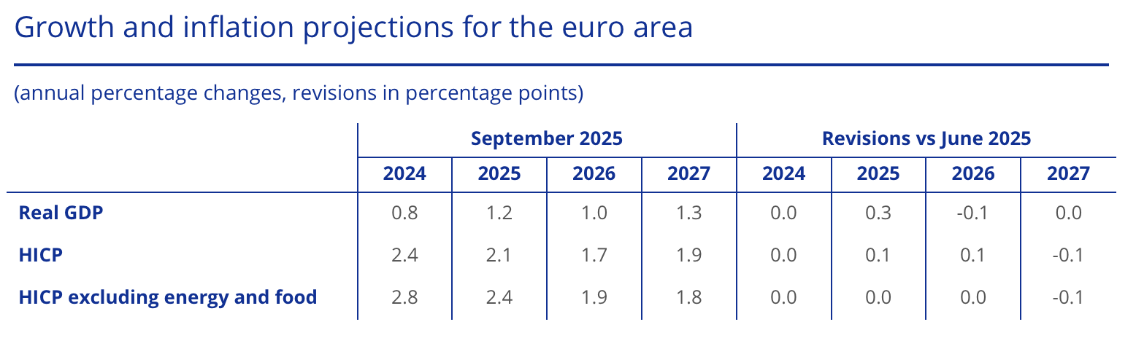
Macro Outlook
Over the next medium term, economic growth in the Euro Area is projected to moderate to 1.3% in 2027.
Inflation (HICP) is expected to decline from ~2.1% to ~1.7% and then settle near ~1.9%.
Meanwhile, in the United States, real GDP growth is expected to stay under 2%,
Core PCE inflation hovering around 2–2.4%.
Globally, the IMF estimates growth of ~3.0–3.3% in 2025, with headline inflation at ~4.2% in 2025 gradually easing in 2026.
Sources: Federal Funds Target Range - Upper Limit (DFEDTARU) | FRED | St. Louis Fed, Key ECB interest rates, Refinitiv

Slide 7
German Statutory Pension System
Financing
Simple Example
In 2025, 45 years old
Annual Gross Earning = €81,600
German Averge Earnings = €50,493
Pension Points Earned in this year = 1.62 points
Employer + Employee each contribute 50%: 9.3% of gross salary, total contribution 18.6%.
Benefit Determination
Pension Points = Individual Earnings ÷ German Average Earnings
(Rentenpunkte) (Durchschnittsentgelt)
In 2048, 68 years old
Cumulative Pension Points for 38 years = 60.53 points
Annual Current Pension Value = €771.84 / point
(Aktueller Rentenwert)
Retirement Pension = €45,808
(Bruttorente)
Retirement Pension = Total Points × Current Pension Value
(Bruttorente) (Aktueller Rentenwert)
Data source: § 65 SGB VI

Slide 8
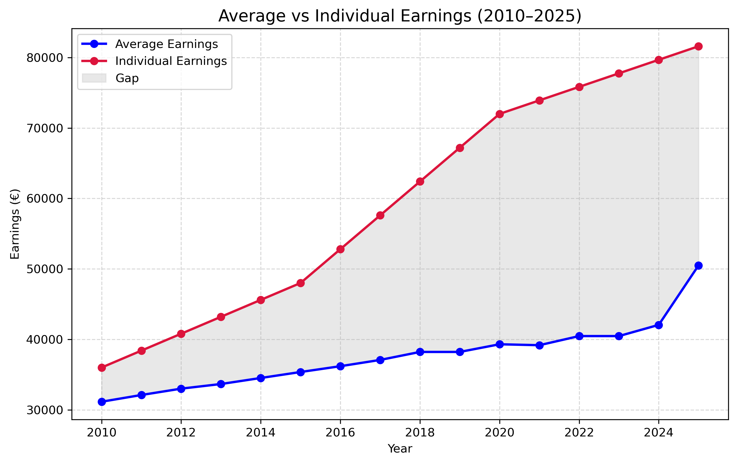
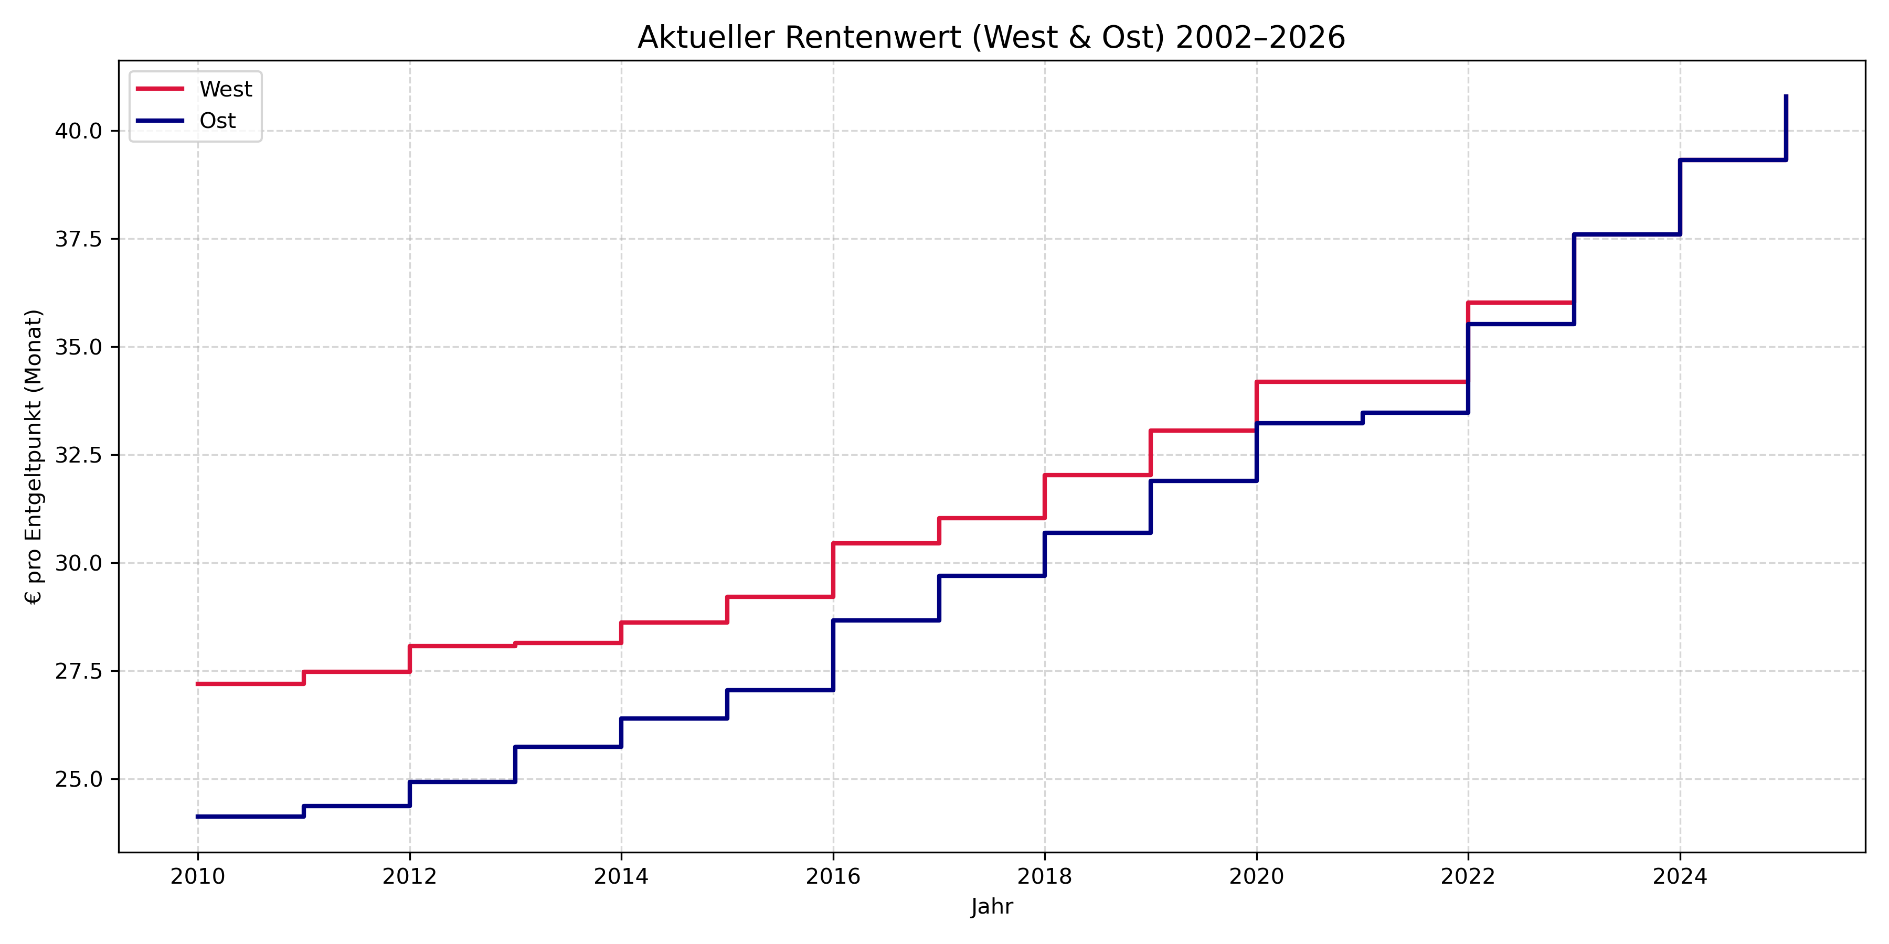
Macro Assumptions
historical data
assumptions
2010
2025
2048
Assumption1: IE and GAE increase by the inflation rate 2%
2025-2048: stable
Pension Points/yr = 1.62
Greater gap generated increasing pension points berfore 2025
Total Pension Points = 60.53 points
assumptions
2048
Assumption 2: point value increases by the inflation rate 2%
Assumption 2: point value increases by the inflation rate 2%
€771.84 / point
€489.48 / point
Data source: § 65 SGB VI

Slide 9
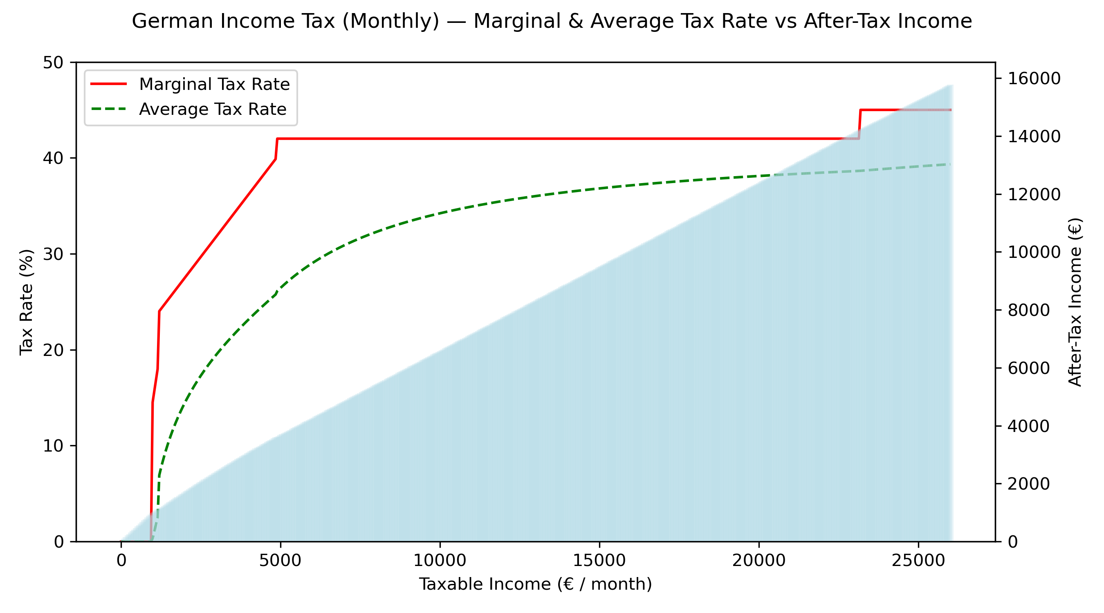
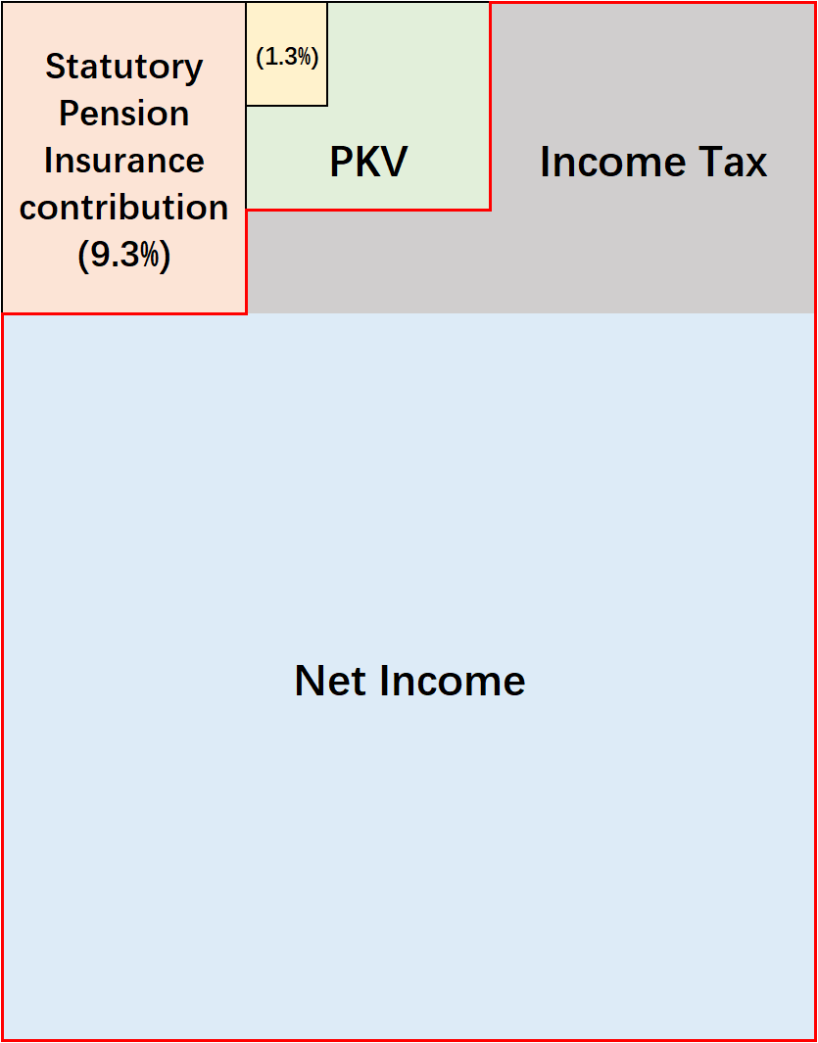
From Gross to Net: Income
Income Breakdown
Umemployment Insurance contribution
In 2047, 67 years old, last working year:
Annual Net Income = €84509
Zone (English / Deutsch) | Taxable Income zvE (€/month) | Marginal Rate | Explanation
Basic Allowance (Grundfreibetrag) | ≤ 967 € | 0 % | Tax-free threshold
Progressive Zone 1 (Progressionszone 1) | 968 € – 1,188 € | 14 % → ~24 % | Smooth increase from 14% up to ~24%
Progressive Zone 2 (Progressionszone 2) | 1,189 € – 4,883 € | 24 % → 42 % | Smooth increase from 24% up to 42%
Top Tax Rate Zone (Proportionalzone, 42%) | 4,884 € – 23,152 € | Fixed 42 % | Marginal tax rate constant at 42%
Surtax Zone (Reichensteuer, 45%) | ≥ 23,153 € | Fixed 45 % | Very high incomes taxed at 45% marginal rate

Slide 10
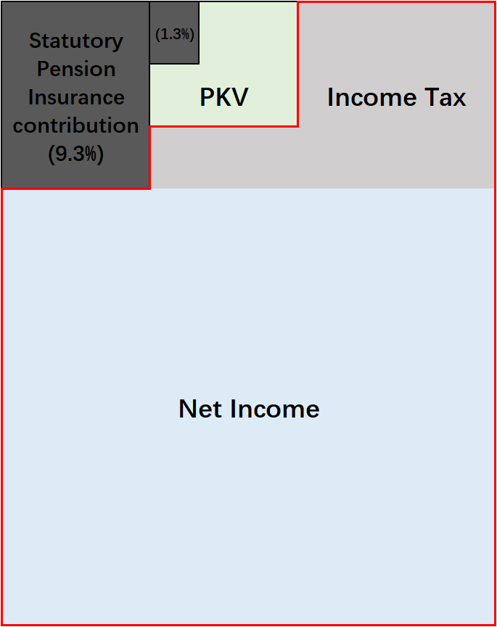
From Gross to Net: Statutory Pension
Step 1: Determine Gross Pension
Step 2: Apply Taxable Portion
„Ab 2023 steigt der Besteuerungsanteil nur noch um einen halben Prozentpunkt pro Jahr an. Damit wird die vollständige Besteuerung der Renten (100 %) erst im Jahr 2058 erreicht.“
Taxable Pension Income = Gross Pension × 95.5%
Step 3: Deduct Allowable Expenses
Health insurance contributions
Long-term care insurance contributions
Other deductible provisions
Step 4: Calculate Taxable Income(zvE) Tax
Data source: Meldungen | Wachstums­chancengesetz: Besteuerungs­anteil der Renten steigt langsamer | Deutsche Rentenversicherung

Slide 11
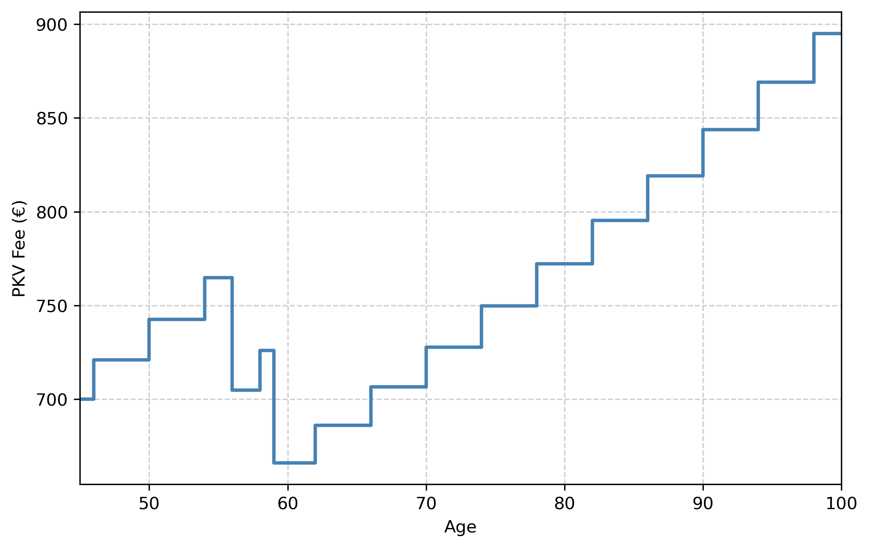
Gap between Needed Cashflow and Statutory Pension
Retirement Income Replacement Rate: the proportion of pre-retirement income that is typically needed in retirement to maintain the same living standard.
“A common rule of thumb is that total retirement income—Social Security plus pensions, asset income, and other sources—should replace about 70 percent of preretirement earnings.”
—— SSA – Alternate Measures of Replacement Rates (Policy Paper)
Needed Cashflow in 2048
=
80% × Last Net Income
+
Full Private Health Insurance Fee
Assumptions:
PKV fee increases every 3 years, increase rate 3%
Child‘s PKV fee = €60/month
Timepoints children turn to 18
Data source: Alternate Measures of Replacement Rates for Social Security Benefits and Retirement Income (SSA Bulletin, Vol. 68, No. 2, 2008)

Slide 12
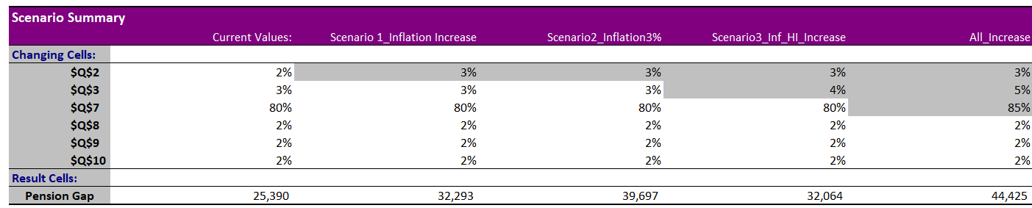
Scenario Insights – What Drives the Pension Gap?
Raising inflation to 3% widens the gap to €32–40k/year (+25–55%).
Pension sustainability is highly sensitive to price stability.
Increasing replacement rate from 80% → 90% pushes the gap to ~€34k/year (+34%).
Higher lifestyle expectations in retirement materially raise the funding need.
Premium growth of 5% vs 3% adds ~€6k to the gap.
Medical inflation is a risk to watch, though less dominant than general inflation.

Slide 13
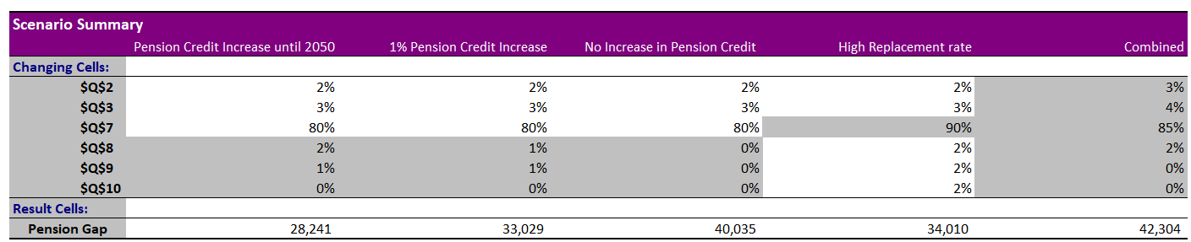
Scenario Insights – What Drives the Pension Gap?
Pension credit indexation matters for downside protection.
If pension credits are not increased, the gap remains above €40k.
Indexation protects against severe downside.
Worst-case scenario is severe.
Combining high inflation, high healthcare cost growth, and higher replacement rate pushes the gap to ~€42k — almost 70% higher than the base case (€25k).
Required returns rise to 7–8%, which is much harder to achieve sustainably. Portfolio must be designed to deliver 5–6% nominal CAGR in base case​

Slide 14
Why ETFs for the Pension Portfolio?
Diversification → one ETF = hundreds/thousands of stocks or bonds. Reduces single-company/issuer risk
Cost Efficiency → very low management fees (TER ~0.1–0.3%) compared to active funds
Transparency → ETFs track clear indices (MSCI World, Euro Gov Bonds, etc.), easy to monitor
Liquidity & Accessibility → traded daily on exchanges like stocks; easy to buy/sell for private investors
Tax Efficiency → equity ETFs enjoy 30% partial exemption (Teilfreistellung) in Germany
Global Access → exposure to markets (Emerging, US, REITs, gold) otherwise hard for individual investors to replicate
RITESH

Slide 15
ISHARES CORE MSCI WORLD
Security Information
ISIN: IE00B4L5Y983
Fund Type: ETF
Asset Group: Global Equity
Category Group: Equity Developed World
Geo. Focus: Global
Expense Ratio: 0.20%
Index Weight: Market Cap
Rebalancing Frequency: Quarterly
Top Industry Group
Internet (10.88%)
Semiconductor (10.39%)
Software (8.93%)
Banks (7.89%)
Top Geographic
U.S. (70.67%)
Japan (5.45%)
U.K. (3.52%)
Canada (3.29%)
France (2.58%)
Switzerland (2.57%)
Metrics
Annual Return: 13.11%
Volatility: 15.7%
Sharpe Ratio: 0.66
Security Description
iShares Core MSCI World UCITS ETF is an exchange-traded fund incorporated in Ireland. The Fund aims to track the performance of the MSCI World Index.

Slide 16
ISHARES CORE EM IMI ACC
Security Information
ISIN: IE00BKM4GZ66
Fund Type: ETF
Asset Group: Global Equity
Category Group: Equity Emerging Markets Global
Geo. Focus: Emerging Markets
Expense Ratio: 0.180%
Rebalancing Frequency: Quarterly
Top Industry Group
Semiconductors (16.08%)
Banks (13.41%)
Internet (12.23%)
Diversified Finan Serv (4.64%)
Top Geographic
China (21.44%)
Taiwan (19.76%)
India (16.81%)
South Korea (11.46%)
Hong Kong (4.45%)
Brazil (4.25%)
Metrics
Annual Return: 9.68%
Volatility: 18.72%
Sharpe Ratio: 0.37
Security Description
iShares Core MSCI EM IMI UCITS ETF is an exchange-traded fund incorporated in Ireland. The Fund aims to track the performance of the MSCI Emerging Markets IMI Index.

Slide 17
ISHARES GLBL INFRASTRUCTURE
Security Information
ISIN: IE00B1FZS467
Fund Type: ETF
Asset Group: Sector Equity
Category Group: Equity Thematic
Expense Ratio: 0.650%
Index Weight: Market Cap
Rebalancing Frequency: Quarterly
Top Industry Group
Electric (46.81%)
Transportation (15.95%)
Pipelines (15.73%)
REITS (5.28%)
Top Geographic
U.S. (63.03%)
Canada (12.60%)
Japan (4.28%)
U.K. (3.69%)
India (2.09%)
Hong Kong (1.92%)
Metrics
Annual Return: 9.13%
Volatility: 14.33%
Sharpe Ratio: 0.44
Security Description
iShares Global Infrastructure UCITS ETF is an exchange-traded fund incorporated in Ireland. The Fund aims to track the performance of FTSE Global Core Infrastructure Index.

Slide 18
ISHARES CORE EURO GOVT BOND
Security Information
ISIN: IE00B4WXJJ64
Fund Type: ETF
Asset Group: Global Fixed Income
Category Group: Global Government Bond
Geo. Focus: Eurozone
Expense Ratio: 0.07%
Index Weight: Market Cap
Rebalancing Frequency: Quarterly
Top Industry Group
Sovereign (99.86%)
Banks (0.01%)
Top Geographic
France (23.95%)
Italy (21.91%)
Germany (18.80%)
Spain (14.31%)
Belgium (4.91%)
Netherlands (4.04%)
Metrics
Annual Return: 1.83%
Volatility: 4.93%
Sharpe Ratio: -0.19 (Irrelevant)
Security Description
iShares Core EUR Govt Bond UCITS ETF is an exchange-traded fund incorporated in Ireland. The Fund aims to track the performance of the Bloomberg Euro Treasury Bond Index.

Slide 19
ISHARES CORE EURO CORP BOND
Security Information
ISIN: IE00B3F81R35
Fund Type: ETF
Asset Group: Global Fixed Income
Category Group: Global Corporate Bond
Rating: Investment Grade BBB or higher
Expense Ratio: 0.09%
Index Weight: Market Cap
Rebalancing Frequency: Monthly
Top Industry Group
Banks (31.51%)
Electric (5.72%)
Telecommunications (4.92%)
Auto Manufacturers (4.82%)
Top Geographic
France (19.73%)
U.S. (15.76%)
Netherlands (15.40%)
Germany (8.46%)
U.K. (6.96%)
Spain (5.88%)
Metrics
Annual Return: 3.84%
Volatility: 3.97%
Sharpe Ratio: 0.27
Security Description
iShares Core EUR Corp Bond UCITS ETF is an exchange-traded fund incorporated in Ireland. The Fund aims to track the performance of the Bloomberg Euro Corporate Bond Index.

Slide 20
ISH EB.REXX GVTGRMNY10.5 DE
Security Information
ISIN: DE000A0D8Q31
Fund Type: ETF
Asset Group: Global Fixed Income
Category Group: Fixed Income European Region
Rating: Investment Grade BBB or higher
Expense Ratio: 0.160%
Rebalancing Frequency: Monthly
Top Industry Group
Sovereign (99.96%)
Top Geographic
Germany (99.96%)
Metrics
Annual Return: 2.1%
Volatility: 11.15%
Sharpe Ratio: -0.06 (Irrelevant)
Security Description
iShares eb.rexx Government Germany 10.5+yr UCITS ETF (DE) is an open-end, UCITS compliant exchange traded fund incorporated in Germany. The fund aims to track the performance of the eb.rexx Government Germany 10.5+ index. The fund distributes income received to shareholders.

Slide 21
INVESCO PHYSICAL GOLD ETC
Security Information
ISIN: IE00B579F325
Fund Type: ETC
Asset Group: Commodity
Category Group: Precious Metals
Expense Ratio: 0.120%
Index Weight: Single Asset
Top Industry Group
NA
Top Geographic
NA
Metrics
Annual Return: 12.80%
Volatility: 14.64%
Sharpe Ratio: 0.69
Security Description
Invesco Physical Gold ETC is a UCITS eligible Exchange Traded Certificate incorporated in Ireland. It aims to provide the performance of the spot gold price (London PM fixing price). Each Gold ETC is a certificate which is secured by physical gold held in JP Morgan Chase Bank's London vaults. The vast majority of gold is held in allocated gold bars.

Slide 22
ISHARES DVL MKT PROPERTY YLD
Security Information
ISIN: IE00B1FZS350
Fund Type: ETF
Asset Group: Real Estate
Category Group: Indirect Real Estate
Expense Ratio: 0.590%
Index Weight: Market Cap
Rebalancing Frequency: Quarterly
Top Industry Group
REITS (87.50%)
Real Estate (11.06%)
Top Geographic
U.S. (63.51%)
Japan (8.33%)
Australia (4.52%)
U.K. (3.70%)
Hong Kong (3.42%)
Singapore (3.37%)
Metrics
Annual Return: 11.94%
Volatility: 17.88%
Sharpe Ratio: 0.51
Security Description
iShares Developed Markets Property Yield UCITS ETF is an exchange-traded fund incorporated in Ireland. The Fund aims to track the performance the FTSE EPRA/NAREIT Developed Dividend+ Index.

Slide 23
SPDR GLOBAL REAL ESTATE
Security Information
ISIN: IE00B8GF1M35
Fund Type: ETF
Asset Group: Real Estate
Category Group: Indirect Real Estate
Expense Ratio: 0.40%
Index Weight: Market Cap
Rebalancing Frequency: Quarterly
Top Industry Group
REITS (91.22%)
Real Estate (7.53%)
Top Geographic
U.S. (70.10%)
Japan (8.85%)
U.K. (3.64%)
Singapore (2.77%)
Australia (2.74%)
France (1.96%)
Metrics
Annual Return: 7.46%
Volatility: 16.86%
Sharpe Ratio: 0.28
Security Description
SPDR Dow Jones Global Real Estate UCITS ETF is an open ended, UCITS compliant, physically-backed exchange traded fund, domiciled in Ireland. The fund's objective is to track the performance of the Global Real Estate Securities Market.

Slide 24
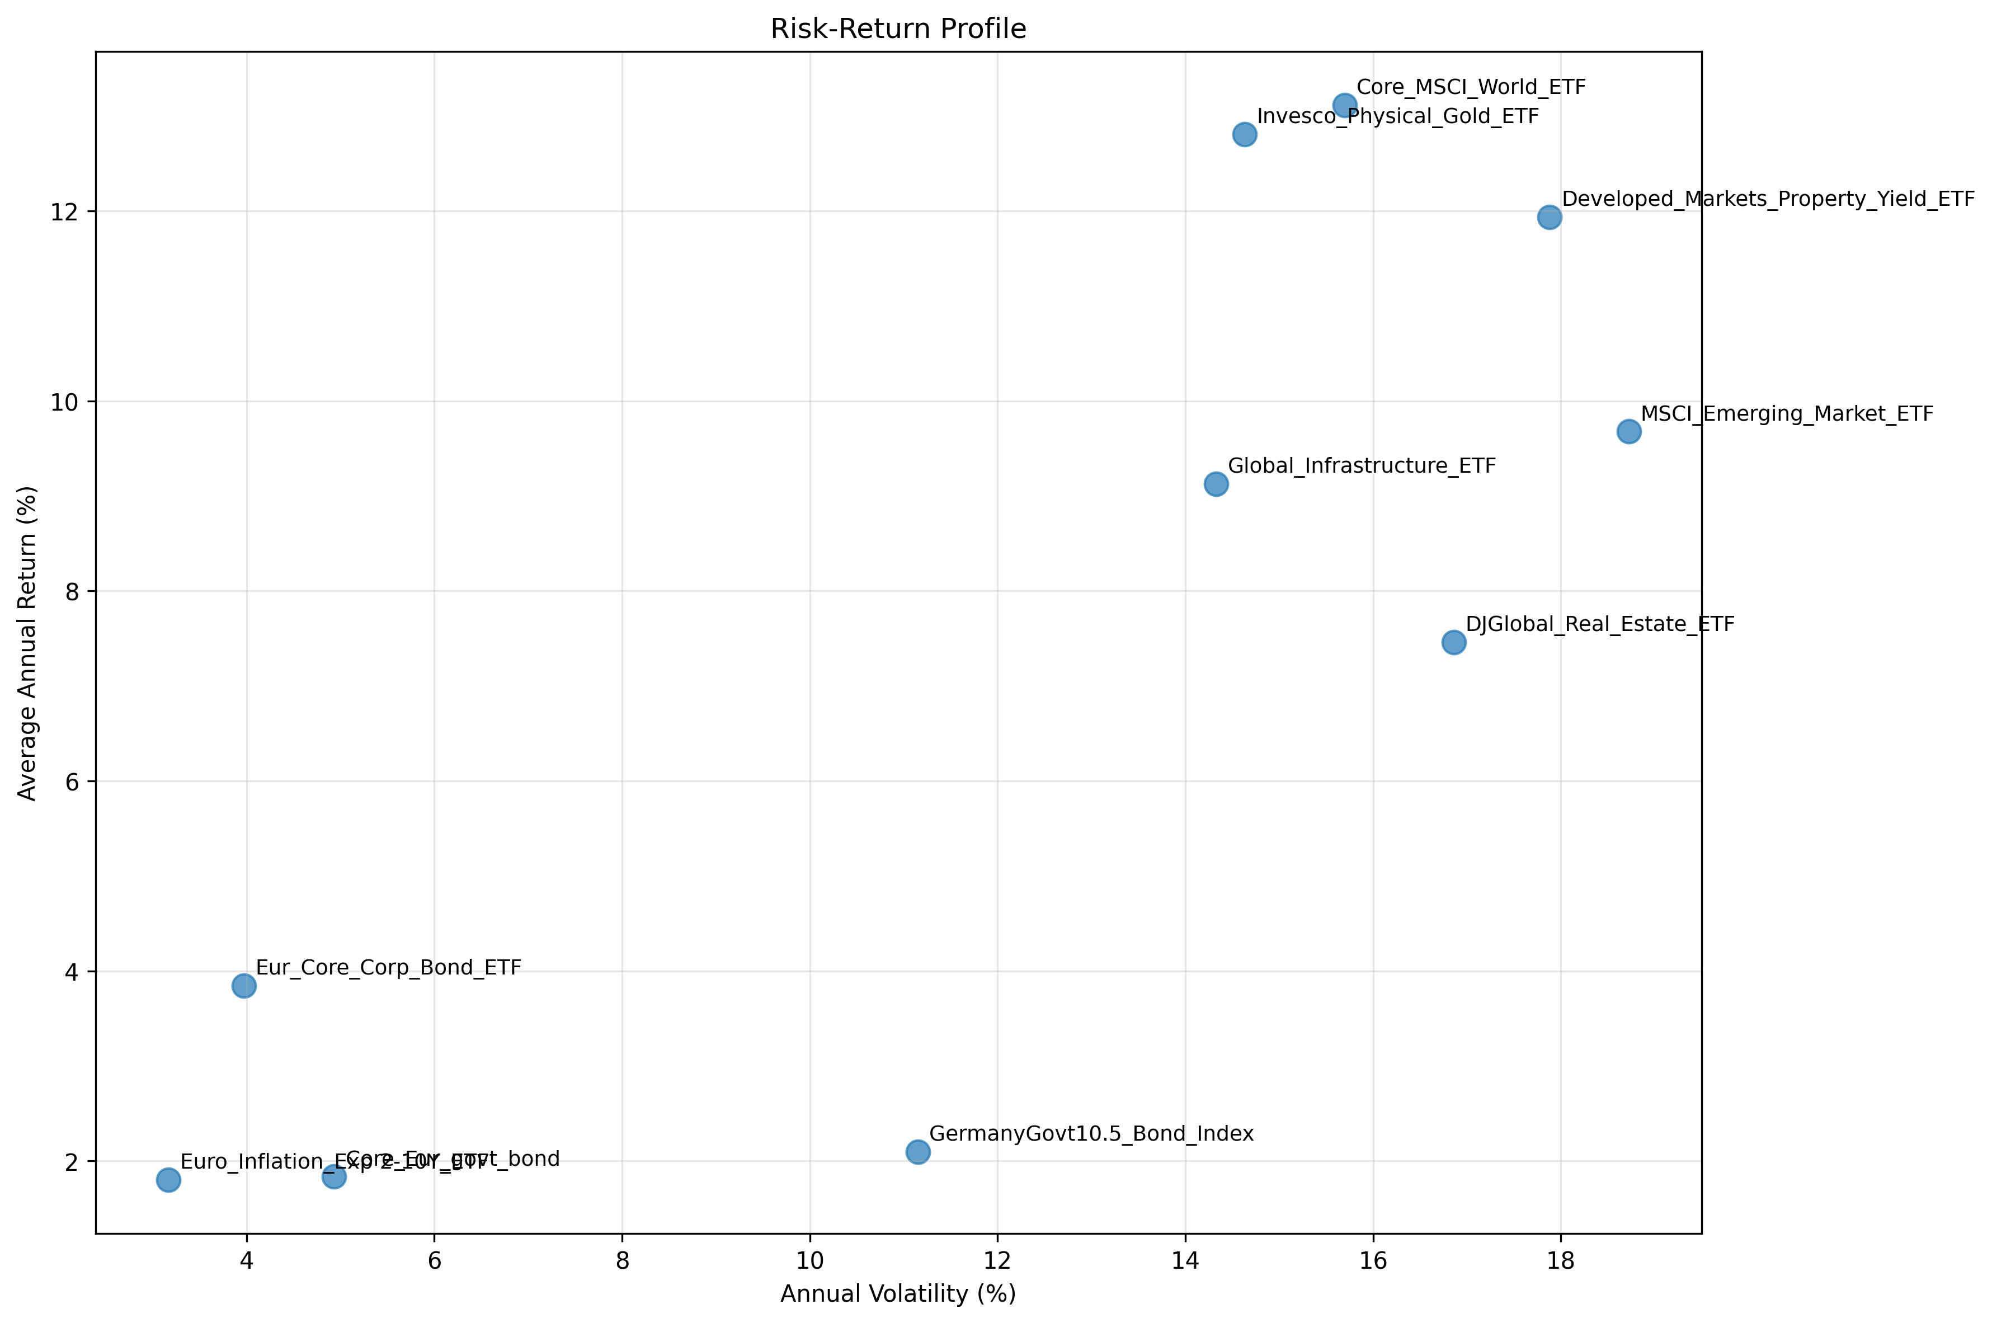
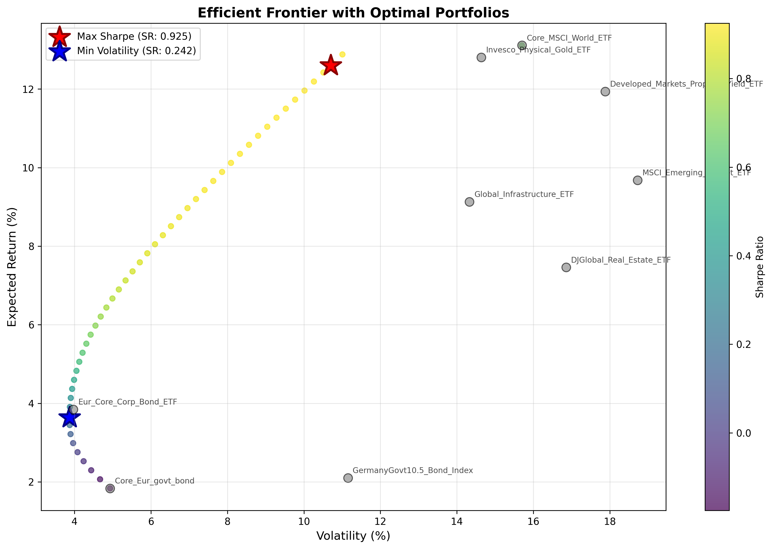
Efficient Portfolio
Markowitz Theory & Efficient Frontier
Efficient Frontier is Curve showing optimal portfolios with maximum return for each risk level
Diversification reduces risk without sacrificing return

Slide 25
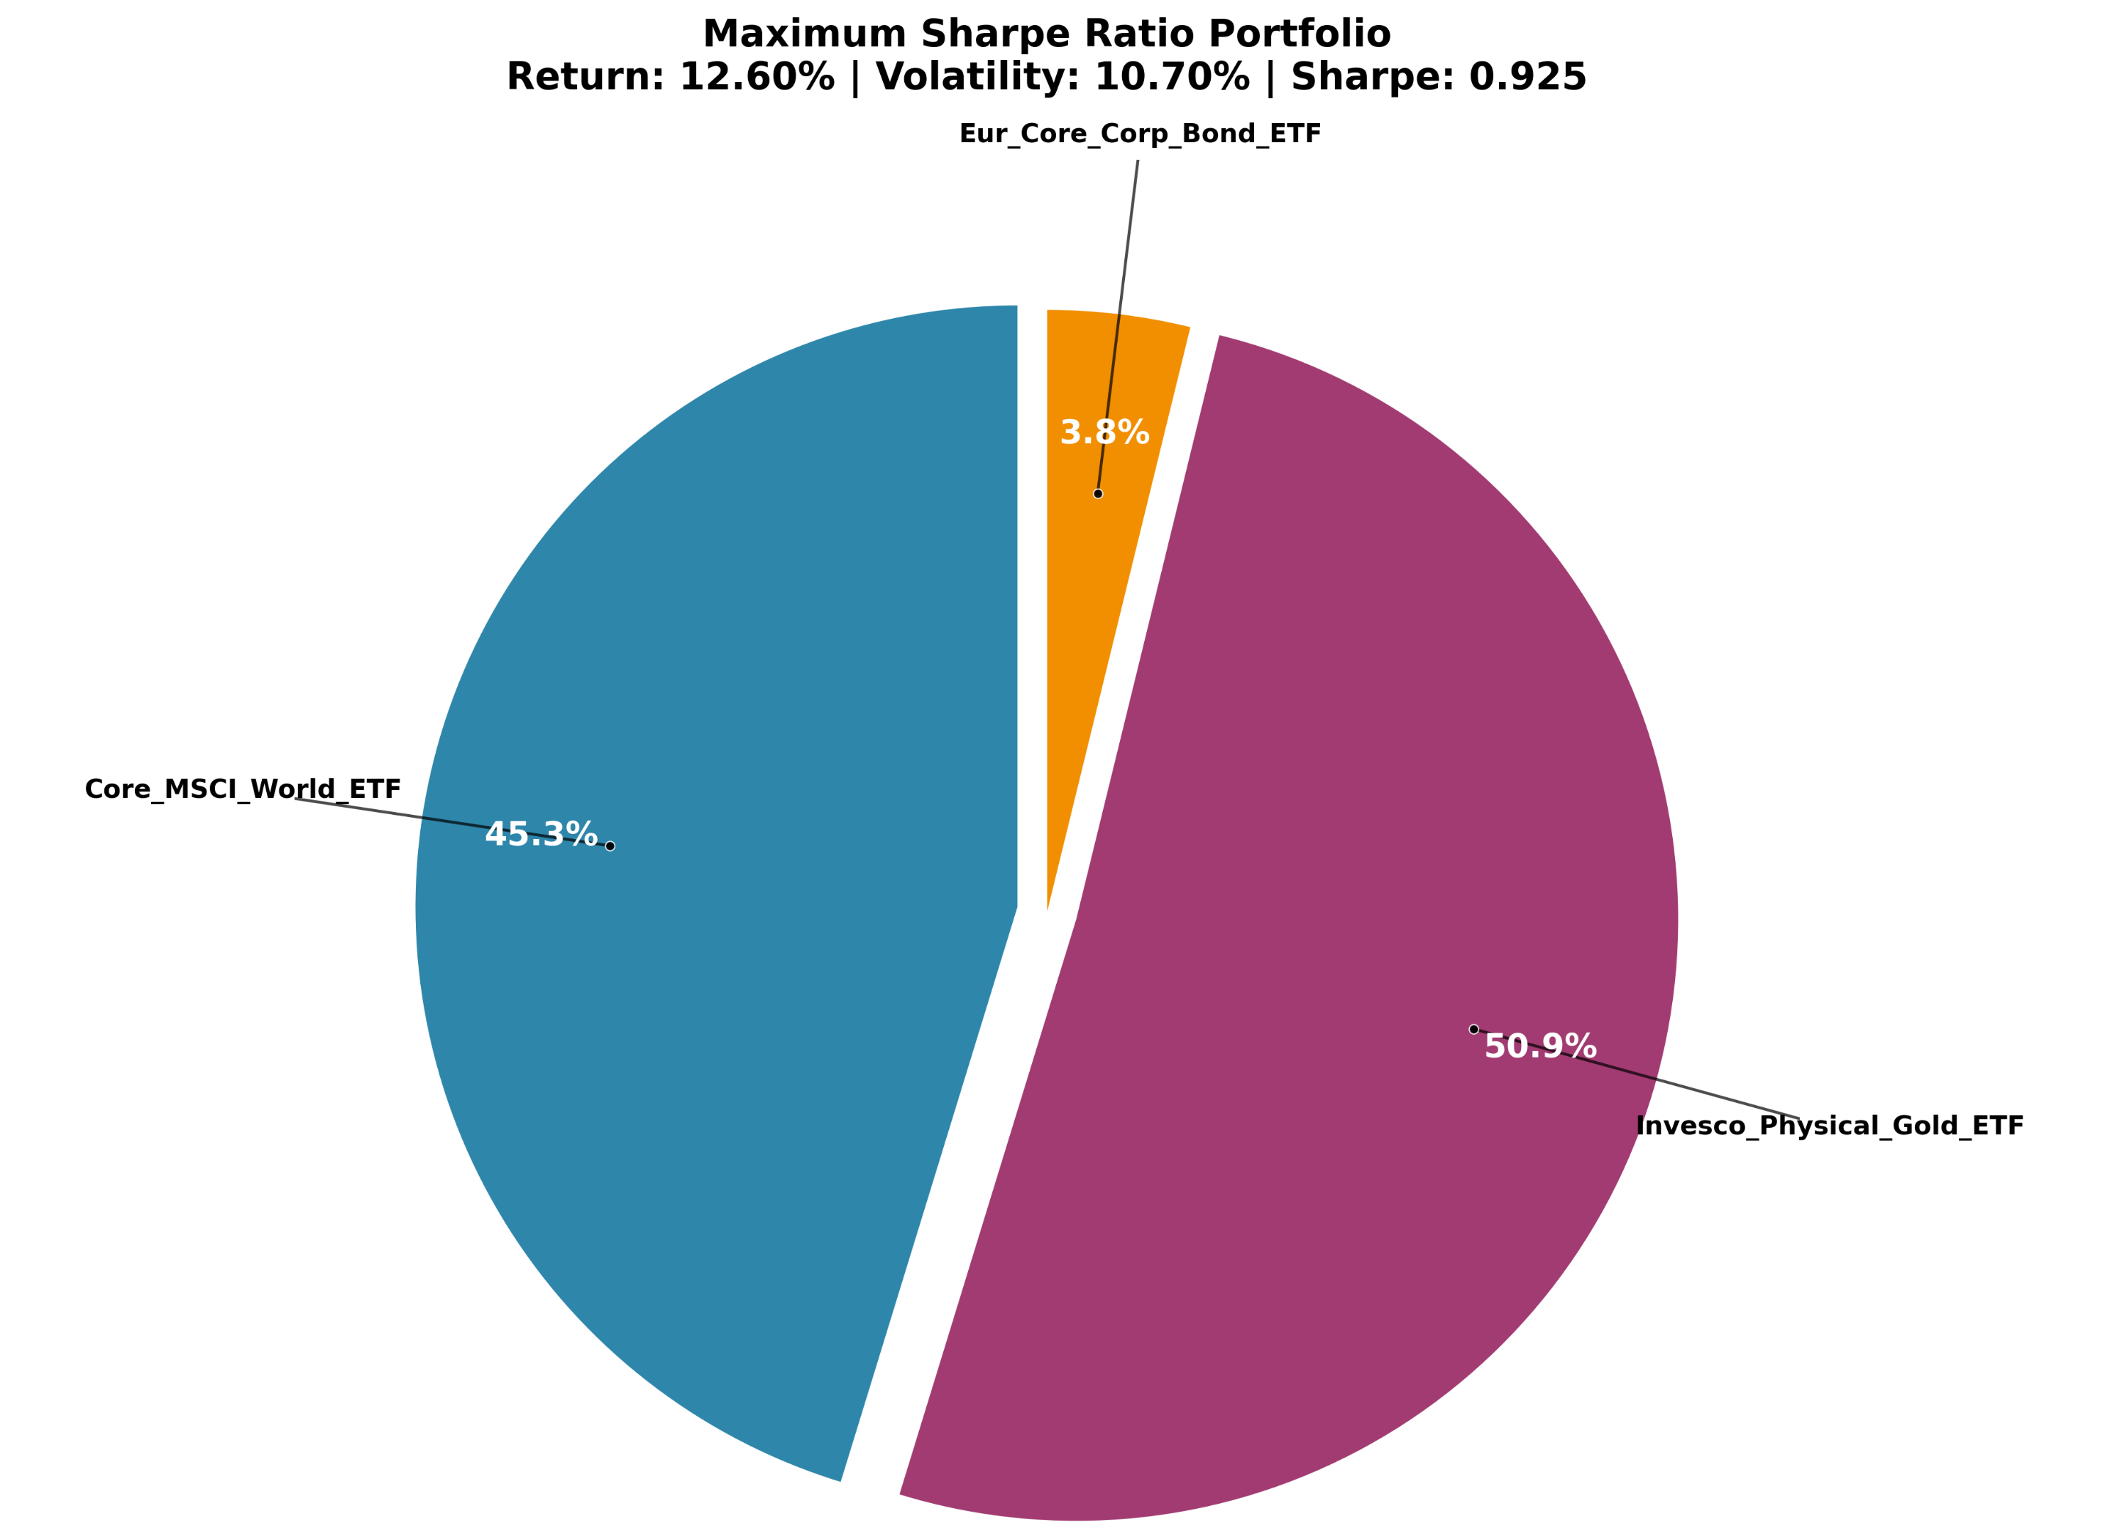
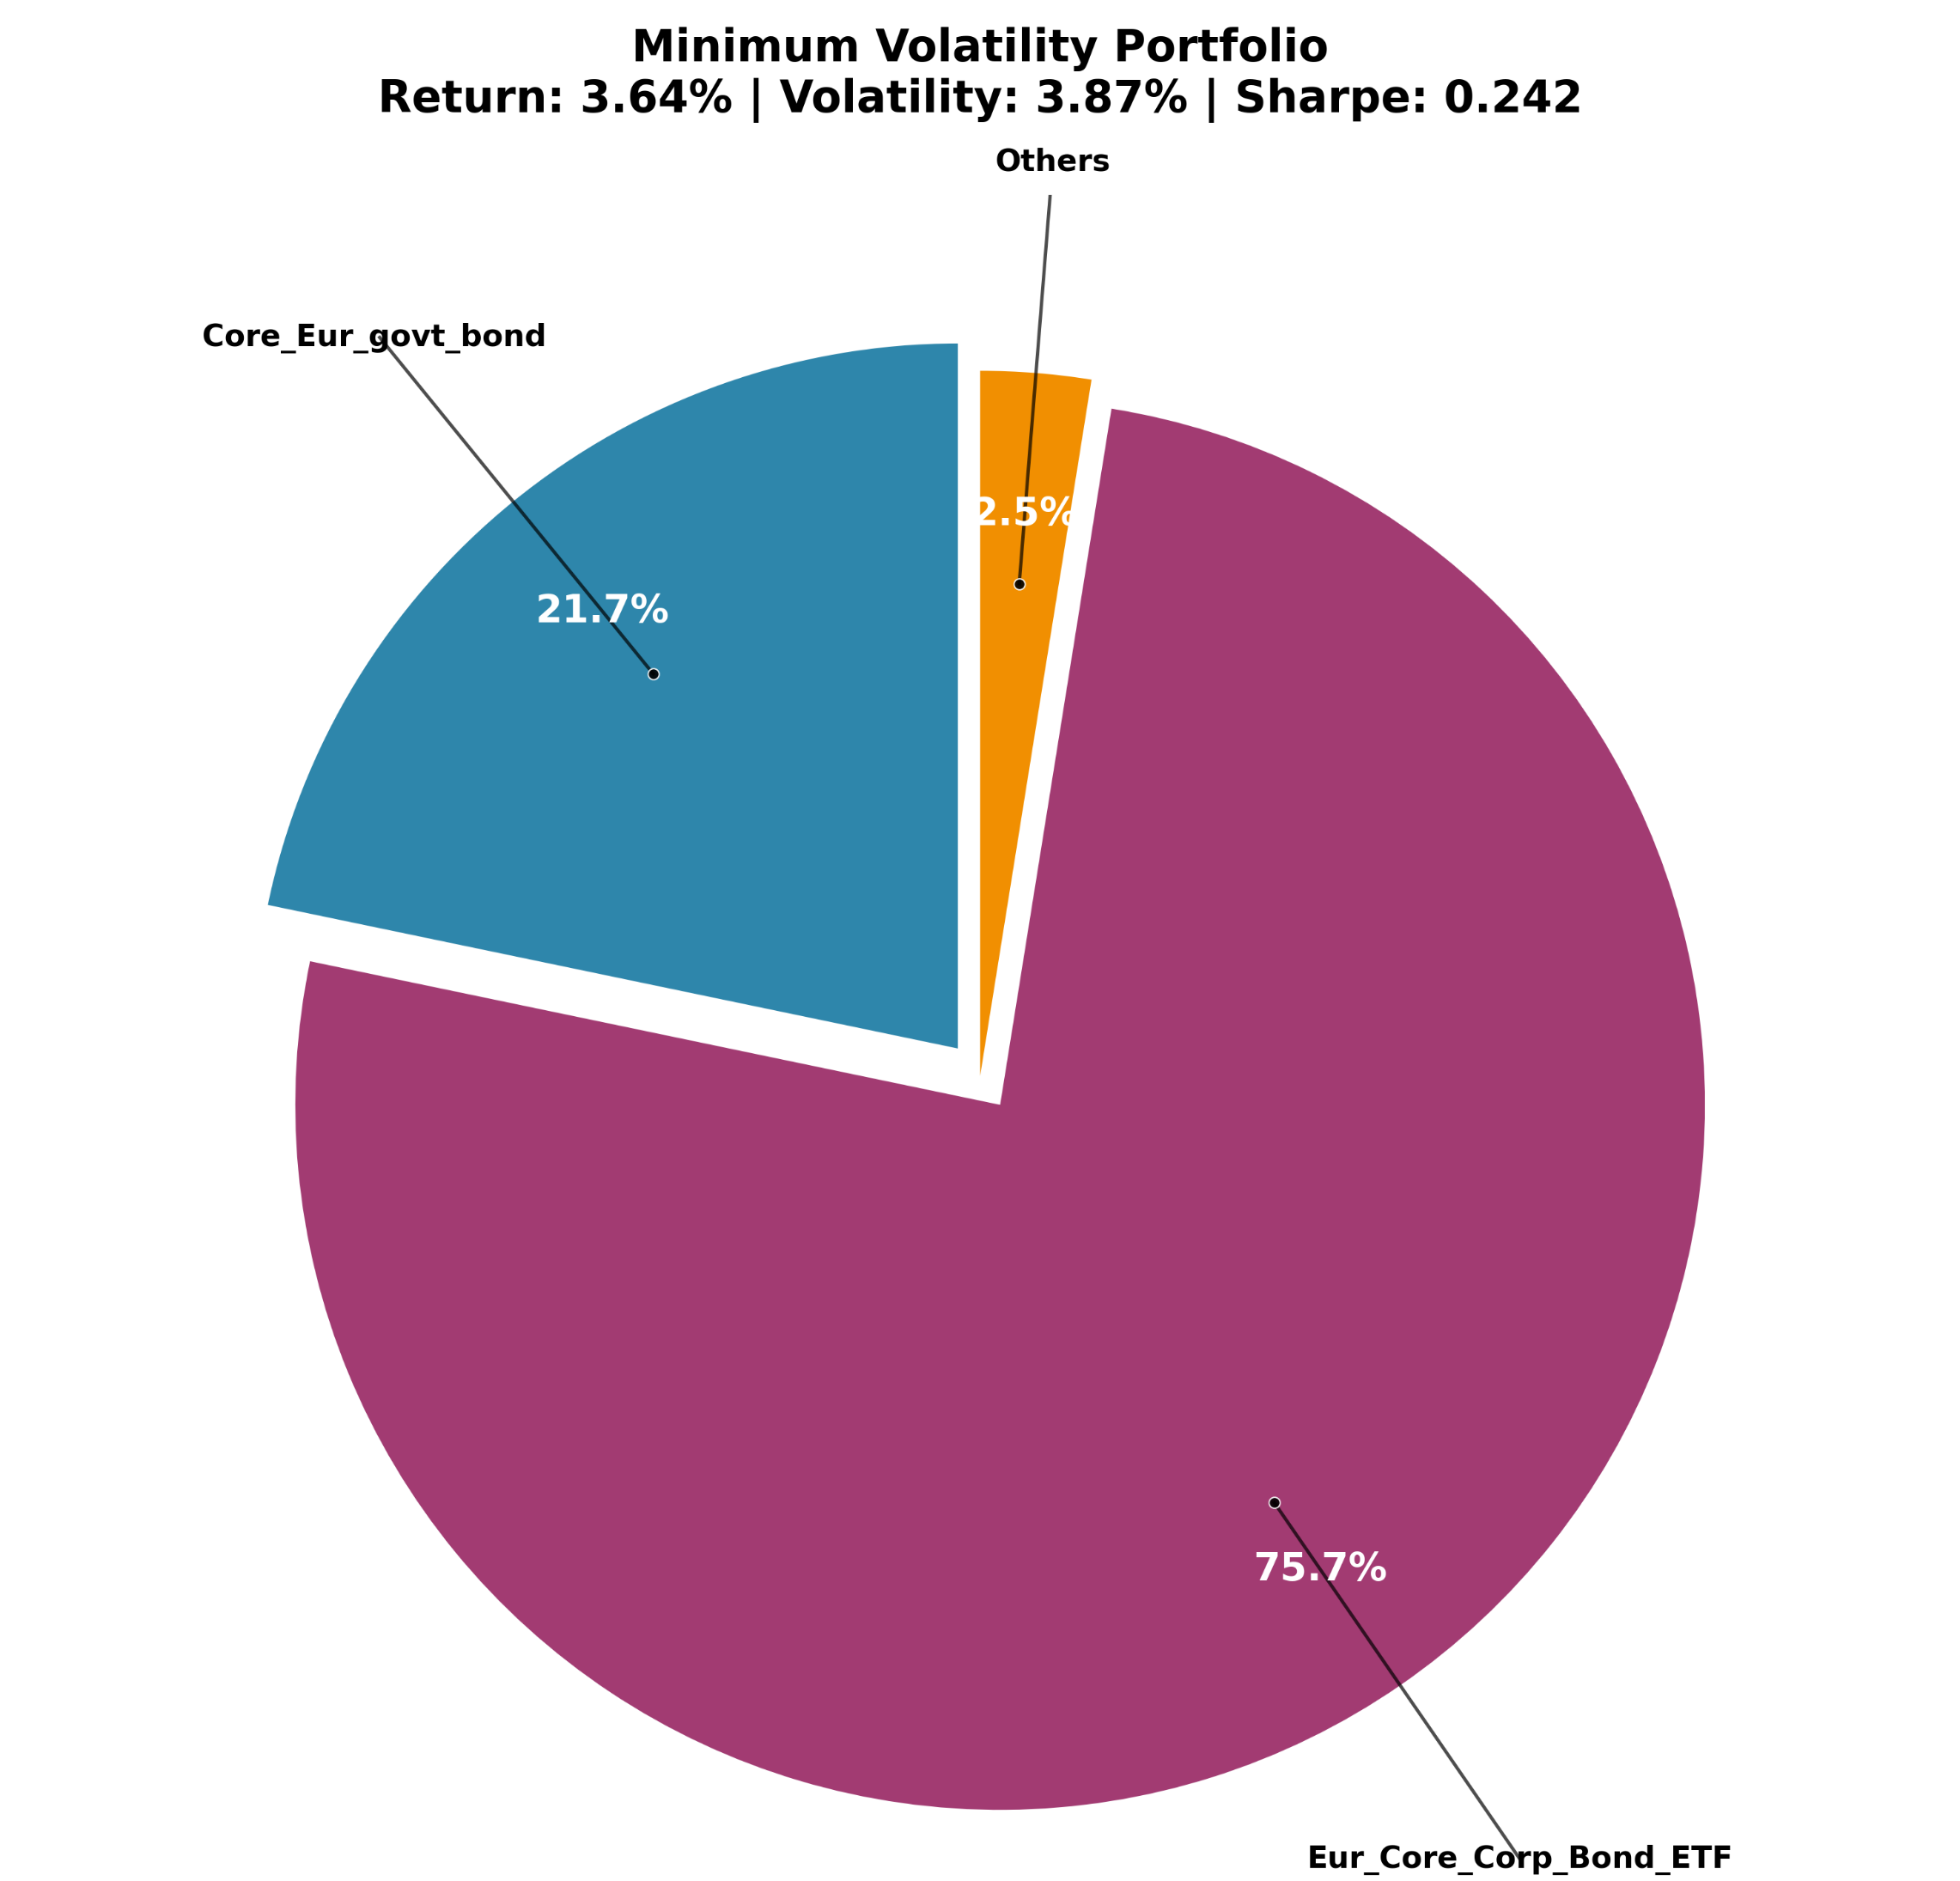
Efficient Portfolio
Maximum Sharpe Ratio
Best risk-adjusted return
Good For Long-term growth
For us, Too equity-heavy, exceeds risk tolerance
Minimum Volatility
Lowest possible risk, Minimise portfolio volatility
Good for Capital preservation (approaching retirement)
For us, bond-heavy, return potential too low.

Slide 26
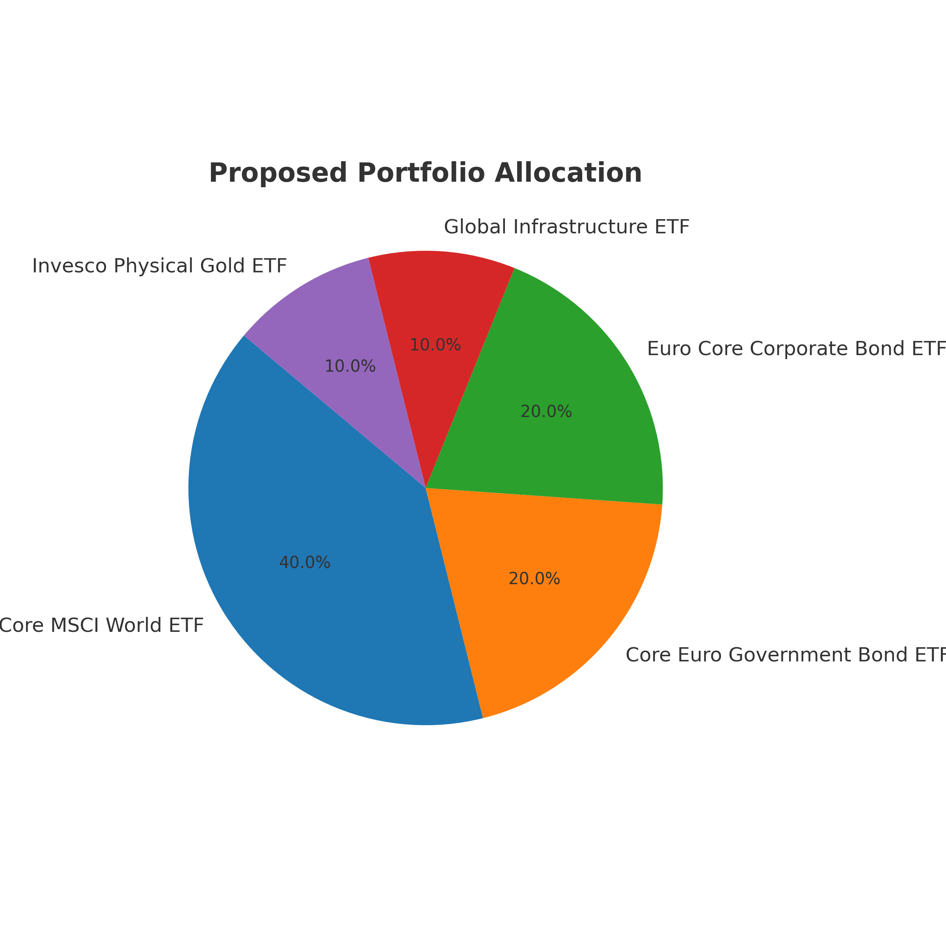
Proposed Portfolio Composition
Core MSCI World ETF – 40%
Core Euro Government Bond ETF – 20%
Euro Core Corporate Bond ETF – 20%
Global Infrastructure ETF – 10%
Invesco Physical Gold ETF – 10%
Other ETFs (EM, Property, Real Estate, German Gov Bonds) – 0%
Target Outcome
Growth via global equities + infrastructure.
Stability via bonds.
Diversification & inflation hedge via gold.

Slide 27
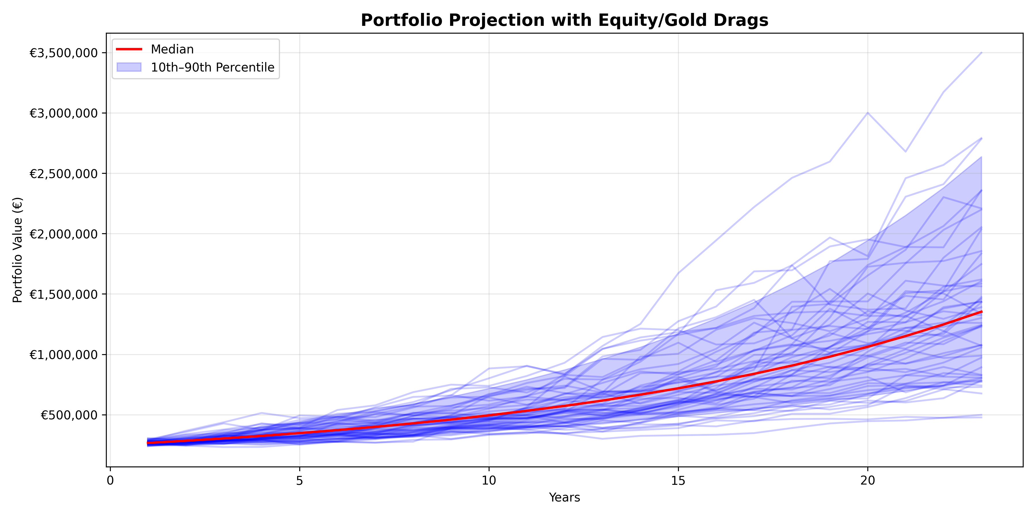
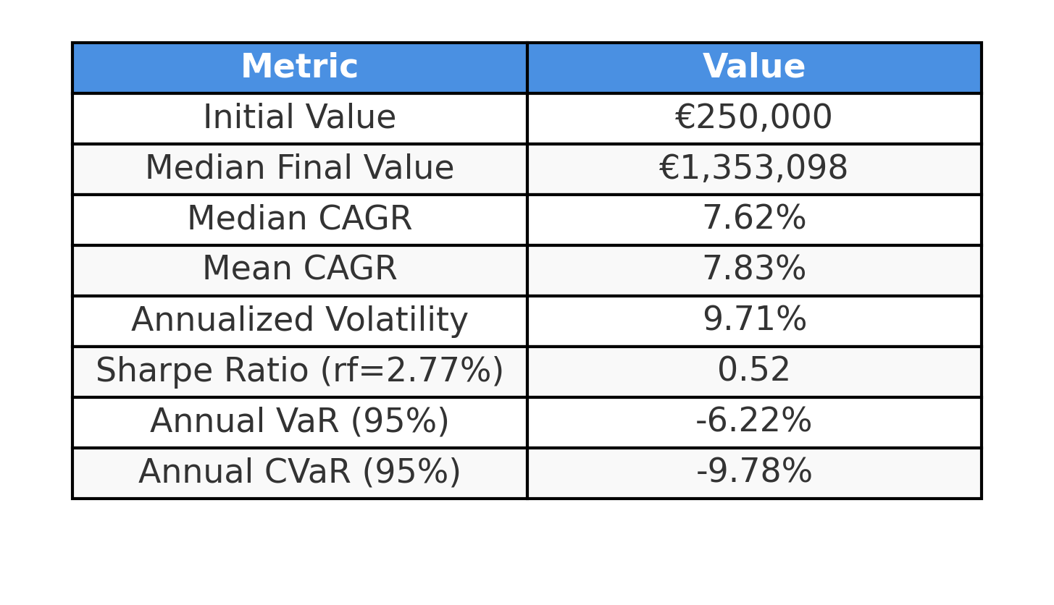
Portfolio Modelling
Methodology
Simulates portfolio evolution using daily i.i.d. normal returns for each ETF individually.
Historical data used to estimate μ (expected return) and σ (volatility) per asset.
100,000 Monte Carlo paths over the investment horizon (for simplicity)

Slide 28
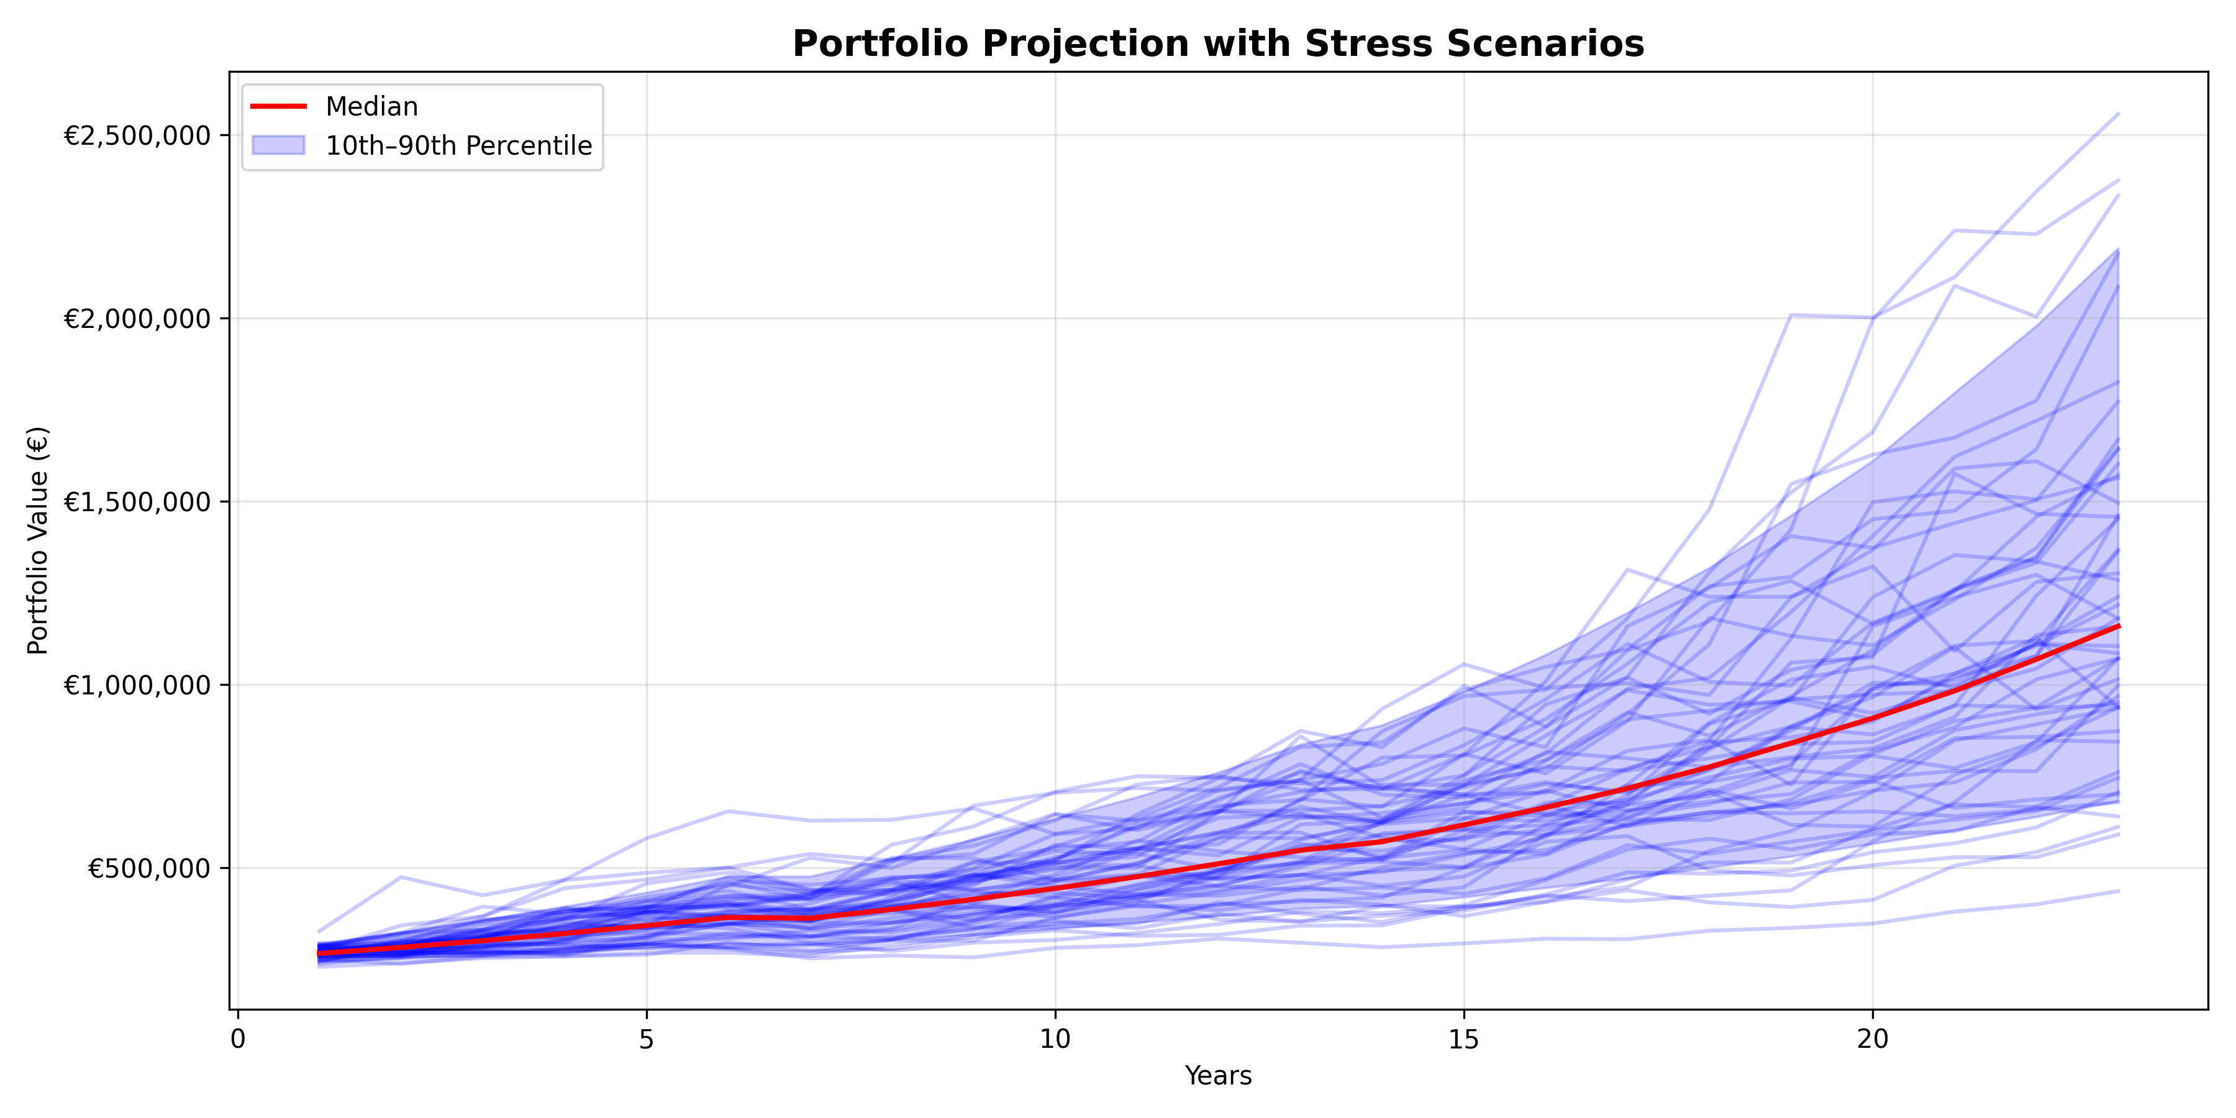
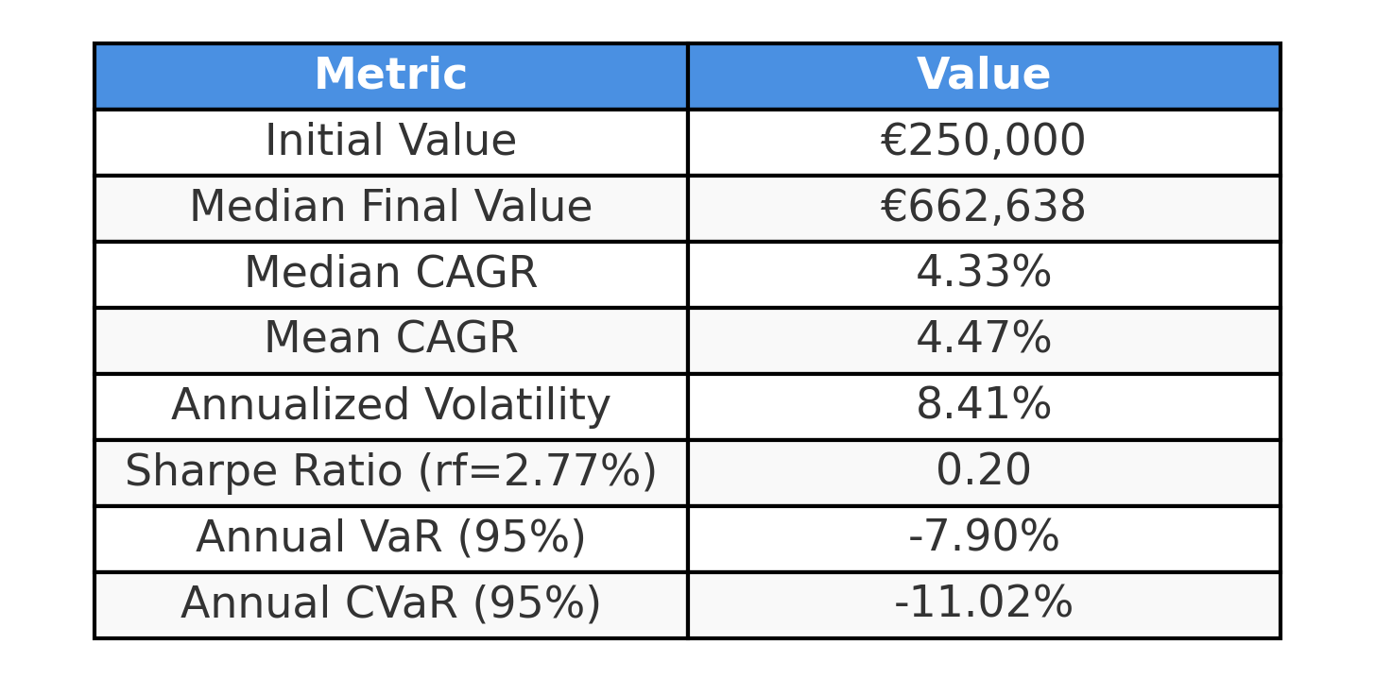
Stress Modelling – Case 1
We need to model risks due to external shocks like trade frictions or equity crash
Assumes that the market is under stress by introducing a stress factor that drags the mean return down.
Historical data used to estimate μ (expected return) is stressed and portfolio is then modelled similar to base case.

Slide 29
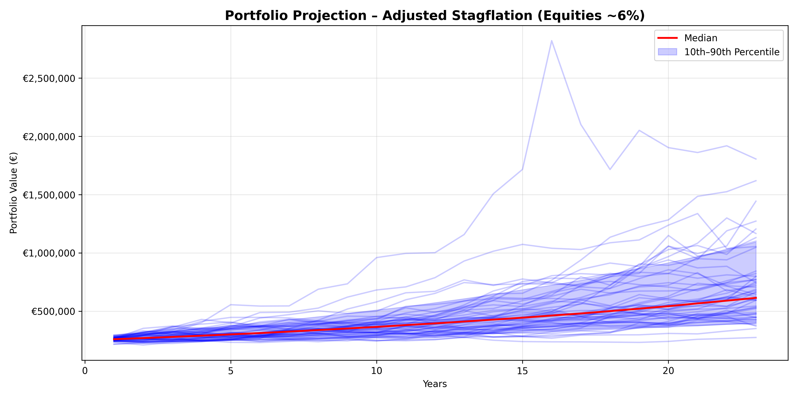
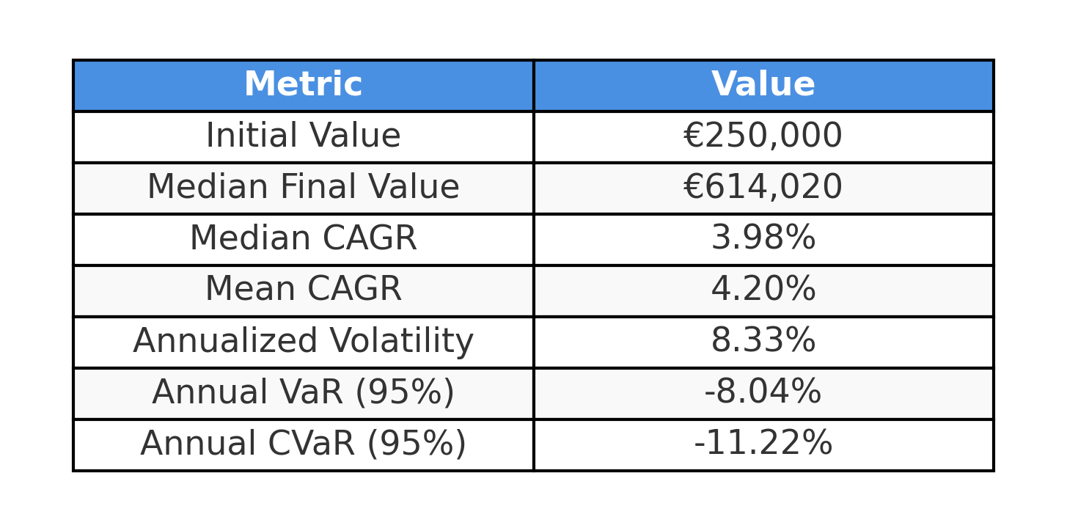
Stress Modelling – Case 2
Stagflation scenario when there is little or no growth in economy
Assumes that the returns for equities, bonds and gold all decrease.
Historical data used to estimate σ (volatility) and portfolio is then modelled similar to base case with reduced return assumption.

Slide 30
Rebalancing Modeling Limitations
Complexity of Assumptions
Choice of frequency (monthly, quarterly, annually).
Transaction costs and bid–ask spreads.
Tax impacts (e.g. realization of gains in Germany).
Strong path dependency on market timing.
Modeling Limitations
Requires simulating dynamic allocation rules vs. static weights.
Adds heavy computational complexity on top of return projection.
Realistic costs and frictions are hard to calibrate.
Theoritical Treatment Instead
Rebalancing = essential for risk control (maintains target allocation).
Prevents equity drift from dominating long-term risk profile.

Slide 31
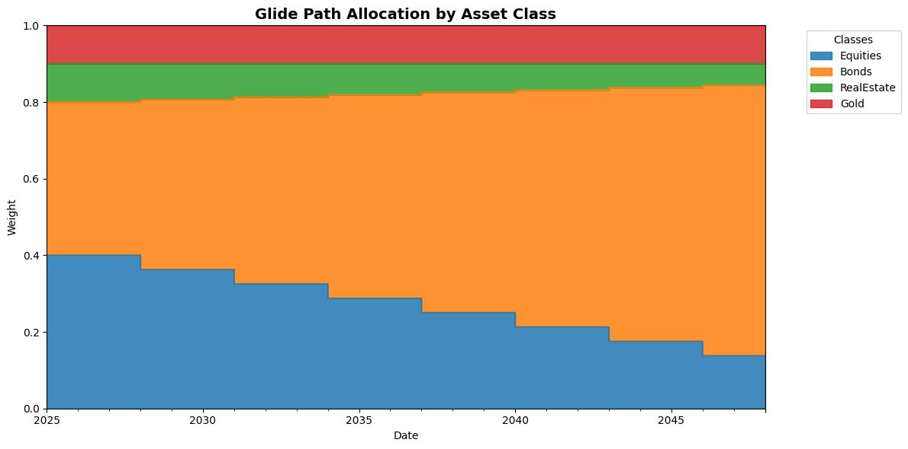
Glide Path Allocation by Asset Class

Slide 32
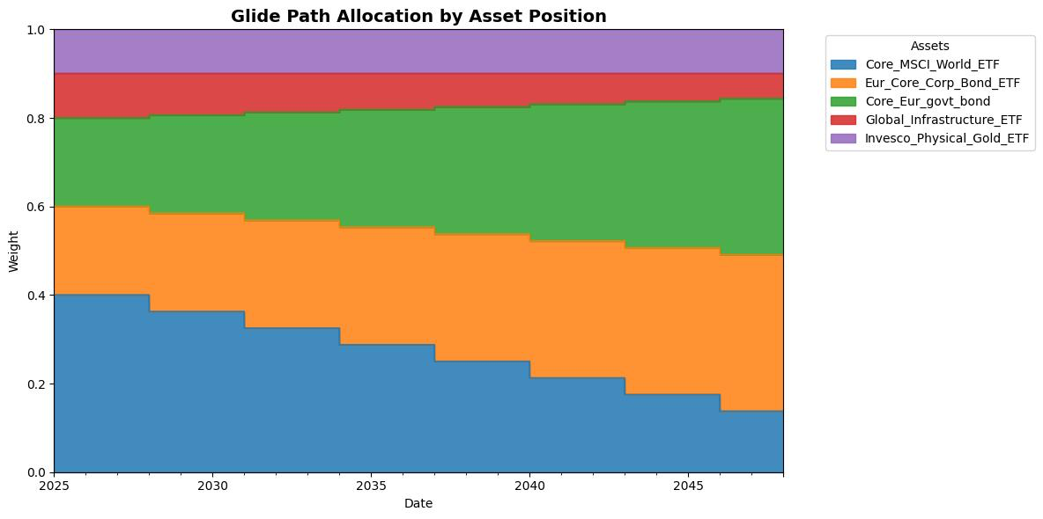
Glide Path Allocation by Positions

Slide 33
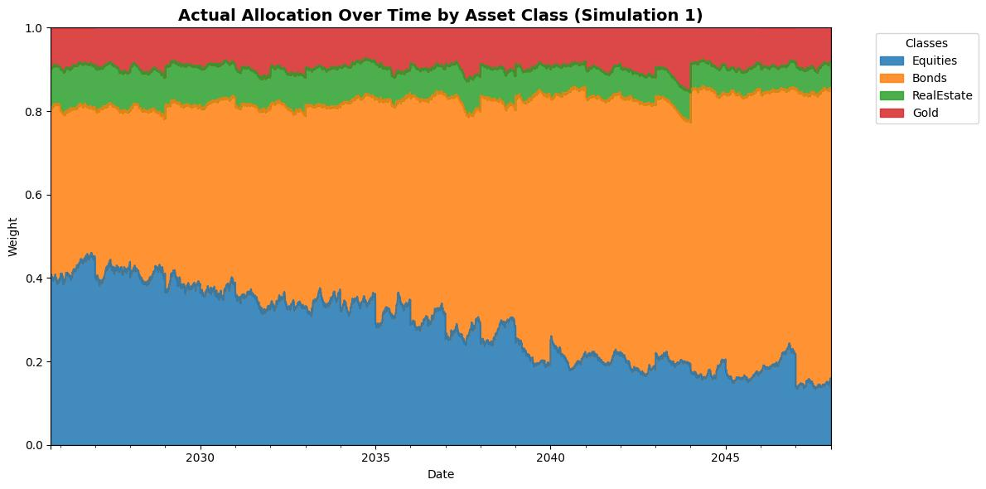
Glide Path Allocation by Positions

Slide 34
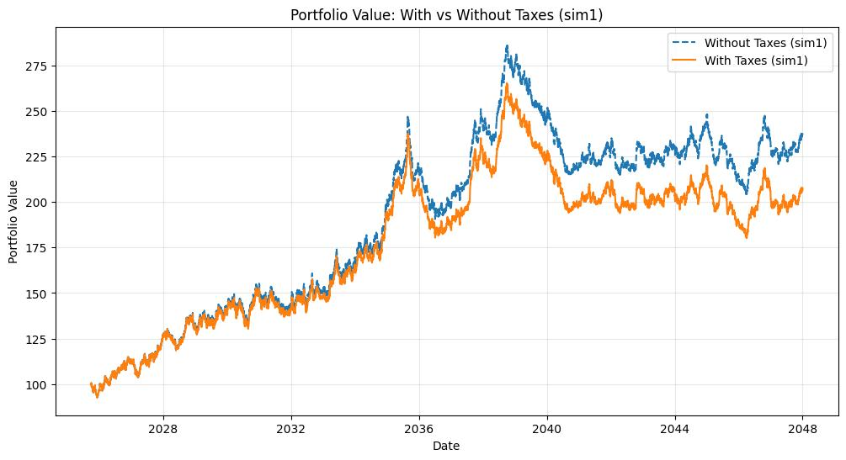
Impact of Taxes on Portfolio Value

Slide 35
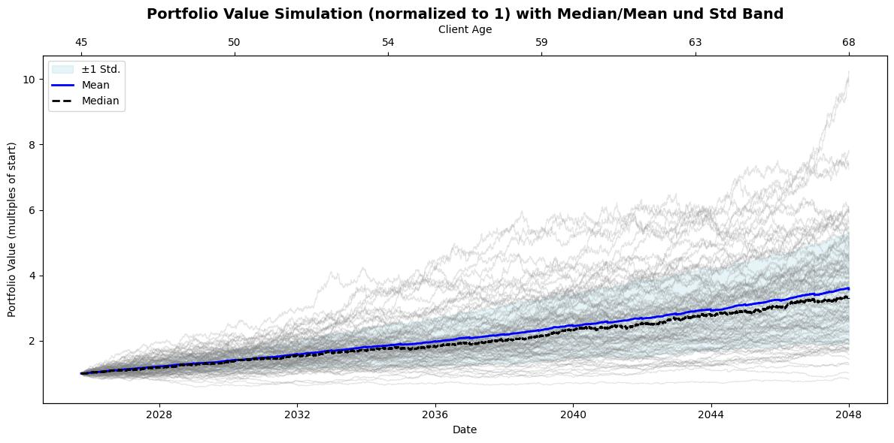
Rebalancing with Monte Carlo Simulation of Portfolio Value

Slide 36
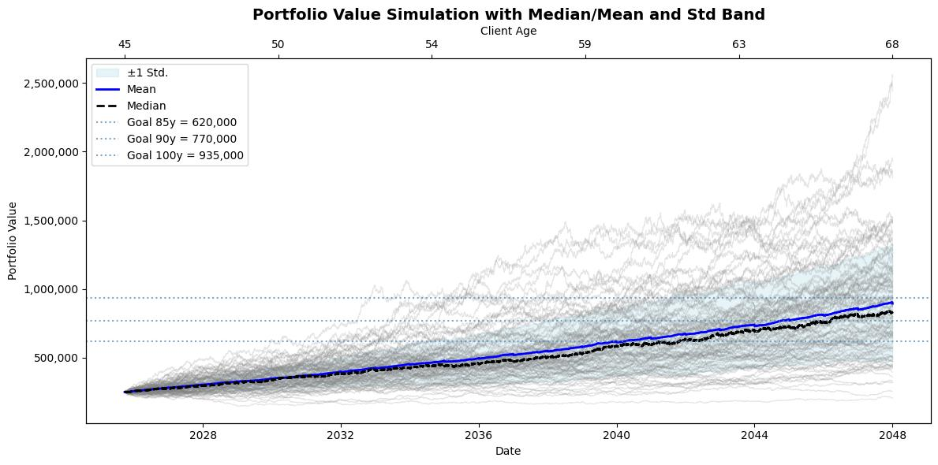
Rebalancing with Monte Carlo Simulation of Portfolio Value

Slide 37
Retirement Investment Risks
“We have a portfolio… but what could derail it?”
Even a well-constructed portfolio faces external risks that can threaten retirement security:
Longevity Risk → living longer than expected, exhausting assets.
Inflation Risk → erosion of purchasing power over decades due to high inflation.
Market Risk → Economic downturns near retirement causing permanent losses.
Withdrawal Risk → unsustainable drawdowns accelerating depletion.
Tax and Policy risk → Policy changes causing the expected return to drop due to increased costs/taxes.
To be well informed and make our portfolio resilient, we must now examine these risks and the strategies we could use to mitigate them.

Slide 38
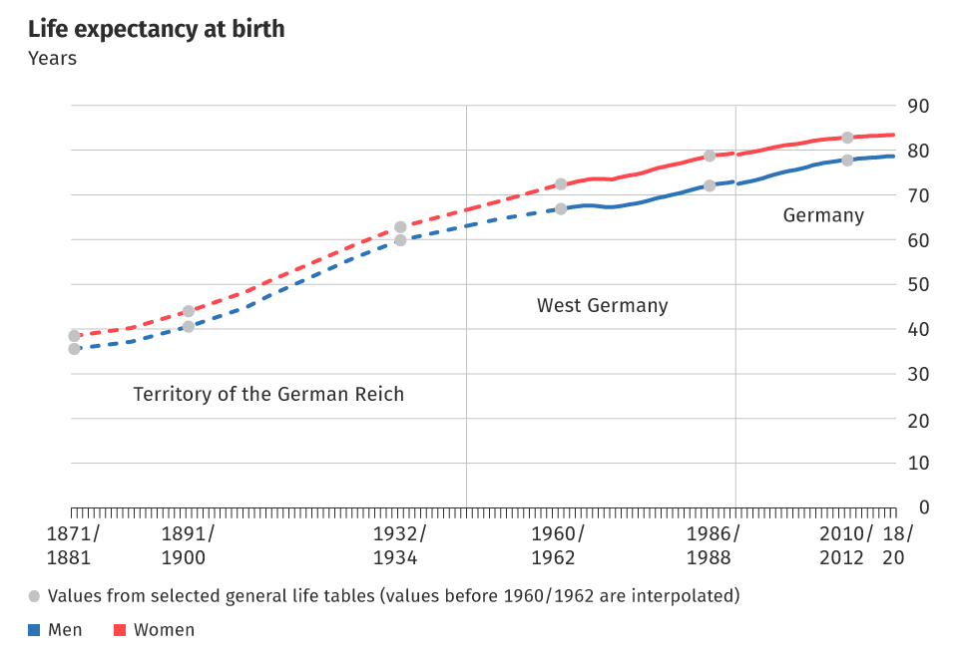
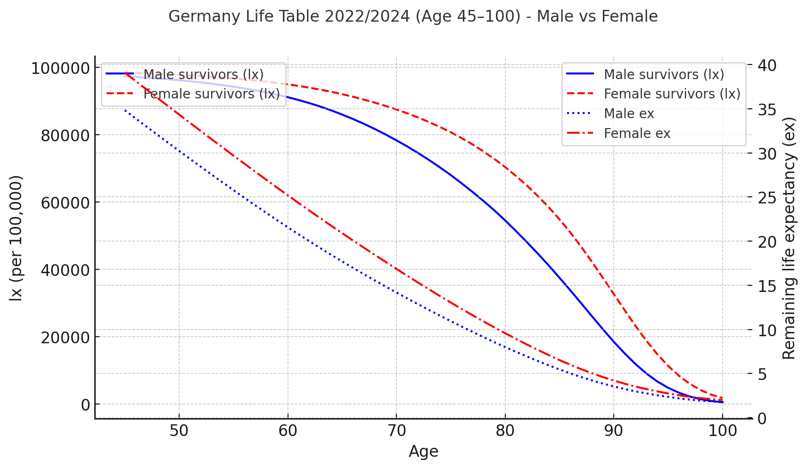
Longevity Risk - Context
A longer-than-expected lifespan may significantly strain retirement resources, potentially exhausting the investment portfolio.
Data source: Statistisches Bundesamt (Destatis)

Slide 39
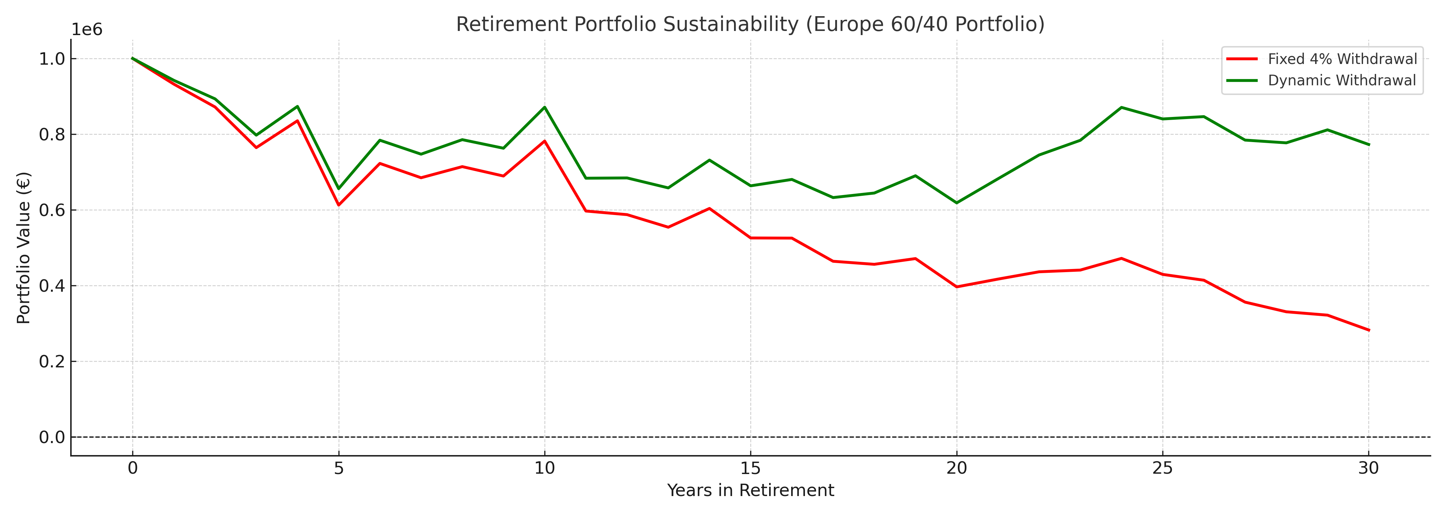
Longevity Risk - Mitigation
Longevity risk can be mitigated through withdrawal strategies and maintaining growth potential throughout retirement.
Maintain equity exposure in retirement (20–30%)：Continuing equity allocation supports growth over long horizons, hedging against outliving assets.
Dynamic withdrawal rules (flexible spending)：Adjust withdrawals up or down depending on market returns to avoid depleting assets.
Data source: Illustrative simulation based on withdrawal strategy research (Bengen, 1994; Guyton & Klinger, 2006; Pfau, 2013)

Slide 40
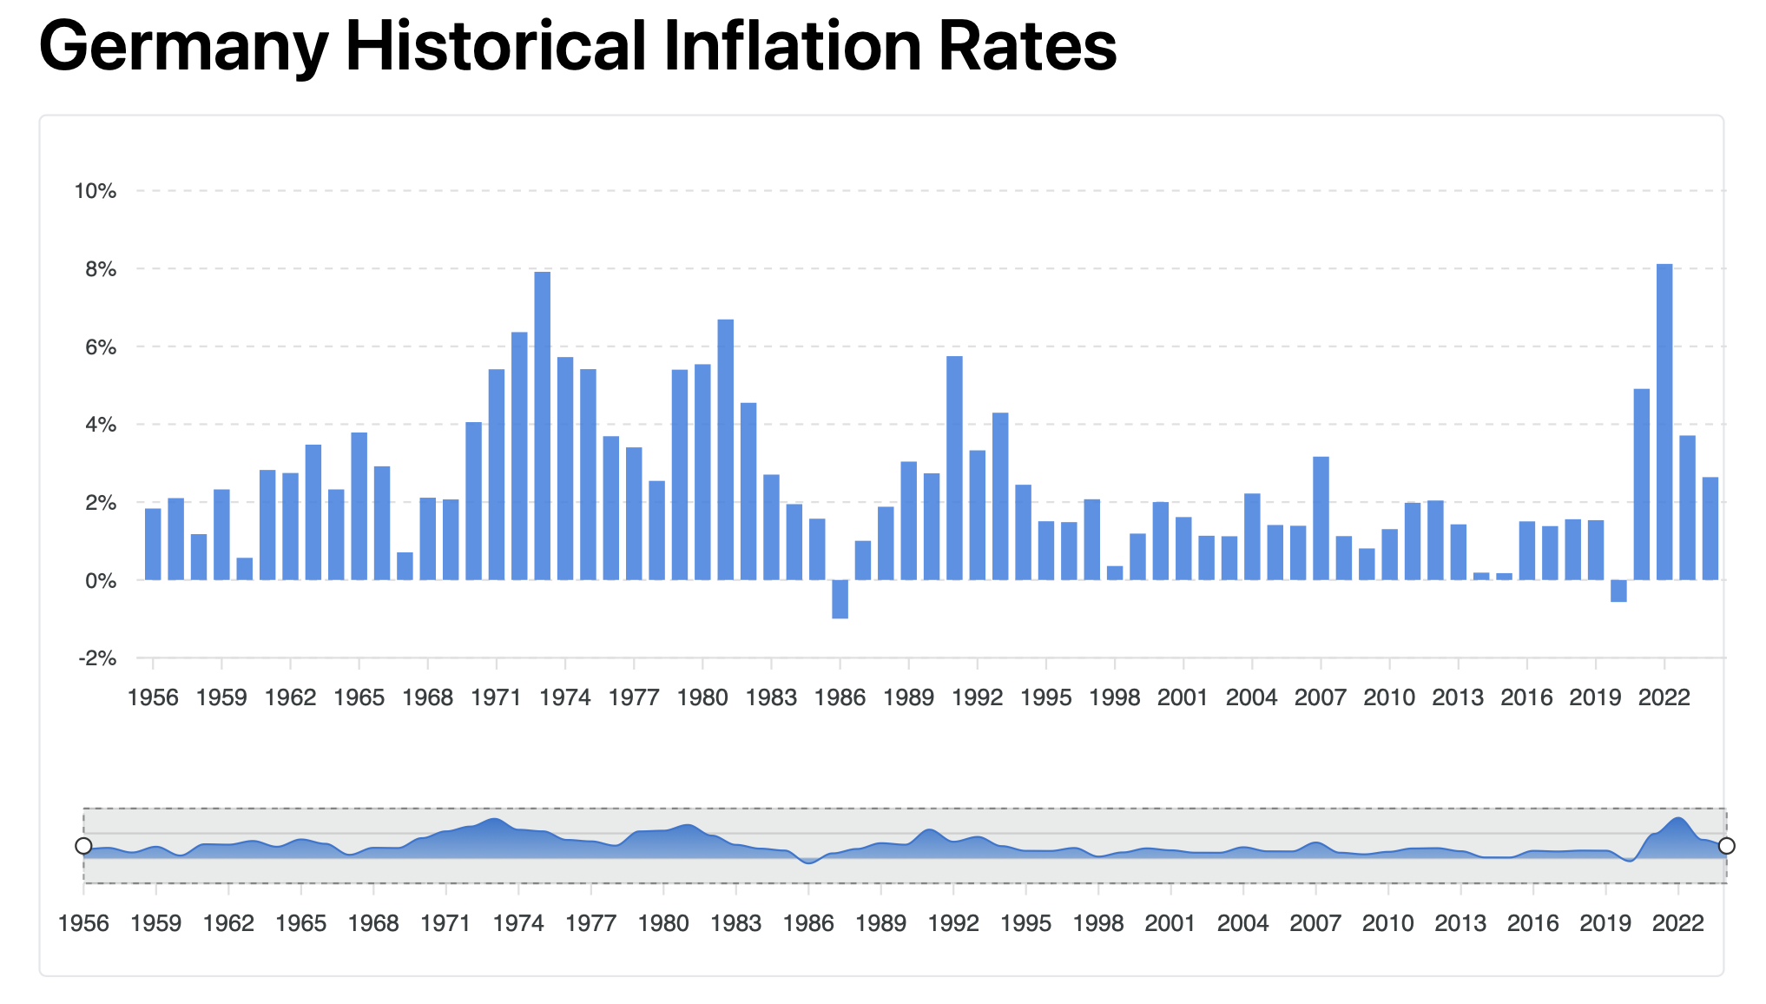
Inflation Risk - Context
Inflation erodes the purchasing power of retirement income. Even modest inflation compounds significantly over 20–30 years.
1990s-2010s: low and stable inflation (1- 2%)
Inflation rate spiked to 8% due to the energy crisis and supply chain shocks：Retirees cannot rely on “low inflation” assumptions.
Data source: RateInflation.com

Slide 41
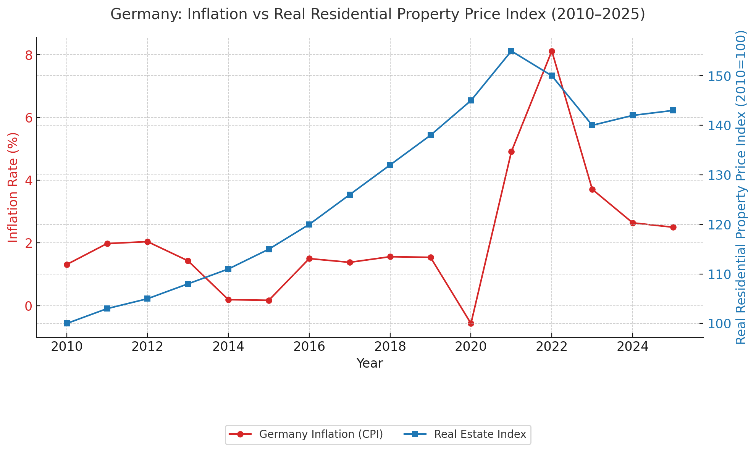
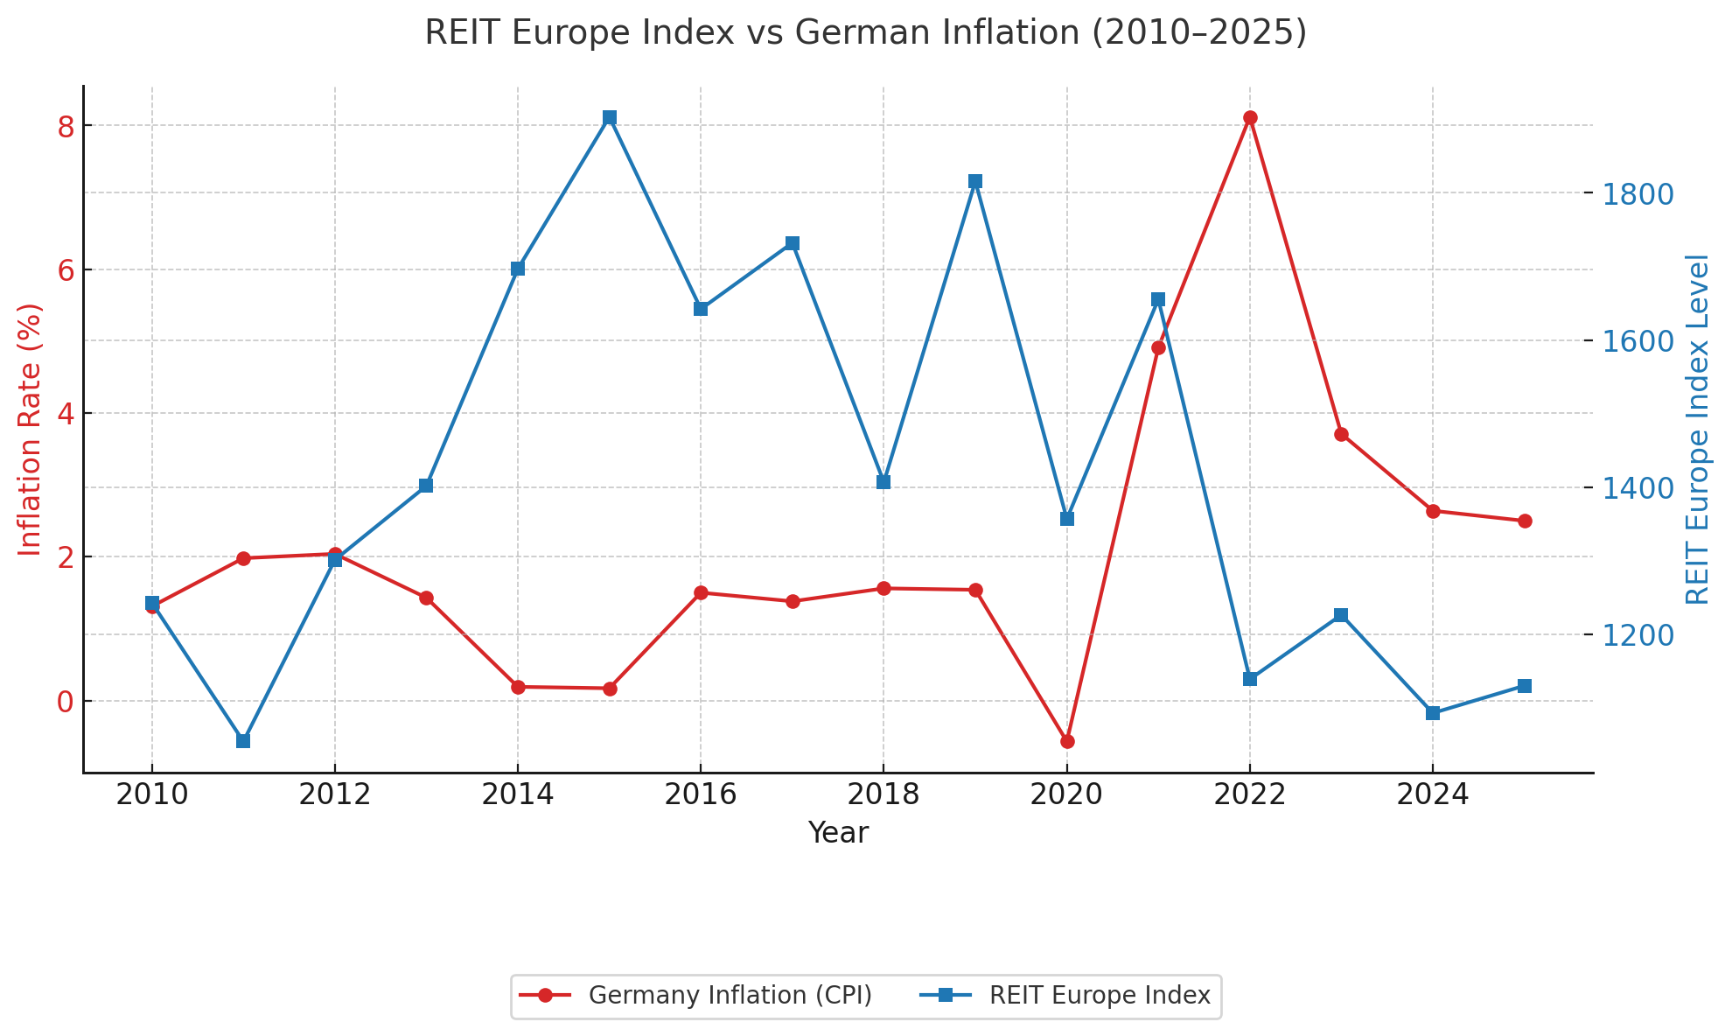
Inflation Risk - Mitigation
To protect retirement income from inflation, portfolios must include strategies that preserve real purchasing power across different economic environments.
Inflation-Linked Bonds (ILBs/TIPS)：Euro ILBs provide principal and coupon indexed to inflation → stable real income stream.
Real Estate / REITs：Property values and rents tend to rise with inflation, providing a partial hedge.
Data source: RateInflation.com & FRED

Slide 42
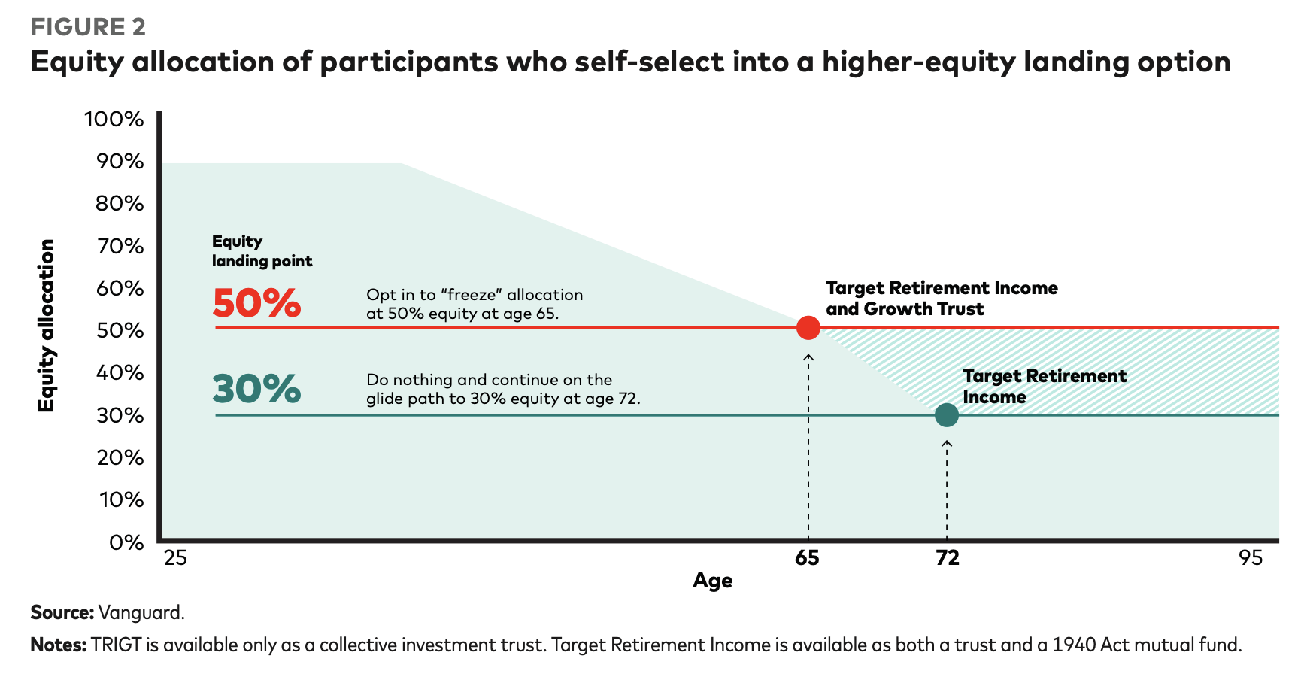
Market Risk – Context & Mitigation
If such a crash occurs close to retirement age, the portfolio may not recover, leading to a permanent shortfall.
Example：In 2008, global equities fell around 40%, so a investor with a 60/40 portfolio could have lost about a quarter of the wealth in just one year.
Mitigation: Glide path reduces equity exposure before retirement.
> eg. Investors may choose different “landing points,” but industry standard is to de-risk near retirement.
Data source: Vanguard

Slide 43
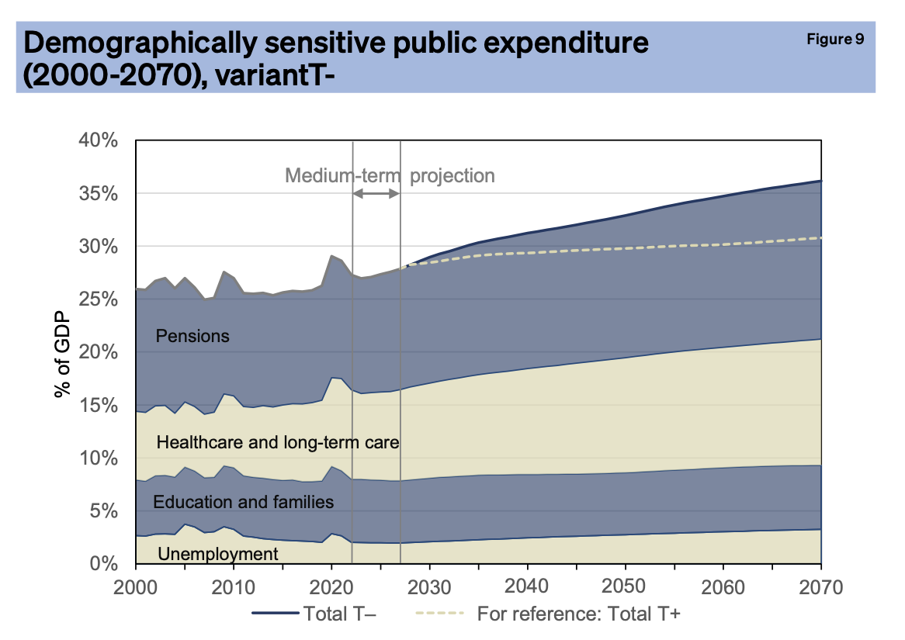
Tax Risk – Context & Mitigation
Future tax and policy changes can reduce net retirement income, so projections must include buffers and tax diversification.
Impressions：German capital income currently taxed at flat 25%. But with policy uncertainty, retirement projections may overstate future net income.
Mitigation: Build a Buffer in Projections.
> Incorporate a haircut on projected net returns (e.g., assume future taxation rises by 5-10%).
Data source: Werding et al.

Slide 44







Team
Ying Liu
8513629
Abdul Malik
8512905
Marco Leibersperger
8518121
Ritesh Kumar
8510249
Shangrun Jiang
8501084
Mujtaba Ali Bhutto
8513611
Chang Liu
8514049

Slide 45

Thank you !

Slide 46
APENDIX

Slide 47
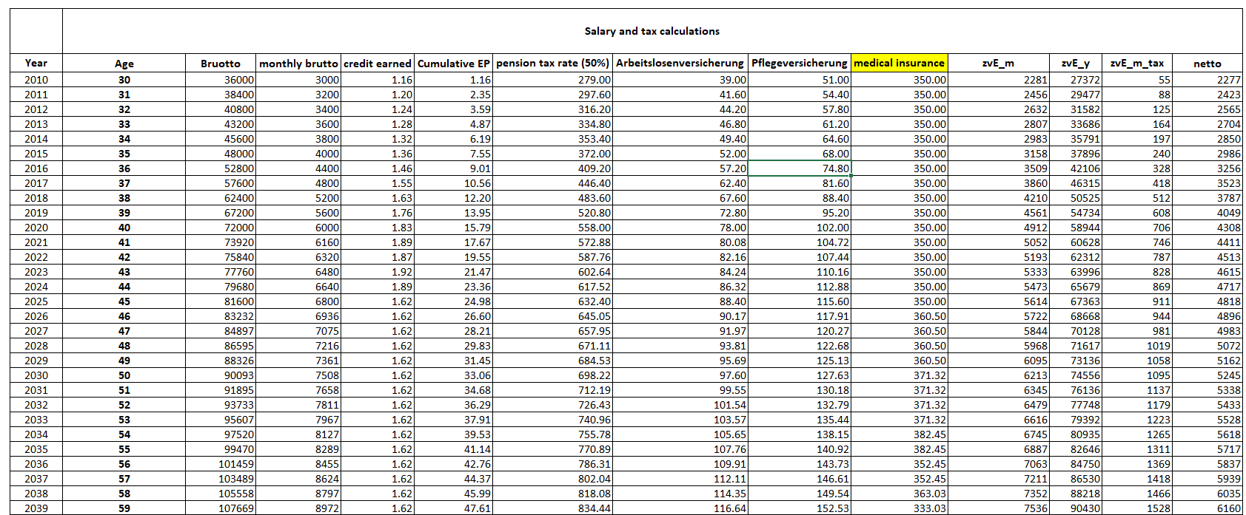
Salary Projections and Tax

Slide 48
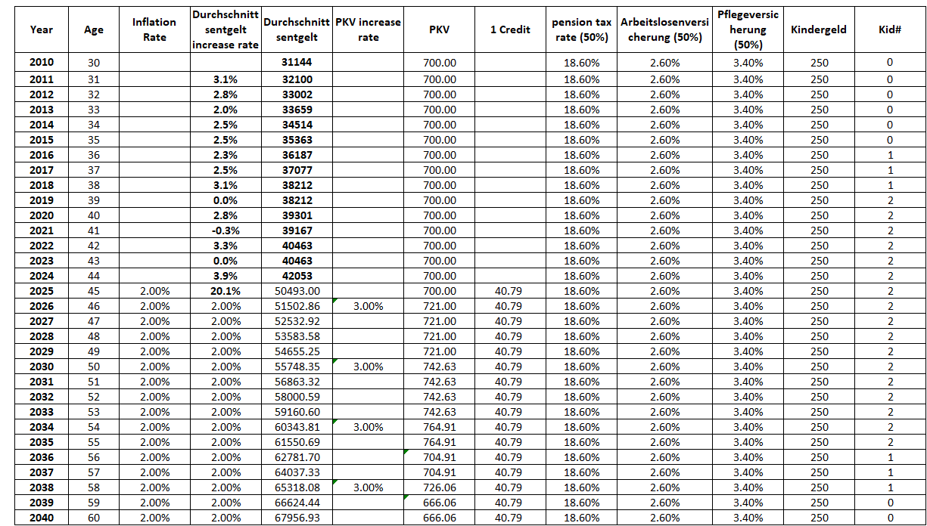
Pension EP Projections

Slide 49
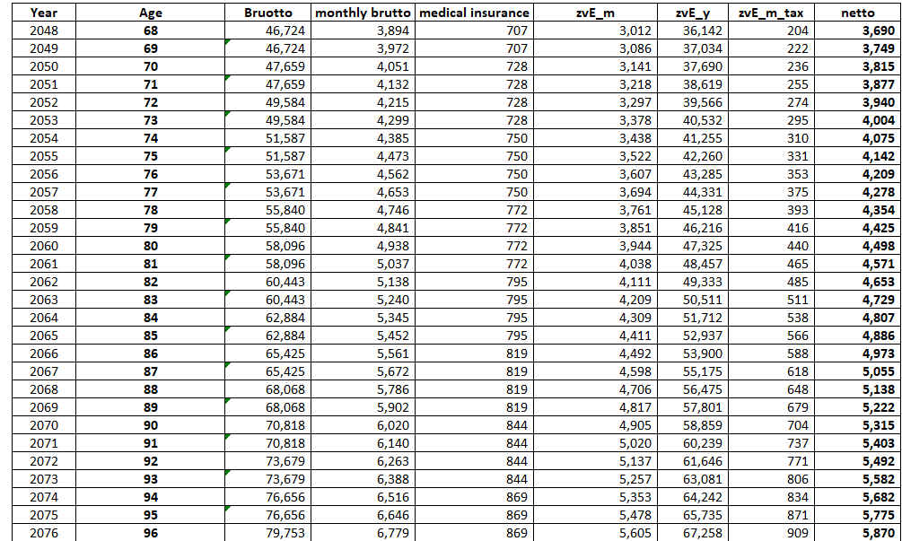
Pension Projections and Tax

Slide 50
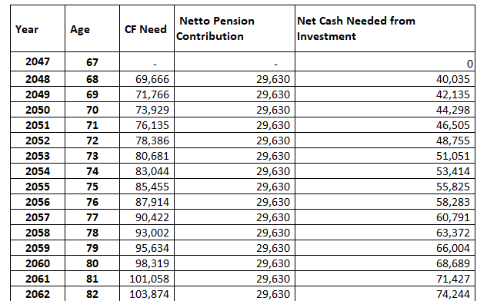
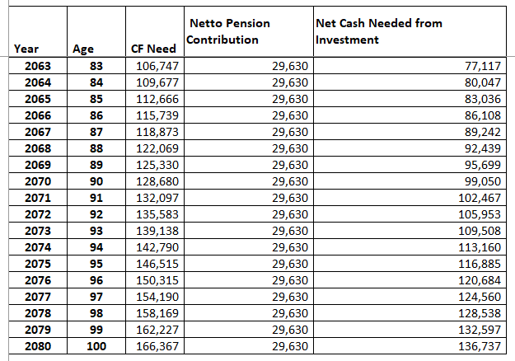
Cashflow Projections

