Slide 1
Abdoul-Raouf Mukaila Alh Shittu
Web Tech Summer 2025 Final Exams

Slide 2
Abdoul-Raouf is developing a data-powered website to help tailors get more visibility for the products they produce and for customers who are busy with their work or whatever they do to access those products without moving from where they are.

Slide 3
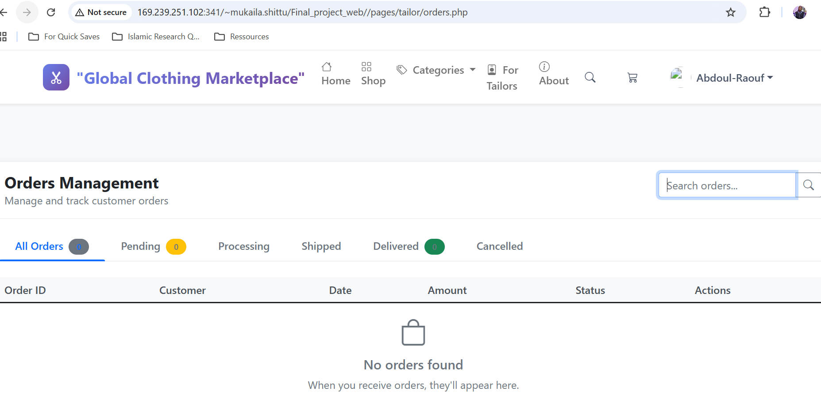
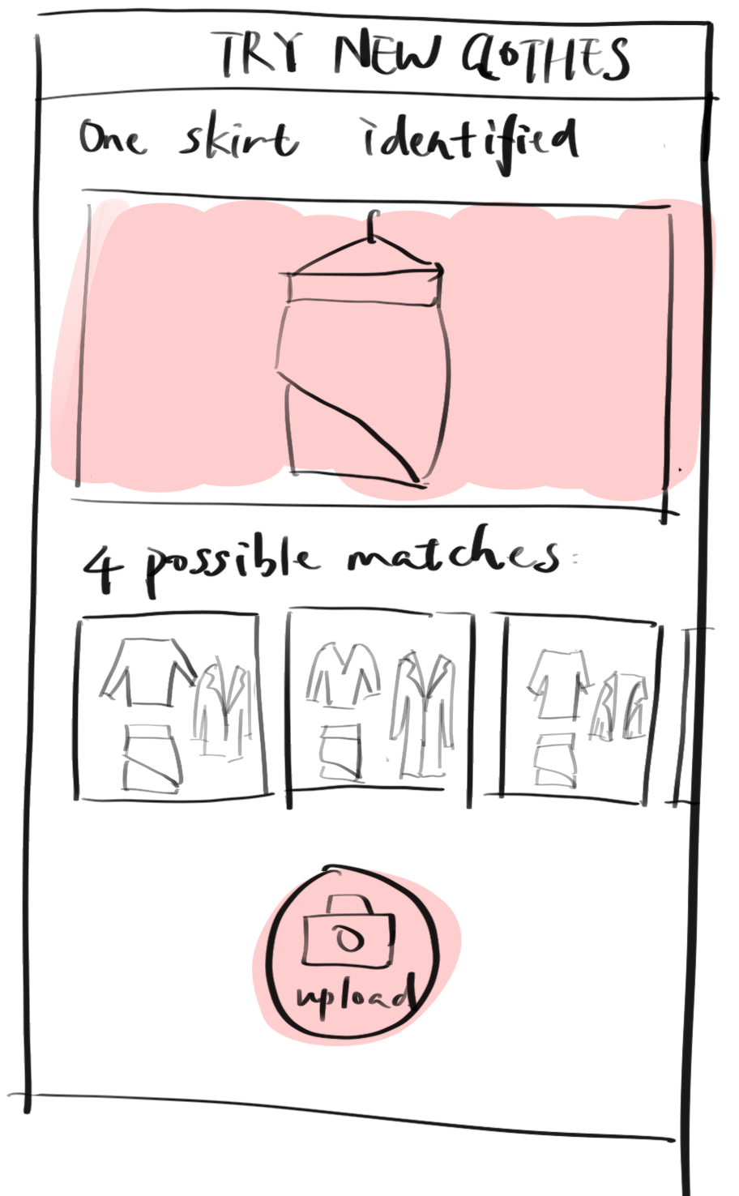
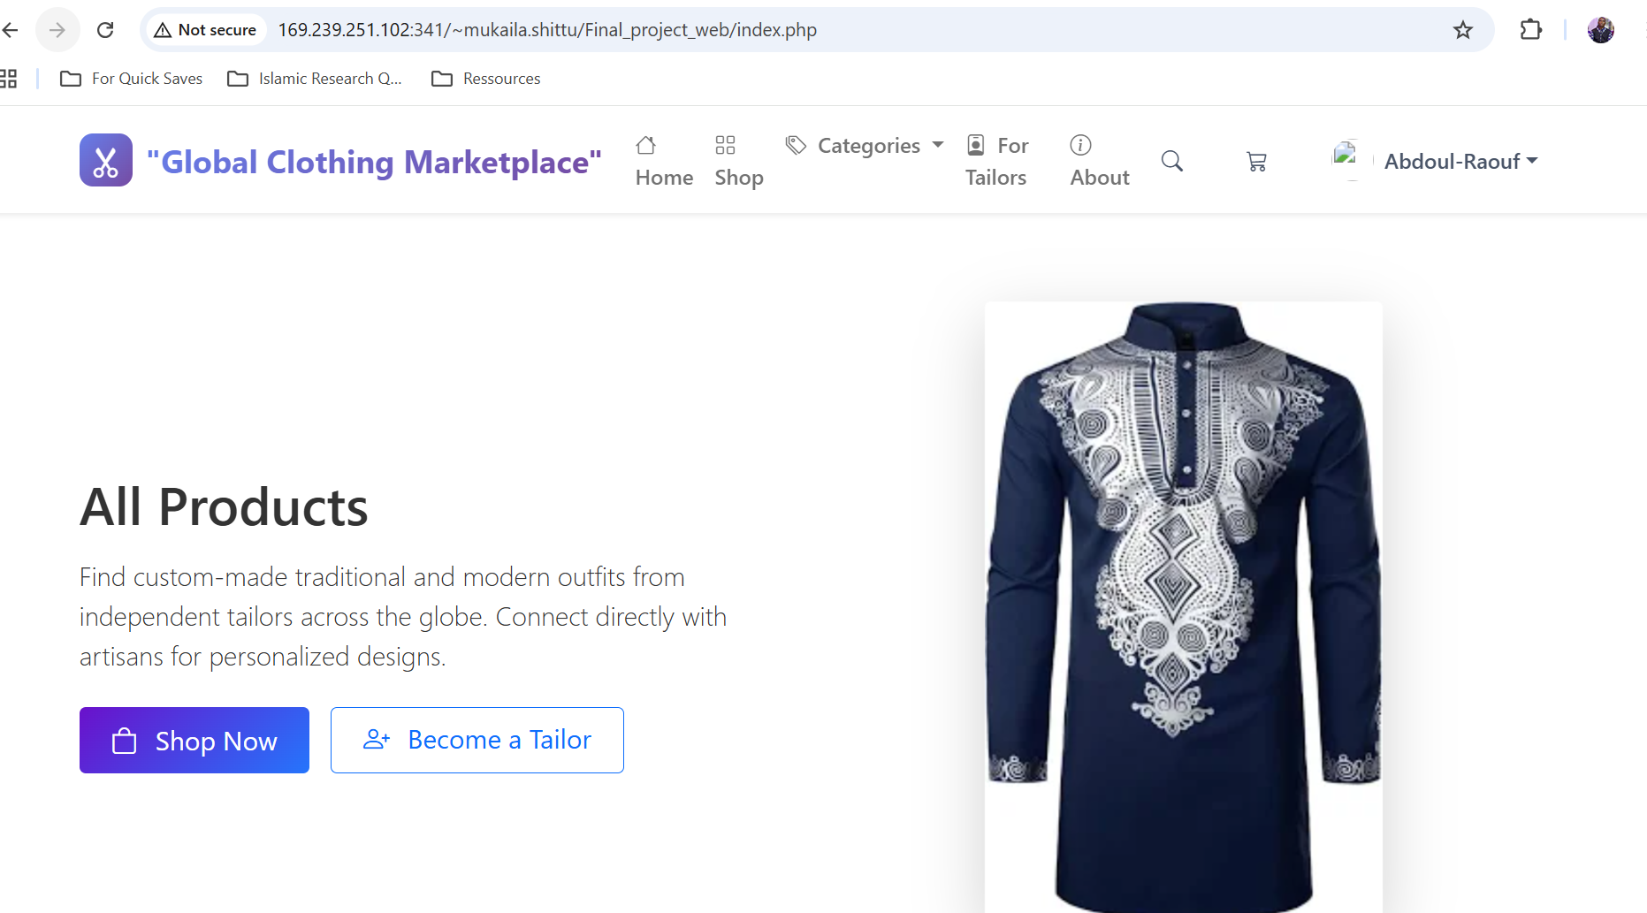
Project Title
ddd
Customers can't find custom-made clothing and tailors lack platforms to showcase their skills globally.
A tailor dashboard showing real-time orders, customer messages, and sales analytics proving increased business success.
Fashion-conscious customers seeking unique clothing and independent tailors wanting to reach global markets.
Users get access to unique custom clothing while tailors gain global customers and steady income.

Slide 4
User / Customer
A global online marketplace connecting independent tailors with customers seeking custom-made traditional and modern clothing. Mission: To democratize bespoke fashion by providing traditional artisans with modern e-commerce tools while giving style-conscious consumers access to unique, high-quality, personalized garments.

Slide 5
Main Functions of the Website
The platform follows a standard 3-tier architecture to ensure scalability and security.
Presentation Tier (Frontend): * Technologies: HTML5, CSS3 (Bootstrap 5), and JavaScript.
  Why: Provides a responsive, user-friendly interface for customers and tailors across different devices.
Application Tier (Logic): * Technologies: PHP 8.x.
  Why: Handles server-side processing, user authentication, and business logic (like calculating order totals or processing measurement data).
Data Tier (Database): * Technologies: MySQL / MariaDB.
  Why: A relational database is ideal for managing complex relationships between users, orders, and varied measurement profiles.

Slide 6
Architecture
Digital Measurement Vault: A standardized system for customers to save and share body metrics, ensuring a perfect fit regardless of geographic distance.
Artisan Storefront & Gallery: A dedicated space for tailors to showcase their unique traditional and modern designs to a global audience.
Secure Order & Communication Hub: A centralized system for real-time messaging and order tracking to bridge the communication gap between buyer and artisan.
Global Review & Rating System: A quality assurance mechanism that builds trust in traditional craftsmanship through modern social proof.

