Slide 1
Project Proposal
Saving the Salmon: Efficiency of Collaborative Watersheds in Oregon
Maaz Kamal
Anishka Tahiliani

Slide 2
Summary
Decades of overfishing, pollution, lack of legislature and building of dams and barriers in northwest pacific resulted in endangerment and listing of numerous salmonid species in 1990’s.
This project will explore how collaborative structural characteristics effect the cost of environmental projects done in watersheds of Oregon

Slide 3
Illustration
Data Munging
Discover
Structure
Modeling
Association Rule Mining
Decision Tree
Validation
Cross Validation
Confusion Matrix
Clean
Clustering
Error
Accuracy
f scores
Outcome
↑ in collaboratives
Public vs Private land
Experience of collaboratives
Analysis
Validate
Outcome

Slide 4
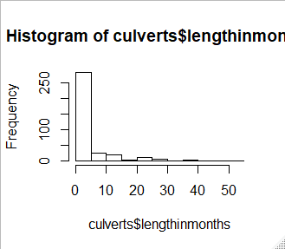
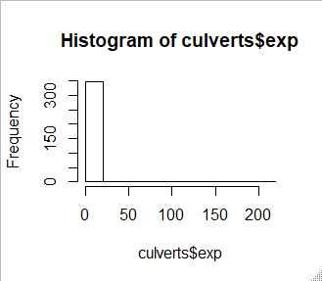
Summary
Collaborative structural characteristics effect the actions undertaken in watersheds of Oregon by different collaborative governance regimes (CGR)
Dataset Summary
THE FACTS
DataSets
Plantation Of Riparian Trees
Culvert Removal/Replacing
Rows
Plantation Of Riparian Trees-588
Culvert Removal/Replacing-359
Models
Association Rules
Clustering
Decision Tree
Challenges
Right Skewed Data
Not a lot of numeric values
Data Munging
Discover
Structure
Modeling
Association Rule Mining
Decision Tree
Validation
Cross Validation
Confusion Matrix
Clean
Clustering
Error
Accuracy
f scores
Outcome
↑ in collaboratives
Public vs Private land
Experience of collaboratives
Analysis
Validate
Outcome
Goals
By analyzing the data we are going to find how different structural characteristics are affecting the cost of the project

Slide 5
Data Summary
lengthinmonths
THE FACTS
DataSets
Planting of Riparian Trees
Culvert Removal/Replacing
Rows
Plantation Of Riparian Trees-588
Culvert Removal/Replacing-359
Attributes
Length In months
Public
Experience
Basin fixed
Challenges
Right Skewed Data
Discretizing Numerical Data

Slide 6
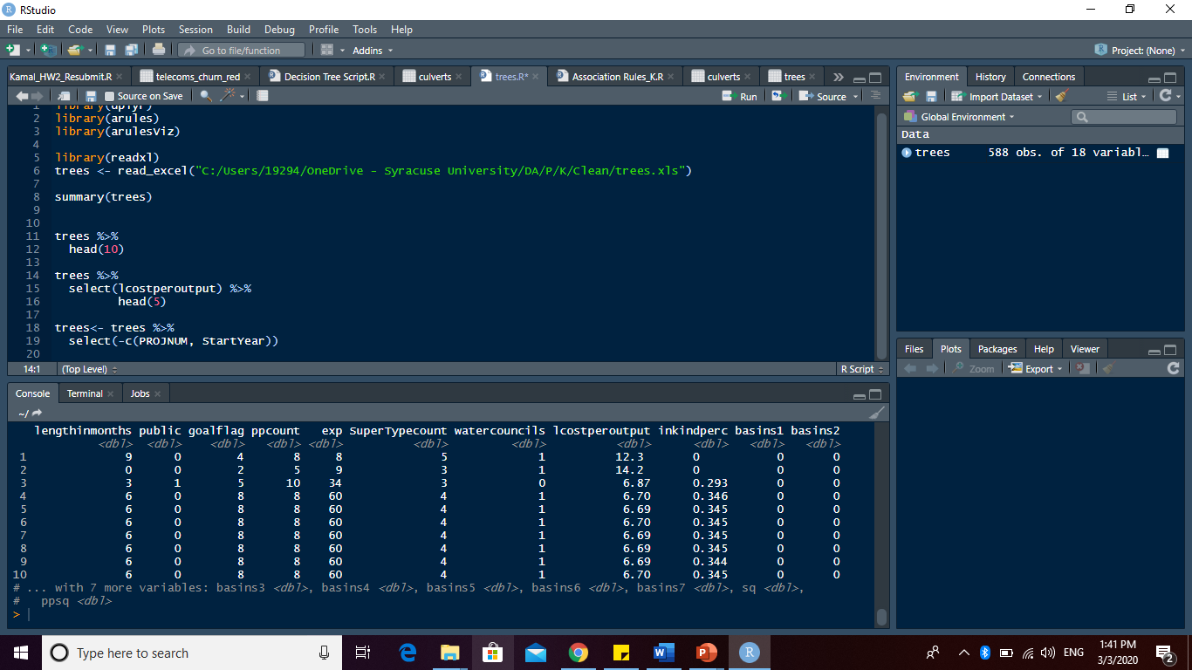
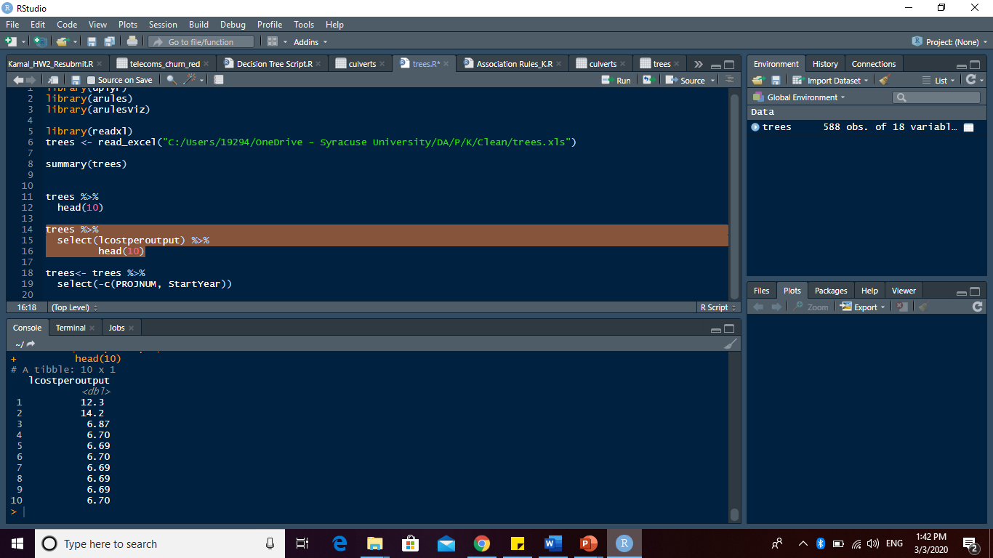
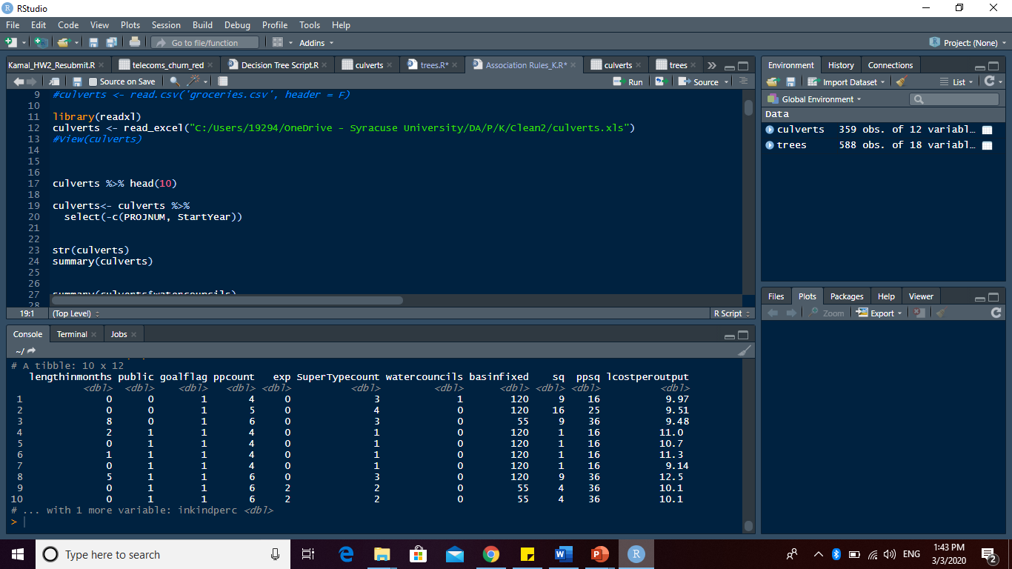
Data Summary

Slide 7
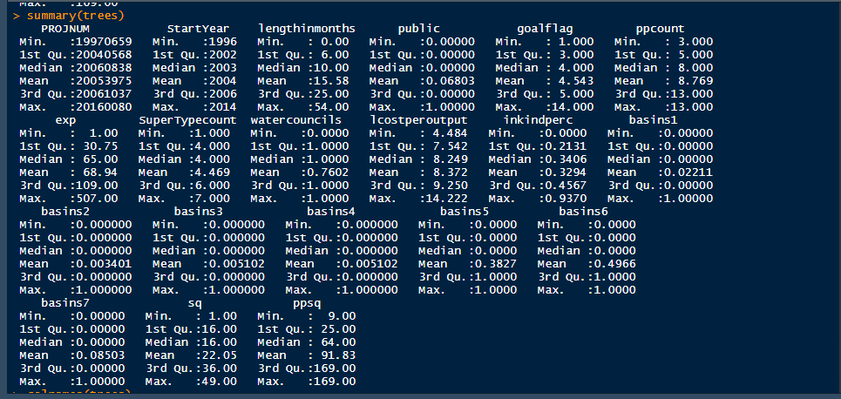
Data Summary

Slide 8
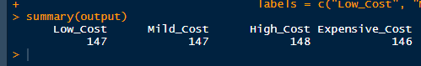
Data Summary
Unbalanced Dataset

Slide 9
Models
Models
Association Rules- For finding patterns between cost effective projects and structural characteristics
Clustering - Grouping together similar performing projects and their structural characteristics
Divergence of the Euclidean distance
Decision Tree – Classification of projects based on their structural characteristics data

Slide 10
GOALS
By analyzing the data we are going to find how different structural characteristics are affecting the cost of the project
Affects of increase in the number of participants
Affects of type of land (Public vs Private)
Does experience of collaboratives improve efficiency?
Does pooling resources increase efficiency?
Given a new set of structural characteristics predict the cost efficiency of the resulting project!

