Slide 1

Introduction to Competitive Programming (CP)

Slide 2
Content
What is Competitive Programming?
Why Competitive Programming?
To Whom is Competitive Programming?
How to in Competitive Programming?
Competitive Programming in CSEC-ASTU
What is ICPC?
Experiences of CSEC-ASTU in ICPC
CSEC-ASTU

Slide 3
Next
What is Competitive Programming?
Why Competitive Programming?
To Whom is Competitive Programming?
How to in Competitive Programming?
Competitive Programming in CSEC-ASTU
What is ICPC?
Experiences of CSEC-ASTU in ICPC
CSEC-ASTU

Slide 4
What is Competitive Programming?
Competitive Programming is writing a computer programs to solve real world and imaginative problems in a contest environment.
One has a limited time to solve a problems. Ranging from few hours to few days, usually 0.5 second to 2 days.
The solution should be efficient in terms of execution time, memory used in some cases even the length of code.
Competitive programmers use their knowledge of algorithms and data structures and logical reasoning skills to solve challenging algorithmic problems in a limited time frame.
Competitive Programming also described as mind sport over the internet or local area network
CSEC-ASTU

Slide 5
Next
What is Competitive Programming?
Why Competitive Programming?
To Whom is Competitive Programming?
How to in Competitive Programming?
Competitive Programming in CSEC-ASTU
What is ICPC?
Experiences of CSEC-ASTU in ICPC
CSEC-ASTU

Slide 6
Why Competitive Programming?
Helps you solve complicated problems
Makes you faster and more focused
Makes you a desirable candidate to major companies
Teaches you how to work in teams
Training and participation helps you prepare for a career in coding
It’s a way to publicly demonstrate your skills
CSEC-ASTU

Slide 7
Next
What is Competitive Programming?
Why Competitive Programming?
To Whom is Competitive Programming?
How to in Competitive Programming?
Competitive Programming in CSEC-ASTU
What is ICPC?
Experiences of CSEC-ASTU in ICPC
CSEC-ASTU

Slide 8
To Whom is Competitive Programming?
IT’S FOR EVERY ONE
CSEC-ASTU

Slide 9
Next
What is Competitive Programming?
Why Competitive Programming?
To Whom is Competitive Programming?
How to in Competitive Programming?
Competitive Programming in CSEC-ASTU
What is ICPC?
Experiences of CSEC-ASTU in ICPC
CSEC-ASTU

Slide 10
How to in Competitive Programming?
Be Competitive Programmer
  Reading
  Practicing
  Participating
Read
  Book (Competitive Programming 3, Steven Halim)
  Online Resources (YouTube, geeksforgeeks, hackerearth, hackerrank)
Practice
  Online Judge (Kattis, Codeforces, TopCoders)
CSEC-ASTU

Slide 11
Cont...
Participate
  Community (ICPC, IOI, CodeJam)
  Everything in Competitive
  Programming is about
              Practice
CSEC-ASTU

Slide 12
Next
What is Competitive Programming?
Why Competitive Programming?
To Whom is Competitive Programming?
How to in Competitive Programming?
Competitive Programming in CSEC-ASTU
What is ICPC?
Experiences of CSEC-ASTU in ICPC
CSEC-ASTU

Slide 13
Competitive Programming in CSEC-ASTU
Competitive Programming the one main function of CSEC-ASTU. In CPD there will be tutorial, practice and problems solvings.
Achievements
From being least in the content to be participant in Arab African Collegiate Programming Contest
CSEC-ASTU

Slide 14
Next
What is Competitive Programming?
Why Competitive Programming?
To Whom is Competitive Programming?
How to in Competitive Programming?
Competitive Programming in CSEC-ASTU
What is ICPC?
Experiences of CSEC-ASTU in ICPC
CSEC-ASTU

Slide 15

What is ICPC?
The International Collegiate Programming Contest, known as the ICPC, is an annual multi-tiered competitive programming competition among the universities of the world.
ICPC is mainly focused on problem solving and algorithms.
It is only for undergraduate students.
Has three stages
  National, Regional and World
CSEC-ASTU

Slide 16
Cont...
The Contest
  Team of 3 students
  Only using one computer per team
  4 to 5 hours
  8 to 13 Problems
CSEC-ASTU

Slide 17
Next
What is Competitive Programming?
Why Competitive Programming?
To Whom is Competitive Programming?
How to in Competitive Programming?
Competitive Programming in CSEC-ASTU
What is ICPC?
Experiences of CSEC-ASTU in ICPC
CSEC-ASTU

Slide 18
Experiences of CSEC-ASTU in ICPC
Judges: are a computer systems which evaluate programmers code and output one of the following results. Judges may be online or installed on local system(personal computers)
Accepted / Correct / Yes (CA): If the judges give one of these outputs (depends on the judge) it means the code given to the judge has return the expected output for inputs provided by the judge it self.
Wrong Answer / No (WA): if this was the result return from the judge it means the code is compiled successfully, but it doesn’t print the expected output. Those errors could be happened because of many reasons
  ex. Wrong formatting in output (‘Yes’ and ‘yes’ are different while checking the answer).
  Wrong interpretation of problem or missing what the problem is about.
  Submitting different problem.
CSEC-ASTU

Slide 19
Cont...
Time Limit Exceeded (TLE): this output will be given if the code gives ans answer in greater time(usually in seconds) than the time given in the problem while running. The judge will check for this situations and break the code execution if it greater than the given time. This output is independent of the answer it means the code may get accept or be wrong if the time required is satisfied.
Memory Limit Exceeded : this outputs is almost the same with TLE except it is about memory usage in runtime.
CSEC-ASTU

Slide 20
Cont...
Compiler Error : this type of output will occur when the judge is unable to compile or interpret the code successfully. The best example for this situation is submitting the .obj file instead of .cpp to judge which could not been compiled.
Runtime Error : this will happen if the code crash while running Ex. Index out of range while accessing array or list in any programming language.
There are also another outputs like No Output, Abnormal Terminations which will occur in runtime.
CSEC-ASTU CPD use its own judge called Andalus (built inside the lab) to evaluate and manager competitive programmers.
CSEC-ASTU

Slide 21
Cont...
Programming Language
In competitive programming anyone is allowed to use any programming language as much as the judge support these languages. The problems are not dependent on any programming language.
Although it is possible to use many programming in CP it is also common and recommended to use C, C++, Python and Java in contests, this is because there libraries and communities and too huge.
These programming languages are available in all competitive programming judges.
Andalus also support those 4 programming languages as expected
CSEC-ASTU

Slide 22
Cont...
Prerequisites
Since competitive programming is the about solving a problem using a computer program. You are expected to know at least basics of one general purpose programming language.
Chose your programming language and start learning to day.
CSEC-ASTU

Slide 23
Use full links
Online Judges
Kattis (https://open.kattis.com)
Codeforces (https://www.codeforces.com)
UVa (https://onlinejudge.org)
Online Resources with Judges
HackerEarth (https://www.hackerearth.com)
Hackerrank (https://www.hackerrank.com)
Books
Competitive Programming 3, Steven Halim (https://www.cpbook.net)
CSEC-ASTU

Slide 24
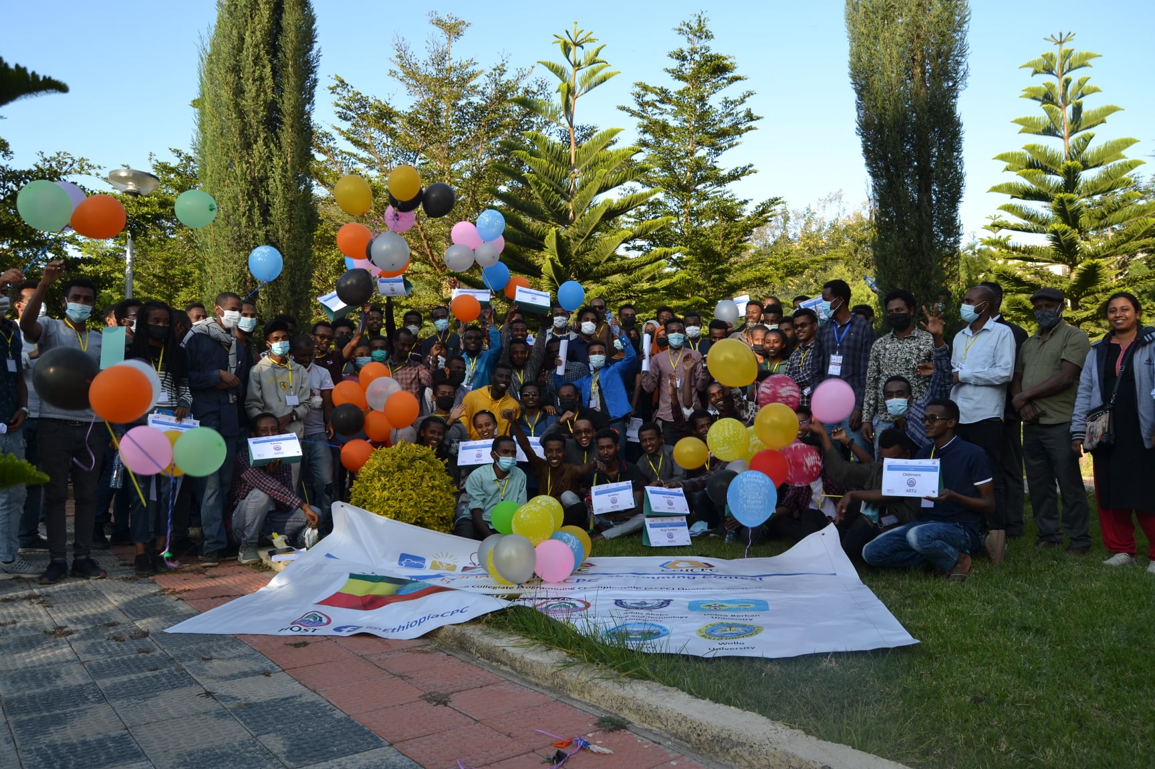
Thank You!

