Slide 1
Elastic Cloud Compute

Slide 2
Introduction
We can launch as many virtual server as we need by use of ec2.
Ec2 instance login can be performed with key pair.
With EC2 we only pay for what we use.
We can have 5000 key-pair per region.
Provides scalable computing service
Key pair consist of public and private key & the public key is with AWS stores and private key with users.(i.e, public-key cryptography)

Slide 3
Key-pair formats
To create key which is compatible with OpenSHH we use .pem format.
To create key which is compatible with PuTTY we use .ppk format.
NOTE:
If we use an SSH client on a macOS or Linux computer to connect to our Linux instance, we use the following command to set the permissions of our private key file so that only we can read it.
Command:
chmod 400 key-pair-name.pem
OpenSSH
PuTTY If we do not set these permission then we can not connect to the instance.

Slide 4
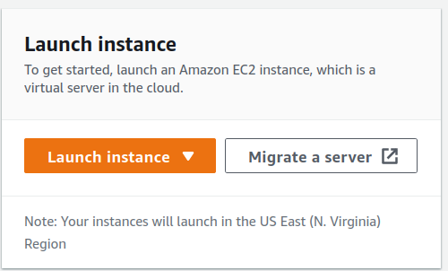
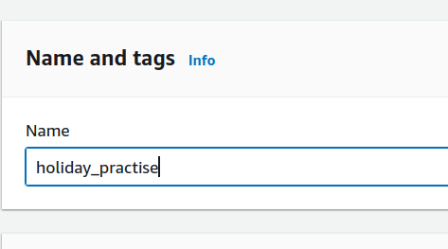
STEP 1: Launching a linux instance:
Go to EC2 service and click on 2. Naming the instance

Slide 5
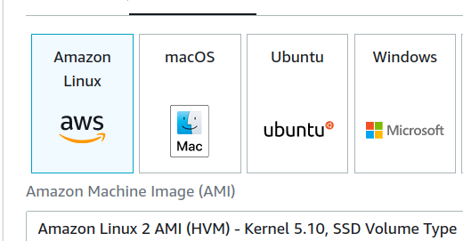
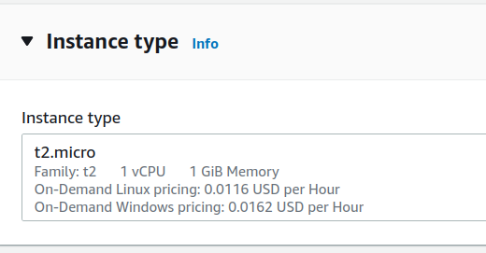
3. Under AMI choose
4. Choose instance type

Slide 6
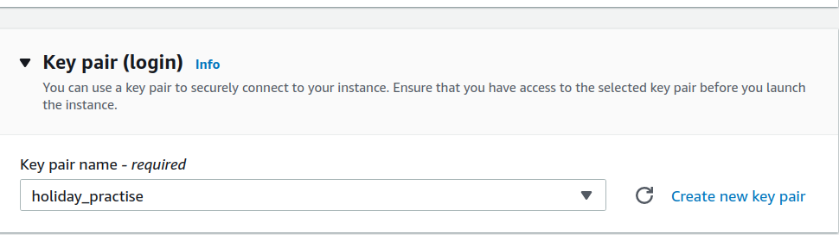
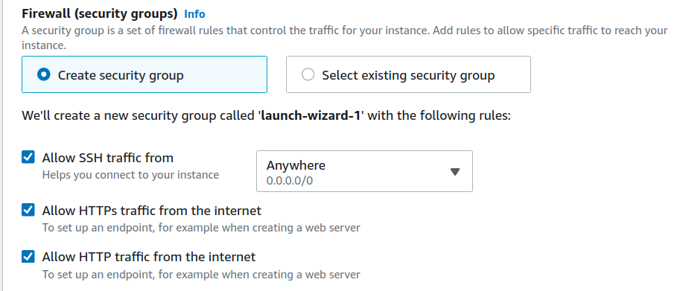
5. Create key-pair
6. Security groups

Slide 7
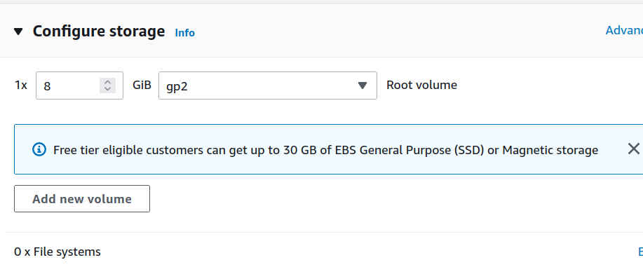
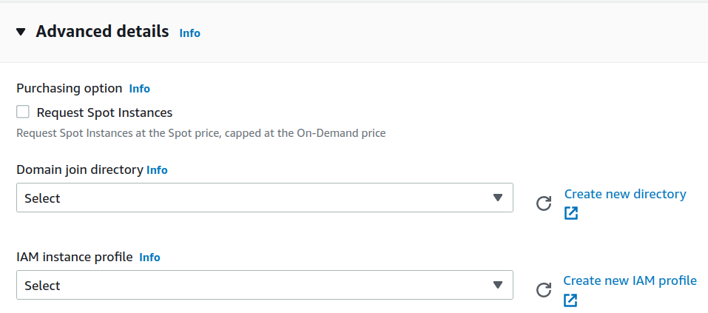
7. Configure storage
8. Some advanced settings

Slide 8

9. Click in launch instance option

Slide 9
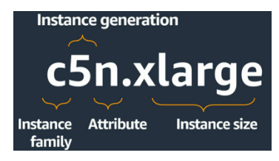
Instance types naming:
Instance type are named based on:
Family
Generation
Additional capabilities
Size

Slide 10
Instance types:
General purpose instance: They provide a balance of compute, memory, and networking resources
Burstable performance instance(T instance): General purpose do not need high CPU performance so their is the chance of CPU wastage. These instances provide baseline CPU performance and can burst its ability whenever needed.
Compute optimized instance: This instance is ideal for compute-bound application that benefit from high speed processor.
Memory optimized: Delivers fast performance to workloads that process large dataset in a memory.
Storage optimized: Designed for workloads that need high, sequential write and read access to very large data set on local storage. Deliver low latency and random I/O operation/sec.
Accelerated computing: Uses co-processor or hardware accelerators to perform some function with more parallelism.

Slide 11
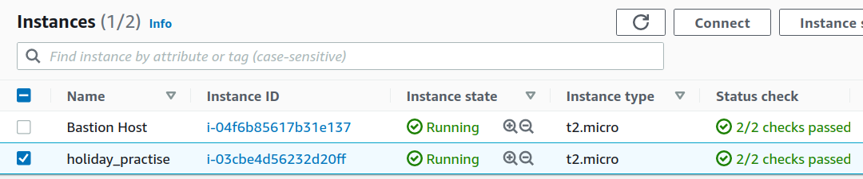
STEP 2: Connecting to instance using SSH client
Choose the instance created and click on

Slide 12
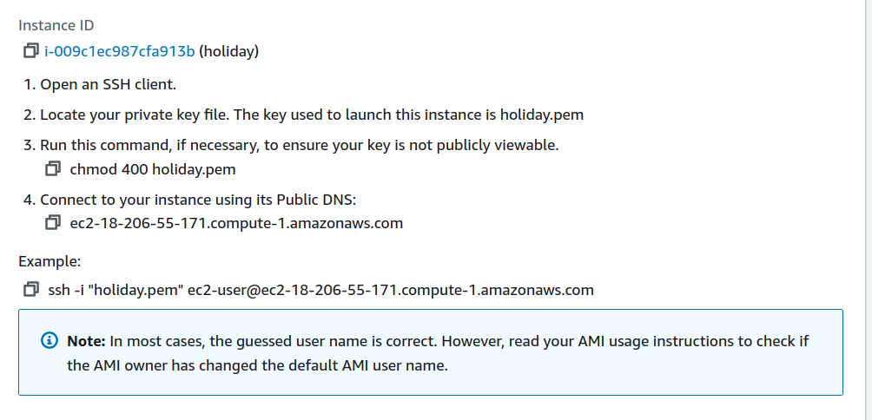
In order to connect using a SSH client, we use the ssh command to connect to the instance in a terminal. We specify the path and file name of the private key (.pem), the user name for our instance, and the public DNS name or IPv6 address for our instance.
2. Enter the code(@) in the terminal window
@

Slide 13
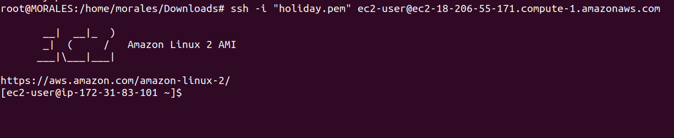
3. Connection established

Slide 14
Fleet
EC2 fleet
Spot fleet
Group of instance controlled by single command In a single API call a fleet can launch multiple instances

Slide 15
Monitoring EC2
Automated monitoring A. System status check B. Instance status check C. Amazon cloud watch alarms D. Amazon event bridge E. Cloud watch event
Manual monitoring
Monitoring is an important part of maintaining the reliability, availability, and performance of your Amazon Elastic Compute Cloud (Amazon EC2) instances. Status check performed every minute.

Slide 16
EC2 instance IP addressing
We can assign both IPv4 and IPv6 address on our instance.
Each private IPv4 address can be associated with a single EIP.
EC2 supports both IPv4 & IPv6 addressing protocols.
By default private IPv4 addressing.

Slide 17
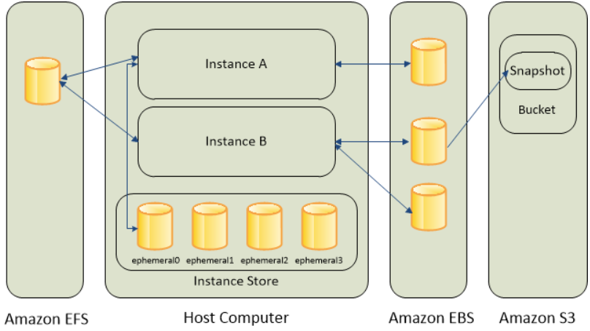
Storage option in instance
Amazon EBS: Recommended storage when we run a database on an instance.
Instance store: Temporary block level storage for instance. Data on an instance persist only during life if instance.
EFS file system: Provides scalable file storage to Amazon EC2.
Amazon S3: EC2 uses S3 to store EBS snapshots & instance store backed AMIs.
Multiple Volume to an instance

