Slide 1
Amazon Machine Images
A template that provide info to launch instances

Slide 2
Introduction
AMI can be selected based on:
Region
OS
Architecture
Launch permission
Storage for root device
An AMI is a template that contains the software configuration (operating system, application server, and applications) required to launch your instance.

Slide 3
Storage for root device
AMI creation is much easier for AMIs backed by Amazon EBS. Hibernation can be performed.
This instance can’t be in stopped state i.e, either it is in start or terminated state.
AMI are categorized as:
EBS-backed AMI
Instance store-backed AMI

Slide 4
Billing
EBS-backed
You're charged for instance usage, EBS volume storage and usage, and storing your AMI as an EBS snapshot.
Each time you customize an AMI and create a new one, only the changes are stored. So, the storage footprint for subsequent AMIs that you customize after the first is much smaller, resulting in lower AMI storage charges.
When an instance with an EBS volume for its root device is stopped, you're not charged for instance usage;
Instance store-backed
You're charged for instance usage and storing your AMI in Amazon S3.
Each time you customize an AMI and create a new one, all of the parts are stored in Amazon S3 for each AMI. So, the storage footprint for each customized AMI is the full size of the AMI.
You're still charged for volume storage. As soon as you start your instance, we charge a minimum of one minute for usage. After one minute, we charge only for the seconds used.

Slide 5
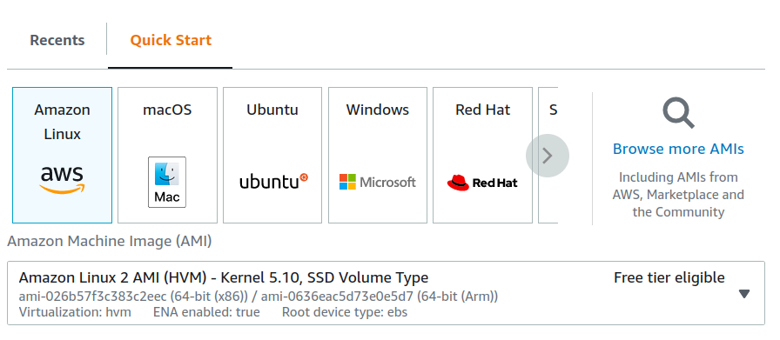
Determine root device type of AMI using console
Root device types:
ebs-> EBS-backed
Instance store-> instance backed
Open EC2 console
Choose AMIs
Check the value of root device types

Slide 6
Virtualization in AMI: HVM is best to use
Paravirtual(PV)
They cannot take advantage of special hardware extensions such as enhanced networking or GPU processing.
Not all.
Current generation instance types do not support PV AMIs.
Hardware virtual machine(HVM)
HVM guests can take advantage of hardware extensions that provide fast access to the underlying hardware on the host system.
All Regions support HVM instances.
All current generation instance types support HVM AMIs.

Slide 7
Shared AMIs
A shared AMI is an AMI that a developer created and made available for others to use.
You use a shared AMI at your own risk.Amazon can't vouch for the integrity or security of AMIs shared by other Amazon EC2 users.
AMIs are a Regional resource. When you search for a shared AMI (public or private), you must search for it from the same Region from which it is shared. To make an AMI available in a different Region, copy the AMI to the Region, and then share it.
We can find shared AMI:
Using EC2 console
Using CLI

Slide 8
AMI:Lifecycle
You can create EBS-backed & instance store-backed AMIs.
You can copy an Amazon Machine Image (AMI) within or across AWS Regions.
You can store an Amazon Machine Image (AMI) in an Amazon S3 bucket, copy the AMI to another S3 bucket, and then restore it from the S3 bucket.
You can deprecate an AMI to indicate that it is out of date and should not be used. You can also specify a future deprecation date for an AMI.
You can deregister an AMI when you have finished using it. After you deregister an AMI, you can't use it to launch new instances.
You can restore a resource from the Recycle Bin at any time before its retention period expires.
We can _____ AMI:
Create
Copy
Store & restore
Deprecate
Deregister
Recover

