Slide 1
DevOps & Its Tools
Dev: Development + Ops: Operation
Evolution of Agile Model

Slide 2

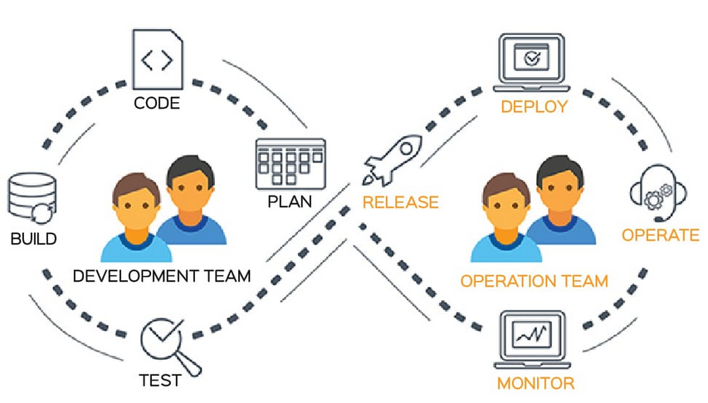
What is DevOps?
DevOps means the unification & automation of processes.

Slide 3
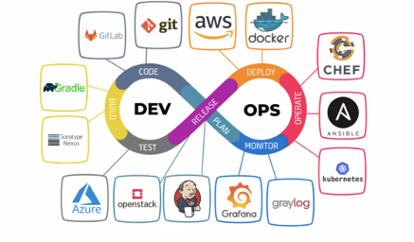
DevOps Tools
DevOps tools helps to automate manual tasks, manage complex environments at scale etc.
Some of the tools of DevOps are:
1. Jenkins,
2. Puppet,
3. Gradle,
4. CricleCI,
5. Bamboo, etc.

