Slide 1
Corpus Creation
Tim Smith, Ph.D.
E-mail: smith515@usf.edu
Portions of this are copyrights by Anol Bhattacherjee. Used with permission.

Slide 2
Outline
Why build a corpus?
Structure of a corpus.
How to build a corpus:
API.
Web scraping.
How to manage preprocessed corpus:
Pickling.
1. Problem Definition
2. Building a Text Corpus
3. Text Preprocessing
4. Feature Extraction
5. Text Vectorization
7. Insights & Recommendations
6. Text Analysis (NLP)

Slide 3
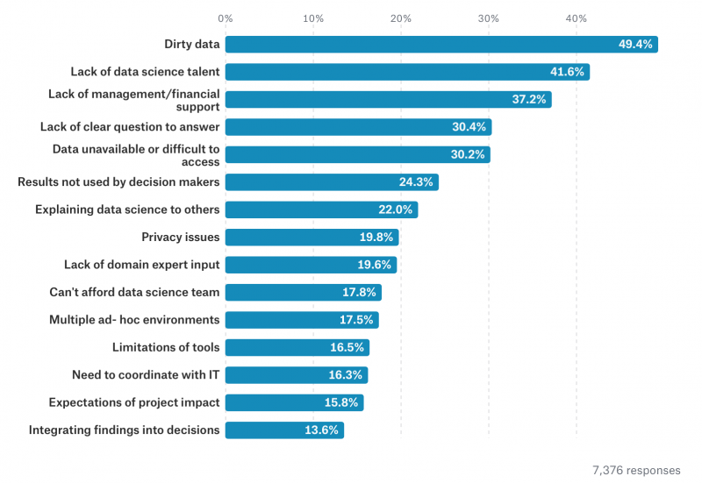
There is no Data Science Without Data
What are the top reasons for failure of ML initiatives?
Reason #1: Bad/dirty data
(garbage in, garbage out)
Source: “The State of Data Science & Machine Learning,”
Kaggle’s 2017 survey of 16,000 data scientists,
https://www.kaggle.com/surveys/2017.

Slide 4
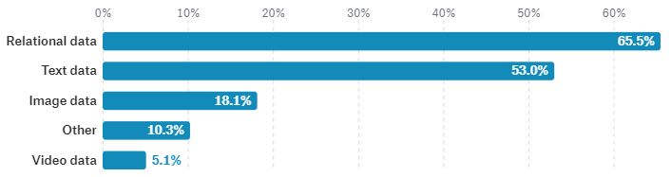
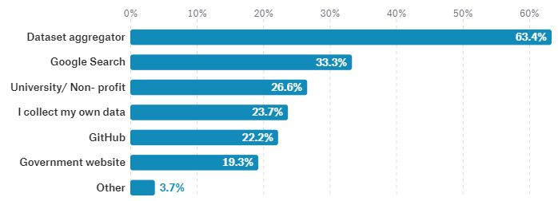
Kaggle Data Science Survey (2017)
What type of data do you use at work?
How do you access external data?
Source: “The State of Data Science & Machine Learning,”
Kaggle’s 2017, https://www.kaggle.com/surveys/2017.

Slide 5

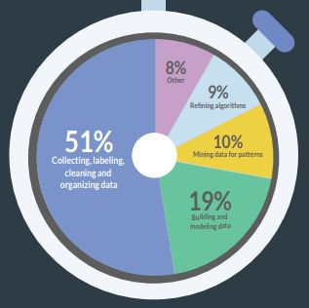
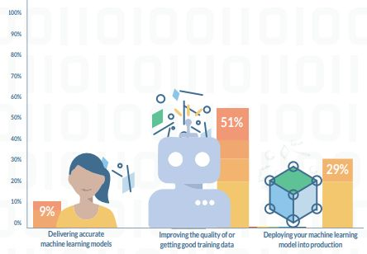
What Do “Data Scientists” Do?
What is your biggest bottleneck in
running successful AL/ML projects?
Source: “2017 Data Scientist Report,” Crowdflower,
https://visit.figure-eight.com/rs/416-ZBE-142/images/CrowdFlower_DataScienceReport.pdf.

Slide 6
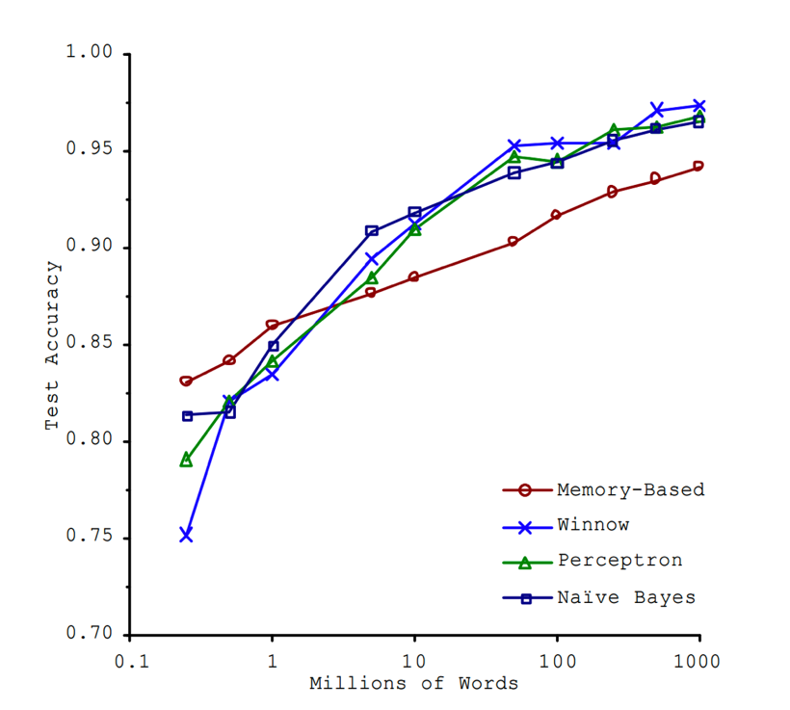
Data Matters More Than Algorithms
Simple and complex ML algorithms exhibit similar performance on the complex task of natural language disambiguation, if they are given sufficient data (Banko & Brill, Microsoft, 2001)
For complex problems, sufficient quantities of quality data outperforms any ML algorithm or combinations of algorithms (Havely et al., Google, 2009)
Source: Michele Bank & Eric Brill (2001), “Scaling to very very large corpora for natural language disambiguation”, Proceedings of the 39th Annual Meeting on Association for Computational Linguistics, 26-33, doi: 10.3115/1073012.1073017.
Brown corpus (NLTK): 1 million words
Google corpus (2006): 1 trillion words (from unfiltered web pages; contains typos, incomplete sentences, etc.)

Slide 7
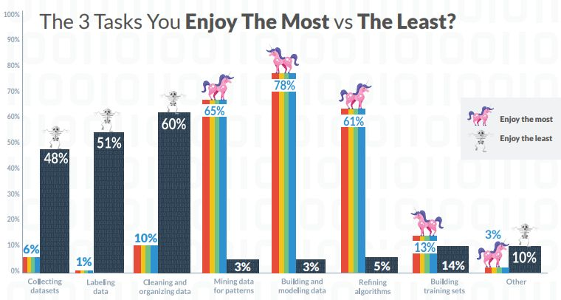
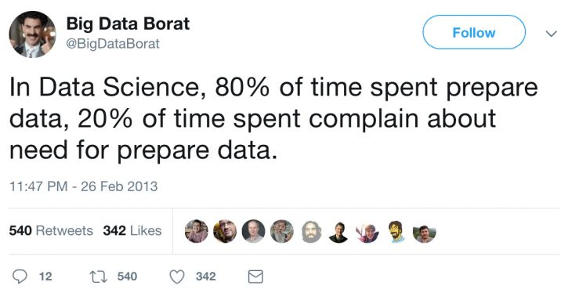
Quality over Quantity
Source: “2017 Data Scientist Report,” Crowdflower,
https://visit.figure-eight.com/rs/416-ZBE-142/images/CrowdFlower_DataScienceReport.pdf.

Slide 8
Building a Data Corpus
Key considerations:
Where do I get the data from? (source)
What format is the data in?
What format do I need for analysis?
Common text formats:
Plain text (.txt), comma or tab separated values (.csv, .tsv)
Native formats: Word (.doc), Adobe (.pdf).
Markup languages: html, xml
Special formats for big data: json.
Sourcing a corpus:
Download a preprocessed corpus.
Use API to download data and build corpus.
Use web scraping to build your own corpus.

Slide 9
Structure of a Corpus
Corpus:
A collection of related documents to be used for machine learning.
May contain structured data, unstructured data, HTML pages, images, etc.
Examples: Wikipedia, IMDB pages, e-mails,
May be small or large (a 200-employee company today will have about 500 GB of e-mail).
May be annotated (e.g., e-mails marked as spam) or without annotations (no labeling).
Documents:
May contain text, meta-data (e.g., HTML tags).
May contain paragraphs (units of discourse that generally express a single idea), further divided into sentences (units of syntax), words (lexical units), punctuations, affixes, characters, etc.
Characters are individually meaningless, words convey some semantic meaning, but are more meaningful when combined into sentences, paragraphs convey contexts.
May require serious cleaning to extract meaningful content.

Slide 10
Corpus Depends on Questions Asked
Questions | Corpus
Which hashtags do Donald Trump use most in his tweets? | A set of Donald Trump tweets
What are the central characters in Jane Austen’s novel “Pride and Prejudice”? | A full-text download of the novel “Pride and Prejudice”
What are customers complaining most about Verizon on social media? | A set of customer comments on Verizon’s Facebook page
How strongly do Republican and Democratic voters feel about “Medicare for All”? | Comments on “Medicare for All” from Republican and Democratic voters on a trustworthy website
What product features customers care about most in the iPhone XR? | Customer reviews of iPhone XR
How can we identify the key participants in a potential corporate fraud case? | All e-mails from corporate mail servers

Slide 11
Text Formats
Plain text:
Clean text with no formatting (bold face, italics, etc.).
Suitable for machine learning algorithms.
Word documents, PDF, or HTML files:
Must be converted to plain text (dropping all formatting) for ML algorithms.
May still require post-editing to correct conversion errors.
This is an example of a plain text document.
It does not contain any bold font, italics, etc.
Quotation marks should be "straight" and not “squigly”.

Slide 12
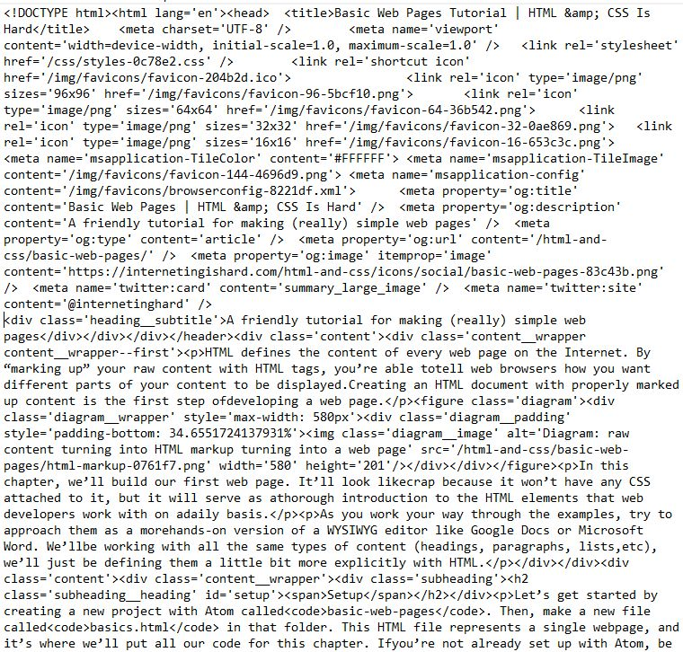
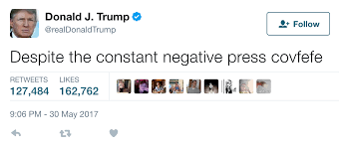
HTML files
HTML:
Contains tags, meta-data, URLs, scripts, that must be cleaned before the text can be processed.
Requires HTML parsers.
Twitter:
Each post is a gigantic JSON object, from which we may process only a few text fields.

Slide 13
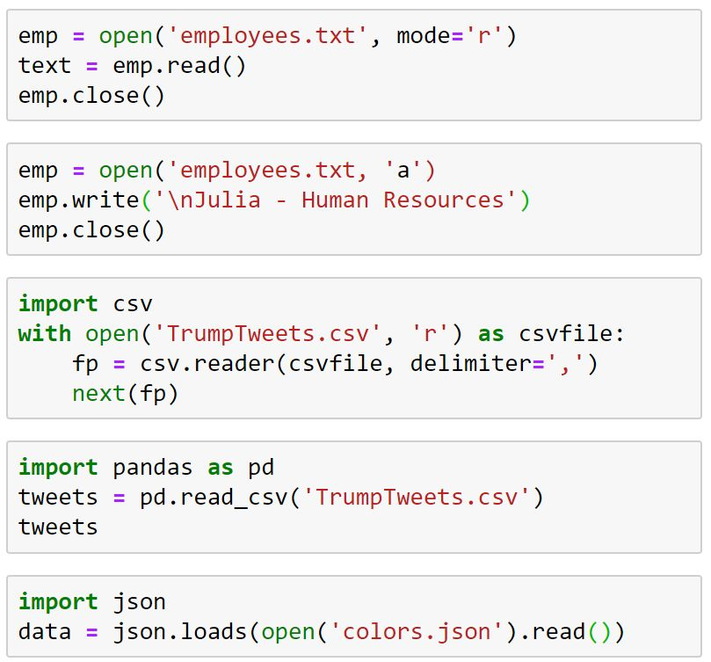
Reading Data from Files
File open in ‘read’ mode;
open files should be closed
Files can also be opened in ‘w’, ‘a’, ‘r+’ and other modes
Reading csv files; with open() closes file automatically; next(fp) moves pointer beyond first row
Reading files into pandas dataframes; entries in row 1 read as field names
Reading json files

Slide 14
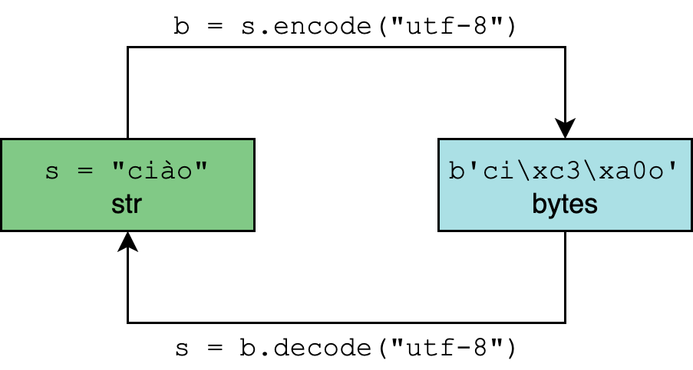
Character Encodings in Python
Default is utf-8:
Unicode Transformation Format
utf-8 uses 8 bits (1 byte) to represent characters; allows 2^8 = 256 possible values.
First 128 characters in the Unicode table correspond to the ASCII characters; but also allows non-ASCII characters like El Niño, résumé, and €.
Other options:
utf-16, utf-32 allows expanded character sets to include 𐀀, ത, 𝕂,♞, 😀, 뇎닎돎듎, etc.
latin-1 (also called ISO-8859-1) is the default for HTTP.
Should not mix and match encoding styles; utf-16 is not an expanded version of utf-8, but totally different.
letters = ‘αβγδ’
rawdata = letters.encode(‘utf-8’)
rawdata.decode(‘utf-8’)
Out[25]: 'αβγδ'
rawdata.decode(‘utf-16’)
Out[26]: '뇎닎돎듎‘
rawdata.decode('latin-1')
Out[32]: 'Î±Î²Î³Î´'

Slide 15
NLTK Corpas
https://www.nltk.org/nltk_data/

Slide 16
NLTK’s Gutenberg Corpus
import nltk
from nltk.corpus import Gutenberg
gutenberg.fileids()
type(gutenberg)
emma = gutenberg.words('austen-emma.txt')
len(emma)
for fileid in gutenberg.fileids():
num_chars = len(gutenberg.raw(fileid))
num_words = len(gutenberg.words(fileid))
num_sents = len(gutenberg.sents(fileid))
num_vocab = len(set([w.lower() for w in gutenberg.words(fileid)]))
print(int(num_chars/num_words), int(num_words/num_sents),
int(num_words/num_vocab), fileid)
4 24 26 austen-emma.txt
4 26 16 austen-persuasion.txt
4 28 22 austen-sense.txt
4 33 79 bible-kjv.txt
4 19 5 blake-poems.txt
4 19 14 bryant-stories.txt
4 17 12 burgess-busterbrown.txt
4 20 12 carroll-alice.txt
4 20 11 chesterton-ball.txt
4 22 11 chesterton-brown.txt
4 18 10 chesterton-thursday.txt
4 20 24 edgeworth-parents.txt
4 25 15 melville-moby_dick.txt
4 52 10 milton-paradise.txt
4 11 8 shakespeare-caesar.txt
4 12 7 shakespeare-hamlet.txt
4 12 6 shakespeare-macbeth.txt
4 36 12 whitman-leaves.txt

Slide 17
NLTK’s Corpus of US Inaugural Presidential Speeches
from nltk.corpus import inaugural
inaugural.fileids()
speech = inaugural.raw('2009-Obama.txt')
print(speech)
['1789-Washington.txt',
'1793-Washington.txt',
'1797-Adams.txt',
'1801-Jefferson.txt',
'1805-Jefferson.txt',
…
'1993-Clinton.txt',
'1997-Clinton.txt',
'2001-Bush.txt',
'2005-Bush.txt',
'2009-Obama.txt']
My fellow citizens:
I stand here today humbled by the task before us, grateful for the trust you have bestowed, mindful of the sacrifices borne by our ancestors. I thank President Bush for his service to our nation, as well as the generosity and cooperation he has shown throughout this transition.
…
Thank you. God bless you. And God bless the United States of America.

Slide 18
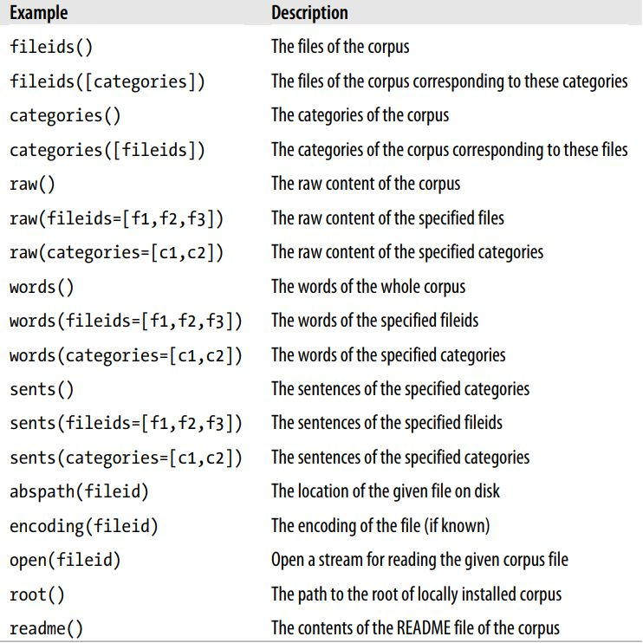
NLTK Corpus Methods and Descriptions
from nltk.corpus import inaugural
inaugural.fileids()
speech = inaugural.raw('2009-Obama.txt')
inaugural.abspath('2009-Obama.txt')
inaugural.readme()
inaugural.categories()
vocab = set([w for w in inaugural.words(fileid)])

Slide 19
Big Data: XML vs JSON
XML (eXtensible Markup Language):
<?xml version="1.0"?>
<book id="123">
<title>Object Thinking</title>
<author>David West</author>
<published>
<by>Microsoft Press</by>
<year>2004</year>
</published>
</book>
JSON (Javascript Object Notation):
{
"id": 123,
"title": "Object Thinking",
"author": "David West",
"published": {
"by": "Microsoft Press",
"year": 2004
}
}

Slide 20
Big Data: XML vs JSON
Similarities:
Both are lightweight format for data interchange.
Both are "self describing" (human readable).
Both are hierarchical (values within values).
Both can be parsed and used by many programming languages.
Both can be fetched with HttpRequest.
Differences:
JSON doesn't use end tag; XML does.
JSON is shorter than XML.
JSON is quicker to read and write than XML.
JSON can use arrays; XML cannot.
XML must be parsed with an XML parser; JSON can be parsed by a standard JavaScript function.
Which is better?

Slide 21
Working with JSON
import json
dir json
movie1 = '''{
"title": "Minority Report",
"director": "Steven Spielberg",
"composer": "John Williams",
"cast" : ["Tom Cruise", "Colin Farrell"],
"budget": 102000000
}'''
json_obj = json.loads(movie1)
json_obj
type(json_obj)
json_obj["title"]
json_obj["cast"]
movie_str = json.dumps(json_obj)
movie_str
json_fp = open('json_movie1.txt', 'w‘, encoding='utf-8')
json.dump(json_obj, json_fp, ensure_ascii=False)
json_fp.close()
with open('json_movie1.txt', 'r') as json_fp:
json_movies = json.load(json_fp)
json_movies
Loading JSON objects from string
List methods in json module
JSON objects are stored as dict
Writing JSON objects to a string
A string to convert to a JSON object
Writing JSON objects to a file
Loading JSON objects from a file

Slide 22
JSON versus Python
Importing JSON objects in Python:
JSON objects are stored in Python as dictionaries.
Since dictionaries are not nested, JSON -> Python conversion can be problematic.
Python dictionaries -> JSON conversion is fine.
JSON and Pandas:
JSON objects can be imported into Pandas dataframes.
Pandas dataframes can also be converted to JSON files.
Python | JSON
dict | Object
list | Array
tuple | Array
str | String
int | Number
float | Number
True | true
False | false
None | null

Slide 23
Using APIs to Source Data
Application Programming Interface:
Code that allows two software programs to communicate with each other using predefined rules.
Web APIs allow users to access clearly defined types of data directly from corporate or government agency databases using a few lines of code (or sometimes without code using a standardized interface).
API data outputs:
Usually JSON or CSV/TXT.
JSON is more popular because it preserves more hierarchical structure and meta information about a dataset than csv/tsv files.
How to download data using APIs:
Using API “wrappers” or tools that users can employ to request data directly from an API using a programming language like R or Python.

Slide 24
Popular APIs
Facebook Graph API:
Download posts, comments, shares, likes, etc. using Python or R scripts.
https://developers.facebook.com/docs/graph-api
Twitter API:
Download tweets made by a certain user, tweets containing a particular term, tweets on a topic in a certain date range, etc.
Google Map API:
Can be used to identify location coordinates, distances between locations, routes etc. (e.g., for building your own Uber-like cab application).
IBM Watson API:
APIs for tone analysis, document conversion, personality insights, visual recognition, text-to-speech, speech-to-text, etc.
Quandl API:
Time series data on stock prices, volumes, etc. a the specified date range (for stock price prediction, stock profiling, etc.).
World Bank API:
16,000 time series country-level indicators on GDP, infrastructure, education, healthcare, poverty, ease of doing business, etc.
Center for Medicare & Medicaid Services:
Medical claims, insurance, marketplace, etc.
https://developer.cms.gov/

Slide 25
Accessing Twitter Data
What can you do with Twitter data:
Analyze tweets to gauge public sentiments, consumer preferences, or trends for marketing.
Conduct product analysis or identify service failures.
Identify social networks of Twitter users.
What you get: A JSON object containing the following:
Tweet information: text of tweet, date/time of tweet, geolocation, etc.
User profile information: Username, name and number of followers, etc..
Community information: number of retweets, quoted tweets, etc. (at time of download).
Limits to Twitter API use:
Data on passive observers not available (not released publicly).
Historical data is limited to one week of data (professional subscription allows one month).
Provides only a 1% unverified sample (which may still be a few million tweets per day).
Rate limits: 15 requests per application per 15 minute window for REST APIs (streaming API exempted).

Slide 26
Twitter APIs
Different types of Twitter APIs::
REST (Representational State) API: Allows searching for historical data (usually one week).
Streaming API: Allows access to real-time data, as tweets are published.
Ads API.
Streaming API:
Allows collecting a sample of tweets in real-time based on user id, keywords, or location.
Data continues to be collected until connection is closed by developer.
Has two endpoints:
Filter endpoint: To request data on keywords (hundreds), user ids (thousands), and locations (25).
Sample endpoint: 1% random sample of all Tweets.
Python package: Tweepy
Requires your own user account for authentication.
Requires access token from Twitter developer site (developer.twitter.com).
StreamListener class tells Tweepy how to handle incoming data.

Slide 27
Accessing Twitter Data using Tweepy
import tweepy
from tweepy import OAuthHandler
consumer_key = 'YOUR-CONSUMER-KEY'
consumer_secret = 'YOUR-CONSUMER-SECRET'
access_token = 'YOUR-ACCESS-TOKEN'
access_secret = 'YOUR-ACCESS-SECRET'
auth = OAuthHandler(consumer_key, consumer_secret)
auth.set_access_token(access_token, access_secret)
api = tweepy.API(auth)
for tweets in tweepy.Cursor(api.home_timeline).items(10):
print(tweet.user.screen_name, tweet.created_at, tweet.text)
with open('C:/Users/abhatt/Desktop/python/Tweets.json', 'a') as f:
for tweet in tweepy.Cursor(api.home_timeline).items(10):
json.dump(tweet._json, f)
To get these keys, you must create a Twitter account, then a Twitter developer account, and create your first app on Twitter
User authentication
Extracting tweets posted on your own Twitter timeline using REST API
Tweets are JSON objects; they can be saved in a JSON file

Slide 28
Web Scraping
What is scraping:
Automated collection of data from public websites.
Can be done using Python libraries such as urllib, requests, or Scrapy.
HTML data is very noisy; requires extensive cleaning.
Why would businesses want to scrape data?
Scrape competitor’s websites for price information to adjust their own product prices.
Scrape online reviews of their own products/services or gauge public opinion.
Scrape social media sites for generating potential client leads.
What else can you scrape?:
Transaction and bidding data from e-commerce websites like ebay, Kickstarter, etc.
Financial and corporate information from S&P or Yahoo Finance.
Data on crimes, education, healthcare from government websites that don’t provide an API.

Slide 29
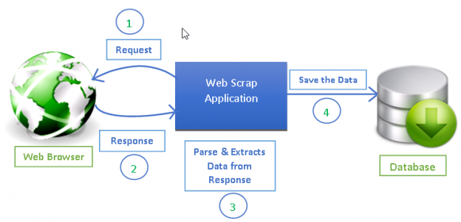
The Process of Web Scraping
urllib
Scrapy
Pandas dataframes
CSV/JSON files

Slide 30
Demo: Building a Web Crawler
Problem 1:
Build a web crawler to download New York MTA's weekly turnstile data.
Data: http://web.mta.info/developers/
Problem 2:
Build a web scraper to extract data from a Wikipedia table into a Pandas dataframe.
Problem 3:
Download product and price data from a live e-commerce website like Amazon or Flipkart.
Scraping static web sites
Requires Python libraries like requests, urllib, or scrapy to fetch web pages
Requires libraries like BeautifulSoup to parse HTML code from fetched pages
Scraping dynamic web sites
Requires Python libraries like selenium to execute Javascript code and render processed pages in HTML format
Requires BeautifulSoup to parse HTML code

Slide 31
Pickling Objects in Python
What is pickling:
The process of converting a Python object in memory to a byte stream that can be stored on disk or sent over a network (serialization).
This character stream can later be converted back to a Python object (deserialization).
Why pickle:
For storing temporary state data for later use, without starting processing from scratch.
Example: pretrained ML algorithms to make predictions later, without retraining the model again.
When not to pickle:
Pickle protocol is specific to Python and is not compatible across platforms.
You can’t use pickles across different programming languages or different versions of Python.
You should not unpickle data from untrusted sources that may contain malicious code.

Slide 32
Pickling Objects in Python
What can be pickled:
Booleans, integers, floats, complex numbers, strings.
Tuples, lists, sets, and dictionaries containing picklable objects.
Classes, and functions, if they are defined at the top level of a module.
What cannot be pickled:
Generators, inner classes, lambda functions and defaultdicts.
Pickle versus JSON:
JSON is standardized and language-independent.
JSON is also more secure and faster than pickle.
However, JSON is just for data and cannot store classes, functions, trained ML models, etc.
cPickle is an alternative to pickle; it is nearly identical to pickle, but written in C, which makes it up to 1000 times faster.

Slide 33
Pickling in Python
Pickling a dictionary:
Unpickling a file:
import pickle
dogs_dict = { 'Ozzy': 3, 'Filou': 8, 'Luna': 5, 'Skippy': 10, 'Barco': 12, 'Balou': 9, 'Laika': 16 }
filename = 'dogs'
outfile = open(filename,'wb')
pickle.dump(dogs_dict,outfile)
outfile.close()
Specify the filename to store the pickle (extension optional), open file to write in binary mode, and write to file using pickle.dump( )
infile = open(filename,'rb')
new_dict = pickle.load(infile)
infile.close()
print(new_dict)
print(type(new_dict))

Slide 34
Multiprocessing in Python
Why multiprocessing:
Large computational tasks can be distributed into several processes, and processed on different CPUs (or cores and/or threads) to save processing time.
Example: Training machine learning models or neural networks.
Sharing data between processes:
Since processes don’t share memory, if they have to send information to each other, they use serialization, which is done using the pickle module.
import multiprocessing as mp
from math import cos
p = mp.Pool(2)
p.map(cos, range(10))
p.map(lambda x: 2**x, range(10))
Pool specifies number of processes to run
Cosine of values in the range (0, 10)
Objects that can’t be pickled can’t be multiprocessed

