Slide 1
Supervised Learning: Text Classification
Tim Smith, Ph.D.
E-mail: smith515@usf.edu
Copyright 2023, Dr. Tim Smith
Portions are copyrighted by Anol Bhattacherjee. Used with permission.

Slide 2
Outline
Classifier testing:
Accuracy, recall, precision, F1 score, specificity, ROC, AUC.
Precision-recall tradeoff.
Overfitting/underfitting:
Bias-variance tradeoff.
Cross-validation.
Regularization.
Classification models:
Logistic regression.
Decision tree.
Support vector machines.
Bagging models: Random Forest.
Boosting models: Adaboost, XGBoost.
Neural Network
1. Problem Definition
2. Building a Text Corpus
3. Text Preprocessing
4. Feature Extraction
5. Text Vectorization
7. Insights & Recommendations
6. Text Analysis (NLP)

Slide 3
Supervised Learning
Requires labeled documents.
Labels must be reliable (manually coded?).
Labels may be:
Binary: Spam / Not spam
Multi-class: Finance / Sports / Technology / Entertainment / Health
Opinions or Emotions: Like / Hate / Neutral
ID | News story | Label
1 | A recent outbreak of red tide in Florida … | Health
2 | Chicago Cubs wins the MLB with a narrow win over the Colorado Rockies … | Sports
3 | A new study says that coffee is good for your health, but … | Health
You cannot do classification without predefined labels

Slide 4
Classification Methods
Manual classification:
Used by Yahoo, Looksmart, about.com, ODP, Medline.
Very accurate when job is done by experts.
Consistent when the problem size and team is small.
Difficult and expensive to scale.
Automatic document classification:
Hand-coded rule-based systems.
Used by Reuters, CIA, Verity, …
Commercial systems use complex query languages (information retrieval research).
Supervised learning of document-label assignment function:
Used by Autonomy, Kana, MSN, Verity, …
Algorithms used: Naive Bayes (simple, common method), k-Nearest Neighbors (simple, powerful), support vector machines (new, more powerful), plus many other methods.
Requires hand-classified training data.

Slide 5
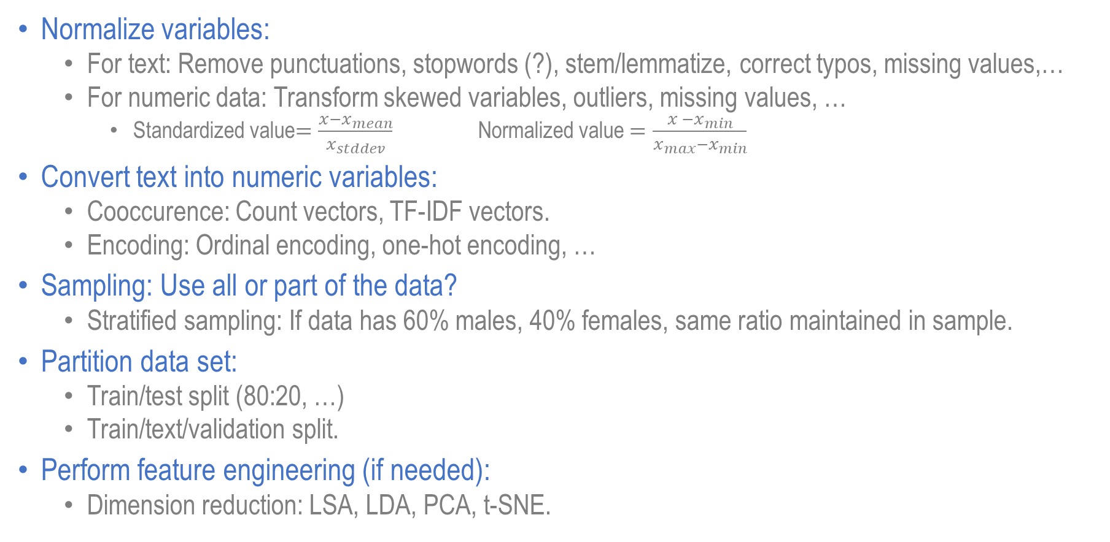
Preparing Data for Classification
Normalize variables:
For text: Remove punctuations, stopwords (?), stem/lemmatize, correct typos, missing values,…
For numeric data: Transform skewed variables, outliers, missing values, …
Standardized value$=\frac{x−x_{mean}}{x_{stddev}}$ Normalized value $=\frac{x −x_{min}}{x_{max}−x_{min}}$
Convert text into numeric variables:
Cooccurence: Count vectors, TF-IDF vectors.
Encoding: Ordinal encoding, one-hot encoding, …
Sampling: Use all or part of the data?
Stratified sampling: If data has 60% males, 40% females, same ratio maintained in sample.
Partition data set:
Train/test split (80:20, …)
Train/text/validation split.
Perform feature engineering (if needed):
Dimension reduction: LSA, LDA, PCA, t-SNE.

Slide 6
Model Validation/Testing
Metrics:
Accuracy, recall, precision, specificity, F₁ score, AUC, …
Evaluating classifier accuracy requires a baseline: a naïve model?
ID | Age | Salary | Delinquent | Predicted Delinquent
1 | 25 | 20000 | 1 | 1
2 | 26 | 30000 | 0 | 0
3 | 25 | 40000 | 0 | 1
4 | 30 | 50000 | 1 | 1
5 | 35 | 50000 | 0 | 1
How accurate is this model?
What is the baseline accuracy?

Slide 7
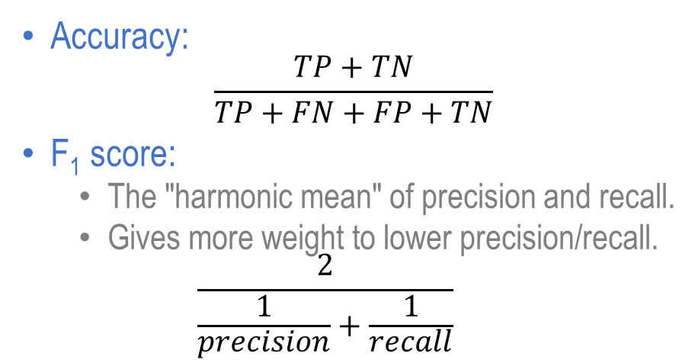
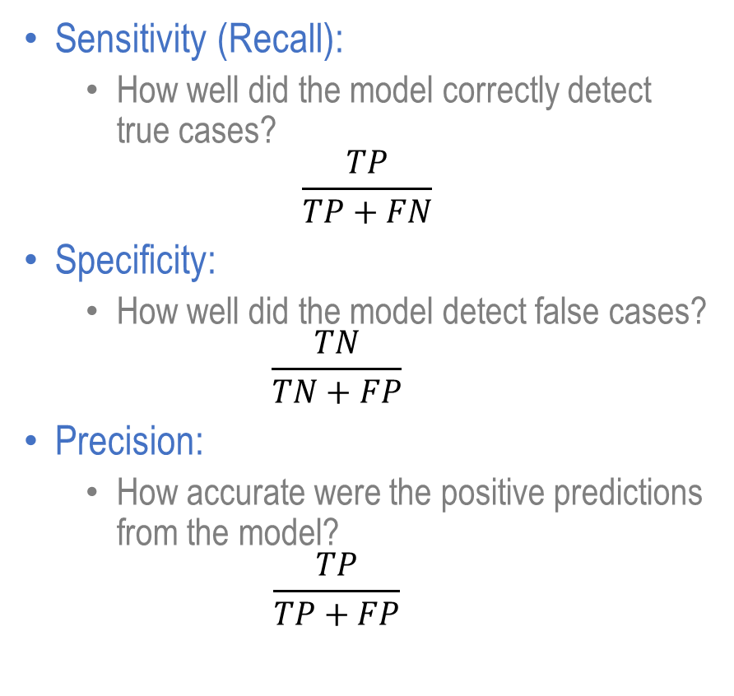
Classification Metrics
Sensitivity (Recall):
How well did the model correctly detect true cases?
$$\frac{TP}{TP+FN}$$
Specificity:
How well did the model detect false cases?
$$\frac{TN}{TN+FP}$$
Precision:
How accurate were the positive predictions from the model?
$$\frac{TP}{TP+FP}$$
Actual Class | Predicted Class
 | 1=P | 0=N
1=T | True positive | False negative
0=F | False positive | True negative
Recall
Specificity
Precision
Accuracy:
$$\frac{TP+TN}{TP+FN+FP+TN}$$
F₁ score:
The "harmonic mean" of precision and recall.
Gives more weight to lower precision/recall.
$$\frac{2}{\frac{1}{precision}+\frac{1}{recall}}$$

Slide 8
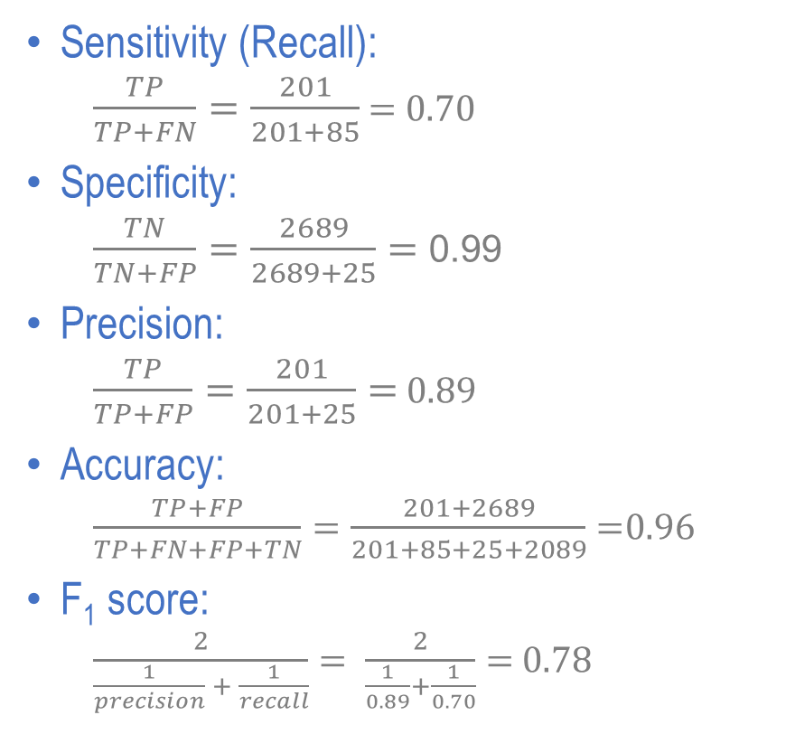
Classification (or Confusion) Matrix
Sensitivity (Recall):
$\frac{TP}{TP+FN}=\frac{201}{201+85}$ = 0.70
Specificity:
$\frac{TN}{TN+FP}=\frac{2689}{2689+25}=$ 0.99
Precision:
$\frac{TP}{TP+FP}=\frac{201}{201+25}=$ 0.89
Accuracy:
$\frac{TP+FP}{TP+FN+FP+TN}=\frac{201+2689}{201+85+25+2089}=$0.96
F₁ score:
$\frac{2}{\frac{1}{precision} + \frac{1}{recall}}= \frac{2}{\frac{1}{0.89}+\frac{1}{0.70}}=$ 0.78
ID | Age | Salary | Delinquent | Predicted Delinquent
1 | 25 | 20000 | 1 | 1
2 | 26 | 30000 | 0 | 0
3 | 25 | 40000 | 0 | 1
4 | 30 | 50000 | 1 | 1
5 | 35 | 50000 | 0 | 1
The model correctly predicts only 70% of True cases
The model correctly predicts 99% of False cases
When the model predicts a 1, it correct only 89% of the time
 | Predicted
Actual | 1=P | 0=N
1=T | TP=201 | FN=85
0=F | FP=25 | TN=2689
Dominated by
the larger class
Accuracy is an inappropriate classification metric for unbalanced classes

Slide 9
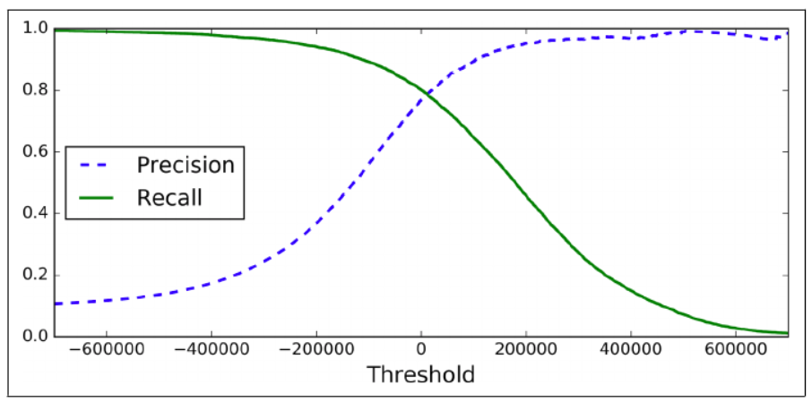
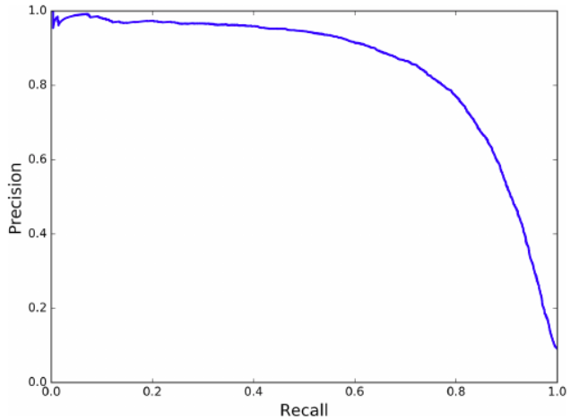
Precision/Recall Tradeoff
Actual Class | Predicted Class
 | 1=P | 0=N
1=T | TP | FN
0=F | FP | TN
Recall
Precision
Increasing precision reduces recall (and vice versa)

Slide 10
Precision/Recall Tradeoff Examples
Scenario 1: High precision, low recall
You contact customers who are predicted to buy a gadget.
You will miss many customers who might have also bought your gadget but you didn’t contact them because your model predicted otherwise (many false negatives).
Model too restrictive: You lose a lot of sales.
Scenario 2: High recall, low precision
Model does well in detecting patients with cancer but poor at detecting patients without cancer.
You contact patients who are likely to have cancer.
You test many people who don’t actually have cancer (many false positives).
Model too generous: You waste a lot of resources.
Actual Class | Predicted Class
 | 1=P | 0=N
1 | TP | FN
0 | FP | TN
Recall
Precision
Scenario 2
(Generous)
Scenario 1
(Restrictive)
What type of model would you prefer?

Slide 11
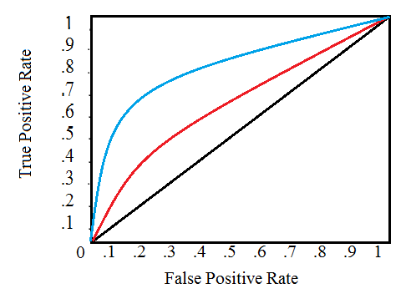
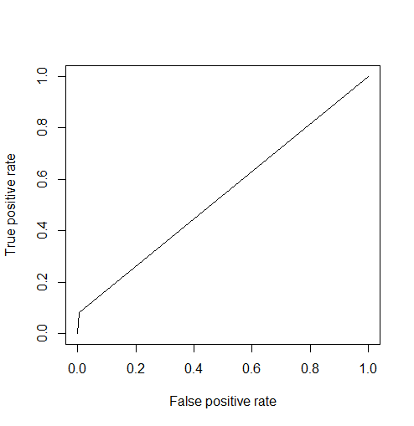
ROC Curve and AUC
Classifier A
Classifier B
Receiver Operating Characteristic (ROC) Curve:
Plot of true positive rate vs false positive rates for different thresholds of each.
The diagonal is the baseline – a random classifier.
The classifier that yields the highest “lift” (gain) above the random classifier is the best classification model.
AUC (Area Under the ROC Curve):
An aggregate performance metric between 0 and 1.
A random classifier (baseline) has an AUC of 0.5.
Baseline classifier
library(ROCR)
pr <- prediction(predlogit, test$TenYearCHD)
prf <- performance(pr, measure = "tpr", x.measure = "fpr")
plot(prf)
auc <- performance(pr, measure = "auc")
auc <- auc@y.values[[1]]
auc
[1] 0.5361173

Slide 12
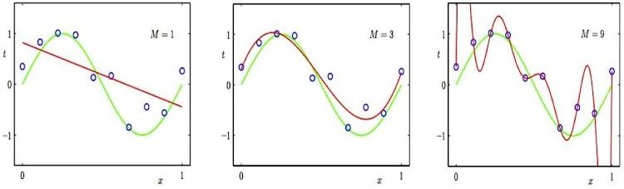
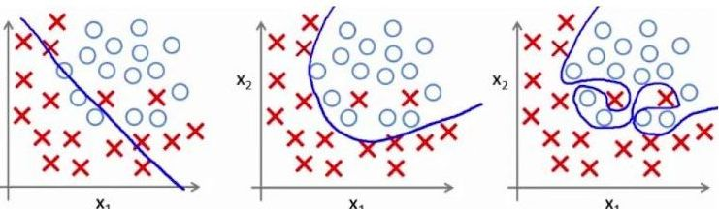
Evaluating Model Fit
Regression
Classification
Underfitting
Model too simple;
Predictor too inflexible to capture pattern
Good fit
Predictor just right
Overfitting
Model too complex; Predictor captures noise in data

Slide 13
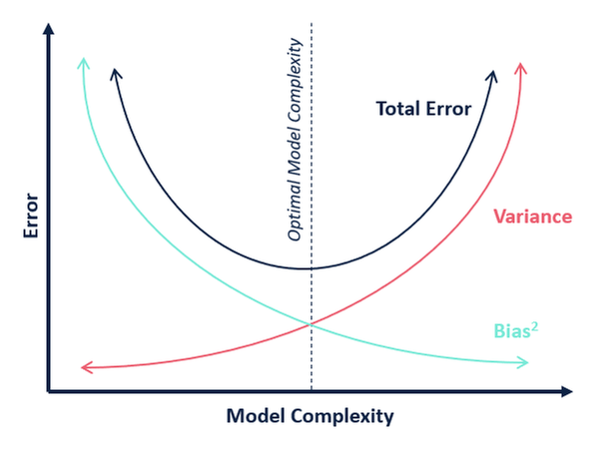
Bias-Variance Tradeoff
There are two sources of error in ML models.
Bias (systematic error):
Difference between the expected value and the true value of estimated parameter.
Simple (underfitted) models tend to have more bias (toward wrong predictions) and less variance.
Variance (random error):
Error in model attributed to noise in data.
Square of standard error: Var(θ) = σ_{θ}²
Overly complex (overfitted) models tend to have high variance and low bias and are very sensitive to small variations.
Underfitting zone
Overfitting zone
Bias and variance are inversely related. Model features should be selected to minimize Total error = ∑(bias² + variance)

Slide 14
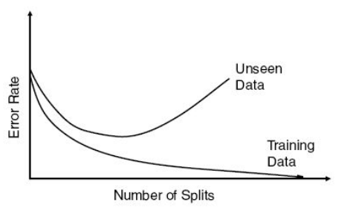
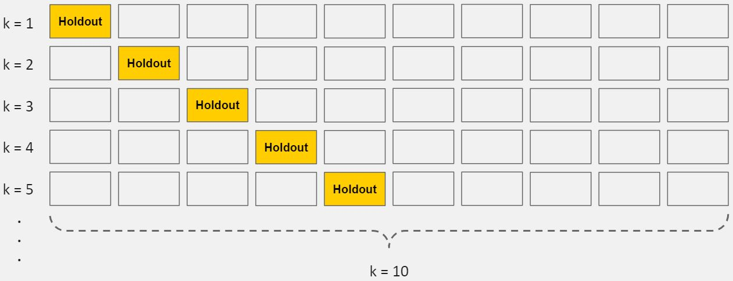
Overfitting
Optimal size
Detecting overfitting:
Split data into training and test datasets.
Build model using training data.
Test model using test data.
If model performs well with training data but not with test data, we have an overfitted model.
Cross validation:
A powerful preventative technique against overfitting.
From initial training data, generate multiple (k) mini train-test splits called folds.
Iteratively train the model on k-1 fold, while using the remaining “holdout” fold as the test set.
Allows opportunity to tune hyperparameters.
Validation data

Slide 15
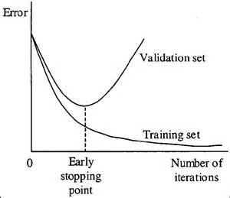
Avoiding Overfitting
Remove less relevant input features:
Justify each feature. If you can’t justify it, drop it.
Some algorithms have built in feature selection.
Train with more data:
More data helps algorithms detect signal better.
But it does not help if you add more noisy data.
Early stopping:
With an iterative learning algorithm, we can measure how well is model performs in each iteration.
Up to a certain point, more iterations improve the model. After that point, if more iterations weakens model performance, stop the training process.
Commonly used in deep learning models.

Slide 16


Avoiding Overfitting
Regularization:
A broad range of methods to force a model to be simpler.
Very widely used in classical machine learning model to reduce overfitting.
Often, regularization is a hyperparameter that can be tuned through cross-validation:
Specific regularization method depend on the type of learning used:
Decision tree: Prune Max_depth, Max_leaf_nodes, Max_features.
Neural network: Use dropout.
Regression: Use a penalty parameter to the cost function.
L2 regularization (Ridge regression): Add squared magnitude of coefficient as penalty term to the cost function:
L1 regularization (Lasso regression): Add absolute magnitude of coefficient as penalty term to the cost function:

Slide 17
Avoiding Overfitting
Ensembling:
Machine learning methods that combine predictions from multiple independent models.
Bagging models:
Trains many “strong” (relatively unconstrained) learners in parallel.
Then combines these strong learners to “smooth out” their predictions.
Boosting models:
Trains many “weak” (constrained, e.g., decision tree with limited depth) learners in sequence.
Each learner in the sequence learns from the mistakes of the prior learner.
Boosting then combines all the weak learners into a single strong learner.
Bagging uses complex base models and tries to “smooth out” their predictions, while boosting uses simple base models and tries to “boost” their aggregate complexity.

Slide 18
Classification Models
Machine learning:
Logistic Regression.
Naïve Bayes.
Decision Trees.
Support Vector Machines (SVM):
Linear and Non-linear.
Bagging models:
Random Forest.
Boosting models:
Adaptive Boosting.
Gradient Boosting.
Stochastic Gradient Boosting.
Deep learning:
Perceptron.
Deep neural network.
Convolutional Neural Networks (CNN).
Recurrent Neural Network (RNN):
Gated Recurrent Unit (GRU).
Long Short Term Memory (LSTM).
Generative Adversarial Networks (GAN).
Multilayer Perceptron (MLP).
Self Organizing Map (SOM).
Deep Belief Network (DBN).
Restricted Boltzmann Machines (RBM).
Autoencoders.

Slide 19
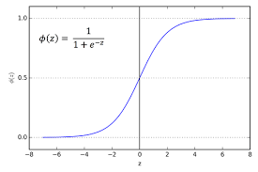
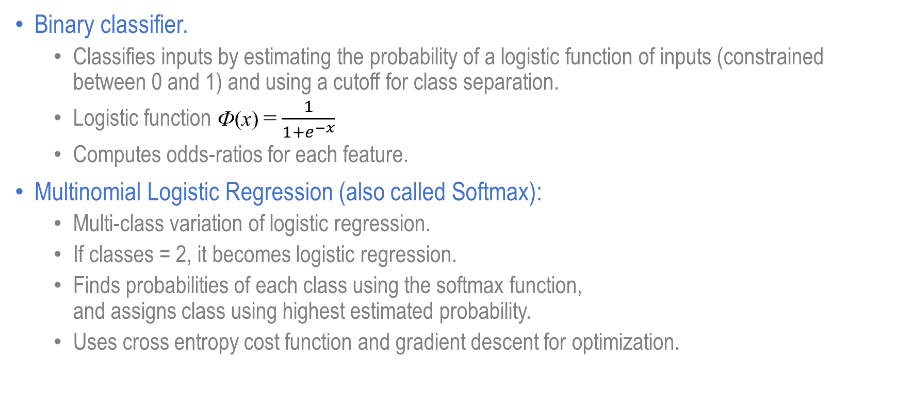
Logistic Regression
Binary classifier.
Classifies inputs by estimating the probability of a logistic function of inputs (constrained between 0 and 1) and using a cutoff for class separation.
Logistic function Ф(x) = $\frac{1}{1+e^{−x}}$
Computes odds-ratios for each feature.
Multinomial Logistic Regression (also called Softmax):
Multi-class variation of logistic regression.
If classes = 2, it becomes logistic regression.
Finds probabilities of each class using the softmax function, and assigns class using highest estimated probability.
Uses cross entropy cost function and gradient descent for optimization.
https://scikit-learn.org/stable/modules/generated/sklearn.linear_model.LogisticRegression.html

Slide 20
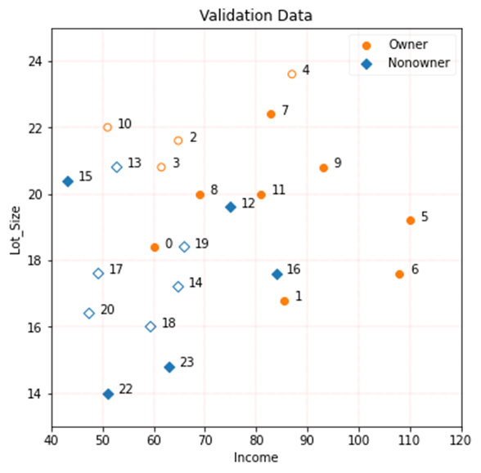
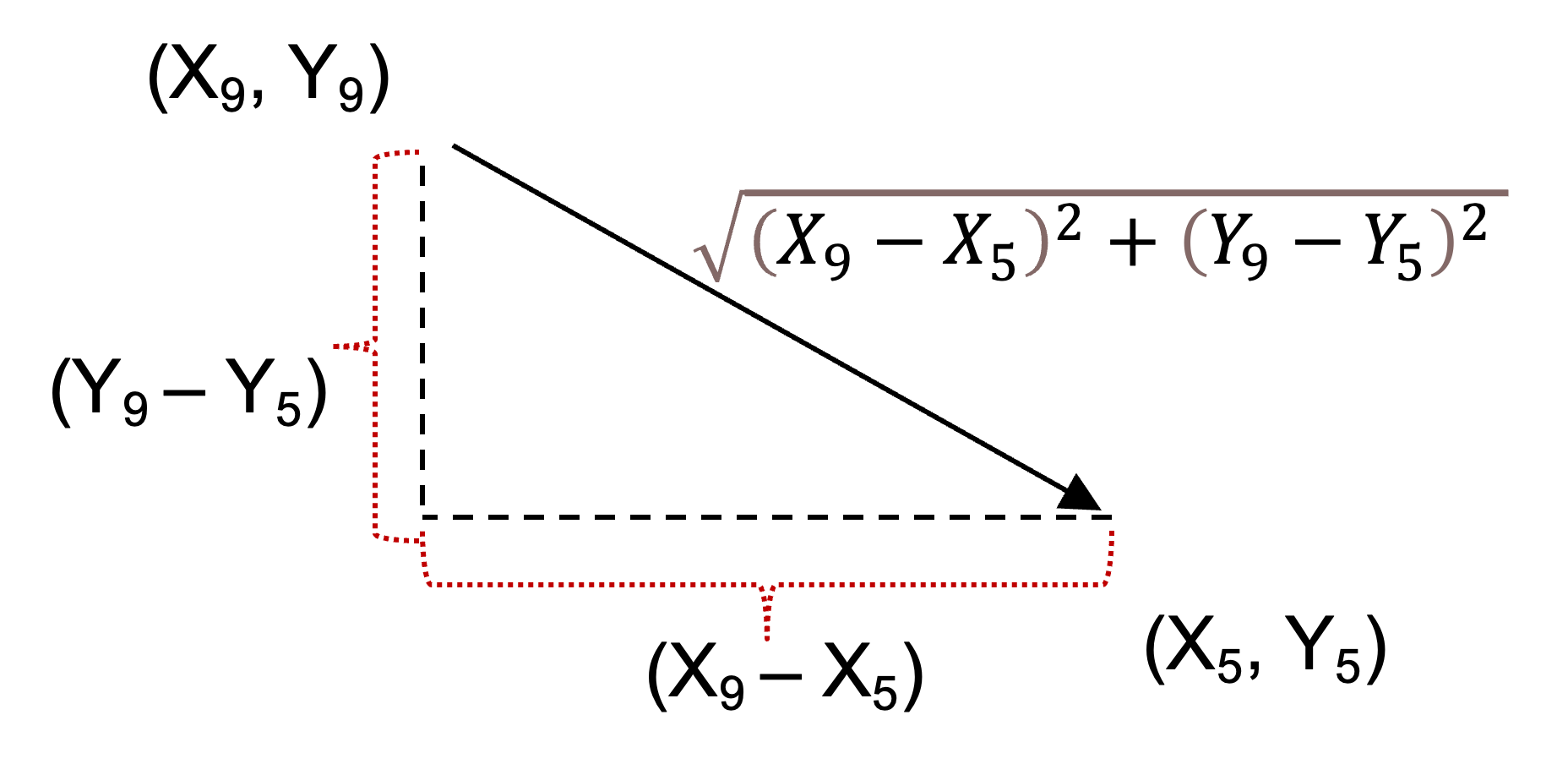
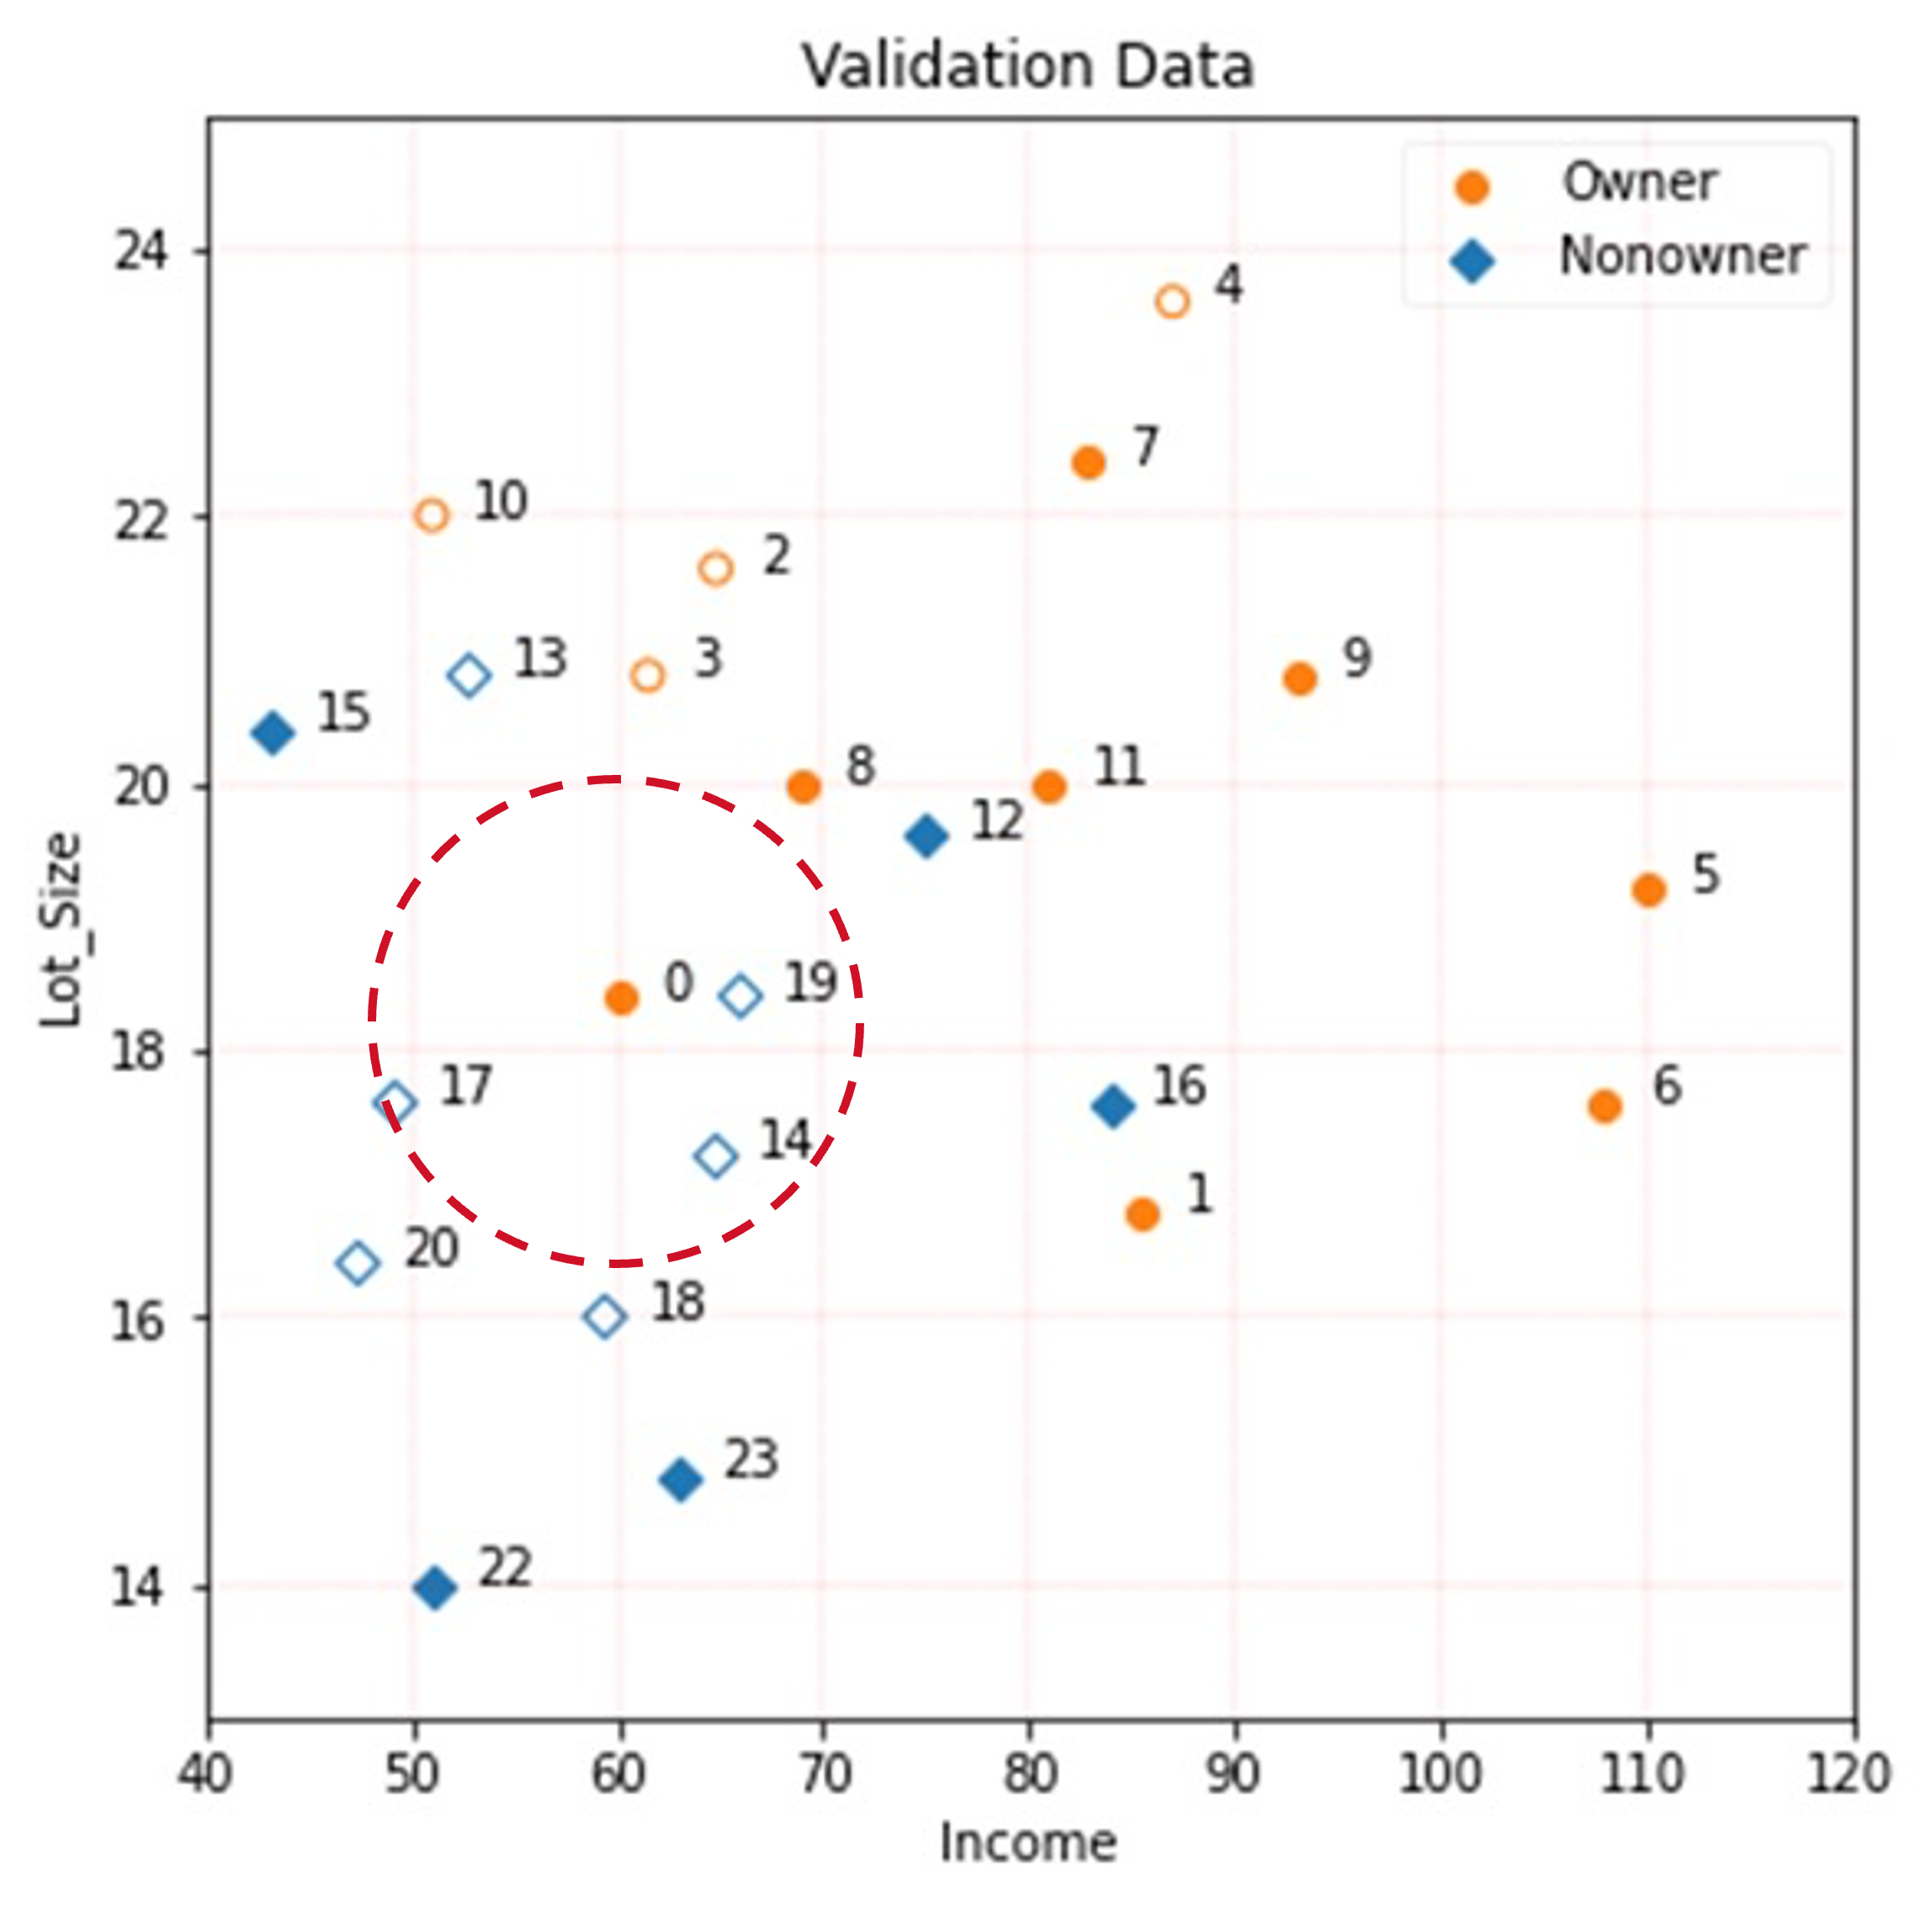
KNN (K nearest neighbors)
Works as a classifier and a Regressor
Calculates distances between values
Chooses k-nearest values to ‘vote’ on the target value you are trying to predict
Pros
Simple
Many distance measures can be used
No training time
Can model non-linear relationships
Cons
Each prediction requires calculating distances with all other targets
Can often require testing many different values of K; which can be computationally expensive
Very sensitive to differences in scale
https://scikit-learn.org/stable/modules/generated/sklearn.neighbors.KNeighborsClassifier.html

Slide 21
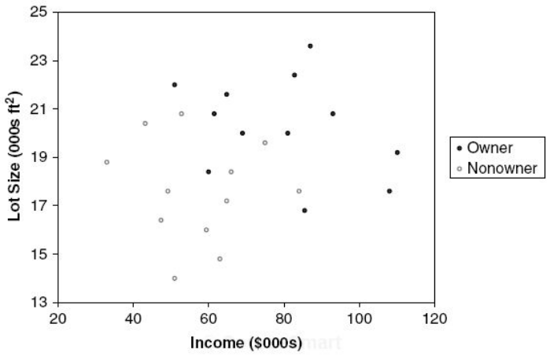
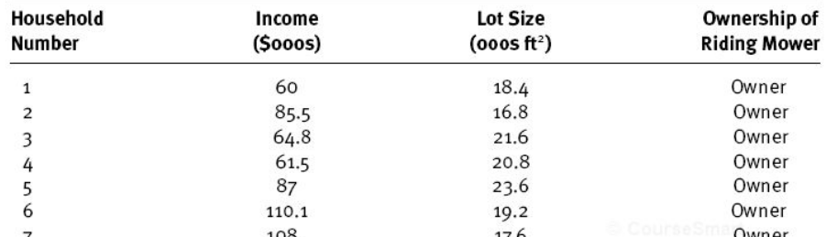
Decision Tree Example
How to create a decision tree for the following data:
Step 1: Create scatterplot.
Step 2: Draw a vertical or horizontal line to increase "purity" (homogeneity) of each resulting space; if you stop here, create confusion matrix and assess classification metrics.
Owners: 12
Non-owners: 12
Lot size≤19
Y
N
Two predictors
(two dimensions)
Target variable (owners/non-owners)
Owners: 3
Non-owners: 9
Owners: 9
Non-owners: 3

Slide 22
Decision Tree Example
Classification task (continued):
Step 3: Draw another vertical or horizontal line to increase "purity" (or homogeneity) further.
Owners: 12
Non-owners: 12
Lot size≤19
Y
N
Owners: 3
Non-owners: 9
Owners: 9
Non-owners: 3
Income≤84.75
Y
N
Owners: 1
Non-owners: 9
Owners: 2
Non-owners: 0

Slide 23
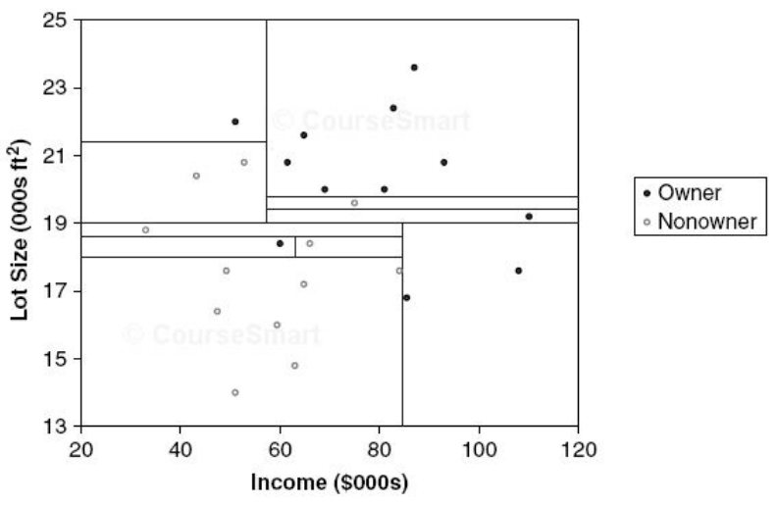
Decision Tree Example
Classification task (continued):
Step 4: Continue until each resulting space is homogeneous.
Each cell has 100% purity!!!
Questions:
What is the risk of achieving 100% purity?
When should you use decision tree vs Naïve Bayes vs logistic regression?
Which approach is better suited for text classification?

Slide 24
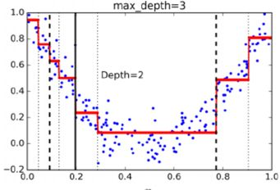
Decision Trees: Pros and Cons
Pros:
Easy to use.
Creates understandable rules (white box).
Performs variable selection automatically.
Not sensitive to outliers.
Can detect non-linear relationships.
Cons:
Uses only horizontal or vertical lines; no diagonal lines.
Requires large data sets.
Can be computationally expensive.
Susceptible to overfitting!!!
https://scikit-learn.org/stable/modules/generated/sklearn.tree.DecisionTreeClassifier.html

Slide 25
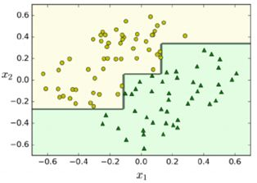
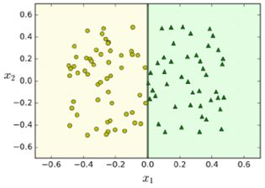
Creative Use of Decision Trees
Decision trees use only vertical and horizontal lines!
If variables are not orthogonal, trees get complex!
What can you do if variables are not orthogonal:
Use PCA to rotate data.
Simplifies the decision tree.

Slide 26
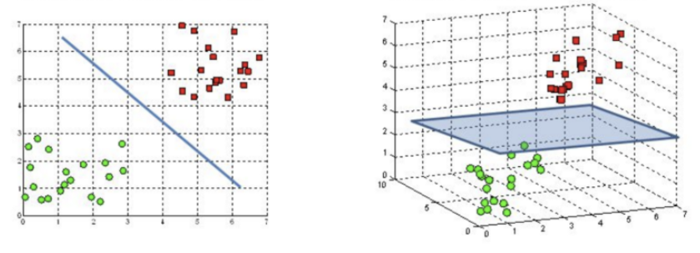
Support Vector Machines
Linear SVC:
The classifier is a hyperplane separating two classes; training points are support vectors.
The goal is to maximize the margin (width) around this hyperplane.
Hyperparameter C controls margin width: High C: Smaller margin; Low C: Wider margin.
Margin
Hyperplane
w^{T}x_{i} + b = 0
Classifier:
f(x_{i}) = w^{T}x_{i} + b
Support vectors
w^{T}x_{i} + b = +1
In a 2D feature space, the hyperplane is a line
In a 3D feature space, the hyperplane is a plane

Slide 27

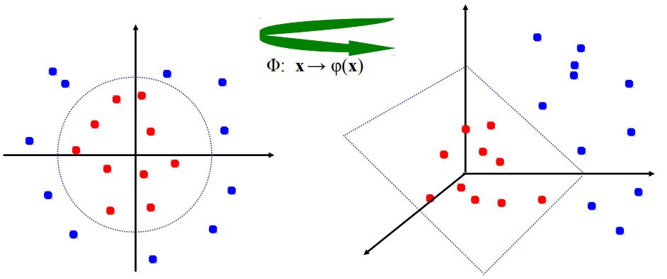
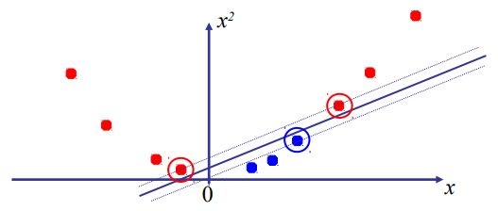
Nonlinear SVM
What if linear SVM can’t linearly separate data:
Option 1: Rotate original feature space to a higher-dimensional space where observations are linearly separable.
Option 2: Apply a non-linear kernel function to make observations linearly separable.

Slide 28
SVM: Pros and Cons
Pros:
Can handle both classification and regression (can predict numerical values too).
Often outperforms decision tree classifiers.
Works well with high-dimensional data, such as text.
Can fit both linear and nonlinear relationships, but linear classifiers are often sufficient for most text classification tasks.
Cons:
Linear SVC is fast, but non-linear SVMs are resource intensive, especially with large data sets.
https://scikit-learn.org/stable/modules/generated/sklearn.svm.SVC.html

Slide 29
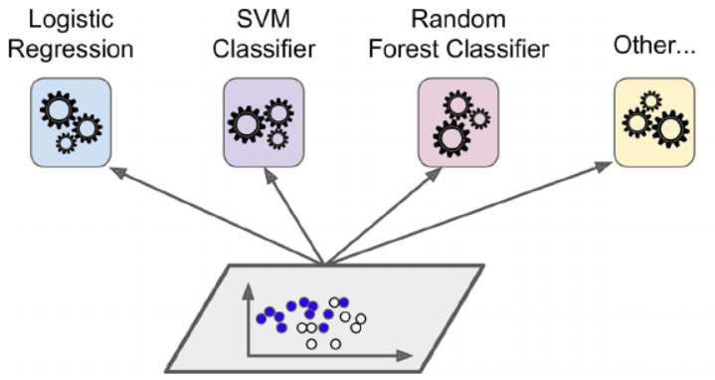
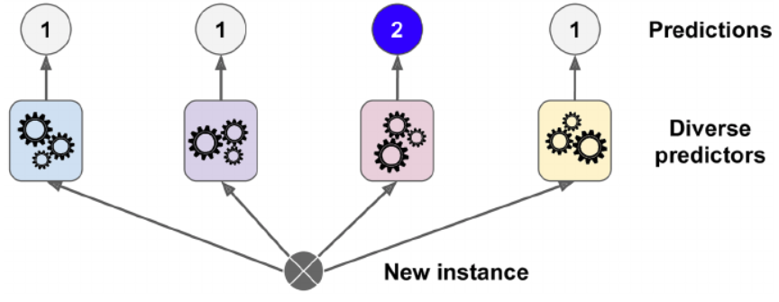
Ensemble Methods: Bagging Models
Select the best among a group of strong learners:
Run a “bag” of sufficiently diverse strong (unrestricted) models in parallel.
Select best model by “voting”.
How to build diverse models:
Use different algorithms (to maximize error variance).
Use the same algorithm on different training subsets.
Bagging with and without replacement:
Bootstrapping: random data subsets with replacement.
Pasting: random data subsets without replacement.
Voting:
Hard voting: Simple majority.
Soft voting: Based on highest average probability.
Prob=0.52
Prob=0.54
Prob=0.60
Prob=0.58
Soft voting

Slide 30
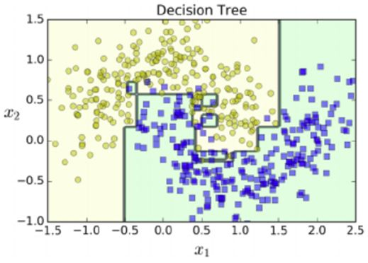
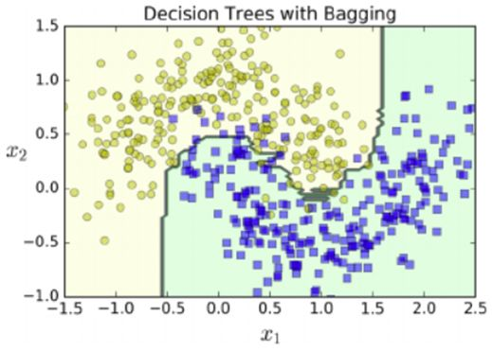
Random Forest
Ensemble of decision trees with “bagging”.
Uses a random subset of features at each split to reduce overfitting.
Provides feature importance:
How much does a feature reduce impurity?
Since there are many trees, this is a weighted average.
If a feature is not used in any tree, it has 0 importance.
Two key hyperparameters:
n_estimators: Number of decision trees.
max_depth: Depth of each decision tree.
Can do both classification and regression:
RandomForestClassifier()
RandomForestRegressor()
https://scikit-learn.org/stable/modules/generated/sklearn.ensemble.RandomForestClassifier.html
500 trees

Slide 31
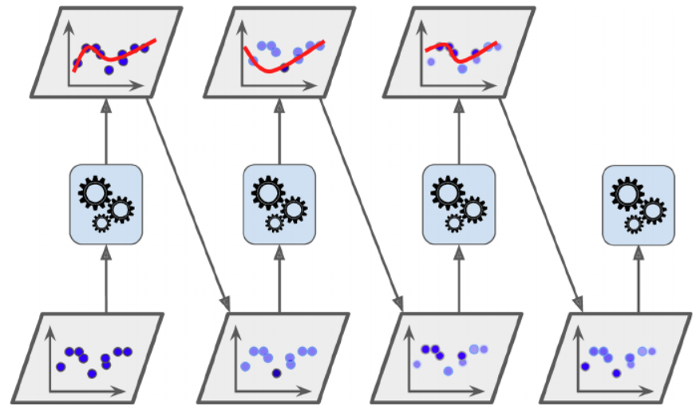
Ensemble Methods: Boosting Models
Convert multiple “weak” learners to one strong learner:
Weak learner: A decision tree with only 1 level (decision stump).
Train models sequentially (as opposed to simultaneously).
Each model used the same training data set, and is assigned a weight “α” based on its accuracy on weighted training set (“boost” weights for models with higher accuracy).
Each model corrects its predecessor by focusing on "underfitted" models.
Two types:
Adaptive boosting (AdaBoost).
Gradient boosting.

Slide 32
Adaptive Boosting
Can be used for:
Classification (AdaBoostClassifier).
Regression (AdaBoostRegressor).
SAMME (Stagewise Additive Modeling using a Multiclass Exponential loss function):
Multiclass version of AdaBoost.
Steps:
Train model with decision stumps.
Identify misclassified instances.
Increase (boost) the relative weights of stronger models.
Train a new model.
Repeat 2-4.
Stop: if max_number is reached, OR perfect model is achieved.
https://scikit-learn.org/stable/modules/generated/sklearn.ensemble.AdaBoostClassifier.html

Slide 33
Gradient Boosting
Steps:
Uses decision trees, called Gradient Boosting Trees.
Optimize hyperparameters:
Learning rate: If set too low, add more trees.
Early stopping: Stop when validation error reaches a certain acceptable level; prevents overfitting.
Subsample (for stochastic gradient boosting): Train each tree on a randomly selected subsample (e.g., 25%) of data
Unlike Adaboost, Gradient boosting has no weights. Instead it fits the new model to the “residual error” from the previous model: y_{act} – y_{pred.}
Better generalization than Adaboost.
Can be used for:
Classification (GradientBoostingClassifier).
Regression (GradientBoostingRegressor).
https://scikit-learn.org/stable/modules/generated/sklearn.ensemble.GradientBoostingClassifier.html

Slide 34
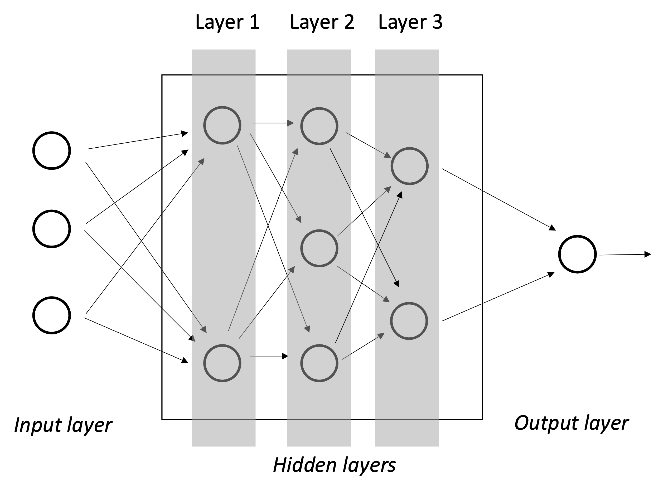
Neural Networks
Steps:
Arrows represent a weight.
Arrows entering a neuron are Weight * Output from the previous node
All these weights and values are added together
Each node takes these added weights and values and uses an activation function to determine the output.
This process ‘feeds forward’ for all nodes until a prediction is output.
The prediction error (aka cost) is then used to back propagate through the network and adjust weights.
This feed-forward then backpropagation process continues back and forth until finished.
Can be used for:
Classification
Regression
1
1
Softmax
2
1
…
…
…
3
p
…
k
https://scikit-learn.org/stable/modules/generated/sklearn.neural_network.MLPClassifier.html
n

Slide 35
NN’s – Pros and Cons
Pros:
Learning ability
Non-Linear Relationships
Parallel Processing
Fast Predictions Once Trained
Many different possible architectures (Deep, RNN, LSTM, AutoEncoder, etc.)
Can handle a wide range of problems
Cons:
Can be computationally expensive to train
Can be prone to overfitting (but this can be mitigated)
‘Black Box’ – low explainability
Doesn’t perform well on small datasets

Slide 36
HyperParameter Tuning
Each of the machine learning models has several parameters.
These parameters are often optional and have defaults.
You can change the way the model learns by changing these parameters.
There are so many possible options you often need to resort to a search for the best combination of argument values.
There are two general approaches to such searches:
GridSearch – an exhaustive search that checks all combinations or parameter ranges given
The number of these combinations snowballs as parameter ranges increase
Unless you are careful, this can result in model training taking much too long
RandomSearch – given a set of parameter ranges, randomly select a given number of all the possible combinations.
You directly control how many combinations and, thus, how long it will take to train.
Often used in combinations with Grid Search:
Use RandomSearch to test a wide range of possible parameter values
Use GridSearch to search near the best ones determined by Random Search

Slide 37
Classification Summary
No universally “best” approach:
Choice of algorithms depends on data.
Binary or multi-class classification:
Not all algorithms support multi-class classification (e.g., LinearSVC).
But you can convert multi-class to multiple binary classifiers (“one-vs-rest” or ovr):
Many judgment calls:
Select appropriate hyperparameters to reduce overfitting and allow reasonable convergence.
Use cross-validation for small samples.
Run alternative models and compare them using appropriate classification metrics.

