Slide 1
Text Preprocessing
Tim Smith, Ph.D.
E-mail: smith515@usf.edu
Portions of this are copyrights by Anol Bhattacherjee. Used with permission.

Slide 2
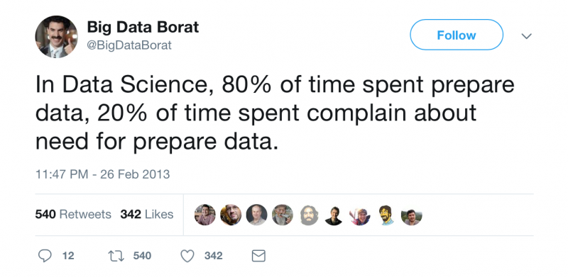
Text Analytics Workflow
1. Problem Definition
2. Building a Text Corpus
3. Text Preprocessing
4. Feature Extraction
5. Text Vectorization
7. Insights & Recommendations
6. Text Analysis (NLP)

Slide 3
Why Preprocess/Clean/Wrangle Text
Noise removal:
Noise: Text fragments that are not relevant to the text’s context or meaning.
Punctuations, URL links, social media entities (hashtags).
Stop words: Frequently used words that don’t help extract context or content (e.g., is, a, the, this, I, we).
Lexicon normalization:
Multiple representations of the same word:
E.g., play, player, playing, plays, played (related to the same root or lemma “play”).
Normalizing (collapsing) these words reduces feature dimensionality and require less computational resources to process.
Two techniques: Stemming, Lemmatization.
Object standardization:
Standardize acronyms, colloquial slangs, and misspelled words.
E.g., rt: retweet; dm: direct message, awsm: awesome, lol: laugh out loud, …
A lookup dictionary is needed for standardization.

Slide 4
Data Cleaning or Preprocessing
Convert all characters to lowercase
Drop?
Punctuations (“, ?, .)
Symbols (<, @, #)
Numbers (0, -3.14)
HTML escape sequences (&amp, &gt)
URLs (http://www.nasa.gov)
If it looks like a duck, swims like a duck, and quacks like a duck, then it is probably a duck
if
it
looks
like
a
duck
swims
like
a
duck
quacks
like
a
duck
then
it
is
probably
a
duck

Slide 5
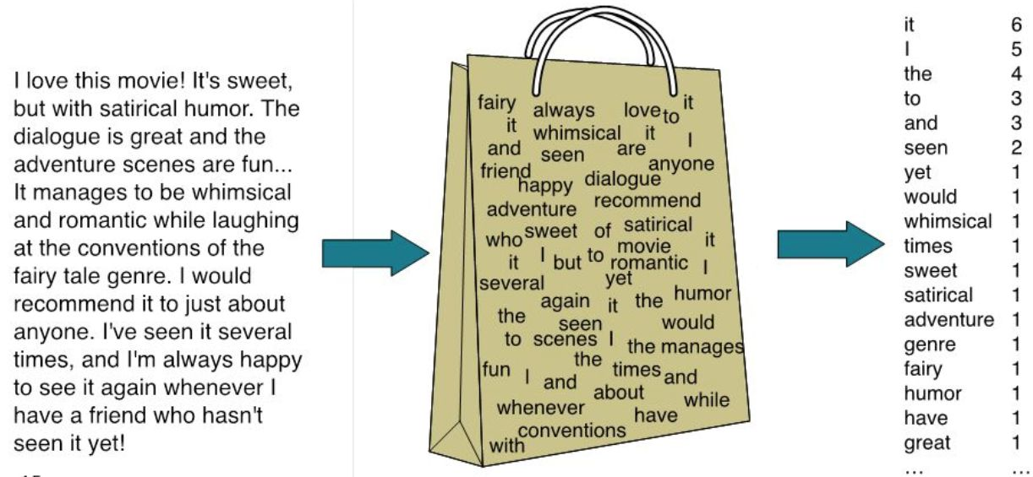
Bag of Words (BOW) Model

Slide 6
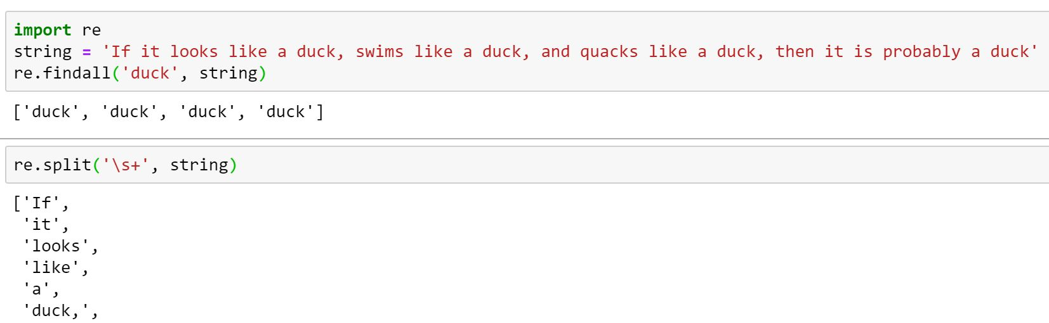
Regular Expressions
Strings with a special syntax that allows us to match patterns to strings
Applications:
Remove or replace unwanted characters
Find all web links in a document
Parse e-mail addresses.

Slide 7
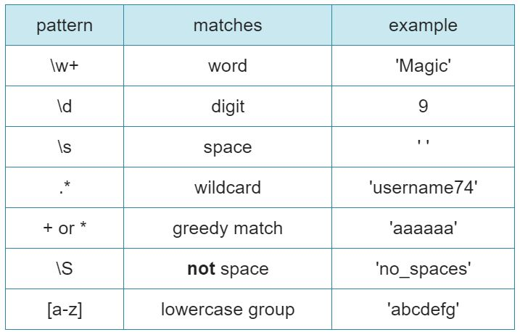
Python’s RegEx Module
Common functions:
re.split(pattern, string): Split a given string.
re.findall(pattern, string): Find all instances of a specific pattern in a given string.
re.search(pattern, string): Search for a pattern.
re.sub(pattern1, pattern2, string): Substitute pattern1 with pattern2 in a string.
Usage:
Syntax: function(pattern, string)
r’[ ] indicates literal pattern.
May return an iterator, string, or match object.
Common Regex Patterns
\ is escape character

Slide 8
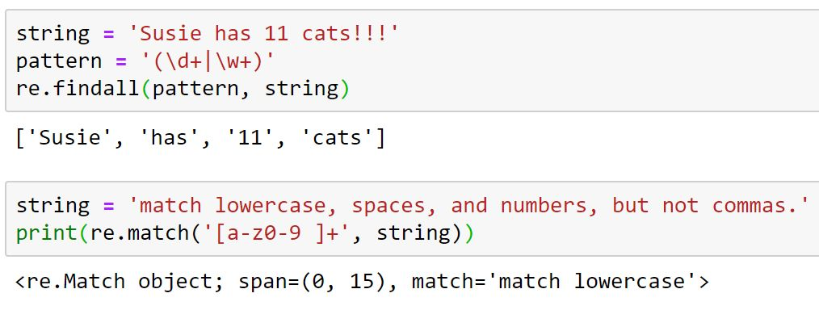
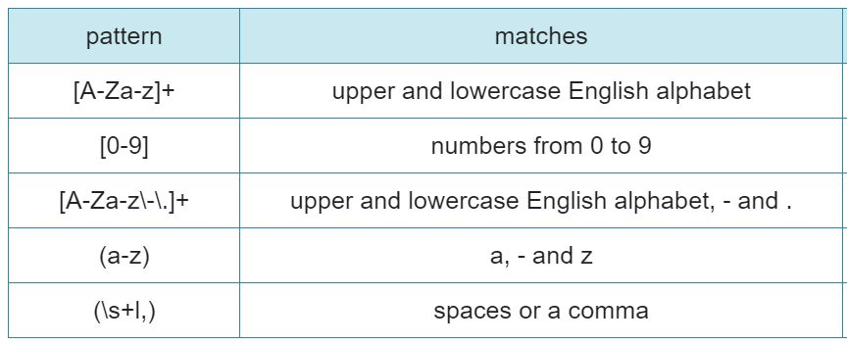
Regex Ranges and Groups
| represents OR: digits or words
re.match( ) starts at the start of a string
and stops at the first instance of mismatch
re.findall( ) does not stop after the first
mismatch; repeats operation until end of
string
[ ] can be used to customize re patterns

Slide 9
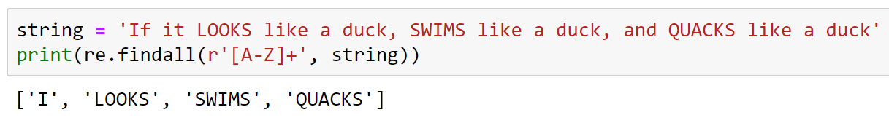
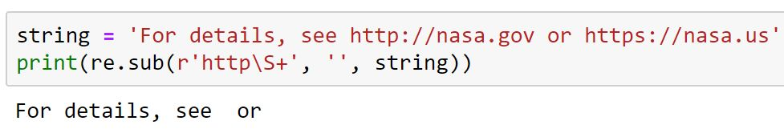
Exercise
Write down the RE code to print all capitalized letters in a sentence.
Write down the RE code to delete all URLs in a tweet.

Slide 10
Tokenization
Tokenization:
The process of splitting out a corpus of data into small chunks, such as sentences or words, for analysis.
Punctuations may be tokenized into separate tokens or affixed to previous words.
If it looks like a duck, swims like a duck, and quacks like a duck, then it is probably a duck
Tokenization
If
it
looks
like
a
duck
,
swims
like
a
duck
,
and
quacks
…
Bag of words (a collection of words with no ordering)

Slide 11
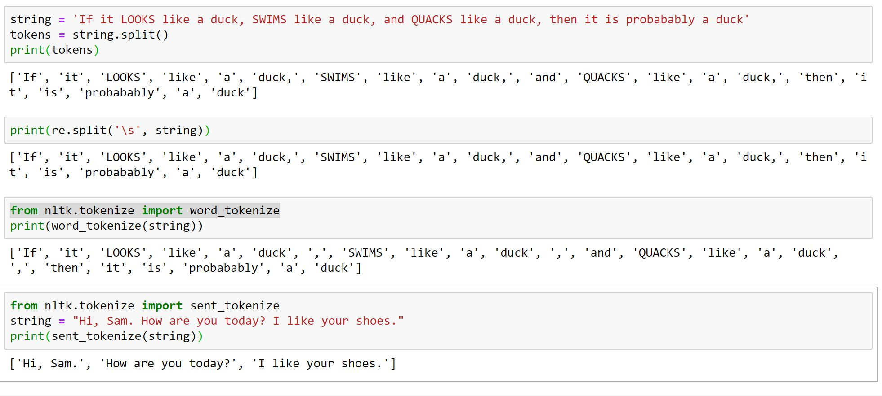

Tokenization
split( ) uses whitespace (space, \t, \n) as separator; punctuations stay with adjacent word)
RegEx split( ) can use any string as separator
NLTK’s word_tokenize( ) separates punctuations into independent strings
NLTK sent_tokenize( ) can tokenize sentences
Create your own sentence tokenizer using regex

Slide 12
Issues with Tokenization
I’m → I m - what does “m” mean?
isn’t → isn t - what does either of these two tokens mean?
U.S. → US - are these the same, especially when “US” is normalized to “us”
New York - one or two tokens?
General Electric - same as “general” and “electric”?
L’ensemble (French) - one or two tokens?
Lebensversicherungsgesellschaftsangestellter (German)
- “life insurance company employee” (compound word)
Chinese and Japanese languages have no space between words:
莎拉波娃现在居住在美国东南部的佛罗里达。
莎拉波娃 现在 居住 在 美国 东南部 的 佛罗里达
Sharapova now lives in US south eastern Florida
Japanese script may include multiple character sets, and date/times can be in multiple formats:
フォーチュン500社は情報不足のため時間あた$500K(約6,000万円)
Katakana
Hiragana
Kanji
Romaji

Slide 13
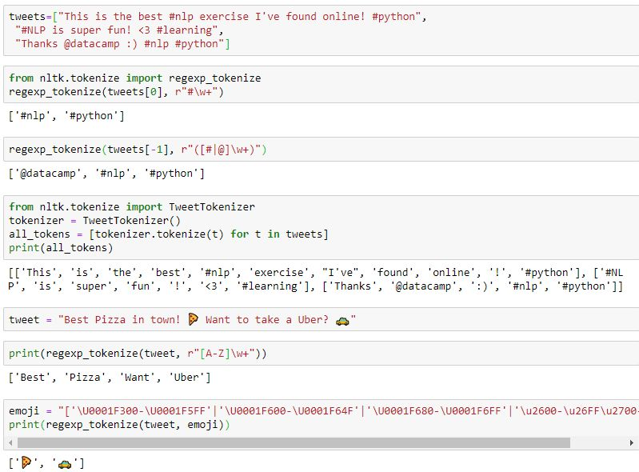
Advanced Tokenization
Using regexp_tokenizer( ) to find hashtags
Matching both hashtags and mentions
TweetTokenizer( ) works on a list of strings
Tokenizing only capitalized words
Tokenizing emojis

Slide 14
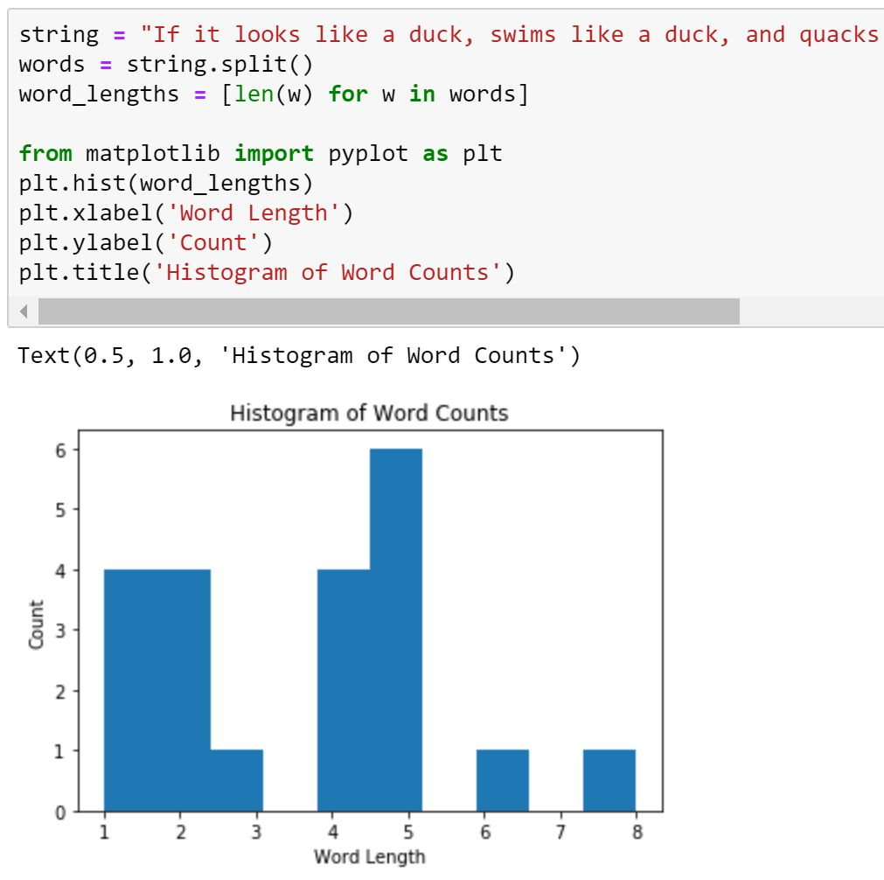
Visualization: Histogram
Returns a list: [2, 2, 5, 4, 1, 5, …]
Import only the pyplot module from matplotlib

Slide 15
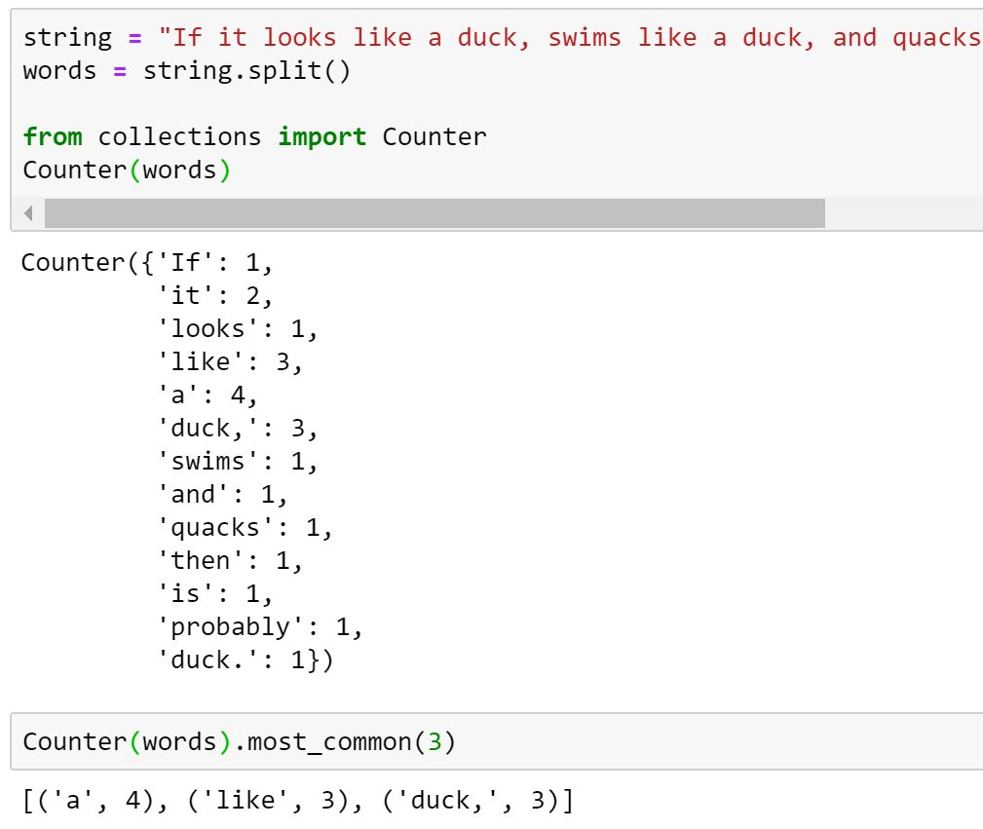
Word Frequencies
Counter function returns an “Counter” object which has a structure similar to a dictionary (of tokens and frequency of each token)
We have four ‘duck’s. Why does it show 3 ‘duck’s?
“Counter” object also includes a method most_common( ) which takes an integer argument (e.g., 3) and returns a tuple of most frequent tokens and their frequencies
Note: Does not sort tokens by frequency

Slide 16
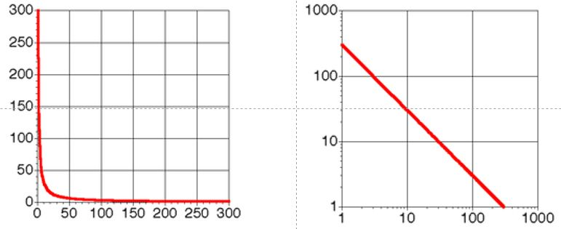
Typical Distribution of Words in a Corpus
Typical distribution:
A few words occur very frequently.
A medium number of words have medium frequency.
Many words occur very infrequently.
Government documents:
157734 words, 32259 unique
8164 the
4771 of
4005 to
2834 a
2827 and
2802 in
1592 The
1370 for
1326 is
1324 s
1194 that
973 by
969 on
915 FT
883 Mr
860 was
855 be
849 Pounds
798 TEXT
798 PUB
798 PROFILE
798 PAGE
798 HEADLINE
798 DOCNO
1 ABC
1 ABFT
1 ACFT
1 ACI
1 ACQUI
1 ACQUISITIONS
1 ACSIS
1 ADFT
1 ADVISERS
1 AE
Linear scale
Log scale
…..
Zipfian Distribution
(see Zif’s Law)

Slide 17
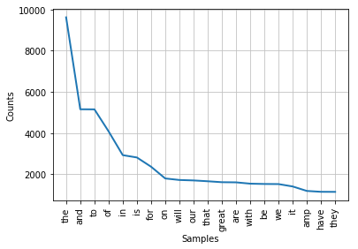
Zipf’s Law
Zipf’s Law:
In any natural language corpus, the frequency of any word (f_{i}) is inversely proportion to the rank of the word (r_{i}) in the frequency table.
What it means:
If the most frequent word appears C times in a corpus, the 2nd most frequent word appears about C/2 times, the 3rd most frequent word appears C/3 times, ...
Data that exhibit Zipf distribution:
Book sales on Amazon.
Web page requests.
Population of cities.
Words in a text collection (in any language).
f_{i} = C/r_{i}

Slide 18
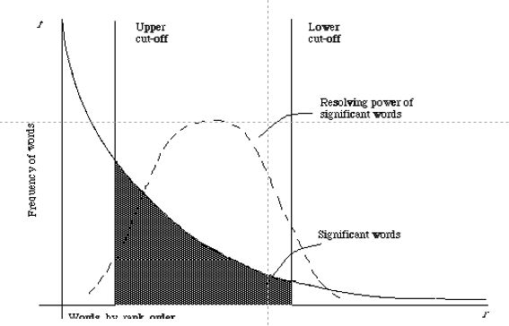
Zipf Distribution for Text Data
Medium frequency words are usually the most informative
Words that occur once or twice may be typos or otherwise unimportant
Most frequent words (a, an, the, are, he, she, …) add very little to a corpus’ content or meaning
The most frequent words are not always the most informative

Slide 19
Stop Words
Stop words:
Frequently used words with very little semantic content that are of limited value in NLP.
E.g., a, an, the, in, by, but, my, this, …
Why remove stop words:
Improves signal/noise ratio and let us focus on more meaningful content.
But also destroys the morphological structure of sentences.
if
it
looks
like
a
duck
looks
like
duck
swims
like
a
duck
quacks
swims
like
duck
quacks
like
a
duck
then
it
is
like
duck
then
probably
a
duck
probably
duck
Vocabulary size: 20
Vocabulary size: 12

Slide 20
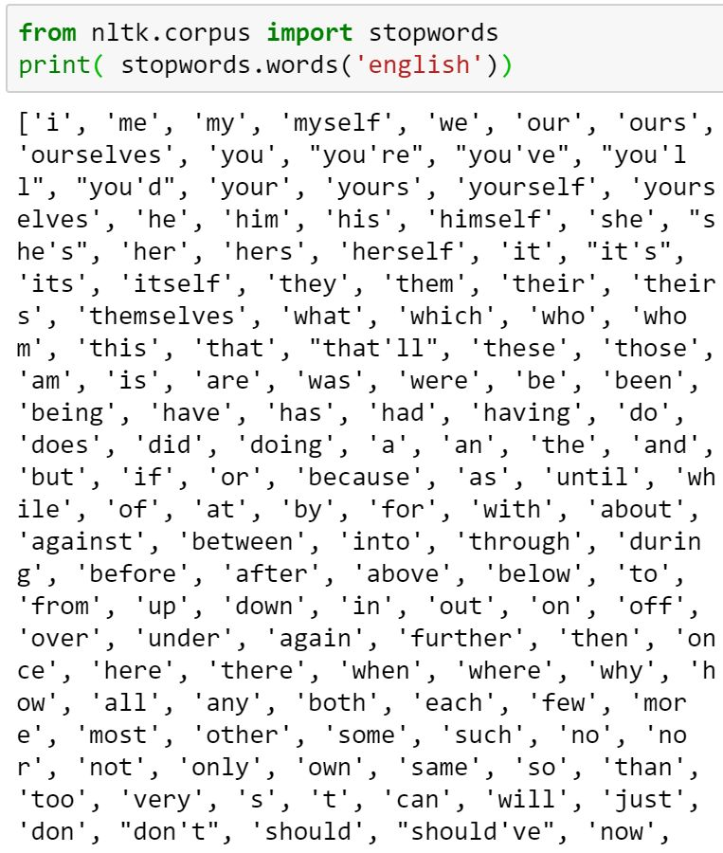
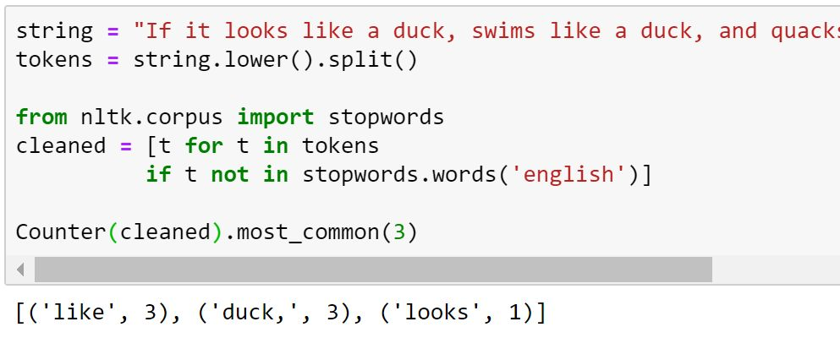
Data Cleaning & Stopword Removal
The most frequent words in this string are “like” and “duck”

Slide 21
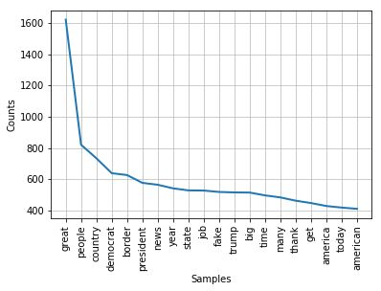
Corpus of Donald Trump’s Tweets
Before stop word removal
(Word count = 182,165)
After stop word removal
(Word count = 101,357)
Zipf distribution still applies even after stop word removal

Slide 22
Normalization
Why normalize?
How normalize?
Deleting periods:
U.S.A. → USA.
Case folding:
Convert all letters to lowercase.
General Electric → general electric; SAIL → sail.
Stemming:
Converting all words to their root form by deleted suffixes and affixes.
automate, automatic, automation → automat.
Lemmatization:
Converting each word to its canonical form.
see, saw, seen → see; am, are, is → be.
For proper matching with indexed keywords.
To reduce feature space (dimensionality).

Slide 23
Stemming
Stemming:
Normalizing words to their morphological roots, by dropping prefixes and suffixes.
Morphemes:
Small meaningful units that make up words.
Stems: Core meaning-bearing units.
Affixes: Segments that adhere to stems that often serve grammatical functions.
Why stem:
Reduces the number of words to process (dimensionality of feature space).
Fast, because it only slices word strings.
Problems with stemming:
Chopping affixes may not retain meaning.
Sometimes too restrictive
Original
Words
…
consign consigned consigning consignment consist consisted consistency consistent consistently consisting consists …
Stemmed
Words
…
consign consign consign consign consist consist consist consist consist consist consist …

Slide 24
Porter’s Stemmer
Step 1a
sses → ss caresses → caress
ies → i ponies → poni
ss → ss caress → caress
s → ø cats → cat
Step 1b
(*v*)ing → ø walking → walk
sing → sing
(*v*)ed → ø plastered → plaster
…
Step 2 (for long stems)
ational→ ate relational→ relate
izer→ ize digitizer → digitize
ator→ ate operator → operate
…
Step 3 (for longer stems)
al → ø revival → reviv
able → ø adjustable → adjust
ate → ø activate → activ
…
Porter’s algorithm is the most popular English stemmer in NLTK

Slide 25
Problems with Stemming
Errors generated by PorterStemmer:
Sometimes too aggressive:
Organization/Organ ➔ Organ
Police/Policy → Polic
Execute/Executive → Execut
Arm/Army → Arm
Sometimes too timid:
Europe/European → Europe
Search/Searcher → Search
Foreign languages may require more complex morpheme segmentation:
Uygarlastiramadiklarimizdanmissinizcasina (Turkish)
Means: (behaving) as if you are among those whom we could not civilize.
Uygar ‘civilized’ + las ‘become’ + tir ‘cause’ + ama ‘not able’ + dik ‘past’ + lar ‘plural’ + imiz ‘p1pl’ + dan ‘abl’ + mis ‘past’ + siniz ‘2pl’ + casina ‘as if’
for example compressed and compression are both accepted as equivalent to compress
for exampl compress and compress ar both accept as equival to compress
This building was built by 3G Builders & Sons
This buil was buil by 3G Buil & Son

Slide 26
Lemmatization
Lemmatization:
Uses a dictionary to look up every token and returns a canonical “head” word, called a lemma.
Takes into account the semantic origin of a word, rather than morphological root.
Alternative to stemming.
Challenges:
Detailed dictionary lookup is needed to link each word back to its original lemma
Noticeably slower than stemming, but more effective, e.g., “gardener” is not shortened to “garden”.
going
go
gone
went
go

Slide 27
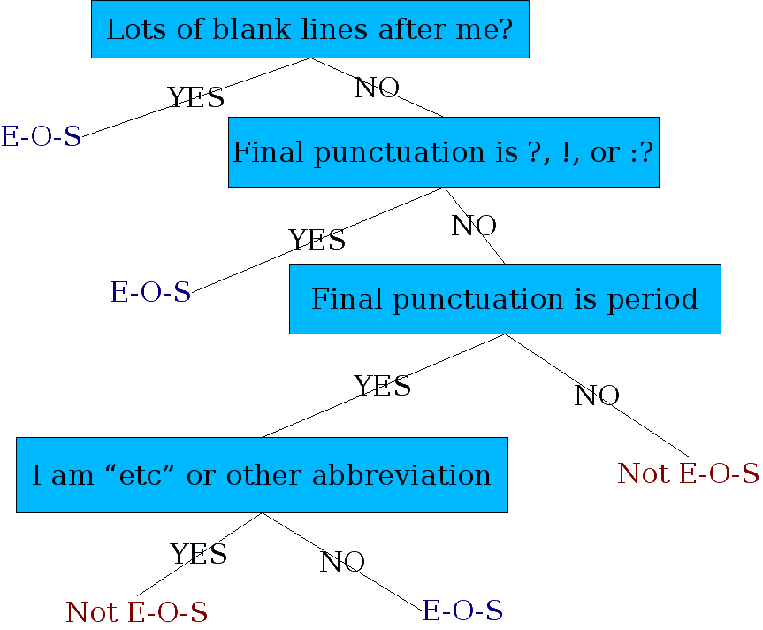
Sentence Tokenizing
Splitting a text corpus into a set of sentences.
Sentences are typically separated by ., !, and ?
But periods (.) can be confusing with numbers like 17.3% or abbreviations like Inc. and Dr.
A binary classifier looks at a “.” and decides EndOfSentence/NotEndOfSentence based on:
Rules: Is “.” followed by a lowercase or uppercase character.
Machine learning: Decision tree, logistic regression (probabilities), SVM.
In ML, sentence structure is learned via training from a corpus.
For more on stemming and lemmatization …
https://towardsdatascience.com/stemming-lemmatization-what-ba782b7c0bd8

Slide 28
Bigrams, Trigrams, and N-Grams
N-gram:
An ordered sequence of n-words: bigrams (2 words), trigrams (3 words), …
Semantic meaning is often preserved in the ordering of words.
E.g., United States of America
To capture semantic content, we may want to capture co-occurrence of sets of words:
Two words: “river bank”, “not good” (bigrams).
Five words: “withdraw money from the bank”, “fishing by the river bank” (n-grams).
However, most n-grams are nonsensical: “He went to”, “went to withdraw”, “fishing by the”, …
What does “bank” mean in the following sentences?
He went to withdraw money from the bank.
He went fishing by the river bank.

Slide 29
Summary
Text preprocessing:
Remove punctuations (all of them?).
Make lowercase.
Remove stop words.
Tokenize/lemmatize.
Tokenization problems:
Word-based tokenization (bag of words model) loses all context (e.g., “break a leg”).
Must not tokenize meaningful word combinations like New York, White House, and President Donald J. Trump?
Social media data may have emoticons, acronyms, misspelled words, non-ASCII characters which may convey contexts and should not be deleted (but converted to text).
What’s next: Text vectorization:
Converting text into a vector of numbers to that they can be processed by ML algorithms.
Machine learning algorithms process numbers, not texts.

